Slide 1
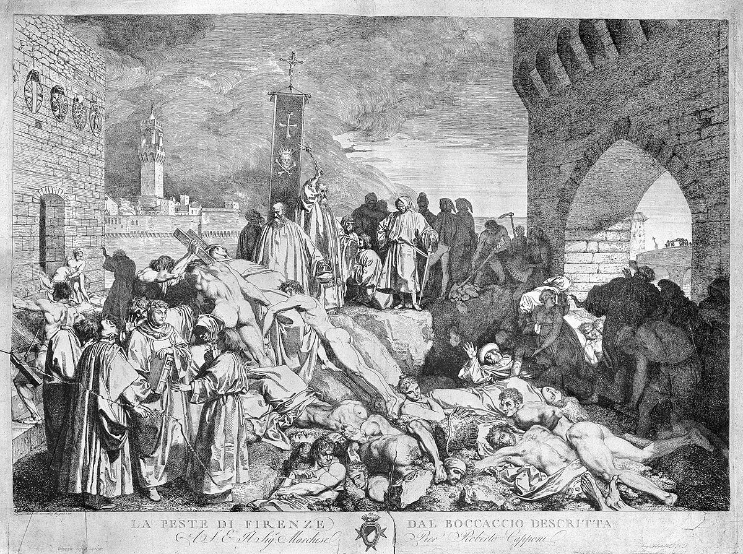
Historical Evolution of Epidemics- The Three Plague Pandemics
The 1348 plague in Florence as depicted in Bocaccio's Decameron.

Slide 2
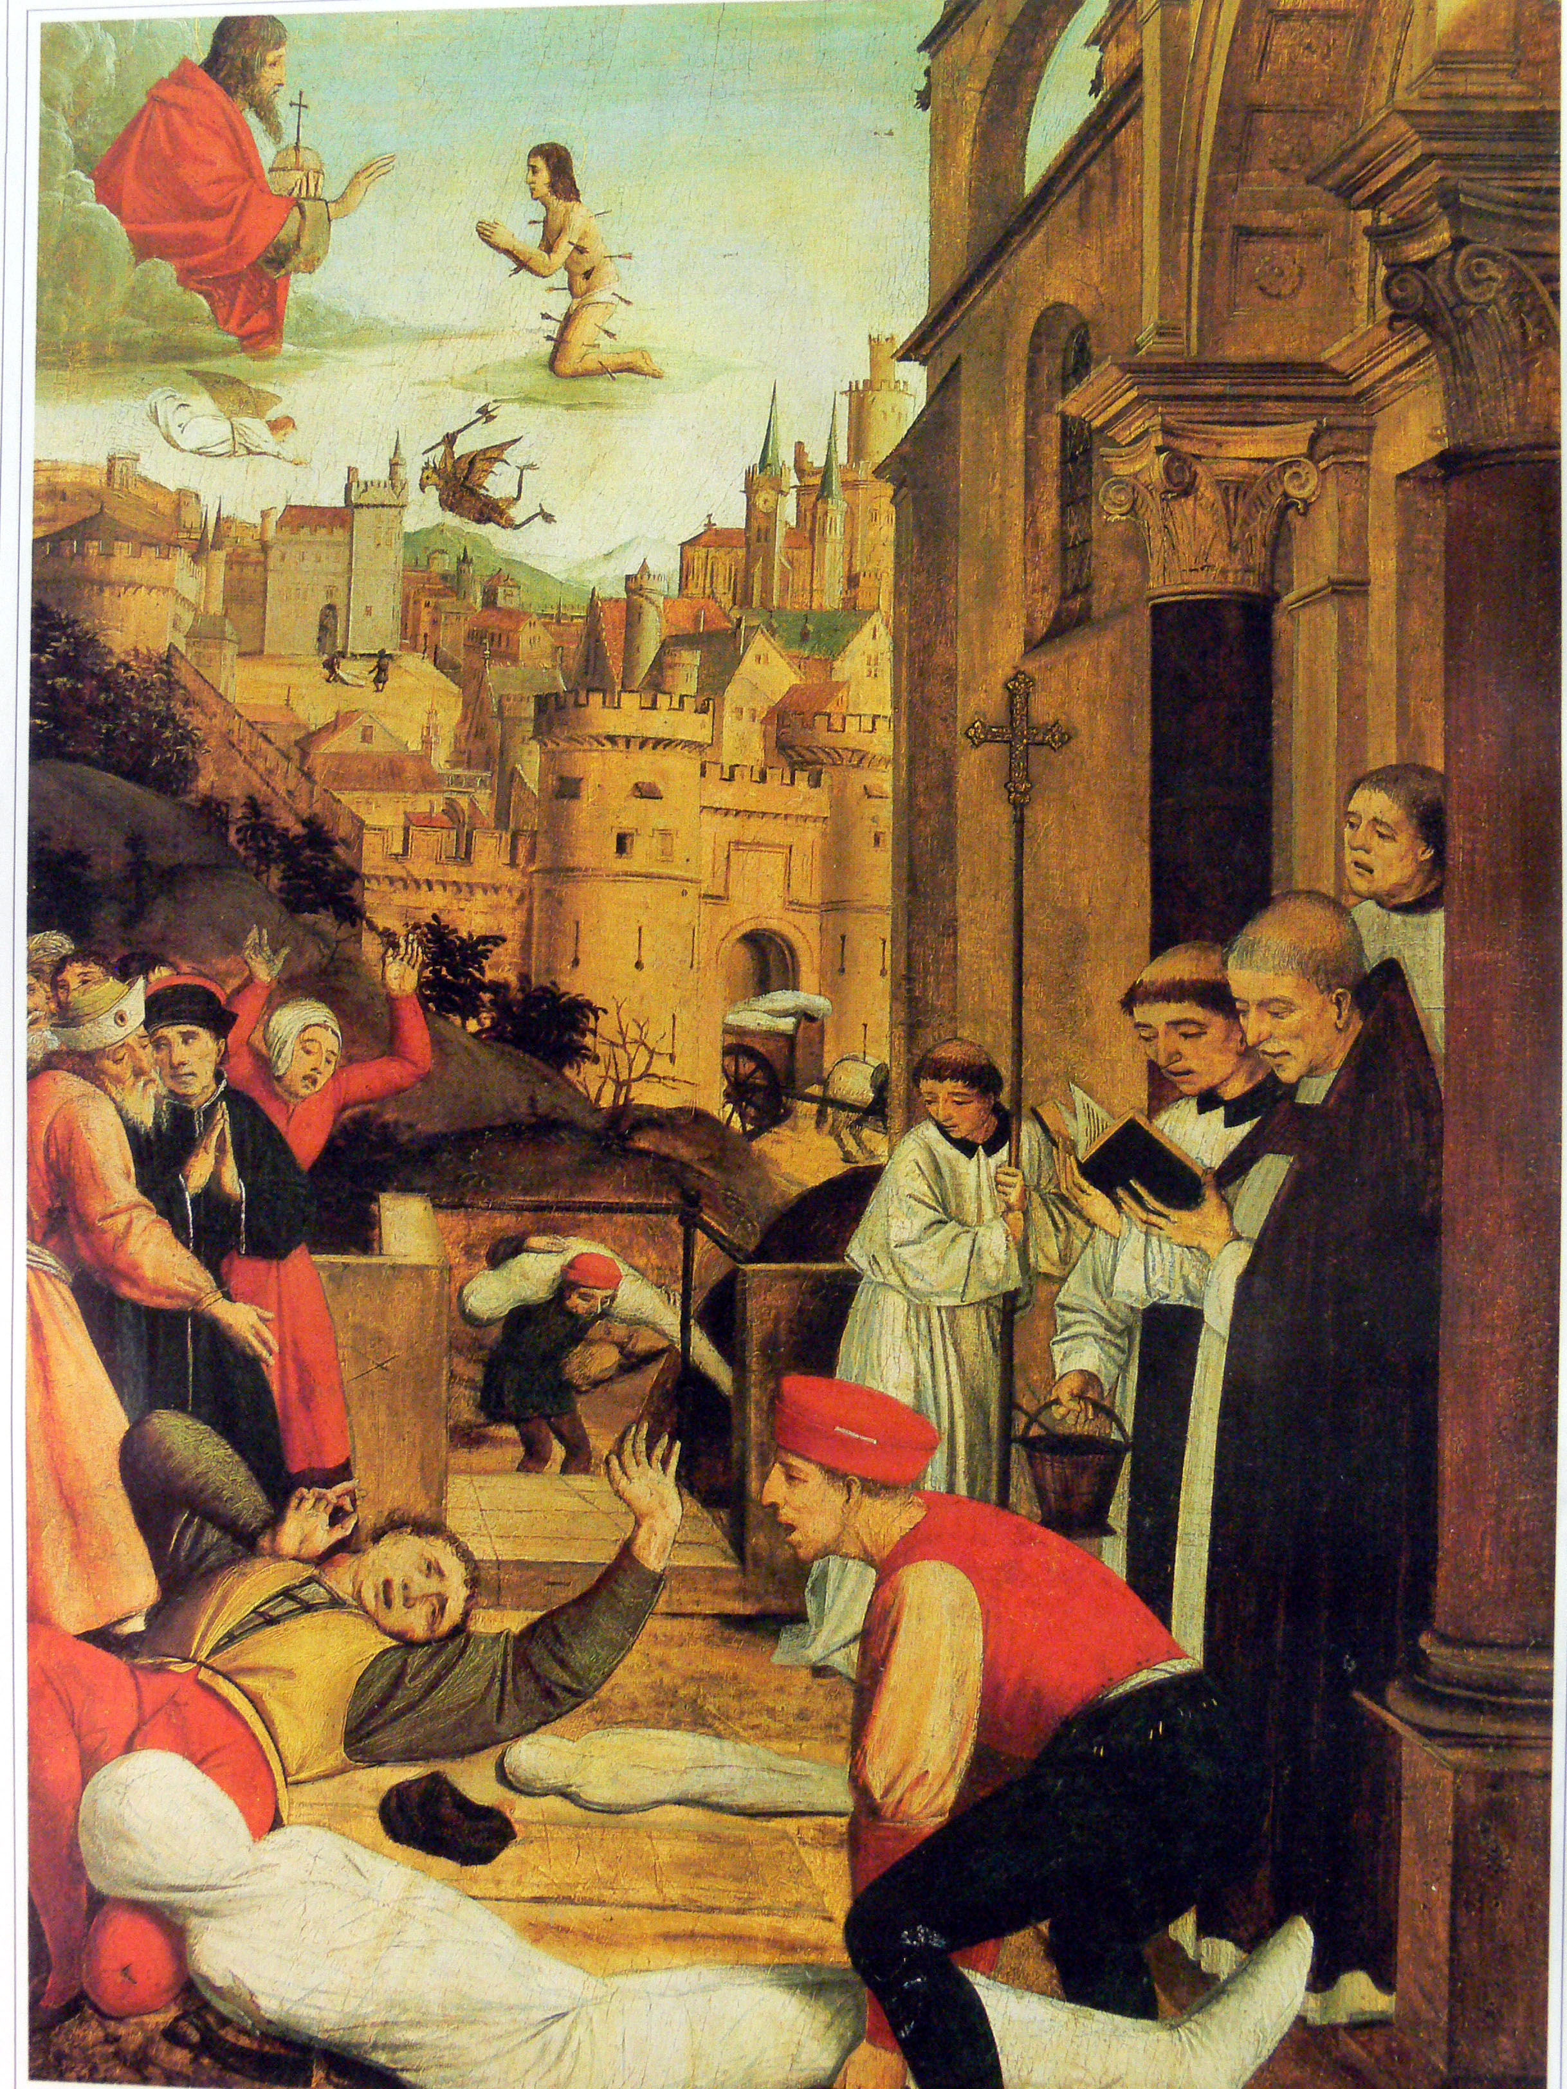
The Uniqueness of the Plague Pandemics
High mortality of the young and healthy- unimaginable social and economic toll.
Responses of people from the plague of Justinian(6th century CE) to Spanish Flu(1918)- the religious and social response
First public health initiatives devised in response to plagues
Spread through urban expansion, trade routes globally and via human-human contact- devastation captured in art.
15th Century painting depicting St. Sebastian praying to Jesus to protect people during the Justinian plague- 16th century painting.

Slide 3

The Plague of Justinian (6th century CE)
Emperor Justinian
Procopius- the chronicler and historian
Common People
Priest/Astrologer
Activity- The Plague Motion Picture
The Main Actors- The Rat and the Flea
The Bubonic Plague of the 19th Century
Reporting from China
Reporting from India
Reporting from Europe
Reporting from the Americas
The Black Death(14th to 17th Centuries)
The common people
The royal elite and the feudal lords
The municipal health authorities
Church authorities

Slide 4
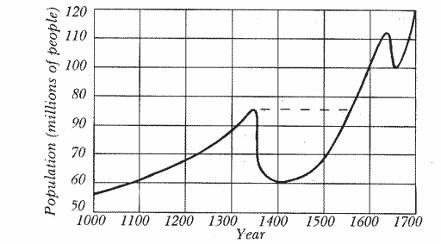
Changes in European population after the Black Death- 14th to 16th centuries

Slide 5
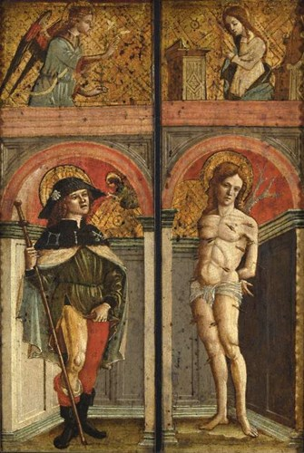
The plague saints in the middle ages- St. Sebastian and St. Roch
Historical context of saint worship came about in medical practice
The relationship between the sacred, the fantastical, the medical and the human when it came to seeking the causes and cures for plague
The role of shrines and monasteries in pre-modern medicine

Slide 6
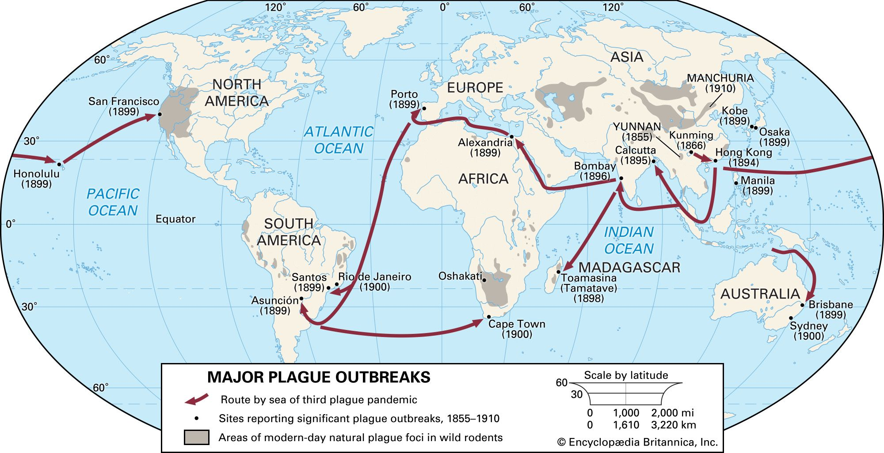
Spread of the bubonic plague in the nineteenth century

Slide 7
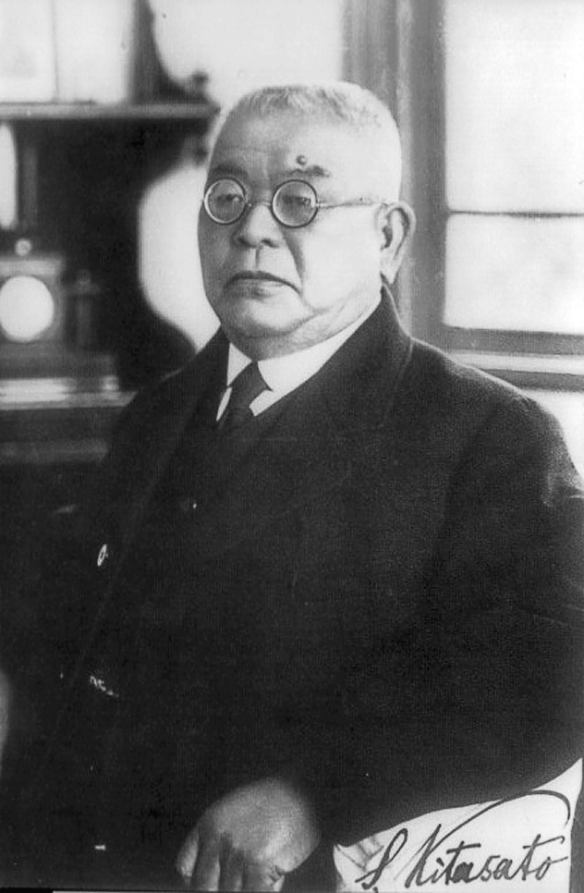
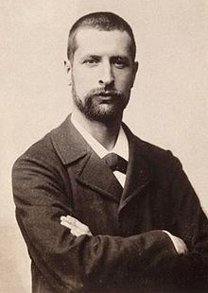
Kitosato Shibasaburo(left) and Alexandre Yersin (right) isolated and identified the plague bacteria- Yersinia pestis in Hongkong in 1894.

Slide 8
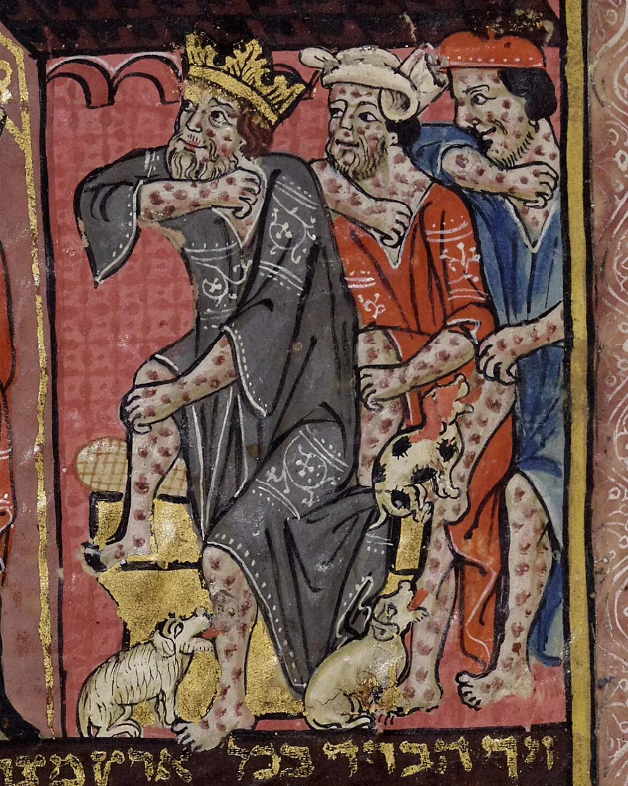
Significance of the Plague Pandemics
The concept of plague- an illness that impacts populations at mass scale comes from the three plague pandemics
The varied responses of people- religious, astrological, medical: instances of human cultures coming to terms with the disease
Socio-economic networks that caused the rise of plagues and its impact on people- their lives, livelihoods families
Rise of public health response
The art and cultural efflorescence that the plague caused.
14th Century Illustrations of plague and its deadly impact

