Slide 1
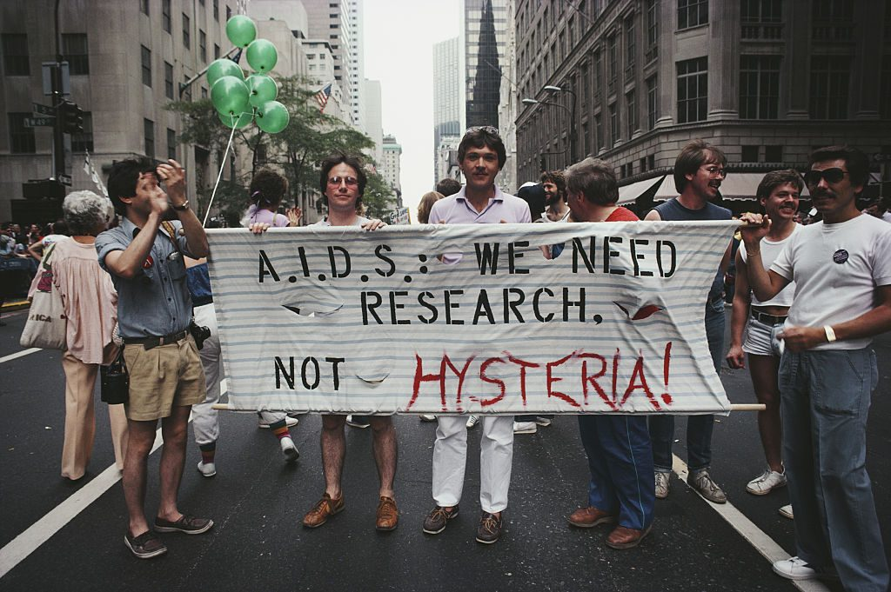
What is an Epidemic? The Historical Example of HIV-AIDS

Slide 2
Play Time!
A four Act Drama- An epidemic of cholera has broken out in the city in 1850s Philadelphia. We are following the lives and deeds of a doctor, a town planner, a priest, and one or two ordinary citizens at different stages of the epidemic. Based on Rosenberg’s idea of the progress of epidemics as a four act drama, each group will create a small skit based on the four acts:
ACT I: Progressive Revelation
ACT II: Managing Randomness
ACT III: Negotiating Public Response
ACT IV: Subsidence and Retrospection

Slide 3
Discussion Questions and Themes
We went over the dramatic evolution of pandemics in the last class- Could you cite historical examples of different pandemics/epidemics to present this dramatic and episodic narrative of disease outbreak? State with examples and events how have origins, causes, differing susceptibilities or responses been historically framed?
What role does “ritual” play in all of this- take the example of AIDS or any historical epidemic/pandemic for that matter.
The role of class, race in the evolution of pandemics- approach of public health?
How was HIV also different from other pandemics in history?- A postmodern epidemic- social construction vs. the biological pathways of disease?
The historical pattern of explaining epidemics- configuration, contamination, predisposition- elaborate on this with examples.
Evaluating the historical pattern of epidemics, can you say medicine is a social field or dependent on biological agents/interventions alone?

Slide 4
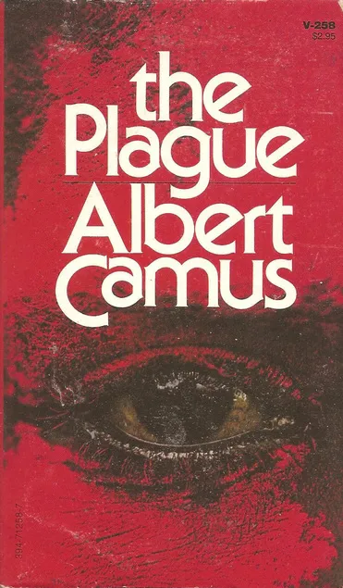
The dramatic structure of an epidemic/ pandemic
Act I : An unwillingness to accept the reality or the coming a pandemic
Act II : Making sense of the event and ascribing reasons whether it be supernatural, moral or biological
Act III : Negotiating public response- public health, religious ritual or social action
Act IV : Eventual end of a pandemic and the retrospective act of evaluating its impact
While there may be a pattern, each epidemic/pandemic also is unique in its own way.

Slide 5
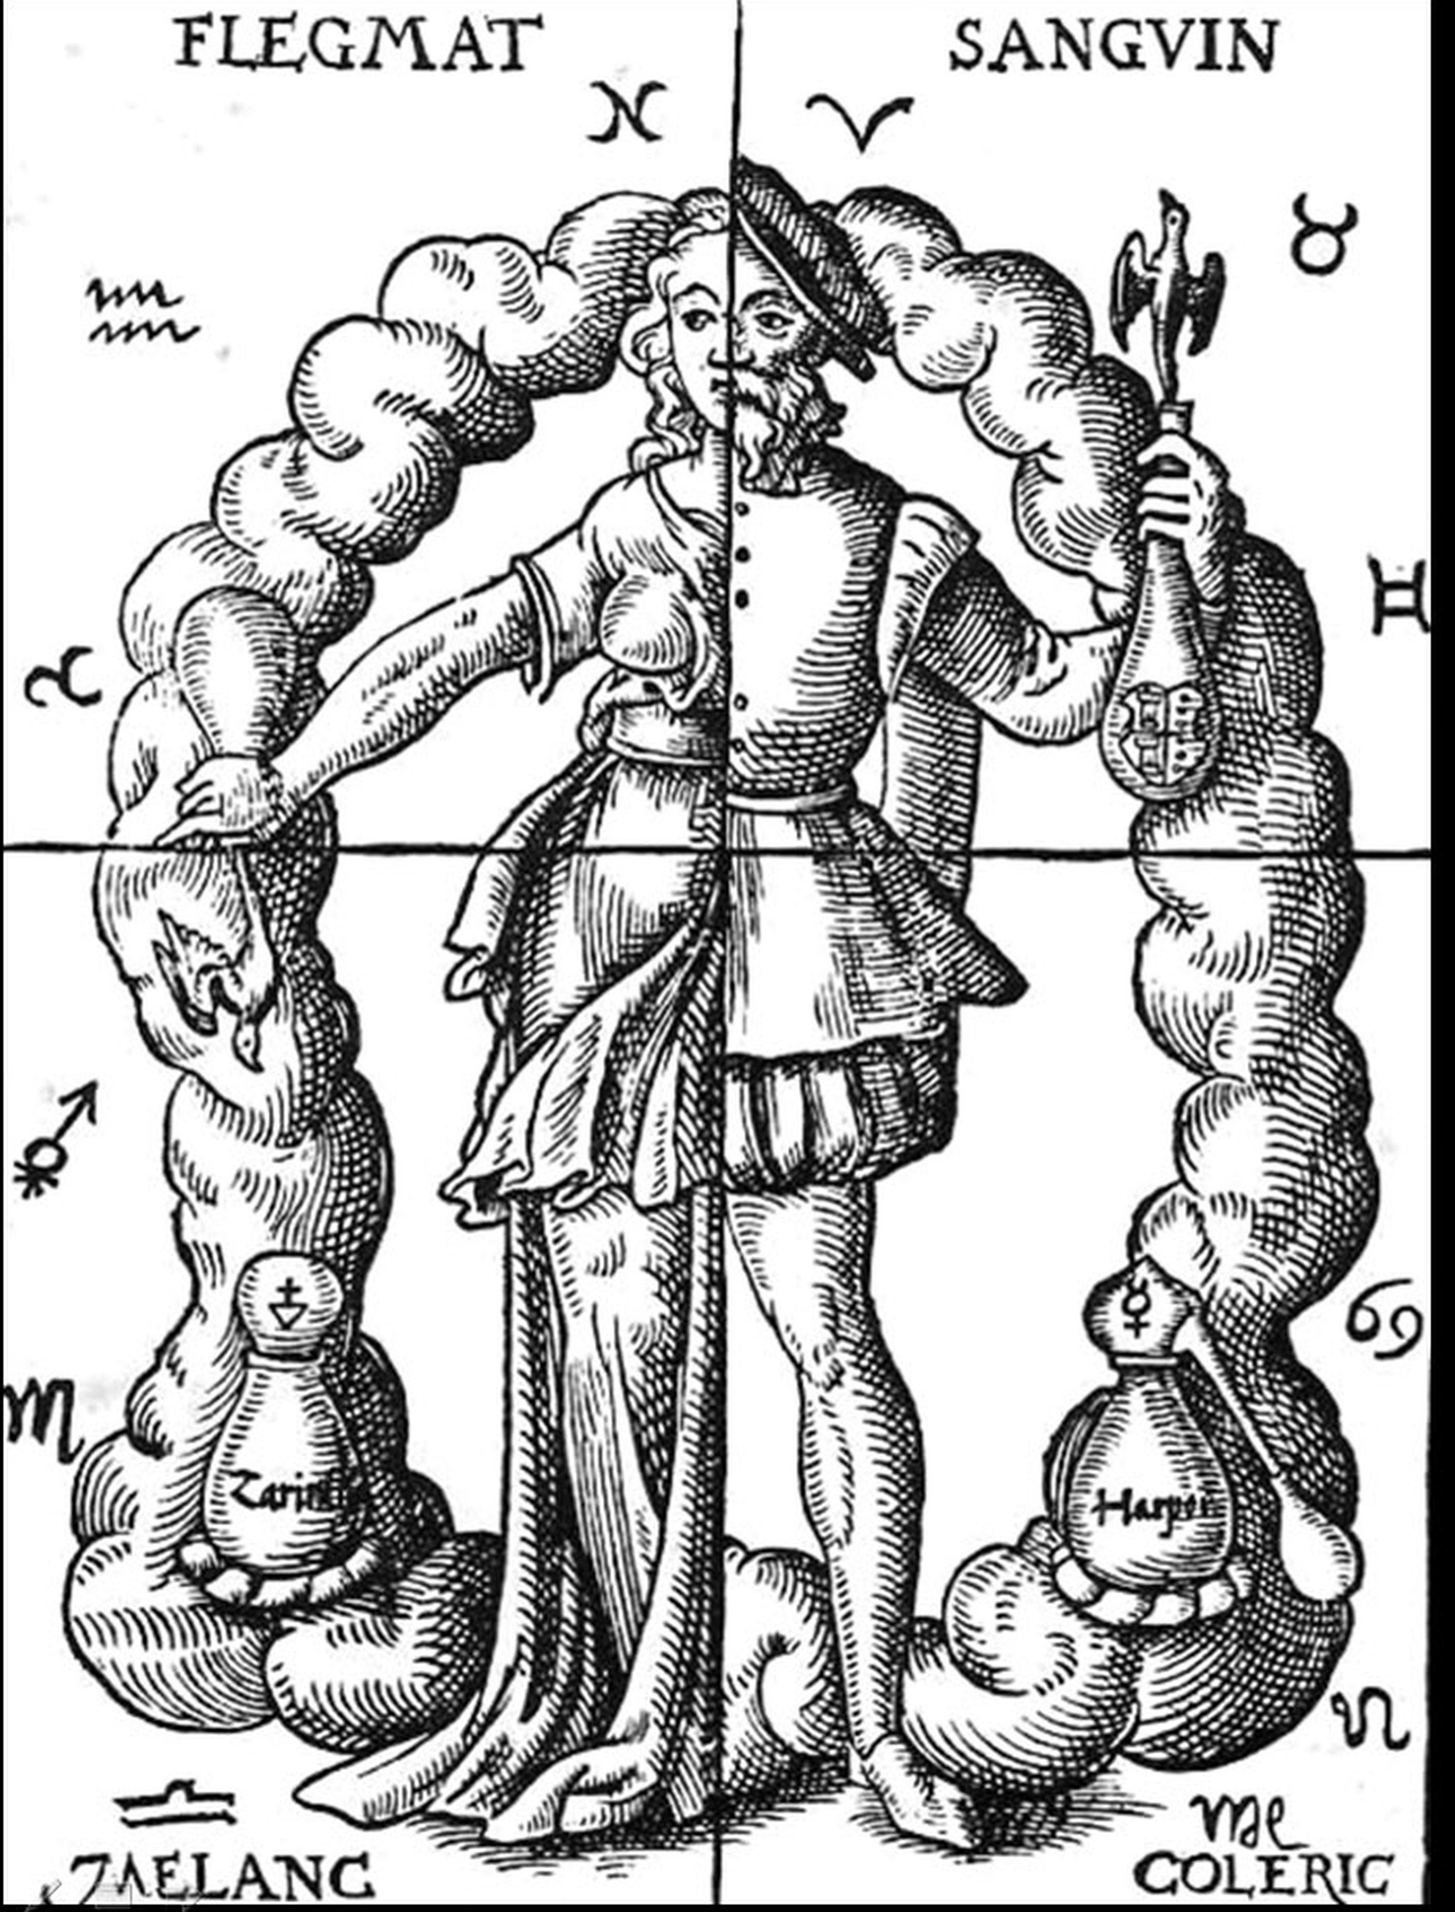
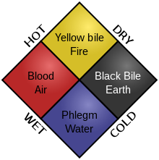
Pre-Modern Medicine

Slide 6
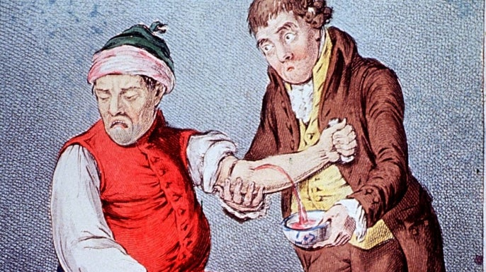
Pre-Modern Medicine and its views on Contagion
Pre-modern medicine based on the humoral framework conceptualized health on the basis of the balance of the humors.
Treatment- involving emetics, laxatives, blood-letting, inducing sweats, releasing of pus were focused on reinstating humoral balance.
The physical constitution of a person depended on his humoral health but also his social and environmental context, the food he ate, sleep, exercise, emotions,.
Epidemics- plagues understood as contagious but dependent on the constitution and situation of the patient- no concrete idea of germs.

Slide 7
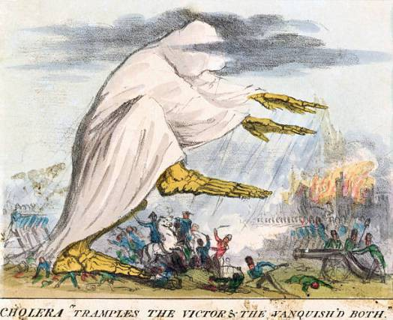
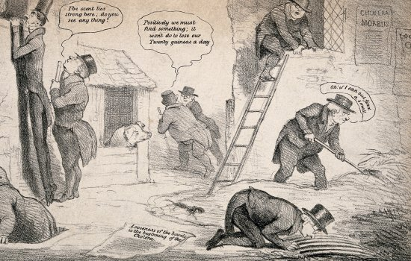
Miasma, Contagion vs. Anti-Contagion- Cholera in the 19th Century

Slide 8
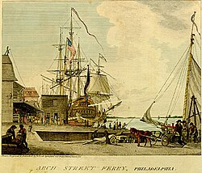
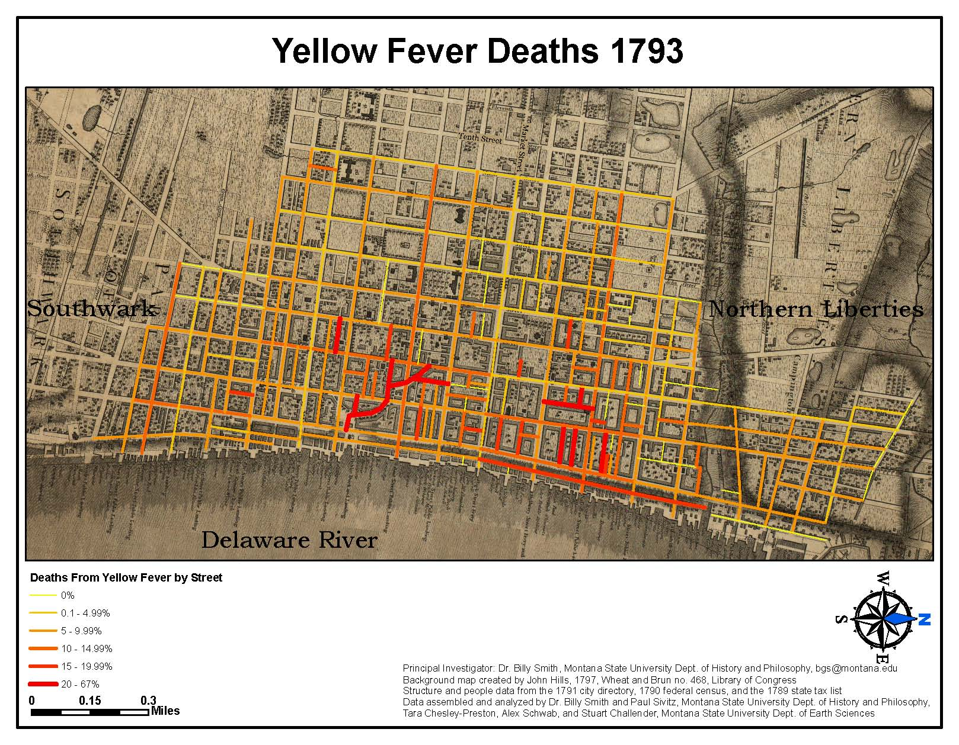
Yellow Fever Epidemic of Philadelphia(1793)

Slide 9
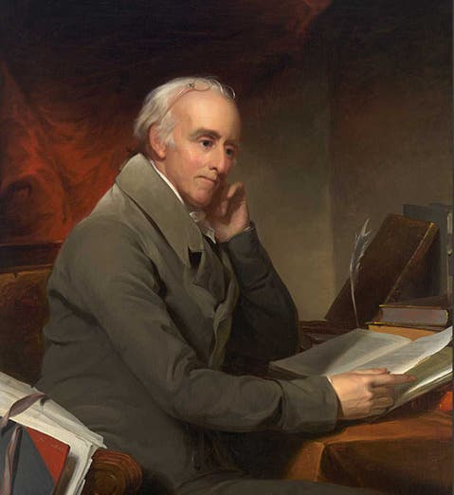
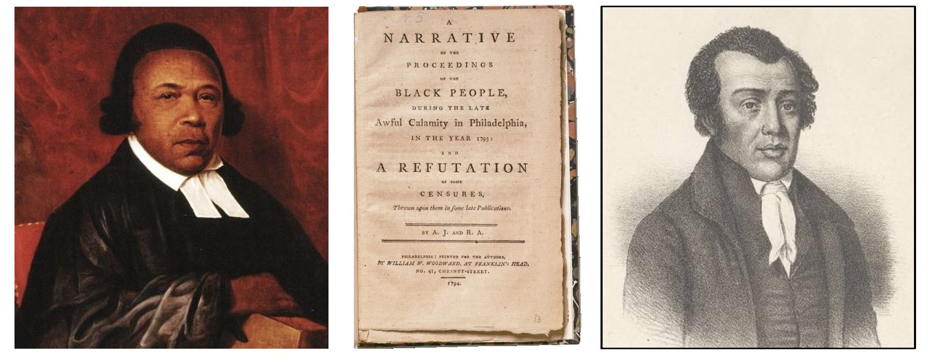
Yellow Fever Epidemic of Philadelphia(1793)- hyperlink
Dr. Benjamin Rush (1746-1813)
Rev. Absalom Jones (left) and Rev. Richard Allen

Slide 10
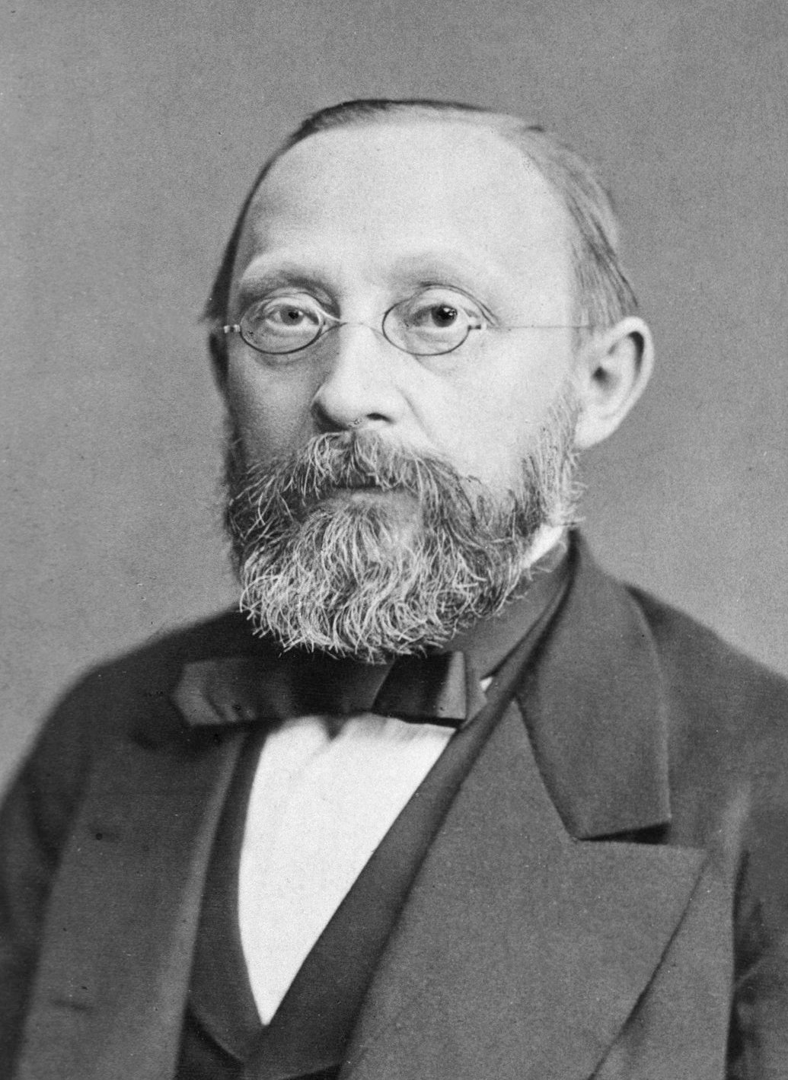
Rudolf Virchow (1821-1902)
He was a German physician and pathologist known as the founder of “social medicine.” The German government had assigned him to carry out an investigation into a typhoid outbreak in Central Europe in 1847-48 and he concluded that the outbreak could be prevented by improving the living conditions of the people- better nutrition, housing, employment.

Slide 11
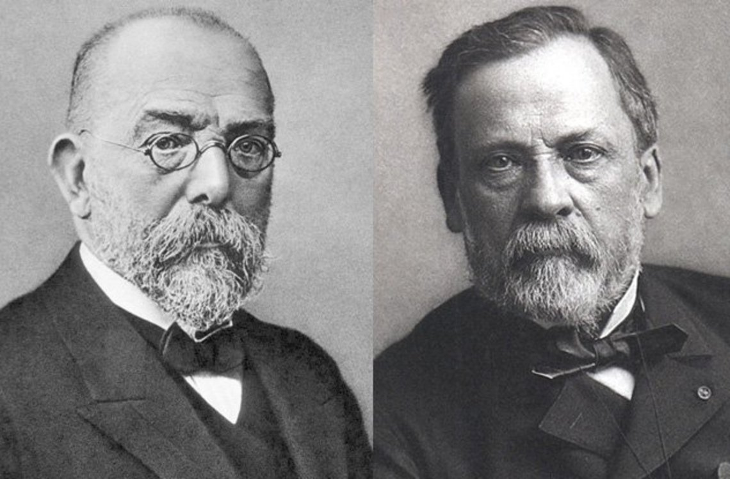
Germ Theory of Disease
Robert Koch(1843-1910) Louis Pastuer(1822-95)

Slide 12
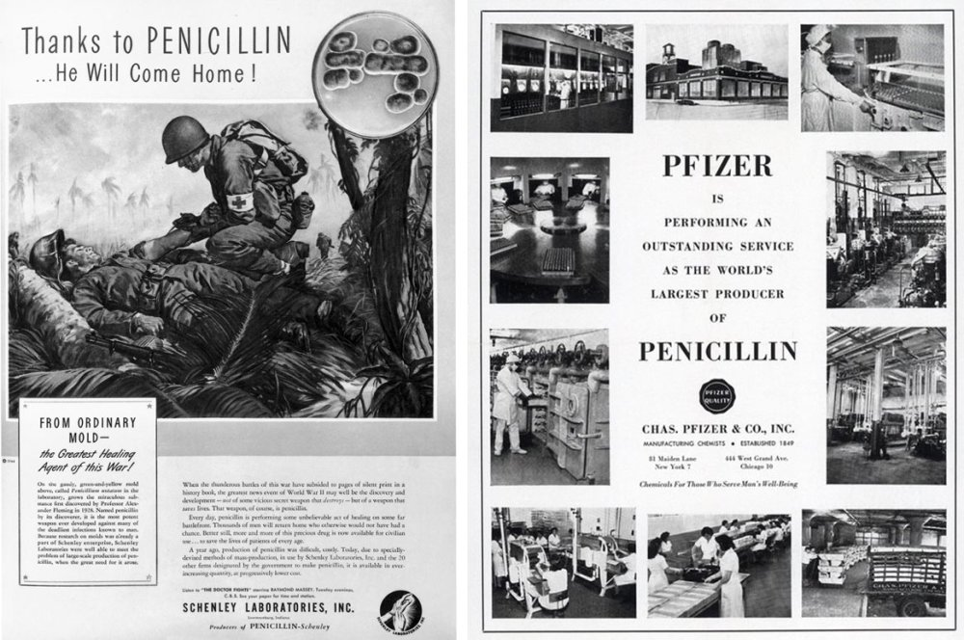
The 20th Century- the Golden Age of Medicine?
Advertisement for Penicillin- early 1940s.

Slide 13
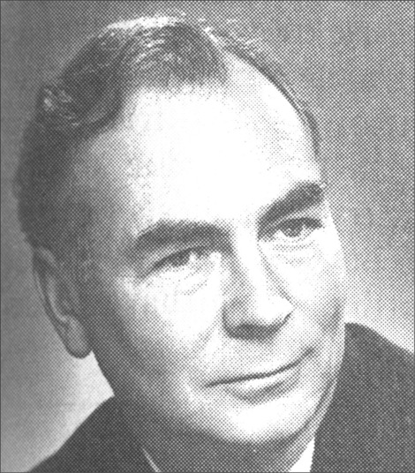
Thomas McKeown (1912-1988)
Scottish physician, epidemiologist, and historian of medicine.
Studied death records in England and Wales from the mid 19th to the early 1960s.
He found that life expectancy had been increasing since the mid 19th century before the introduction of antibiotics and other medical technologies.
Such improvement in life expectancy was attributed to better conditions of living overall- including nutrition, sanitation and clean water.
Advanced medicine helped but was not the only factor.

Slide 14
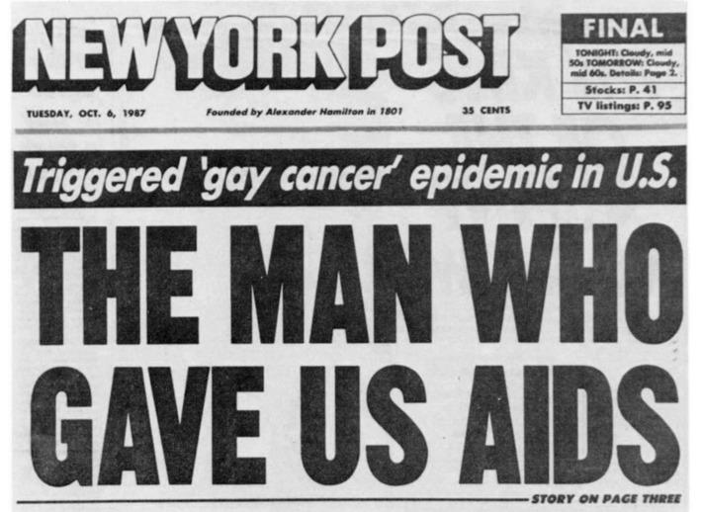
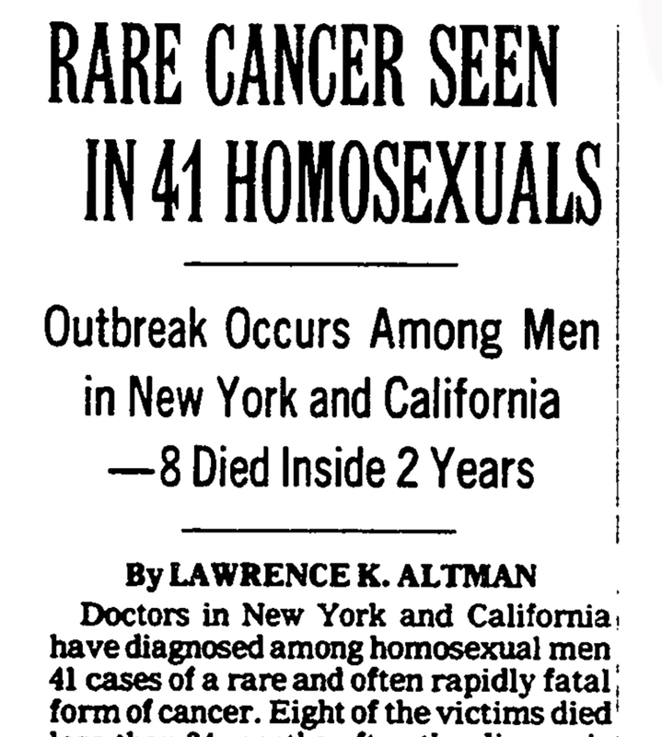
HIV-AIDS-The “Gay Cancer”?

Slide 15


The role of HIV-AIDS Activism

Slide 16
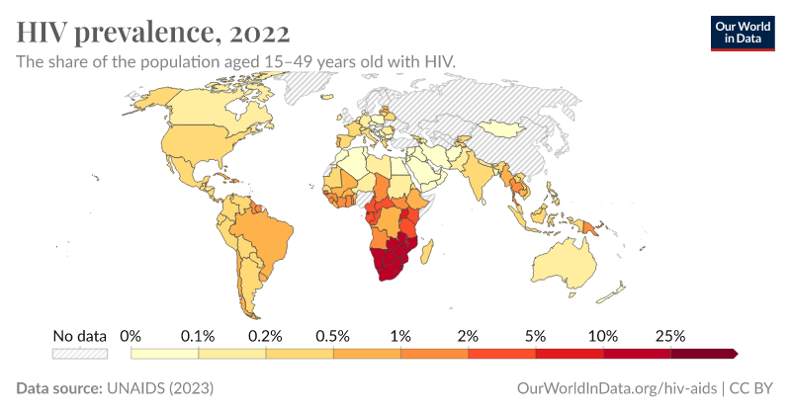
Global HIV- AIDS Prevalence

Slide 17
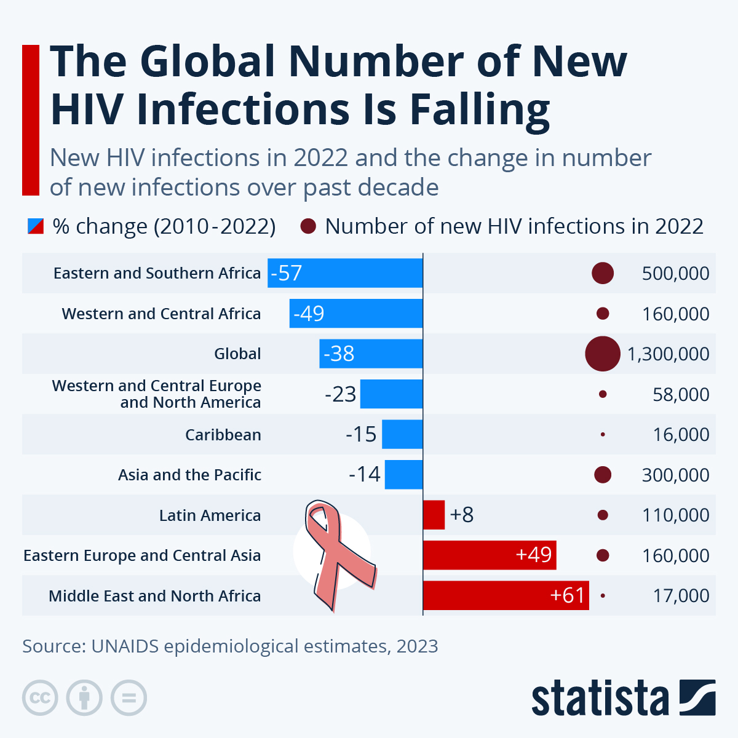
Global HIV- AIDS Prevalence

Slide 18

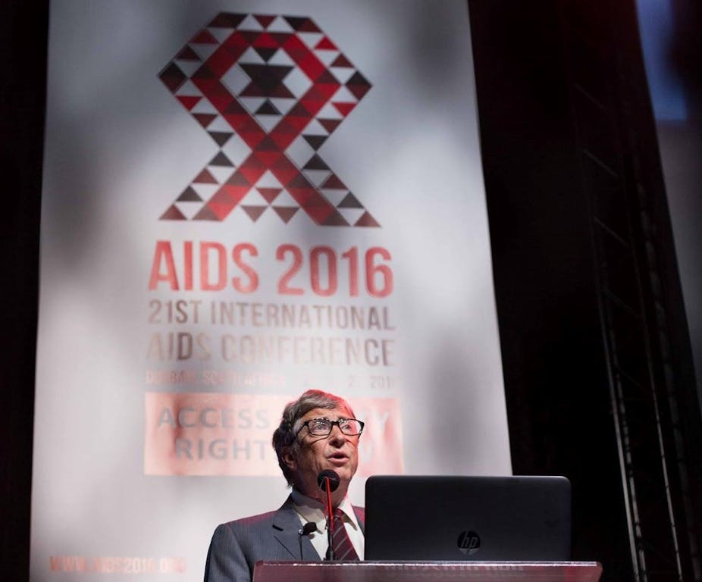
Global Health and AIDS- PEPFAR and the Gates Foundation.

Slide 19

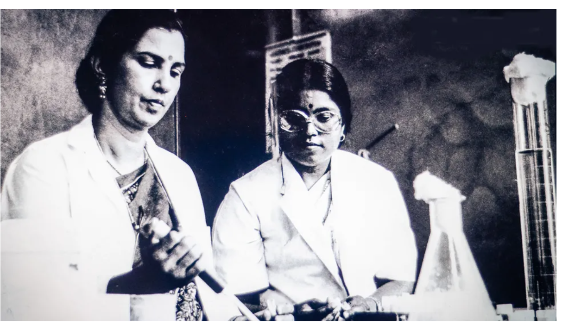
Suniti Solomon(left) and her student Sellappan Nirmala

Slide 20
Epidemics/ Pandemics in History
Episodic/dramaturgic nature of pandemics but there is also something unique in each pandemic/epidemic that sets it apart- role of public opinion/activism in HIV-AIDS, racism during 1793 yellow fever outbreak.
Historically contagion understood in relation to overall health and constitution of the patient.
Public health interventions devised during pandemics can often be more punitive on the marginalized along with the underprivileged being disproportionately impacted during pandemics/epidemics.
Every disease outbreak and evolution of a pandemic or even a disease is dependent upon an intricate set of connections between the biological agents and pathways of the disease together with the social conditions and contexts that characterize the disease- example of latent TB or disproportionate impact of pandemics on some communities depending on race, class, etc.

