Slide 1
Q-center: https://www.brynmawr.edu/inside/offices-services/q-center/q-center-schedule
Office Hours: M 1:30pm – 3:00pm
(in Park 169) W 11:00am – 12:00pm
or by appointment (email me)
or just email me with questions!
TA Hours: TBD
8/31/2026
Register for Achieve:
https://achieve.macmillanlearning.com/courses/2w2sob
Course ID: 2w2sob

Slide 2
Syllabus & Course Resources
Syllabus link
Course calendar
Textbook: OpenStax 2e (not the “Atoms First” version)
Online homework platform: Achieve - course ID 2w2sob
Office hours (in Park 169): M 1:30pm – 3:00pm
W 11:00am – 12:00pm
or by appointment (email me)
or just email me with questions!
TA hours: TBD (will be shared ASAP)
When2meet poll for TA/office hours link
All of this is on Moodle!

Slide 3
Tips for success
Come to class prepared.
  Read the assigned text sections before class.
  Lectures will not be recorded.
Be active in class.
  Ask questions!
Know how to do every assigned homework problem.
  You should work the Achieve problems by hand, as you would on a quiz or exam, and enter the final answer on Achieve. Show your work (even though it won’t be submitted).
Use all the resources at your disposal.
  Office hours, TA’s, textbook, email/talk to me!
Study with others.
Practice consistently & effectively.
  “Retrieval Practice” versus re-reading/reviewing
  Work problems! End-of-chapter problems are good extra practice.

Slide 4
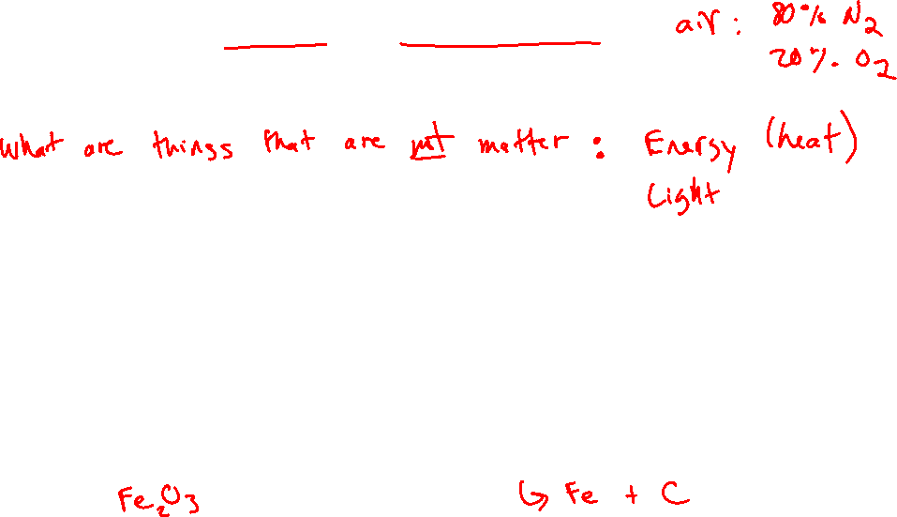
What is Chemistry?
The science that seeks to understand what matter does by studying what atoms and molecules do.
Matter is anything that has mass and takes up volume.
Naturally occurring matter:
  Wood
  Sand
  Water
  Metal ores
Synthetic (human-made) matter:
  Nylon
  Styrofoam
  Ibuprofen
  Steel

Slide 5
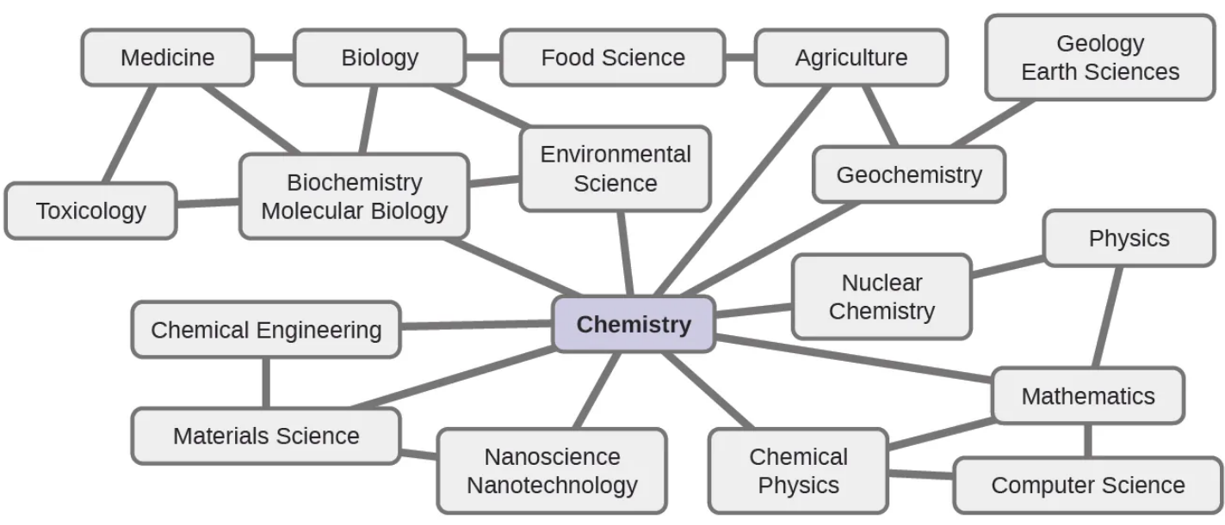
What is Chemistry?
relevant xkcd

Slide 6
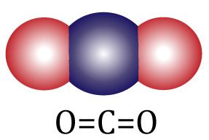
Atoms and Molecules
Atoms are very small. Atoms and molecules are tiny particles that compose all common matter.
Ex: H, O, C….
Atoms are bound together to form many different types of molecules.
Ex: O₂, H₂O, CO₂ , CH₄ ….
Chemical bonds are the attachments that hold atoms together.

Slide 7
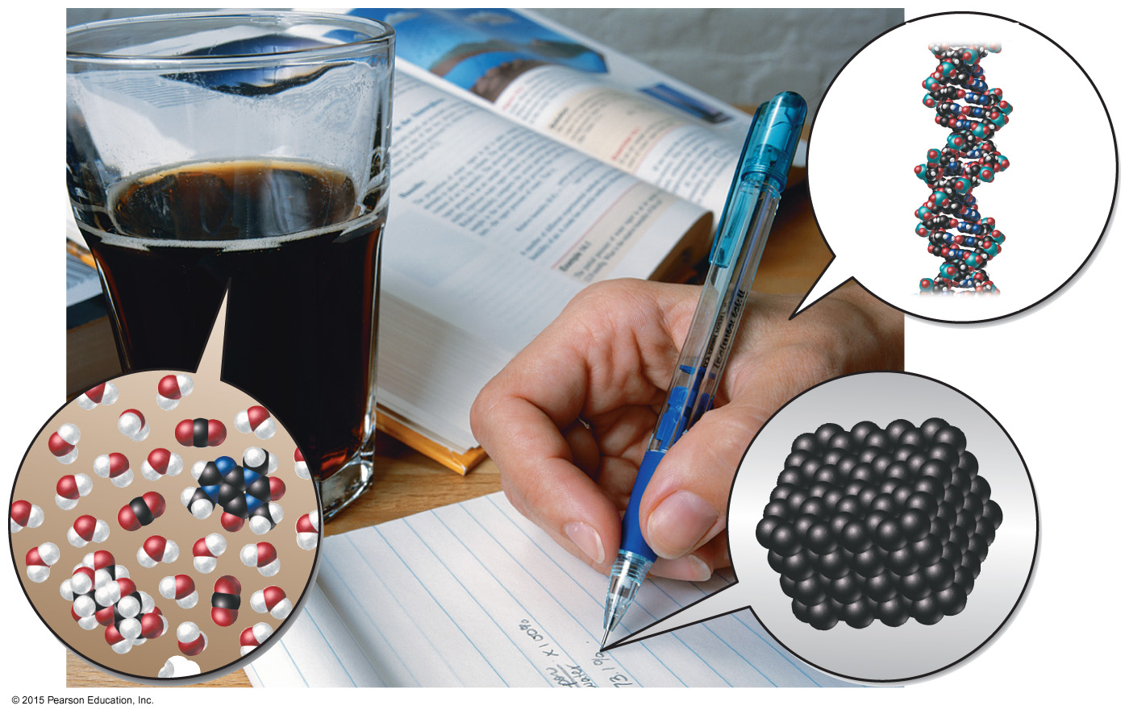
Chemicals Compose Ordinary Things

Slide 8
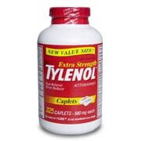
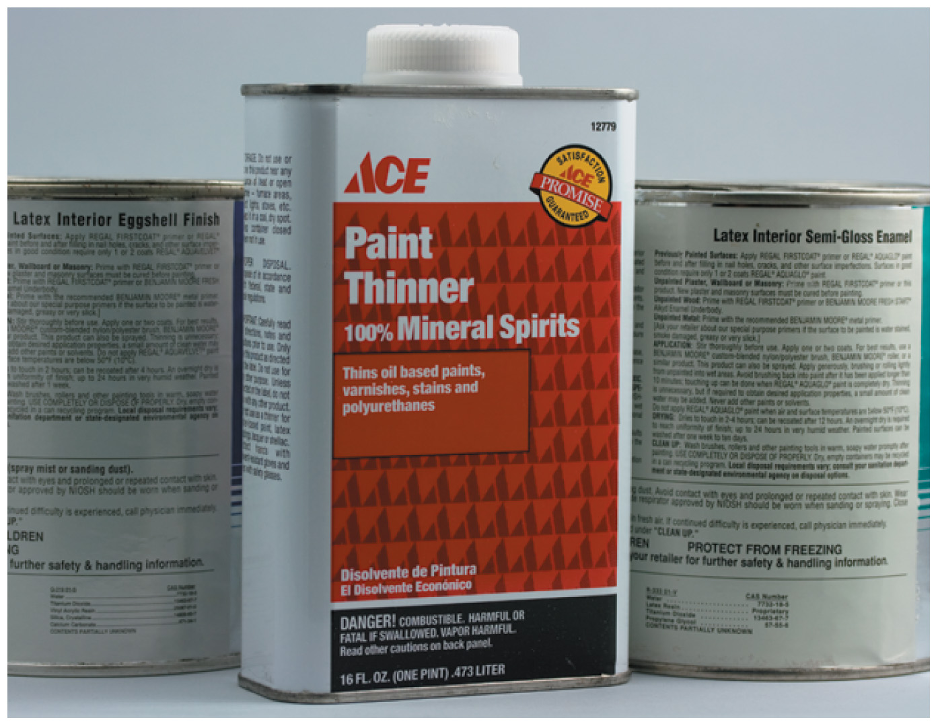
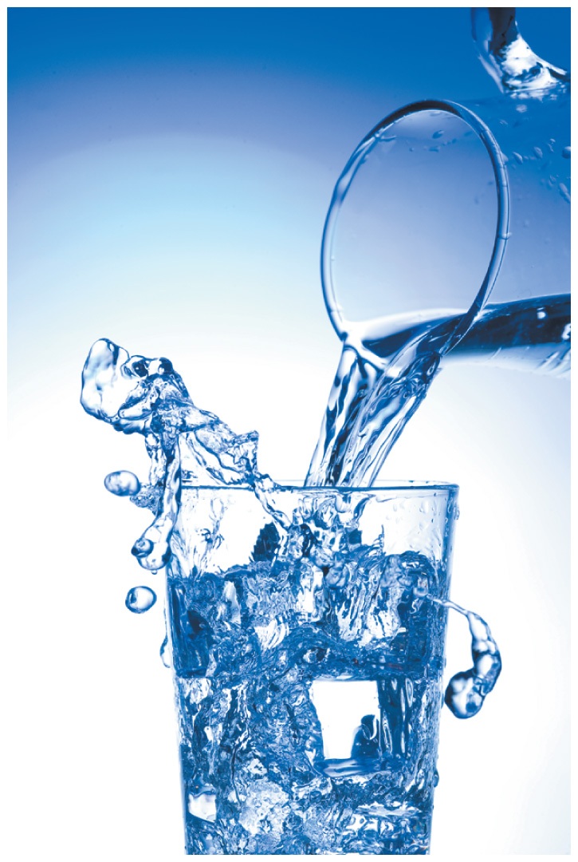
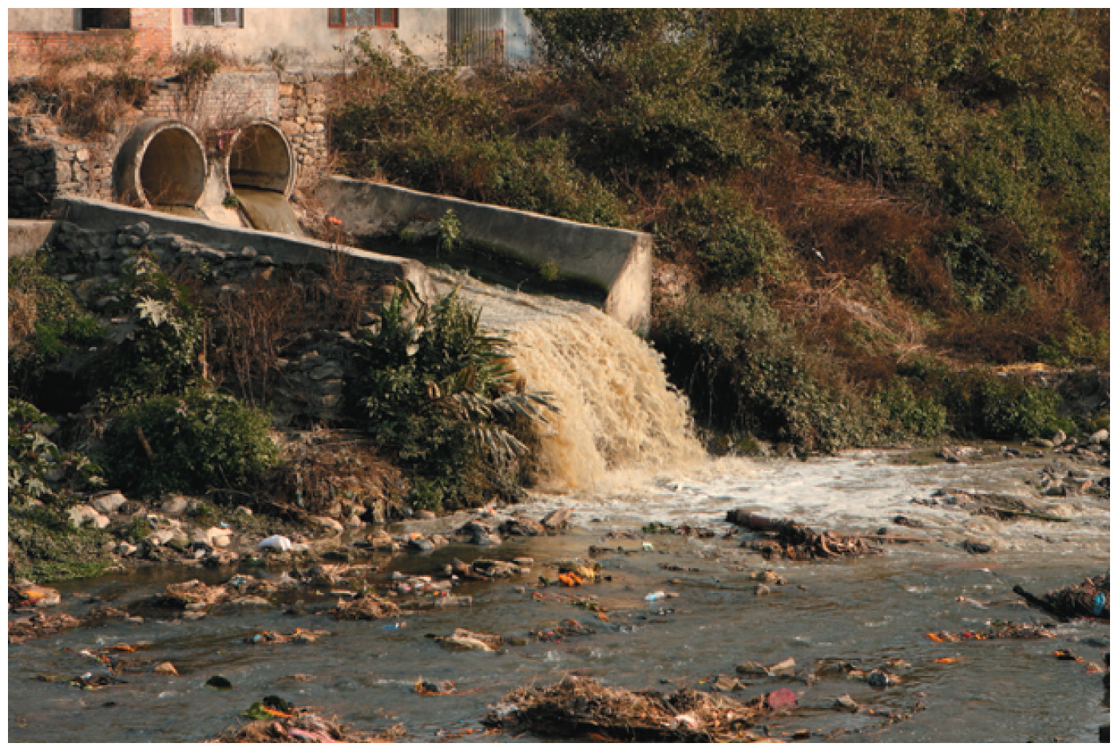
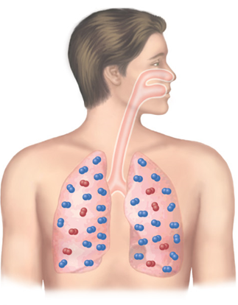
People often have a very narrow view of chemicals, thinking of them only as dangerous poisons or pollutants.

Slide 9
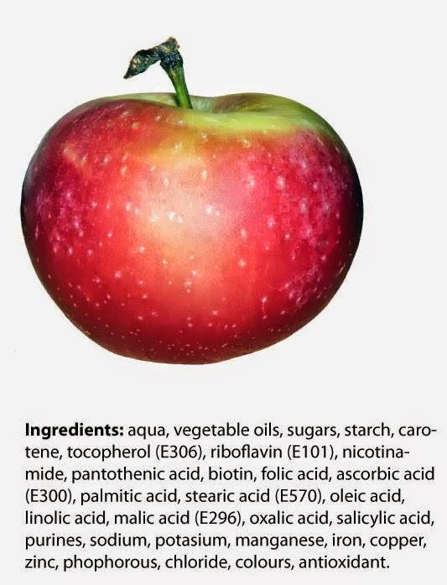

Slide 10
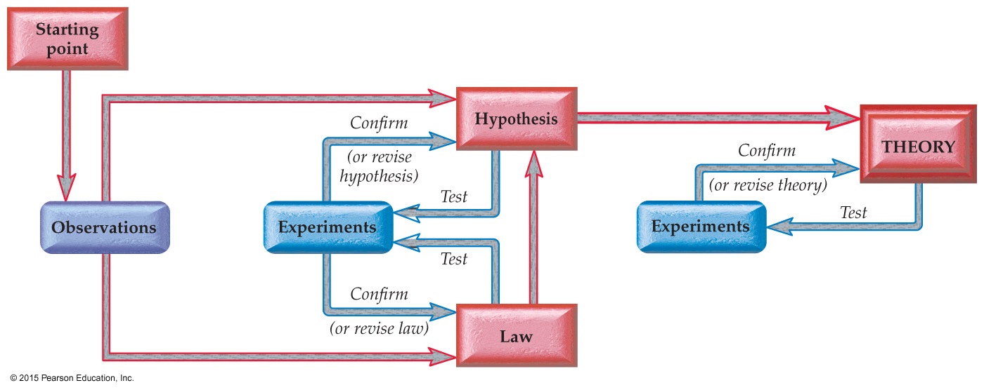
The Scientific Method
Chemistry uses the scientific method: a mode of investigation that emphasizes a cycle of observation, prediction and experimentation.

Slide 11
The Scientific Method: How Chemists Think
Observations involve measuring or sensing some aspect of nature.
Hypotheses are testable predictions about the observations.
Laws summarize the results of a large number of observations.
Theories are models that try to explain the underlying cause/mechanism for observations and laws.

Slide 12
The Scientific Method: Overview

Slide 13
Scientific Notation
In chemistry, we often use very _________or ________ small numbers!
Scientific notation makes them more manageable
0.00000000012

Slide 14
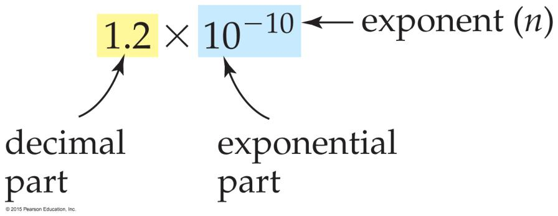
Scientific Notation
A number written in scientific notation has two parts:
The decimal part: a number that is between 1 and 10.
The exponential part: 10 raised to an exponent, n.

Slide 15
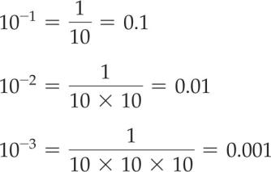
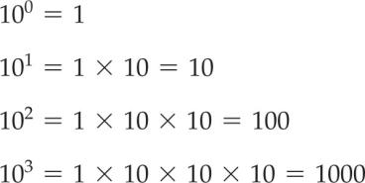
Writing in Scientific Notation
positive exponent:
multiply by 10 n times.
negative exponent (–n):
divide by 10 n times.

Slide 16
Converting a Number to Scientific Notation
Find the decimal part. Find the exponent.
0.00000000012
Move the decimal point n times to obtain a number between 1 and 10 (the decimal part).
Multiply the decimal part by 10^{n} or 10^{-n} as appropriate.

Slide 17
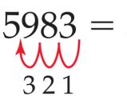
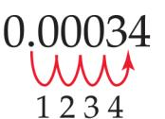
Converting a Number to Scientific Notation
If the decimal point is moved to the left, the exponent (n) is positive.
If the decimal point is moved to the right, the exponent (n) is negative.

Slide 18
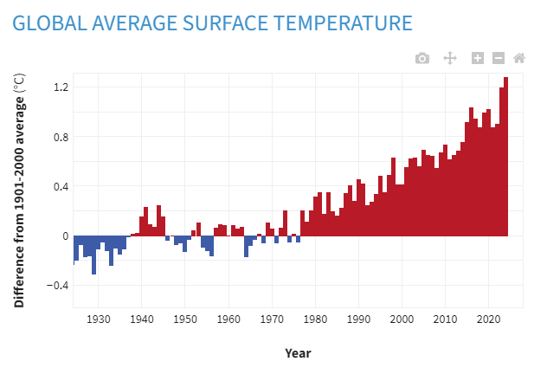
Expressing Uncertainty in a Measurement
The uncertainty in a measurement is indicated by the last reported digit.
A measurement has three “parts”: quantity, unit, and uncertainty.
  Example: measuring global temperatures
  Average global temperatures have risen by 1.51 °C in the last century. (1924-2024)
  Reporting a temperature increase of 1.51 °C really indicates 1.51 ± 0.01 °C -- reflects the precision of measurement
  The temperature rise could be as much as 1.52 °C or as little as 1.50 °C, but it is certain to be in that range.
source

Slide 19
Accuracy vs Precision
Accuracy is a measure of ________________________
Precision is a measure of _________________________

Slide 20
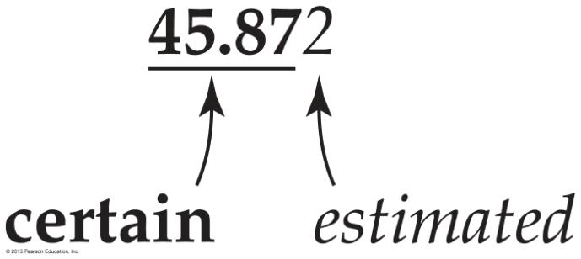
The first four digits are certain; the last digit is estimated.
The greater the precision of the measurement, the greater the number of “significant figures.”
Significant figures are important!! They communicate the precision of a measurement!!
Reporting Uncertainty in Measurements

