Slide 1

Lewis Structure, Formal Charge, and Bonding
Q-center: https://www.brynmawr.edu/inside/offices-services/q-center/q-center-schedule
Office Hours: M 1:30pm – 3:00pm
(in Park 169) W 11:00am – 12:00pm
or by appointment (email me)
or just email me with questions!
TA Hours: TBD
8/31/2026

Slide 2
Syllabus & Course Resources
Syllabus link
Course Calendar w/HW problems
Office hours (in Park 169): M 1:30pm – 3:00pm
W 11:00am – 12:00pm
or by appointment (email me)
or just email me with questions!
When2meet poll for TA/office hours
All of this is on Moodle

Slide 3
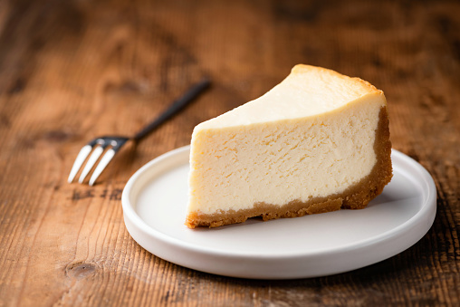
In-class Polling with PollEverywhere
pollev.com/timcook653 or text timcook653 to 22333
(Also has Android/iPhone app)
Poll
Is cheesecake a cake or a pie?
Cake
Pie
Neither
I need more time to decide

Slide 4
Poll
Do you want a printed copy of each handout?
Yes
No
Sometimes/Maybe

Slide 5
Tips for success
Know how to do every assigned homework problem.
  “2nd language” textbook has additional problems as well
Use all the resources at your disposal.
  Office hours, TA hours, textbook, email/talk to me!
Study with others.
Practice consistently & effectively.
  “Retrieval Practice” versus re-reading/reviewing
  Work problems!
Come to class prepared.
  Read the assigned text sections before class.
  Lectures will not be recorded.
Be active in class.
  Ask questions!

Slide 6
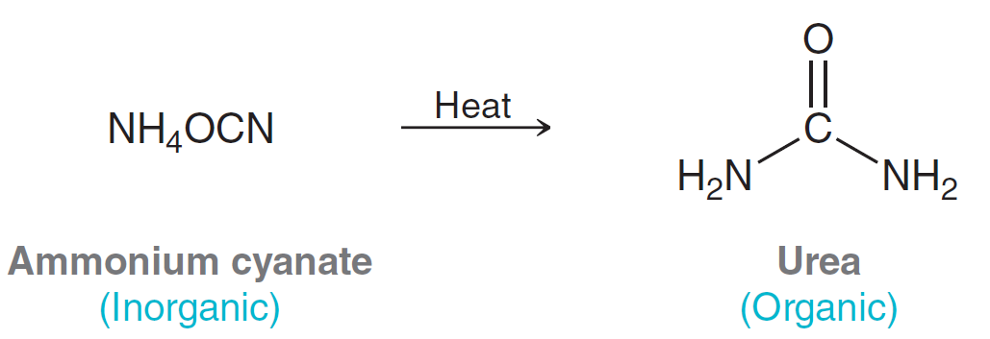
What is organic chemistry?
Early 1800’s: Organic matter – derived from living things
Inorganic matter – derived from nonliving things
Vitalism – organic matter is imbued with a “life force”
inorganic is not, and cannot be converted to organic matter
Friedrich Wohler, 1828
Called “vitalism” into question

Slide 7
What is organic chemistry?
The study of biomolecules, and their analogs (molecules with similar structures).
Most biomolecules are made from “Carbon and Friends”
Why does it matter to you?

Slide 8

“Electrons go from where they are to where they aren’t.” – describes most chemical processes.
Where can electrons be in a molecule?

Slide 9
Lewis Structures
Represent valence electrons in a molecule as bonding or nonbonding (“lone pairs”)
  Use “dots” to represent nonbonding electrons
  Use lines to represent bonding electrons
    1 line -> single bond -> 2 electrons
  Lewis Structures of Row 2 atoms:
Can predict geometry, polarity, and stability of a molecule
Based on the octet rule – atoms are most stable with 8 valence electrons
  Hydrogen (and Helium): stable with 2 valence electrons
To generate Lewis Structure: count total valence electrons in molecule and distribute so every atom has an octet!

Slide 10
Example: Draw the Lewis Structure of CH₂O

Slide 11
Predicting stability
=
“Bond-line” drawing: revisit next week
Also called “line-angle” drawing
Is this a feasible molecule? Why or why not?

Slide 12
Typical #’s of Covalent Bonds
Atoms bond in predictable ways to reach octet, based on their starting # of valence electrons
If an atom bonds in a different way than above, it likely lacks an octet (usually very unstable) and/or have a nonzero formal charge

Slide 13
Formal charge
A method of keeping track of electrons in a molecule
Considers all electron pairs to be shared equally
  Oxidation state is a different method that accounts for unequal sharing
“VUSF” (note – the book uses a different approach, but the same math, and you are welcome to use whichever method you prefer)
Sum of individual formal charges = charge of molecule
Molecules with individual formal charges close to 0 tend to be more stable.
  If multiple structures are possible, the “best” structure follows this rule most closely.

Slide 14
Example: find the formal charge of each atom in the molecules below.
NO₃⁻
O₃

Slide 15
Poll
Which atom has a nonzero formal charge?
O
C
N
Br

Slide 16
Poll
**MCAT Question**
The formal charges of the atoms in the hypochlorite ion ClO⁻ are:
+1 for chlorine, -2 for oxygen
-1 for chlorine, 0 for oxygen
0 for chlorine, -1 for oxygen
-1/2 for both atoms

Slide 17
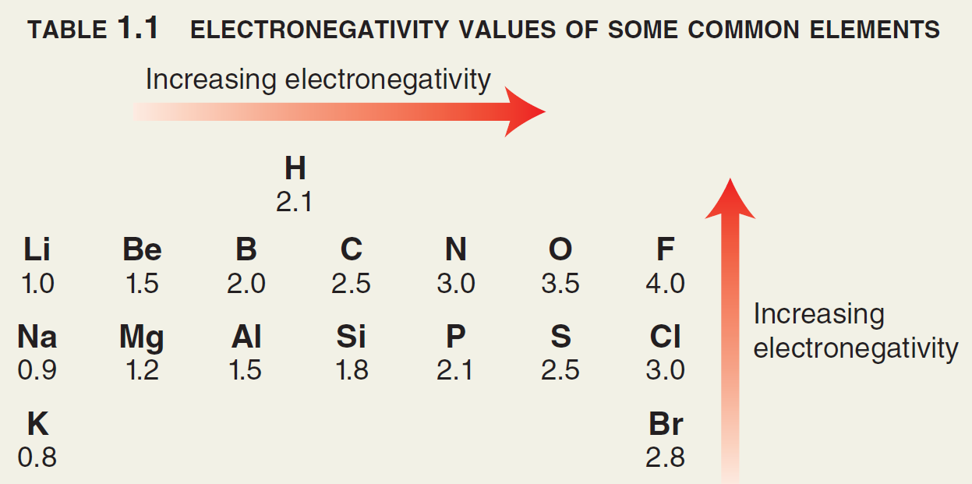
Bond polarity
Bond polarity is shown with a crossed arrow pointing toward the more Electronegative (EN) atom.
Partial charges (δ) depict unequal distribution of electrons in a bond.
For an individual bond between two atoms…. (from Gen Chem)
If ΔEN < 0.5 → bond is nonpolar
If ΔEN is between 0.5 and 1.7 → bond is polar
If ΔEN > 1.7 → “bond” is ionic &
e⁻ are not shared!

Slide 18
Bond polarity (for Organic Chemists)
Organic chemists characterize bonds
between Carbon & Friends based more on
___________ ____________ than Pauling Scale EN values.
Common nonpolar bonds:
Common polar bonds:
“Pauling Scale” electronegativity (EN)

