Slide 1
EMERGENT MULTILINGUAL LEARNERS IN U.S. SCHOOLS
Fall 2026
Dr. Kelly Gavin Zuckerman

Slide 2
Please make a name tent with your preferred name and pronouns.

Slide 3
  Today’s Class
  Preview of Today’s Class and Next Class
  Today’s Invitation
  Syllabus Overview
  What’s in a Name? Labels as Limitations Discussion
Notes:
[Start with a warm and welcoming tone to engage the audience.]
Welcome, everyone! Today, we’re going to navigate through some exciting topics and discussions that will set the tone for our class. Let's dive in!
[Pause for a moment to allow the audience to settle in.]
First, let's look at what we’ll cover today and preview what’s coming up next. We'll start by reviewing the syllabus—it's our roadmap for the semester, so it's crucial to get familiar with it. [Emphasize the importance of understanding the syllabus.]
Now, an important part of today’s class is our discussion on “What’s in a Name? Labels as Limitations.” We’ll explore how names—and the labels we attach to them—can shape perceptions and experiences. It’s a powerful conversation that invites us to reflect on identity and meaning.
[Encourage participation.]
As we move through these topics, I invite you to think about your own experiences and prepare to share your thoughts. This is a space for open dialogue and learning from one another.
[Conclude with a positive note.]
Let's make this session interactive and insightful. I’m looking forward to hearing your perspectives and stories. Remember, your voice adds value to our collective learning experience.

Slide 4
  For Next Class
“A Letter to Parents and Teachers on Some Ways of Looking and Reflecting on Children”by Patricia F. Carini , pp. 56-64)
Discussion Post #1 Due Sunday by 12:59 pm
Notes:
https://www.youtube.com/watch?v=ST3LBmJt3nM

Slide 5
Read the “My Name” vignette by Sandra Cisneros in front of you. Consider the following questions:
1. Is there a story behind your first name? How and why was it chosen for you?
2. What people, places, events, things or ideas do you associate with your name?
3. If you go by a nickname, did you choose it or did others? What is the story behind it?
4.What do you know about the history of your last name?
5. How does your name represent and reflect who you are?
Be prepared to share your answer to one of the questions above with the class as part of your introduction.
  Today’s
invitation

Slide 6
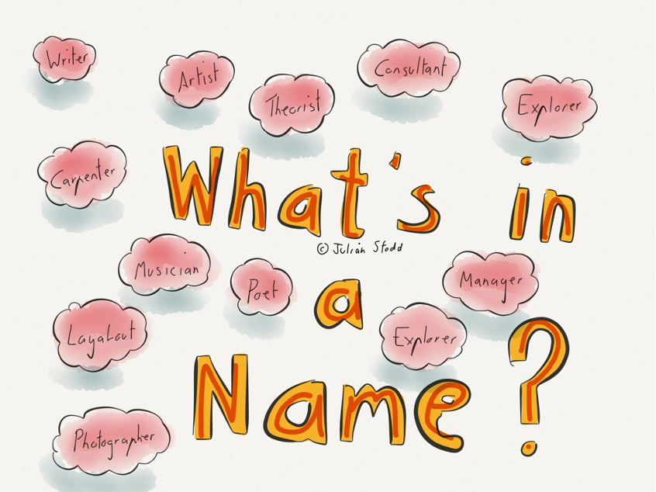
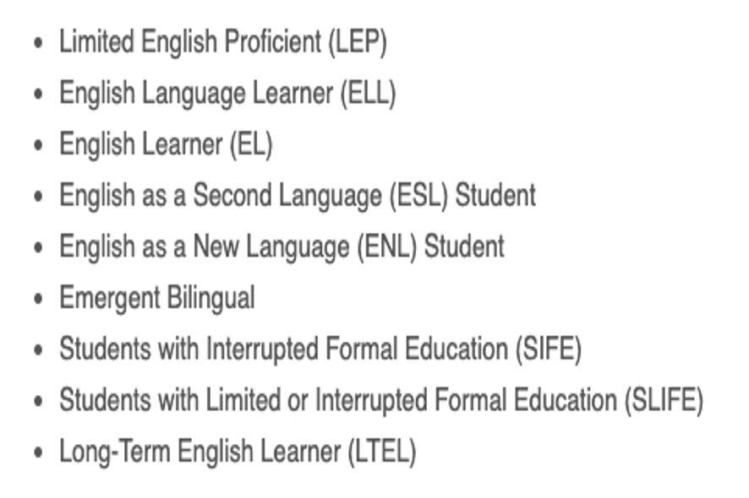
  What’s in a name?

Slide 7
Educating Emergent Bilinguals
  From
“The terms bilingual/multilingual learner or multilingual learner has many advantages over the English learner label. Identifying students as bilingual/multilingual learners does not focus on the needs of these students to learn English. Instead, it celebrates these students for their bilingual/multilingual capacities” (p. 4)

Slide 8
Syllabus Overview

Slide 9
What stood out to you, surprised you, challenged you in the piece “Labels as Limitations”?
In what ways, if at all, have labels been limitations in your own life and educational experience?
What questions does this piece raise for you as we begin our journey together this semester?
Labels as Limitations

