Slide 1
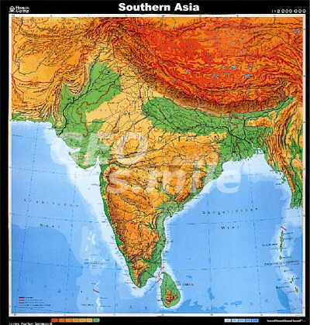

Slide 2
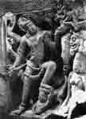
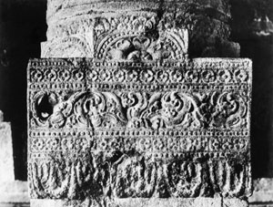
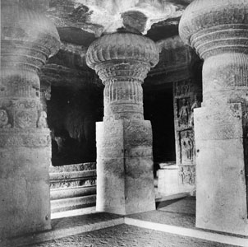
Ellora: 1) 8th-14th century CE, Brahmanical affiliation; 2) 4th-7th century CE, ca. 600-700 CE, Buddhist affiliation; 3) ca. 500-550 CE, Calukya, interior detail, Buddhist affiliation
AIIS Center for Art and Archaeology Photo Archive

Slide 3
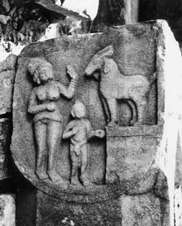
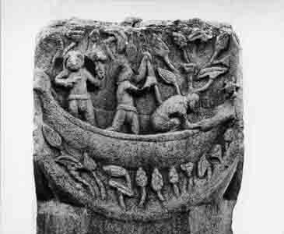
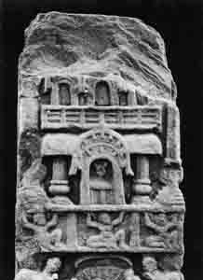
Bodhgaya, Gaya, Bihar, ca. 99-1 BCE a) Rohantumiga Jataka, railing pillar (now at Bodhgaya Museum), b) Railing pillar, c) railing pillar

Slide 4
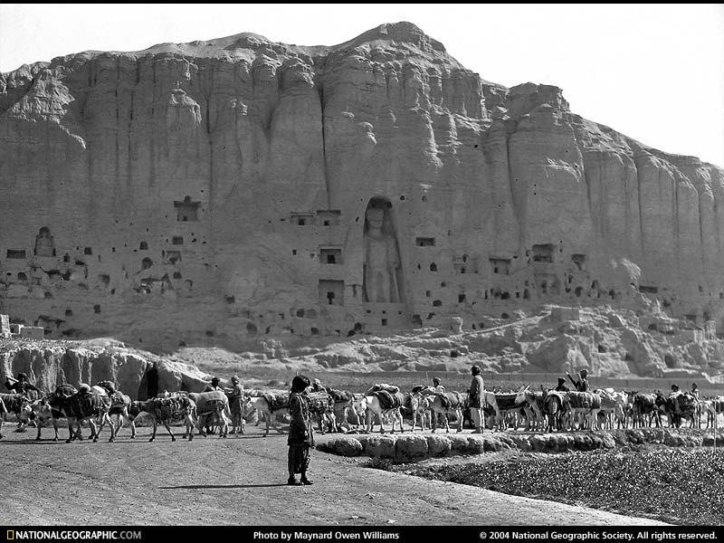
Bamiyan Buddha, installed by 6th century CE, when the Chinese Buddhist monk Hsüan-tsang described them, around 632 CE, in what is now Afghanistan

Slide 5
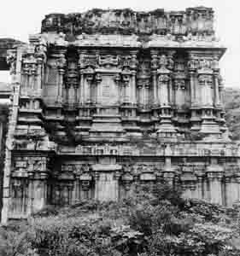
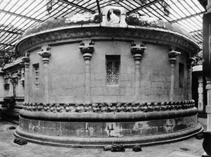
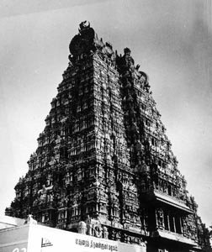
Madurai, Tamilandu: Alagarkoil temple, Brahmanical affiliation, ca. 1600-1699 CE; Alagarkoil temple, brahmanical affiliation, ca. 1200-1299 CE; Minaksi temple, Brahmanical affiliation, ca. 1600-1699 CE

Slide 6
G.W.F. Hegel, ch. 3, “Freedom, Individual and the State,” Introduction to the Philosophy of History 1828
“The state is the Idea of Spirit in the externalized form of human will and its freedom. It is in the state, therefore, that historical change occurs essentially, and the elements of the Idea are reflected in the state as various political principles. The forms of government in which the world-historical peoples have blossomed, are characteristic of those peoples. Thus the various forms do not present one universal basis of government…Rather, there is a difference, here, in the underlying principles themselves.” (50)

Slide 7
“In German, the term for `history’ (Geschichte) is derived from the verb “to happen”…Thus the term combines the objective and the subjective sides: it denotes the actual events (in Latin, res gestae) as well as the narration of the events (in Latin, historiam rerum gestarum). A shared inner source produces history in both senses at the same time….It is the state, however, which first presents a subject matter that is entirely appropriate to the prose of history; indeed, the state creates it as it creates itself … A community that is in the process of shaping itself into a state requires rules, laws, universal and universally binding directives. And as it produces them it also produces an intelligent and definite record of (and interest in) actions and events whose results are lasting. Mnemosyne is thereby driven to give enduring remembrance to them, in the interest of the permanent purposes that are characteristic of the state as it forms…For an integrated understanding of itself [the state] needs a consciousness of the past.” (65)

Slide 8
The time periods…that have elapsed for peoples before the writing of history, may have been filled with revolutions, migrations, the wildest changes. But these peoples are without an objective history, because they have produced no subjective historical narratives. If the accounts are missing it is not because they have accidentally disappeared, but because they never could have existed. Only in the state, with the consciousness of laws, are there clear actions – and with them the clarity of consciousness having the capability and the need to preserve them. Everyone who begins to become acquainted with the treasures of Indian literature finds it striking that this land – so rich in the most profound spirituality – has no history….Not only does India have ancient religious texts and brilliant works of poetry, but [also] ancient codes of law – the very thing that was set down just now as a precondition in the formation of history – and yet it has no history.” (Hegel, ch. 4, “History in Its Development,” p. 65)

Slide 9
“Due to the unfreedom arising from the natural permanence of the caste system,, the cohesion of society is nothing but wild arbitrariness – fleeting activity or blind rage – without any goal for progress or development. Hence there is no thoughtful remembrance, no object there for Mnemosyne. And although there is a deeper fantasy, it is still wild; but to be capable of having a history this fantasy would have to a purpose that relates both the the actual world and to substantial freedom.
Because this is the precondition of history, much has happened without giving rise to history; the rich and immense growth of families into tribes, of tribes into nations; their consequent spread, along with so many complications, wars, revolutions and decline – all occurring with much noise and clamor, although all has remained in effect silent and has passed by stealthily, unnoticed.” (Hegel, ch. 4, “History in Its Development,” p. 65)

Slide 10
“History in its Development,” ch. 4, Hegel, Introduction to the Philosophy of History
“The time periods…that have elapsed for peoples before the writing of history, may have been filled with revolutions, migrations, the wildest changes. But these peoples are without an objective history, because they have produced no subjective historical narratives. If the accounts are missing it is not because they have accidentally disappeared, but because they never could have existed. Only in the state, with the consciousness of laws, are there clear actions – and with them the clarity of consciousness having the capability and the need to preserve them.” (65)

Slide 11
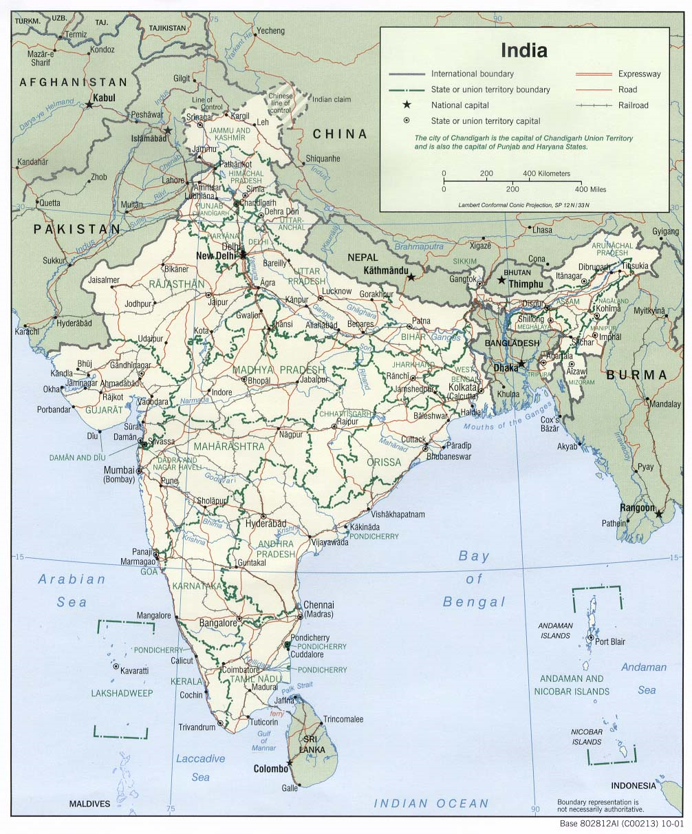
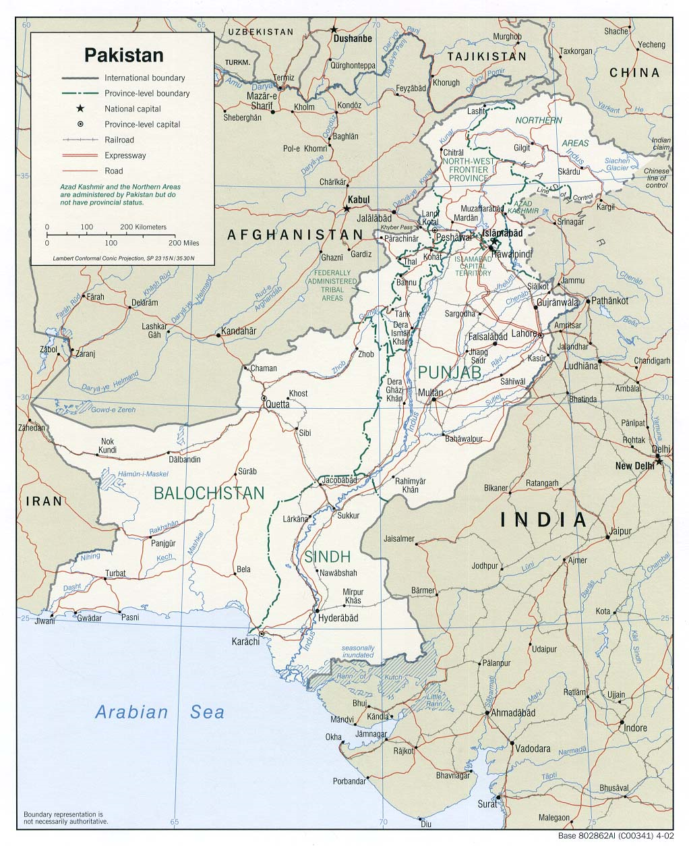
Perry-Casteñada Map Collection, University of Texas at Austin: India and Pakistan (CIA maps)

Slide 12
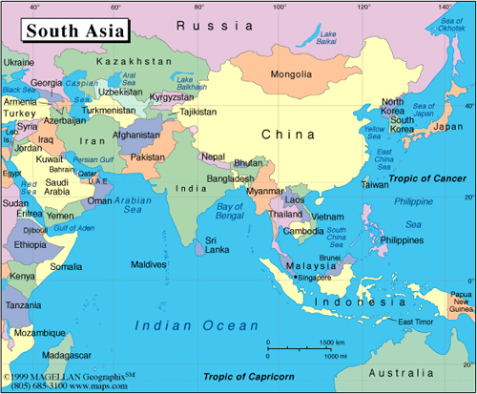
South Asia Political Map 1999
Asia Society, AskAsia.org

