Slide 1
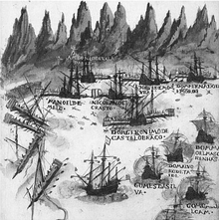
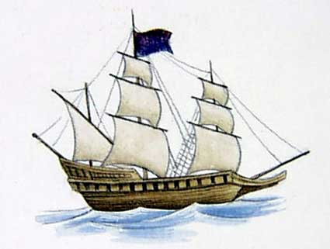
Some Shipping News
1565: Portugese interventions in politics of Indian coast (befriend any enemy of a Muslim ruler) contributed to destabilization => Deccani sultans in the plateau and along the coast and to successfully combine and defeat the “Hindu” kingdom of Vijayanagar, and eventually to the destabilize Portugese authority in Goa, seat of the viceroyalty in the east
1580: Philip II of Spain takes over Portugal, combines the 2 kingdoms and their possessions, closes Portugese ports to the Protestant Dutch who, along with their co-religionists in England, sought alterative routes to the riches of the east
1588: Armada destroys Spanish naval power => Dutch and English plying routes around Cape of Good Hope to Asia
1600: English East India Company formed with 24 shareholders or “Committees” (later Directors) and 15-year monopoly charter conferred by Queen Elizabeth
1602: Dutch company (VOC) with 6.5 million guilders in capital (ten times the amount raised by their English counterparts) and 76 shareholders; monopolize trade from Magellan to Good Hope for 21 years
1603: 4 ships sent to Malaccas return to launch a lucrative monopoly trade for the 24 Committees making an average profit of 170% on the 1st eight voyages: 95% on the 1st and 2nd and 234% on the 3rd and 5th
Portugues ambush against the galleys of Seydi Ali as depicted in the livro de Lisuarte de Abreu

Slide 2
Business pages: East India Company
1608: 1st EIC ship arrives in Surat, Jehangir’s imperial port on the Indian Ocean
1609: James I confers a charter monopoly of indefinite duration
salaries for EIC servants set to discourage independent trading (£5-£200)
1611: 1st factory on the Coromandel coast
1612: EIC ships disperse a Portugese fleet => disrupting balance of power
Surat factory built
1613: separate subscriptions for each EIC voyage replaced by the 1st Joint Stock
1616: Sir Thomas Roe presents gifts to Jehangir (who has no fleet of his own)
1619: Roe secures agreement to establish an EIC factory at Surat (and warned against attempting to extend territorial reach as Portugese had done)
Anglo-Dutch treaty => suspension of hostilities in Malaccas between EIC and VOC ships and traders

Slide 3
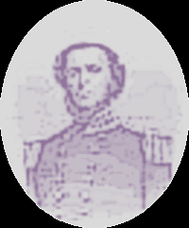
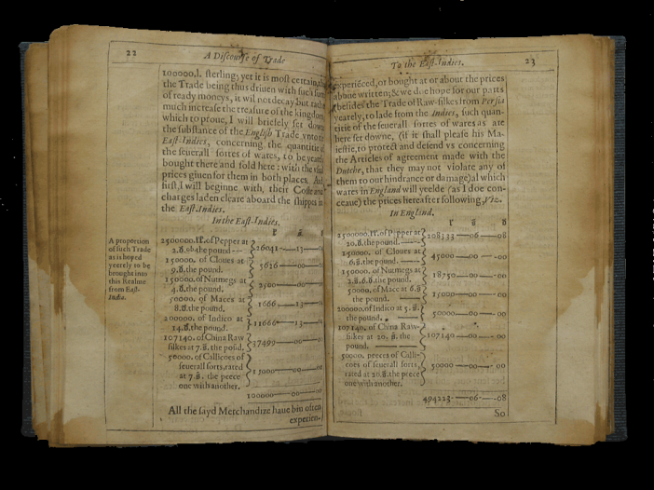
Discourse of Trade unto the East Indies
1620:Thomas Mun (1571-1641) EIC Director publishes Discourse of Trade unto the East Indies which argued that “money doth attend merchandise, for money is the price of wares and wares are the proper use of money, so that coherence is inseperable.” An argument for monopoly, it also insisted that exchanging specie for goods to sell at profit and reinvest in ongoing and proliferating trade was the very basis of national wealth and as such worth protection from “piracies” of all kinds, on high seas, in marketplaces and in royal court (or Parliament)

Slide 4
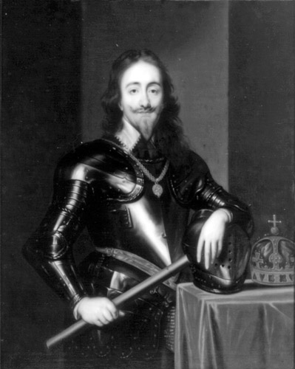
Politics “at home” and “abroad”: Bad shipping news for the EIC Directors
1623: Anglo-Dutch alliance disintegrates →massacre at Amboina and →EIC retaliation against VOC in Indian Ocean → destruction of Portugese power there
1630: Drought in Gujarat and Deccan and along Coromandal coast
1631: floods in same regions
1635: Convention of Goa => détente with Portugese in Indian Ocean
–Charles I abrogates EIC charter, granting exclusive trading rights to a courtier in exchange for a loan of £200,000. One of his ships plundered a Mughal one at Surat, getting the EIC factor jailed for 2 months and fined to the tune of £18,000.
-EIC’s 18 London employees get salaries cut
1639: London salaries cut again, and both shipbuilding and the joint stock practice suspended
-Fort St. George built on Coromandel Coast (Madras)
1640: EIC stocks sell at 60% face value
1641: EIC “sells” £61,000 pepper to Charles I (in effect a gift)
1643: EIC’s Deptford yard sold and Blackwall scaled back
1649: Charles I executed
Ireland invaded
Irish rebellion in Barbados
Levelers’ pamphlets New Chains Discovered and 3rd Agreement of the People
1650: Blackwall sold, leaving EIC only Fort George as an asset in property
1658: Directors declare liquidation and sale of remaining assets; new Charter granted by Cromwell

Slide 5
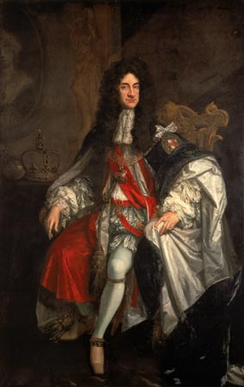
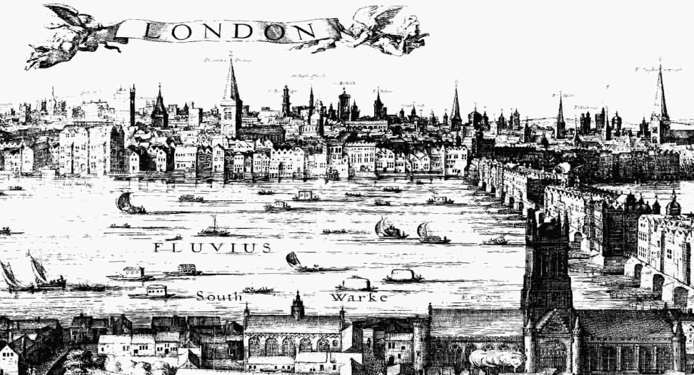
Return of the King:
Happy Days Are Here Again
1660: Restoration of Stuart monarch (Charles II)
-1st Navigation Act stipulated that colonial produce (American and Caribbean: sugar, indigo, tobacco, cotton) could be supplied only to England; expanded (to cover trade in African slaves) and refined in subsequent Acts of 1662, 1663, ’70, ’73 and 1696)
1661: Cromwell’s 1658 Charter replaced by a royal one
-Charles II m. Catherine of Braganza => acquisition of Bombay (sold to EIC)
1662: EIC loans £10,000 to the Crown (after having voted £3,000 silver plate to Charles and £1,000 of same to brother James
1665: £100 EIC stock purchased in 1658 fell to £70
1670: Around this year, 5 Acts renew Charter of 1657 and extend it: General Stock would be permanent, ensuring continuity of capital; stipulations for administrative responsibility among directors; right to acquire territory abroad, mint money, have a standing army, make war and peace treaties and act as governor over acquired territories and populations
1667: £100 EIC stock in 1658 rose to £245
1683: same stock rose to between £360-£500; value of EIC imports £800,000

Slide 6
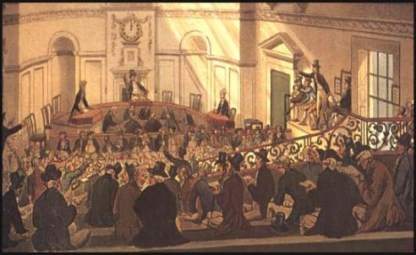
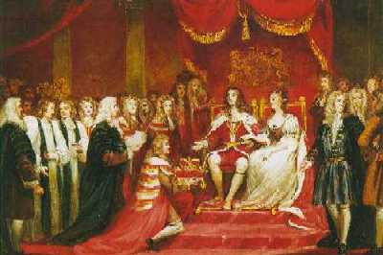
English State and Commerce march into the 18th century
1688: “Glorious Revolution”
1690: Fort William founded (Calcutta)
1693: National Debt
1694: Bank of England
1696: Board of Trade
-Lloyd’s News published in London
-Beginning of deregulation of Royal African Company
-“Act for the More Effectual Suppression of Piracy”
1698: EIC entitled to use motto Auspicio Regis et Senatus Angliae
1702: £3.2 million to the Treasury in return for a 3-year monopoly on trade in the East.
1705: -Virginia Act “Concerning Servants and Slaves”
1707: -Act of Union with Scotland
1710: -EIC Shareholders regularly getting 8%
1712: -Act renews EIC charter
1713: -End of the War of Spanish Succession
1716: -Farrukhsiyar, awards EIC farman
1730: -Charter renewed to 1766
1739 -Persian Nadir Shah occupies Delhi
1742: -Charter again extended, to 1783 (£1 million loan to Treasury)

Slide 7
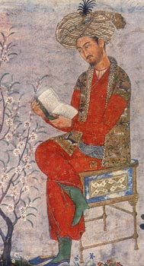

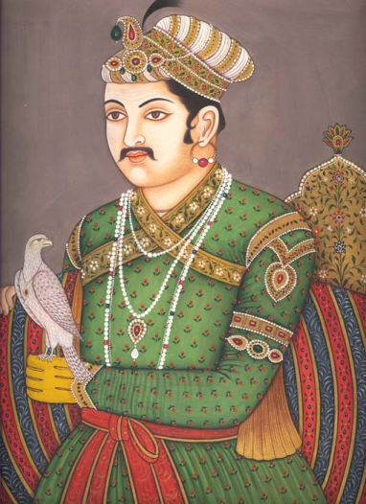


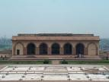


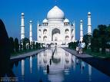

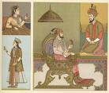
“Great Mughals”
Babar 1526-1530
Humayun 1530-40
  Sher Shah Suri 1540-45
  Islam Shah Suri 1545-54
Humayun 1555-6
Akbar 1556-1605
Jahangir 1605-27
Shah Jahan 1627-58
Aurangzeb 1658-1707
Bahadur Shah (Shah Alam) 1707-12
Jahandar Shah 1712-13
Furrukhsiyar 1713-19* firman to trade duty-free in Bengal to EIC

Slide 8
Administration:
After an elaborate and exhaustive cadastral survey of his territories, Akbar’s empire was divided into:
12 provinces or subhas, [gov’d by subhadars] and subdivided into districts or
sarkars, which in turn were usually broken down into subdistricts or
parganas.
Cities were separately administered by kotwals who supervised various municipal bureaucracies, including police forces.
District military commanders or faujdars were responsible for countryside policing, supporting and protecting the revenue collection done by the amalguzars.
Law:
  Shari’at, interpreted by ulema (scholars) and enforced by qazis (judges) whose judgments could be appealed to emperor.
  For Hindus, Dharmashastra was applied by Brahman specialists, or village panchayat, and decisions were final unless appealed to emperor.

Slide 9
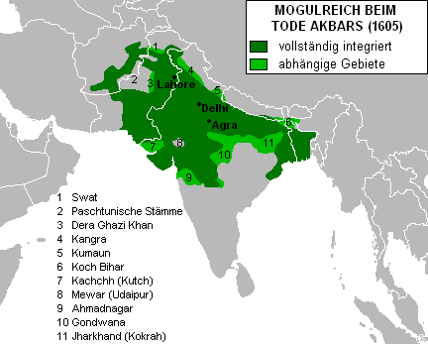
31 ranks of Mughal officialdom under Akbar (1542-1605)
each official rank was assessed on number of cavalry a man could raise and deploy in emperor’s service.
Lowest mansabdar or title holder was a “commander of ten,” and appointed through nomination by a courtier, or amir.
Higher-ranking officers were hand-picked, mostly from cadre of men with origins outside India – as in case of British raj (70%) – but included also Rajputs, Jats and a sprinkling of Marathas (like, indeed, Shivaji), who constituted the Hindu 15% of the remaining proportion of mansabdars [rest were presumably Indian Muslims]. 21 Hindus held mansabdaris of 5,000 and above in Akbar’s reign.
Titles had started out as non-hereditary, but devolved into privileges an officer could and did pass on to heirs.
The officers were paid salaries from the imperial coffers, and not through their own extractions of revenues, which was in the hands of a separate bureaucracy
mansabdars were warrior-courtiers, not tax-collectors under Akbar
this changed under Shah Jahan who reduced their ranks from a high of 1,800 to fewer than 800 of whom fewer had huge mansabs than under Akbar, and those who had the largest were his sons

Slide 10
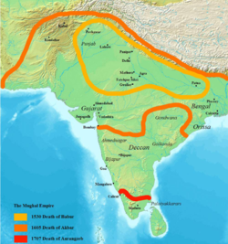
Extending Borders, Declining discipline and proliferating personnel:
Revenues:
The revenue expectations of the Mughal state under Akbar were made in decennial surveys and assessed either of zamindars who controlled groups of villages and their agricultural output, or of ryots directly.
Average assessments varied from region to region and with availablility of resources like irrigation and so on, but was generally about 1/3 total harvest or 1/3 cash value of harvest; in times of distress, revenue collectors were directed to remit taxes.
Under SJ, revenue demands rose to an average of half of all crops, and the surpluses the Mughals had enjoyed dwindled and disappeared; courtiers inc’ly restive and resentful and plotting, fratricidal sons => hemorrhage of specie and goodwill
Akbar abolished the jizya or discriminatory poll tax imposed on Hindus
It was reimposed by Aurangzeb in 1679 along with duties that doubled what Hindu merchants paid over Muslim counterparts for the same merchandise sold by Muslim merchants.
Under Aurangzeb, administrative Mansabdars were assigned jagirs of land to sustain themselves and their cavalries, and inc’ly, they began to squeeze cultivators, even though it was forbidden, diverting these monies to profit rather than emperor’s cavalries. Accelerating peasant revolt and allegiance pledged to Jat, Maratha, Sikh and Rajput zamindars like Shahaji and Shivaji

Slide 11
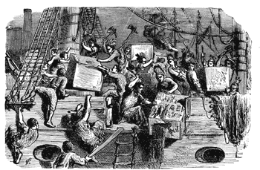
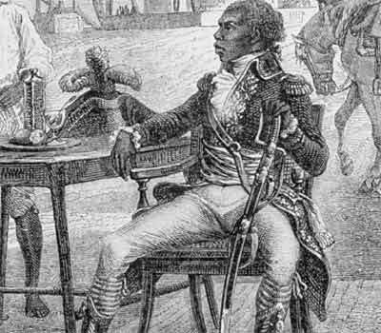

Meanwhile...elsewhere in empty homogeneous time:
American revolution and its critique of British mercantilism and the (colonial) governance with which it thrived
French revolution and critique of mercantilist privileges and their abuse
Haitian revolution and concerns about the implications of corruption of state by wealthy, self-interested and highly influential colonial factions (West Indian merchant or planters) heretofore subsidized by state, but increasingly a liability

Slide 12
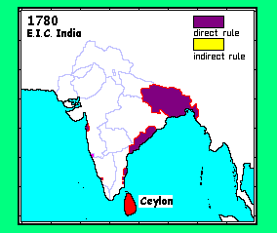
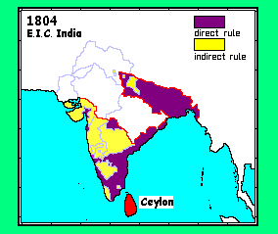
EIC to 1790
EIC 1790-1815 http://www.zum.de/whkmla/histatlas/india/haxbrindia.html

Slide 13
Edmund Burke, “Speech in Opening the Impeachment of Warren Hastings, Esq. First Day, 15th February 1788”
David Bromwich, ed., On Empire, Liberty, and Reform. Speeches and Letters (YUP)
“...this process is the cement, which binds the whole together: this is the individuating principle, that makes England what England is. In this Court it is, that no subject, in no part of the Empire, can fail of competent and proportionable justice; here it is, that we provide for that, which is the substantial excellence of our Constitution; I mean the great circulation of responsibility, by which (excepting the supreme power) no man, in no circumstance, can escape the account, which he owes to the laws of his country.” (p. 384)

Slide 14
Edmund Burke, “Speech in Opening the Impeachment of Warren Hastings, Esq. First Day, 15th February 1788”
David Bromwich, ed., On Empire, Liberty, and Reform. Speeches and Letters (YUP
”...the crimes, which we charge in these Articles, are not lapses, defects, errours, of common human frailty, which, as we know and feel, we can allow for. We charge this Offender with no crimes, that have not arisen from passions, which it is criminal to harbor; with no offences, that have not their root in avarice, rapacity, pride, insolence, ferocity, treachery, cruelty, malignity of temper; in short, in nothing, that does not argue a total extinction of all moral principle; that does not manifest an inveterate blackness of heart, died in grain with malice, vitiated, corrupted, gangrened to the very core...We charge him with nothing, that he did not commit upon deliberation; that he did not commit against advice, supplication, and remonstrance; that he did not commit against the direct command of lawful authority...The crimes of Mr. Hastings are crimes not only in themselves...[t]hey were crimes, not against forms, but against those eternal laws of justice, which are our rule and our birthright. His offences are...in substance and effect, High Crimes and High Misdemeanours...We have brought before you such a person, that, if you strike at him wit the firm and decided arm of justice, you will not have need of a great many more examples. You strike at the whole corps, if you strike at the head.” (388)

Slide 15
Edmund Burke, “Speech in Opening the Impeachment of Warren Hastings, Esq. First Day, 15th February 1788”
David Bromwich, ed., On Empire, Liberty, and Reform. Speeches and Letters (YUP
  “It is well know, that enormous wealth has poured into this country from India through a thousand channels, publick and concealed and it is no particular derogation from our honour to suppose a possibility of being corrupted by that, by which other empires have been corrupted, and assemblies, almost as respectable and venerable as your Lordships, have been directly or indirectly vitiated. Forty millions of money, at least, have within our memory been brought from India into England. In this case the most sacred judicature ought to look to its reputation...God forbid, that...when you try the cause of Asia in the presence of Europe, there should be the least suspicion, that a narrow partiality, utterly destructive of justice, should so guide us, that a British Subject in power should appear in substance to possess rights, which are denied to the humble allies, to the attached dependents of this kingdom, who by their distance have double demand upon your protection, and who, by an implicit (I hope not a weak and useless) trust in you, have stripped themselves of every other resource under heaven.”

Slide 16
Edmund Burke, “Speech in Opening the Impeachment of Warren Hastings, Esq. First Day, 15th February 1788”
David Bromwich, ed., On Empire, Liberty, and Reform. Speeches and Letters (YUP
“A fair revenue many be collected without the aid of wicked, violent, and unjust instruments...When we know, that men must be well paid (and they ouight to be well paid) for the performance of honourable duty, can we think, that men will be found to commit wicked, rapacious, and oppressive acts...for the sole emolument of dishonest employers? No; they must have their full share of the prey...We must not therefore flatter ourselves, when Mr. Hastings takes 40,000l. In bribes for Dinagepore and its annexed provinces, that from the people nothing more that 40,000l. is extorted...four times forty must be levied on the people; and these violent sales, fraudulent purchases, confiscations, inhuman and unutterable tortures...general despair, general in insurrection, the massacre of the officers of revenue by the people, the massacre of the people by the soldiery, and the total waste and destruction of the finest provinces in India, are things of course; and all a necessary consequence inbolved I the very substance of Mr. Hasting’s bribery....”
“...I impeach Warren Hastings..of High Crimes and Misdemeanours...in the name of the Commons of Great Britain in Parliament assembled, whose parliamentary trust he has betrayed....whose national character he has dishonoured....in the name of the people of India, whose laws, rights, and liberties he has subverted; whose properties he has destroyed, whose country he has laid waste and desolate....in the name, and by virtue, of those eternal laws of justice, which he has violated...in the name of human nature itself, which he has cruelly outraged, injured, and oppressed in both sexes, in every age, rank, situation, and condition of life.”

Slide 17
James Mill, The History of the British India (1826):
Preface paragraphs 1 and 2
“In the course of reading and investigation, necessary for acquiring that measure of knowledge which I was anxious to possess, respecting m country, its people, its government, its interests, its policy, and its laws, I was met, and in some degree surprised, by extraordinary difficulties, when I arrived at that part of my inquiries which related to India...The knowledge, requisite for attaining an adequate conception of that great scene of British action, was collected nowhere. It was scattered in a great variety of repositories...often mixed up with subjects of a very different nature...what was useful lay commonly embedded in a large mess of what was trifling and insignificant; and of a body of statements, given indiscriminately as matters of fact, ascertained by the senses, the far greater part was in general only a matter of opinion, borrowed, in succession, by one set of Indian gentlemen from another.”

Slide 18
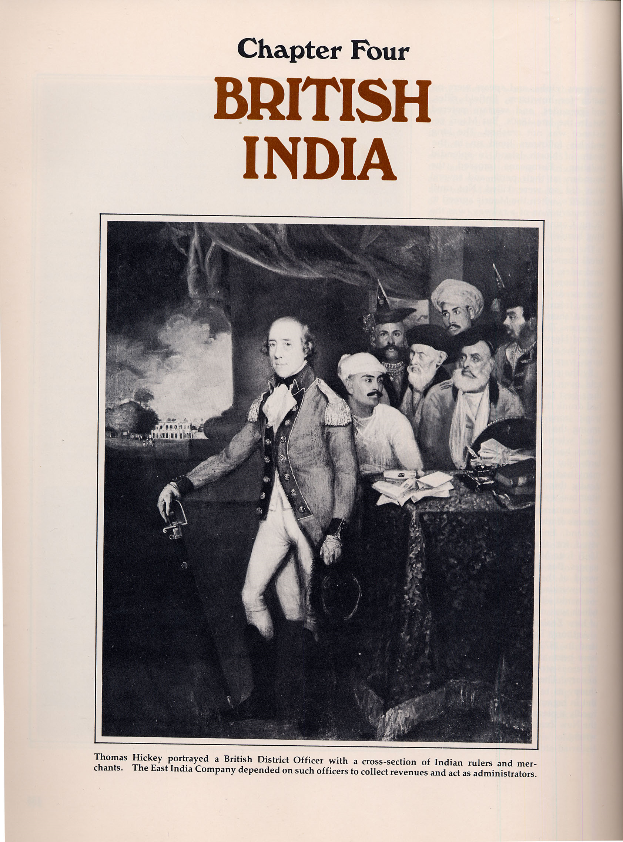

Slide 19
James Mill, The History of the British India (1826):
Preface
“I have no doubt of being able to make out, to the satisfaction of all reflecting minds, that the man who should bring to the composition of a history of India, the qualifications alone which can be acquired in Europe, would come, in an almost infinite degree, better fitted for the task, than the man who should bring to it the qualifications alone which can be acquired in India; and that the business of acquiring the one set of qualifications is almost wholly incompatible with that of acquiring the other.” (x)
“...It will not...admit of much dispute that the habits which are subservient to the successful exploration of evidence are more likely to be acquired in Europe than in India.” (xii)
“Whatever is worth seeing or hearing in India, can be expressed in writing. As soon as everything of importance is expressed in writing, a man who is duly qualified may obtain more knowledge of India in one year in his closet in England, than he could obtain during the course of the longest life, by the use of his eyes and ears in India.” (xii)

Slide 20
James Mill, The History of British India vol. 2, book 3, ch. 5, “A Comparison of the State of Civilization among the Mahomedan Conquerers of India with the State of Civilization among the Hindus,” pp. 424-30
“The question...is, Whether a government, moulded and conducted agreeably to the properties of Persian civilization, instead of a government moulded and conducted agreeably the properties of Hindu civilization, the Hindu population of India lost or gained...it will not admit of any long dispute, that human nature in India gained, and gained very considerably, by passing from a Hindu to a Mahomedan government...The defects of Mahomedan rule, enormous as they justly deserve to be held, can by no means be regarded as equal to those which universally distinguish the government of the Hindus.” (p. 429)
“Under the simplicity of Oriental despotism, there is not much room for diversity of form. Yet there are circumstances which distinguish to a considerable extent the state of government among the Mahomedans from that among the Hindus; and all of them to the advantage of the former.” (p. 430)

Slide 21
James Mill, The History of British India vol. 2, book 3, ch. 5, “A Comparison of the Stat of Civilization among the Mahomedan Conquerers of India with the State of Civilization among the Hindus,”
“Though no great amount of salutary effects is...ascribed to the operation of manners, under the sovereigns, either of Hindu or of Mahomedan breed, the benefit, as far as it went, was all on the side of the Mahomedans. There was, in the manners of the Mahomedan conquerors of India, an activity, a manliness, an independence, which rendered it less easy for despotism to sink, among them, to that disgusting state of weak and profligate barbarism, which is the natural condition of government among such a passive people as the Hindus.
Further, along with those remains of barbarism which in considerable amount adheres to the best of the Mahomedan nations, as well as to all the other inhabitants of Asia, a considerable portion of plain good sense marked the character of the conquerors...while the natives of that country are distinguished by a greater deficiency in the important article of practical good sense, than any people, above the rank of savages, of whom we have any record.” (p. 434)

Slide 22
James Mill, The History of British India vol. 2, book 3, ch. 5
“The laws of the Hindus...are such as could not originate in any other than one of the weakest conditions of the human intellect; and of all the forms of law know to the human species, they exhibit one of the least capable of producing the benefits which it is then end and the only good consequence of law, to ensure.
The Mahomedan law, as introduced into India by its Mogul conquerors, is defective indeed, as compared with any very high standard of excellence; but compare it with the standard of any existing system, with the Roman law for instance, or wit the law of England, and you will find its inferiority not so remarkable...” (p.441)

Slide 23
J. Peggs, India’s Cries to British Humanity: An Historical Account of Suttee, Infanticide, Ghat Murders and Slavery in India (London: Seely & Son, 1830): pp. v-vi
“The infatuated Suttee, the murdered female infant, the perishing Pilgrim...the sick exposed by the Ganges, and the degraded Slave, present their cry to Britain; and shall not that cry be heard and reiterated...till the Senate and the Throne hear, and feel, and redress their wrongs?...May the Father of the fatherless and the Judge of the Widow, even `God in his holy habitation,’ incline those who hold in their hands the destinies of India to regard `India’s Cries to British Humanity’.”

Slide 24
Rudyard Kipling, “The White Man’s Burden,” 1899
Take up the White Man's burden--
Send forth the best ye breed--
Go bind your sons to exile
To serve your captives' need;
To wait in heavy harness,
On fluttered folk and wild--
Your new-caught, sullen peoples,
Half-devil and half-child.
Take up the White Man's burden--
In patience to abide,
To veil the threat of terror
And check the show of pride;
By open speech and simple,
An hundred times made plain
To seek another's profit,
And work another's gain.
Take up the White Man's burden--
The savage wars of peace--
Fill full the mouth of Famine
And bid the sickness cease;
And when your goal is nearest
The end for others sought,
Watch sloth and heathen Folly
Bring all your hopes to nought.
Take up the White Man's burden--
No tawdry rule of kings,
But toil of serf and sweeper--
The tale of common things.
The ports ye shall not enter,
The roads ye shall not tread,
Go mark them with your living,
And mark them with your dead.
Take up the White Man's burden--
And reap his old reward:
The blame of those ye better,
The hate of those ye guard--
The cry of hosts ye humour
(Ah, slowly!) toward the light:--
"Why brought he us from bondage,
Our loved Egyptian night?"
Take up the White Man's burden--
Ye dare not stoop to less--
Nor call too loud on Freedom
To cloke your weariness;
By all ye cry or whisper,
By all ye leave or do,
The silent, sullen peoples
Shall weigh your gods and you.
Take up the White Man's burden--
Have done with childish days--
The lightly proferred laurel,
The easy, ungrudged praise.
Comes now, to search your manhood
Through all the thankless years
Cold, edged with dear-bought wisdom,
The judgment of your peers!

Slide 25
Curzon, November, 1900, on arriving in India
“…it is by native confidence in British justice that the loyalty of the Indian peoples is assured and the man who either by force or by fraud shakes that confidence is dealing a blow at British dominion in India. If to justice we can add that form of mercy which is best expressed by the word consideration, and which is capable of showing itself in almost every act and incident of life, we have, I think, a key that will open most Indian hearts.”

Slide 26
Curzon, November 1905, on leaving India
“A hundred times in India have I said to myself, Oh that to every Englishman in this country, as he ends his work, might be truthfully applied the phrase, `Thou hast loved righeousness and hated iniquity.’ No man has, I believe, ever served India faithfully of whom that could not be said…Perhaps there are few of us who make anything but a poor approximation to that ideal. But let it be our ideal all the same – to fight for the right, to abhor the imperfect, the unjust or the mean, to swerve neither to the right hand, nor to the left, to care nothing for flattery or applause or odium or abuse – it is so easy to have any of them in India – never to let your enthusiasm be soured or your courage grow dim, but to remember that the Almighty has placed your hand on the greatest of his ploughs, in whose furrow the nations of the future are germinating and taking shape, to drive the blade a little forward in your time, and to feel that somewhere among these millions you have left a little justice or dignity, a spring of patriotism, a dawn of intellectual happiness or prosperity, a sense of manliness or moral enlightenment or a stirring of duty where it did not exist before – that is enough, that is the Englishman’s justification in India. It is good enough for his watchword while he is here, for his epitaph when he is gone. I have worked for no other aim. Let India be my judge.”

Slide 27
Curzon, November 1905
“I earnestly hope that the Viceroy in India may never cease to be head of the Government in the fullest sense of the term. It is not one-man rule…But it is one-man supervision, which is the very best form of Government, presuming the man to be competent. The alternative in India is a bureaucracy, which is the most mechanical and lifeless of all forms of administration.”

Slide 28
Gokhale on Curzon, Presidential Address, INC, Benares, 1905
“To [Curzon], India was a country where the Englishman was to monopolise for all time all power and talk all the while of duty. The Indian’s only business was to be governed and it was a sacrilege on his part to have any other aspiration. In his scheme of things there was no room for the educated classes of the country; and having failed to amuse them for any length of time by an empty show of taking them into confidence, he proceeded in the end to repress them…India exists only as a scene of the Englishman’s labours, with the toiling millions of the country – 80% of the population – in the background…Had Lord Curzon been less self-centred, had he had more humility in his nature, he might perhaps have discovered his mistake before it was too late…but I doubt if the main current of his administration would even then have flowed in another channel. Lord Curzon’s highest ideal of statesmanship is efficiency of administration…Taking [him] at his highest, we find him engaged in a Herculean attempt to strengthen the Englishman’s monopoly of power in India and stem the tide of popular agitation and discontent by rousing the members of the bureaucracy to a sense of duty similar to his own and raising the standard of administrative efficiency all round. The attempt has failed…Never was discontent in India more acute and widespread than when the late Viceroy laid down the reins of office; and as regards the bureaucratic monopoly of power, I think we are sensibly neared the time when it will be successfully assailed.”

Slide 29
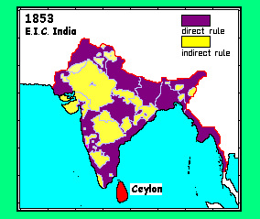
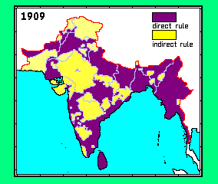
EIC 1816-1857
British India 1858-1918 http://www.zum.de/whkmla/histatlas/india/haxbrindia.html

