Slide 1
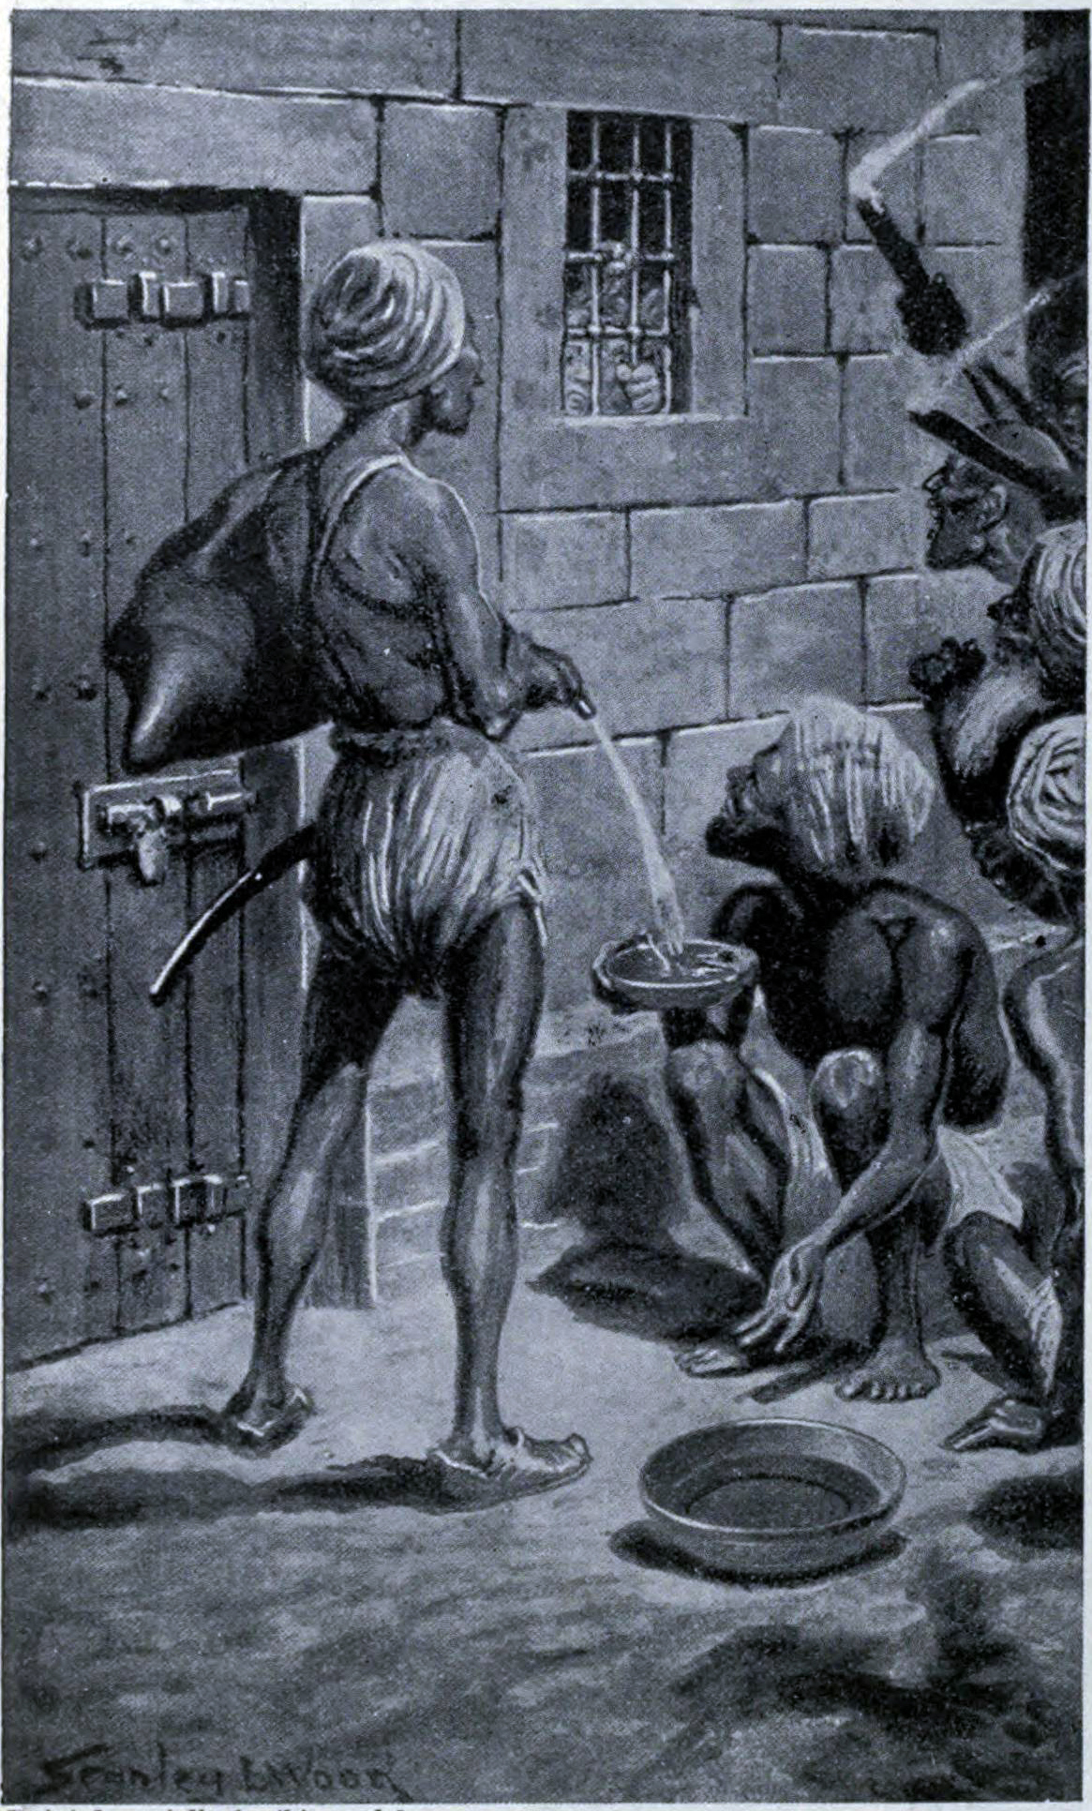
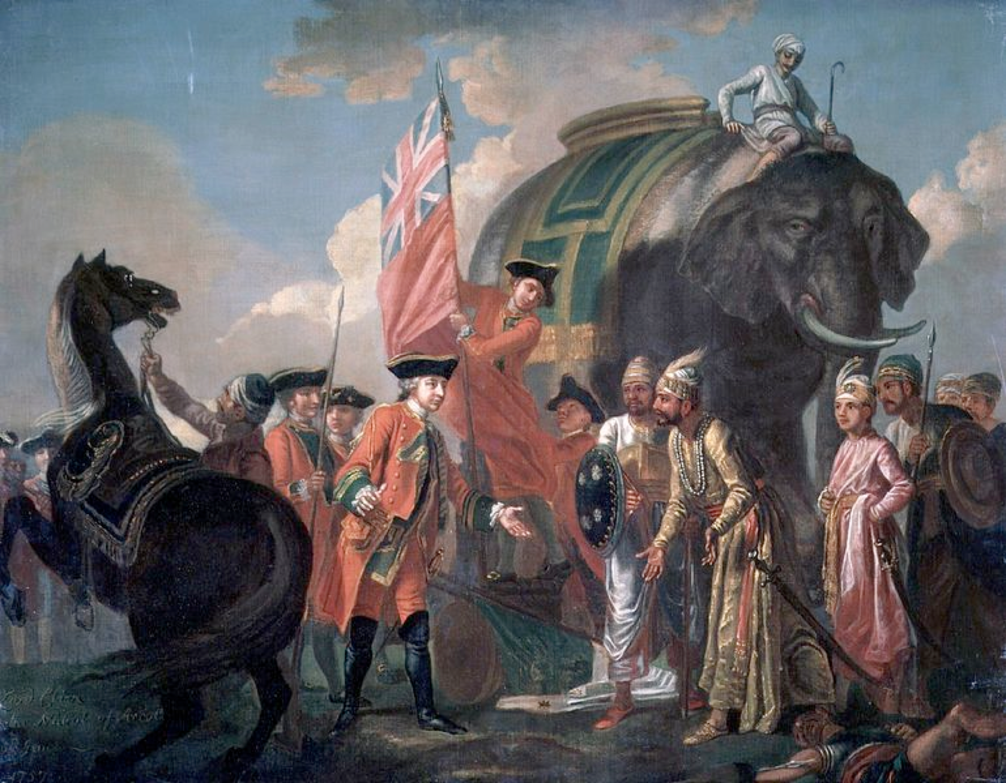
The Black Hole of Calcutta (20
Clive meeting Mir Jafar after the Battle of Plassey, oil on canvas (Francis Hayman, c. 1762)
June 1756) from the Hutchinson's story of the nations

Slide 2
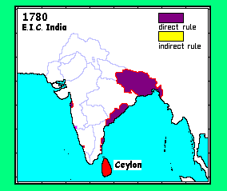
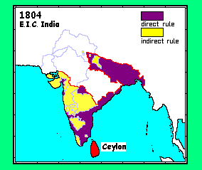
EIC to 1790
EIC 1790-1815 http://www.zum.de/whkmla/histatlas/india/haxbrindia.html

Slide 3
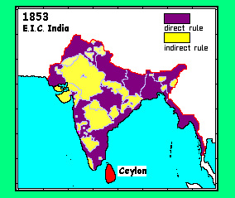
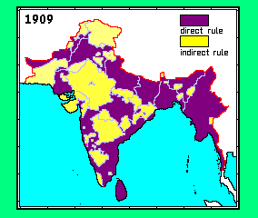
EIC 1816-1857
British India 1858-1918 http://www.zum.de/whkmla/histatlas/india/haxbrindia.html

Slide 4
Bentinck’s Minute on the Suppression of Sati (1829) notes that he was faced with the:
“awful responsibility” either to:
“consent to the consignment year after year of hundreds of innocent victims to a cruel and untimely end, when the power exists of preventing it…a predicament which no conscience can contemplate without horror”
OR:
“to put to hazard…the very safety of the British Empire in India, and to extinguish at once all hopes of those great improvements -- affecting the condition not of 100s and 1000s but of millions – which can only be expected from the continuance of our supremacy, is an alternative which even in the light of humanity itself may be considered as a still greater evil.”

Slide 5
The Stakes:
“On the one side, Religion, Humanity, under the most appalling form, as well as vanity and ambition – in short all of the most powerful influences over the human heart – are arrayed to bias and mislead judgment. On the other side, the sanction of countless ages, the examples of all the Mussalman conquerers, the unanimous concurrence in the same policy of our own most able rulers, together with the universal veneration of the people, seem authoritatively to forbid, both to feeling and to reason, any interference in the exercise of their natural prerogative.”

Slide 6
Elaboration
“It might be very difficult to make a stranger to understand, much less believe, that in a population of so many millions…so great is the want of courage and vigour of character, and such the habitual submission of centuries, that insurrection or hostile position to the will of the ruling power may be affirmed to be an impossible danger….Were the scene of this sad destruction of human life [effected by sati] laid in the Upper instead of the Lower Provinces, in the midst of a bold and manly people, I might speak with less confidence upon the question of safety” [of outlawing sati]
Notes:
Bentinck concludes by arguing that the British in India should proceed:
“in accordance with the noble example set to us by the British Government at home, and that the adaptation, when practicable to the circs of this vast Indian population, of the same principles, may promote here as well as there the general prosperity, and may exalt the character of our nation.”

Slide 7
The conclusion:
“With the firm undoubting conviction entertained upon this question, I should be guilty of little short of the crime of multiplied murder if I could hesitate in the performance of this solemn obligation.”
Bentinck goes on to enumerate the reasons why, under the conditions that prevailed to 1829, the EIC gov’t could be excused for leaving alone this question of absolute morality, all of which have dissolved “now that we are supreme.”

Slide 8
“We must at present do our best to form a class who may be interpreters between us and the millions whom we govern; a class of persons, Indian in blood and colour, but English in taste, in opinions, in morals, and in intellect. To that class we may leave it to refine the vernacular dialects of the country, to enrich those dialects with terms of science borrowed from the Western nomenclature, and to render them by degrees fit vehicles for conveying knowledge to the great mass of the population.”
Thomas Babington Macaulay, Law member, Council of India, “Minute on Indian Education,” February 2, 1835

Slide 9
Ludden (A Short History) on EIC governance:
“Defining tradition became an integral feature of imperial governance.” (179) Further, “The government needed native authority to determine what native tradition should be…[making] native experts prominent public figures in cosmopolitan circles where interpreting native tradition became a professional activity for public intellectuals…Empire provoked endless disputes about the legitimacy of practices deemed to be traditional. In this disputation, recognized authorities in imperial society constructed tradition as the ancient inheritance of native cultures.
Thus the rhetorical and analytical opposition of change and stability, reform and orthodoxy, Europe and Asia, and modernity and tradition became ingrained in imperial society…structur[ing] public discourse. Traditionalists sought to protect what they claimed to be ancient rights. Modernists fought for what they imagined to be universal rights. Reformers worked to reinterpret and change tradition on what they saw as modern lines. Meanwhile…people gained new entitlements based on ancient rights, people sued for new rights by invoking tradition, and people used sacred texts to fight for and against innovations in law and social practice.” (180)

