Slide 1
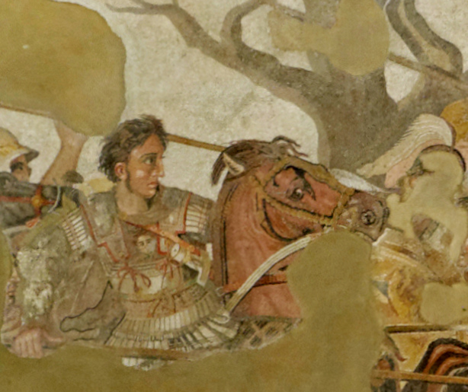
Preliminaries
ARCH B101 – The Age of Alexander
Fall 2026
August 31

Slide 2
Introductions
Name
Where you’re from (however you wish to understand this question)
Who your pets are

Slide 3
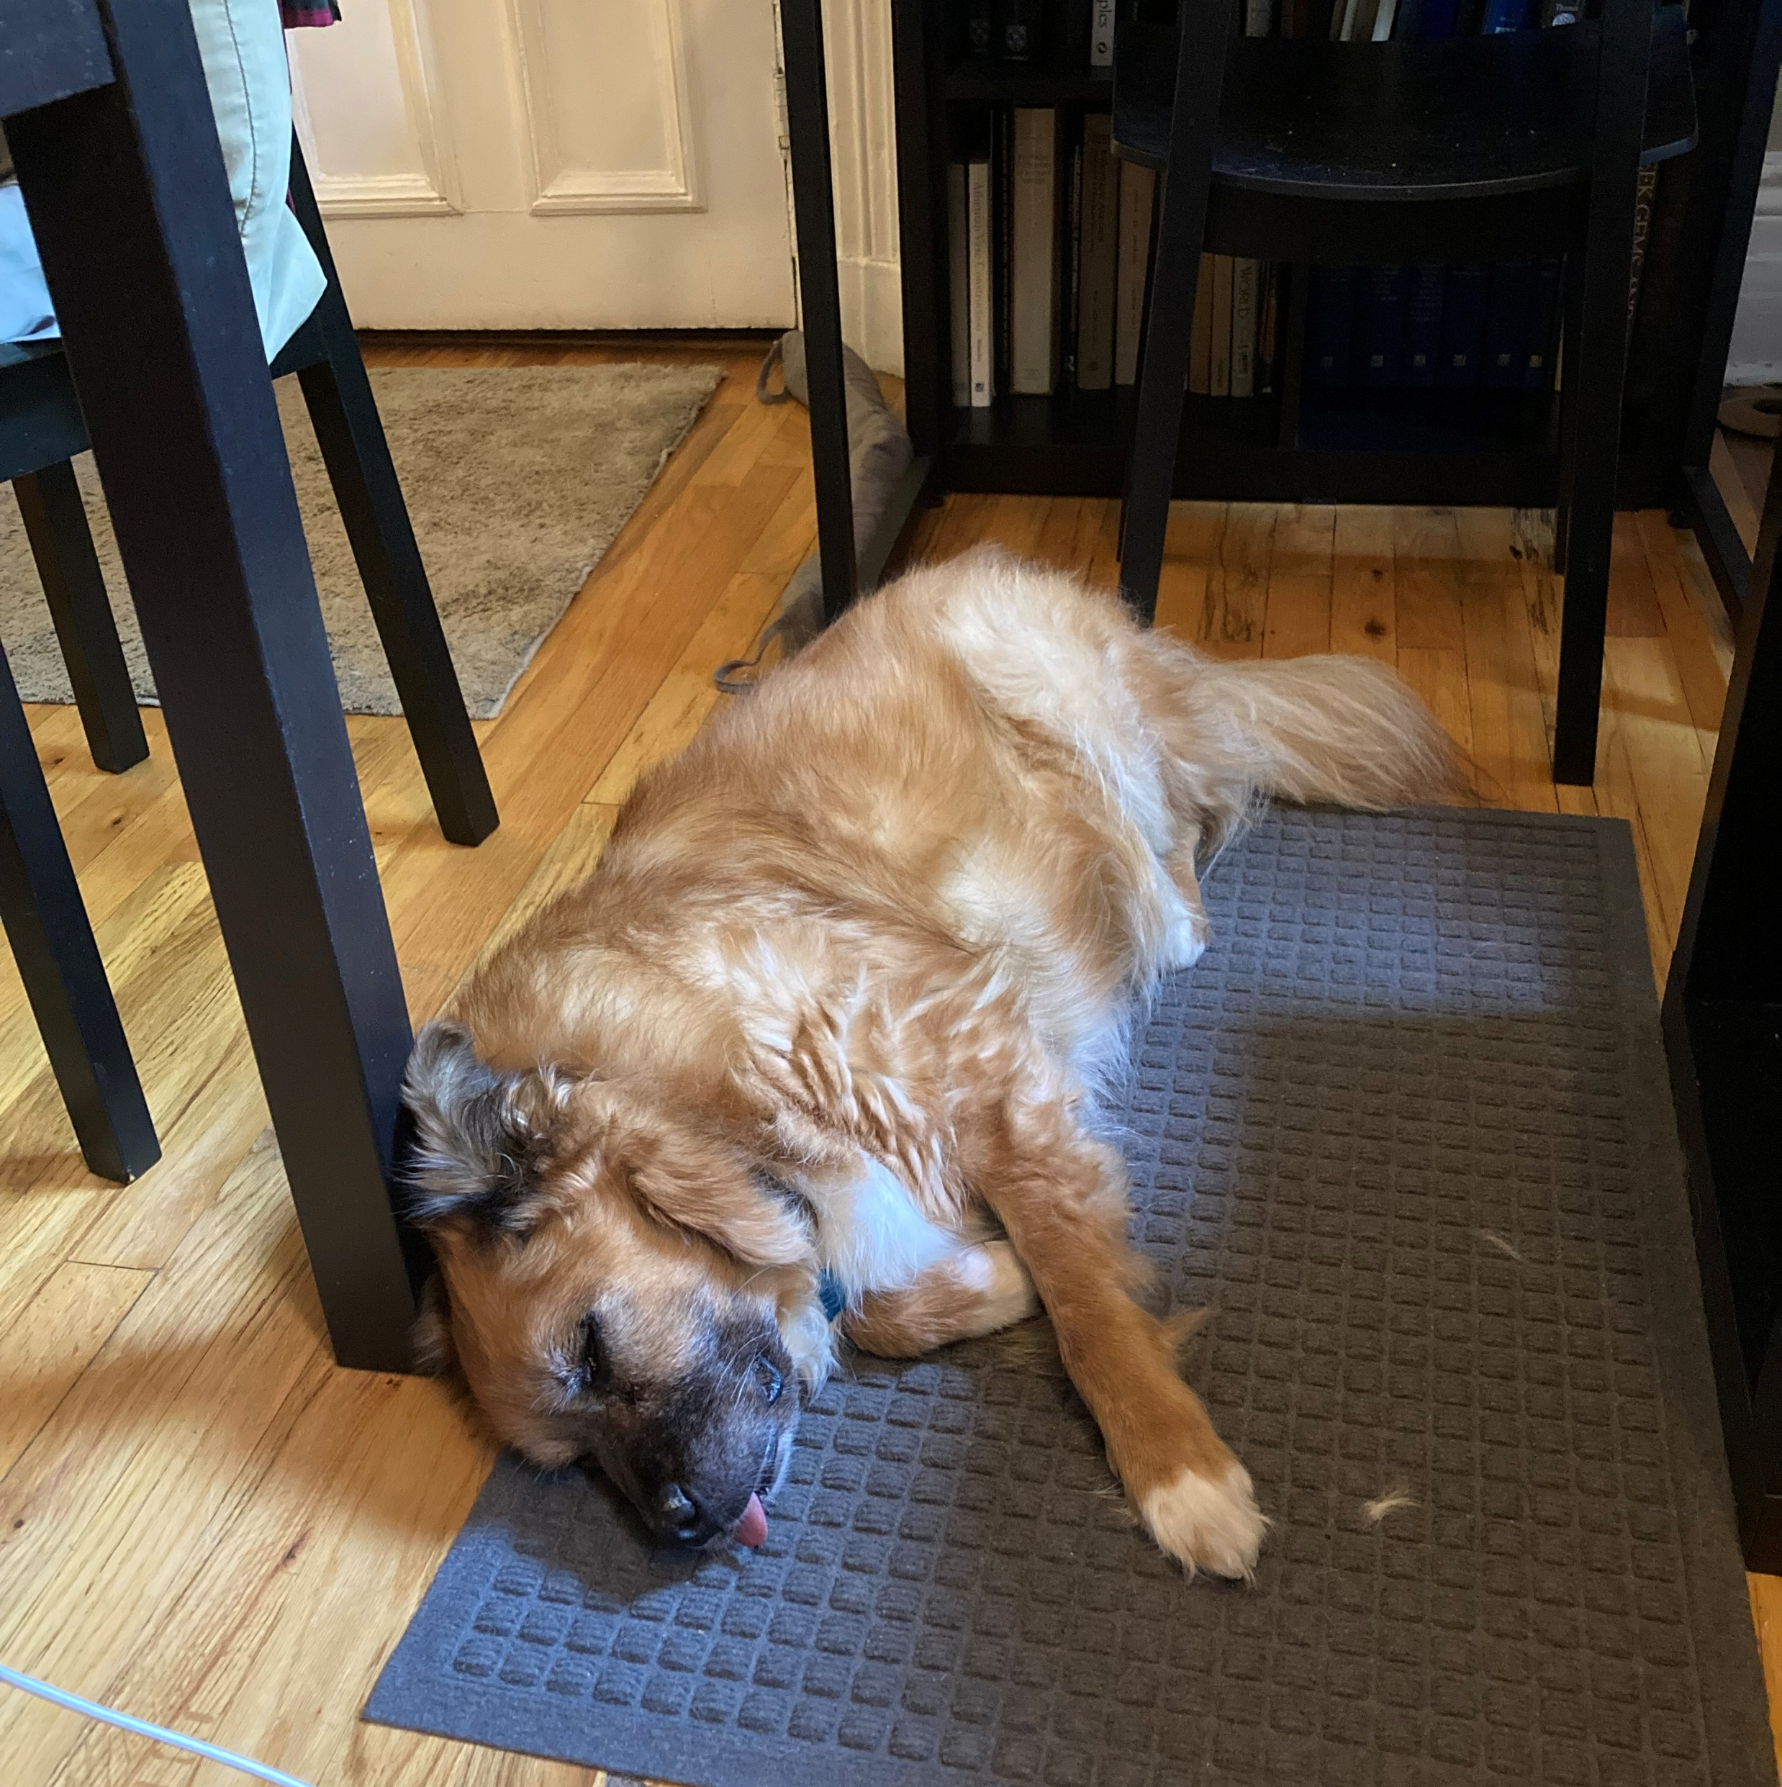
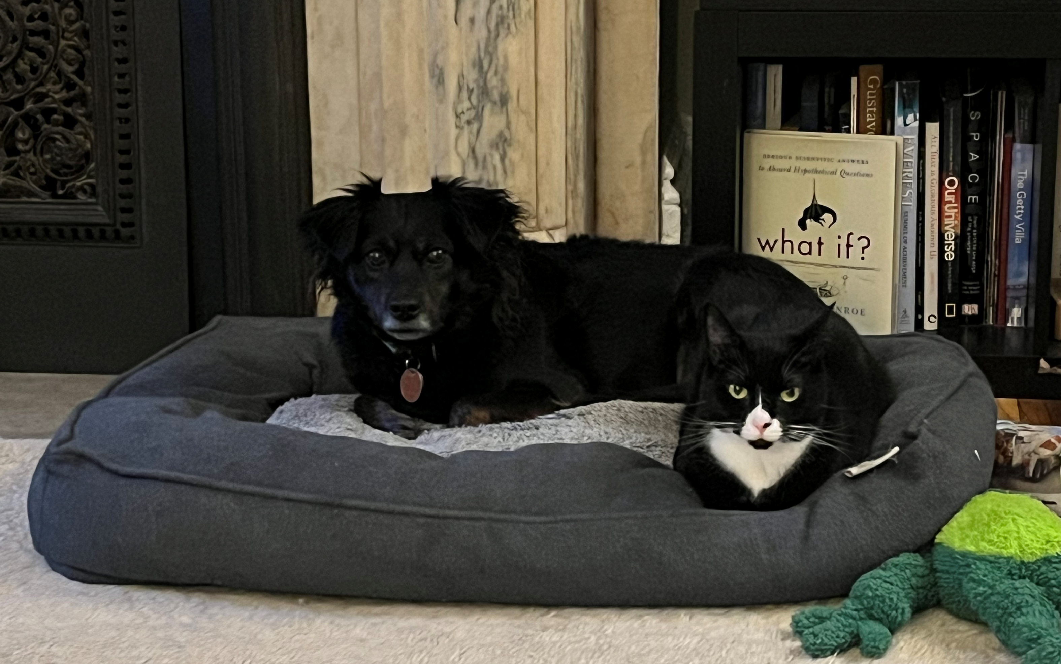

Henry Colburn
Office hours: Wed, 1:00-2:00, Fri 12:00-1:00, Old Library 223
hcolburn@brynmawr.edu
Albert
Olive
Iris
Hilda

Slide 4
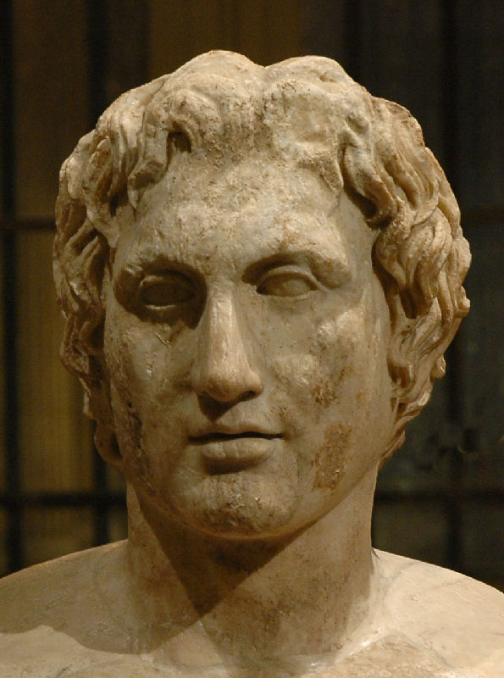
Alexander ‘the Great’
356-323 BCE
King of Macedon in northern Greece from 336 to 323 BCE
Invaded the Persian Empire in 334 BCE
  Defeated the Persians at Granicus, Issus and Gaugamela
  Burned Persepolis
Went east to Afghanistan and India before returning to Babylon, where he died
The Azara Herm, with a Roman version of Lysippus’ statue of Alexander, ca. 335-320 BCE (Louvre)

Slide 5
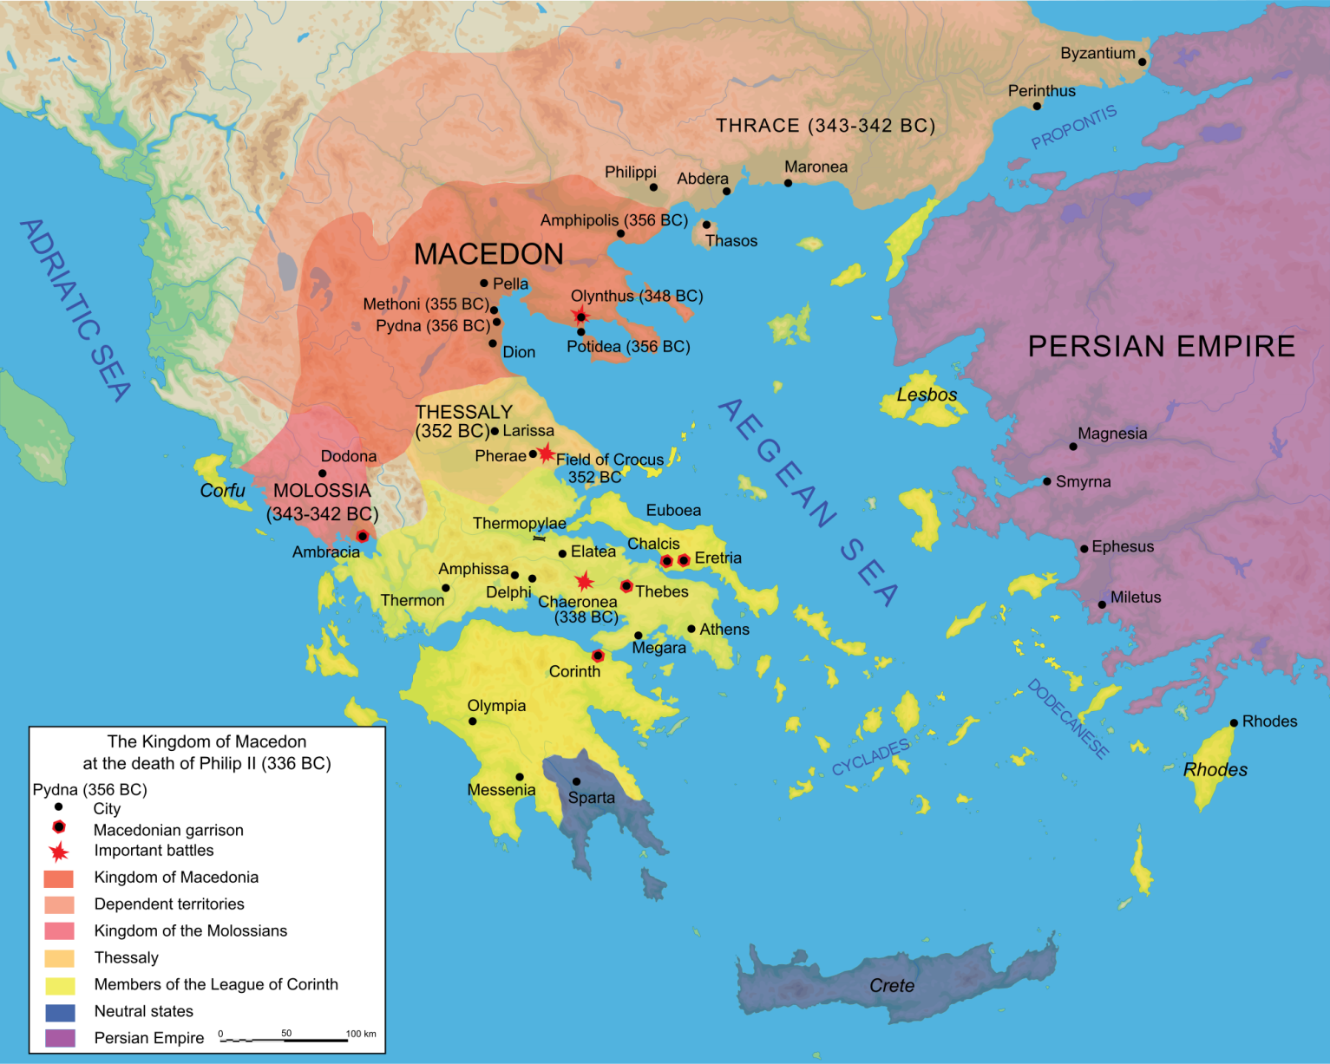
Macedon
Kingdom in the northern Greek mainland
Consisted of the plain around Pella and the mountains to the west
Beginning in the 7th cen. BCE kings in the plain began to conquer tribes to the east and west
Spoke a dialect of Greek
Considered themselves Greek, and kings claimed descent from Heracles

Slide 6
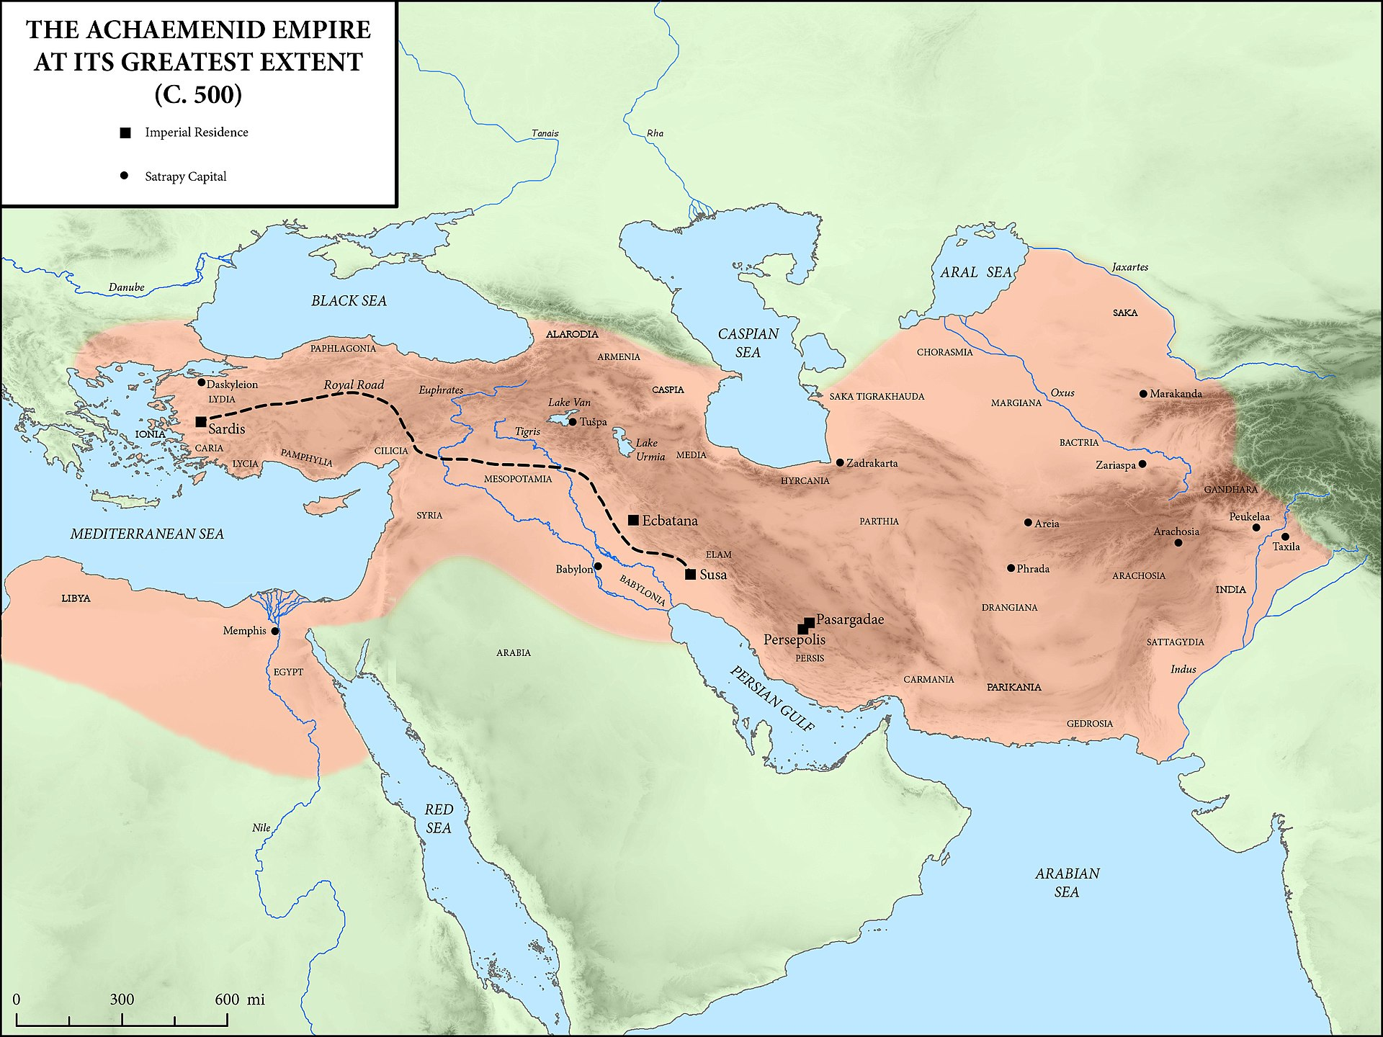
Cyrus (r. ca. 559-530 BCE)
Cambyses (r. 530-522 BCE)
Darius I (r. 522-486 BCE)
Xerxes (r. 486-465 BCE)
Artaxerxes I (r. 465-424)
Darius II (r. 423-404)
Artaxerxes II (r. 404-359)
Artaxerxes III (r. 359-338)
Artaxerxes IV (r. 338-336)
Darius III (r. 336-330)
Ecbatana
Babylon
Susa
Persepolis

Slide 8
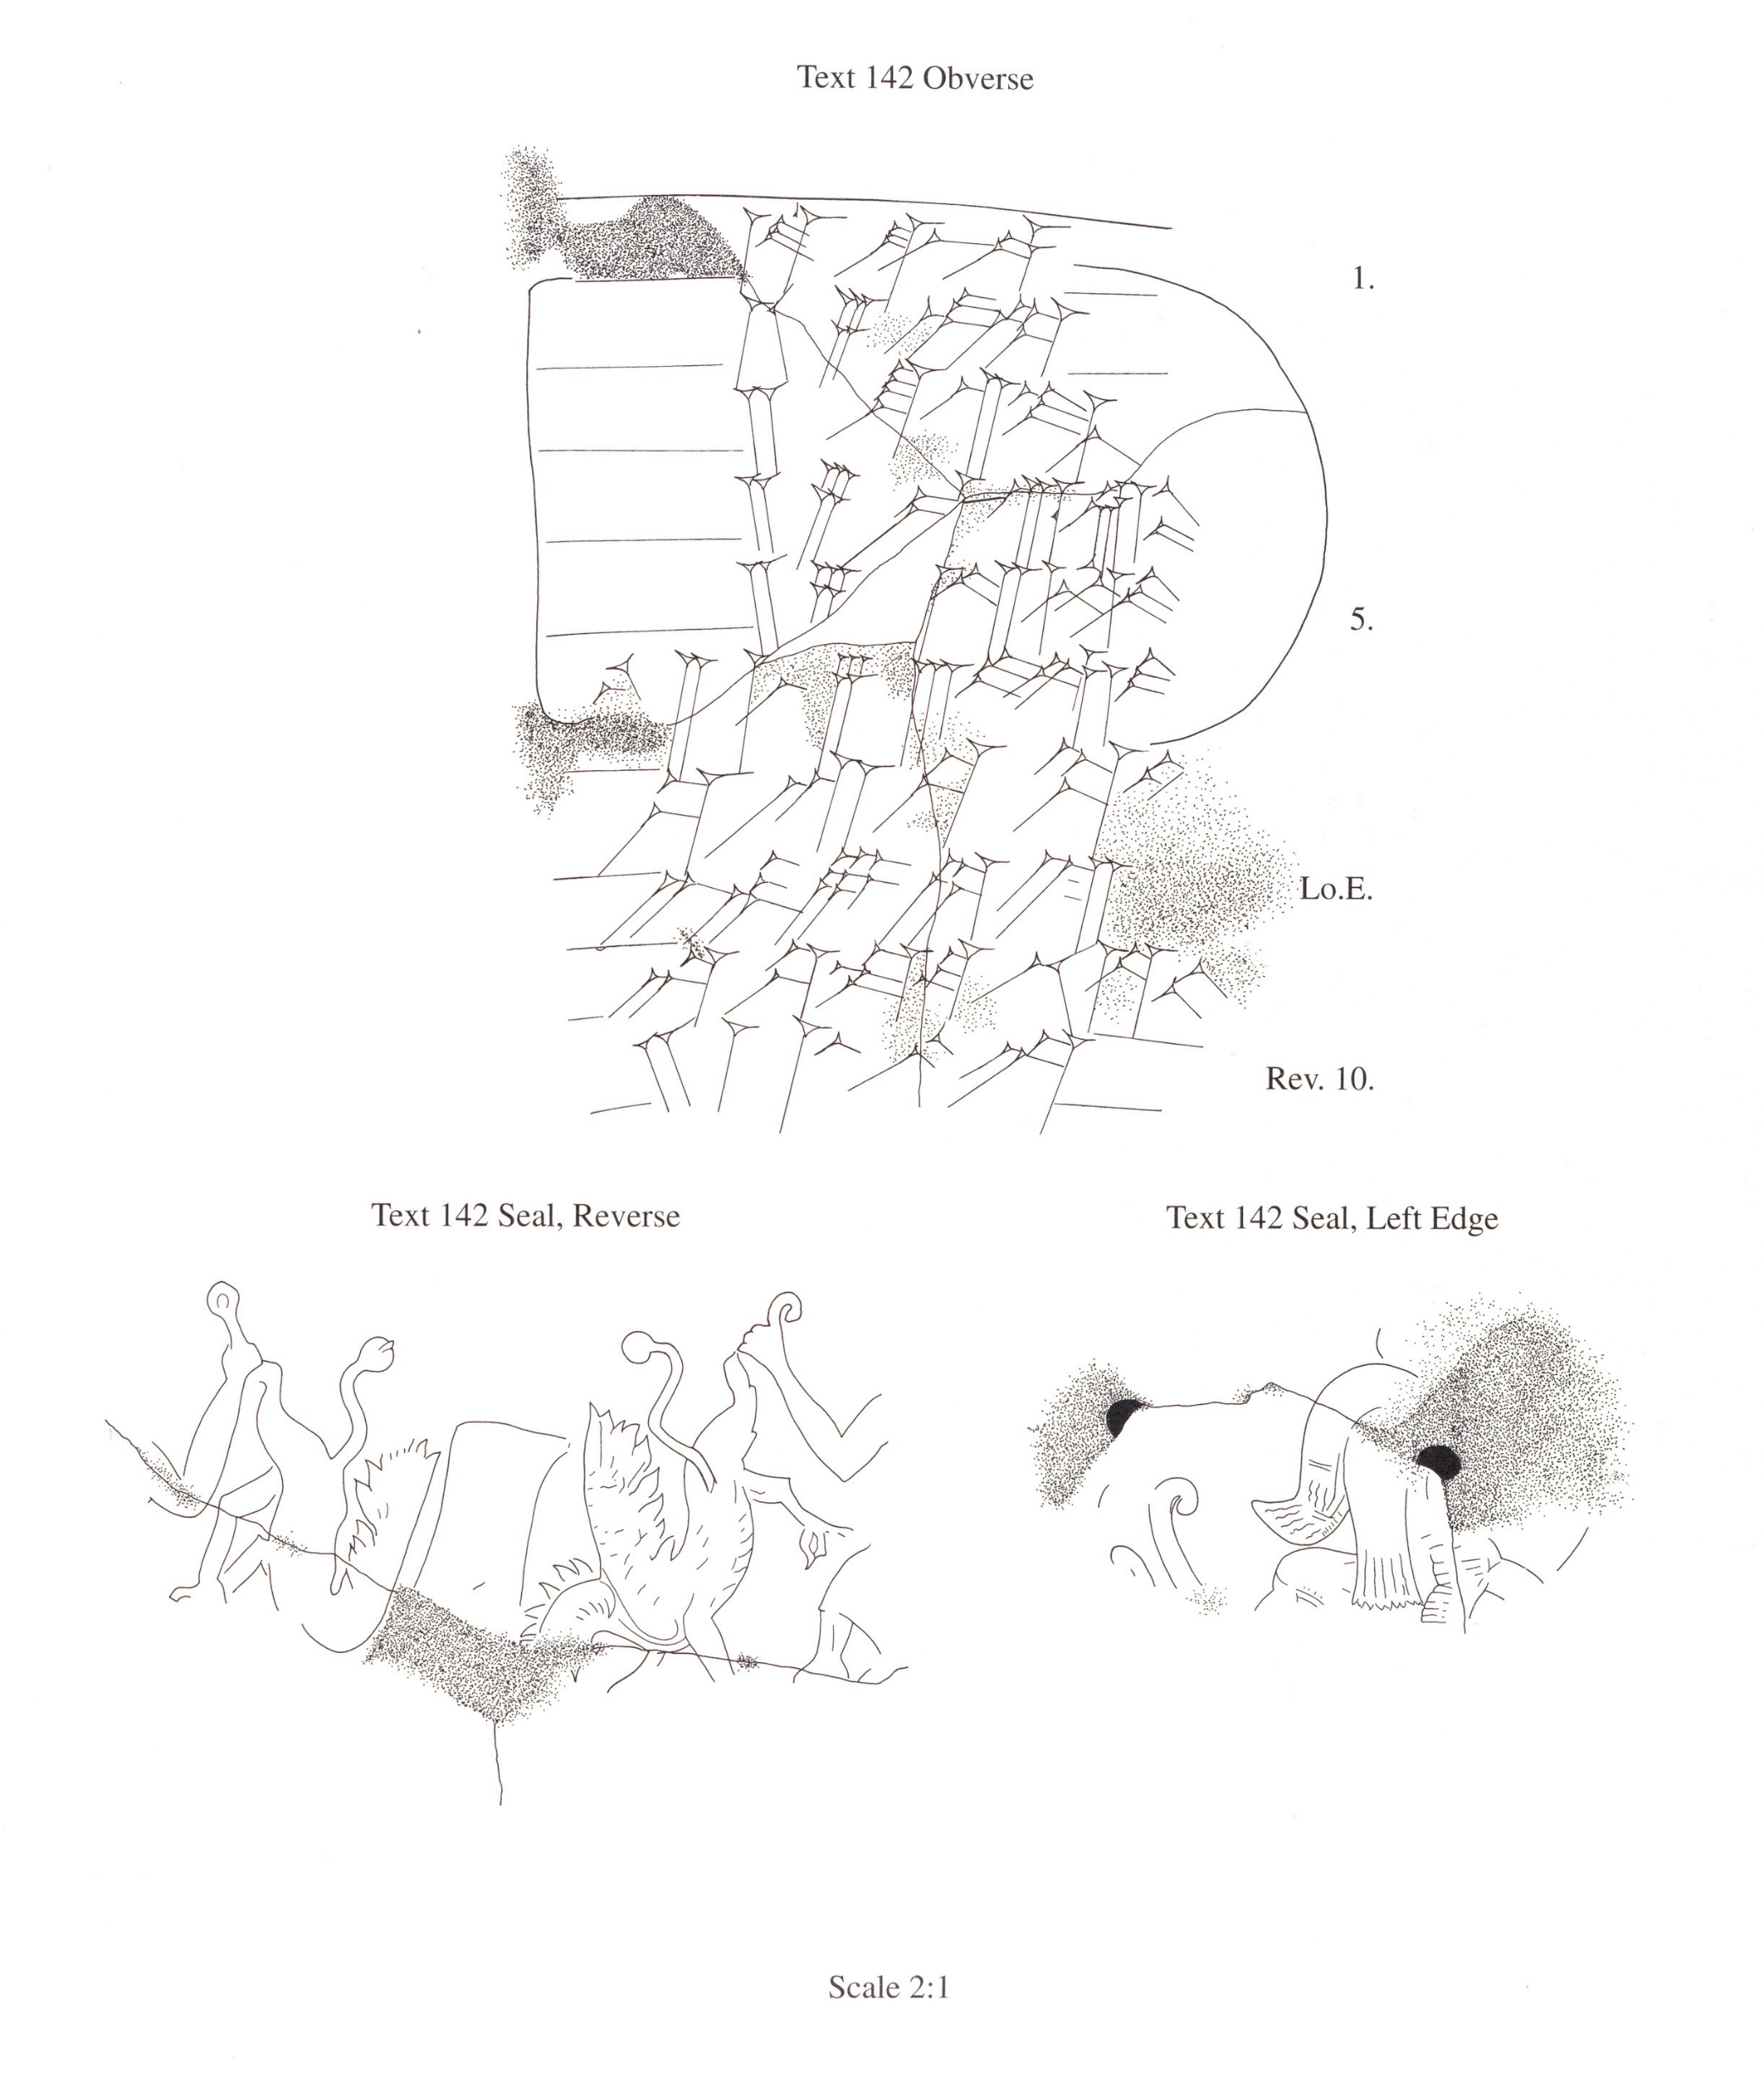
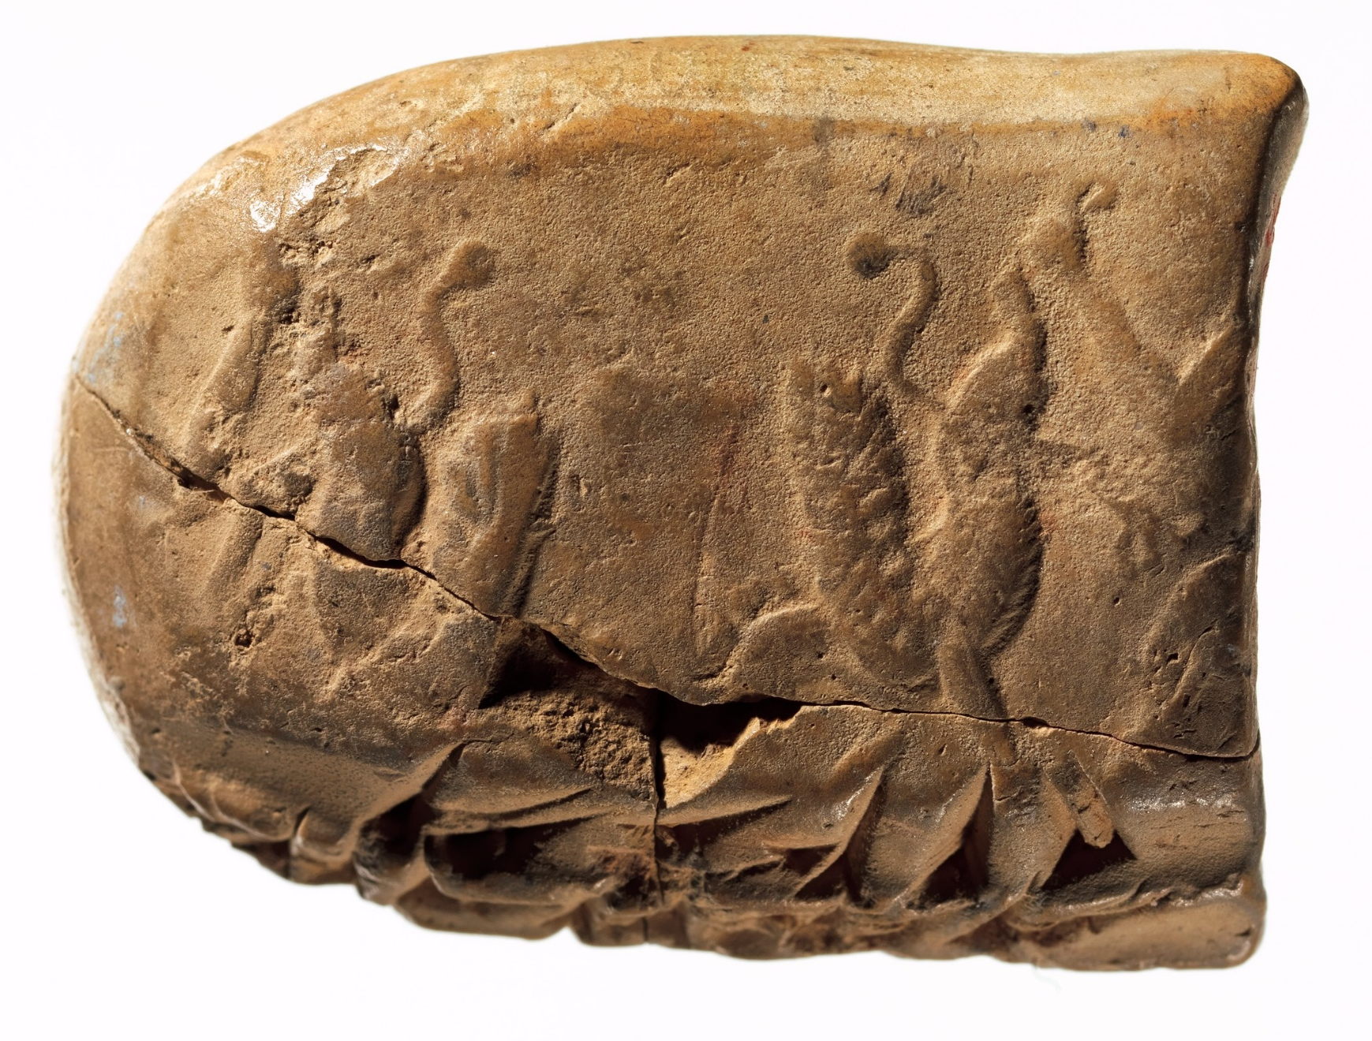
Travel on the Roads
“1 QA (of) wine (was) supplied by Karkašša. 1 woman went from Susa (to) Kandahar. She carried a sealed document of the king, and she received (it). Zišanduš (is) her elite guide. Twenty-second year, second month.” (PF 1550)
“260 l flour, allocation from Karma, (a man) named Mit‹ra›badda, treasurer (kanzabara), received (as) rations. 107 free men each received 1 l, 153 servants each received 1 l. He (M.) carried a sealed document (authorisation) from Parnakka; they went to the King (at) Susa. Twelfth month, 21st year (Feb.-March 500 BCE). The treasury (kanzam) that is located (at) Hidali.” (PF-NN 1564)

Slide 9
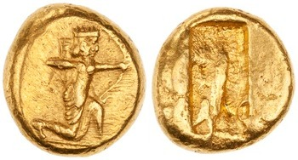
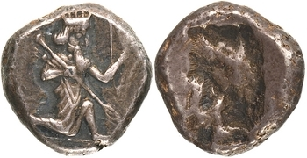
Achaemenid Coins
“The tribute is stored by the king in this fashion: he melts it down and pours it into earthen vessels; when the vessel is full he breaks the earthenware away, and when he needs money cuts off as much as will serve his purpose.”
- Herodotus 3.96
Achaemenid gold and silver coins minted in Sardis, ca. 500-400 BCE; obv.: Great King as archer; rev.: incuse punch

Slide 10
The Persian Pony Express
“There is nothing mortal that is faster than the system that the Persians have devised for sending messages. Apparently, they have horses and men posted at intervals along the route, the same number in total as the overall length in days of the journey, with a fresh horse and rider for every day of travel. Whatever the conditions – it may be snowing, raining, blazing hot, or dark – they never fail to complete their assigned journey in the fastest possible time. The first man passes his instructions on to the second, the second to the third, and so on.”
- Herodotus 8.98

Slide 11
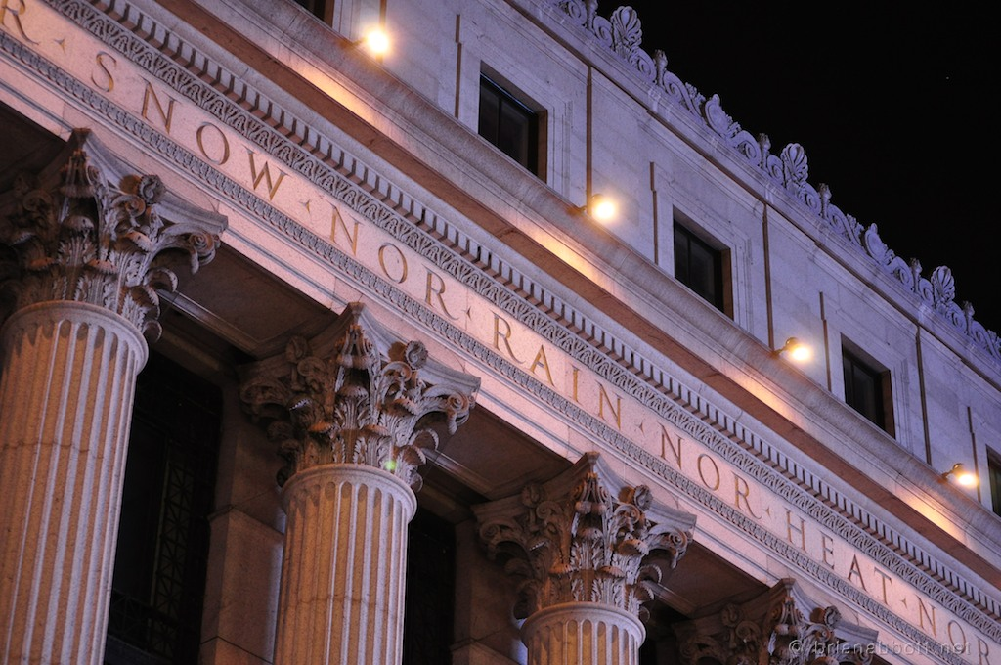
James A. Farley Building (formerly U. S. General Post Office), New York (built 1911-1914)

Slide 12
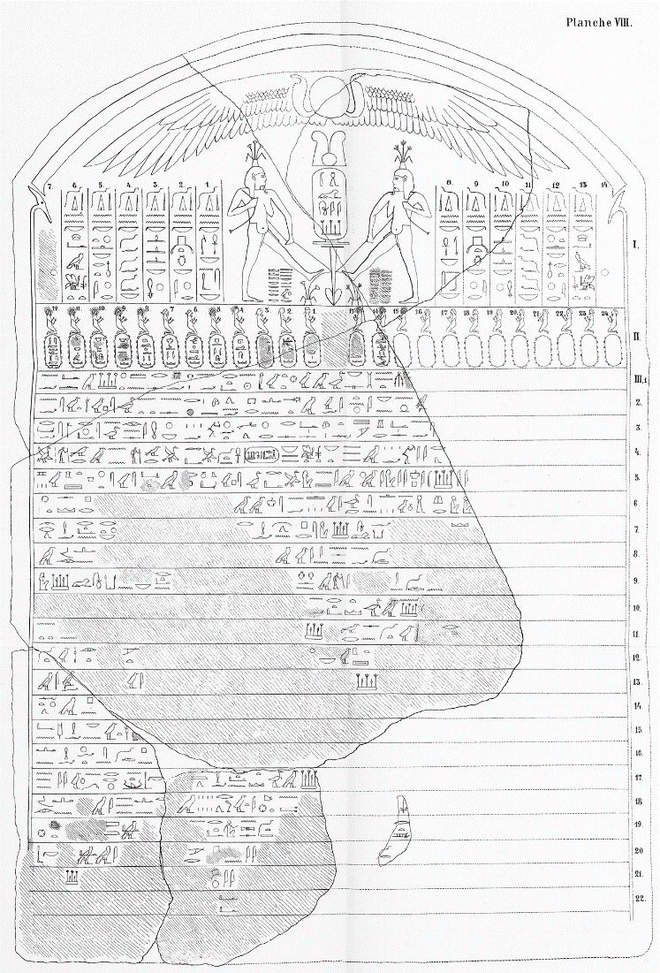
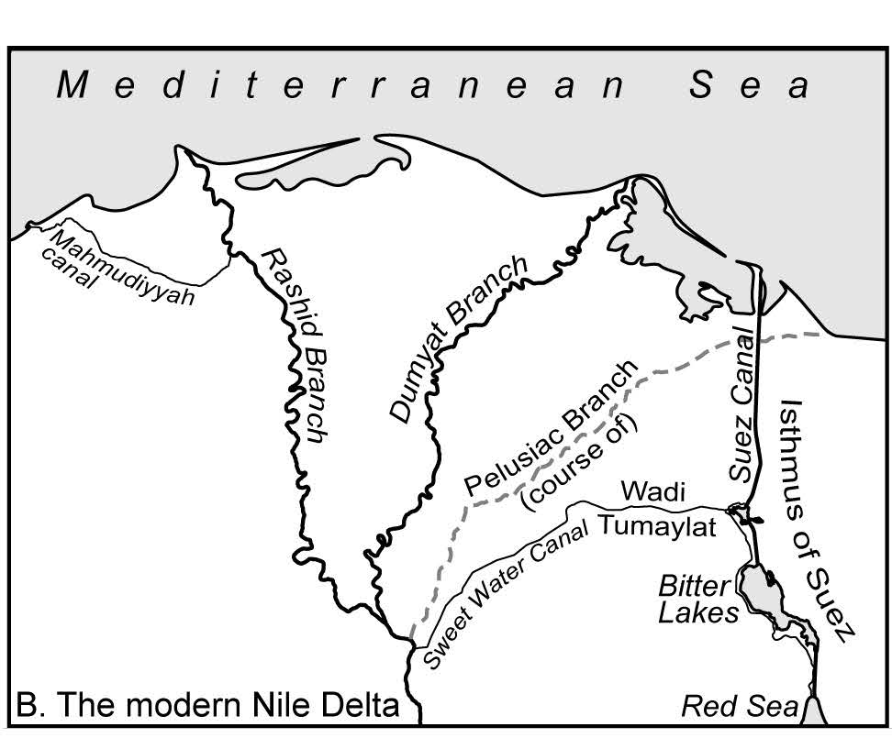
The Red Sea Canal
“I ordered this canal to be dug, from a river called Nile, which flows in Egypt, to the sea which goes to Persia. So this canal was dug as I had ordered, and ships went from Egypt through this canal to Persia, as was my desire (DZc).”
Notes:
Only navigable between August and February at the latest
Too late to the northerly winds on the Red Sea or the Indian Ocean monsoons
But people having been sailing around the coast of the Arabian peninsula for ages
Thor Heyerdal did it with a reed boat in 1978!
And in the cuneiform text of the canal stelae Darius explicits identifies the canal as a connection between Egypt and Persia

Slide 13
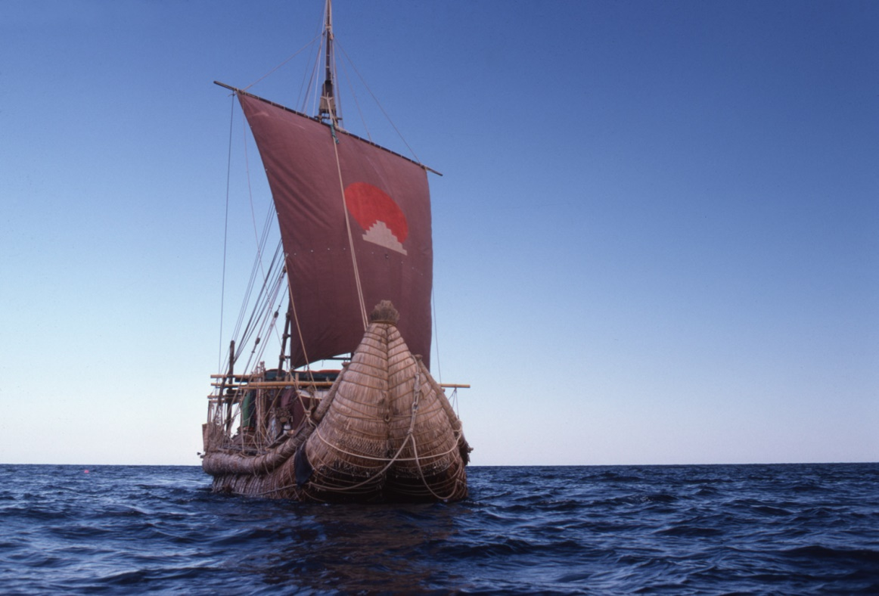
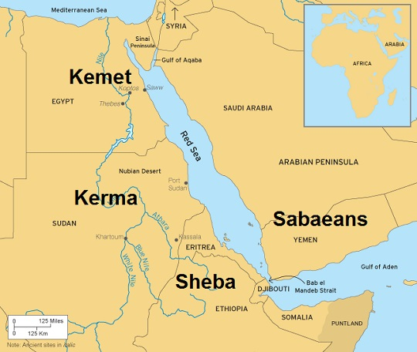
The Red Sea Canal
Thor Heyerdal’s Tigris (1978-9)
Notes:
Only navigable between August and February at the latest
Too late to the northerly winds on the Red Sea or the Indian Ocean monsoons
But people having been sailing around the coast of the Arabian peninsula for ages
Thor Heyerdal did it with a reed boat in 1978!
And in the cuneiform text of the canal stelae Darius explicits identifies the canal as a connection between Egypt and Persia

Slide 14
Persepolis

Slide 15
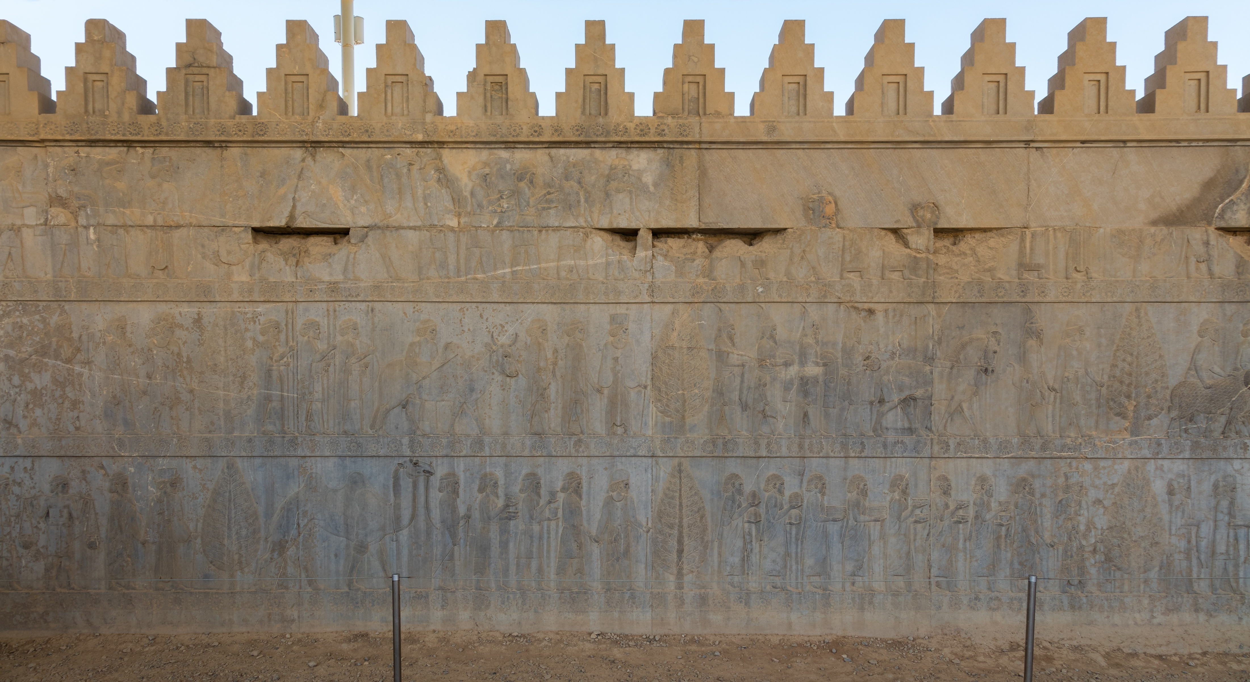

Slide 16
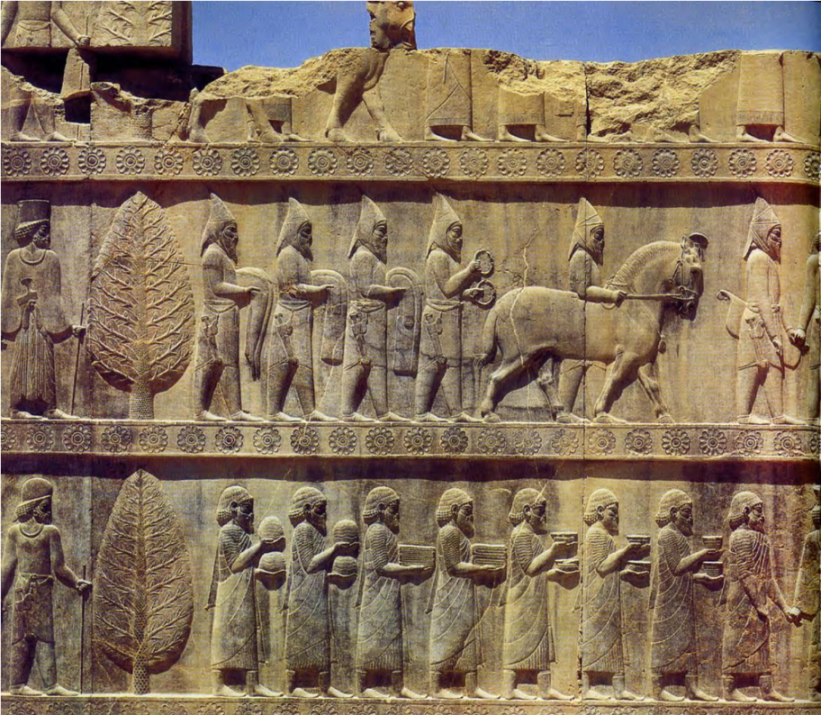
Scythians
(from Central Asia)
Greeks

Slide 17
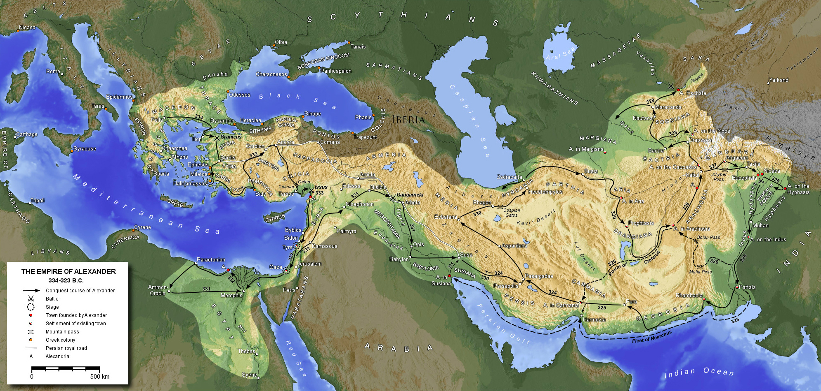

Slide 18
(Some) Alexandrias
Alexandria in Troas (modern Dalyan, Türkiye)
Alexandria by the Latmus (near modern Karpuzlu, Türkiye)
Alexandria at Issus (modern İskenderun, Türkiye, formerly known as Alexandretta)
Alexandria in Egypt (still called Alexandria)
Alexandria Susiana (Jabal Khayabar in southern Iraq)
Alexandria Asiana and Alexandria Carmania (both in eastern Iran)
Alexandria Arachosia (modern Kandahar, Afghanistan)
Alexandria Paropamisadai (near modern Begram, Afghanistan)
Alexandria on the Indus (modern Uch, Pakistan?)
Alexandria the Furthest (near modern Khujand, Tajikistan)

Slide 19
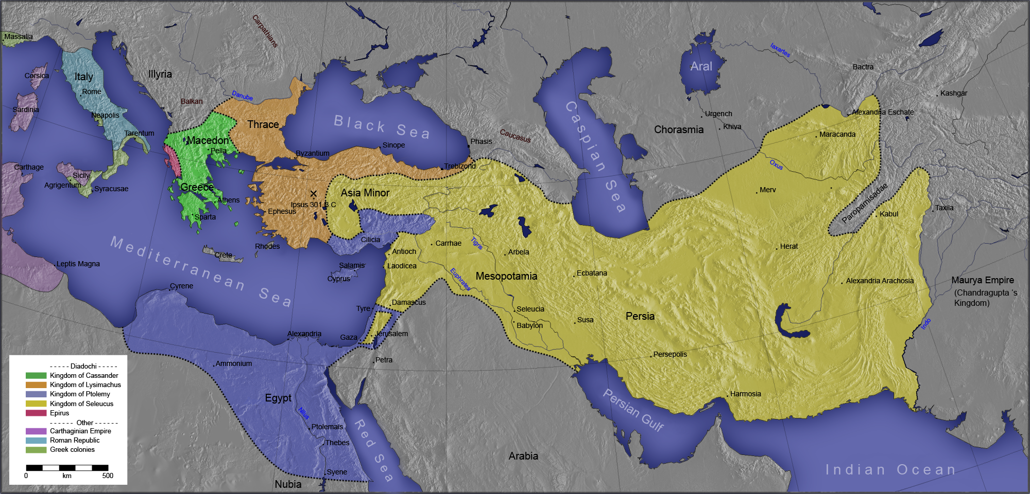

Slide 20
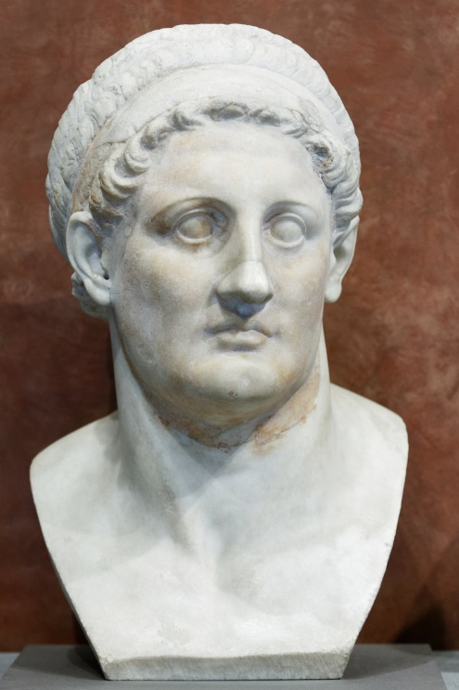
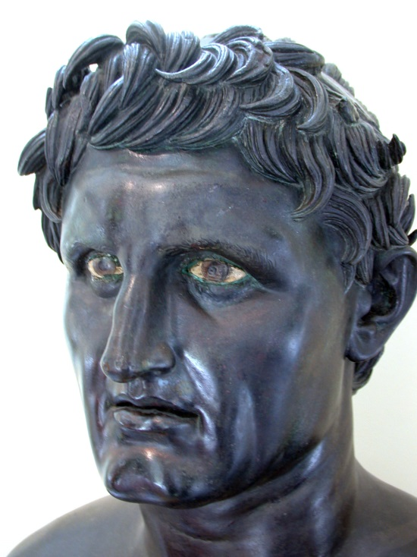
The Successors (‘Diadochoi’)
Ptolemaic Kingdom
(Egypt)
Seleucid Empire
(Middle East)
Elsewhere
Kingdom of Macedonia
Included most of mainland Greece
(Kings named ‘Philip’)
Kingdom of Epirus
Included parts of northwestern Greece
(Most famous king was Pyrrhus)
Kingdom of Thrace
Northern Greece and western Asia Minor
(Ruled by Lysimachus)
Attalid Kingdom
Based in Pergamum in Asia Minor
(Kings named ‘Attalus’ and ‘Eumenes’)
Greco-Bactrian Kingdom
Central Asia and northern India
Kings named ‘Ptolemy’
Kings named ‘Seleucus’ and ‘Antiochus’

Slide 21
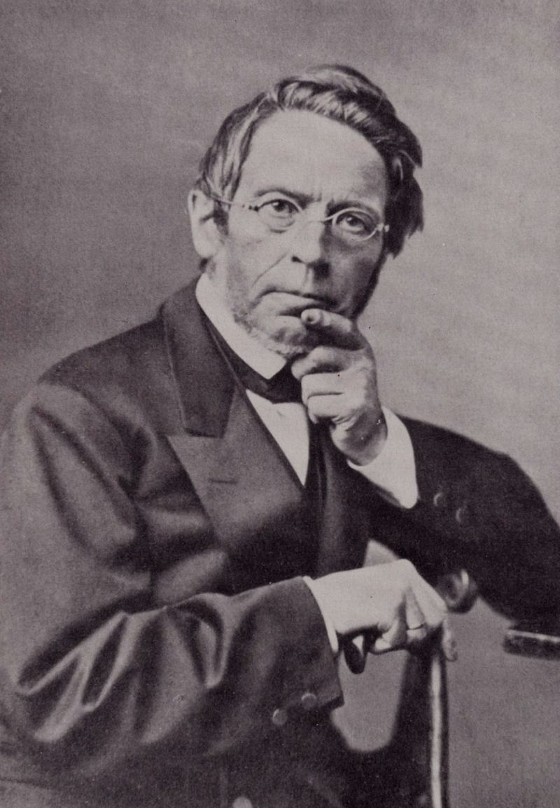
What is ‘Hellenistic?’
Hellenes = ‘Greeks’
Hellenistes = ‘Greek speaker’
In German Hellenistes is Hellenistisch
  Coined by J. G. Droysen in Geschichte des Hellenismus (1836-1843)
So the ‘Hellenistic Period’ is literally the ‘Greek Speaker Period’
Why would he call it this? What does this really mean?

Slide 22
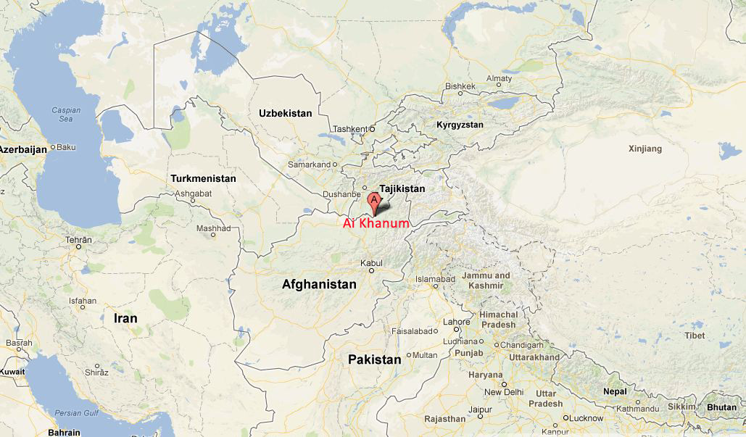

Slide 23
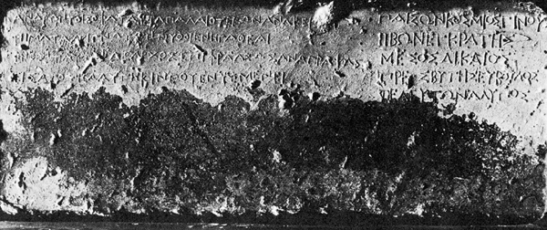
“These wise commandments of men of old – words of well-known thinkers – stand dedicated in the most holy Pythian shrine. From there Clearchus, having copied them carefully, set them up, shining from afar, in the sanctuary of Cineas.”
- Inscription from the Heroon of Cineas at Ai Khanum, ca. 325-300 BCE

Slide 24
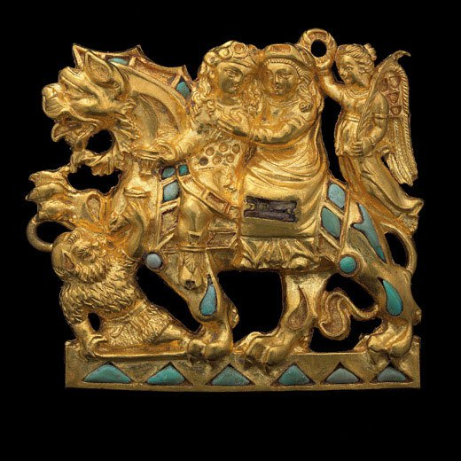
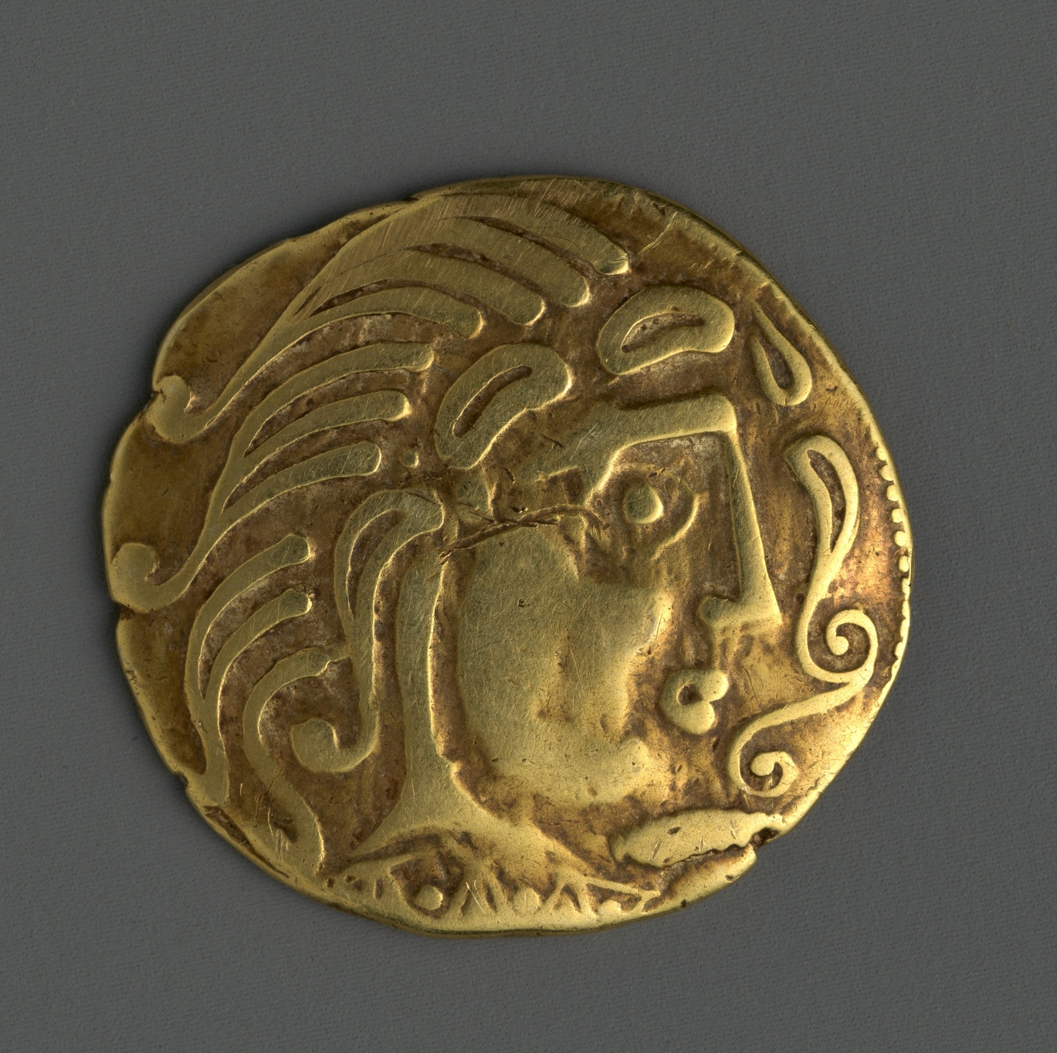
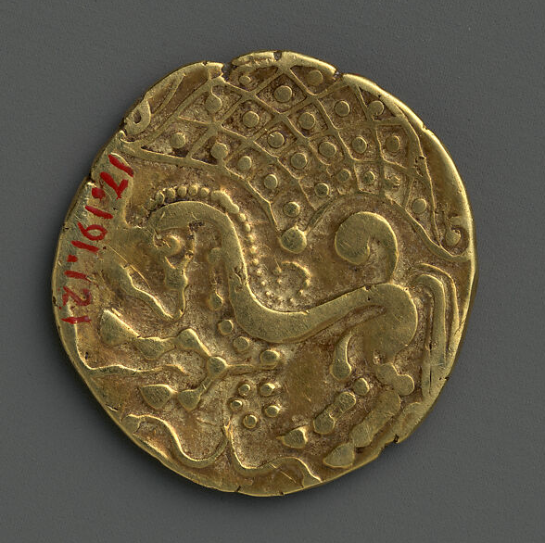
Gold coin of the Parisii, Gaul, 2nd cen. BCE; obv.: head of Herakles? rev.: charioteer?
Inlaid gold plaque depicting Dionysos, Ariadne and Silenos, Tilya Tepe, Afghanistan, 1st cen. BCE-1st cen. CE

Slide 25
Colonialism
Domination of one political entity by another, usually involving direct rule and the physical presence of members of the dominant party
How can one group dominate another? What purposes might this domination serve?

Slide 26
Ethnicity
A group of people sharing common culture, language and religion, and typically linked to a share region of origin
What determines ethnicity? Is it fixed or fluid?
How does ethnicity affect material culture?

Slide 27
Identity
The sum total of an individual or group’s affinities or non-affinities with groups characterized by a shared trait
E.g. Québecois, clowns, Red Sox fans, Hindus, tall people
How does identity relate to material culture? How does your identity affect your decisions about stuff?

Slide 28
Style
Any characteristic way of doing something, on the part of an individual or a group
  From the Latin stilus

Slide 29
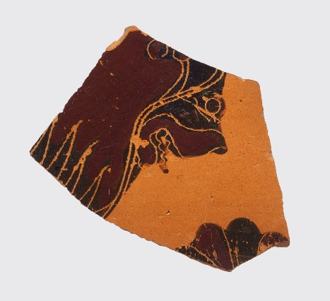
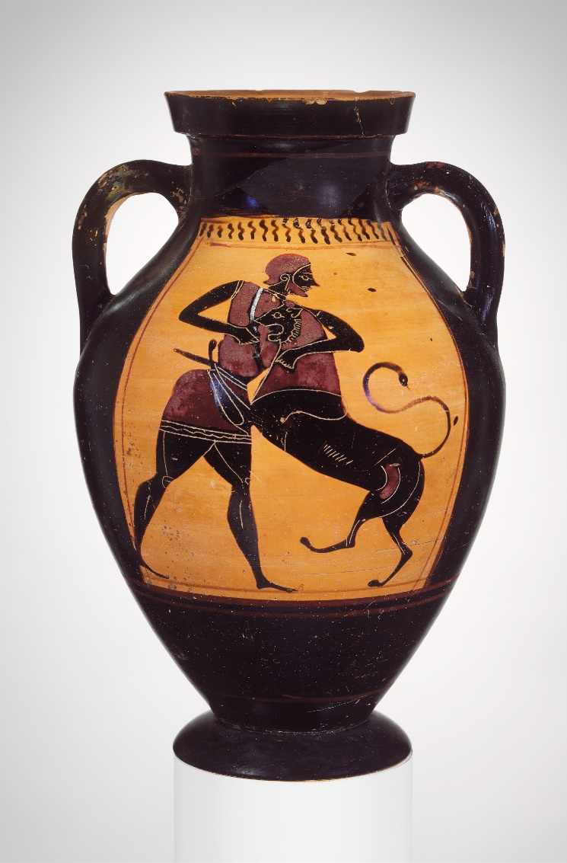
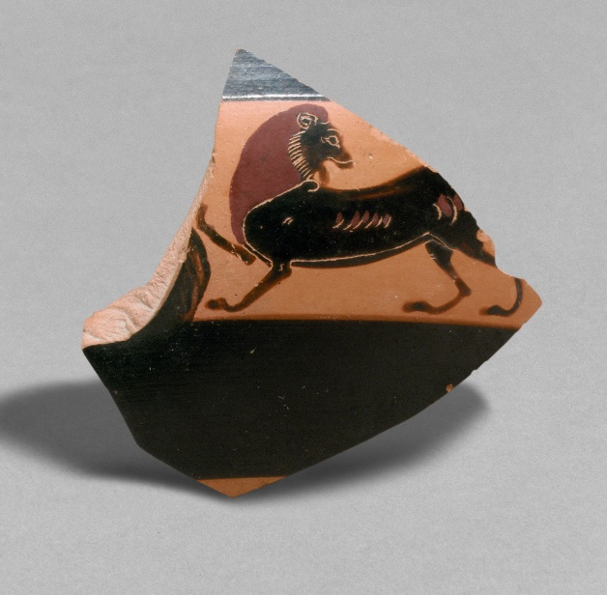
Style
Olpe sherd attributed to the Gorgon Painter, ca. 580 BCE (MMA 60.92.3)
Kylix sherd attributed to the Amasis Painter, ca. 550 BCE (MMA 1986.99.6)
Amphora attributed to the Group of Brussels R 243, ca. 540 BCE (MMA 40.11.20)

Slide 30
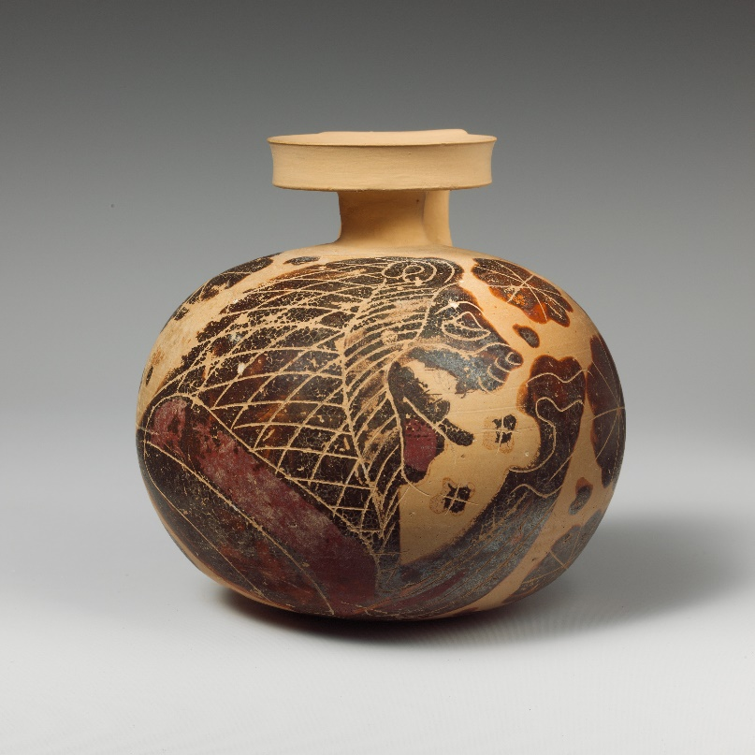
Style
Olpe sherd attributed to the Gorgon Painter, ca. 580 BCE (MMA 60.92.6)
Corinthian aryballos, ca. 620-590 BCE (MMA 41.162.59)
Kylix sherd attributed to the Amasis Painter, ca. 550 BCE (MMA 1986.99.6)
Amphora attributed to the Group of Brussels R 243, ca. 540 BCE (MMA 40.11.20)

Slide 31

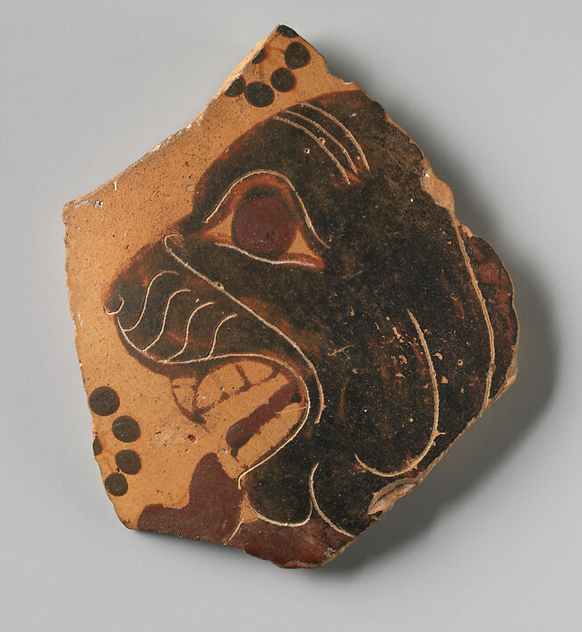
Style
Sherd attributed to the Lion Painter, ca. 630-620 BCE (MMA 38.11.10)
Corinthian aryballos, ca. 620-590 BCE (MMA 41.162.59)

