Slide 1
Q-center: https://www.brynmawr.edu/inside/offices-services/q-center/q-center-schedule
Office Hours: M 1:30pm – 3:00pm
(in Park 169) W 11:00am – 12:00pm
or by appointment (email me)
or just email me with questions!
TA Hours: TBD
Measurements, Uncertainty, and Unit Conversion
9/2/2026
Achieve HW #1 due Wednesday 9/9 at 10:00am
Quiz #1 in Recitation next Friday (9/11)
We need to take attendance today for registration reasons…..

Slide 2
Learning Objectives
Express quantities in scientific notation
Explain the process of measurement
Identify the three basic parts of a quantity
Describe the properties and units of length, mass, volume, density, temperature, and time
Perform basic unit calculations and conversions in the metric and other unit systems
Define accuracy and precision and be able to explain whether a dataset is precise and/or accurate
Distinguish exact and uncertain numbers
Distinguish extensive vs intensive properties
Correctly represent uncertainty in quantities using significant figures
Apply proper rounding rules to computed quantities
Explain the dimensional analysis (factor label) approach to mathematical calculations involving quantities
Use dimensional analysis to carry out unit conversions for a given property and computations involving two or more properties

Slide 3
Accuracy vs Precision
Accuracy is a measure of ________________________
Precision is a measure of _________________________

Slide 4
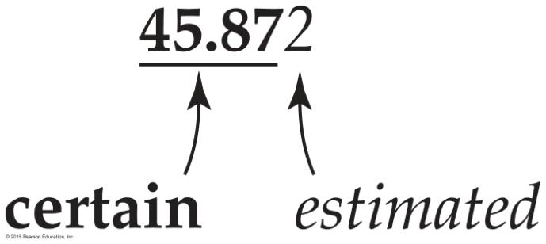
The first four digits are certain; the last digit is estimated.
The greater the precision of the measurement, the greater the number of “significant figures.”
Significant figures are important!! They communicate the precision of a measurement!!
Reporting Uncertainty in Measurements

Slide 5
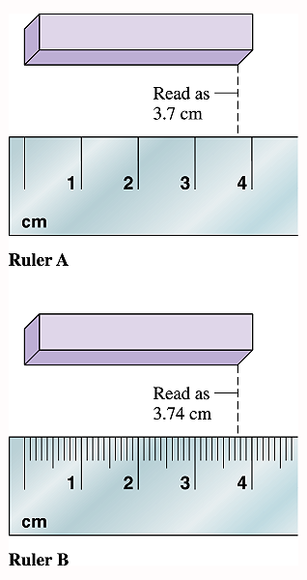
.7 is estimate
3 is known
Marked to every 1 cm
Measurement =
known digits
+ 1 estimated digit
Marked to every 0.1 cm
3.7 is known
.04 is estimate
Copyright © 2001 Houghton Mifflin Company. All rights reserved.
Notes:
6

Slide 6
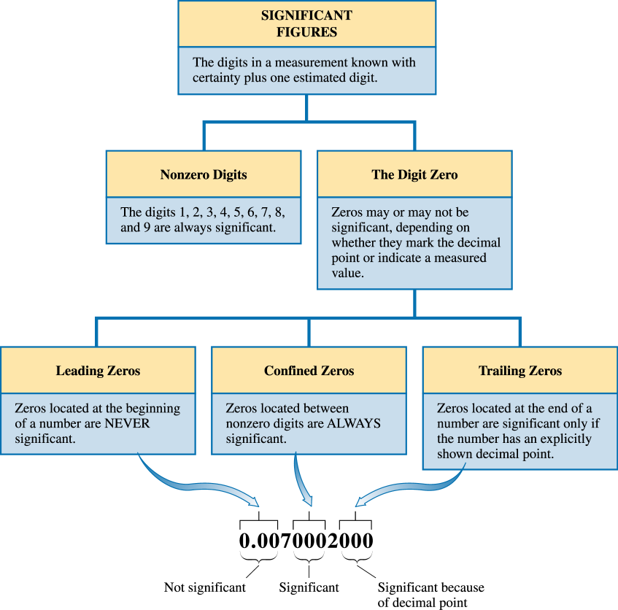
Which digits are significant in
0.0830 ?
Significant figures
Copyright © 2001 Houghton Mifflin Company. All rights reserved.
Notes:
7

Slide 7
Identifying “Exact” Numbers
“Exact” numbers have unlimited significant figures.
  Exact counting of discrete objects
  Ex: 7 apples
  Integer numbers (whole numbers) that are part of an equation
  Ex: Radius = Diameter/2
  Defined quantities
    Some conversion factors are defined quantities, while others are not.
    Treat conversion factors as defined quantities unless specified otherwise.
1 in = 2.54 cm exact

Slide 8
Counting Significant Figures
How many significant figures are in each number?
0.0035
1.080
2371
2.97 × 10⁵
1 dozen = 12
100.00
100,000
2500

Slide 9
Significant Figures in Calculations
Rules for Rounding:
When numbers are used in a calculation, the result is rounded to reflect the significant figures of the data.
For calculations involving multiple steps, round only the final answer— do not round between steps.
Use only the leftmost digit being dropped to decide in which direction to round —ignore all digits to the right of it.
Round down if the last digit dropped is 4 or less;
round up if the last digit dropped is 5 or more.

Slide 10
Accuracy vs Precision
Accuracy is a measure of closeness to the true value
Precision is a measure of reproducibility
We use significant figures so that the least precise measurement is reflected in a calculation
  - Final answer can only be as precise as the weakest link!

Slide 11

Multiplication and Division Rule
In multiplication or division, the result has the same number of
significant figures as the quantity with the fewest significant figures.
Multiplication
5.02
×
89.665
×
0.10
= 45.0118
Division

Slide 12
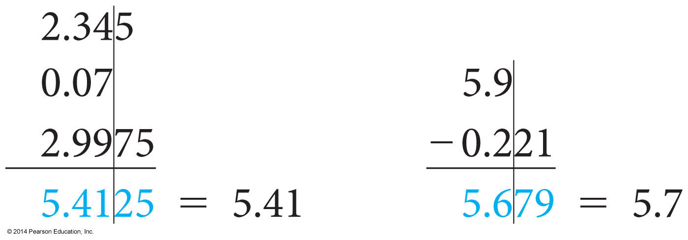
Addition and Subtraction Rule
For addition or subtraction, the answer has the same number of decimal places as the quantity with the fewest decimal places.

Slide 13
Rules for Rounding:
When rounding to the correct number of significant figures,
  Round down if the leftmost digit being dropped is four or less.
  Round up if the leftmost digit being dropped is five or more.
Round to two significant figures:
5.37 rounds to 5.4
5.34 rounds to
5.35 rounds to
5.349 rounds to

Slide 14
Both Multiplication/Division and Addition/Subtraction
3.489 × (5.67 – 2.3)
Use the subtraction rule to determine that the intermediate answer has only one significant decimal place.
5.67 – 2.3 = 3.37
Use the multiplication rule to significant figures
3.489 × 3.37 = 11.758 =

Slide 15
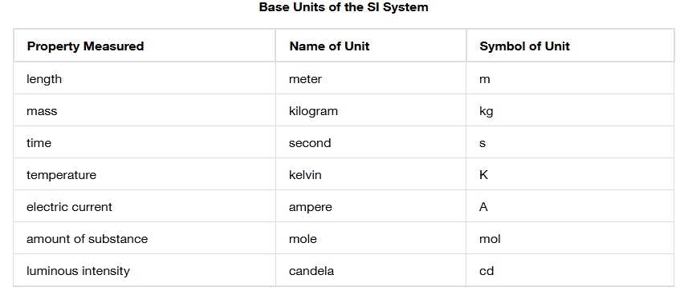
The Basic Units of Measurement
The unit system for science measurements, based on the metric system, is called the International System of Units (Système International d’Unités) or SI units.

Slide 16
Intensive vs Extensive Properties
Intensive properties do not __________ ______ ___________
of substance in a sample.
Extensive properties do.

Slide 17
Weight vs. Mass
The kilogram is a measure of mass, which is different from weight.
The mass of an object is a measure of the quantity of matter within it.
The weight of an object is a measure of the gravitational pull on that matter.
Weight depends on gravity while mass does not.

Slide 18
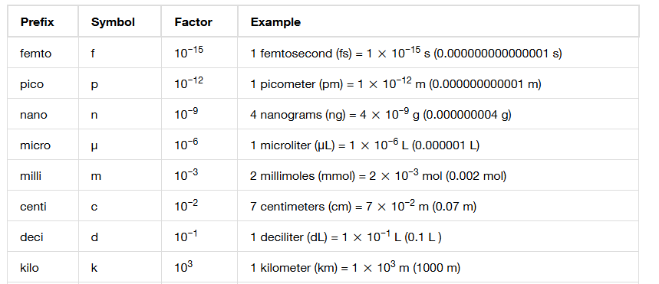
Unit Prefixes
Prefixes are used to scale units up or down by powers of 10.
  Example: kilograms (kg) 1 kg = 1000 grams

Slide 19
Derived Units
A derived unit is formed from other units.
Many units of volume, a measure of 3D space, are derived units.
Any unit of length, when cubed (raised to the third power), becomes a unit of volume.
  Cubic meters (m³), cubic centimeters (cm³), and cubic millimeters (mm³) are all units of volume.
Notes:
Change to equation objects

Slide 20
Unit Conversion
Given one or more quantities, convert them into different units.
Units are multiplied, divided, and canceled like any other algebraic quantities.
Always write every number with its associated unit!!! No shortcuts!!

Slide 21
Some conversion factors
You will always be provided with any unit conversion factors needed for a problem.
You do not need to memorize unit conversion factors. (i.e. 1 kg = 2.205 lb)
You do need to memorize conversion factors for the unit prefixes (i.e. 1 kg = 10³ g) indicated a few slides ago.

Slide 22
Problem Solving Using the Factor-Label Method
Conversion factor: A term that converts a quantity in
one unit to a quantity in another unit.
original
quantity
desired
quantity
x
conversion factor
=
Conversion factors are usually written as equalities.
2.21 lb = 1 kg
To use them, they must be written as fractions.

Slide 23
Solving Problems Using Conversion Factors
Factor-label method: Using conversion factors to manage a complex problem involving many units. Also called Dimensional Analysis.
units are treated like numbers
make sure all unwanted units cancel
all quantities in the calculation have units labeled!
To convert 130 lb into kilograms:
1.3×10² lb
x
conversion factor
? kg
=
original
quantity
desired
quantity

Slide 24
How many kg in 1.3×10² lb ?
2.21 lb = 1 kg
2.21 lb
1 kg
1.3×10² lb
x
or
1 kg
2.21 lb
=
59 kg
Set up the conversion factor with original unit in the bottom of the fraction.
The unwanted unit lb cancels.
The desired unit kg does not cancel, and is on the top of the fraction
→ final unit is kg

Slide 25
Solving Multistep Unit Conversion Problems
Each step should have a conversion factor set up to cancel the units of the previous step
Example: How many km are there in 1.2x10⁴ ft?
1 foot = 0.3048 m

Slide 26
Conversion with Units Raised to a Power
Example: converting cm³ to in³
1 in = 2.54 cm
Must cube both sides of the equality to obtain the proper conversion factor.
How many cubic inches in 251 cm³?
Notes:
Insert equations from page

Slide 27
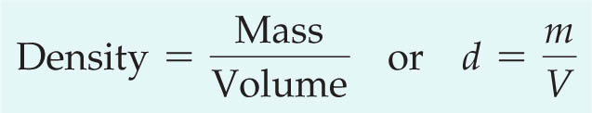
Density
The density of a substance is the ratio of its mass to its volume.
Water has a density of 1.0 g/mL (or 1.0 g/cm³)
Things that are less dense (like oil) will float in water.
Things that are more dense (like CH₂Cl₂) will sink.

Slide 28
Calculating Density
Example: a sample of liquid has a volume of 22.5 mL and a mass of 27.2 g.
Assuming this liquid is not miscible with water (that is, they will separate like oil and water and not mix), will this liquid float or sink in water?

Slide 29
Density as a Conversion Factor
We can use the density of a substance as a conversion factor between the mass of the substance and its volume.
For a liquid substance with a density of 1.32 g/cm³, what volume in liters should be measured to deliver a mass of 68.4 g?
Notes:
Convert to equation object

Slide 30
A 23.5 kg sample of ethanol is needed for a large scale reaction. What volume in liters of ethanol should be used? The density of ethanol is 0.789 g/cm³.
Conversion factors: 1 cm³ = 1 mL

Slide 31
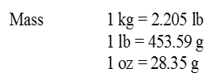
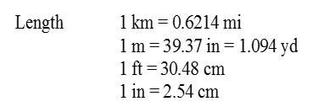
Convert 2.6 lb/in³ to g/ml .

