Slide 1

Bonding, Hybridization, and VSEPR Geometry
Q-center: https://www.brynmawr.edu/inside/offices-services/q-center/q-center-schedule
Office Hours: M 1:30pm – 3:00pm
(in Park 169) W 11:00am – 12:00pm
or by appointment (email me)
or just email me with questions!
TA Hours: TBD
9/2/2026

Slide 2
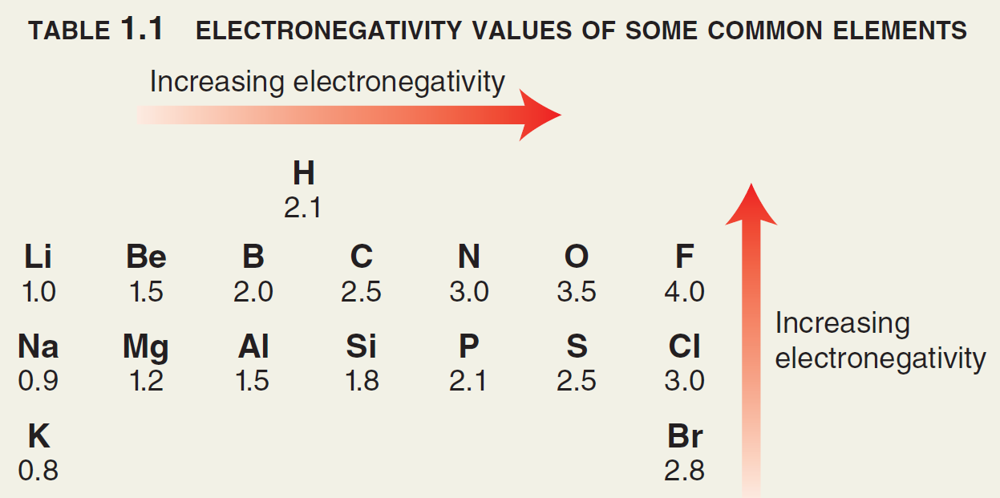
Bond polarity
Bond polarity is shown with a crossed arrow pointing toward the more Electronegative (EN) atom.
Partial charges (δ) depict unequal distribution of electrons in a bond.
For an individual bond between two atoms…. (from Gen Chem)
If ΔEN < 0.5 → bond is nonpolar
If ΔEN is between 0.5 and 1.7 → bond is polar
If ΔEN > 1.7 → “bond” is ionic &
e⁻ are not shared!

Slide 3
Bond polarity (for Organic Chemists)
Organic chemists characterize bonds
between Carbon & Friends based more on
___________ ____________ than Pauling Scale EN values.
Common nonpolar bonds:
Common polar bonds:
“Pauling Scale” electronegativity (EN)

Slide 4




Formal charge/octet – prediction about stability/plausibility of structure
VSEPR – predictions about geometry
  Give approximate bond angles around each C, and “name” the molecule’s geometry
Very simplistic model of “where electrons are” in a molecule

Slide 5
Atomic orbitals
What is an orbital?
Recall from Gen Chem that the energy of electrons is quantized and not continuous –
Visualized as 3D probability density maps: region or “shape” where an electron is ____________ ___________ to be found, if it’s at a certain energy.
An orbital holds a maximum of _____
Cool story and all, but where do these shapes of orbitals come from?

Slide 6
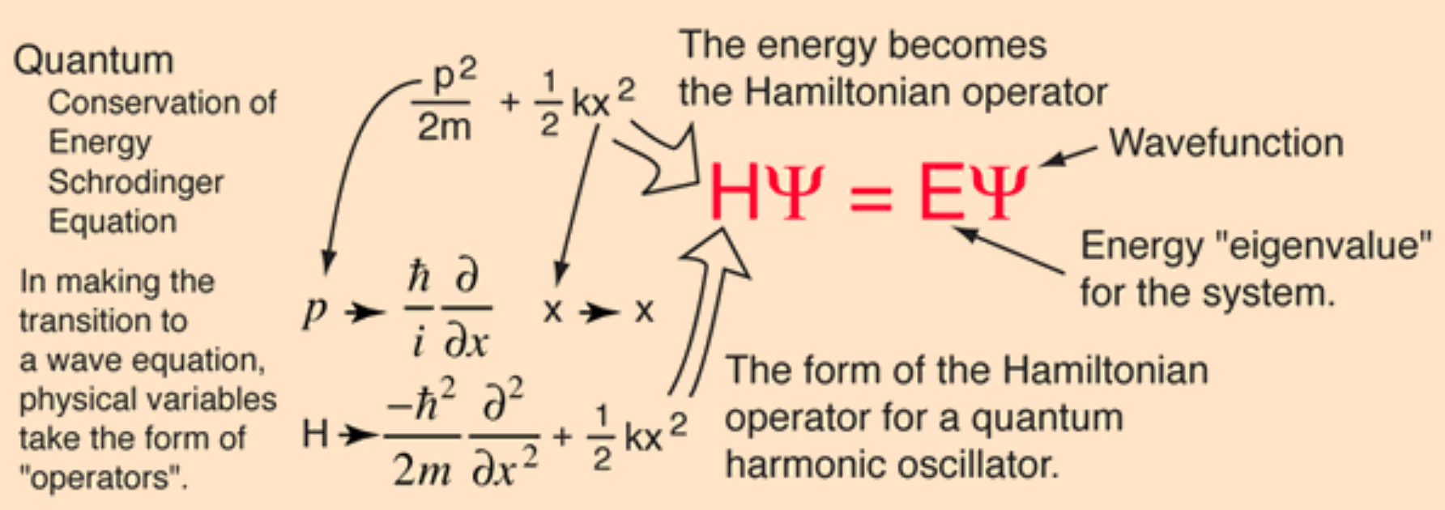
The Schrödinger equation
Electrons have both wave- and particle-like nature
Schrödinger modeled electron as a 3D standing wave around nucleus
Quantized energy levels of orbitals come from this model
  as do their corresponding 3D “shapes” at each energy level!
Notes:
Louis Debroglie 1929 Nobel Prize
Do NOT study the image at bottom

Slide 7
Solutions to the Schrödinger equation for Hydrogen
Orbital shapes:
s p d f
Visualizer of solutions for Hydrogen orbitals
Notes:
Visualizer of solutions for Hydrogen orbitals

Slide 8
More about p orbitals
Notes:
Node, and phasing

Slide 9
Valence Bond Theory
Bonding is a result of _________ _________ between two atoms
Two important flavors of overlap in this class:
σ (sigma) π (pi)
σ-bond is __________ and ___________ than π-bond!

Slide 10
Geometry of CH₄ (methane)
Valence electron configurations of C and H:
What bond angles does Valence Bond theory predict, given the orbitals involved that can overlap?
What bond angle does VSEPR predict for CH₄?
Valence Bond theory needs an adjustment!

Slide 11
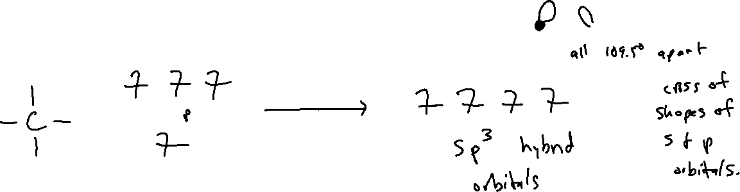
Hybridized atomic orbitals
General idea: within one atom, the orbitals involved in sigma bonding or containing lone-pairs MIX (hybridize) to get new atomic orbital shapes that are degenerate.
sp³
hybridize

Slide 12
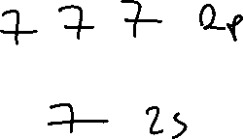
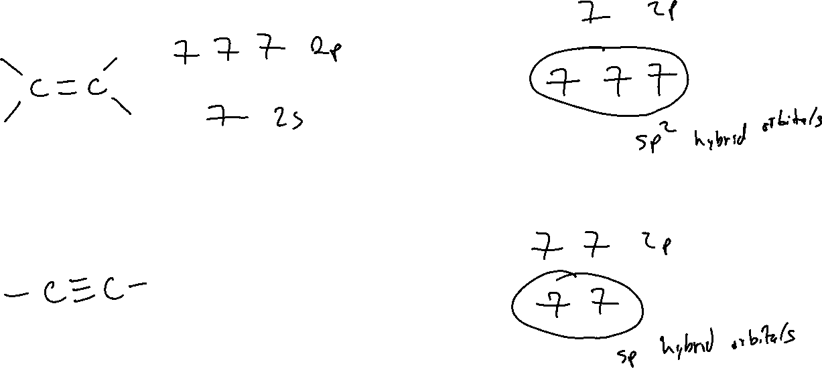
sp²
sp
hybridize
hybridize

Slide 13
*TL;DR for hybridization*
Count the number of electron groups around an atom
  a double or triple bond only counts as one group
  each lone pair counts as one group
Number of groups = the total number of letters in the hybridization label.
Examples:

Slide 14
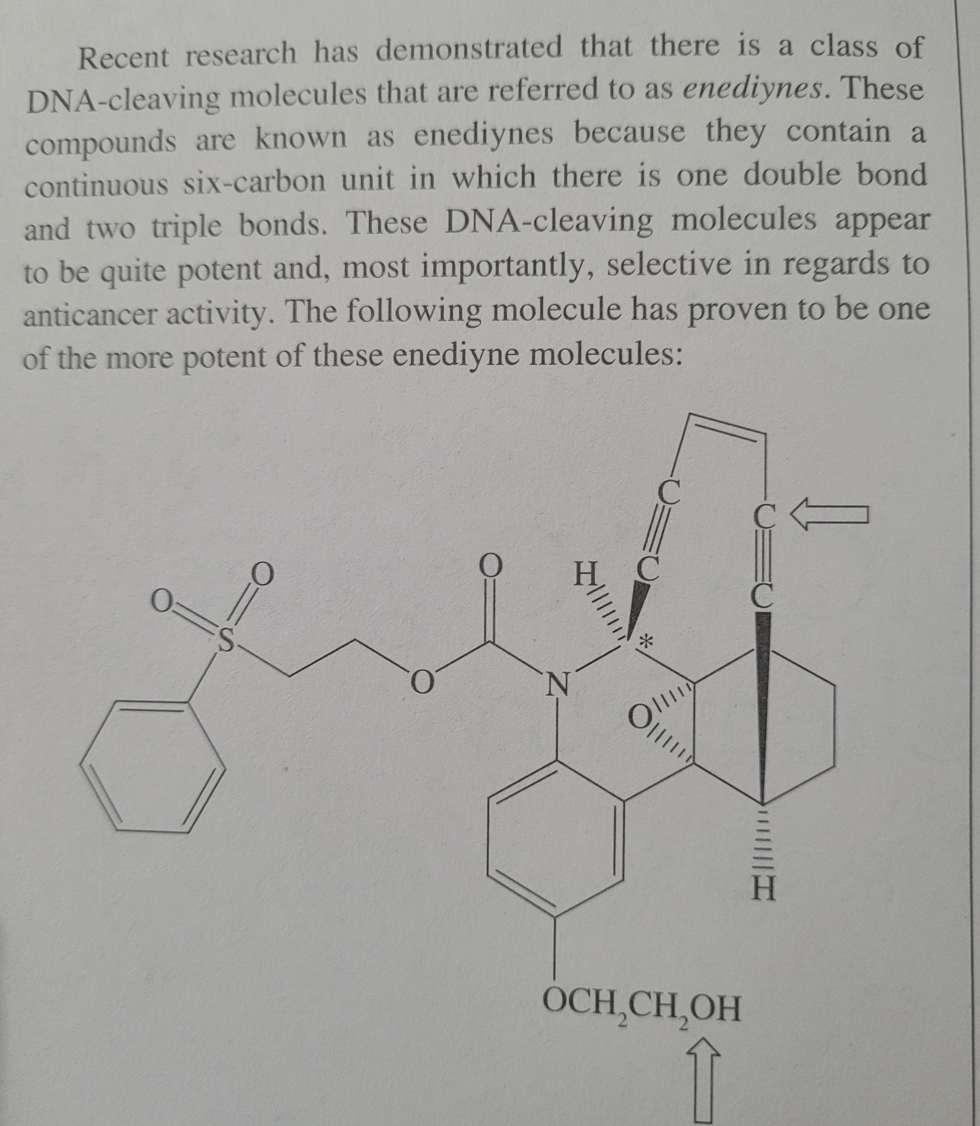
Poll
**MCAT Question**
Identify the hybridization of the carbon atom and the oxygen atom indicated by the arrows.
C: sp, O: sp²
C: sp, O: sp³
C: sp², O: sp³
C: sp³, O: sp³
pollev.com/timcook653 or text timcook653 to 22333 or use android/iphone app
Notes:
Chem/phys – skim passage (30 sec at most, look at figures briefly), or do not read at all.
B/B – skim passage and take brief notes (ca 1 min), especially if passage is about an experimental result
PSB – skim passage and take brief notes (ca 1 min)
CARS – you will usually have to read the passage.

Slide 15
Poll
**MCAT Question**
How many π-bonds does this molecule have?
12
13
14
15
pollev.com/timcook653 or text timcook653 to 22333 or use android/iphone app

Slide 16
Molecular vs electron geometry
Molecular geometry – describes shape formed by the atoms
Electron geometry – describes shape formed by the electron groups (including the lone pairs!)
Notes:
Guaranteed to show up on chem/phys

Slide 17
Molecule polarity
A molecule is polar if it has a net dipole moment – or exhibits permanent, partial charges on atoms due to polar bonds.
A molecule can have polar bonds, but be nonpolar overall!

