Slide 1
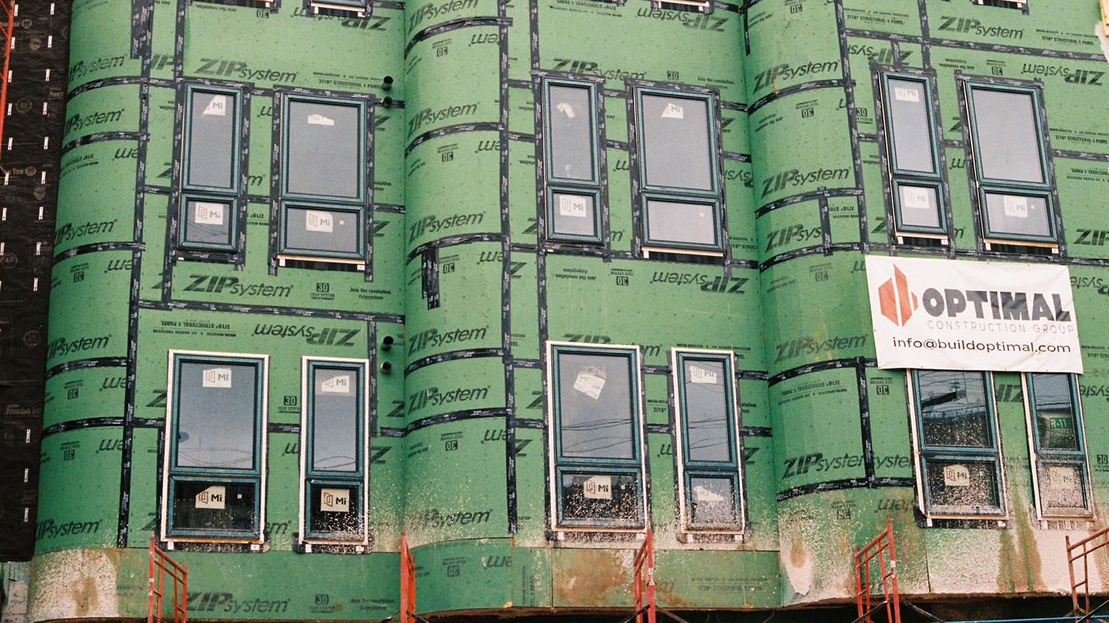
Gentrification (CITY B207)
Dr. Stanley Collins, Ph.D.

Slide 2
Welcome!
Introductions
What is Gentrification?
Course Overview
Learning Objectives & Using Moodle
For Next Class

Slide 3

Who am i?
You can call me Professor Collins or Dr. Collins
I use He/Him/His pronouns
I was born and raised in Philadelphia’s Logan neighborhood
Hobbies: playing guitar, watching movies, photography, writing about music
Morehouse College (BA, Economics); Oklahoma State University (MS, Sociology); Temple University (PhD, Sociology)
Post-Doctoral Fellow, University of Pennsylvania, Weitzman School of Design, City and Regional Planning

Slide 4
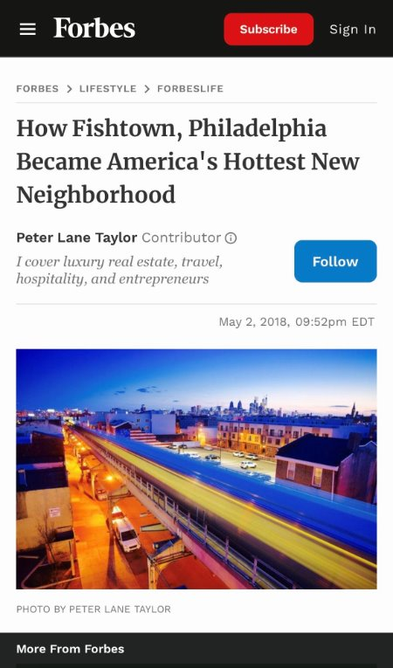
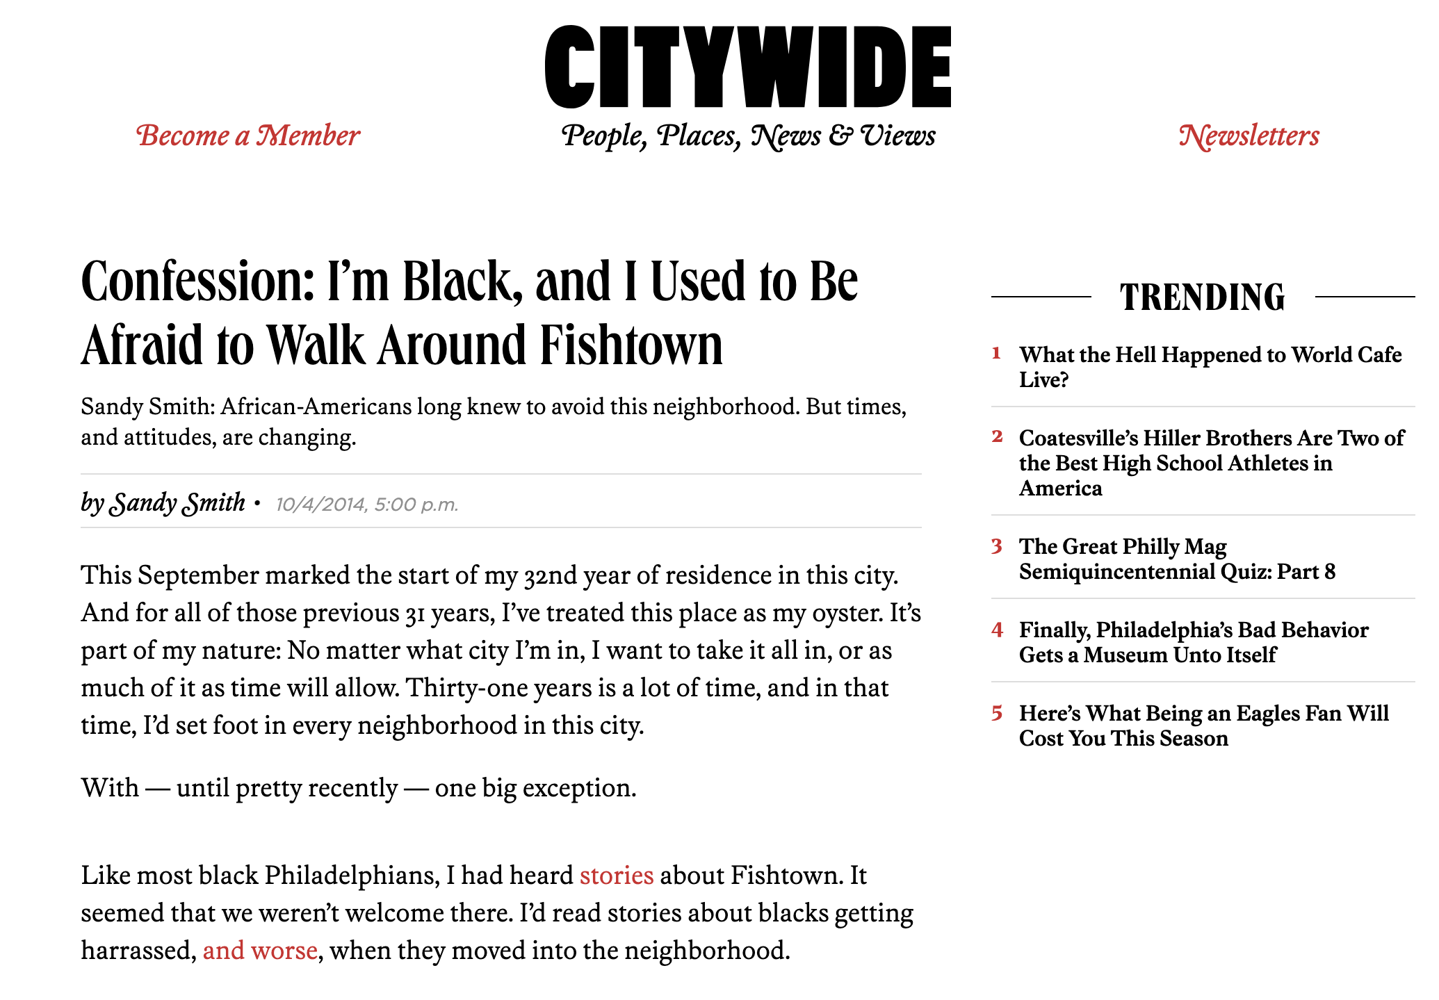
Research
Gentrification, place, race, sound/music
Going to concerts in Fishtown. Where am I?
Historically white, working-class neighborhood located along the Delaware River
Place reputation: how does a neighborhood go from being white and “racist” to white and “cool?”
Music and music venues as part of reputational change

Slide 5
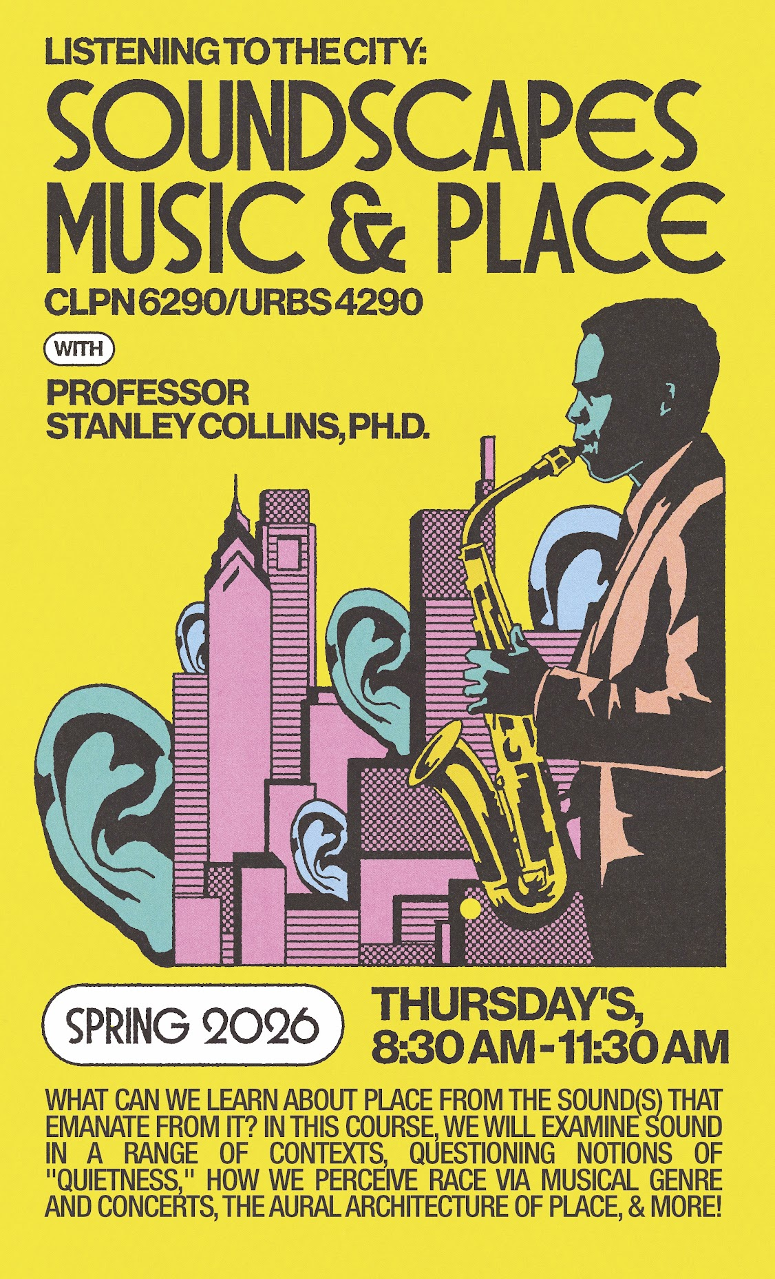
teaching
Fall 2026 Courses
  Gentrification
Spring 2027 Courses
  Listening to the City: Soundscapes, Music, and Place
  Urban Ethnography
  Making Race and the City

Slide 6
Who are you?
Name
Major
Class
Hometown
Last Movie You’ve Seen (Or Your Favorite Movie)

Slide 7
What is gentrification?
In groups, discuss what you think gentrification is.

Slide 8
Learning objectives
To understand the origins and evolution of gentrification as both a concept and process.
To understand the relationship between gentrification and race, gender, sexuality, and place, respectively.
To acquaint students with quantitative and qualitative methods for studying gentrification.
To build critical writing, presentation, and analytical skills for social inquiry that empowers students to ask questions and communicate their unique analysis of historical and contemporary debates related to gentrification.

Slide 9

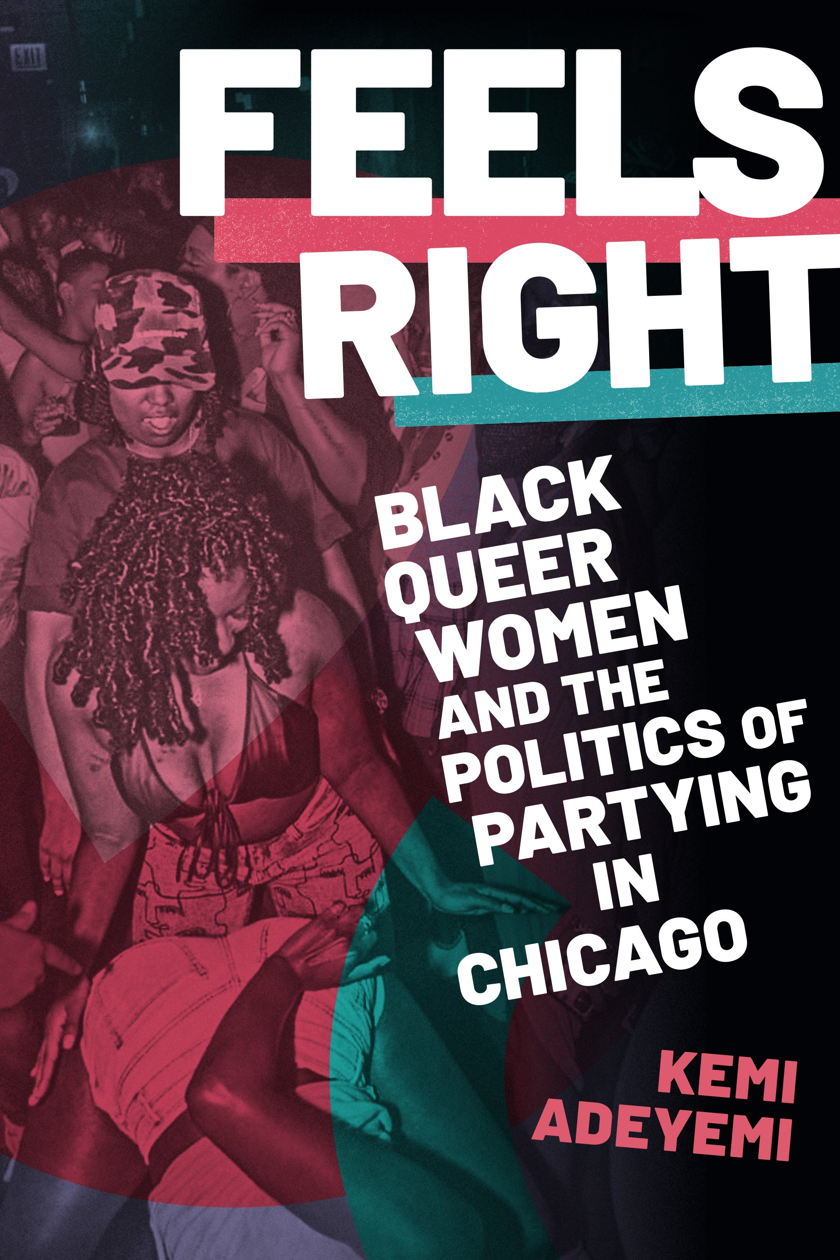
Course overview: Required texts & other materials
Required Texts:
  A Good Reputation: How Residents Fight for An American Barrio
  Feels Right: Black Queer Women and the Politics of Partying in Chicago
Peer-reviewed journal articles, book chapters, magazine articles, movies

Slide 10
Course Overview
Foundations (Weeks 1 – 4)
Race and Gentrification (Weeks 5 – 6)
Gender, Sexuality, and Gentrification (8 – 9)
Commercial Gentrification (Week 10)
Reputations and Gentrification (Weeks 11 – 13)
Resisting Gentrification (Week 14)
Review (Week 15)
Finals (Week 16)

Slide 11
Course overview: assessment
Fieldnotes (20%) → learning in real world environments
  Walking Tour (led by me)
  Philadelphia Gayborhood Tour with Beyond the Bells
  Commercial Gentrification in Fishtown
  Group Tour
2 Exams (50%)
  Mid-term
  Final
Reading Notes (15%) → submitted periodically throughout the semester
Attendance & In-class contribution (15%)

Slide 12
Course Overview: In-class contribution
What does it mean to be a community member in this classroom?
What does contribution look like?

Slide 13
For next class
Required Reading: Ruth Glass, Aspects of Change (1964), Pp. 19 – 30
To do:
  When you hear the word “gentrification” what comes to mind? What is your relationship to it? Does gentrification have a positive or negative connotation, or both, to you? Explain your answer. Your response should be between 100 – 300 words.
  Submit by 11:59 PM, Wednesday, 9/1

