Slide 1
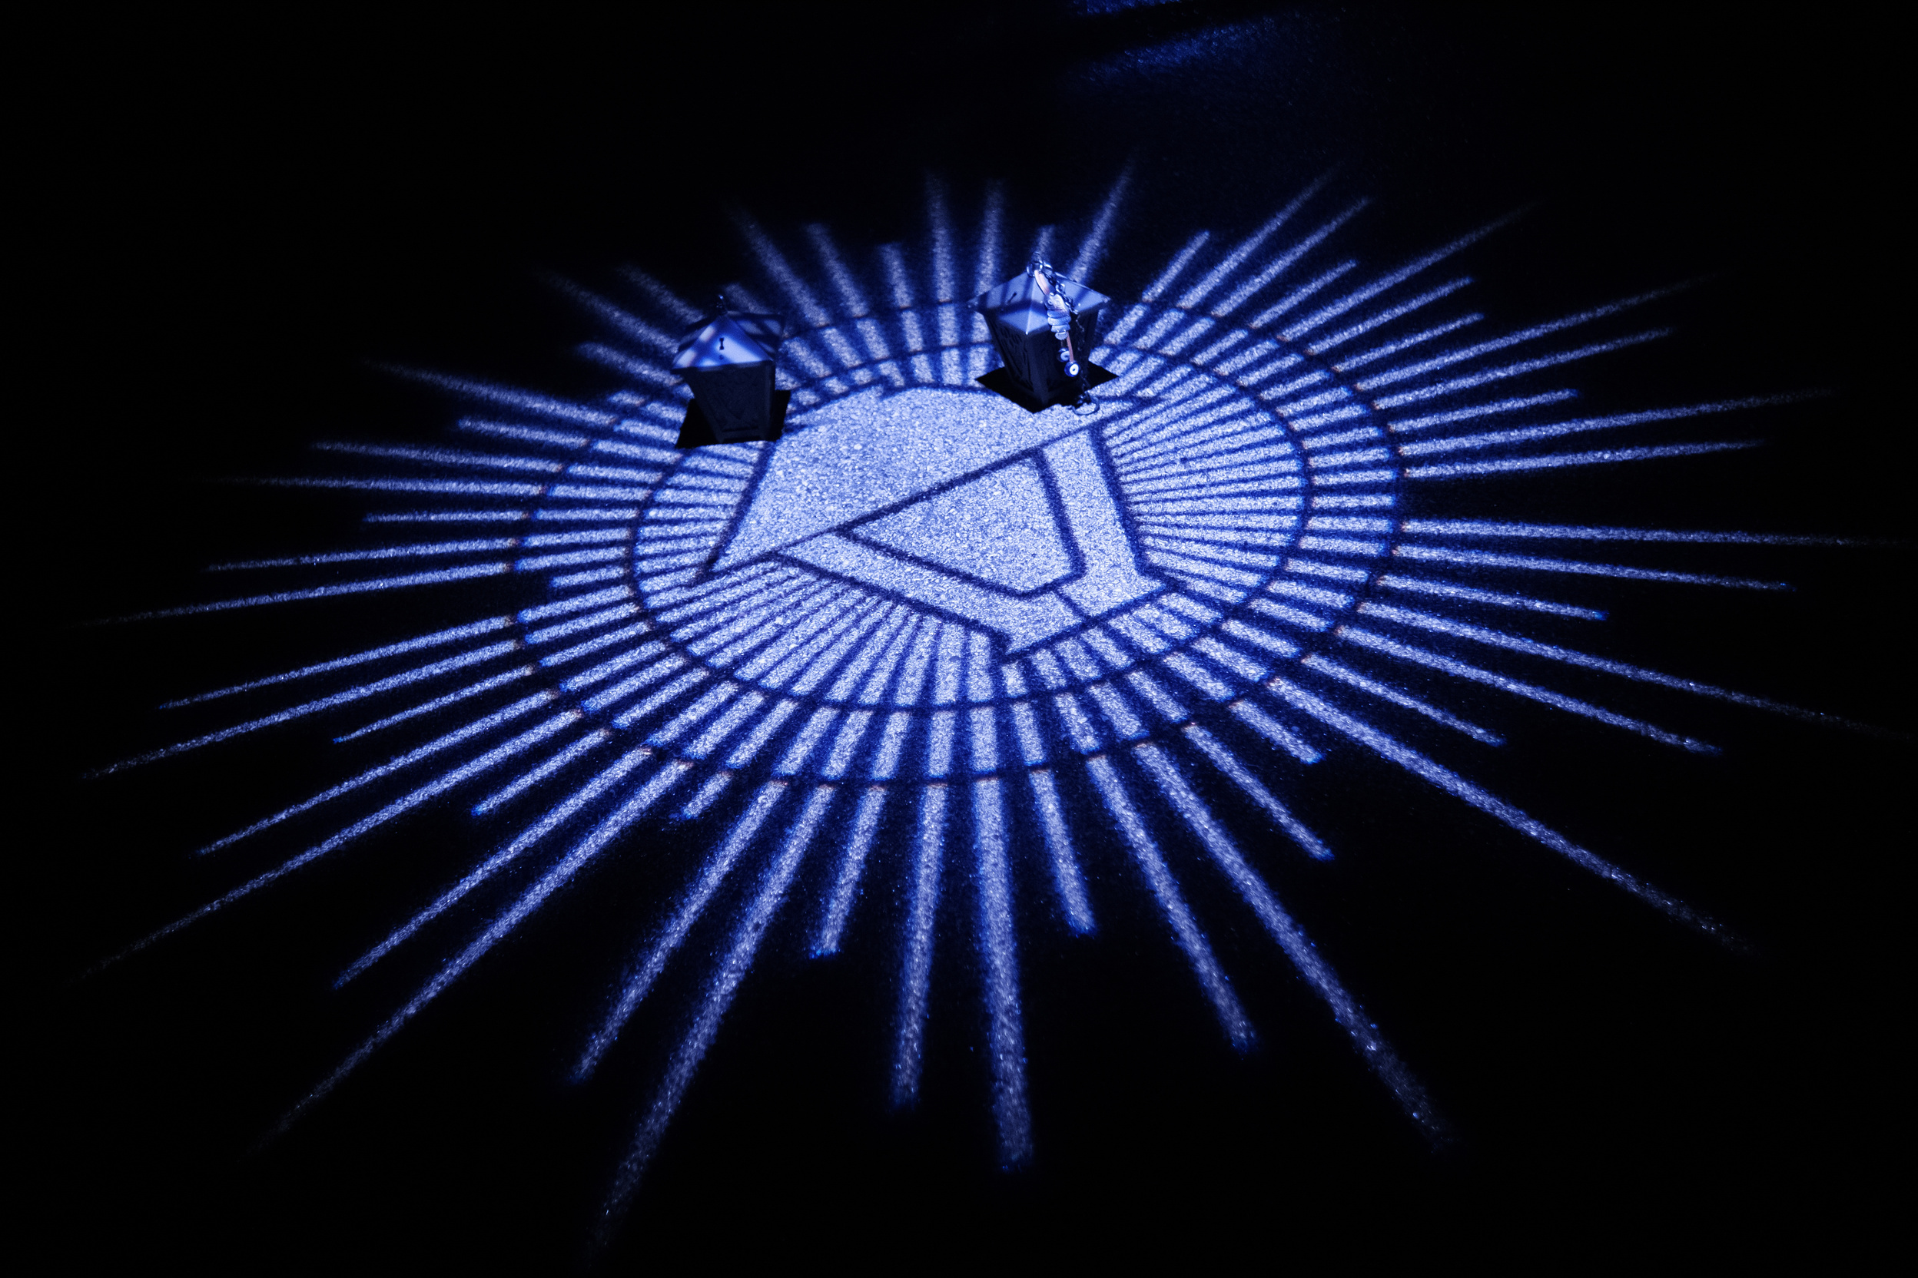
WELCOME TO THRIVE!
Week 1

Slide 2
  Introduction​
  Ice Breaker​
  Syllabus Overview​
  Framing the Course ​
  Envisioning Your First Year​
  Community Agreements​
  Closing and Sense of Belonging Survey
Agenda

Slide 3
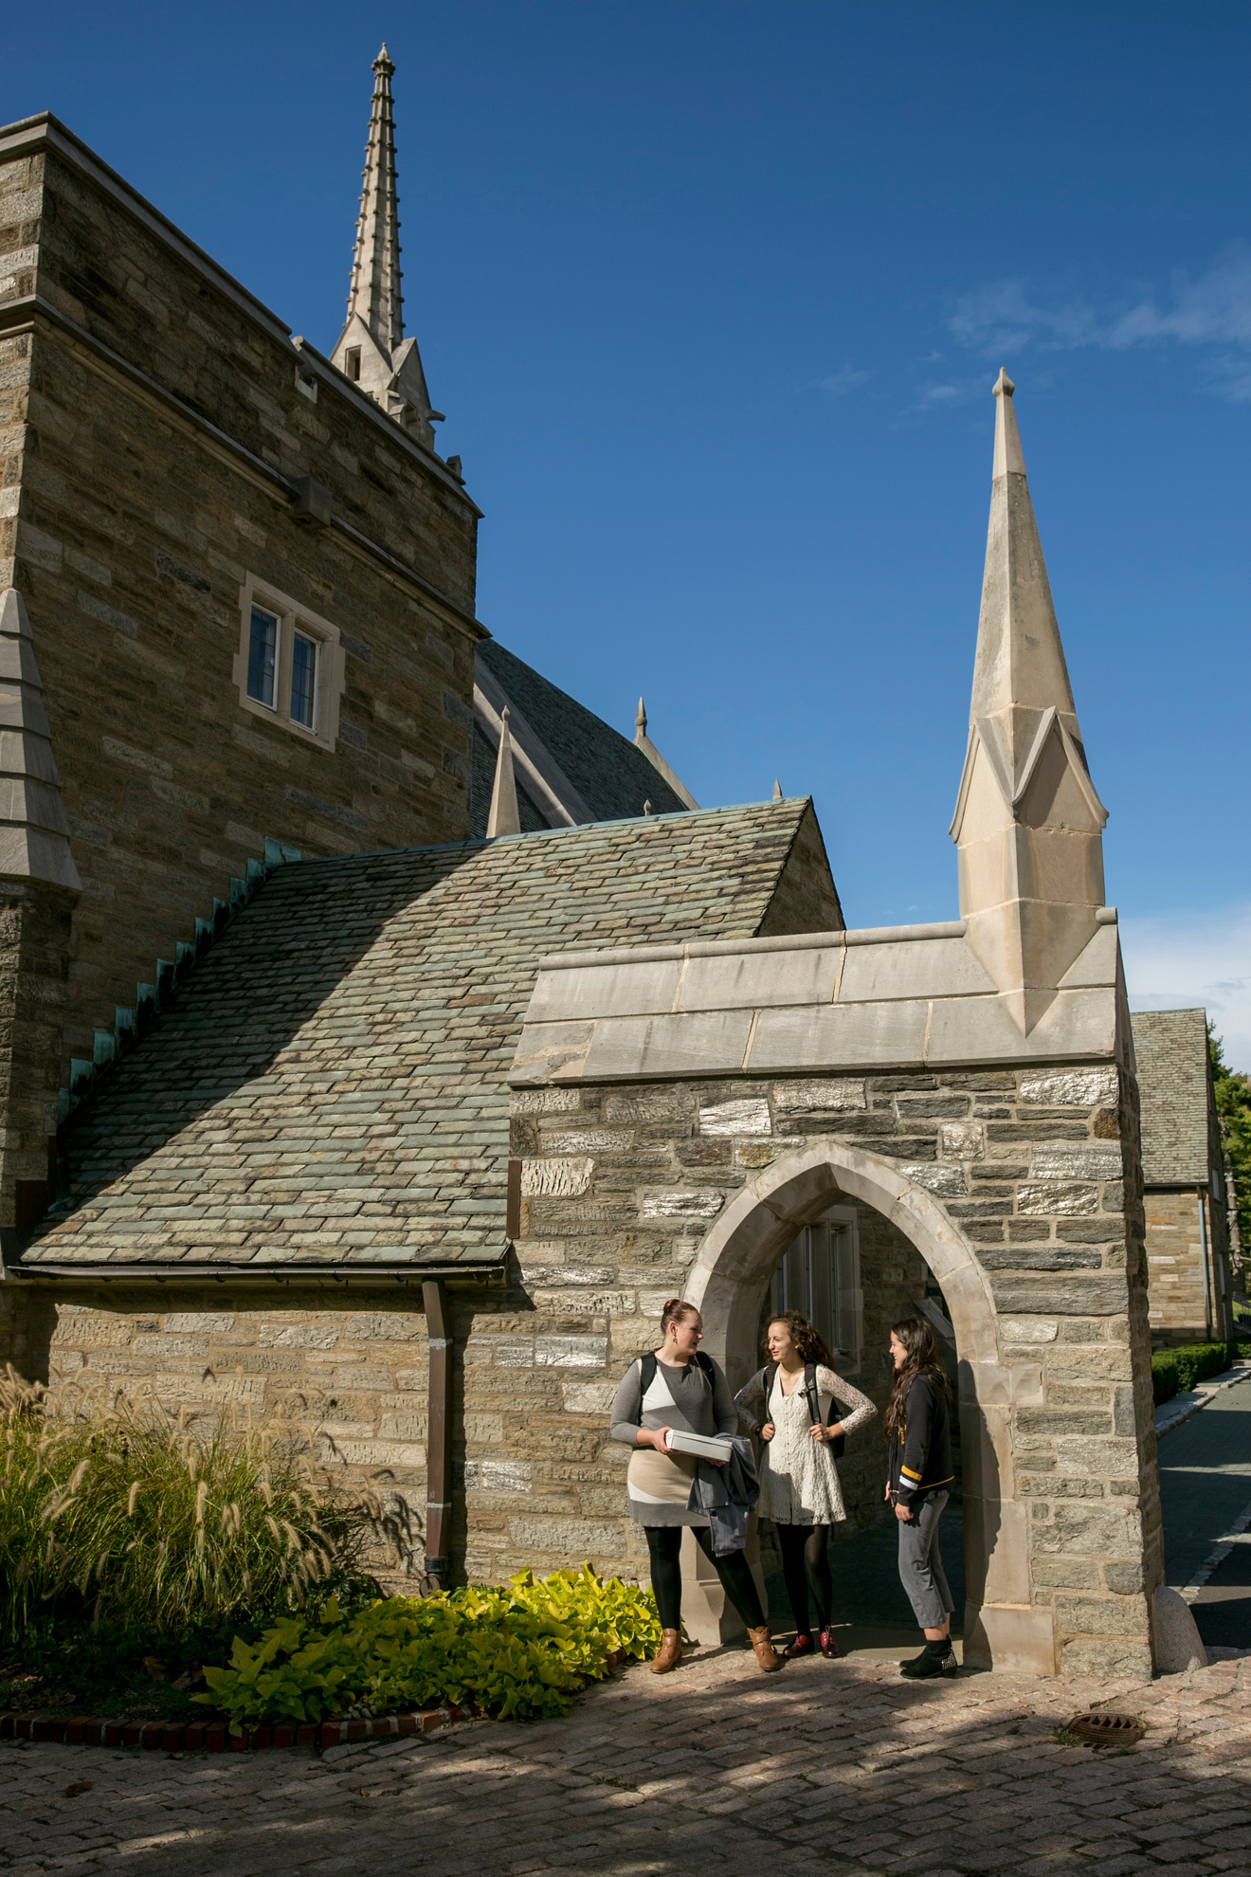
Introductions
3

Slide 4

What is THRIVE?
  THRIVE is a Pass/Fail ​course
  10-Week 1 hour and 15-minute-long course​
  Counts for 2 PE credits​
  This course is an extension of Orientation that will help in your transition to Bryn Mawr and allow you to learn new things about yourself, your peers, and the greater Bryn Mawr community. ​

Slide 5

Envisioning Your First Year
  What do you want your first year at Bryn Mawr to look like?
  What parts of college life feel exciting? What parts feel new, unfamiliar, or challenging?
  What helps you feel comfortable or connected when entering new spaces?
5

Slide 6
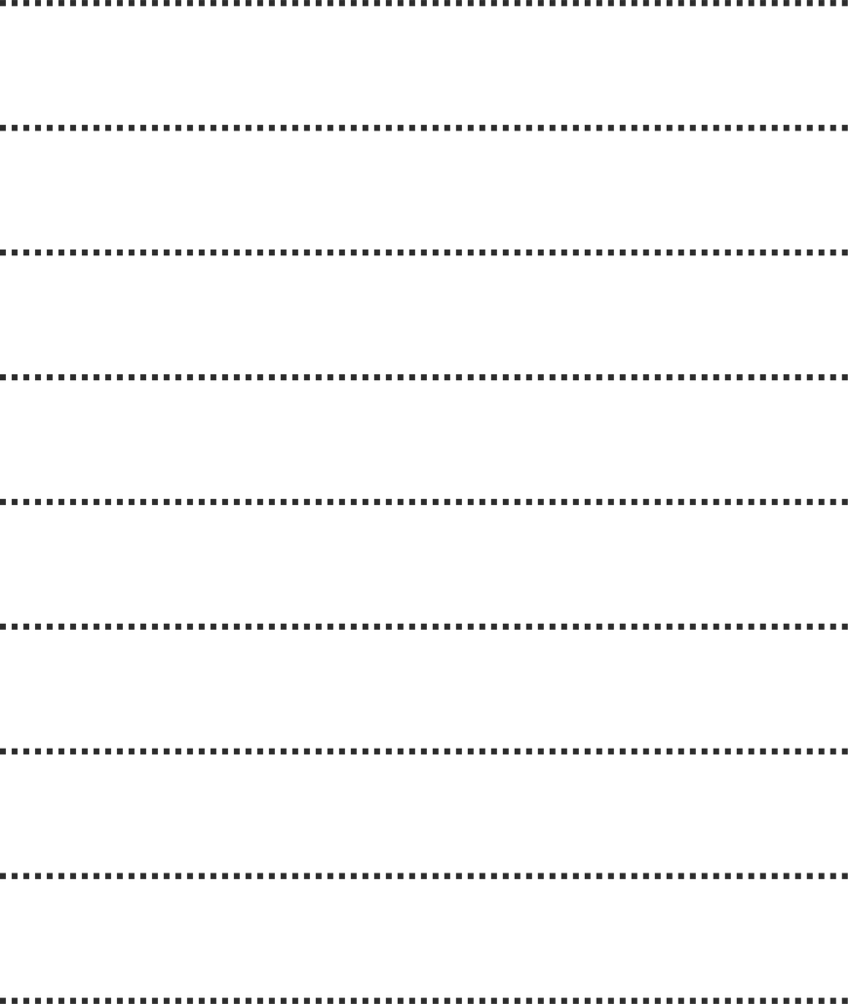
Community Agreements

Slide 7
Instead of ““Be respectful…”
Challenge claims with evidence and avoid character attacks.
Instead of ““Listen to others…”
Reframe or summarize what the other person has said before responding.
Instead of ““Safe space…”
Expect discomfort, take risks, maintain boundaries.
Examples

Slide 8

Homework:
Letter to Your Future Self
Can be handwritten or typed and answer the following prompts below:
  When you look back on your first year, what do you hope you'll be proud of?
  What experiences, people, or ideas do you want to learn more about?
  What advice would you want from your future self?

Slide 9

Homework:
History Presentation
Not sure where to begin?
Scan for a research guide!
During week three you will give a presentation during class in
pairs. Each pair will have a topic related to Bryn Mawr's history. The presentation should be 5 minutes long and both members of the pair must attend the presentation. You do not need visual aids and can give a verbal presentation. No Al is permitted to be used for this assignment.

Slide 10
History Presentation Topics
  Bryn Mawr Founding
  Don't Forget to Remember (Me)
  Self-Governance Association
  Honor Code
  Notable Graduates (Emily Balch, Ume Tsuda, Enid Cook)
  Historic Landmarks
  Student Strike of 2020
  Black at Bryn Mawr Tour
  Perry House
  Erdman Hall
10

Slide 11
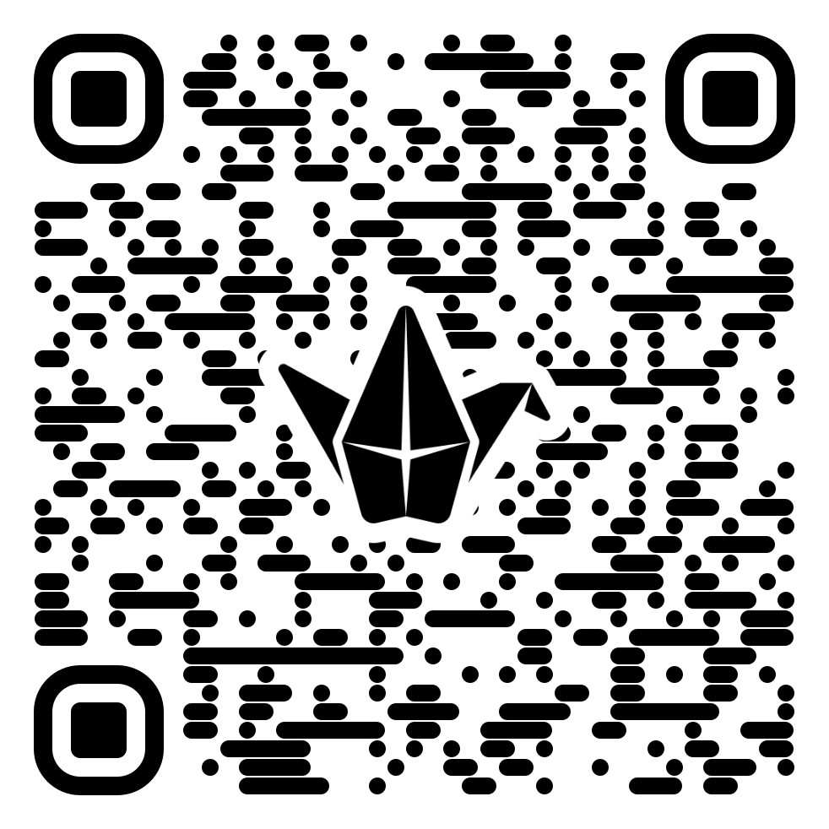
Closing: Know it Owl Padlet
11

Slide 12
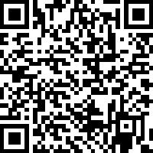
Academic, Social, and Deeper Life Interactions Survey
12

