Slide 1
History of Bryn Mawr

Slide 2
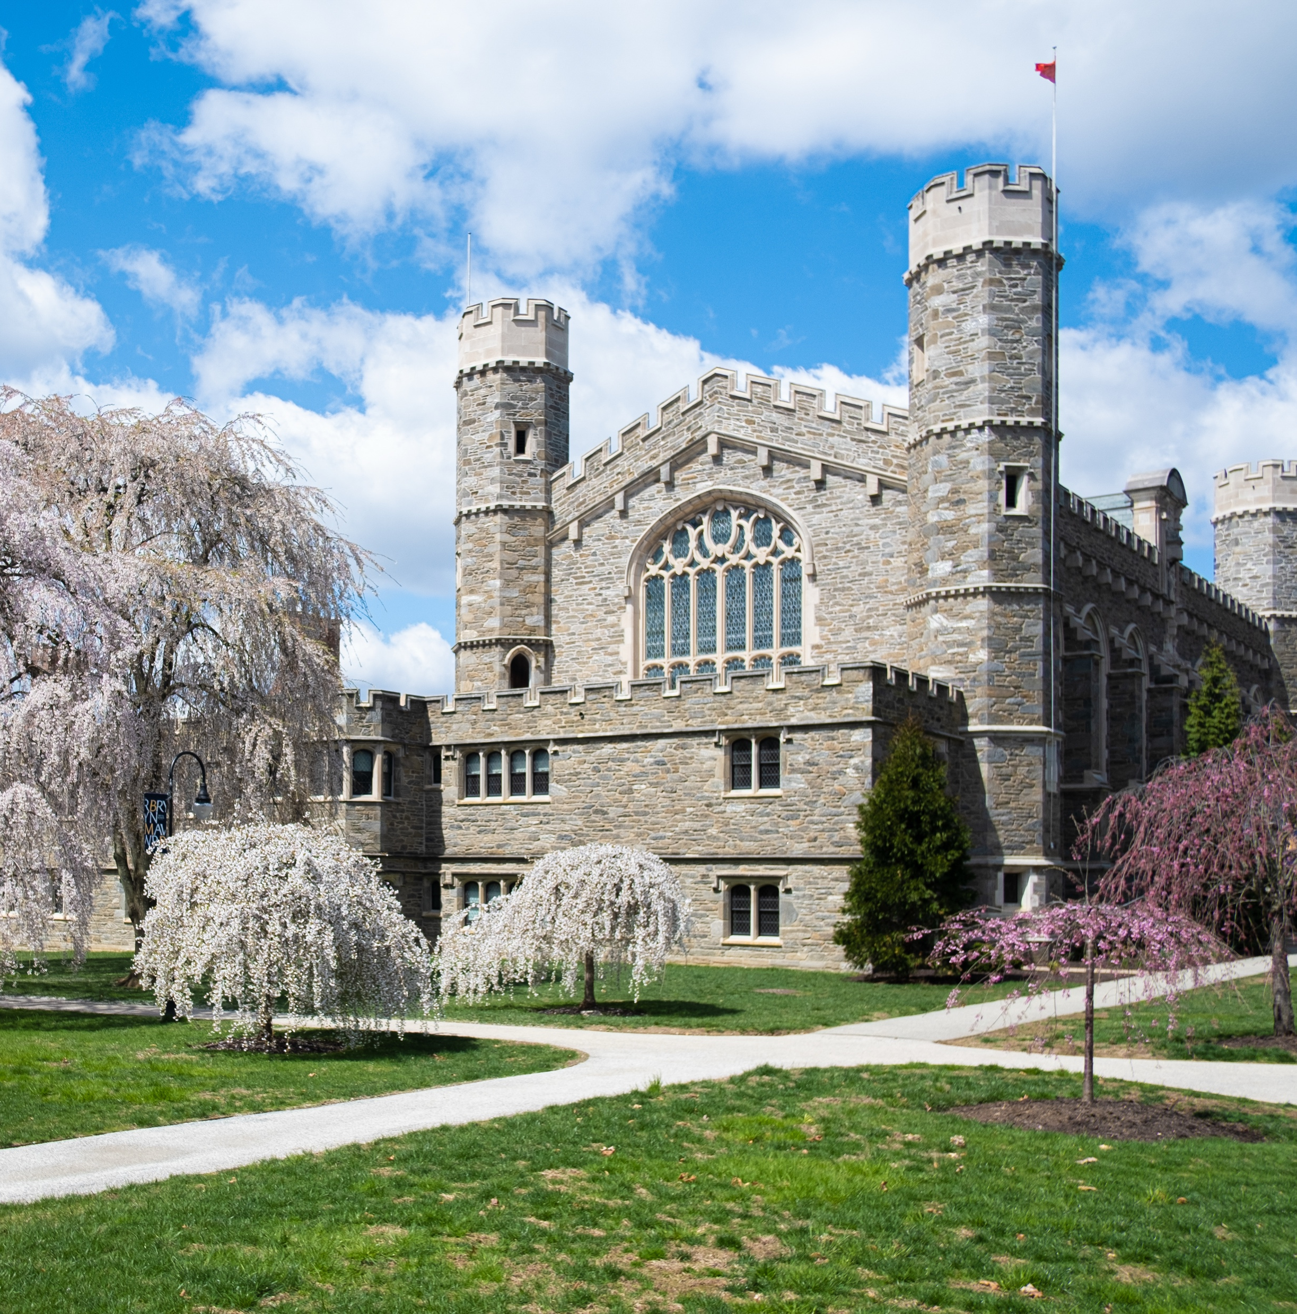
Agenda
Icebreaker​
Presentations​
  Today you are going to share information about Bryn Mawr. These topics are just a small snapshot of the history of Bryn Mawr. ​
3

Slide 3

Closing: Know it Owl Padlet
3

