Slide 1
Week 4
Self Governance & Constructive Dialogue

Slide 2
Agenda
Ice breaker
What is Self-Governance?
How is Change Made?
Constructive Dialogue

Slide 3
Plenary Resolution Group Activity (Resolution 1)
Resolution 1: This resolution proposes a change in Bryn Mawr’s credit transfer policy to include post-matriculation credits from community colleges. As it stands, Bryn Mawr College undergraduate students are only permitted to pursue post-matriculation credits at four-year colleges and universities. Four-year institutions are significantly more expensive and rarely offer financial aid to visiting students, marking them as economically inaccessible and limiting opportunities for Bryn Mawr College students to obtain credits at other institutions.

Slide 4
Plenary Resolution Group Activity Continued (Resolution 1)
This restriction disproportionately impacts first-generation, limited-income (FGLI) students. This resolution would therefore eliminate the economic barriers for Bryn Mawr College students seeking to further their education with summer courses. All other requirements for credit transfer (e.g., they must be in-person liberal arts courses transferred from an accredited college or university where the student received a 2.0 or higher) would remain in place.

Slide 5
Plenary Resolution Group Activity (Resolution 2)
Resolution 2: The establishment of an on-campus bar, Wisdom, would provide a safe, regulated, and accessible social space for students to foster community without needing to leave campus. The bar would be staffed by TIPS trained staff from Dining Services and will promote responsible drinking and allow students to learn how to drink in moderation.

Slide 6
Plenary Resolution Group Activity (Resolution 2 Continued)
Having a specific location on campus would eliminate the need for students to have parties in their dorms, which can have negative impacts on other students. The bar would be located at Applebee Barn and would offer mocktails, providing an inviting environment for all.

Slide 7
Constructive Dialogue Activity
Now, let’s split into 4 groups to practice using constructive dialogue to make informed decisions about how to move forward. Consider the following:
What is the most important thing you would want the other party to understand? (1 sentence)
Draft what you would say using an “I” statement; this means focusing on the specific behavior, your feelings, and what you need to move forward. Try to avoid absolute language like “always” and “never”.
Formulate at least one open-ended curious question to clarify the other person’s perspective.
What would be the common ground in this conversation? The hardest part? Is there anyone you would want to speak to before having the conversation?

Slide 8
Scenario 1
A new professor is teaching a course. In the past this class has been really popular and often is full with a waitlist. Many students signed up for the class assuming it would be similar to what they heard from people who have taken it. They were surprised to learn that while the material was the same, the way it was taught was very different and many students had a difficult time learning the information.

Slide 9
Scenario 1 Continued
Students decided that they wanted to have several of them speak with the professor about learning styles and with concerns about the final exam being closed book because many of them were not doing well in the course.

Slide 10
Scenario 2
You and your roommate live a double with a shared common space. It is a pretty sweet room. You and your roommate decided that the common space would be for hanging out and entertainment during specific hours and agreed to have guests approved in advance in your roommate agreement.

Slide 11
Scenario 2 Continued
You were off campus at a required class field trip. When you return, you find a lot of people in your room. Your roommate was having a party that you didn’t know about. You are upset because you had a long day and just wanted to sleep

Slide 12
Homework: Strengths Quest
Instructions TBD

Slide 13
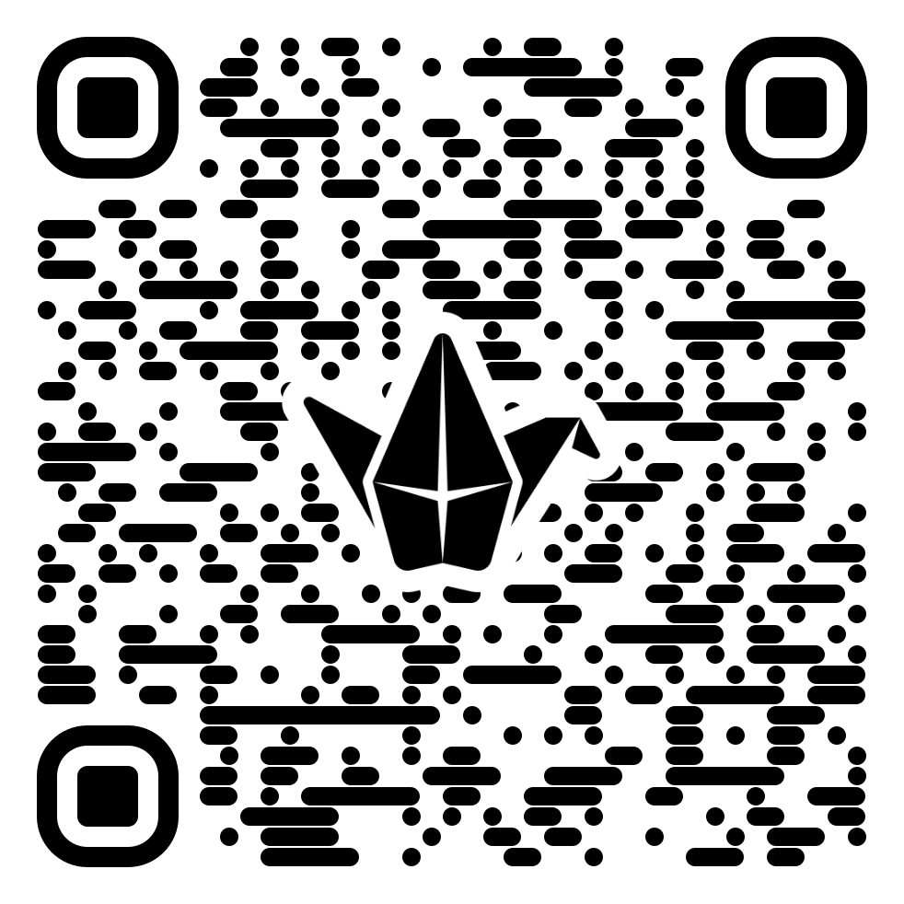
Closing: Know it Owl Padlet

