Slide 1
THRIVE Week 5
Honor Code

Slide 2
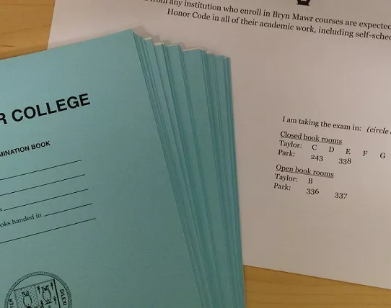
Agenda
Ice Breaker
What is the Honor Code About?
Positive Confrontation
Practice

Slide 3
Ice Breaker

Slide 4
Post-It Activity
Guiding Questions
  What’s is the Honor Code about?
  What does it mean to you?
“The Honor Code embodies the ideals and values according to which both academic and social life at Bryn Mawr ought to be conducted.”

Slide 5
Honor Code Scenario 1
You are in a class that has a clear policy against using AI for anything. You realized that you had a paper due in this class tomorrow. Because you were short on time, you did your best to write something that met the assignment but decided to run it through AI and submitted the result. A few days later your professor contacts you and asks if you used AI for the paper. You met with your professor to discuss their concerns, and you deny using AI. Your professor has reported you to the Honor Board.

Slide 6
Honor Code Scenario 2
You are in the library taking the same exam as somebody else and you notice that the person is using their notes when the professor told the class that the exam was not open book. You see the student finishes the exam and you finish shortly after.

Slide 7
Honor Code Scenario 3
You (Spongebob) are in a quad with your roommates, Patrick, Gary, and Squidward. At first everyone seemed to get along. As fall break approaches, it becomes clear that Gary and Squidward do not like Patrick and have complained to you about them. You go to dinner with Gary and Squidward, and you see that they are posting negative comments about Patrick anonymously online.

Slide 8
Honor Code Scenario 4
In your dorm, you have a few food items in the pantry for specific dietary needs. And it seems like someone keeps eating them. One day, as you were walking down the hall, you saw someone take one of your items. You turn around and go back to your room, very upset at what had taken place.

Slide 9
What helps create positive confrontation?
  Focus on the issue, not the person
  Use “I” statements
  Be clear and specific
  Choose the right time and place
  Assume positive intent
  Listen as much as you speak
  Stay solution oriented
  Manage your emotions
  Set boundaries when necessary
  End with respect and appreciation

Slide 10
Practice
Scenario 1
It is 1am and your neighbor is playing music and singing loudly after quiet hours. You open your door and bang on their door, yelling “shut up” and go back to your room and slam your door closed.
Scenario 2
Someone is smoking and it is bothersome to many people with asthma and allergies. Everyone knows who it is, but they don’t do anything. At your next hall hangout, the smoker is present. Everyone is loudly complaining about smoking.

Slide 11
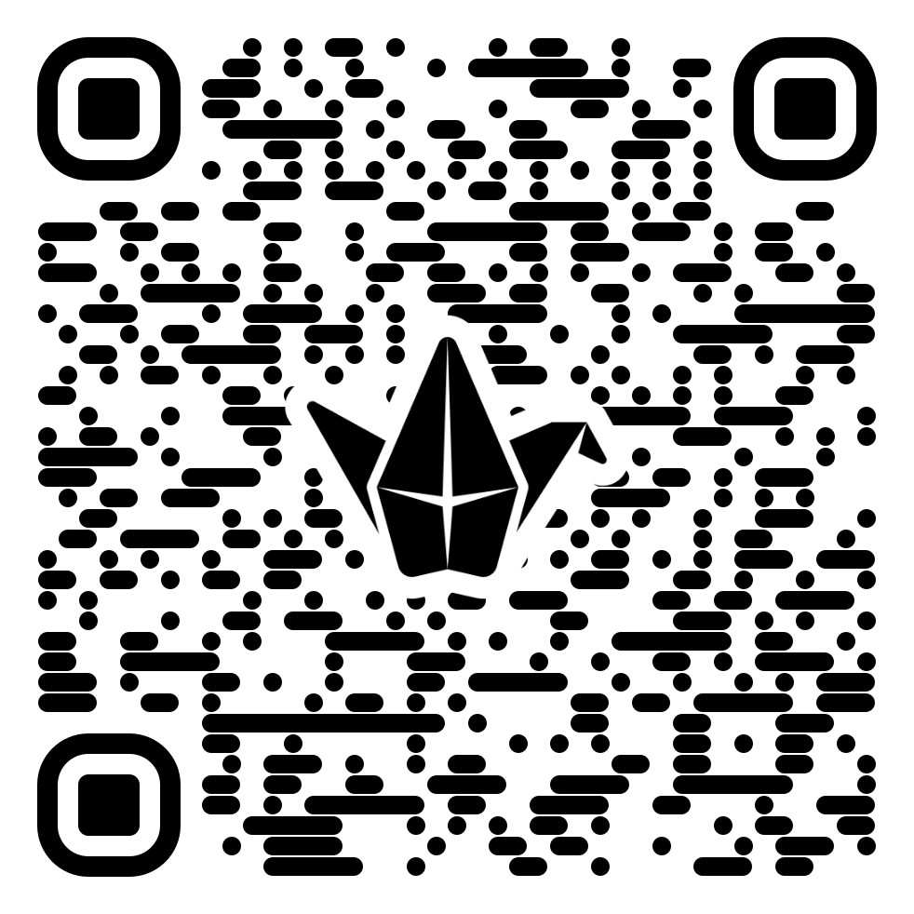
Closing: Know it Owl Padlet

