Slide 1
THRIVE Week 7
Return to Academics

Slide 2
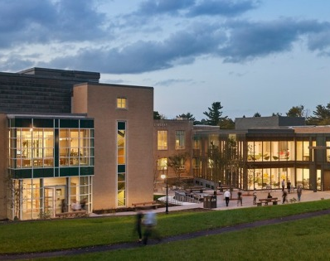
Agenda
Ice Breaker
Major Exploration
Class Game
Academic Advising

Slide 3
Ice Breaker

Slide 4
Reflection
In week two we asked how you learn best and discussed what might be different between your high school and college experiences.
  Have you noticed any differences?
  What are they?
  What has changed for you?

Slide 5
Course Exploration

Slide 6
Discussion
Think about the courses you are enrolled in this semester.
  Why did you select them?
  Were they interests you previously had?
  Are you still interested in that subject?
  Do you have new interests?

Slide 7
Game!
ARCH B252-001 Pompeii
POLS B279-001 City and Immigration
ENGL B357 A Star is Born: Race, Gender, and Celebrity
ENGL B230-001 Speculative Asias
ENGL B305-001 Early Modern Trans Studies
PHIL B307-001 What Is Beauty Good For?
POLS B228-001 Living Justly in an Unkind World
MATH B208-001 Introduction to Modeling and Simulation
PSYC B205-001 Research Methods and Statistics
PSYC B332-001 Unlocking the self-control toolbox
ANTH B354-001 Political Economy in Vietnam
SOCL B307-001 Transnational Queer Politics
GEOL B202-001 Mineralogy and Crystal Chemistry
GEOL B206-001 Energy Resources and Sustainability

Slide 8
Game!
Pompeii
City and Immigration
A Star is Born: Race, Gender, and Celebrity (I can’t find this one)
Speculative Asias
Early Modern Trans Studies
What Is Beauty Good For?
Living Justly in an Unkind World
Introduction to Modeling and Simulation
Research Methods and Statistics
Unlocking the self-control toolbox
Political Economy in Vietnam
Transnational Queer Politics
Mineralogy and Crystal Chemistry
Energy Resources and Sustainability

Slide 9
Dean MB Discusses Academic Advising

Slide 10
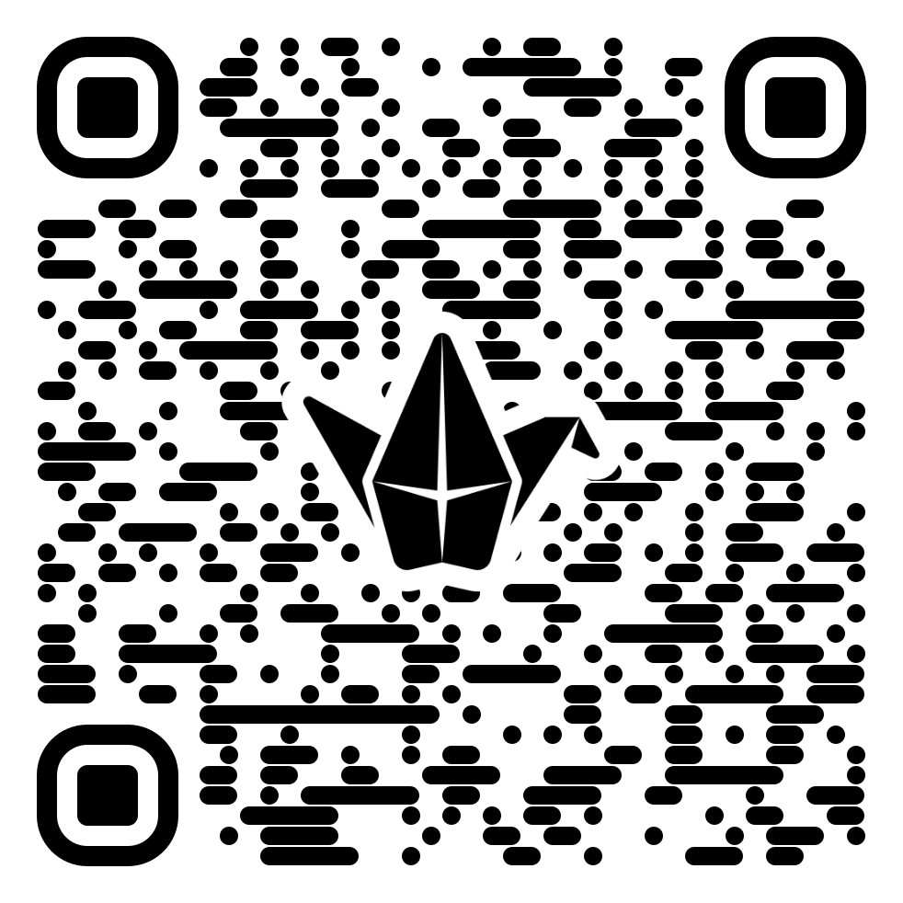
Closing: Know it Owl Padlet

