Slide 1
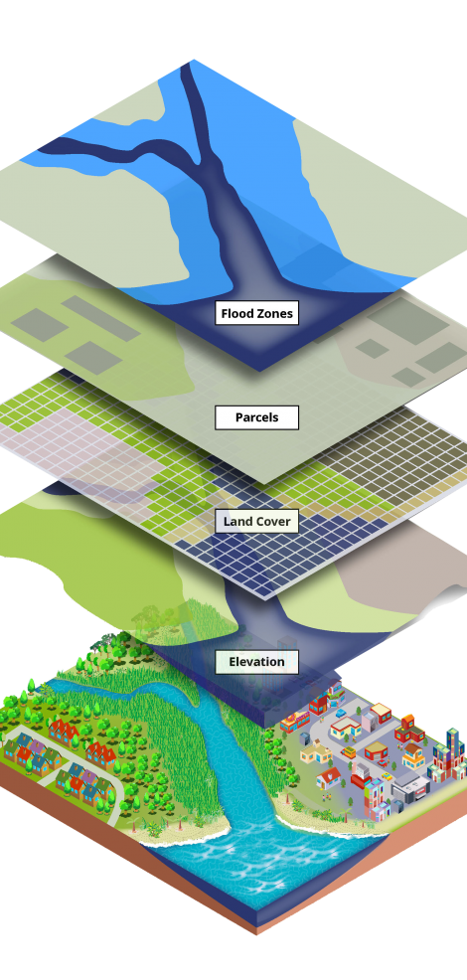
Intro to GIS for Social and Environmental Analysis
FALL 2026, WEEK 1
Dr. Dirk Kinsey
dkinsey@brynmawr.edu
Office Hours: Tues 1-11am and Thurs 1-2pm

Slide 2
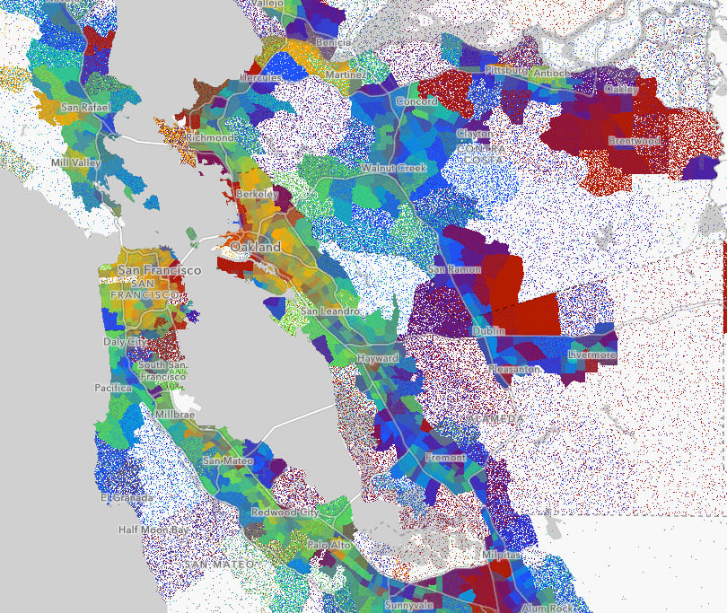
Today’s Agenda
Syllabus & Class details
Moodle overview
Things you need for the class
About the instructor
Thinking in maps and data

Slide 3
Syllabus & Class Details
Graded Assignments
    Labs – written lab reports
    Graded on a simple 4.0 scale:
    2 = pass 3 = good 4 = excellent
    Cumulative lab grade: 80%
    Discussion Leading/Student Presentation
    Lead your choice of readings a from a set of readings
    One discussion lead: 10%
    Final Map
    10%

Slide 4
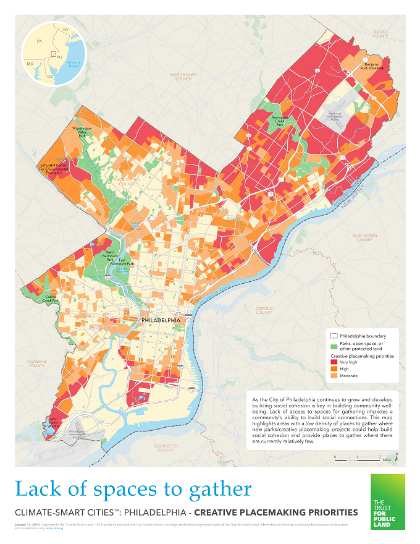
Syllabus & Class Details
Absences & Extensions
  Lab Extensions
    Require prior approval. Reason not important. Email me prior to due date.
    I try to give in-class feedback on Lab assignments.
    Late work with no approved extension will have ½ point deducted (i.e. highest grade could be 3.5 instead of 4). After a full week, I will deduct 1pt (3 instead of 4).
    Written instructor feedback is optional on work submitted late.

Slide 5
What you need
Moodle access – check before Th class
Access to ArcGIS – Options:
Use Apporto or LabStats to connect to lab computers to use ArcGIS
  Follow directions on Moodle to get connected to the point you can open ArcGIS
  Do this ASAP
  IF you have any problems, submit a Help request to the IT help desk at Help@brynmawr.edu - put as much detail as possible in your email about what your problem
  On campus computers
    All public computers at BMC have ArcGIS installed
    For this option, you MUST have a thumb drive for file storage
  Student License to use on your own computer - $100 for 1 year
    Must install on PC or hard disk partition on Mac using Bootcamp
Mouse with right click button is VERY helpful
File management – up next

Slide 6
Data Management
File Management is a big part of GIS
  If you move files around without a clear plan, you WILL have problems
  Working with data files and saving your projects is your responsibility!
Set up a place on your own computer and/or your OneDrive or Google drive for storing all files for this class
When you use ArcGIS, you will have to store data files for ArcGIS to access
  When using Apporto, store data files on a folder on your Apporto desktop
  When using LabStats, store data files on your network One Drive or Google Drive.
  My recommendation is that you back up all of your files for this class in TWO places – your network location (Google/OneDrive) AND a specific folder on your own computer hard drive

Slide 7
Course Goals
Hands-on training in a technical skill set
Learning to use the software in a real-world research context
  How do we ask a question with GIS? How do we answer questions with it?
Learning how to approach a given question spatially
  The “why of where”
Learning to think critically about the geospatial technology/geospatial data, its production and application

Slide 8
MAPS ARE ARGUMENTS
By choosing what information to include and what information to omit, every cartographer is making implicit and or explicit arguments about what is important and what is not.

Slide 9
    LINES
    DO
    WORK
EXCLUDE
INCLUDE
DIVIDE
DIFFERINTIATE
CREATE THINGS
ERASE THINGS

Slide 10
  Space as a social construct, space as produced
    Interactions
    Interconnections
    Implications
  The way that maps describe space defines spatial relationships with material implication
MAPS
DESCRIBE
SPACE
MAPS
PRODUCE
SPACE
MAPS
DESCRIBE
SPACE
MAPS
PRODUCE
SPACE

Slide 11
https://native-land.ca/

Slide 12
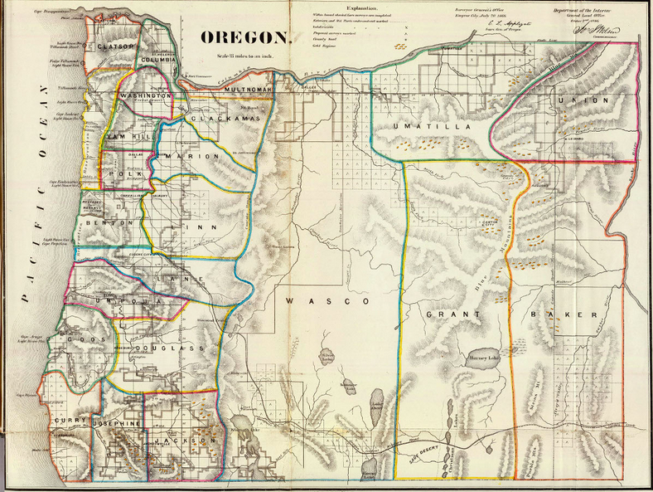

Slide 13
Technology
is political
Data is political
  How we design and build our geospatial technology and how we collect, manage and analysis our data reflect our assumptions, biases and differing versions of an ideal world.
  And that’s okay!

Slide 14
“GIS is not fixed and given but constantly remade through the politics of its use, critical histories of it, and the interrogation of concepts that underlay its design, data definition, collection, and analysis. In other words, futures of GIS are contested and openings exist for new meanings, uses, and effects.”
— Marianna Pavlovskaya, “Theorizing With GIS”

Slide 15
Web Map Activity
Map 1
Map 2
Map 3
Map 4
Map 5
Map 6
Map 7
Answer the following with your group:
  What is your story map about?
  Who is this information for?
  How is GIS used? Is it effective?
  What kinds of data are displayed? What data are missing?
  Is there an argument being made? Are you convinced? Why or why not?
  What questions does this map raise for you?

