Slide 1
Utopia Dystopia Suburbia
So my image of the city remains incomplete, and I think that is proper,because no one should have a final say about the good city. Utopian thinking is an ongoing, time-binding discourse intended to inform our striving. It is no more than that but nothing less.
John Friedmann 2000
To observe the Banlieue is to observe an amphibian- Victor hugo

Slide 2
GOALS OF THE CLASS: A SEMINAR IS WHAT WE BUILD
TOPICS AND READINGS AS ROAD MAPS –TOO MUCH BUT WORTH SAMPLING TO BRING SOMETHING TO SAY TO CLASS
WRITING REGULAR AND REFLECTIVE WITH NO NEW FINAL PROJECT
FIRST MODULE MODELLING A COMMUNITY
SECOND MODULE COMPARISONS
FINAL REFLECTION
VISIONS AND RATIONALES

Slide 3
Core question
Who envisions a utopian community and how/where is it built?
Who are the citizens and how?
What are the roles of economic life and governance ?
What does it look like and why?
What happens and why? (why suburbs as alternatives/experiments, connected yet distinct communities)? How does a utopian experiment become dystopic …or ordinary

Slide 4
Suburbs as Heterotopias pace Michel Foucault (1967) ”of other spaces”
“First there are the utopias. Utopias are sites with no real place. They are sites that have a general relation of direct or inverted analogy with the real space of Society. They present society itself in a perfected form, or else society turned upside down, but in any case these utopias are fundamentally unreal spaces.
“There are also, probably in every culture, in every civilization, real places — places that do exist and that are formed in the very founding of society — which are something like counter-sites, a kind of effectively enacted utopia in which the real sites, all the other real sites that can be found within the culture, are simultaneously represented, contested, and inverted. Places of this kind are outside of all places, even though it may be possible to indicate their location in reality.”
Michel Foucault

Slide 5
he last trait of heterotopias is that they have a function in relation to all the space that remains. This function unfolds between two extreme poles. Either their role is to create a space of illusion that exposes every real space, all the sites inside of which human life is partitioned, as still more illusory (perhaps that is the role that was played by those famous brothels of which we are now deprived). Or else, on the contrary, their role is to create a space that is other, another real space, as perfect, as meticulous, as well arranged as ours is messy, ill constructed, and jumbled. This latter type would be the heterotopia, not of illusion, but of compensation, and I wonder if certain colonies have not functioned somewhat in this manner. In certain cases, they have played, on the level of the general organization of terrestrial space, the role of heterotopias. I am thinking, for example, of the ﬁrst wave of colonization in the seventeenth century, of the Puritan societies that the English had founded in America and that were absolutely perfect other places. I am also thinking of those extraordinary Jesuit colonies that were founded in South America: marvelous, absolutely regulated colonies in which human perfection was effectively achieved. The Jesuits of Paraguay established colonies in which existence was regulated at every turn. The village was laid out according to a rigorous plan around a rectangular place at the foot of which was the church; on one side, there was the school; on the other, the cemetery, and then, in front of the church, an avenue set out that another crossed at ﬁght angles; each family had its little cabin along these two axes and thus the sign of Christ was exactly reproduced. Christianity marked the space and geography of the American world with its fundamental sign.
https://foucault.info/documents/heterotopia/foucault.heteroTopia.en/

Slide 6
Questions? Suggestions?
LET US LOOK AT SOME CASES

Slide 7
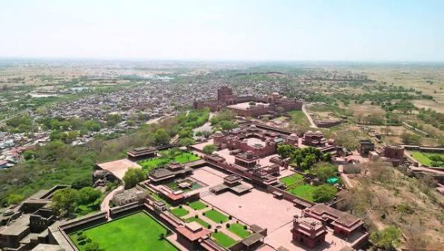
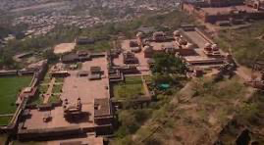
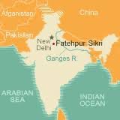
Fatehpur-Sikri, Capital of Mughal India 1571-1588. Maximum pop. 250,000 1580

Slide 8
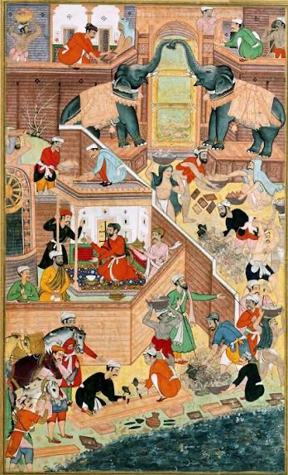
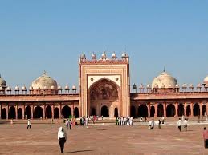
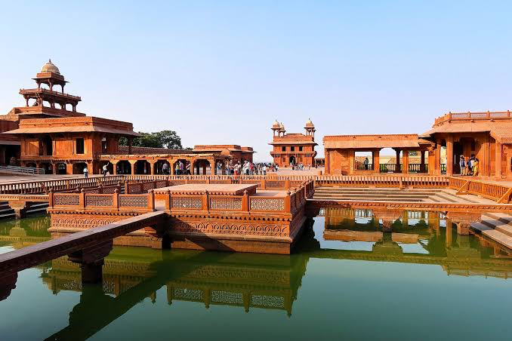
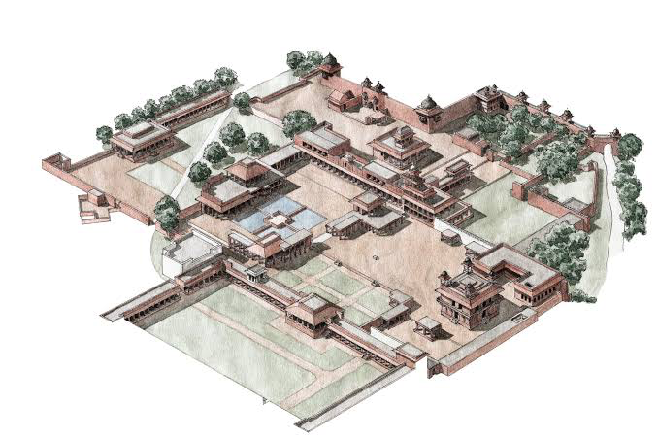
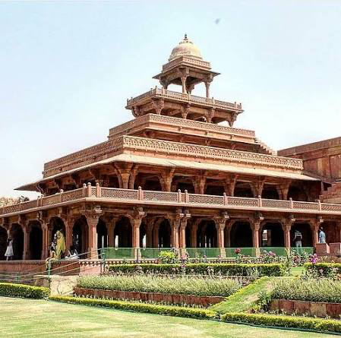
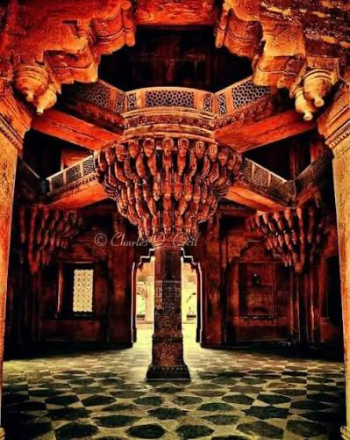
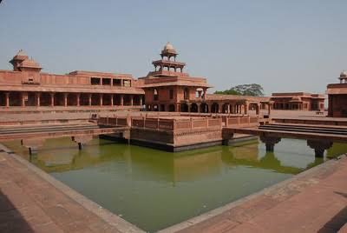

Slide 9
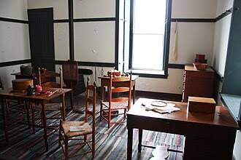
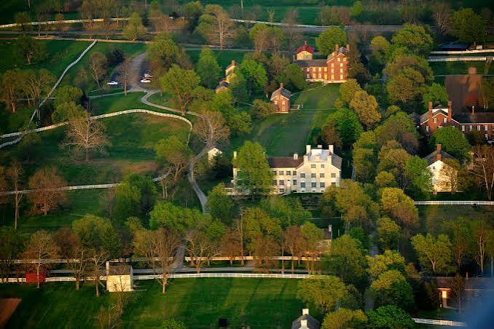
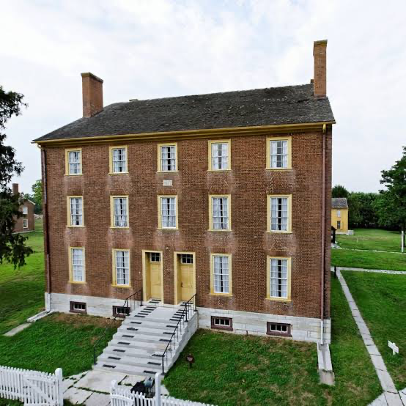
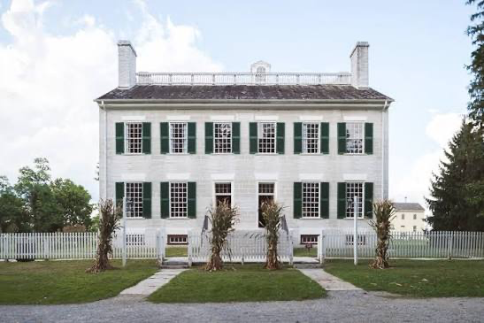
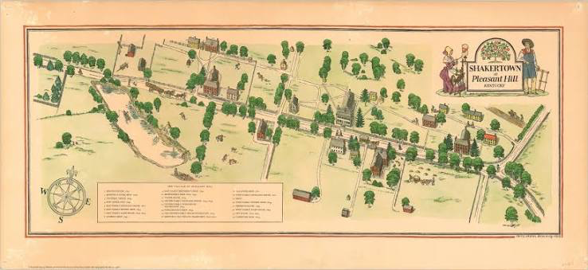
Shakertown at Pleasant Hill, 1806-1910 (600 residents at peak in 1850s
www.youtube.com/watch?v=ePJKxa50pJ4

Slide 10
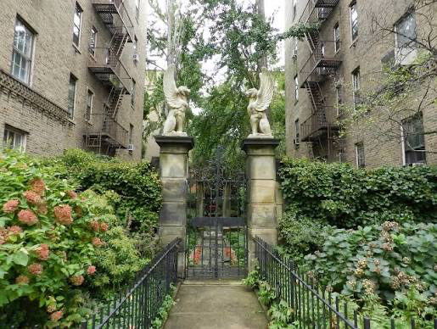
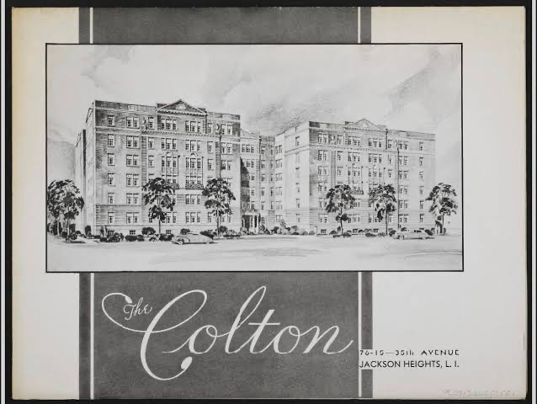
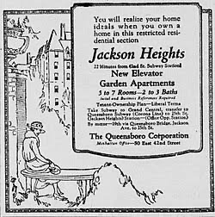
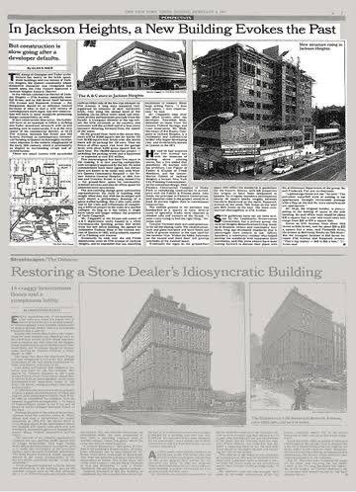
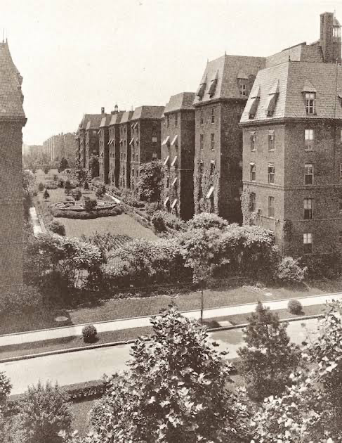
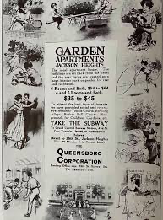
Jackson Heights,. NYC

Slide 12
Jackson Heights Today 103,000 residents, 60% born outside US
103,000 residents
60% born outside US
65% Latino, 16% Asian, 10% White, 4% Black\
80% of the Population speak a language other than English. Spanish and Bengali dominate. 100+languages and dialects are spoken –170 for Queens as a borough.
Median Household income 80,000 (113 for homeowners), 12% below poverty line (NYC 18%)
Median House Price 400,000-500,000

Slide 13
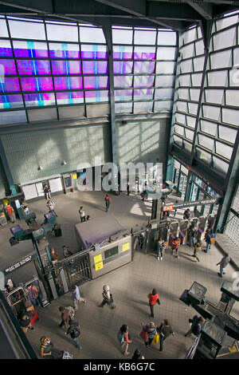
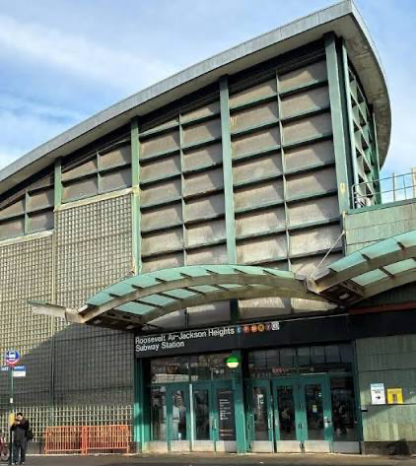
MEETING THE WORLD AT 74TH

Slide 14
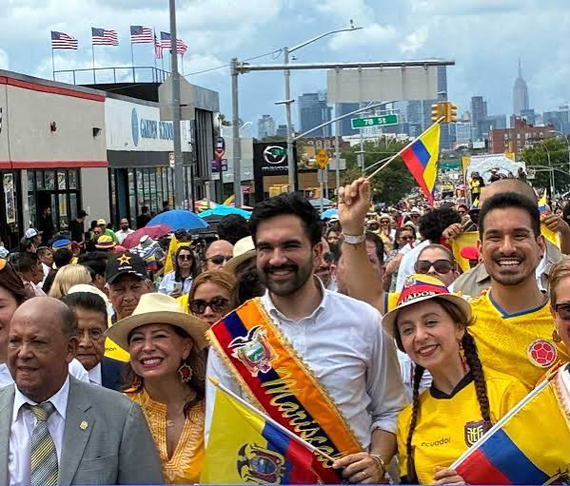
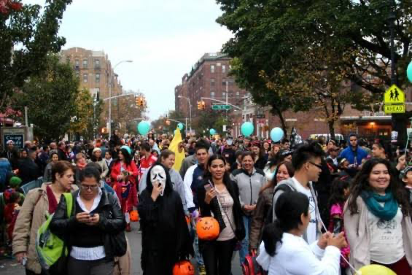
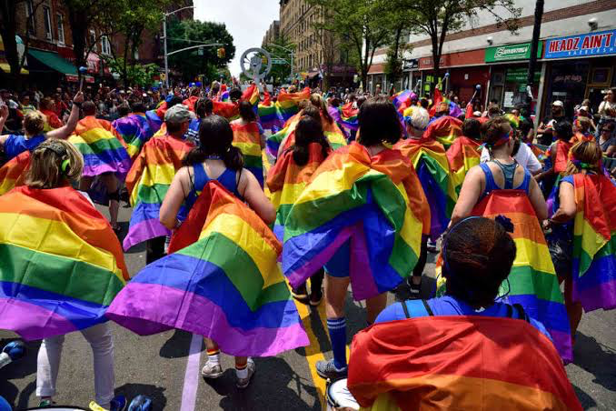
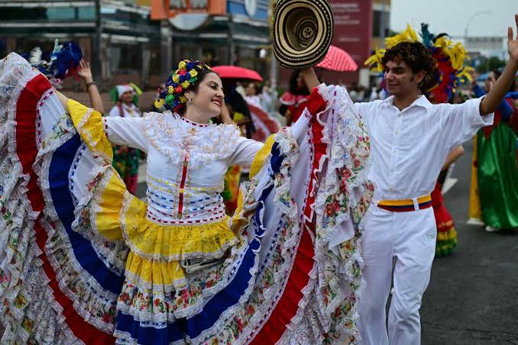
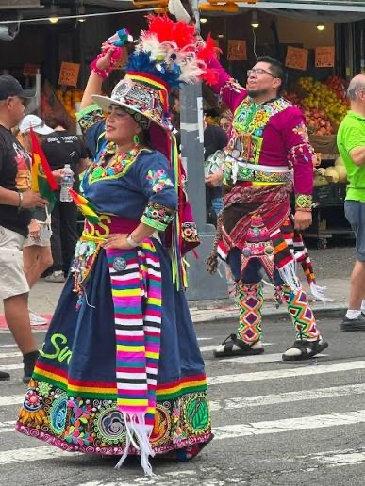
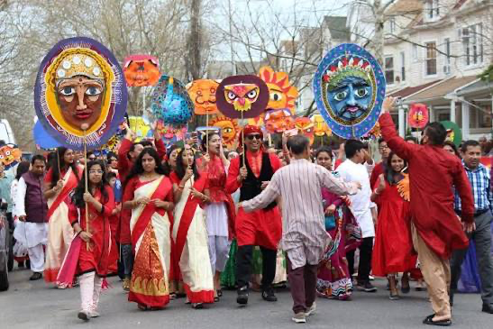
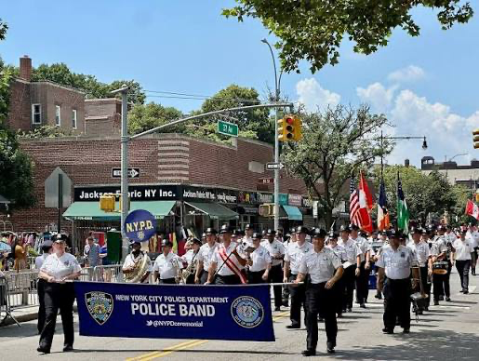
Parades

Slide 15
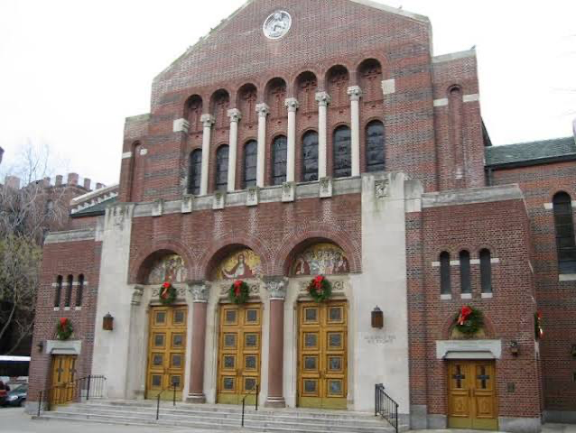
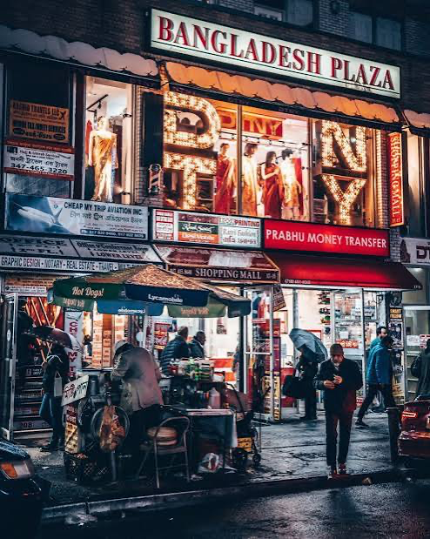
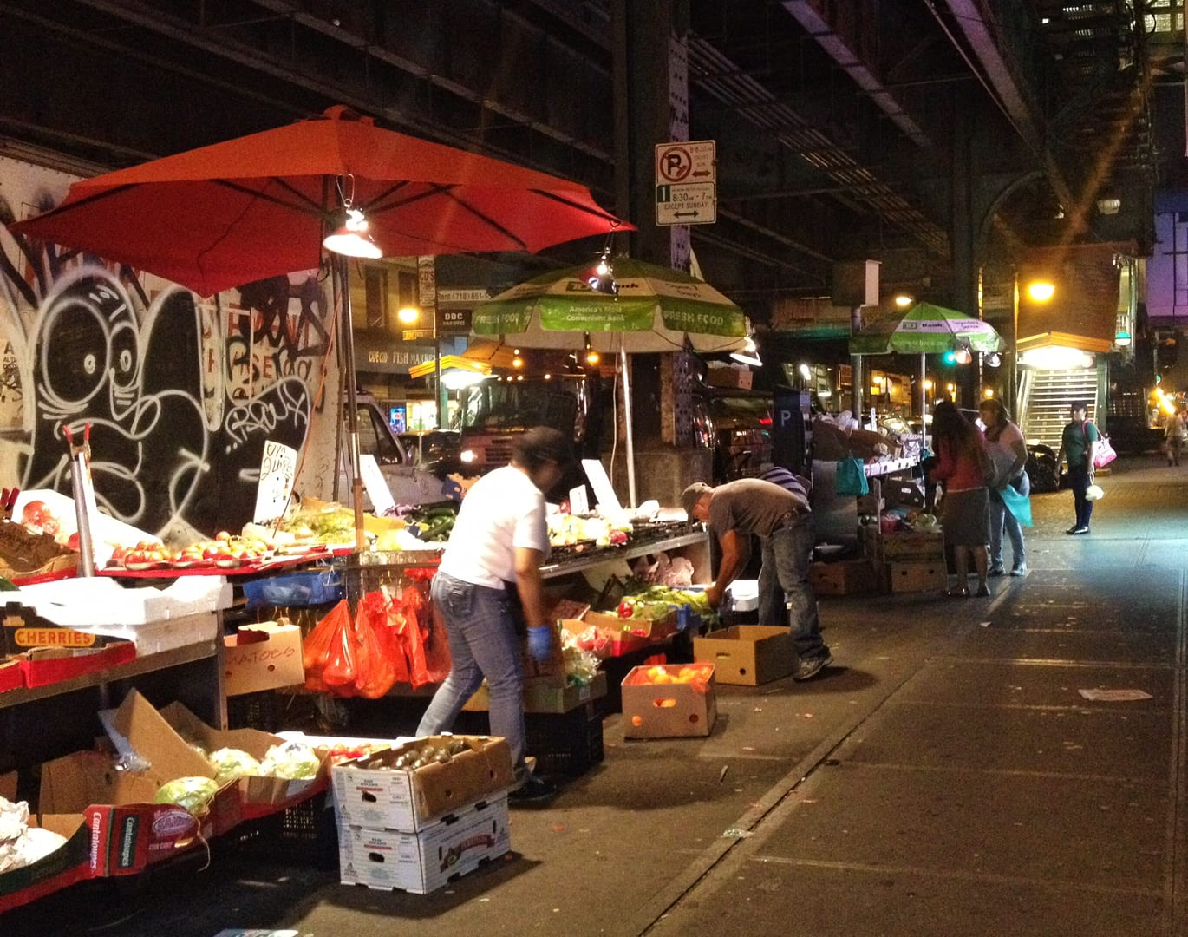
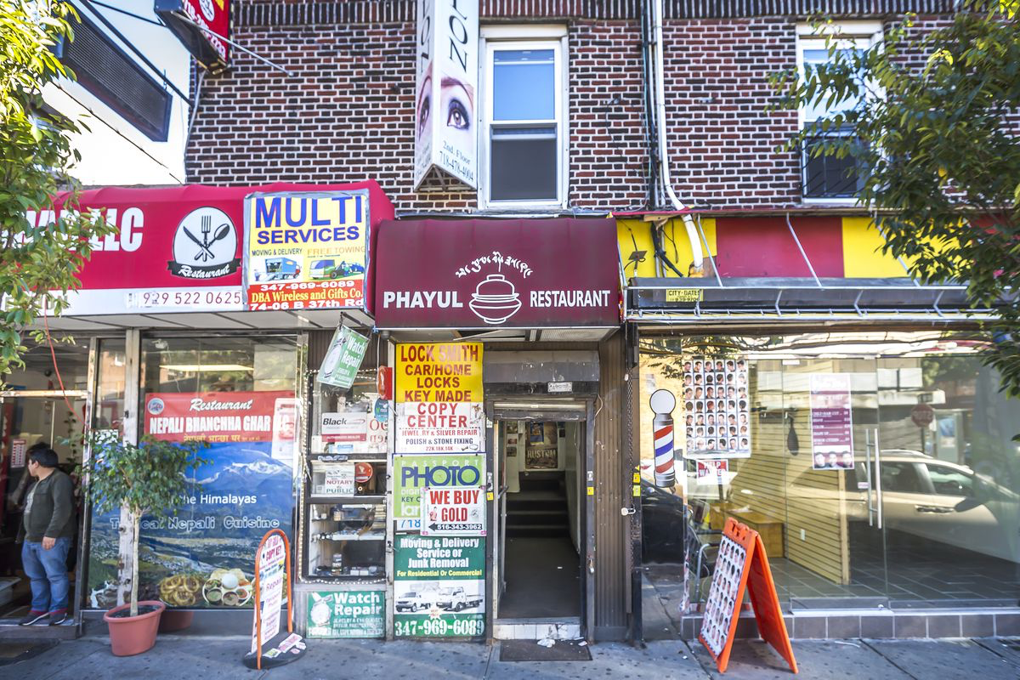
Multi/plicity

Slide 16
But is this NY suburb utopian or dystopian?
https://www.youtube.com/watch?v=OApZePeJSdU

Slide 17

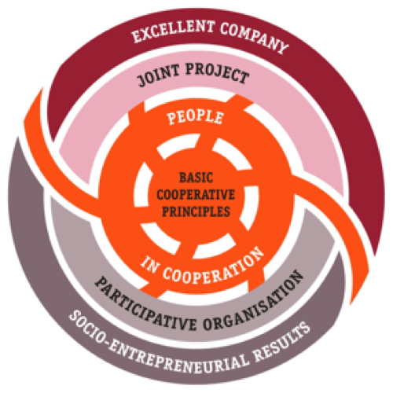
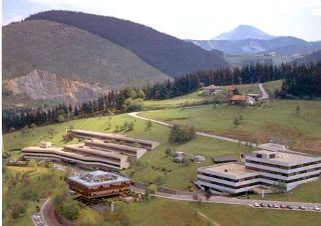
Mondragón Corporation, Spain
Workers cooperative founded by a Catholic priest leader in 1956 in Francoist Spain to develop economic and social life in an impoverished region. Now involves multiple cooperatives and companies from small-scale cooperative to heavy industrial with 71,117 member.
Cooperatives at core: an autonomous association of persons united voluntarily to meet their common economic, social and cultural needs and aspirations through a jointly owned and democratically-controlled enterprise".^{[1]}
https://www.youtube.com/watch?v=87QiNe26mEs

Slide 18
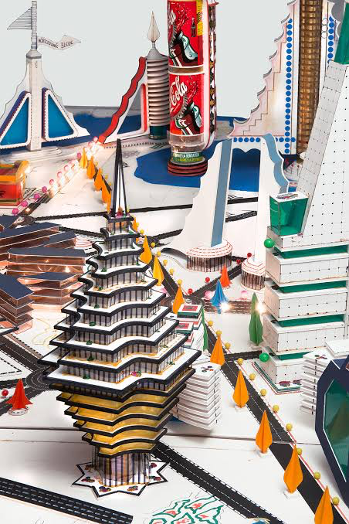
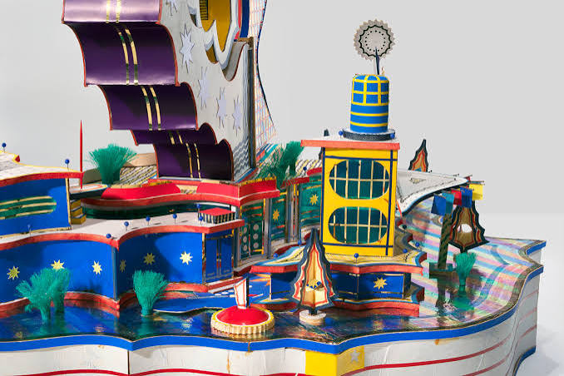
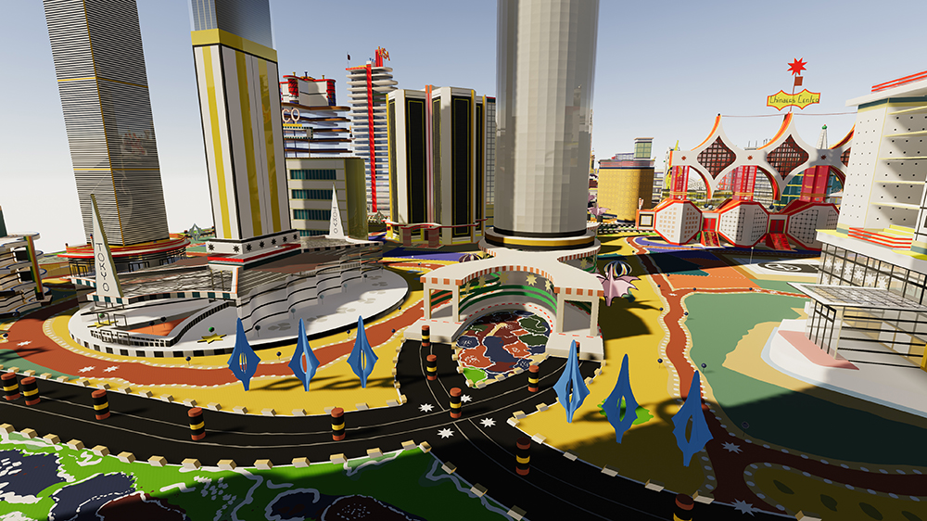
Finally, Isek Bodys Kingelez (1948-2015) https://www.youtube.com/watch?v=8Bjbz3XN0Gg

Slide 19
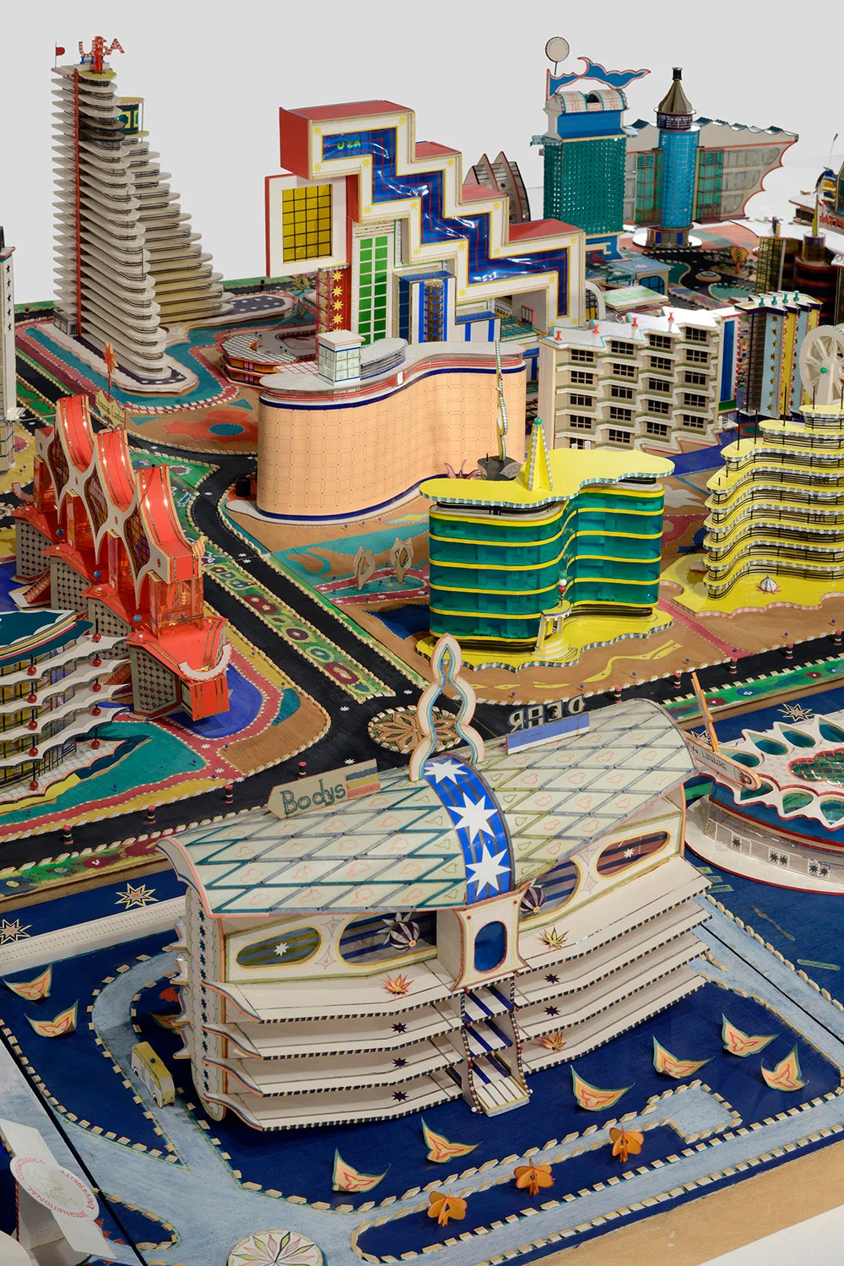

Slide 20
Why?
Born in changing –indeed wartorn and divided Congo –worked as an art restorer but also invented new architectural forms and imagined cities based in African history and pop culture.
He has created hundreds of models from found materials in which paper, cardboard, and plastic are used to construct the present, the future, and the hopes of an African renewal.
“After 1992, he started imagining entire cities. These colossal works are made up of buildings—some playful, some imposing, some utterly fantastic—that are incorporated into a carefully conceived urban grid. Avenues, parks, waterways, stadiums, and monuments are also part of Kingelez’s meticulous vision. Together these elements fulfill all the functions of an ideal metropolis that the artist would like to see built. His first city was called Kimbembele Ihunga, to honour his native village, his dead father and his mother, who still lives there. About these works—Ville Fantôme (1995), Kinshasa: Project for the Third Millennium (1997), the City of the Future (2000), he noted: “I wanted my art to serve the community that is being reborn to create a new world, because the pleasures of our earthly world depend on the people who live in it. I created these cities so there would be lasting peace, justice and universal freedom. They will function like small secular states with their own political structure, and will not need policemen or an army.” https://www.caacart.com/artiste/kingelez-bodys-isek/

Slide 21
As far as I can tell his work is mainly owned by French and American foundations and some private collectors. While exhibited worldwide, it has not been accessible in Congo
“With all the critical potential of Kingelez's work, given the violent political history and economic disaster that has been the Congo even before independence, one could see his work as the deployment of architectural sculpture against political reality and history. The problem, however, is that the number of people living in Congo or on the continent, because they lack access to Kingelez's work or to the western art world in which it circulates, will ever see the interpretive essays about how important this work could be in terms of contributing to the project of reimagining the post-colonial nation.
The kind of readings that we have seen of the work of Kingelez highlighting its aspects of political and social critique are done outside of Kinshasa, outside of the Congo. So you wonder whether all this critical potential of Kingelez, in the way he reimagines the political and socio-economic future of the Congo, is occluded from the Congo people thus making it impossible for his work to contribute to the political and socio-economic debate. There are very few analyses of his work by art critics in the Congo who, I suspect, would have even more to say about what they think is going on in the work of Kingelez. But have they had the opportunity to encounter it, whether in New York or in Europe?” Professor Chika Okeke-Agulu, Princeton
https://chikaokeke-agulu.blogspot.com/2018/08/my-interview-with-okayafrica-on-ongoing.html

Slide 22
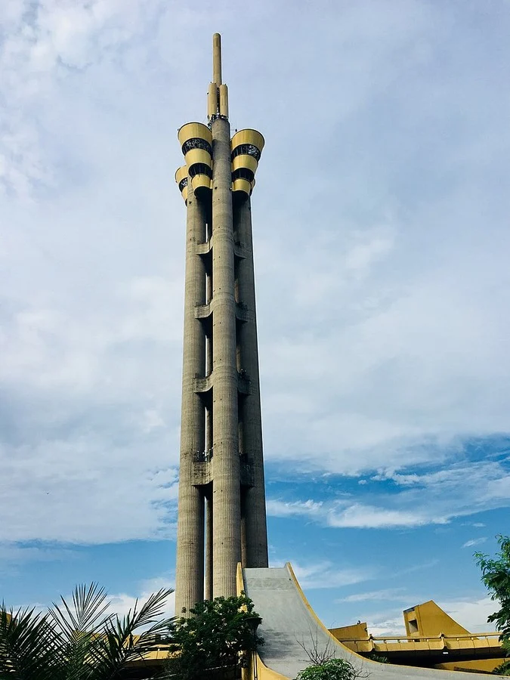
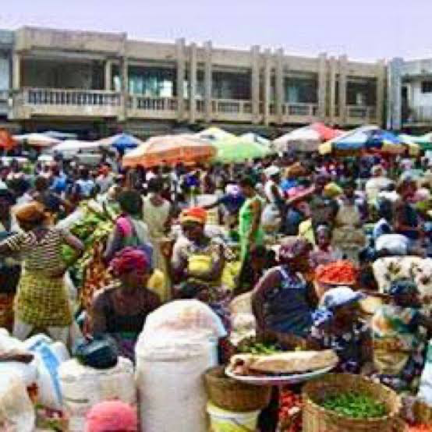
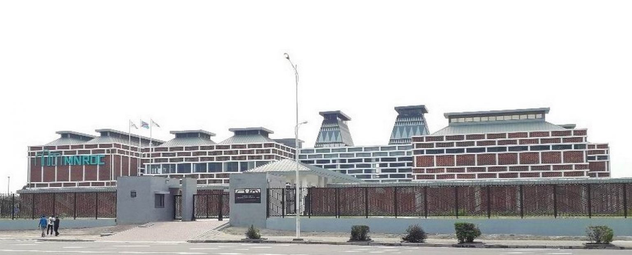
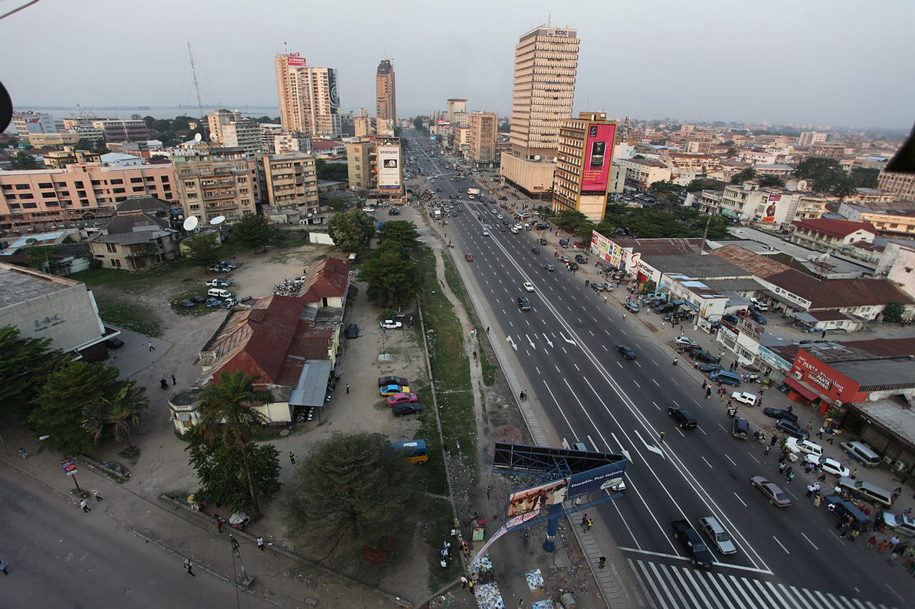
https://www.re-thinkingthefuture.com/architects-lounge/a1577-places-to-visit-in-kinshasa-for-the-travelling-architect/. Kinshasa 18.5-21.5 million

Slide 23
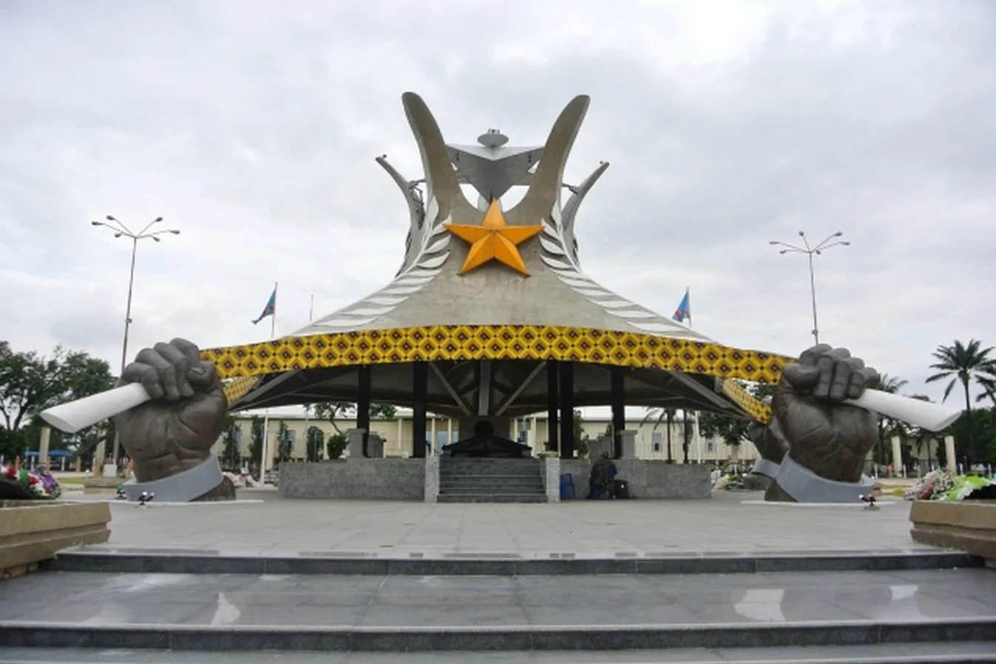
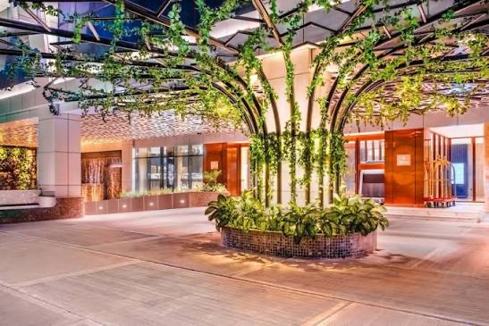
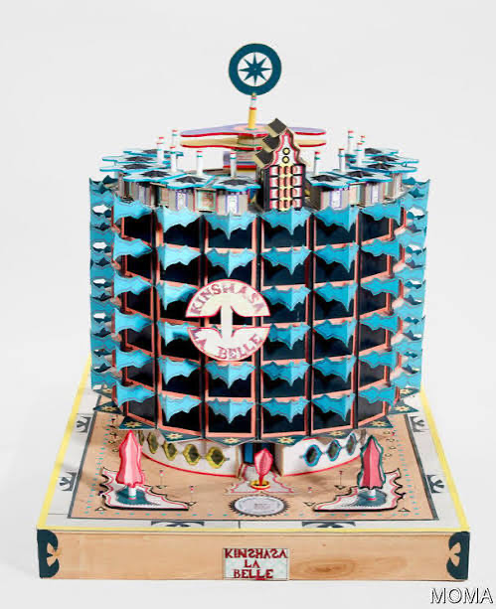
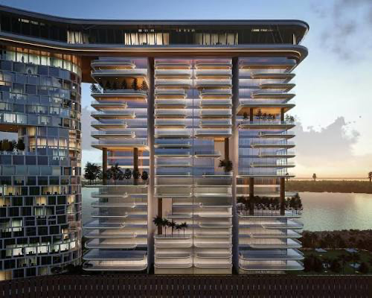

Slide 24
What do we learn from these cases?
Historical and geographical spread
Scale and temporality
Fiction and fact –imagined cities
Evolution and disappearance –flexibility and integration versus problems

Slide 25
Our Core Questions
Founders/Foundation
Citizenship/Intentionality
Economy and Governance
Connections and Separations
Evolution

Slide 26
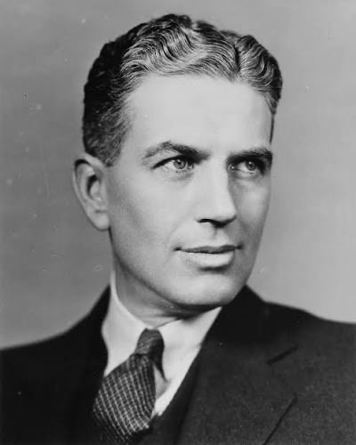
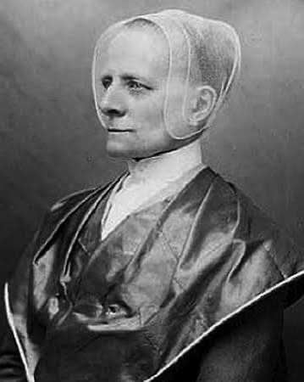



Founders
Who envisions a new intentional community?
What are they opposed to?
Where do they build and why (controls, transnational goals, proximity
What is their role –ideological leader, developer, economic motor
What plans do they have beyond their lifetime?

Slide 27






Landscapes: Central Buildings, Connections, Public/Private, Gree

Slide 28





Citizens & Intentions

Slide 29


Scale
Family
Shared Group
Development
Connection
Replicability

Slide 30



Economy and Governance
Governance
Economy
Charismatic Leadership
Corporate Leadership (Celebration)
Shared Governance
Self-contained (agrarian)
Commercial –trade
Industrial
Highly Linked Commuter

Slide 31




Connections?
Transportation
Economic Ties
Communication and New Mediated Worlds –are there placeless utopias

Slide 32





Evolution/Devolution

Slide 33




What is a Dystopia?
A failed utopia?
A project driven by its own ideology/
Overgrowth or loss

Slide 34
Building A CITY ON A HILL: What are Your Principles
Utopian thinking has two moments that are inextricably connected: critique andconstructive vision. The critique is of certain aspects of our present condition: injustices,oppression, ecological devastation. It is precisely an enumeration of these ‘evils’, how-ever, that implies a code of moral values that is being violated. The code may not bewritten out, or it may merely be suggested symbolically by invoking slogans such as‘freedom’, ‘equality’, ‘solidarity’. But it is there nonetheless. The moral outrage over aninjustice implies that we have a sense, however inarticulate, of justice. And so on, foreach of our terms of condemnation.

Slide 35
Friedmann’s Core Values
Human Flourishing
Multi/Plicity
Good Governance

Slide 36
My Principles at the end
Environmentally sustainable replicable model
Inclusive diversity of people and opportunities
Transparent opportunities and support for just society
Aesthetic values in public and private Space
Sense of grounding in Time from Past to Future

