Slide 1
Dear Reader
September 3 2026

Slide 2
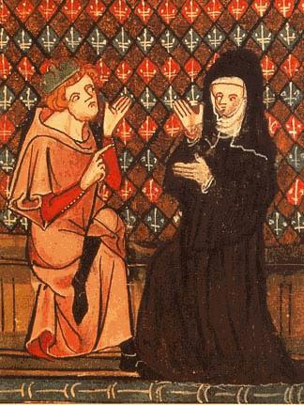
Heloise and Abelard
Lived in France in the 12th century
  Abelard: 1079-1142 CE
  Heloise: ca. 1101-1163 CE
Peter Abelard is well-known for his contributions to philosophy, especially logic and ethics, and theology
Abelard became famous as a teacher in and around Paris
The two met when Abelard was hired by Heloise’s uncle to teach her
They had a love affair, resulting in a son named Astrolabe, a secret marriage, and Abelard’s castration at the order of Heloise’s uncle
Both entered the monastic life, Heloise at Argenteuil and Abelard at Saint-Denis
They would reunite (sort of) at the Paraclete

Slide 3
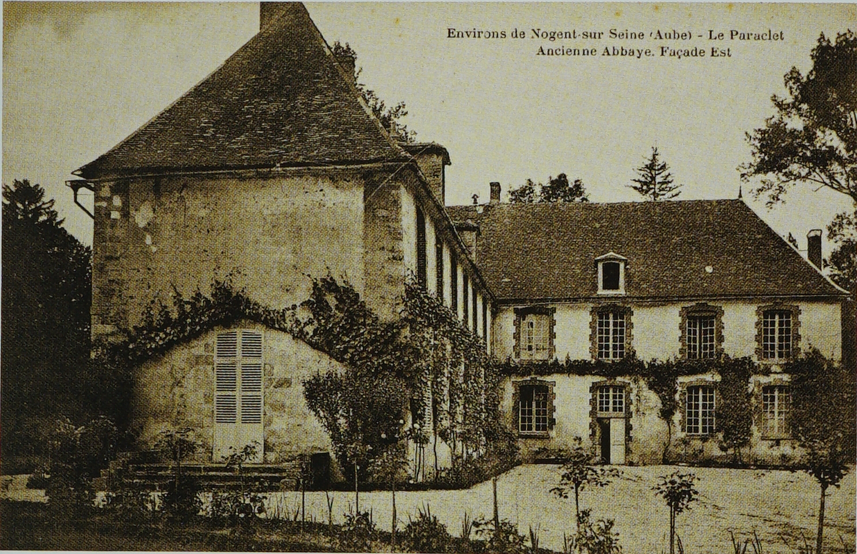
The Paraclete
Monastery dedicated to the Holy Trinity
Located in Troyes (approximately 87 miles southeast of Paris)
Founded by Abelard after leaving Saint-Denis
Paraclete means “one who consoles” and in the Gospel of John refers to the Holy Spirit
Abelard left the Paraclete to become the abbot of a different monastery in Brittany
Abelard granted the Paraclete to Heloise after she was expelled from Argenteuil, and it was refounded as a nunnery with Heloise as abbess
Abelard would visit occasionally to help Heloise, although he had to stop after rumors arose that he was once again pursuing a romantic and sexual relationship with Heloise

Slide 4
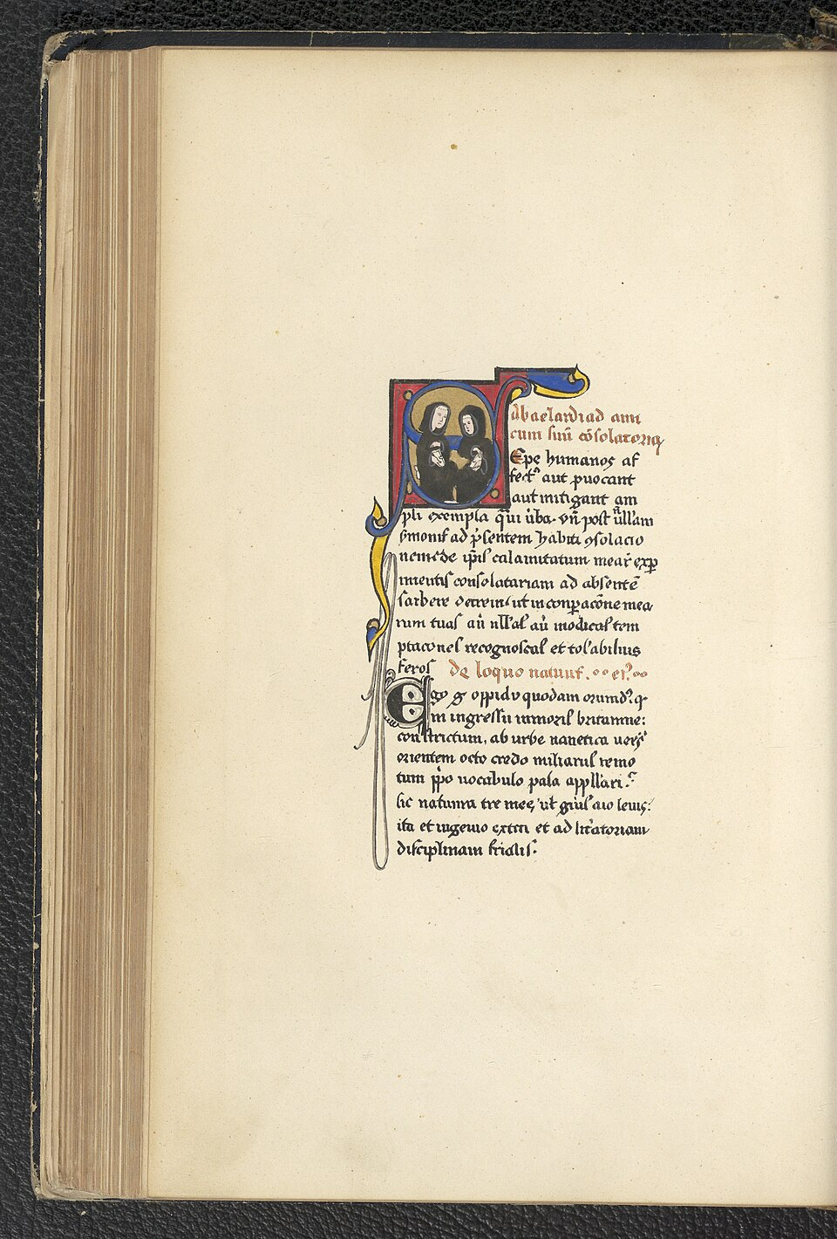
The Letters
Eight letters are preserved in sequence
  Letter 1 is a consolatory letter written by Abelard to one of his friends
  Letters 2-5 are the “personal letters” between Heloise and Abelard
  Letters 6-8 are the “letters of direction”, in which Heloise requests (Letter 6) and receives a letter on the origin of the religious life of nuns (Letter 7) and a rule for nuns (Letter 8)
Date to 1130-1134 CE
The authorship and authenticity of the letters has been heavily debated
There is another collection of 113 anonymous letters, called the Epistolae Duorum Amantium, that has been proposed to have been authored by Heloise and Abelard

