Slide 1
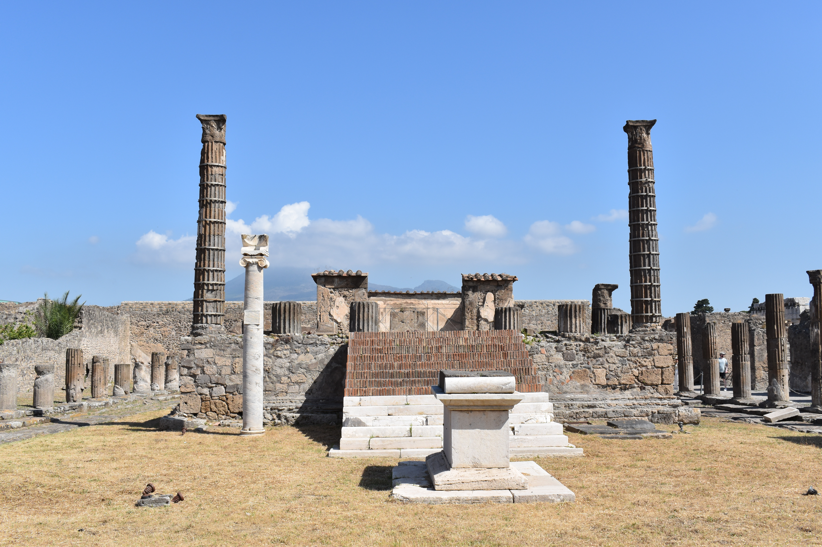
Pompeii: Life in a Roman City
Arch 252
Fall 2026
Bryn Mawr College

Slide 2
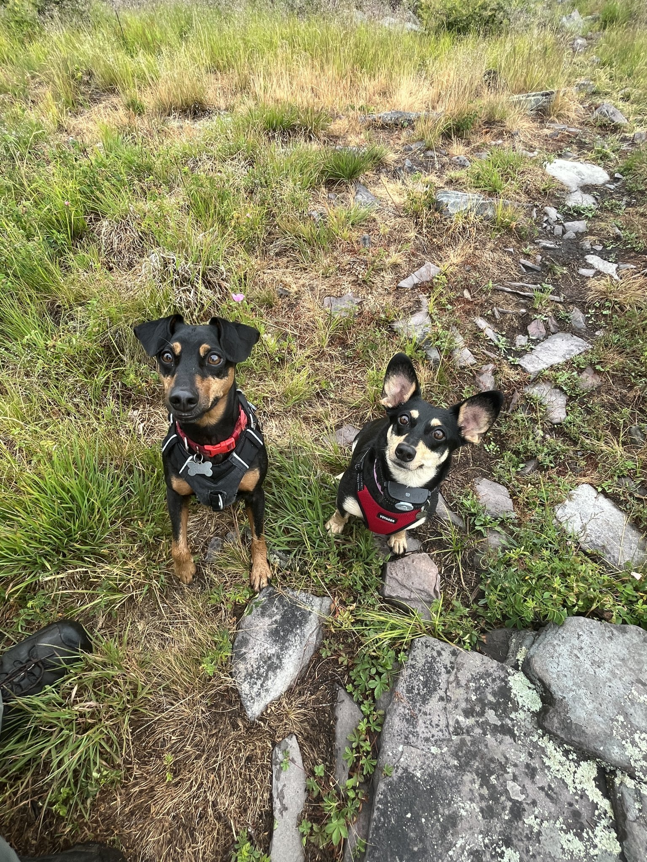
Clare Rasmussen (She/Her)
I will respond to whatever you call me (Prof, Dr., first name, etc). I don’t believe in formalities.
I am a Visiting Professor of Classical and Near Eastern Archaeology at BMC this fall. I am also a faculty member at Temple University in the Department of Greek and Roman Classics.
I am a Roman archaeologist, and I work mostly on Roman materials in Southwest Asia and the Eastern Mediterranean.
I am interested in all things water, but I am also a specialist in Roman imperial architecture, urban planning, and post-colonial approaches.
I am a field archeologist, and I currently excavate in Iraqi Kurdistan with Prof. Palermo but have done research and field work in Jordan, Türkiye, Greece, Italy, and the US.
Ollie (10) and Zoe (8)

Slide 3
Introduce yourselves
Your name
Your year
Where you are from
Something about the ancient world that interests you

Slide 4
Course Objectives
Analyze and interpret the urban, sacred, domestic, and funerary landscapes through archaeological, architectural, and artistic evidence.
Critically examine the history of excavation and research at Pompeii, evaluating the development of archaeology as a discipline and changes in archaeological methods, interpretations, and priorities over time.
Synthesize archaeological evidence and evaluate primary and secondary sources.
Develop foundational skills in academic research and writing through coursework and written assignments.
Critically review, analyze, and respond to scholarly literature.

Slide 5

Map Quiz- September 10 (Next Thursday)
5% of your grade.
Map will be shown in class and given as a handout to take home with you today.
Cover major sites, geographic features, and bodies of water in the Bay of Naples region.
Quiz will be in the first ten minutes of class.

Slide 6
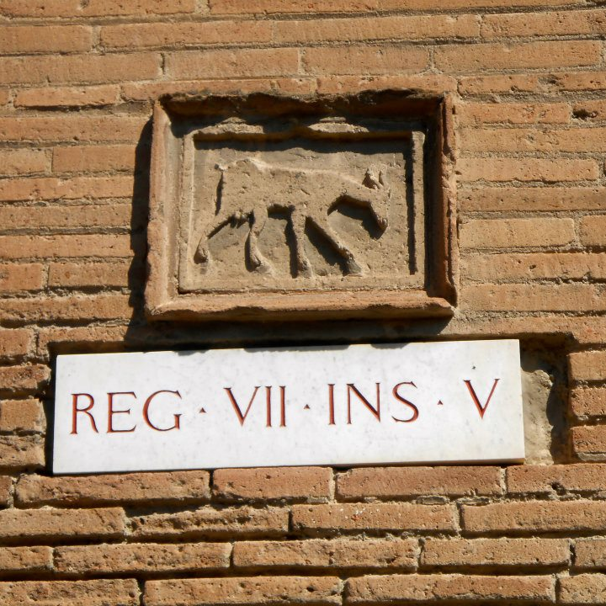
Short Writing Assignments
45% of your total grade (each assignment is 15%)
Three assignments:
Artifact and architectural analysis. 500-800 words. Due October 1.
Spatial analysis. 800-1000 words. Due November 5.
Article Response. 1000 words. Due December 3.
Guidelines for each assignment will be covered in class and posted on Moodle.

Slide 7
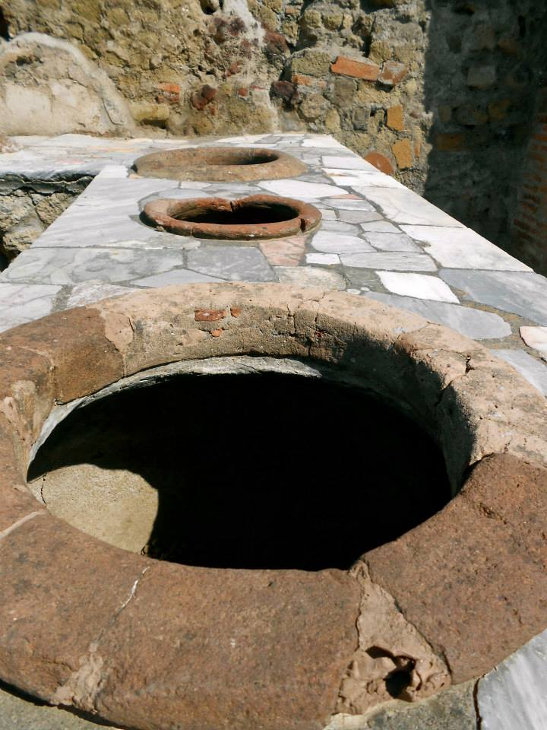
Exams
Two exams worth 40% of your total grade (each is 20%).
First exam will be taken in class on October 22, second exam will be taken during the examination period sometime in December TBD.
Format consists of:
  Image based ID’s (images from slides in class)
  Defining key terms
  Multiple choice
  Short essay question
If you need alternate testing arrangements please come talk to me in advance!

Slide 8
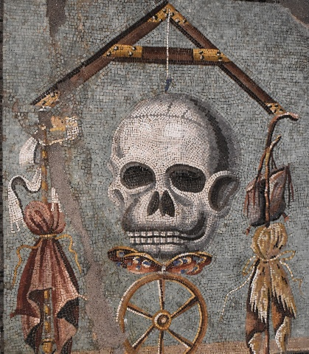
Attendance and Participation
10% of your grade. I will keep track of who comes to class and who doesn’t. 1 or 2 absences is fine, but regularly missed classes will affect your grade negatively.
Please sign the sign in sheet at the beginning of every class.
If you know you are going to miss class, please coordinate with me BEFORE your absence.
Your attendance and participation grade will be determined by:
  How many absences you have
  Your participation and contribution in class discussions

Slide 9
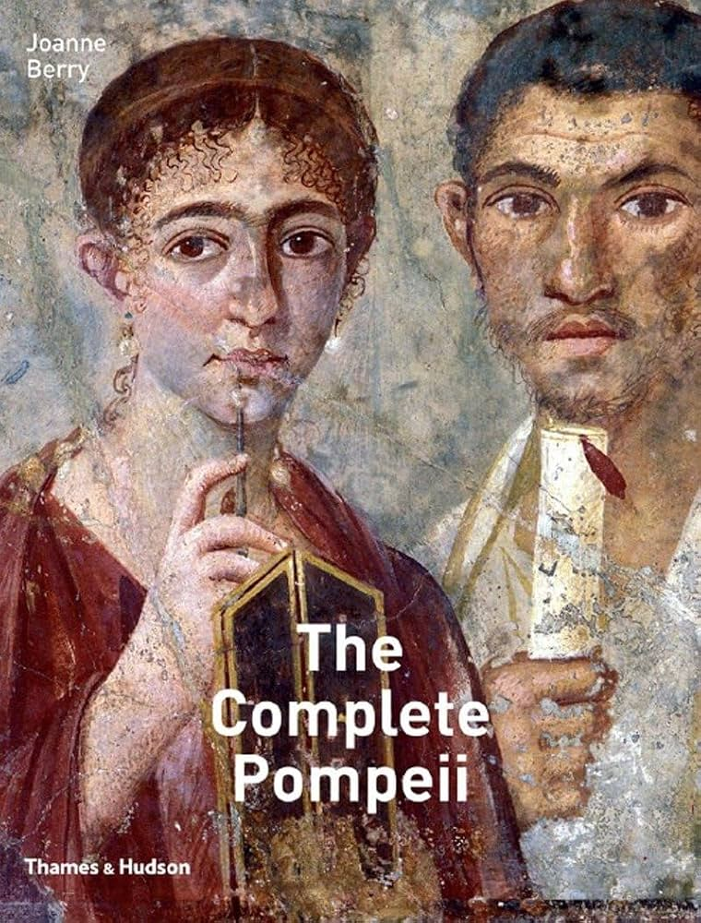
Textbooks and Readings
Berry, J. 2007. The Complete Pompeii. Pompeii. New York: Thames & Hudson.
  A copy for purchase is in the bookstore.
  A copy is also on reserve in Carpenter Library.
  I have a PDF ( but for copyright issues I cannot upload it to Moodle). Come ask me for it after class.
Other readings will be posted to Moodle and on reserves in Carpenter Library.

Slide 10
A Quick Review of Roman Archaeology

Slide 11
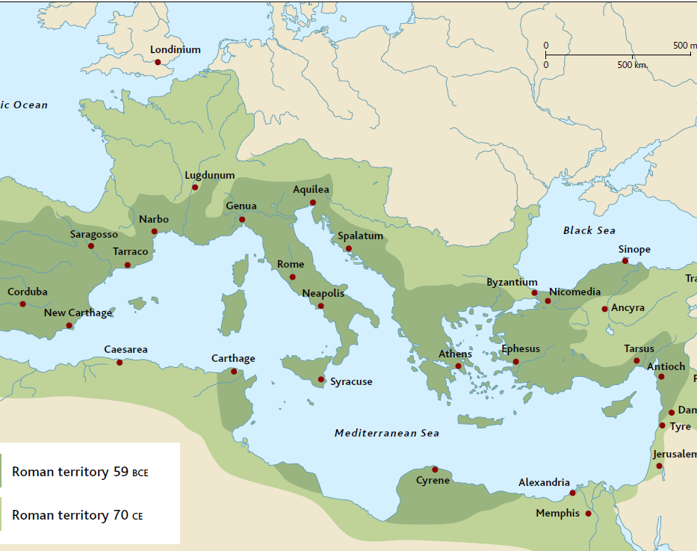
Timeline and Chronology
753 BCE Founding of Rome
700-325 BCE Etruscan Civilization
575 BCE earliest archaic temples in Rome (Sant’Omobono)
509 BCE Establishment of the Roman Republic
  Punic Wars
  Rome expands to control all of the Italian Peninsula, North Africa, Spain, Greece, parts of Asia Minor
  Under Pompey they add all of Asia Minor and the Levant and under Caesar they add Gaul
  44 BCE Assassination of Julius Caesar
27 BCE Establishment of the Empire under Augustus
  Augustus adds Egypt
Julio-Claudian Dynasty 27 BCE-68 CE
  Augustus, Tiberius, Caligula, Claudius, Nero
  68-69 CE ‘Year of the Four Emperors’ (Galba, Otho, Vitellius, Vespasian)
Flavian Dynasty (69-96 CE)
  Vespasian, Titus, Domitian
  Pompeii erupts in 79 CE while Titus was emperor

Slide 12
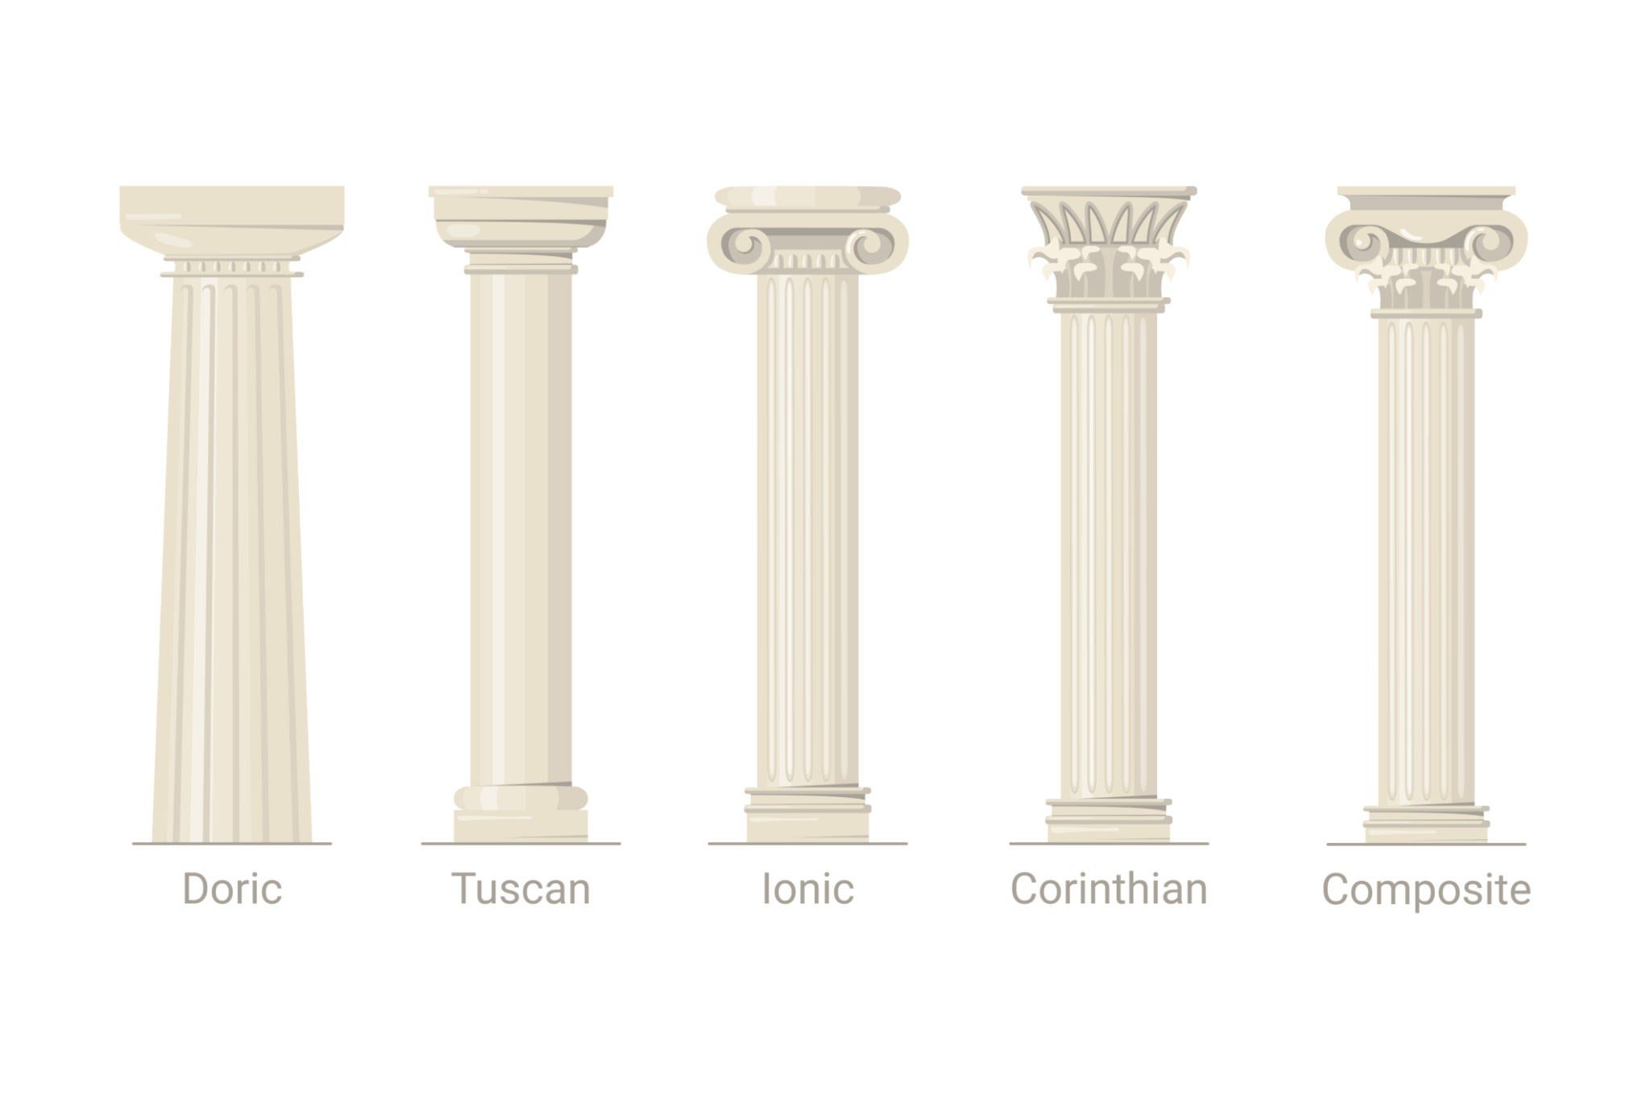
Roman Capital Types
The Romans will adapt the three orders into different styles for their own architecture
Tuscan Order
  Simplified Doric
  Unfluted shafts with simple plain bases
  Based on Etruscan building styles
  Ex. Temple of Jupiter Optimus Maximus
Roman Corinthian
  The signature columnar order for the Romans
  Elaborate entablature
  Use monolithic shafts, fluted or unfluted
  Ex. Pantheon, Maison Carrée
Composite Order
  Emerges in the 1st century CE
  A literal “composite” combining the scrolls of the Ionic order with the acanthus leaves of the Corinthian.
  Ex. Arch of Titus

Slide 13
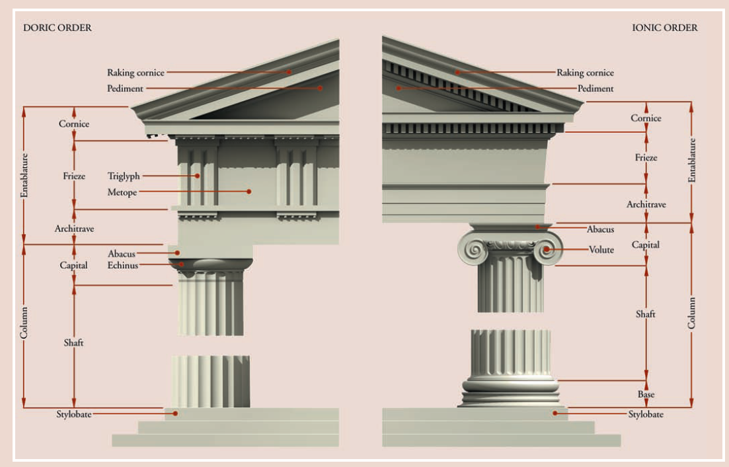
The Three Orders
Doric Order
  The oldest (c. 7th century BCE)
  No base, sits directly on the stylobate
  Plain rounded capital
  Doric frieze: alternating triglyphs and metopes
  Ex. Temple of Hera at Olympia c. 590 BCE
Ionic Order
  C. 6th century BCE
  Sits on a base
  Ionic continuous frieze
  Capital has volutes (scroll-like spirals)
  Ex. Temple of Artemis at Ephesus c. 550 BCE
Corinthian Order
  C. late 5th century BCE
  Sits on a base
  Capital is decorated with acanthus leaves
  Oldest example is the Temple of Apollo at Bassae c. 427-400 BCE

Slide 14
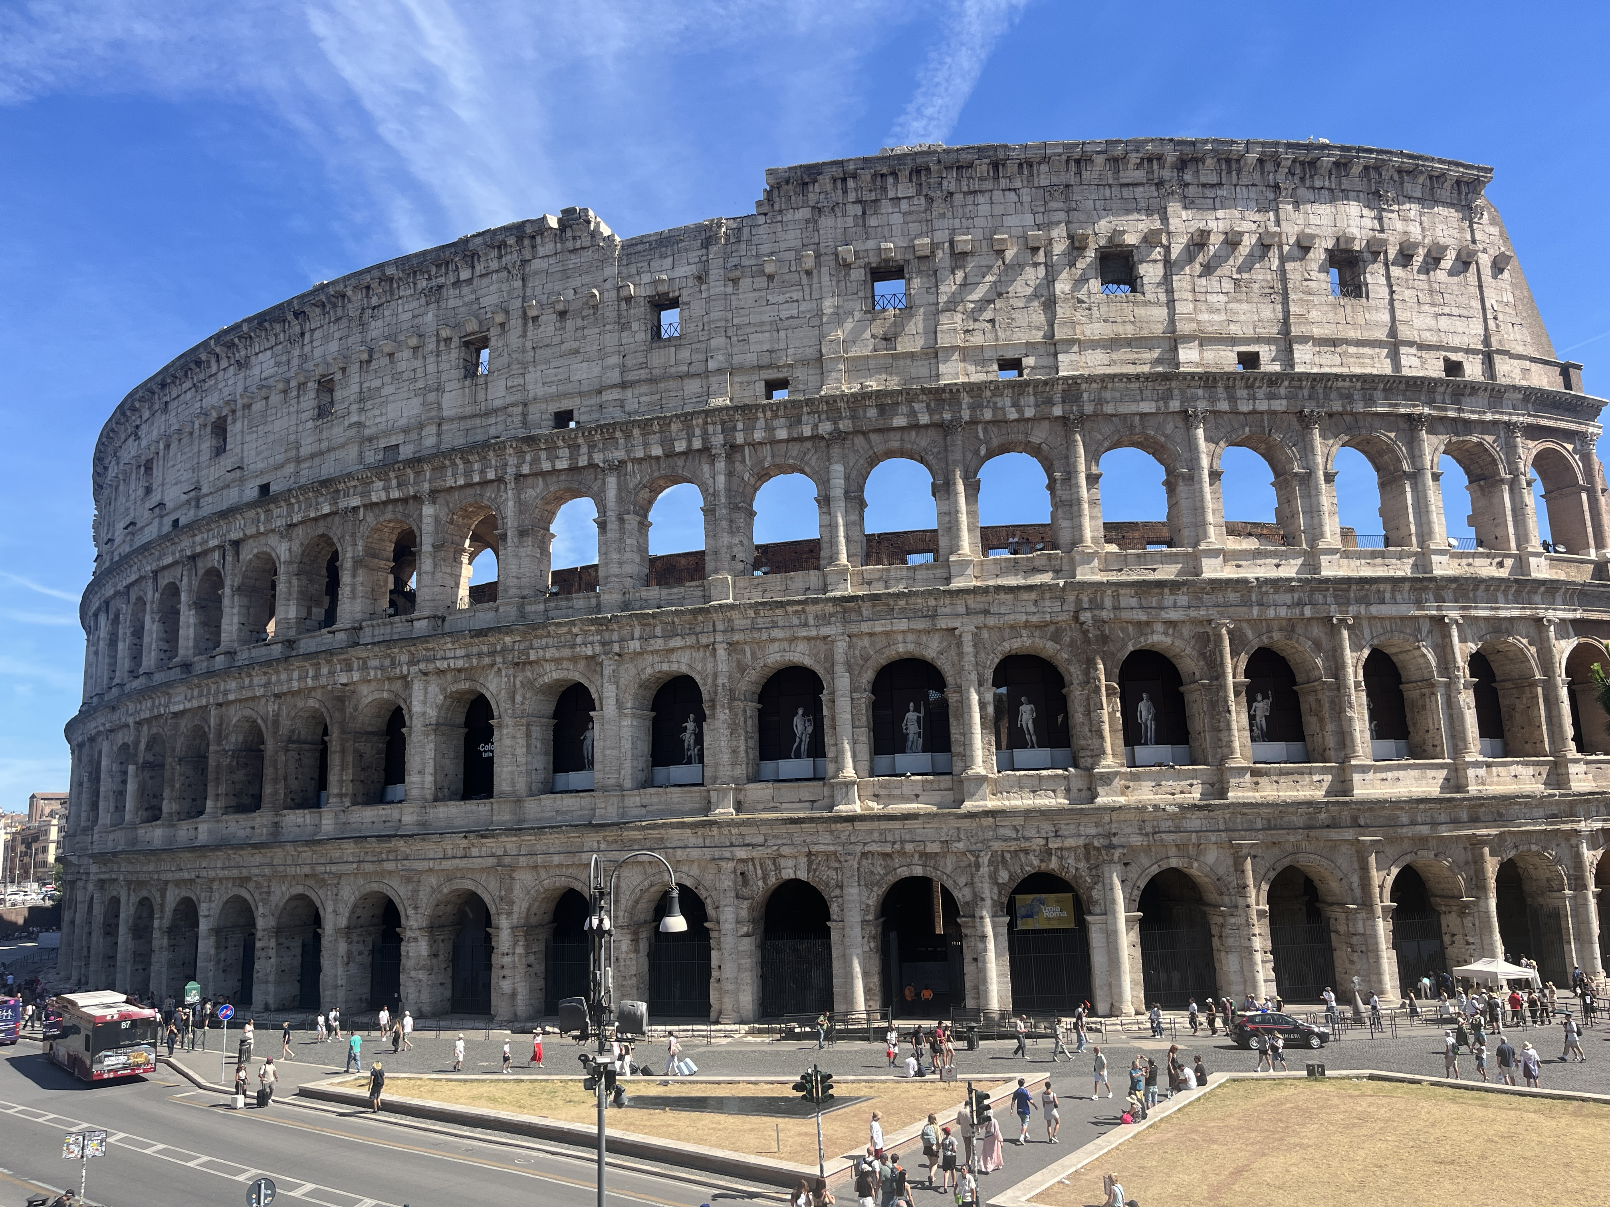
Superimposition of the Orders
4. Corinthian Pilaster
3. Corinthian
2. Ionic
1. Doric/Tuscan

Slide 15
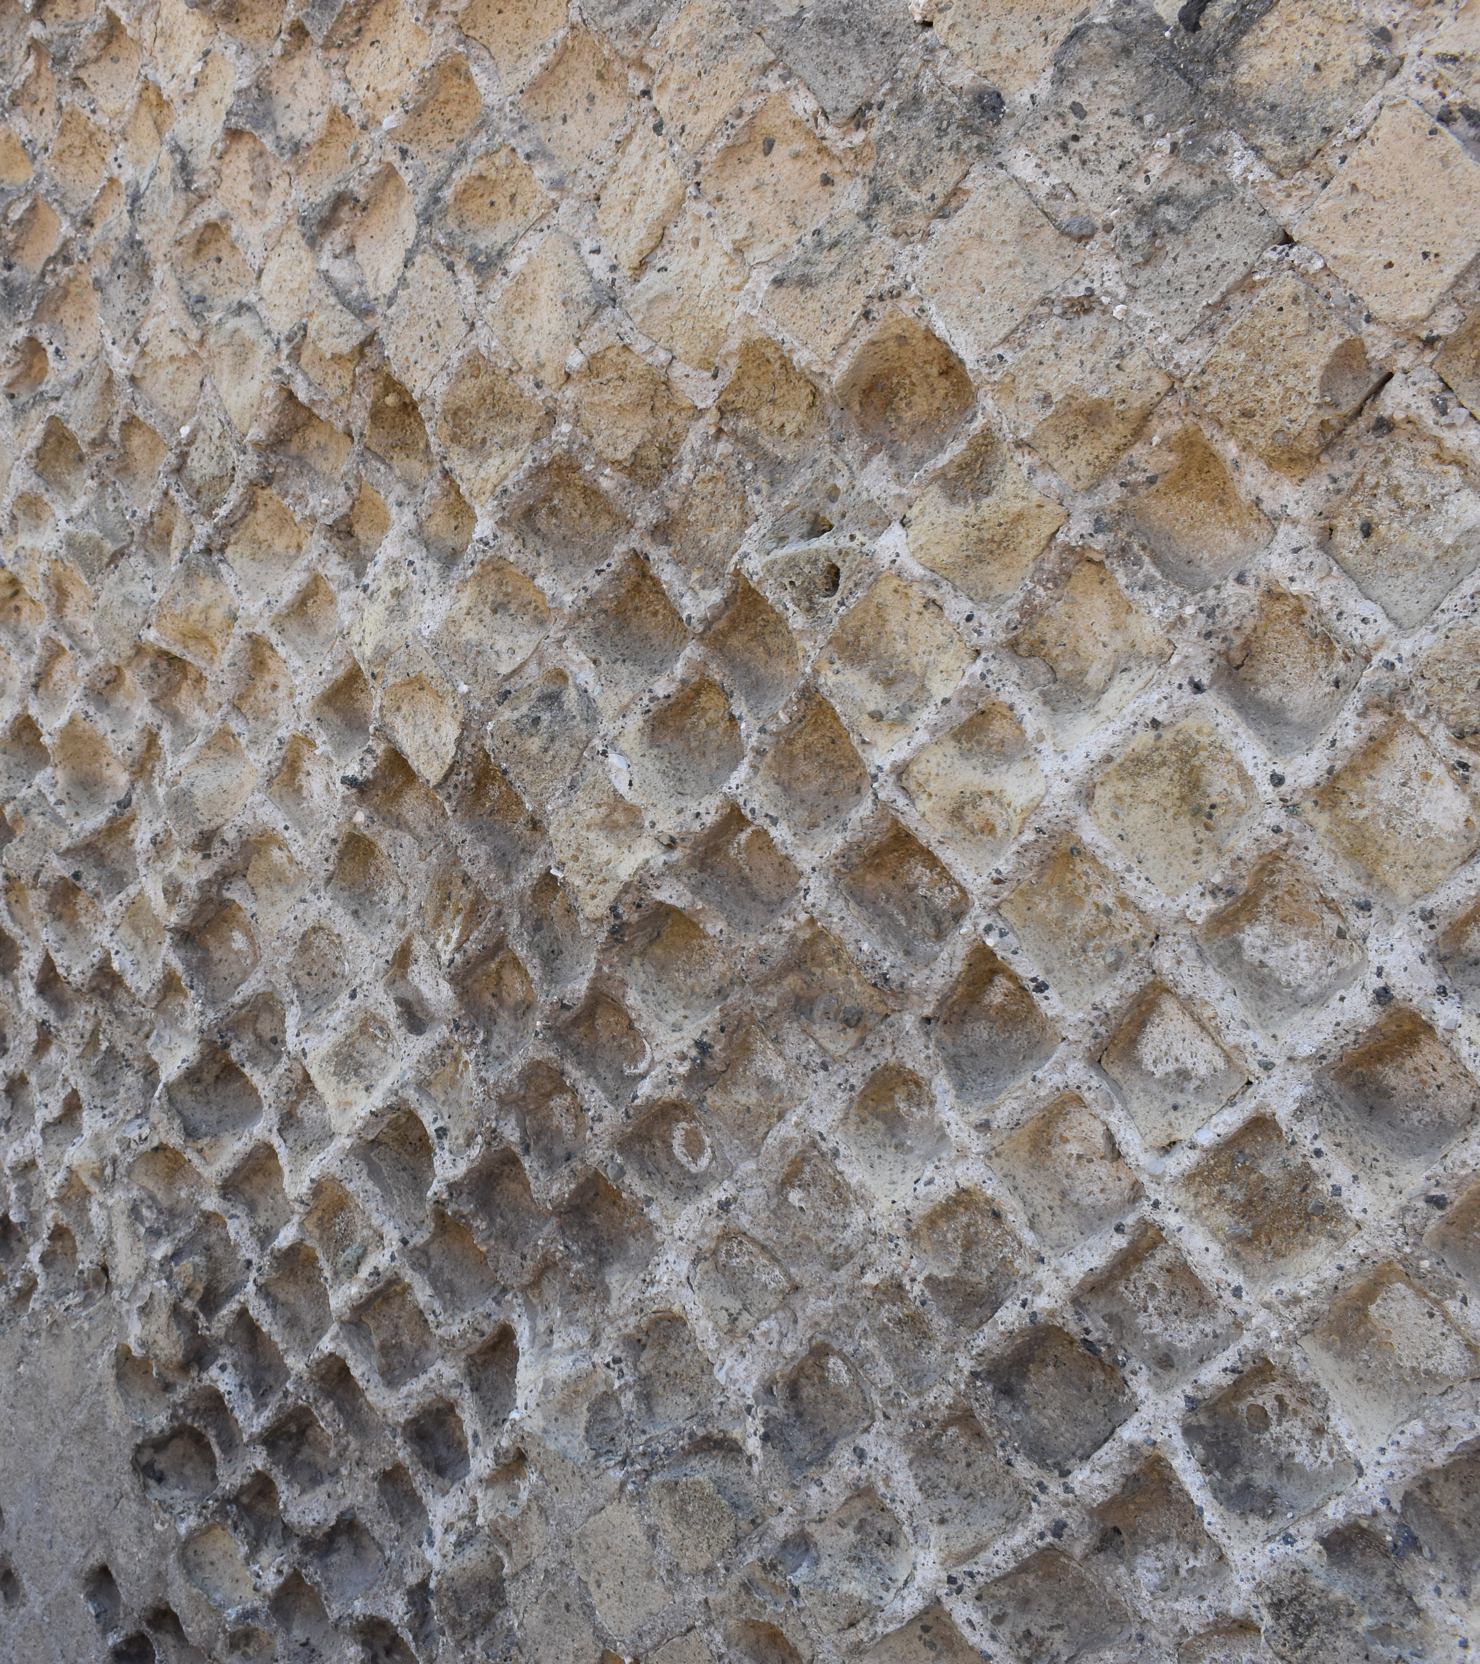
Republican Art and Architecture
C. 509-27 BCE
This period is all about transition; moving away from the Greek-style and experimenting in vaulting
Republican architecture was influenced by the Greek and Etruscans
Etruscan temples: the high podium temple with the columned porch (prostyle)
Tufa and travertine are popular building materials

Slide 16
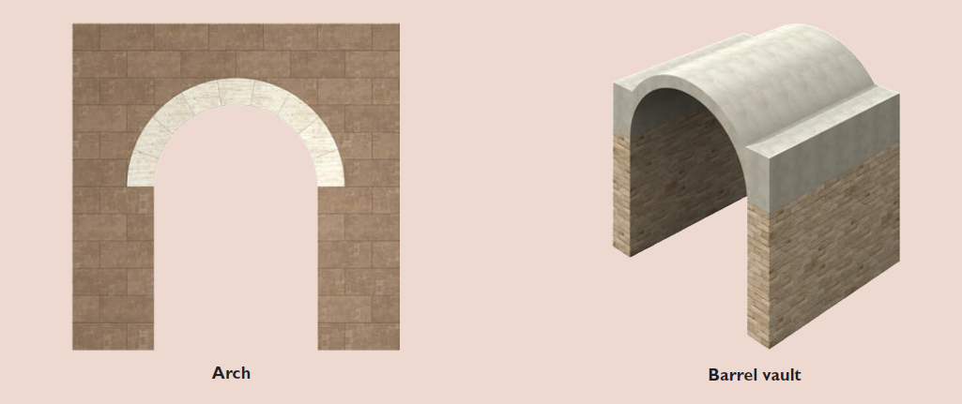
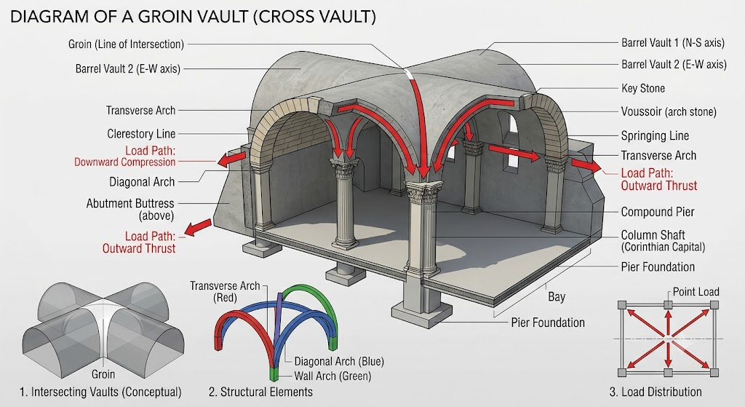
Republican Innovations
Pozzolana= Roman concrete (opus caementicium)
  Volcanic ash mixed with slaked lime, water, and aggregate (like crushed tufa, brick or travertine)
  Could harden undwater
Barrel Vault
  A continuous semi-cylindrical arch that looks like a long tunnel
  Built of concrete or wedge-shaped stones (voissoirs)
  Used to support terraces or substructures
Cross-vault (groin vault)
    Structural intersection of two barrel vaults crossing at right angle
    Concentrates the weight of the vault onto four specific corner pillars, creating massive open, light-filled interior halls diag
    Developed in the late republic

Slide 17
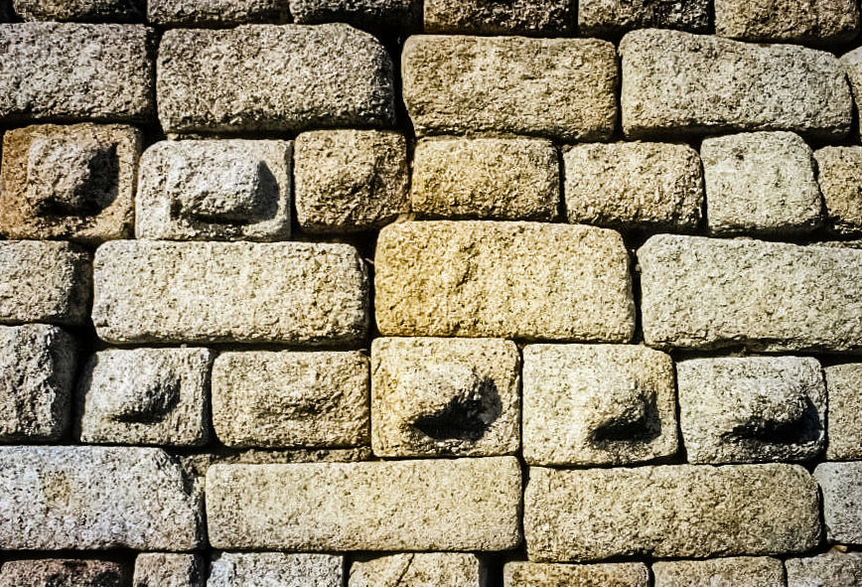
Roman Masonry Styles
Pre-Concrete Facing Styles:
Polygonal Masonry
  Massive, irregular, multi-sided stone blocks carefully carved to interlock like a puzzle
Opus Quadratum
  Also known as ashlar masonry
  Large rectangular blocks of stone stacked in regular horizontal rows.
  In the early republic the stones were used without mortar.
Concrete Facing Styles:
Opus Incertum “Irregular”
  Chaotic patchwork of randomly shaped, fist-sized stones
  Uncut stones were pressed into a wet concrete core.
  Prominent in 2nd century BCE
Opus Reticulatum
  A diagonal checkerboard or fishnet pattern of stones carved into a square-based pyramid shape
  The pointy end was stuck into the concrete leaving the flat square bases visible
  C. 1st century BCE
Opus Testaceum
  Rows of flat, uniform bricks
  Hallmark of the late republic and imperial periods, used until Late Antiquity
Opus Mixtum
  Alternating sections or panels of brick work and stone
  Popularized in the mid to late empire

Slide 18
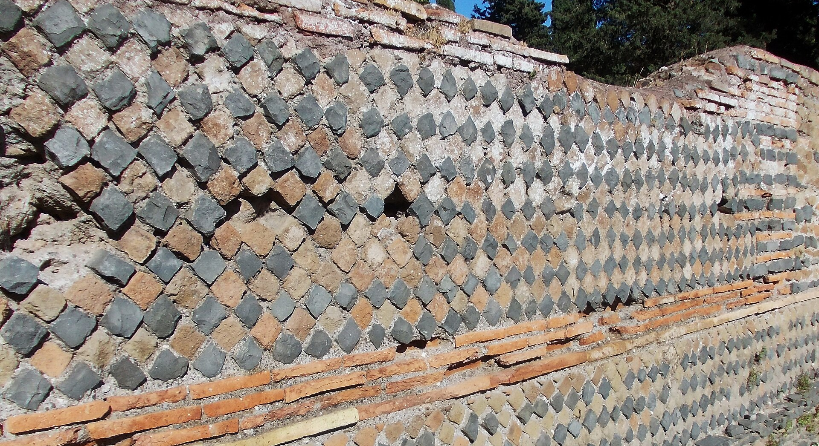
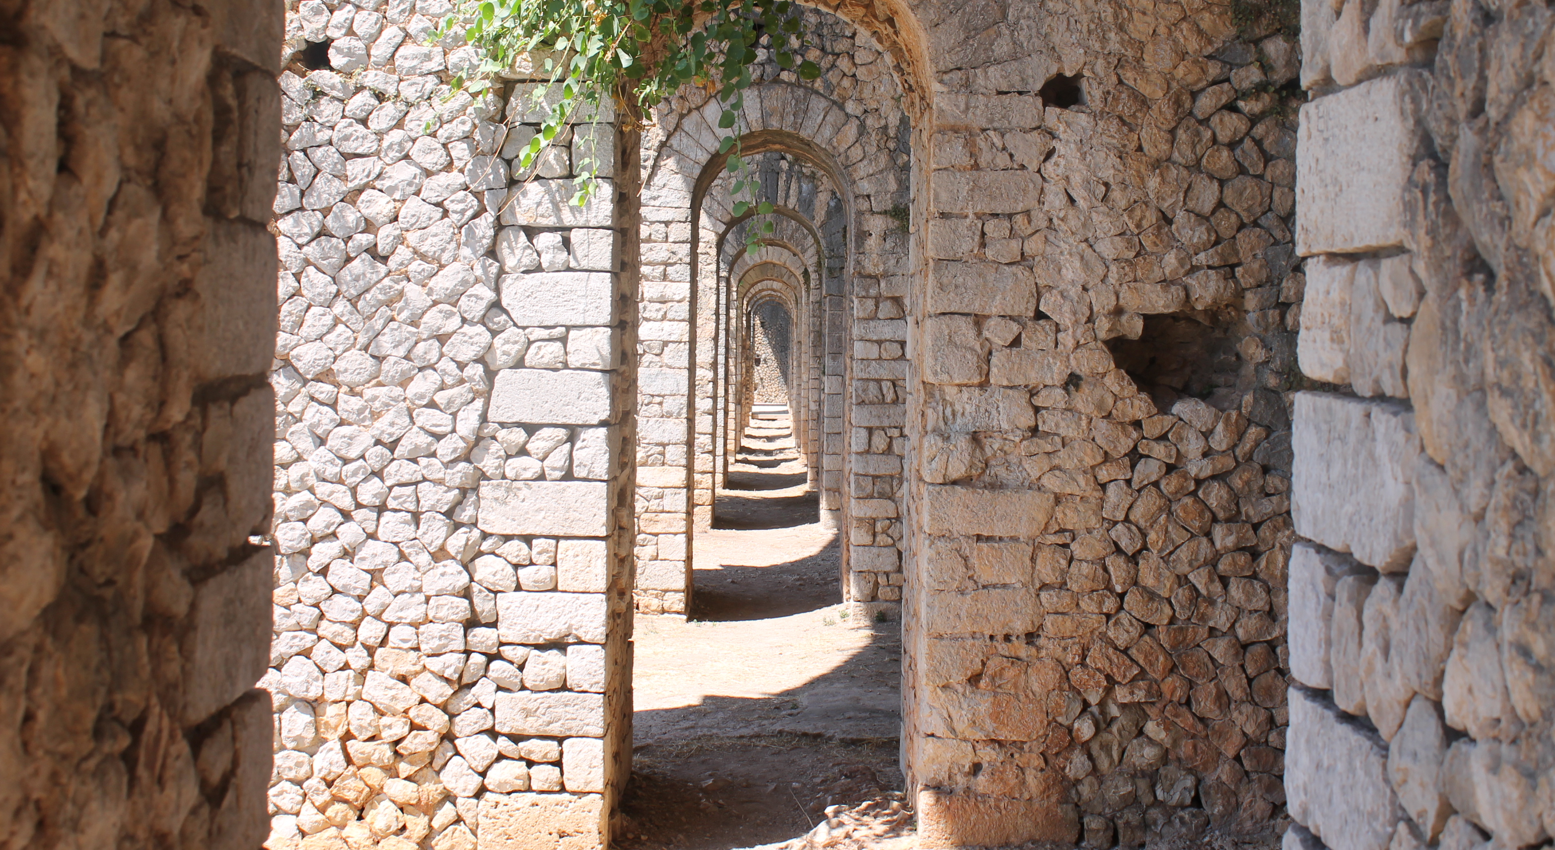
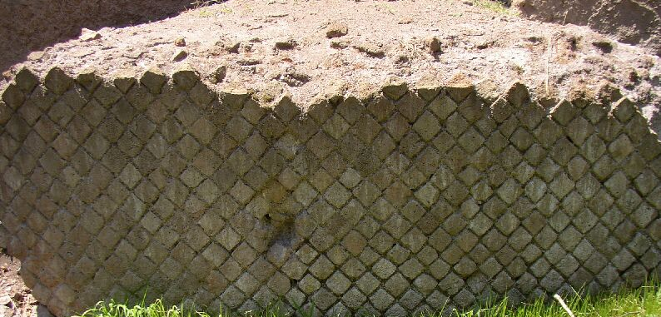
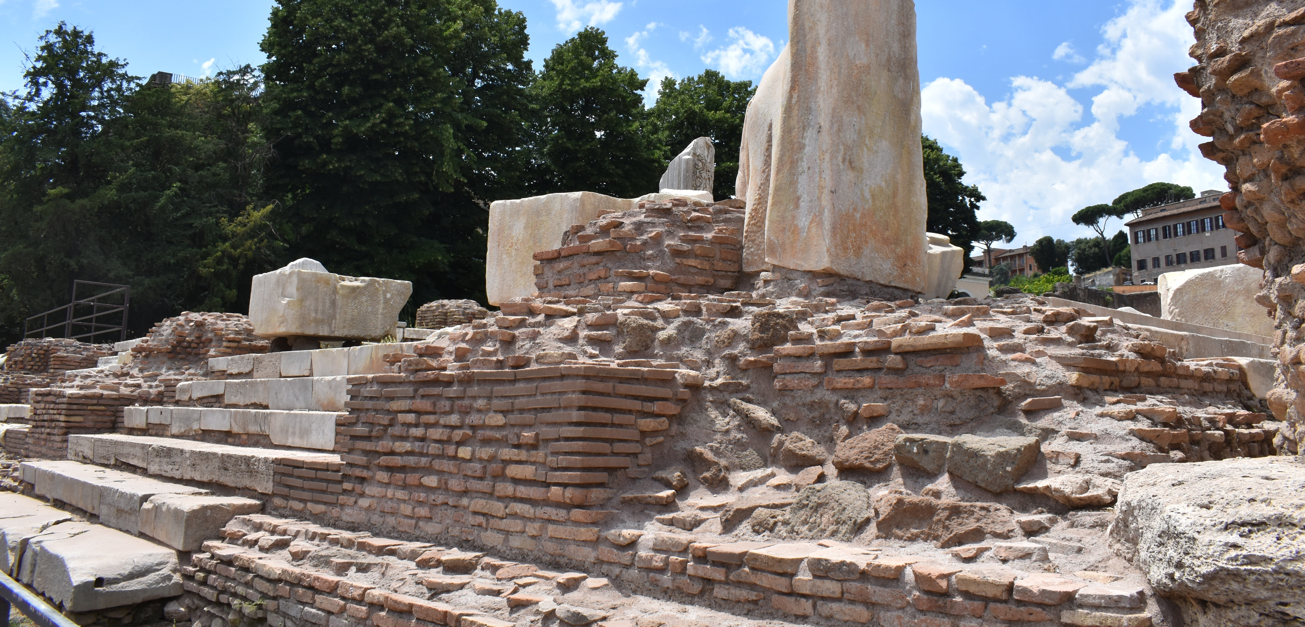

Slide 19
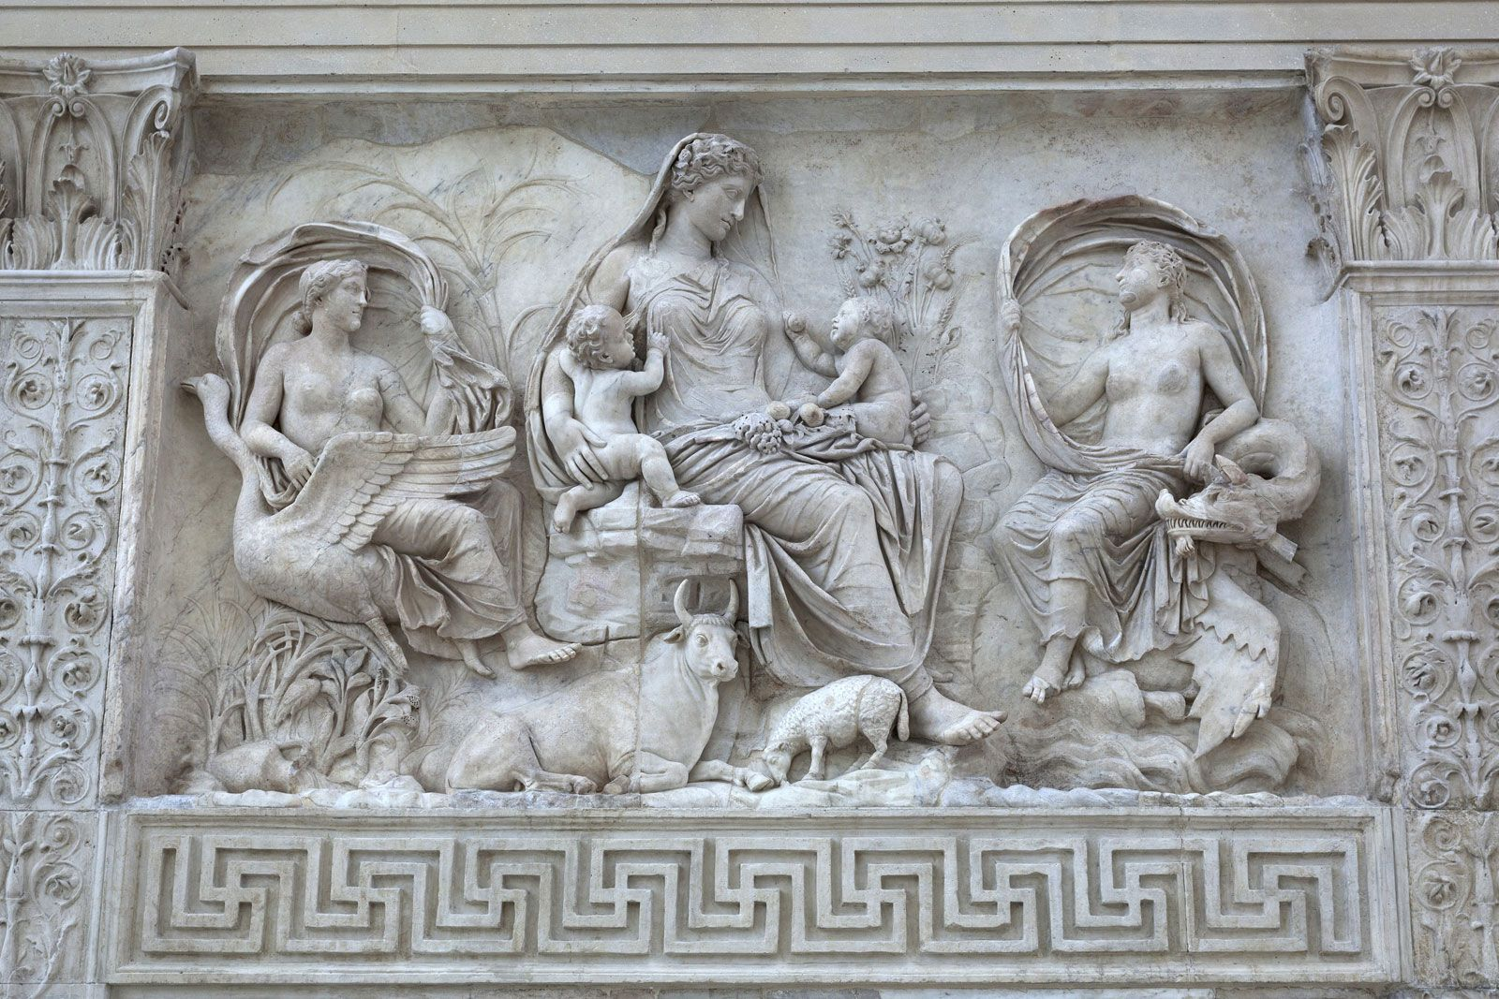
Age of Augustus (27 BCE – 14 CE)
The emperor Augustus weaponized architecture to signal a transition from a chaotic period of the Civil Wars at the end of the Republic to a stable Pax Romana of the new Empire
“I found Rome a city of bricks and left it a city of marble”- Suetonius Life of Augustus
Material Revolution
  Shift to marble from the Republican Tufa and Travertine
  The exploitation of the quarries at Luna (modern Carrara), rather than importing from Greece and Turkey
  Used to decorate façades
Infrastructure projects
  Reorganization of cities and spaces
  Roads, aqueducts, fora, temples, etc.
  Ex. Campus Martius
Art
  Idealized Classicism over verism
  Themes and metaphors of peace, fertility, and prosperity
  Ex. Ara Pacis and the Augustus of Prima Porta

Slide 20
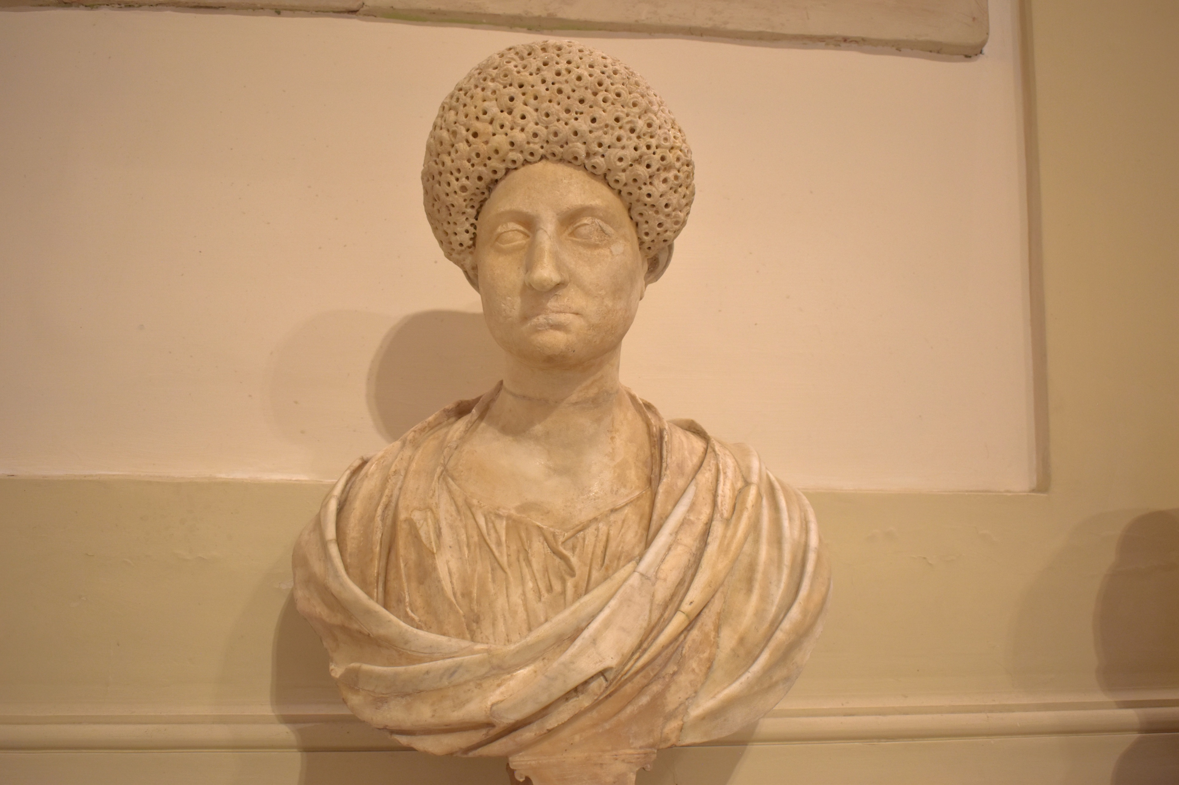
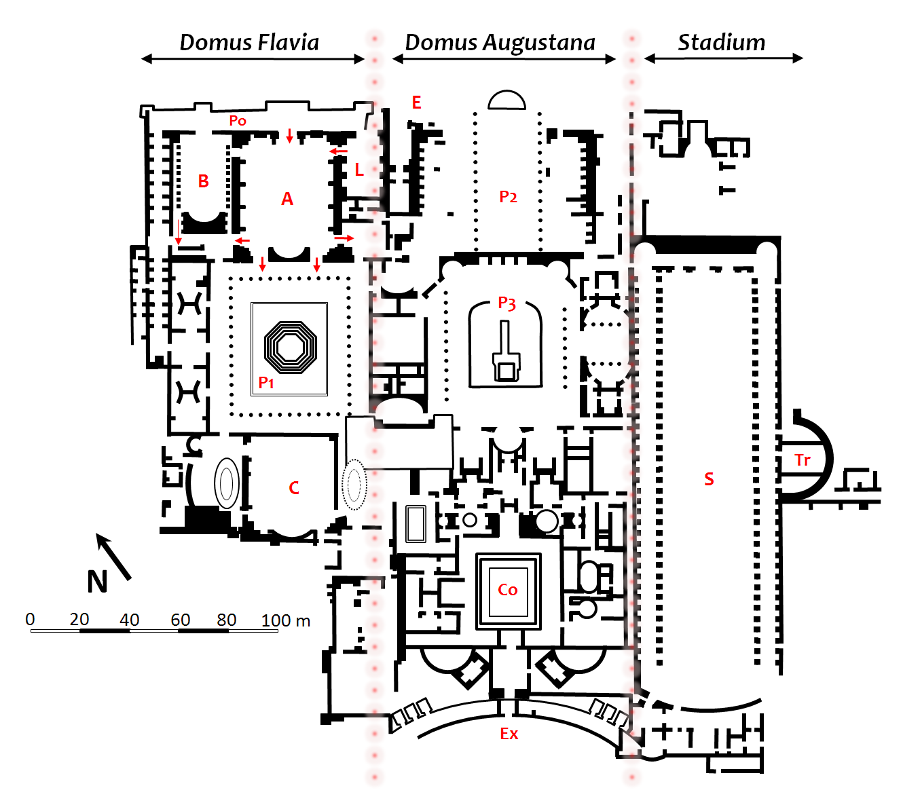
Flavians (69 – 96 CE)
Art and architecture shifted away from elitist self-indulgence toward massive civic utility
“Baroque”
Public over private attitude
  Ex. Colosseum built over Nero’s Domus Aurea
Concrete revolution explodes, using barrel and groin vaults to build taller and wider structures than before
Superimposition of the orders, heavily layered facades with jutting cornice
Return to realism and the use of the drill to create deep undercutting in sculpture

Slide 21
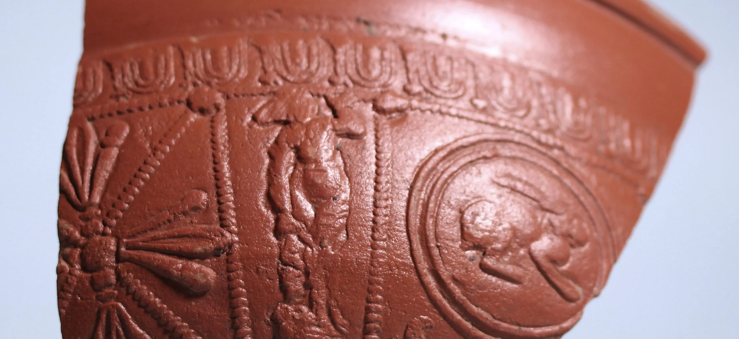
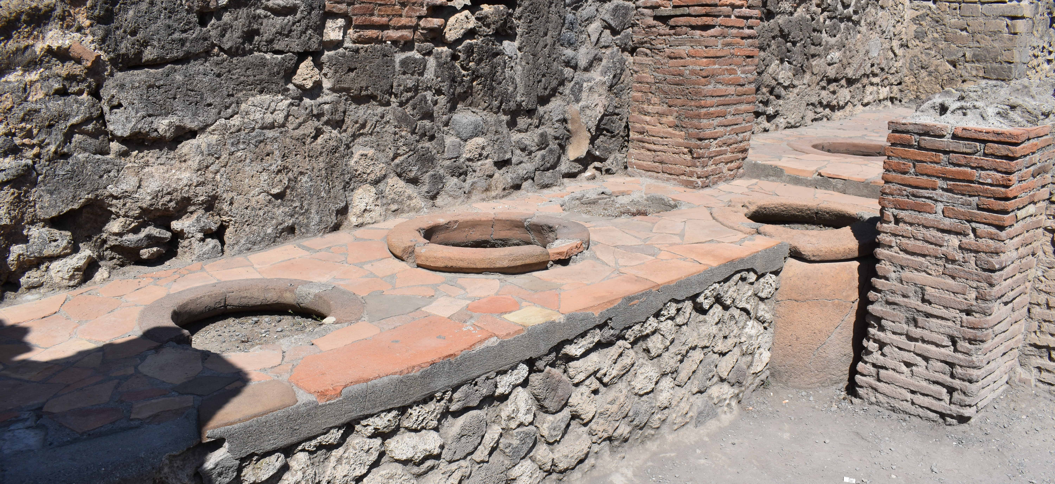
Pottery
Terra sigillata (Arretine Ware)
  Type of fine tableware
  Glossy red slip with a smooth texture
  Some have molded decorations or makers stamps
  Main manufacturing center in Arezzo
Amphora (pl. amphorae)
  Large two-handled terracotta jars with pointed bases used for transport and storage of wine, oil, and garum (fish sauce).
Doleum (pl. Dolia)
  Massive thick-walled storage vat that are permanently buried up to their necks into the floors of shops, thermopolia, and villas to keep wine and grain at stable cool temps.

Slide 22
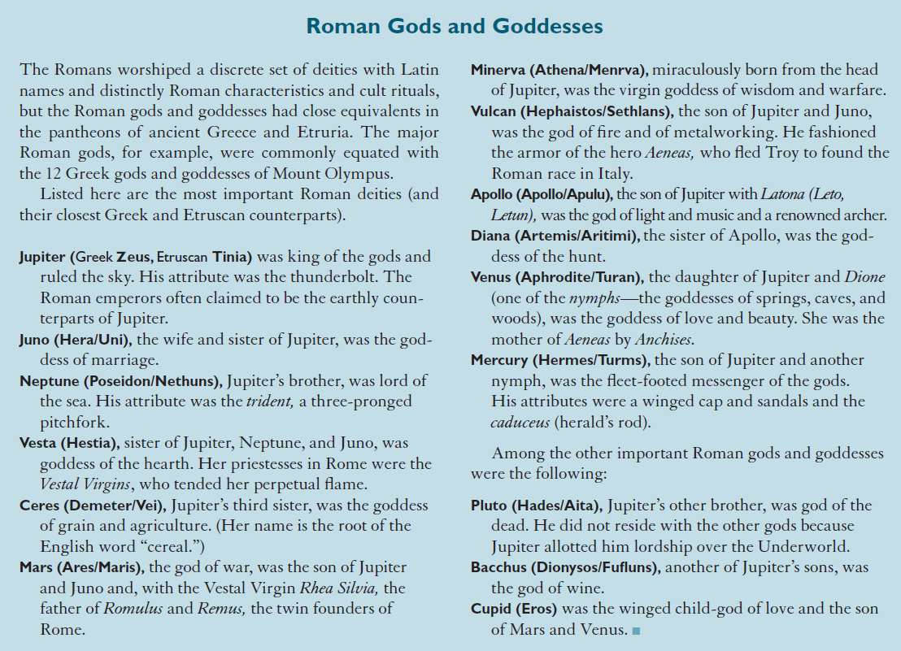

Slide 23
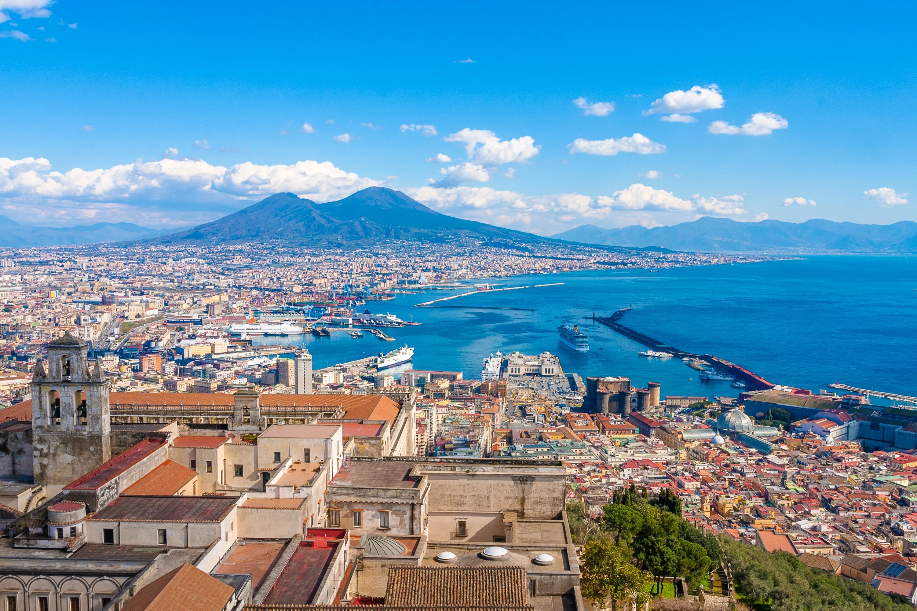
Introduction to the Bay of Naples

Slide 24
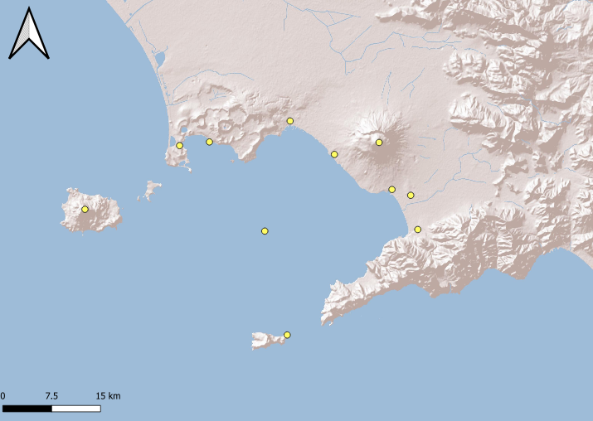

Slide 25
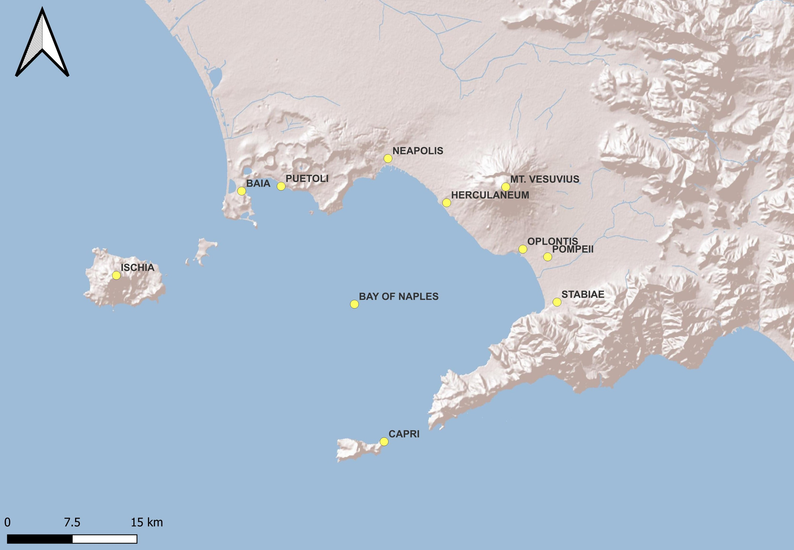

Slide 26
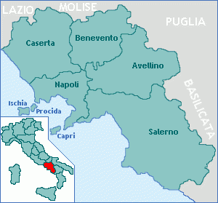
Campania
Campania is located in southern Italy along the Tyrrhenian Sea
Known for fertile volcanic soils and natural harbors
Strategic position between different Italic peoples, Greeks, and Romans
Grains, olives, grapes
Geography consists:
  Coastal region along the Bay of Naples
  Campanian Plain (Campania Felix)
  Phlegraean Fields (Campi Flegrei) volcanic area
  Lattari Mountains along the Amalfi and Sorrentine peninsulas

Slide 27
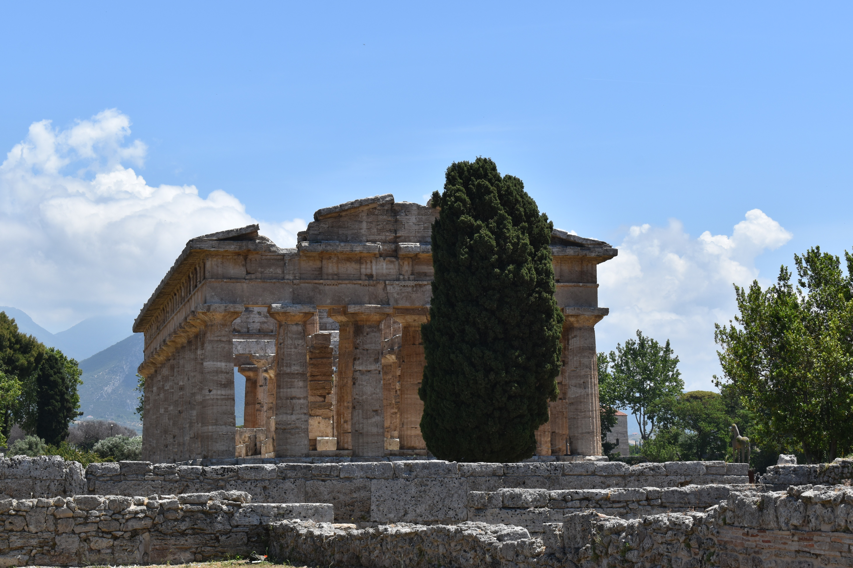
Campania and Greek Colonization
8th – 6th centuries BCE
Greek settlers established colonies throughout southern Italy creating Magna Graecia
  Cumae, Neapolis, Poseidonia, etc
The Greeks introduced:
  Urban planning based on the polis
  Monumental temple architecture
  Coinage
  Alphabetic writing
  Artistic styles (sculpture and ceramics)
  Trade networks spanning the Mediterranean and beyond

Slide 28
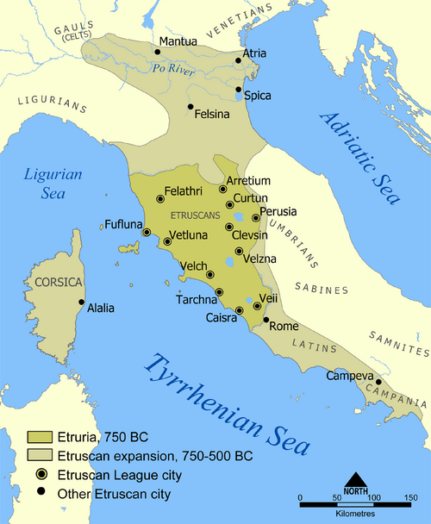
Campania and the Etruscans
8th – 5th centuries BCE
Founded colonies in the Campanian Plain
Etrsucans allied themselves with Carthage against the Greeks
474 BCE Etruscans were defeated at the Battle of Cumae
Area was taken over by Samnites

Slide 29
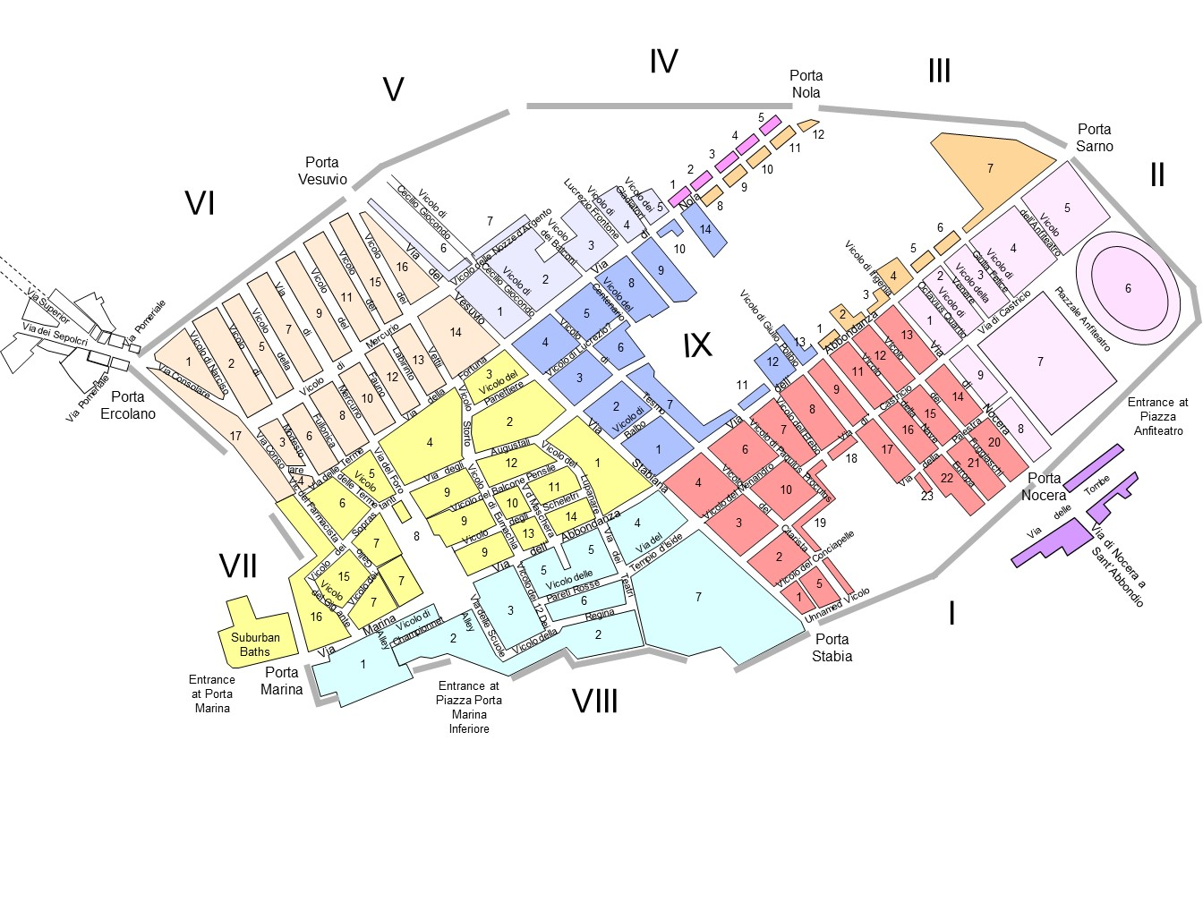

Pompeii
Settlement founded by the Osci in c. 8th-6th centuries BCE, an ancient central Italian tribe
Controlled by other groups like Greeks, Samnites, and Etruscans
Becomes a Roman colony in 80 BCE
80 BCE-62 CE becomes a resort destinations for wealthy Romans
Located on a plateau overlooking the sea and the Sarno River
Only $\frac{2}{3}$ of the site has been excavated. Site is about 66 HA total.
Why is a third not excavated?

Slide 30
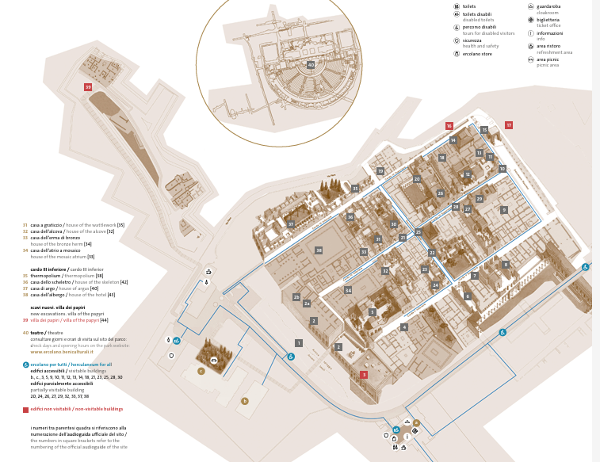
Herculaneum
City was founded by the mythical hero Hercules, which gave it its name
Became a Roman municipium (civic status as a city) in 89 BCE
Became an exclusive seaside resort for wealthy Romans
Destroyed alongside Pompeii in 79 CE
Unlike Pompeii, it was engulfed by superheated pyroclastic flows. This makes it harder to excavate as it is buried in 20 m of volcanic material.
BUT this means better preservation! Including wood, furniture, and organic materials.
Only 4.5 HA have been excavated (total estimated of around 20 HA)

Slide 31
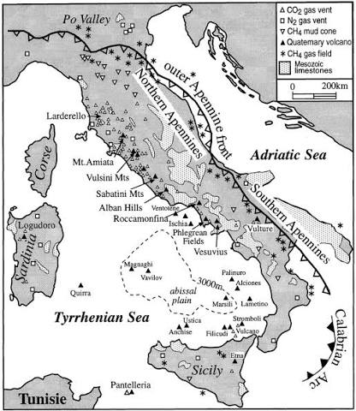
Mt. Vesuvius
1,281 meters asl
Formed by the collision of two tectonic plates, the African and the Eurasian
Somma-stratovolcano
  a Volcanic caldera that has been partially filled by a newer, central conet
  Still active
  25,000 years old
Part of the Campanian volcanic arc
  Other volcanoes include Phlegraeun Fields, Ischia, Palinuro, Vavilev, Masili, and Magnaghi
Central crater in roughly 500 m wide and 200 m deep
79 CE was not the only time it erupted
  Avellino eruption around 1800 BCE was larger
  Erupted many times after 79 CE but never quite as destructive.
  Most recent eruption is 1944

Slide 32
Strabo Geography V.4.8
(late 1st century BCE or early 1st century CE)
Mount Vesuvius is situated above these places and people live ail around on very beautiful farms, except at the summit. This is flat for the main part, but completely unfruitful, like ashes to look at, and it displays porous hollows of rocks blackened on the surface, as if devoured by fire. As a result, one would deduce that this area was previously on fire and held craters of fire, and that it was extinguished when the fuel failed. Perhaps this is also the reason for the fruitfulness of the surrounding area, just as at Catana they say that the part covered by ash carried up by the fire of Etna made the country suited to vine-growing.
Notes:
Greek geographer who was from Asia Minor (pontus) and travelled the Roman empire during the time of Augustus

Slide 33
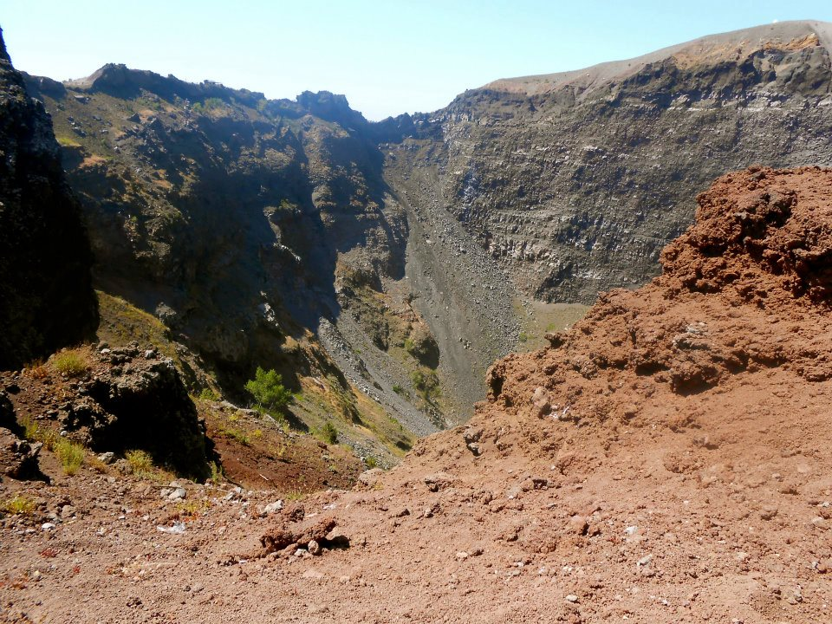
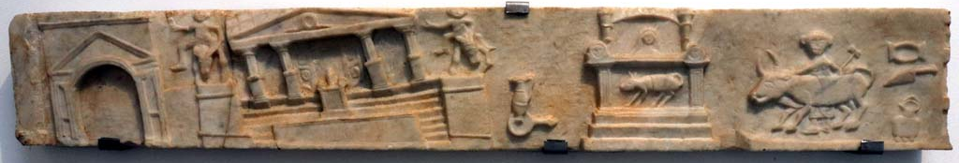
Timeline of the Eruption
Earthquake of 62 CE- estimated magnitude of 5.2–6.1
October 79 CE
Dropped 13-20 feet of volcanic ash in a 24-hour window
A Plinian eruption that shot a column of ash and pumice 20 miles into the atmosphere
Superheated gas and ash surges swept through the city, instantly killing remaining residents
Estimated 2,000 people perished (original populations 10,000-20,000 people)

Slide 34
Firsthand Account by Pliny the Elder
Pliny (the Elder) was an admiral in the Roman navy and was camped at Misenum in the Bay of Naples during the time of the eruption.
He saw the unusual cloud of the eruption and decided to investigate.
Once he realized what had happened, he launched a rescue mission to Herculaneum and Stabiae.
He unfortunately passed away during the course of the mission, probably due to smoke inhalation.
His account is recorded by his nephew Pliny the Younger in a letter to Tacitus.

Slide 35
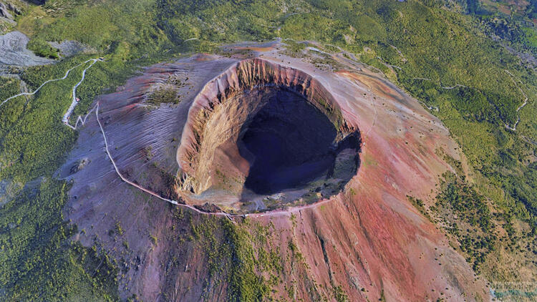
Fortune Favors the Bold:
Pliny the Younger’s Letter to Tacitus
“On the 24th of August, about one in the afternoon, my mother desired him (Pliny the Elder) to observe a cloud which appeared of a very unusual size and shape … A cloud, from which mountain was uncertain, at this distance (but it was found afterwards to come from Mount Vesuvius), was ascending, the appearance of which I cannot give you a more exact description of than by likening it to that of a pine tree, for it shot up to a great height in the form of a very tall trunk, which spread itself out at the top into a sort of branches.”

