Slide 1
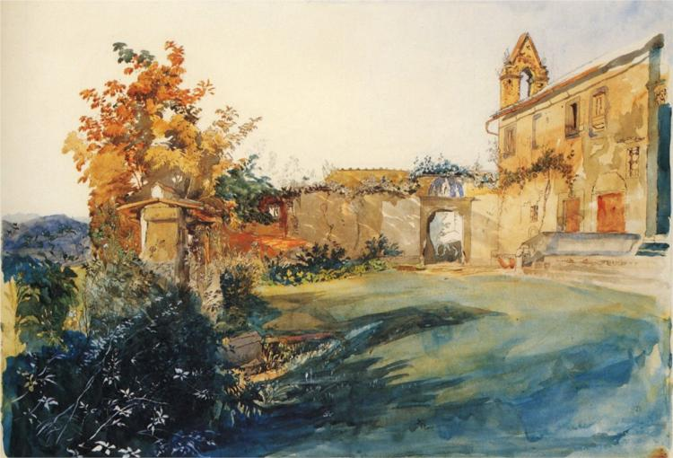
WONDERS OF ITALY:
FROM GRAND TOUR TO OVERTOURISM
Tuesday, September 1, 2026
An Emily Balch Seminar
Prof. Federico Sessolo
Department of Transnational Italian Studies

Slide 2
Today’s Agenda:
Introductions
The Syllabus
Brainstorming: What Do You Know About Italy?
Takeaways: What is Writing to you?

Slide 3
INTRODUCTIONS
What is your name? Where are you from?
What are your preferred pronouns?
Have you ever been to Italy?
What do you hope to learn/gain from this seminar?
What is the last song you listened to?

Slide 4
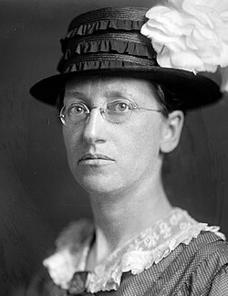

WHO WAS EMILY GREENE BALCH (1867-1961)?
US pacifist, feminist, scholar (sociology)
One of the first Bryn Mawr College alumnae (class of 1889)
Won the Nobel Peace Prize in 1946
Founder and director of the (still existing) Women’s International League for Peace and Freedom (WILPF)

Slide 5

“[She] spent nearly a month exploring Greece and Italy, stopping in Naples, Pompeii, Rome, Tivoli, Venice, and Milan. They visited amphitheaters, temples, palaces, and cathedrals. Emily was particularly impressed with the architecture, chapels, and works of art that she encountered in Italy.”
From Kristen E. Gwinn, Emily Greene Balch: The Long Road to Internationalism, University of Illinois Press: 2010, 48-49

Slide 6

LEARNING GOALS:
Teach critical thinking about broad intellectual questions;
Give students instructions and practice in writing as a flexible tool of inquiry and interpretation;
To make students conscious of writing as a process;
To teach students to use source fairly and effectively;
To model effective discussion strategies;
To inspire and delight students through intellectual inquiry.

Slide 7
READING MATERIAL:
All reading and visual materials will be provided for free by your professor via Moodle, Kanopy, or Tripod.
The Department of Transnational Italian Studies is committed to providing a 100% affordable college experience!

Slide 8
WHAT ARE YOU EXPECTED TO DO IN THIS COURSE?
Reading:
1) A light workload of reading, usually 3-5 pages, to be completed in 1-2 days (from Tuesday to Thursday)
2) A heavy workload of reading, usually 10-15 pages, to be completed in 4-5 days (from Thursday to the following Tuesday)

Slide 9
WHAT ARE YOU EXPECTED TO DO IN THIS COURSE?
Writing:
Four 5-page long papers, written both in and out of class (first draft + revision + final draft)
A dozen short answers, written in class (1/2 or 1 page)
No final exam!

Slide 10
WHAT ARE YOU EXPECTED TO DO IN THIS COURSE?
One-On-One Conversations:
The program requires you to attend at least four (4) 20-minute meetings with your professor throughout the semester, either in person or online.

Slide 11
WHAT ARE YOU EXPECTED TO DO IN THIS COURSE?
Absences:
You are allowed two unexcused absences throughout the semester. Documented illnesses and religious holidays do not count as absences.

Slide 12
WHAT ARE YOU EXPECTED TO DO IN THIS COURSE?
Attendance:
There are many ways to participate in class. You will be evaluated holistically.

Slide 13
AI POLICY
This is a seminar focused on writing and reading. A primary learning goal is to develop complicated ideas in simple ways.
If not explicitly permitted by your professor, the use of AI is not acceptable and considered a violation of the Honor Code.

Slide 14
DIVERSITY, EQUITY, AND INCLUSION:
In this classroom, each voice has something of value to contribute. Students are expected to respect different experiences, beliefs, and values expressed by their peers.

Slide 15
EVALUATION:
PAPERS 65%
SHORT ANSWERS 10%
PARTICIPATION 25%
94-100 | 4.0 (A) | Excellent
90-93 | 3.7 (A-) | Excellent
87-89 | 3.3 (B+) | Very Good
83-86 | 3.0 (B) | Good
80-82 | 2.7 (B-) | Good
77-79 | 2.3 (C+) | Satisfactory
73-76 | 2.0 (C) | Satisfactory
70-72 | 1.7 (C-) | Below Merit
67-69 | 1.3 (D+) | Below Merit
63-66 | 1.0 (D) | Below Merit
0-62 | 0 (F) | Failure

Slide 16
BRAINSTORMING: WHAT DO YOU KNOW ABOUT ITALY?
https://www.mentimeter.com/app/presentation/alxhzdo2y91sxnkdipp1np58awuo39oe/edit

Slide 17
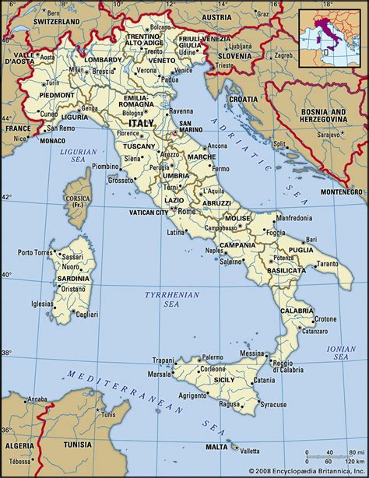
QUICK FACTS ABOUT ITALY:
Unified in 1861; a republic since 1945
Founding member of the EU (1957)
Founding member of NATO (1949)
Population: ca. 59 millions (declining)
Life expectancy: 83.8 years

Slide 18
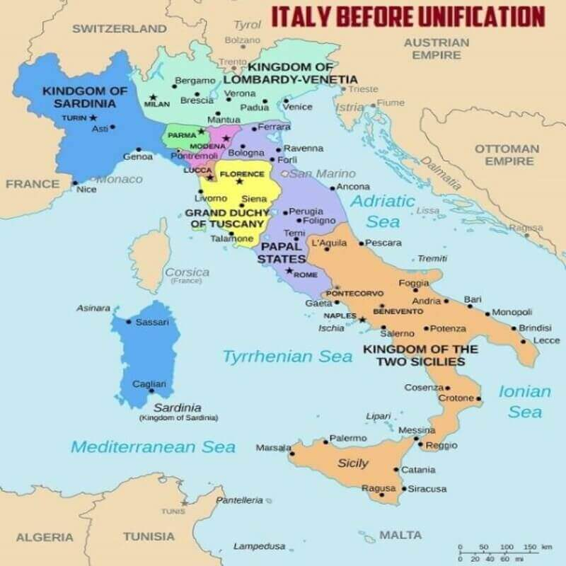
ITALY BEFORE 1861-1870:
Kingdom of Sardinia (Savoy)
Principate of Monaco
Kingdom of Lombardy and Venetia (Austria)
Duchy of Parma and Piacenza
Duchy of Modena and Reggio
Duchy of Massa and Carrara
Gran Duchy of Tuscany
Republic of San Marino
Papal State
Kingdom of of the Two Sicilies

Slide 19
TOURISM IN ITALY: DATA
NUMBER OF NIGHTS BOOKED IN ITALY BY TOURISTS
2020 65.443.303 NIGHTS (6.503.303 NON-EU)
2021 106.123.175 NIGHTS (8.864.840 NON-EU)
2022 201.069.434 NIGHTS (35.682.450 NON-EU)
2023 234.182.255 NIGHTS (54.803.128 NON-EU)
SOURCE: ISTAT (2024)

Slide 20
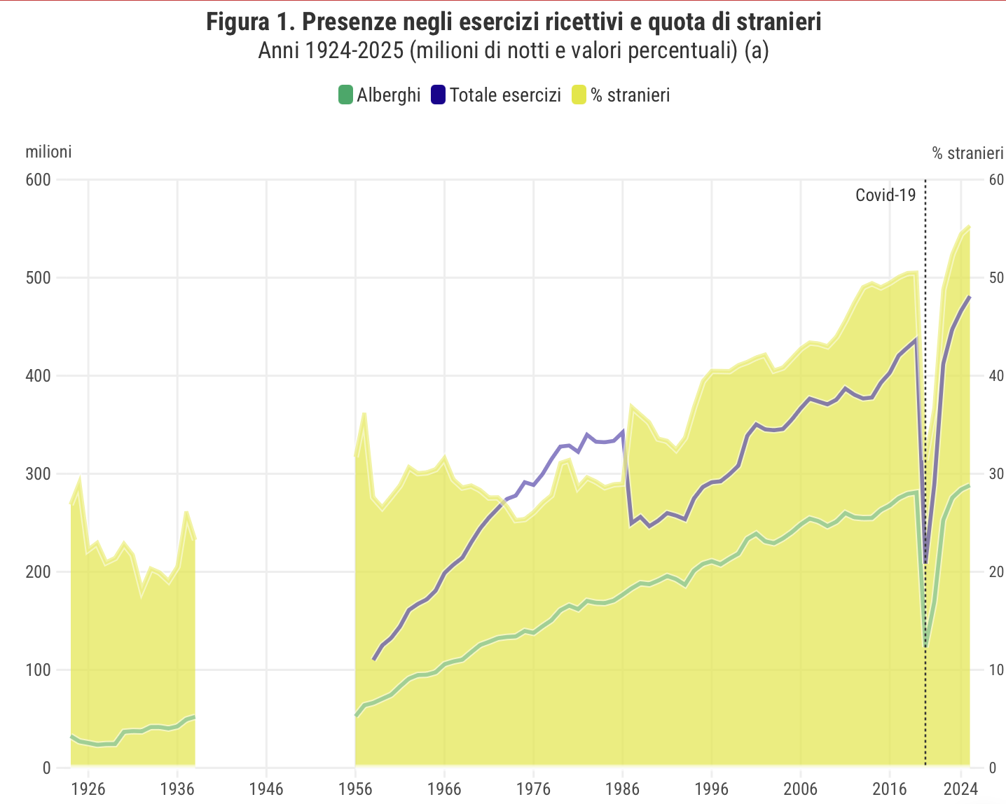
TOURISM IN ITALY: DATA
Green line: number of hotels in Italy
Blue line: number of hosts in Italy
Yellow: Number of tourists
SOURCE: ISTAT (2024)

Slide 21
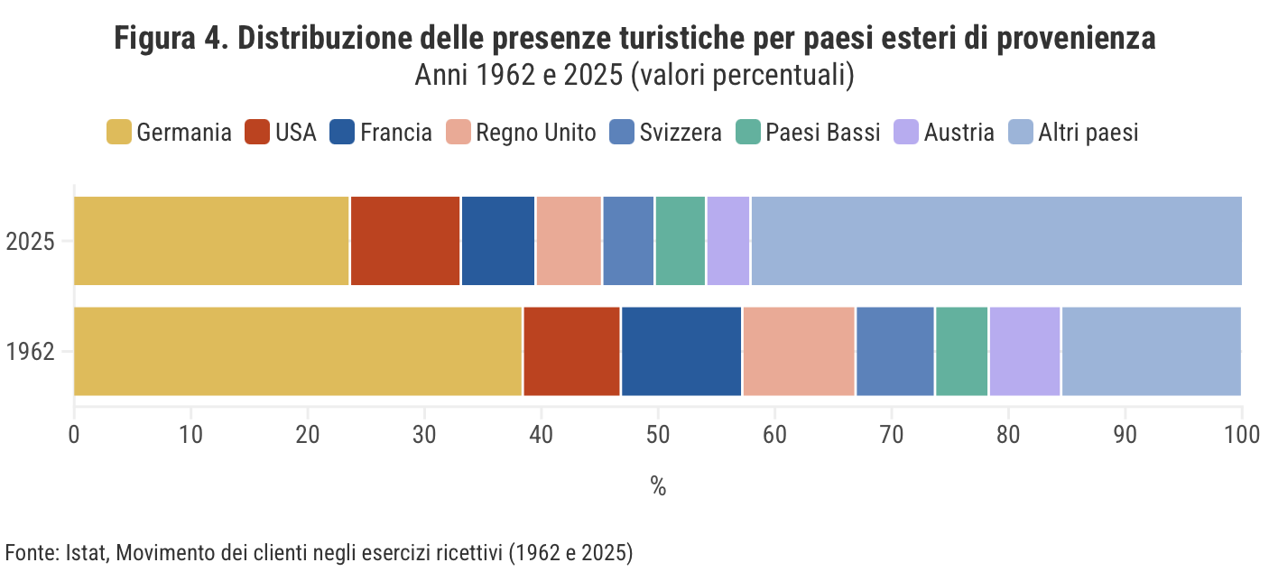
TOURISM IN ITALY: DATA
Nationality distribution of foreigners visiting Italy (Germany, USA, France, UK, Switzerland, Netherlands, Austria, Other Countries)
SOURCE: ISTAT (2024)

Slide 22
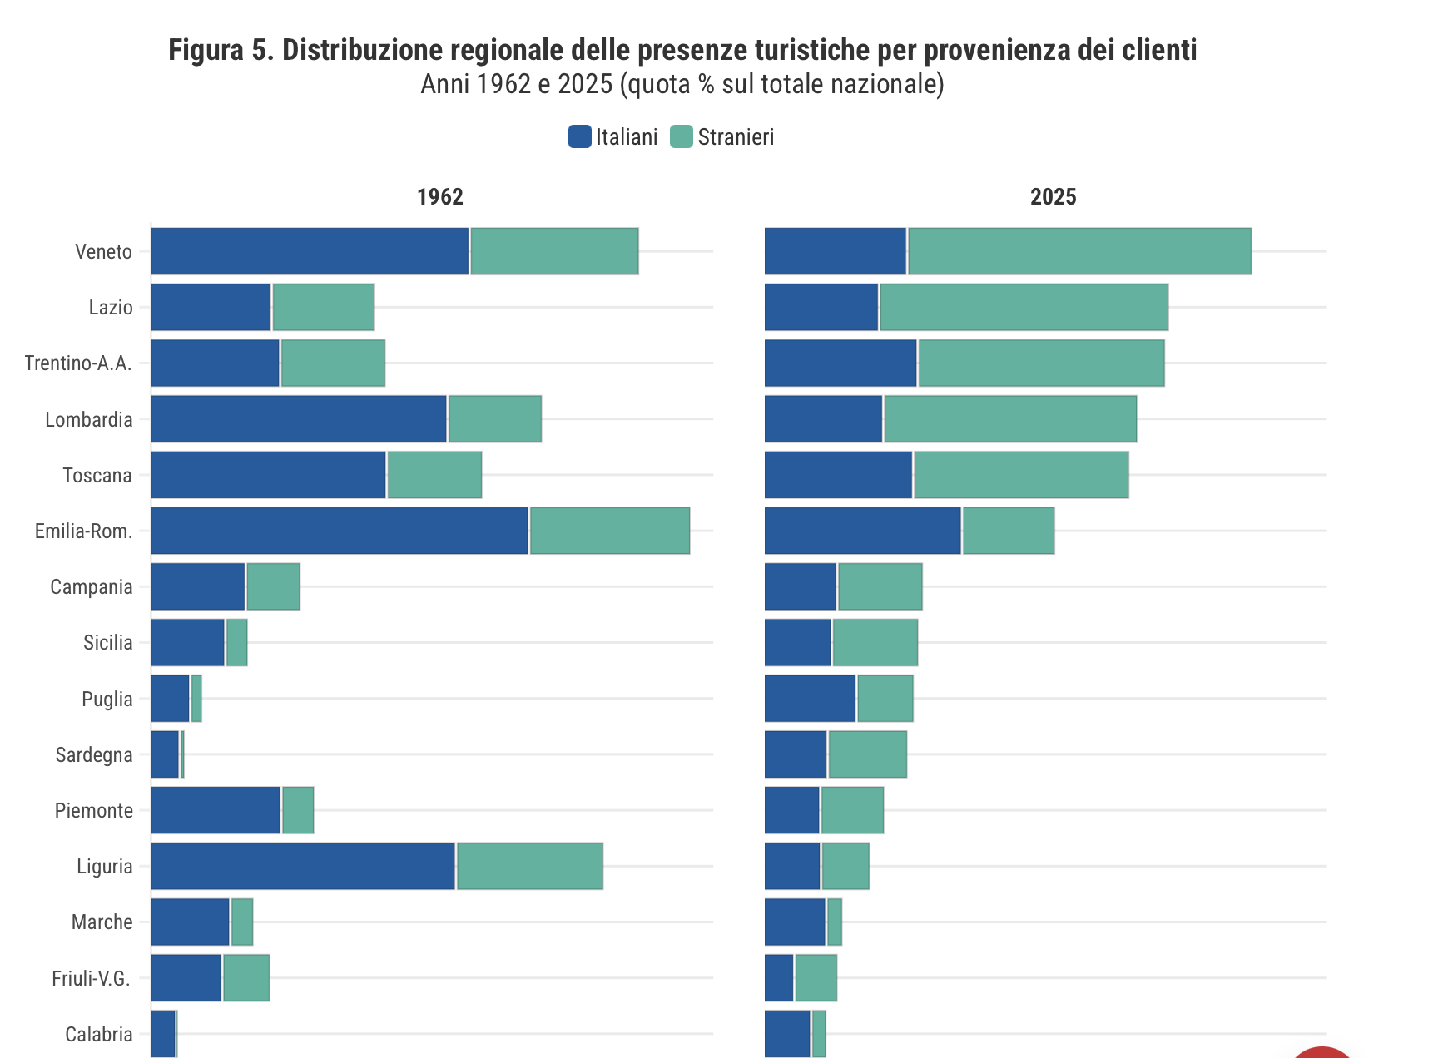
TOURISM IN ITALY: DATA
Number of tourists per region. In blue, Italian tourists; in green, foreign tourists.
SOURCE: ISTAT (2024)

Slide 23
WHAT ARE WE GOING TO READ? PASSAGES FROM…
Travel books / Guides
Scientific articles
Scholarly essays
Cheap/Trivial literature
Nonfiction books
Short stories

