Slide 1
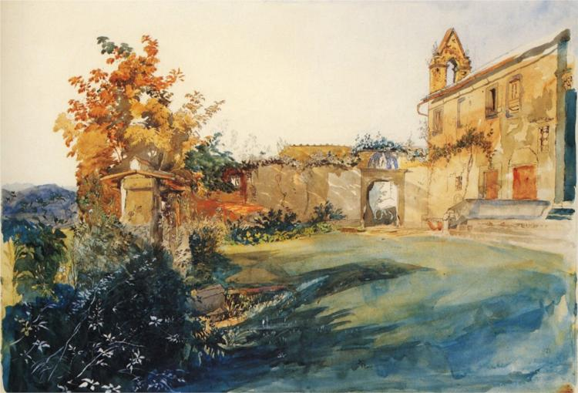
WONDERS OF ITALY:
FROM GRAND TOUR TO OVERTOURISM
THURSDAY, September 3, 2026
Prof. Federico Sessolo
Department of Transnational Italian Studies

Slide 2
Before the end of this week: schedule your first one-on-one appointment with me via Moodle.

Slide 3
Today’s Agenda:
Today’s reading: some context
Discussion
Reading/Writing assessment (not graded)
Exit Ticket

Slide 4
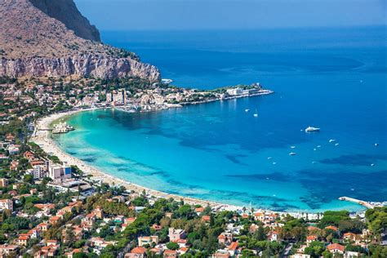
PALERMO
Capital of Sicily (Autonomous region of Italy, with its own Parliament and laws)
Population: 625,075
Founded by the Phoenicians; ruled by Greeks, Romans, Arabs, Normans, Spanish, French, and Italians.

Slide 5
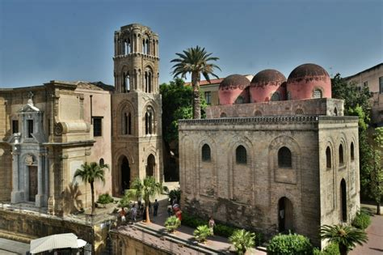
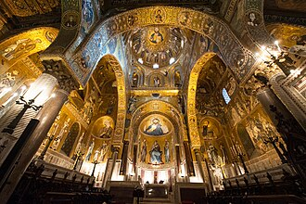
Examples of Arab-Norman architecture in Palermo: Church of San Giovanni degli Eremiti (above), and the Cappella Palatina (Palatine Chapel, below), UNESCO Heritage Site.

Slide 6
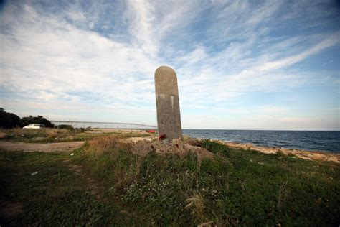
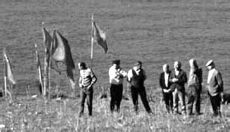
The Mafia pushed to build the international airport of Palermo in the mafia-controlled zone of Punta Raisi to transform the island into a hub for heroine and cocaine. Until the early 2000s, landing at Punta Raisi was extremely difficult. Several planes crashed over the decades.

Slide 7
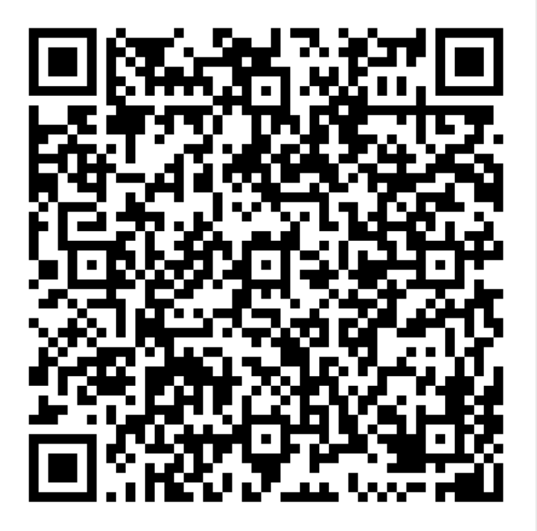
Let’s talk about today’s reading:
E. BUBOLA, M. RICH, “The Spritzes and Carbonaras that Ate Italy”, The New York Times, October 18, 2025
You can either scan the QR or go on our Moodle
Course Page to open a shared and anonymous
Google Doc. We will write our impressions/
comments here throughout the semester.
Take some time to answer
the questions, and then we
will discuss them.
https://docs.google.com/document/d/1iVeM74WLHLzy4J0Ks6a_IpA5ni5z-0UZh3XAmYVlvsM/edit?tab=t.0

Slide 8
READING / WRITING ASSESSMENT
(NOT GRADED!)
You will be handed an article by Elisabeth Rosenthal, “The Fantasy Italy”.
The text is available on Moodle as well.
Read it carefully, and then write a short text (less than 1 page)
I prefer handwriting, but it’s okay if you want to use your laptop!

Slide 9
EXIT TICKET:
As this class ends, go back to our shared Google Doc and answer a couple of questions to reflect on what we did today.

