Slide 1
The power of performance:
Rituals in imperial China
Yanhong Wu 吴艳红

Slide 2
Outline:
Rituals
Rituals in imperial China
The arrangements and requirements of the course

Slide 3
Rituals and the significance

Slide 4
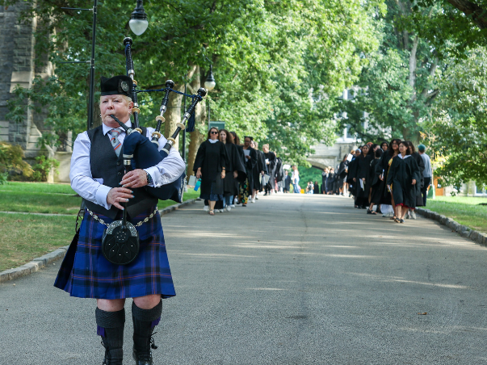

Slide 5
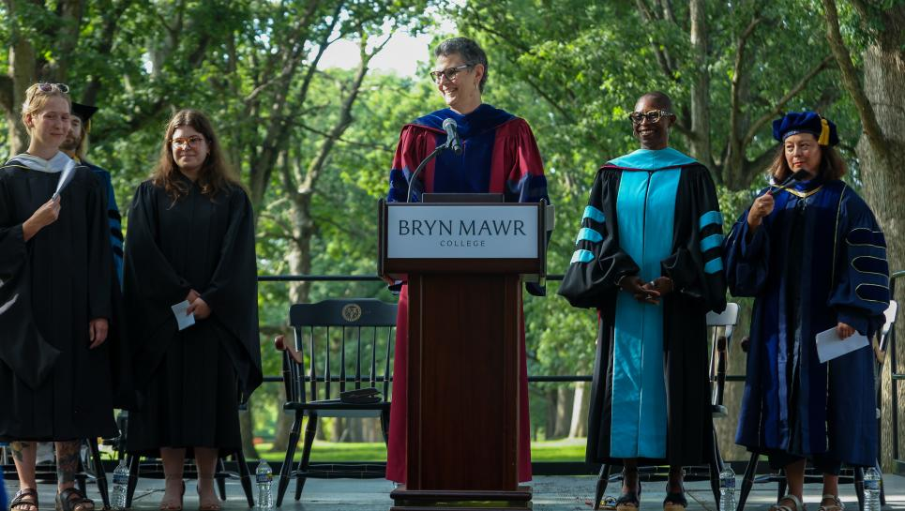

Slide 6
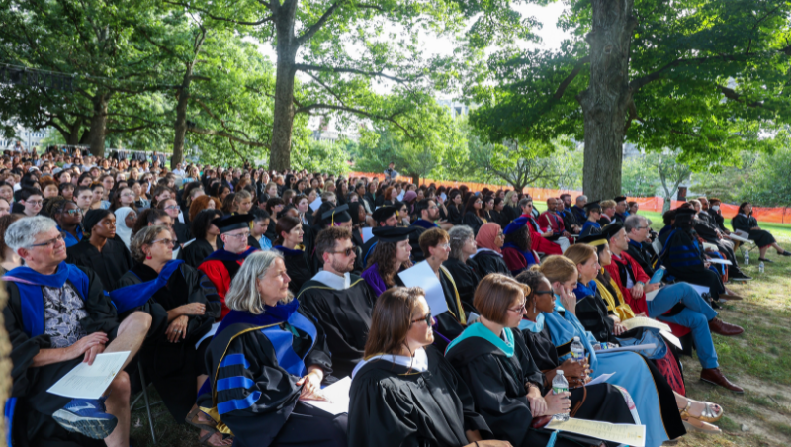

Slide 7
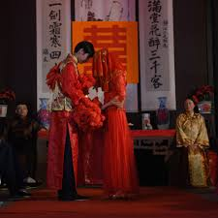
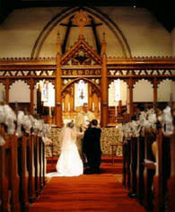
Rituals:

Slide 8
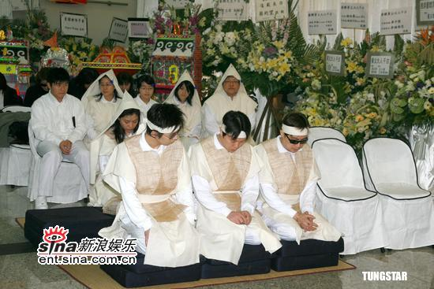
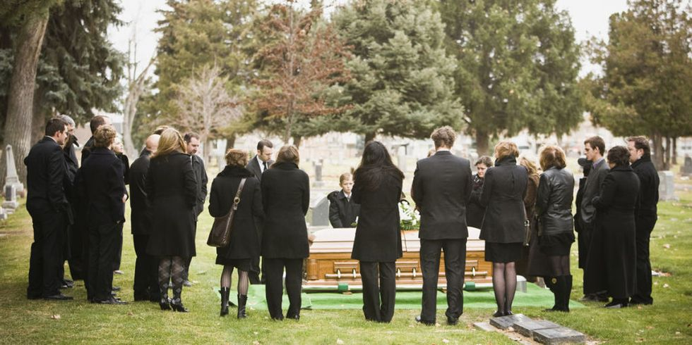
Rituals:

Slide 9
Rituals:
Behavior instead of beliefs and ideas
Repeated
Patterned
Social
Symbolic

Slide 10
Rituals:
Durkheim, Emile. 1995. The Elementary Forms of Religious Life. New York: The Free Press.
“A religion is a unified system of beliefs and practices relative to sacred things------beliefs and practices which unite into one single moral community called a Church, all those who adhere to them.” -------------p.44.

Slide 11
Rituals:
Durkheim, Emile (1858-1917). 1995. The Elementary Forms of Religious Life. New York: The Free Press.
A collective effervescence:
Participants experience a force external to them sweeping them away
They feel themselves as grander than at ordinary times
They feel joined with each other, a sense of we
Rituals and communities

Slide 12
Rituals:
Gennep, Arnold Van. 1960. The Rites of Passage. Chicago: The University of Chicago Press.
Rites of Passage：
“The ceremonial patterns which accompany a passage from one situation to another or from one cosmic or social world to another.
--p. 10.

Slide 13
Rituals:
Separation
Transition
Incorporation
The bridal/bachelor shower

Slide 14
Rituals in imperial China

Slide 15
Imperial China:
The Spring and Autumn Period 770-476 BCE
The Warring State Period 475-2221 BCE
Qin dynasty----Qing dynasty; 220 BCE-1911
The Republic of China: 1912—
The PRC: 1949—
Continuity and discontinuity

Slide 16
Rituals in Imperial China:
Li 礼
The Analects by Confucius
James Legge (1815-1897) : rules of propriety, ceremonies
Gu Hongming 辜鸿铭（1857-1928）“in the practice of art”
Education and good manners
D.C. Lau (1921-2010): “rites”

Slide 17
Rituals in imperial China
Analects: Without learning rites, you cannot establish yourself.
The Zuo commentary of the Spring-Autumn：Rituals are for governing the state, providing the foundation of the society, maintaining orders for the people, and benefiting generations.
Li JI: Rituals are the reasons.

Slide 18
Rituals in imperial China
Self Cultivation
Family management
State governance
Peace in the world
修身，齐家，治国，平天下

Slide 19
Rituals in imperial China
Rituals and Confucianism
Confucianism as the official state ideology

Slide 20
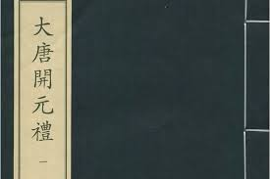
Rituals in imperial China
Official Ritual Manuals:

Slide 21
Rituals in imperial China
Ritual (Canon) of the Kaiyuan Reign of the Great Tang Dynasty
Great Tang Kaiyuan Code of Rites

Slide 22
Rituals in Imperial China:
26 articles included in the Great Ming Code(1398-1644) regarding ritual observing

Slide 23
Rituals in Imperial China:
LAWS ON RITUAL REGULATIONS
[1] In all cases where there is a death in a household, it is essential that the dead be buried in accordance with the Rituals. If, because of fear aroused by geomancy [fengshui] or on some pretexts, the coffin with the remains is kept in the house, and if for more than a year it is still exposed and the burial has not taken place, [the responsible persons] shall be punished by 80 strokes of beating with the heavy stick.

Slide 24
Rituals in Imperial China:
Institutions:
Ministry of Rites
Court of Imperial Sacrifices
Court of State Ceremonial
Directorate of Astronomy
Clerks, dancers, musicians

Slide 25
Rituals in Imperial China:
Norms:
Folkways
Mores
Laws
A unique way to regulate individual behaviors, communities, governance, and social order

Slide 26
The power of performance: Rituals in Imperial China

Slide 27
Rituals in imperial China:
Part 1: Historical context and theoretical perspectives
Part 2: Rituals and political orders
Part 3: Rituals, Communities, and Families/Lineage
Part 4: The Rites of Passage

Slide 28
Rituals in Imperial China:
The power of performance:
Character, audience
Space and place
Costumes, colors, objects
language (voice, sound) , action(motion, gesture)
Historical and social meanings

Slide 29
Rituals in Imperial China:
Historical:
Sociological and anthropological
Changes over time
Confucianism and beyond
Han vs. Non-Han traditions
Official vs. Private
Central vs. Local

Slide 30
Rituals in Imperial China:
Requirements and the composition of the final grade:
(1) Participation in class discussion (30%), 2 questions
(2) Symposiums and presentations (30%).
(3) An Observation-and-Analysis Paper (40%).

Slide 31
Readings of 9/2
Chad, Robert. 2021. Creating Confucian Authority: The Field of Ritual Learning in Early China to 9 CE. Leiden: Brill. Chapter 1, pp. 1-16; chapter 3, pp.113-130.

