Slide 1
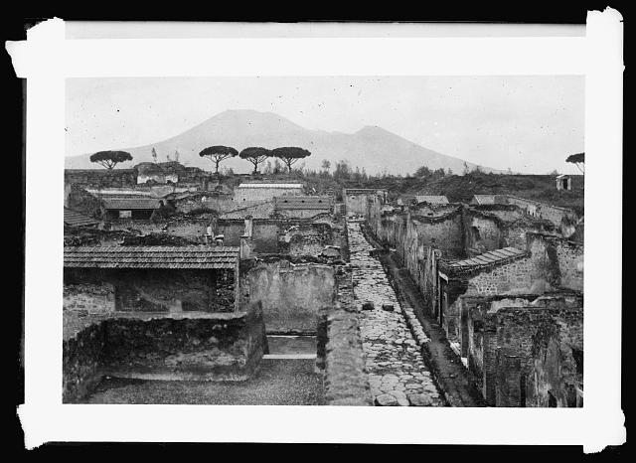
Archaeology and the Rediscovery of Pompeii
September 3

Slide 2
Upcoming Events
Map Quiz Thursday September 10
  Originally, I said we would take it at the beginning of class, but now we will take it during the last 20 mins of class.
Writing Assignment #1 September 24
  Guidelines will be posted this weekend on Moodle

Slide 3
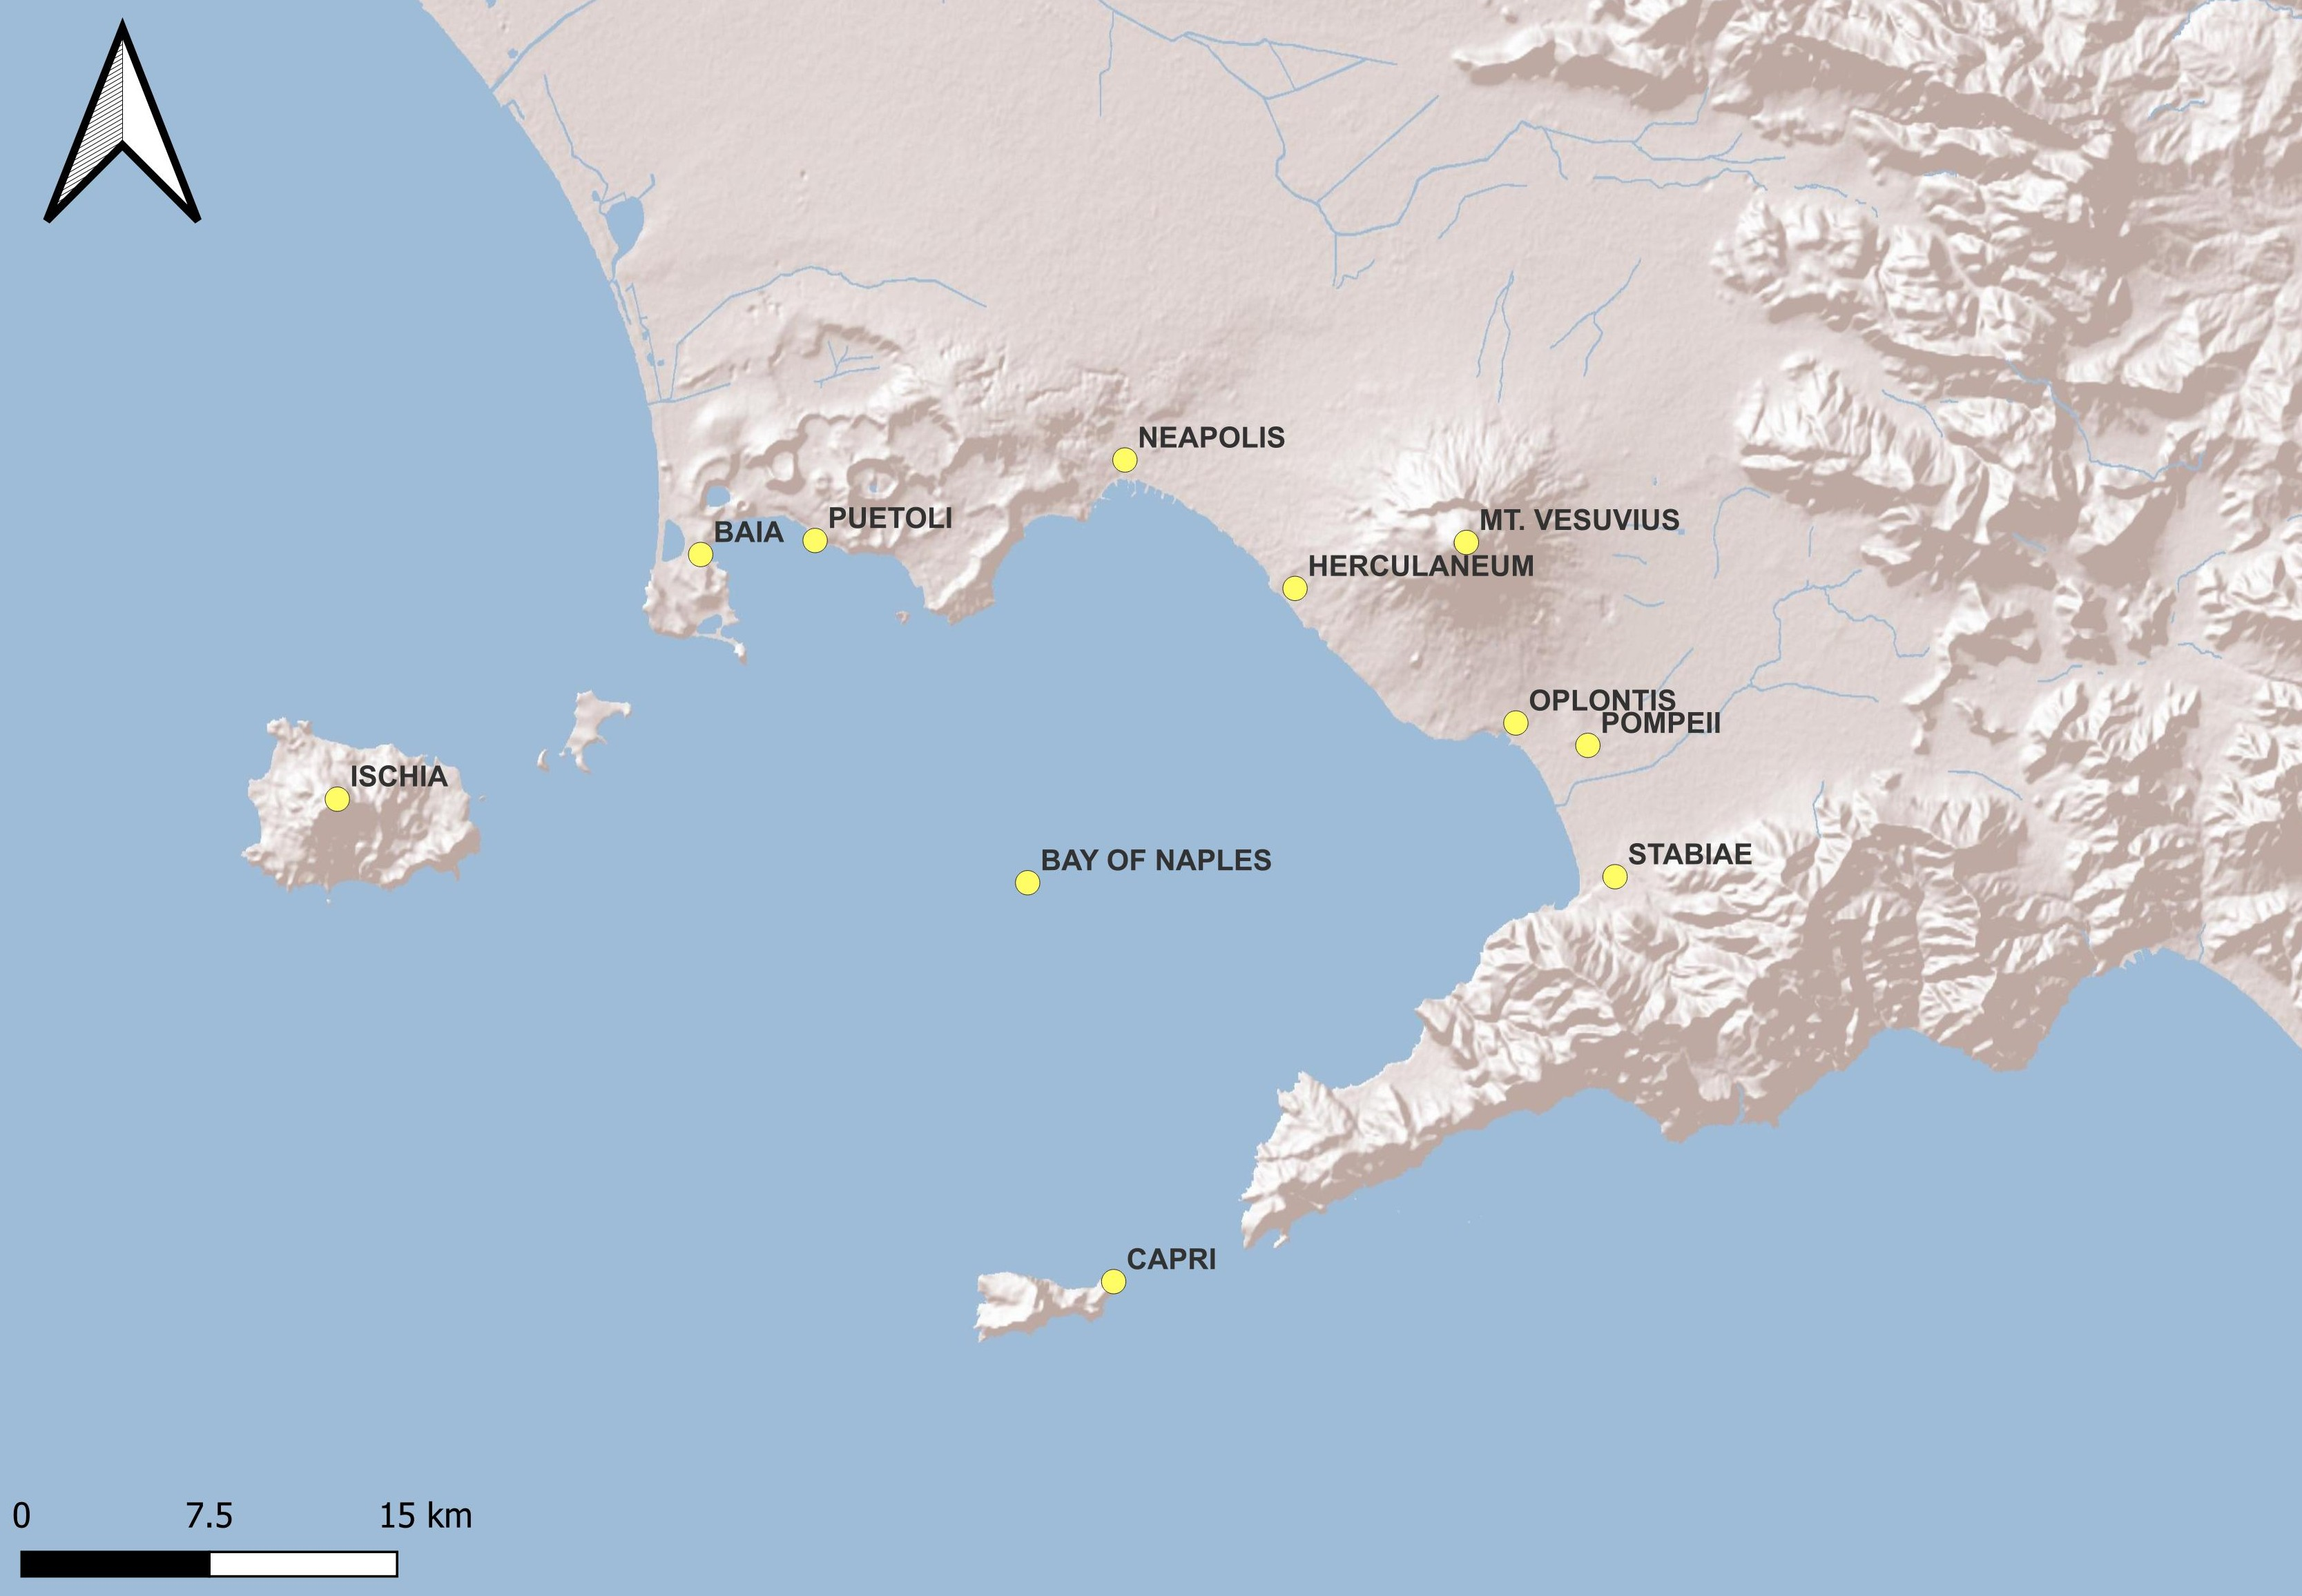
Map Quiz

Slide 4
Writing Assignment #1
Artifact/Architectural Analysis Due October 1
Describe a specific object or architectural space in detail from Pompeii or Herculaneum, moving from physical observation to an interpretation of its daily or social function. You can pick any object from the textbooks and sources provided on the syllabus. Please use scholarly sources only. Images and bibliography do not count toward word length.
500-800 words
See syllabus for formatting guidelines (i.e. citations/font/margins)
We will hopefully have a workshop with LITS on September 24. Please bring a draft of your paper for a peer review in class that day.

Slide 5
Your paper should…
Provide a general description and biography of the object or building
Where in the city is it located? Where was it found (if known)?
Consider how it might have been used in daily life

Slide 6
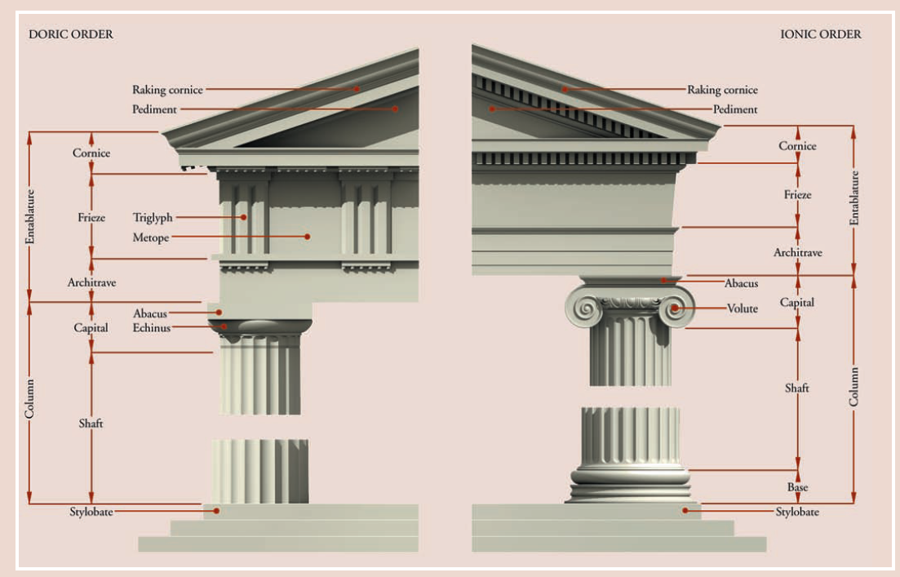
Quick Recap
Went over the syllabus
  Any questions?
Quick review of Roman archaeology
  Architecture, masonry styles, pottery, religion
Introduced the Bay of Naples and Campania and the major sites we will discuss in class.
We discussed Mt. Vesuvius and the eruption

Slide 7
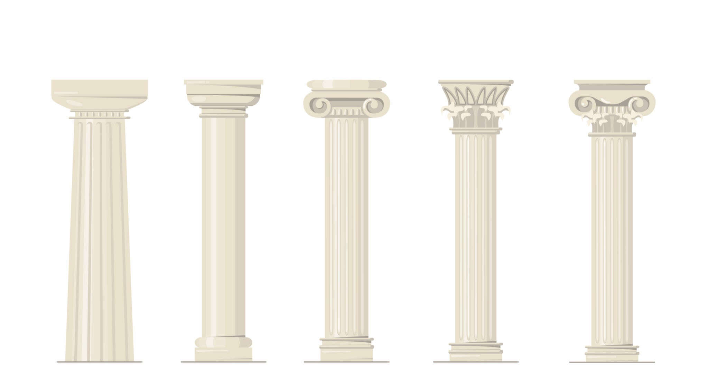
What were the capital types employed by the Romans?

Slide 8
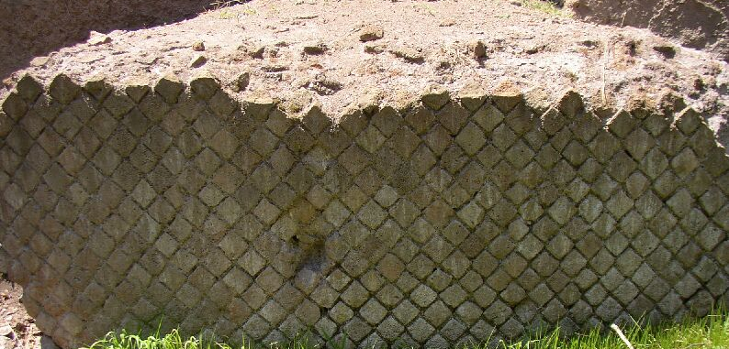
What type of masonry style is this?

Slide 9
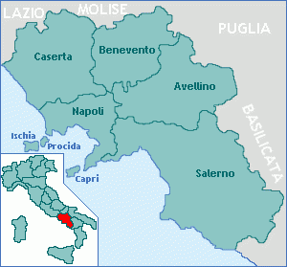
Pompeii is located in what region of Italy?

Slide 10
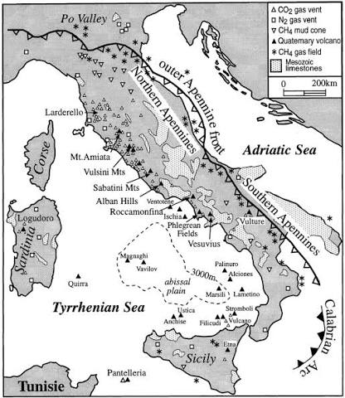
The Campanian volcanic arch, to which Mt. Vesuvius is part of, is formed by the collision of what two tectonic plates?
What year did Mt. Vesuvius erupt and destroy Pompeii?

Slide 11
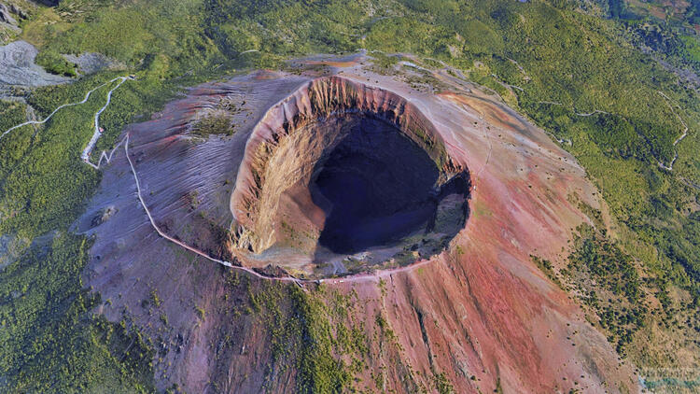
Which Roman geographer recorded his description of the eruption?

Slide 12
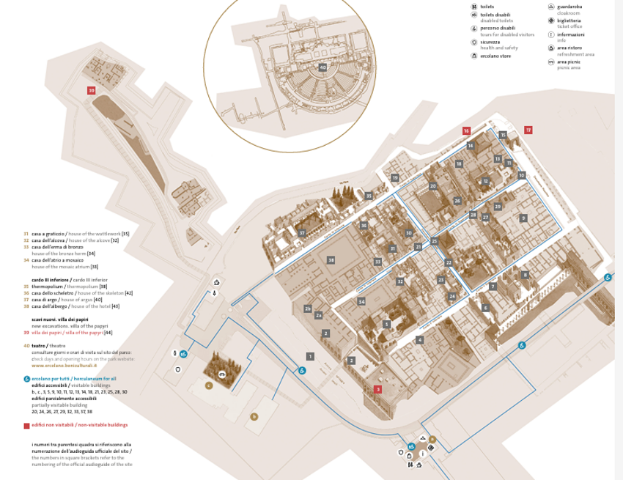
The Rediscovery of Herculaneum
1709 pieces of colored marble were found when digging a well in Resina (near Herculaneum).
1711-1716: Emmanuel Maurice de Lorraine, Duke d’Elbeuf and Prince of Lorraine bought the land to loot artifacts to decorate his estate in Portici and smuggle artifacts to Europe.
Excavated the area of the Roman theater, finding many marble statues.

Slide 13
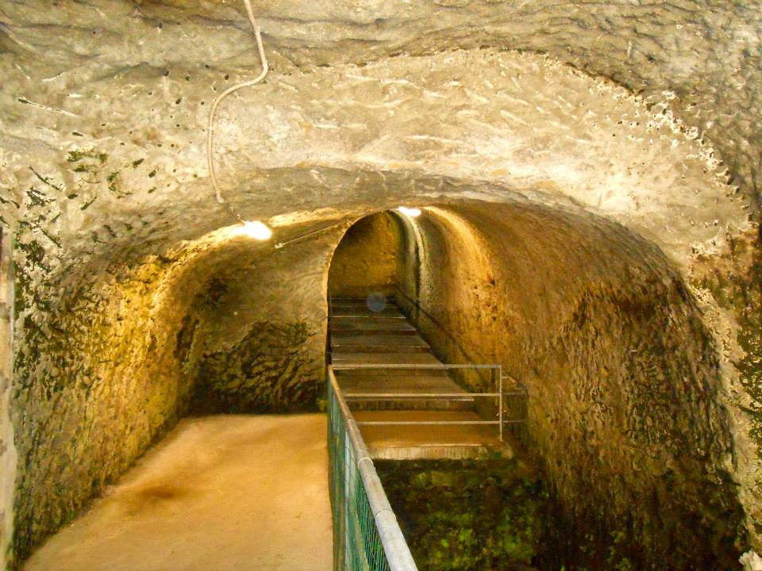
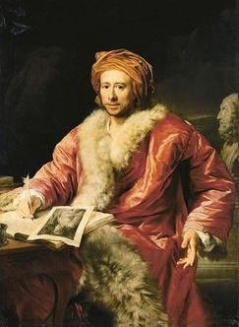
The Spanish Bourbon Excavations
1735: Charles III of Spain, King Sicily and Naples (1735-1759)
  Conducted secret excavations at Herculaneum
  Looking for sculptures to decorate his villa
Rocque Joaquin de Alcubierre
  Military engineer trained in mining techniques and tunneling
  Used miners, soldiers, and prisoners to dig tunnels along the ancient walls
  Discovered the basilica, theater, Villa de Papyri, and palaestra
Notes:
Why would tunneling be a problematic excavation style?

Slide 14
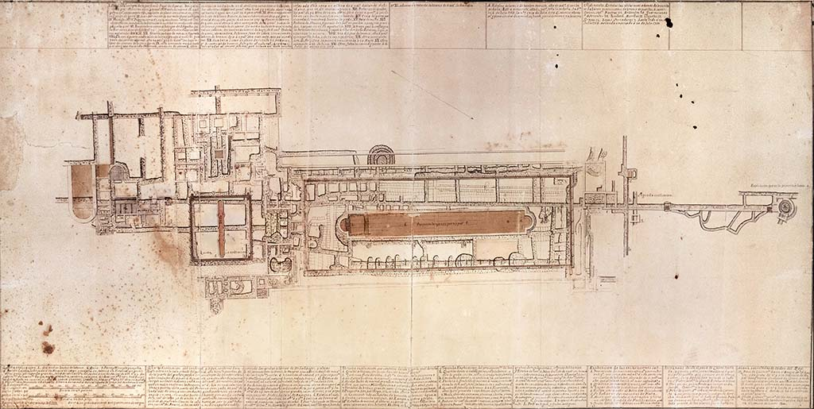
Karl Jakob Weber
  Swiss archaeologist and military engineer of the Royal Guard
  Served as an assistant to Alcubierre
  First person to take a systematic approach to excavation and documentation
  Published first drawings
  These drawings later served as a guide for the Getty Villa in Malibu

Slide 15
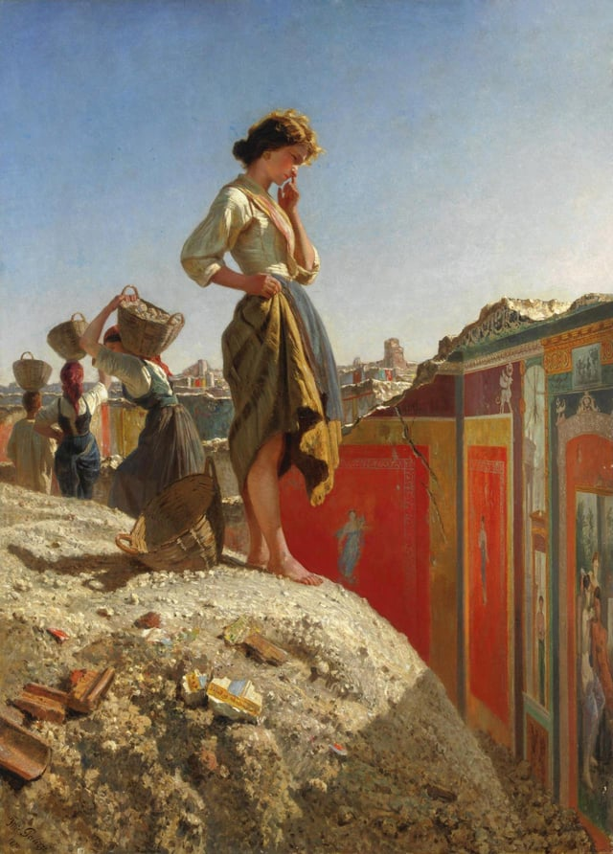
Discovery of Pompeii
1748: Digging in area areas known as “La Civita” discovered several small finds, but were not very exciting. The focus was shifted back to Herculaneum.
This site was originally though to be the site of Stabiae, a coastal town also buried by Mt. Vesuvius.
In 1755, work resumed at Pompeii at the Praedia of Julia Felix
  Early excavations dug like a quarry, with no plan or methodology. Basically, treasure hunting.
  Wall paintings were ripped from the walls and taken to Bourbon palaces in Naples and Portici. Objects deemed uninteresting were destroyed.
In 1755, a law is passed forbidding exports of antiquities. Which allowed the objects from Herculaneum and Pompeii to stay in Naples.
In 1763 an inscription found at La Civita names the city Pompeii: Respublica Pompeianorum
Excavations continued in the theater district as well as the Temple of Isis.
Filippo Palizzi, Pensive Girl at Pompeii Excavations (1865)

Slide 16
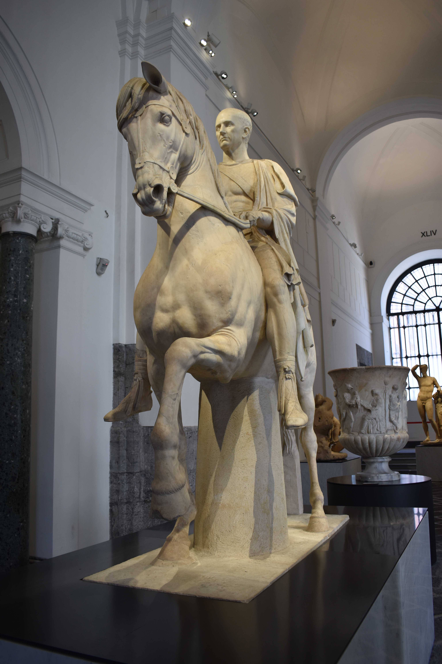
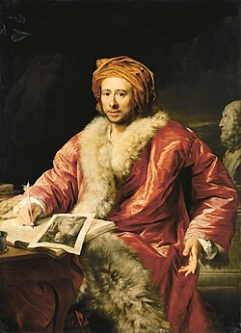
Neoclassicism and Europe in the late 18th and 19th century
Neoclassicism: an artistic, architectural, and literary movement starting in the mid-18th century
Emphasis on “classical education” for adult upper class males
Promotion of early tourism in the “Grand Tour”
  Increase in tourists at Pompeii and Herculaneum
Johann Joachim Winckelmann (1717-1768)
  Archaeologist and art historian, pioneer of categorization by style rather than chronology
  Geschichte der Kunst des Alterthums (1764)
  Published some of the first findings at Herculaneum for the general public: Sendschreiben von den Herculanischen Entdeckungen (1762)
  Critical of the excavation methods at Herculaneum, especially the secrecy, looting, and careless destruction under the Bourbons.
Notes:
Winckelmann
Foucault
Levi-Strauss
Bourdieu

Slide 17
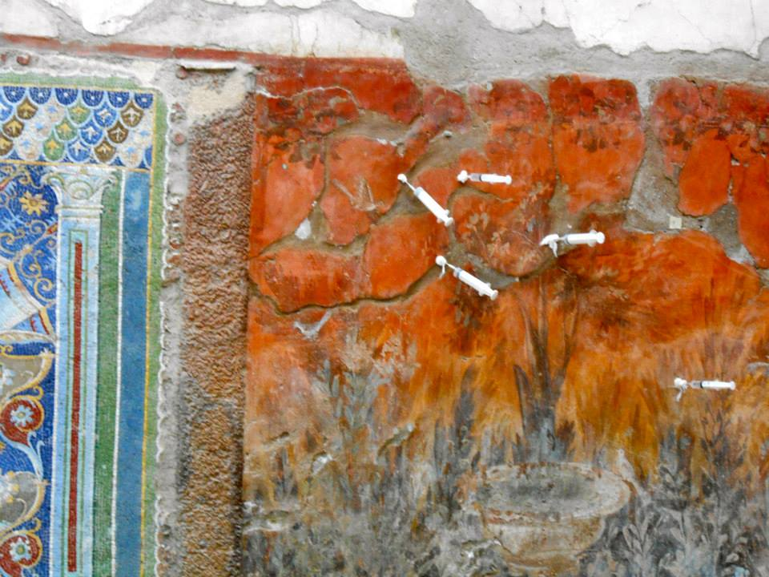
Early Conservation
1780
  First attempts at conserving wall paintings made
  Adding roofs to houses to protect them from the elements
  Some artifacts returned to the site for visitors to see in person

Slide 18
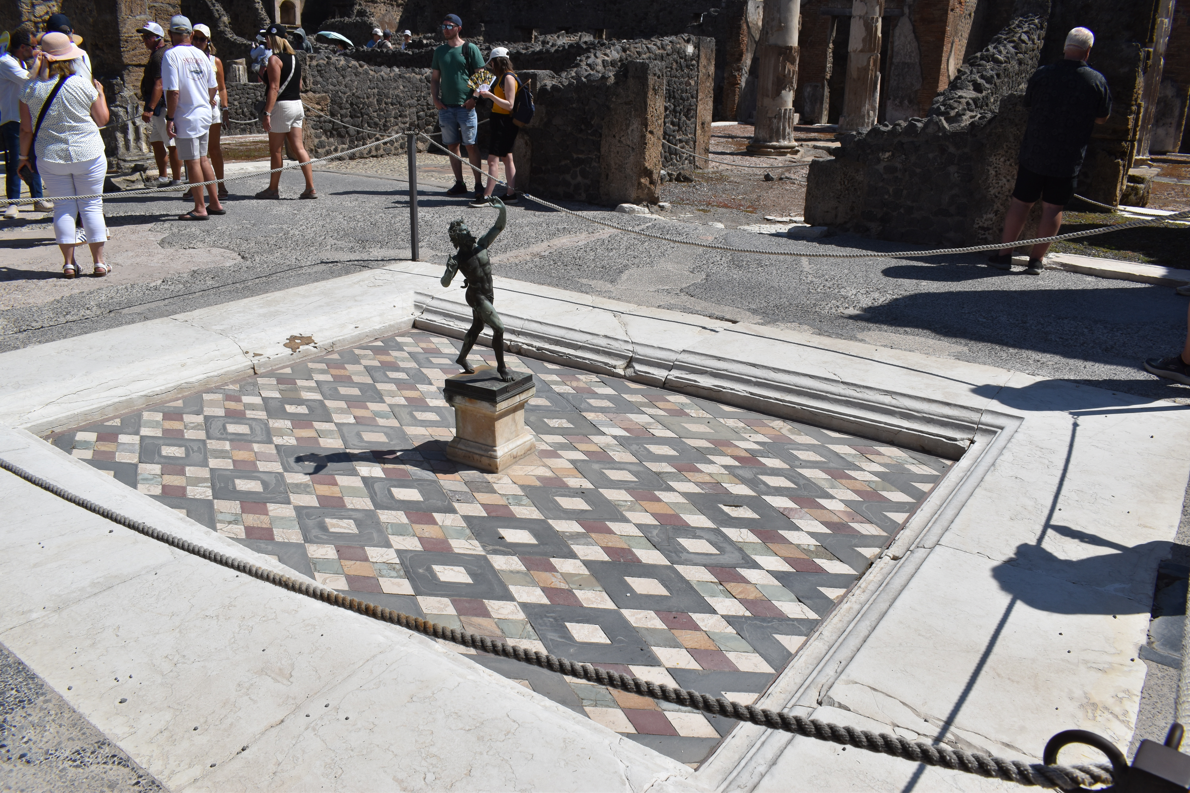
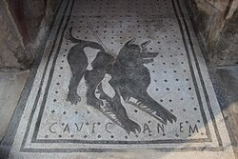
Napoleon and Italy
1806 French conquest of Naples
First scholarly studies published (Mazois 1812) that were widely distributed to other European scholars
Continued excavations at Pompeii, excavating town walls, amphitheater, forum and main roads
Bourbon restoration 1815 under Ferdinand I (King of the Two Sicilies)
  Continued working in the same areas as under Napoleon
  During this time the Forum Baths, House of the Tragic Poet, and House of the Faun were discovered.

Slide 19
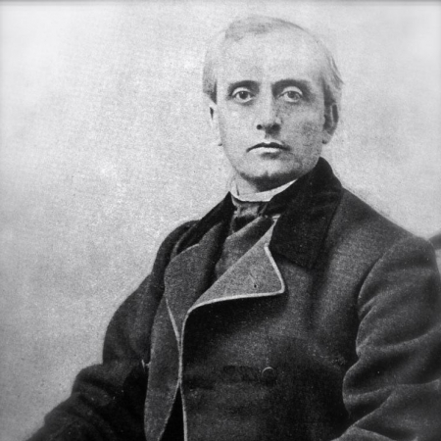
Guiseppe Fiorelli
In1859, Italy is unified (Risorgimento) for the first time since the Roman Empire ended under Giuseppe Garibaldi.
By this time only 1/3 of Pompeii had been excavated (~22 HA).
Fiorelli was a local Italian who was a lawyer and trained numismatist.
In 1863, he became the director of the Naples Museum and Pompeii excavations.
Allowed to visitors to visit the site, charging an entrance fee.
  First time the site was open to the Italian people and general public.

Slide 20
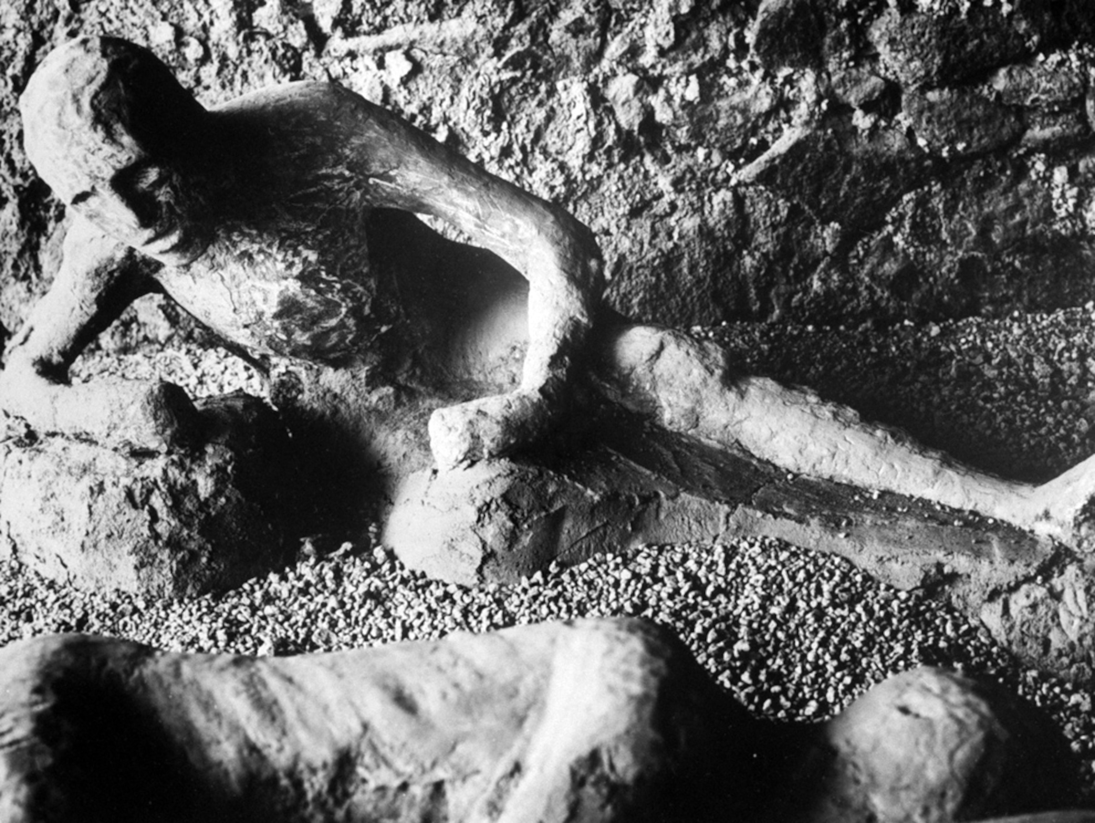
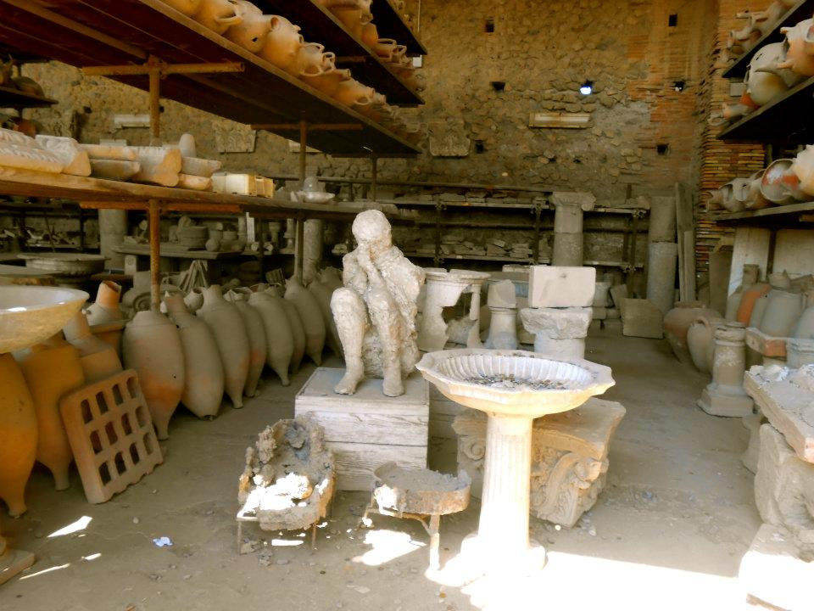
Pompeii’s Plaster Casts
Fiorelli is famous for making plaster casts of the bodies, a technique which had already been used for furniture on the site using Plaster of Paris.
The plaster casts are not mummies, a common misconception. They are the cavities created by the decomposition of the bodies after the ash of eruption hardened into a cement. During excavation, plaster was poured into these cavities to create an impression.
These impressions preserve the final position of the deceased, and many casts show details like clothing and facial expressions.
The skeletons of the bodies are still inside the casts, allowing for DNA studies to be done today on the remains. Many of the victims found together are not actually related and several are of Eastern Mediterranean and North African origin. This challenges many of the initial interpretations of the casts.
  Pilli, Elena, Stefania Vai, Victoria C. Moses, Stefania Morelli, Martina Lari, Alessandra Modi, Maria Angela Diroma et al. "Ancient DNA challenges prevailing interpretations of the Pompeii plaster casts." Current biology 34, no. 22 (2024): 5307-5318.

Slide 21
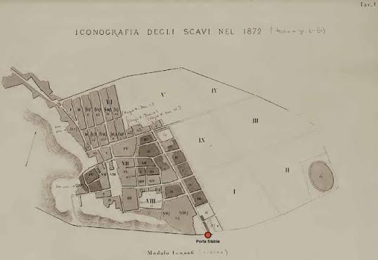
Fiorelli’s Legacy
Excavations became more systematic, excavating by layers rather than tunnels or unplanned digging.
  This method of excavating kept buildings from collapsing and offered better preservation.
Subdivided the city into regions (regio), insulae, and doorways. This system of categorization is still used today.
  Example: House of the Meander is I.10.4
Created the first accurate plan of Pompeii
Published previous campaigns under the Bourbons and his own excavations making Pompeii accessible to scholars
He did not believe in the reconstruction the monuments
He refused to let artifacts be exported.
  As a result, a number of unauthorized and unsupervised excavations took place on private land outside the site .
1874 Fiorelli left his position at Pompeii

Slide 22
The Political side of Archaeology
Unification of Italy under Garibaldi (1848-1871)
  Used archaeology as a way to create a narrative of unification of Italy
  That it was inevitable the Italy unify as it once was, a return to past greatness.
Garibaldi immediately signed decrees transferring royal art and archaeological collections, including Pompeii, to public state ownership. Pompeii was reframed as a shared cultural asset belonging to all citizens of the new, unified Italy.

Slide 23
Fascist Italy
Benito Mussolini took the political use of archaeology to an extreme, transforming historical heritage into totalitarian propaganda centered on Romanita ("Romanness").
Mussolini declared that his regime was the "Third Rome" (following Imperial Rome and Papal Rome).
He presented Fascism not as a new ideology, but as the natural rebirth of the Augustan Roman Empire.
Archaeological digs were heavily funded in order to uncover physical proof of Roman dominance to justify Fascist imperial expansion into East Africa and the Mediterranean.

Slide 24
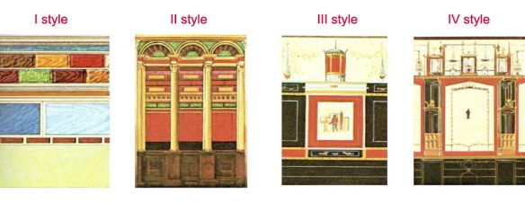
Pompeii in the 20th and 21st centuries
New attempts were made to preserve the wall paintings
  Famous study by Augustus Mau, a German art historian and archaeologist working for the DAI (German Archaeological Institute).
  Mau tried to classify Roman wall painting styles, dividing them into four distinct styles,
Excavation was paused during the World War I and II.
  The Allies bombed Pompeii during WW II while the Germans hid in the ruins of the site
1962: complete restriction of the excavations. New focus on preservation. At this point 2/3 of the site has been excavated.
In 1999, a moratorium on large scale digging, restricting projects to research and micro-digs. Allowing for re-excavation of already opened buildings.
Recently, there has been a renewed interest in the pre-79 CE material and earliest remains of Pompeii.

Slide 25
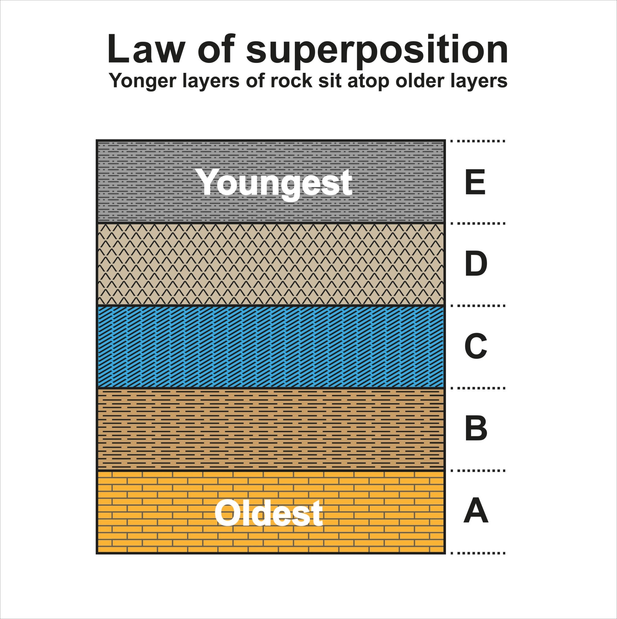
Archaeological Excavation Methods
The Law of Superimposition
In 1669 Nicolas Steno, a Danish scientist formalized a scientific like based on geology.
The law states that in any undeformed sequence of sedimentary strata, the oldest layers rest at the bottom, and each overlying layer is progressively younger.
Principle of Horizontality: Sedimentary layers and soil strata are initially deposited in nearly horizontal positions due to gravity. Deviations from horizontality point to subsequent tectonic or human-induced disturbances.

Slide 26
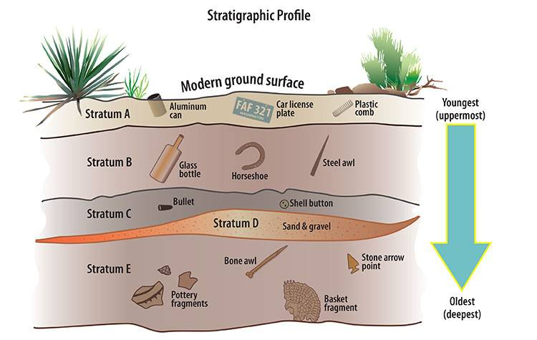
Reading Soil Strata
Relative chronology: established the order of events (what came before what)
Stratification layers: each layer represents a discrete window of time marked by distinct soil composition, color, or sediment

Slide 27
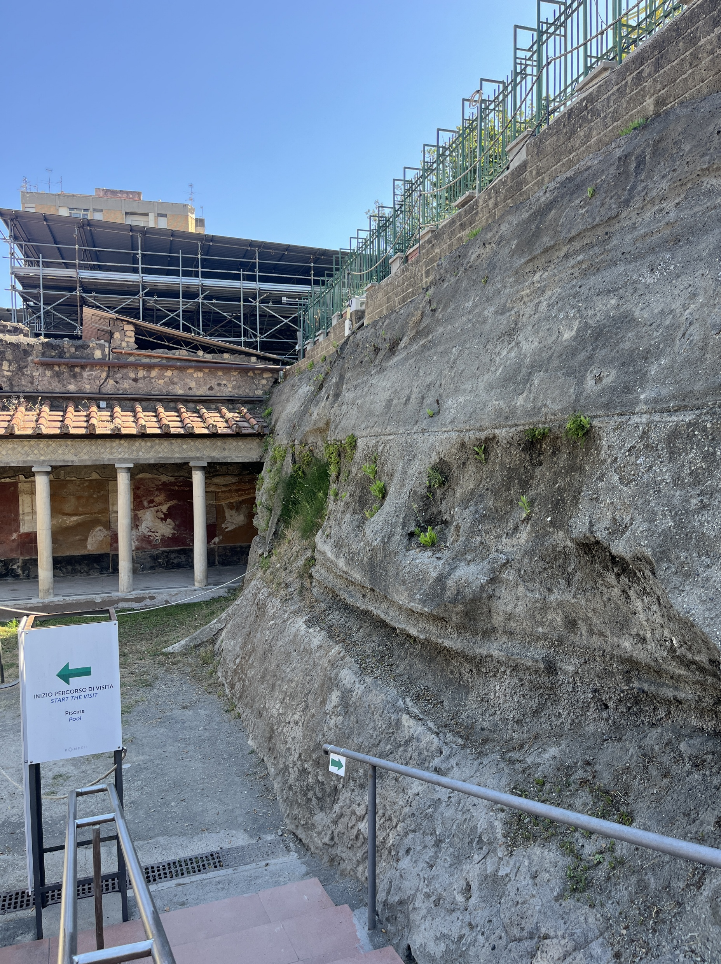
Adoption into Archaeology at Pompeii
Fiorelli in the 1860’s was the first to adopt the top-down grid method of excavation.
This means that digging was done systematically from the modern surface downwards, rather than tunneling
This preserved fragile stratigraphy and wall paintings
It also introduced precise grid coordinates (regiones and insulae) to document artifacts provenance.

Slide 28
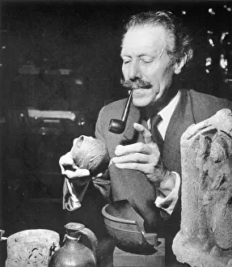
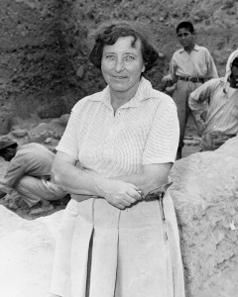
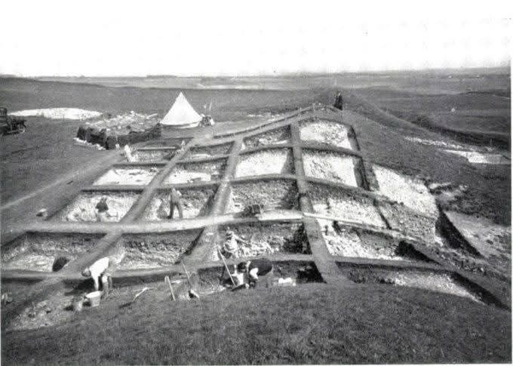
Sir Mortimer Wheeler and Kathleen Kenyon
Grid square method of excavation
Also known as the Wheeler-Kenyon method revolutionized archaeology in the mid-20th century
The technique involves dividing the site into a regular grid of square trenches (5x5 or 10x10 m) separated by earthen walls called baulks (usually 1 m wide)

Slide 29
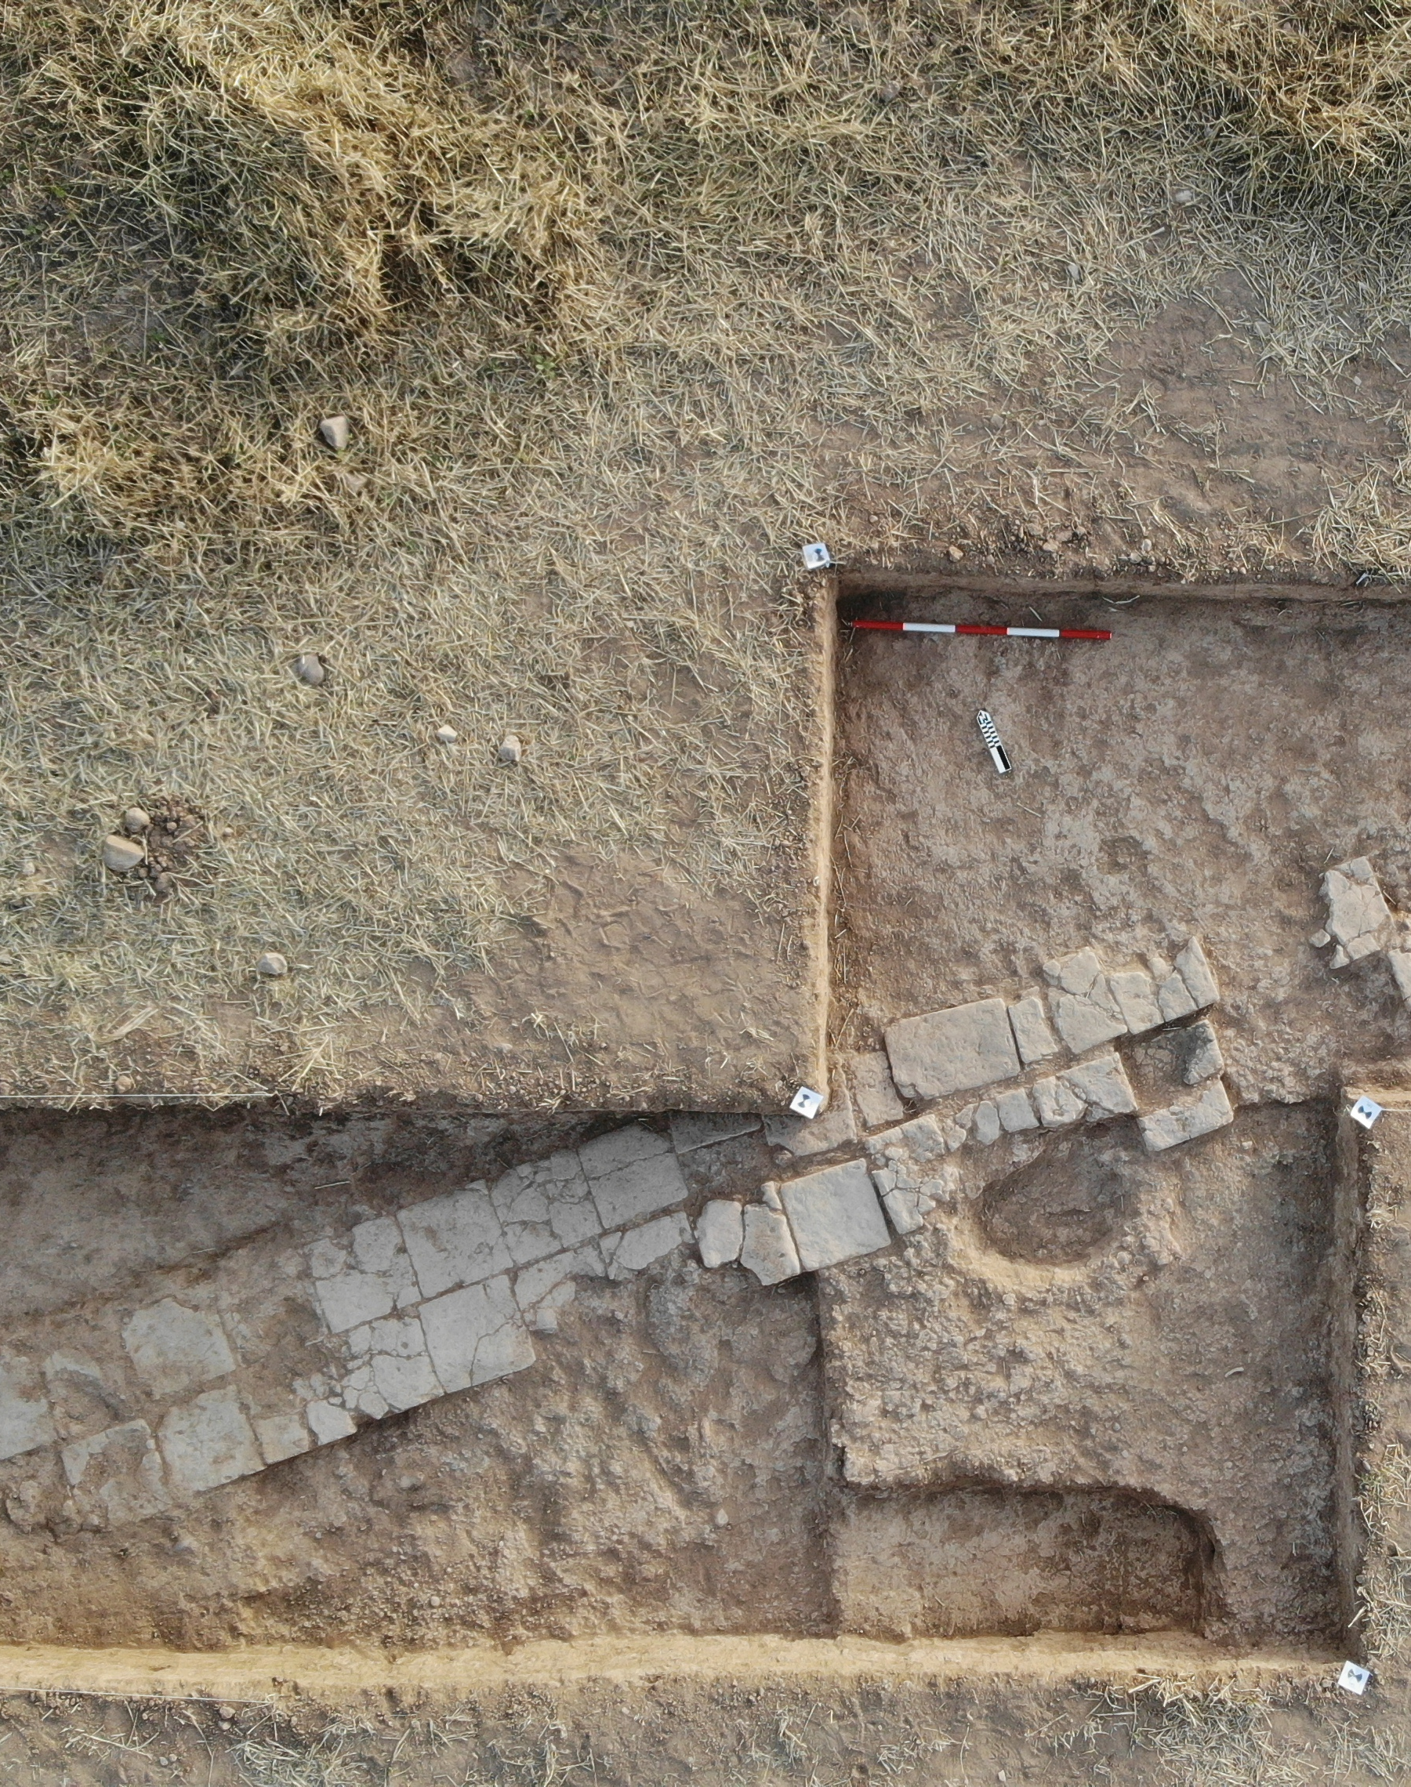
Open Area Excavation
Pioneered by British archaeologist Philip Bakre
Developed in the late 20th century
In response to the Wheeler-Kenyon grid system, as he believed the baulks hid spatial relationships
His technique removed the baulks to uncover large, continuous surfaces at once

Slide 30
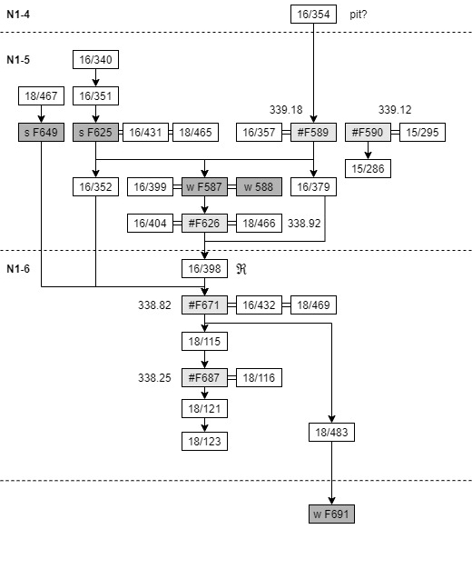
Harris Matrix
Developed in 1973 by Edward C. Harris
It is a tool used to depict and analyze the stratigraphy of the excavation sites
Operates on single-context recording: each action, layer, or change on site is given a unique context number

Slide 31
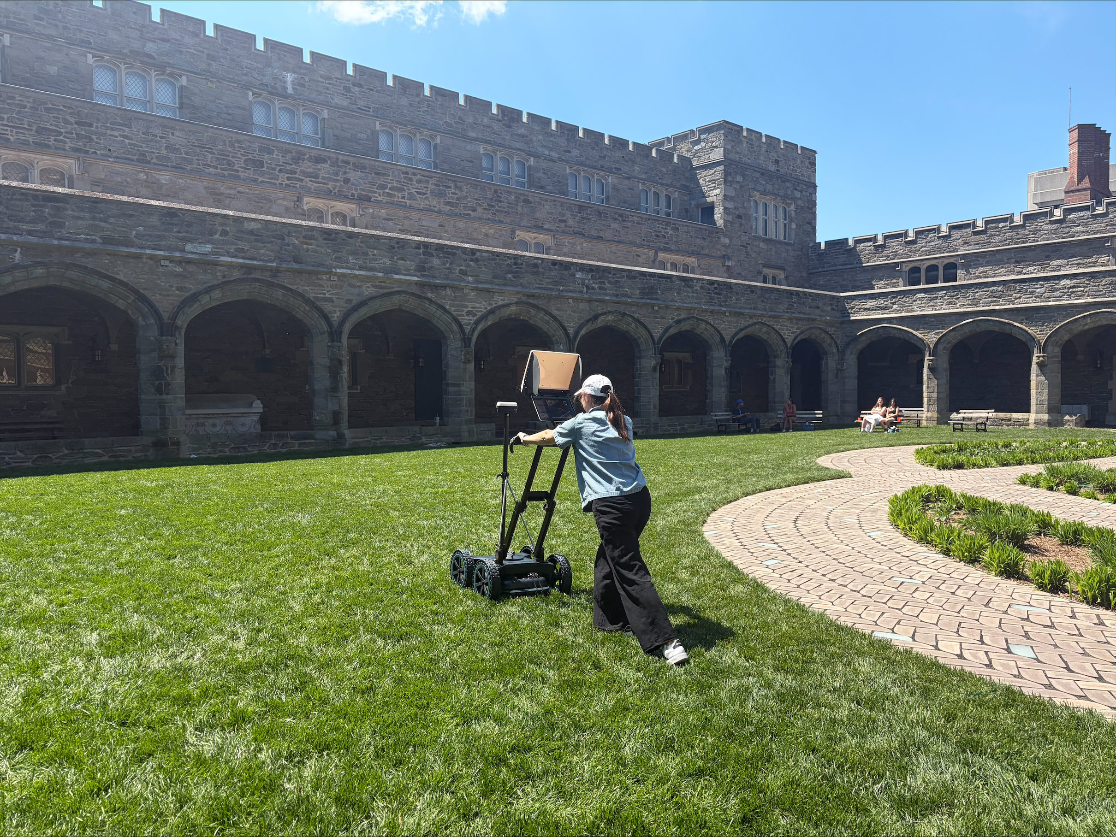
Non-invasive methods
Archaeology=Destruction
Geophysics and Remote Sensing
  Ground-penetrating radar (GPR)
    Sends electromagnetic pulses into the soil and records the reflections of buried features
  Magnetometry
    Detects localized anomalies in earth’s magnetic field, like fired ceramics
GIS (Geographic Information Systems)
LiDAR (light detection and ranging)
Photogrammetry: 3D modelling

Slide 32
Modern Specializations within Archaeology
Bioarchaeology
  Scientific study of human and biological remains
Zooarchaeology
  Study of animals remains
Archaeobotany
  Analysis of plant remains
Material Sciences and Archaeometry
  Petrographic analysis like XRF
  Scientific dating methods like Radiocarbon Dating and Thermoluminescence
  DNA studies
  Isotope analysis, like Strontium

Slide 33
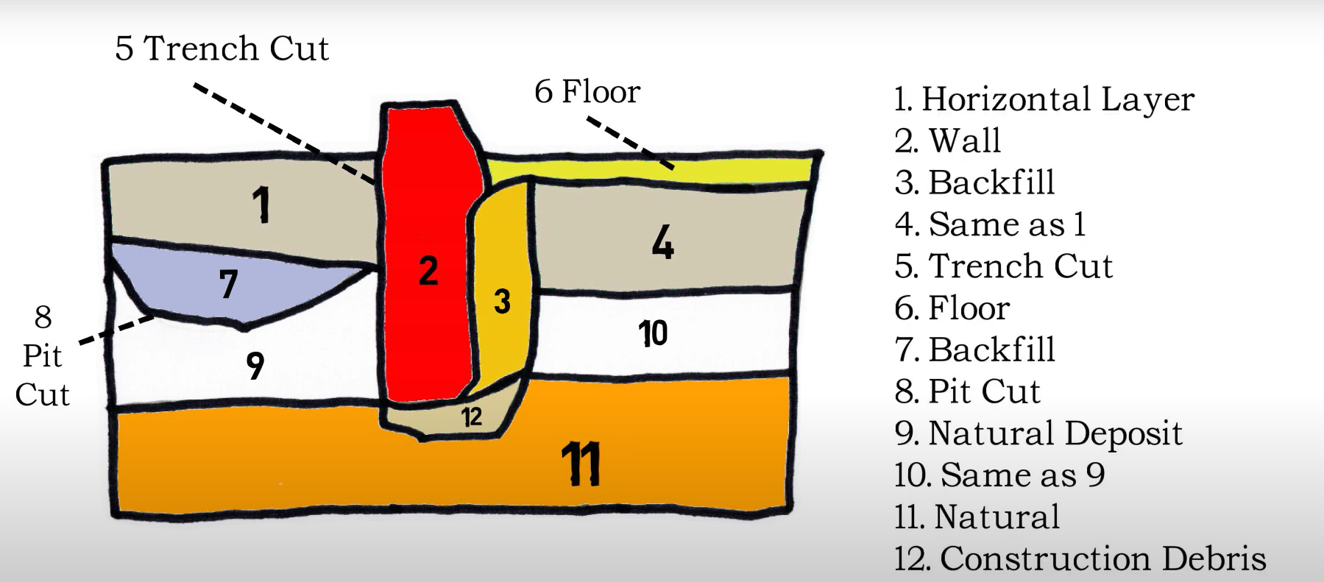
Stratigraphy Exercise

