Slide 1
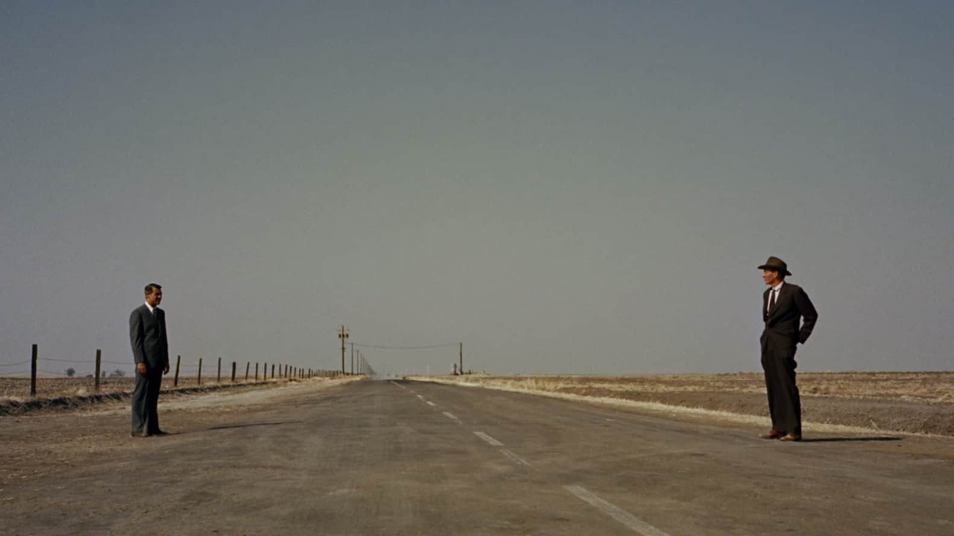
long or wide shot

Slide 2

medium shot

Slide 3
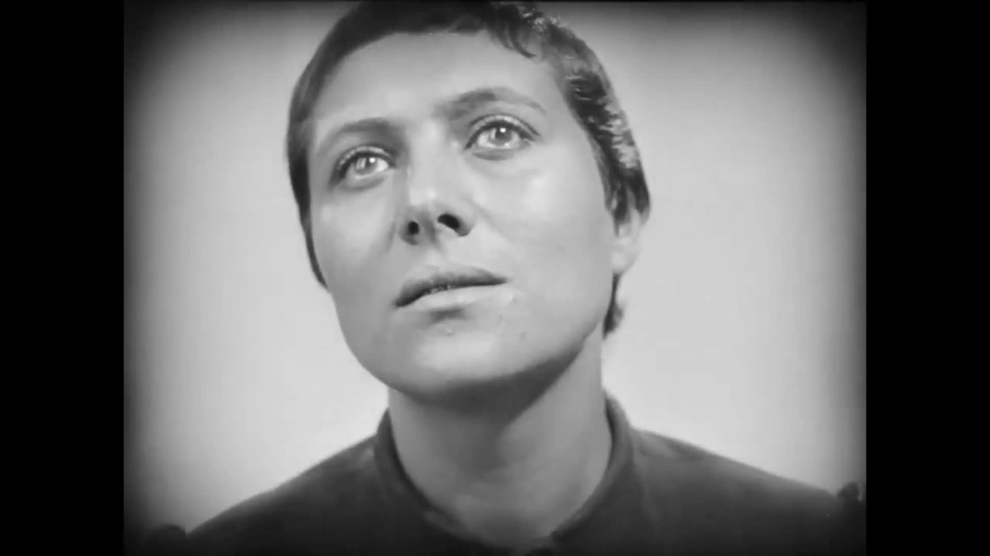
close-up

Slide 4
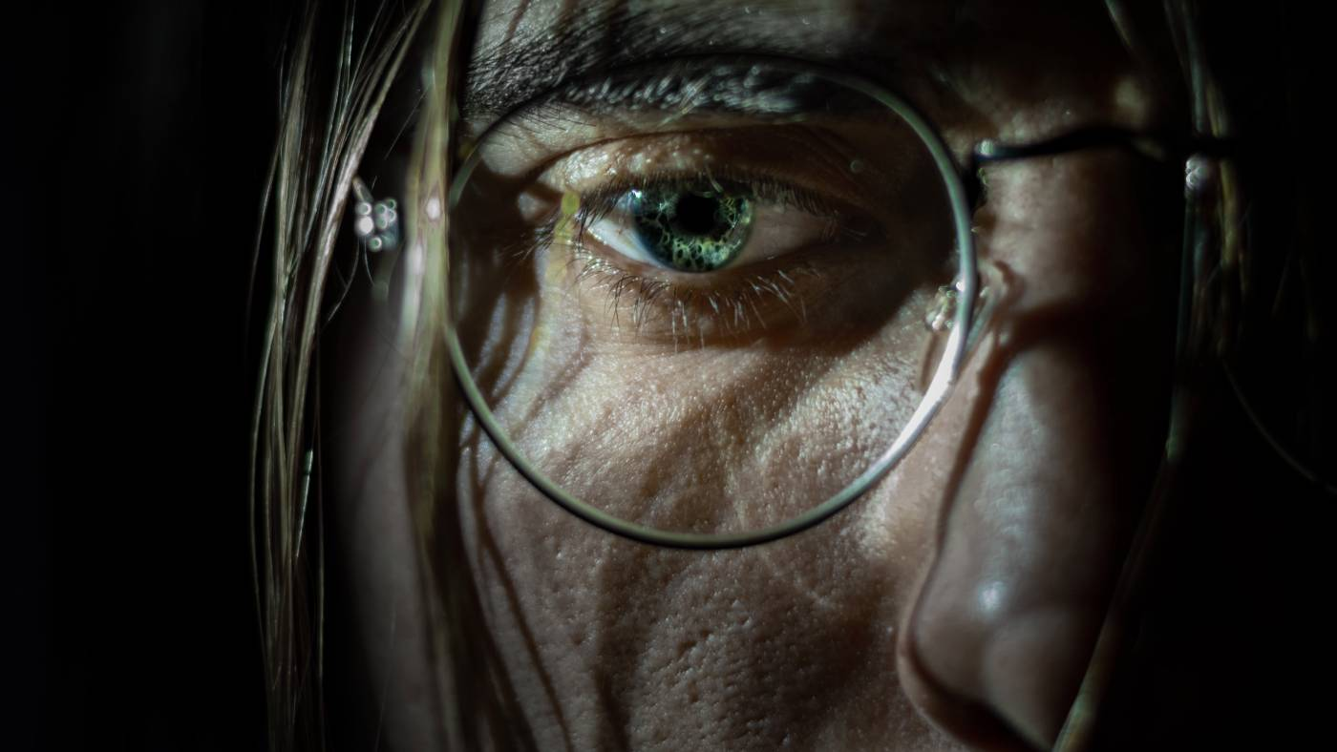
extreme close-up

Slide 5
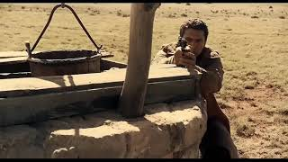
pan shot

Slide 6
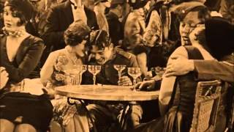
tracking shot

Slide 7
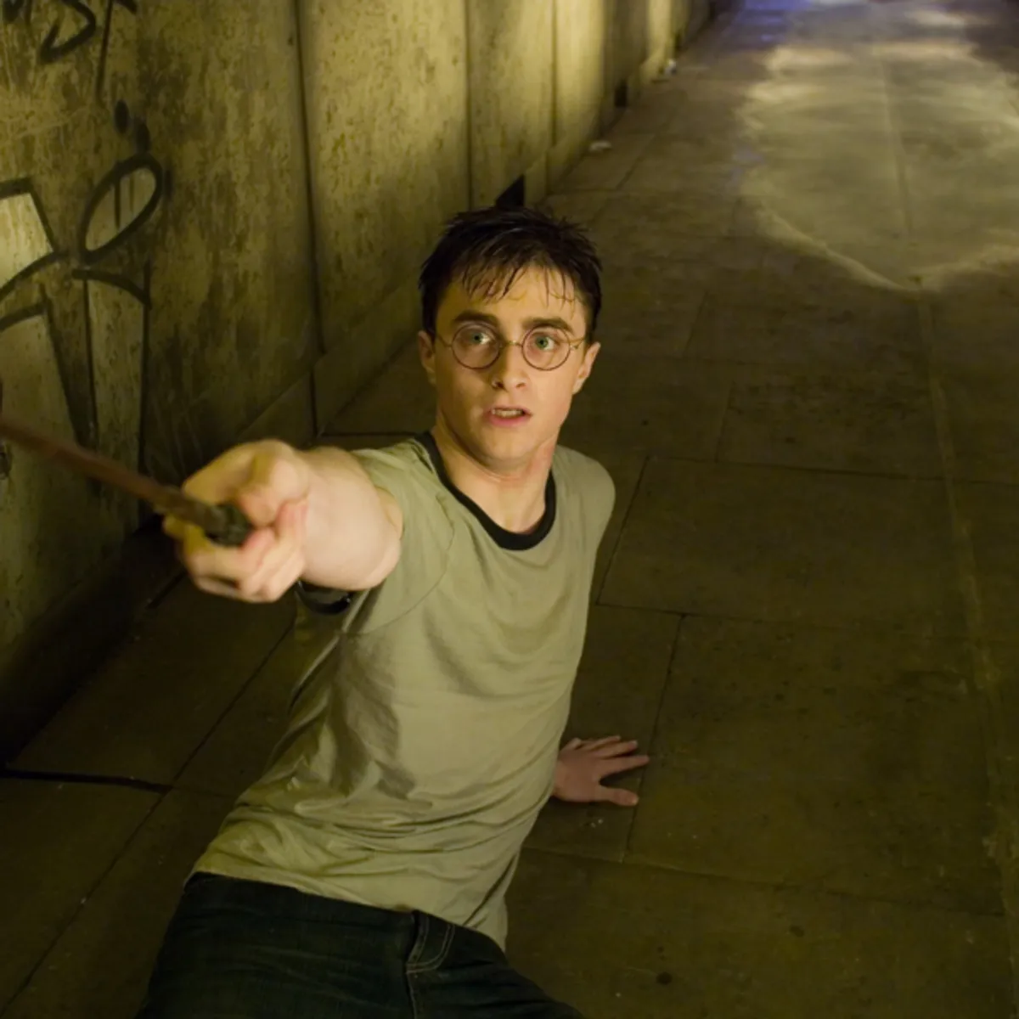
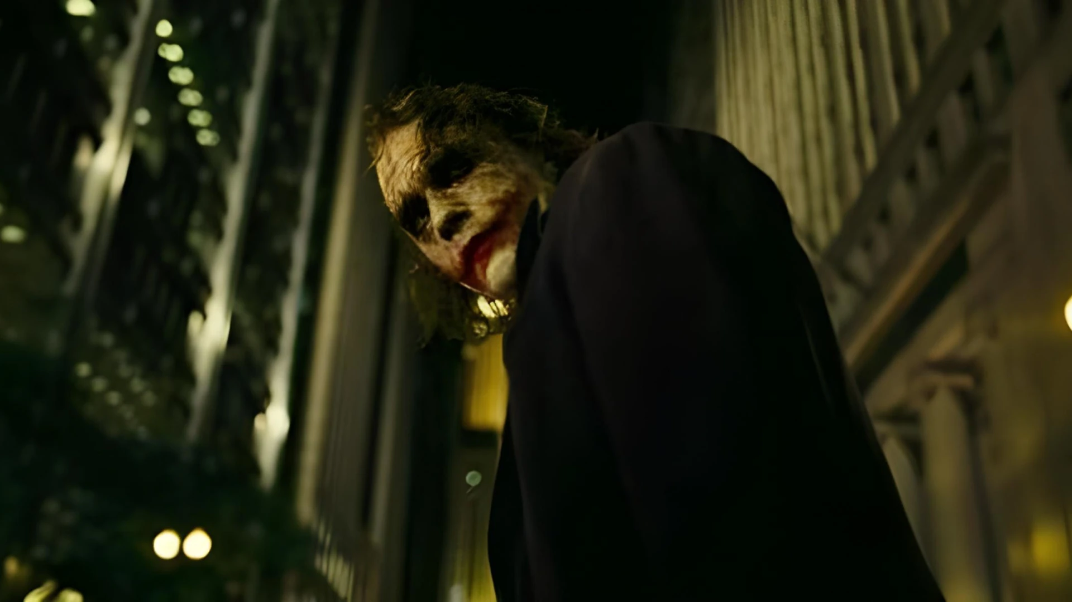
high-angle v. low-angle shots

Slide 8
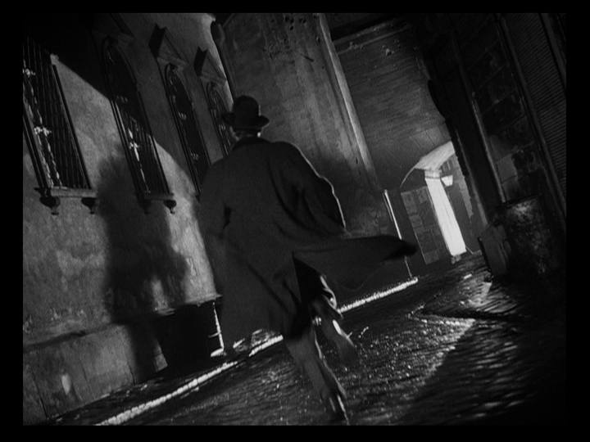
canted angle (or Dutch angle)

Slide 9
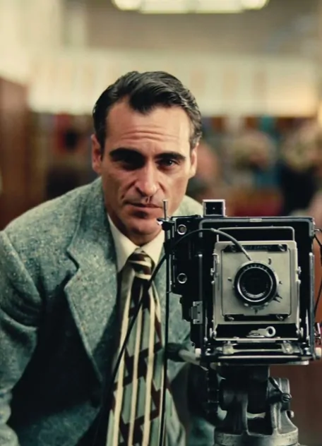
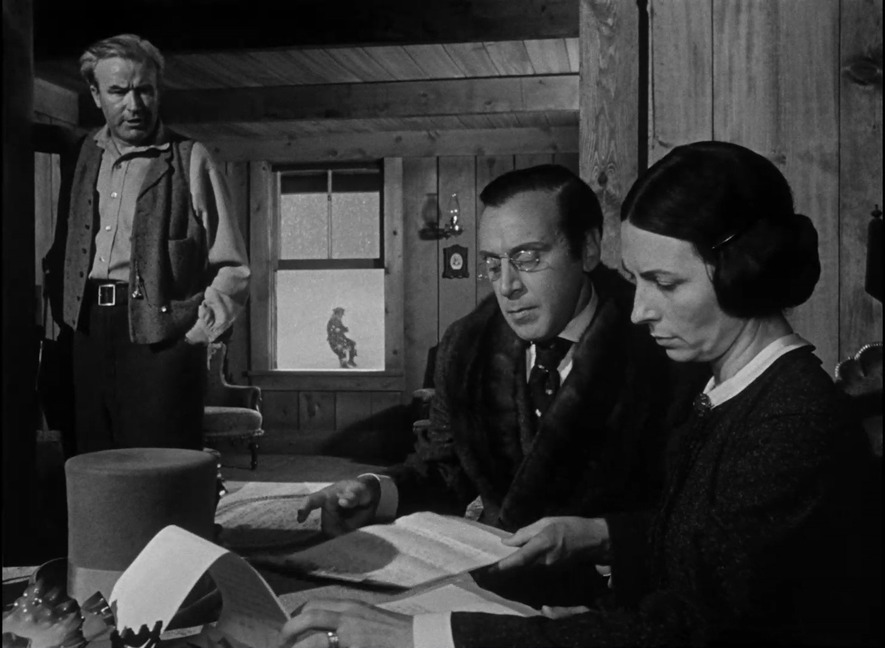
shallow (or soft) focus vs. deep focus

Slide 10

cuts (in the form of, specifically here, jump cuts)

Slide 11
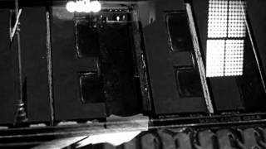
dissolve

Slide 12
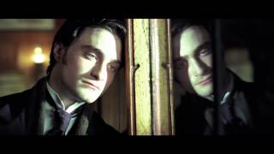
fade in/fade out

Slide 13

iris-in, iris-out

Slide 14
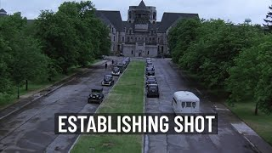
establishing shot

Slide 15
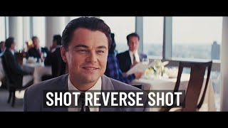
shot/reverse-shot

Slide 16
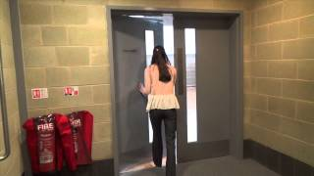
match-on action

