Slide 1
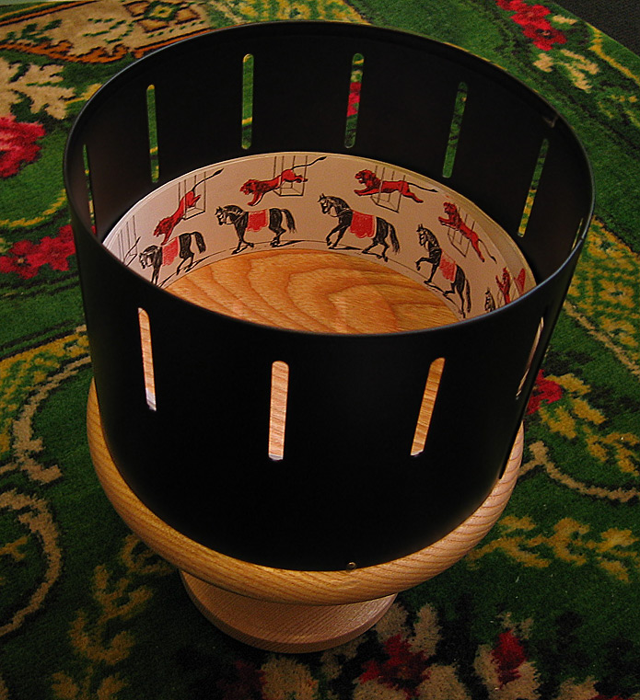
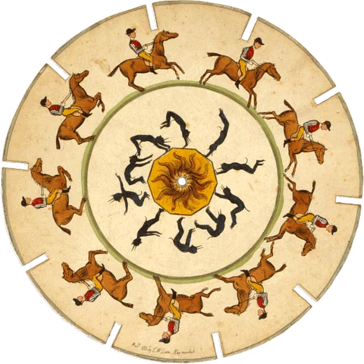
Stroboscope (1833)
Zoetrope (1866)

Slide 2


Slide 3
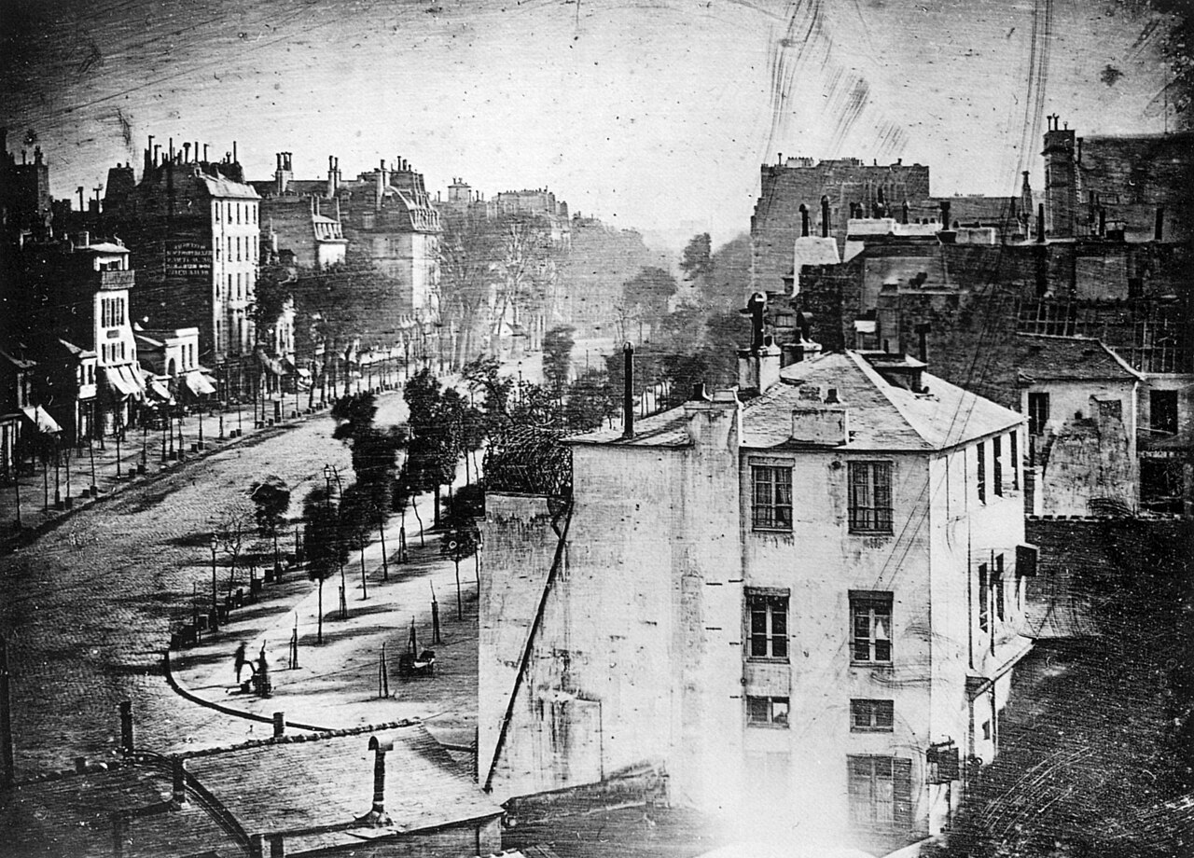
Boulevard du Temple, by Louis Daguerre (1838)

Slide 4
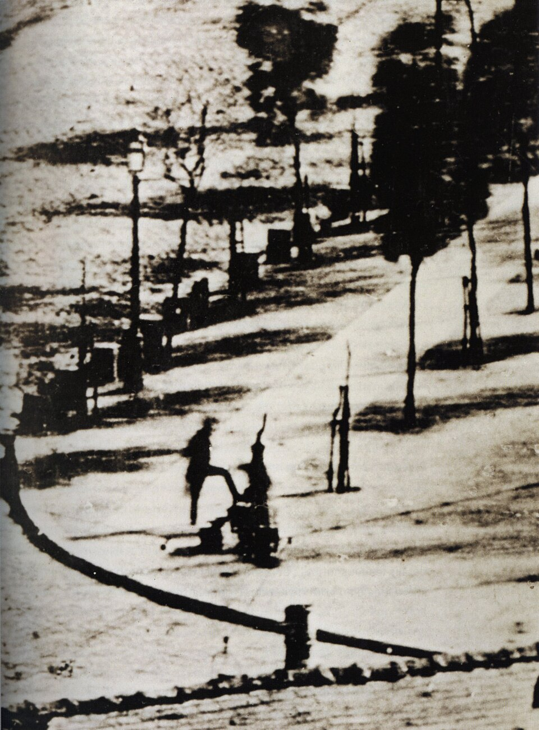

Slide 5
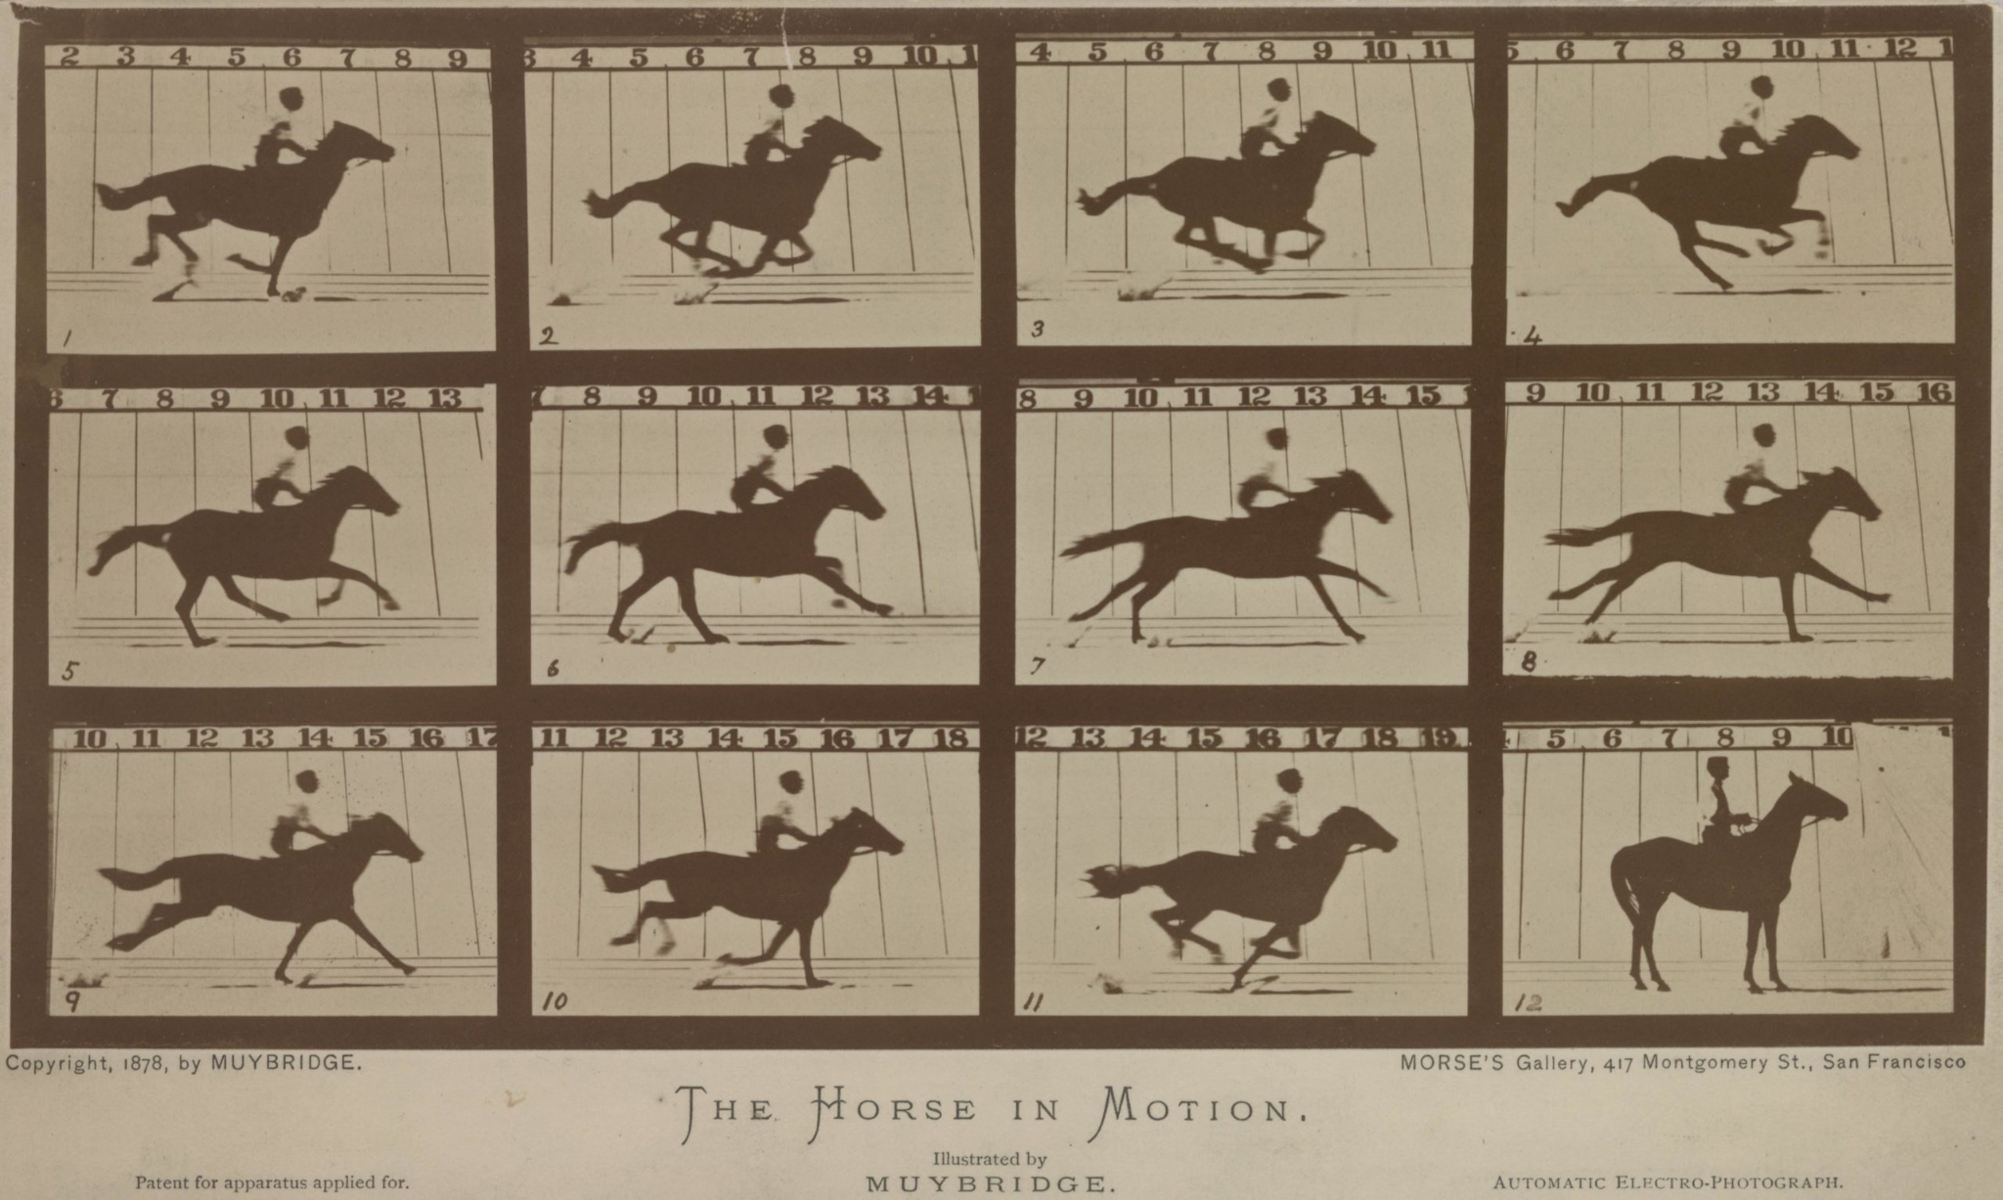

Slide 6
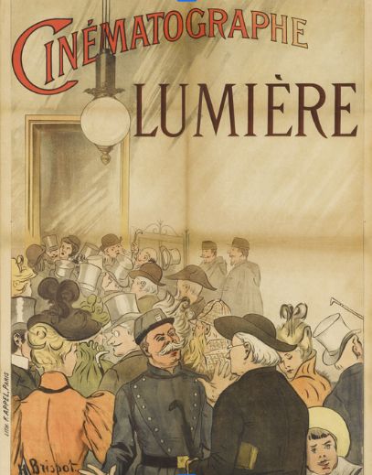
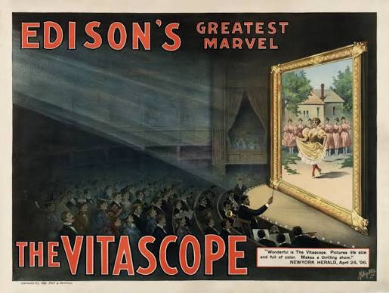

Slide 7
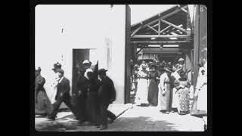

Slide 8
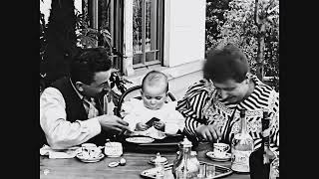

Slide 9
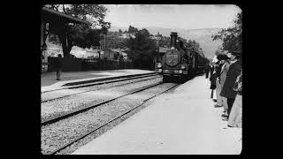

Slide 10
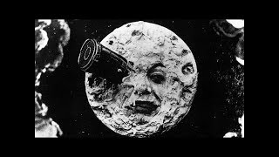

Slide 11
Siegfried Kracauer on the “two tendencies”
Lumière: “The crowded streets captured by the stereographic photographs of the late ’fifties thus reappeared on the primitive screen. It was life at its least controllable and most unconscious moments, a jumble of transient, forever dissolving patterns accessible only to the camera. The much-imitated shot of the railway station, with its emphasis on the confusion of arrival and departure, effectively illustrated the fortuity of these patterns; and their fragmentary character was exemplified by the clouds of smoke which leisurely drifted upward.”
Méliès: “In his beginnings he too treated the audience to sightseeing tours; or he dramatized, in the fashion of the period, realistically staged topical events. But his main contribution to the cinema lay in substituting staged illusion for unstaged reality, and contrived plots for everyday incidents.”

