Slide 1
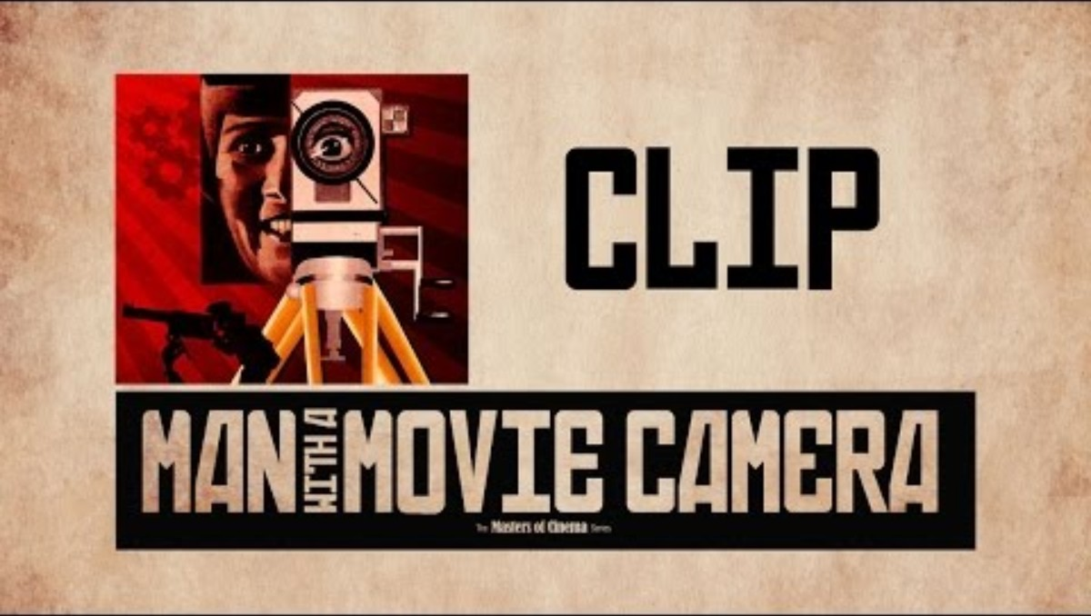
Man with a movie camera (dir. Dziga Vertov, 1929)

Slide 2
Bordwell, “Narrative Form”
“we have expectations that are characteristic of narrative form itself. We assume that there will be characters and that the actions they take will involve them with one another. We expect a series of incidents that will be connected in some way. We usually expect that the problems or conflicts that arise will somehow be settled–either they will be resolved or, at least, a new light will be cast on them. A spectator comes prepared to make sense of a narrative film” (72; my emphasis)

Slide 3
Bordwell: “We can consider a narrative to be a chain of events linked by cause and effect and occurring in time and space”
Situation → Change (via Cause and Effect) → New Situation (Ending/Resolution)

Slide 4
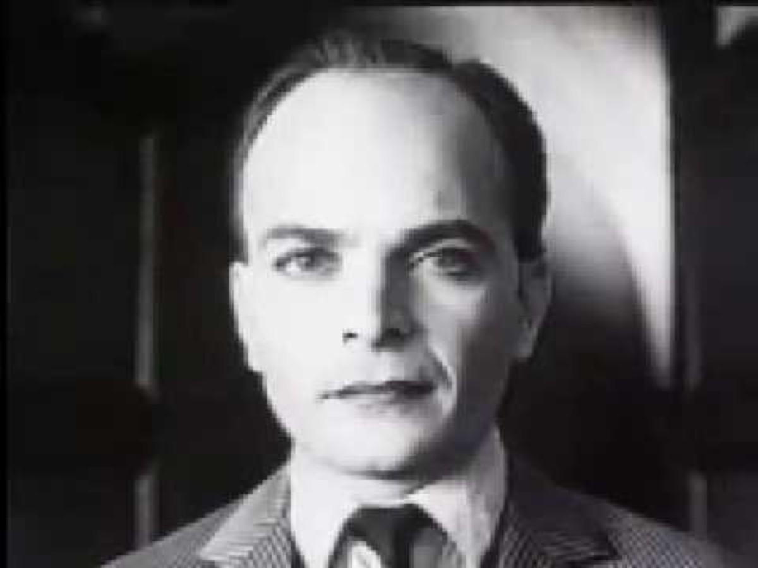
The Kuleshov Effect

Slide 5
Story vs. Plot
Bordwell:
“story is the chain of events in chronological order. But as we’ve seen, that story may be presented in various ways… the same story can be presented in different ways–rendered as different plots–and each variant is likely to have different effects on the audience” (75)
“The filmmakers have built the plot from the story, but viewers build the story from the plot.” (75)
Narration can be restricted, unrestricted, or somewhere in between.

Slide 6
Classical Hollywood Cinema
Plot traces a process of change
Protagonist meets some kind of opposition/obstacle to achieve their goals (e.g., in the form of an antagonist)
Psychological causes and character traits (or flaws) tend to motivate the action
C.f. Soviet cinema, art film, etc.: “causes” in these films might be larger, more impersonal, historical, or collective; no character might be privileged as protagonist. In experimental films, “cause” and “effect” might be disjointed or not even be applicable.

Slide 7
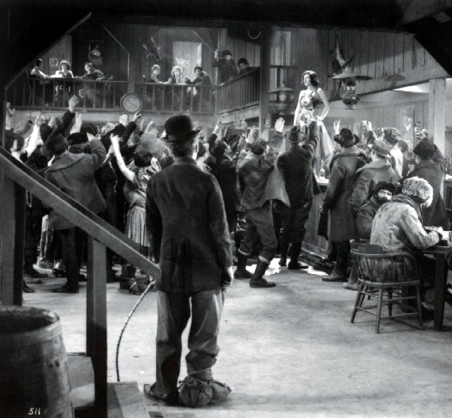
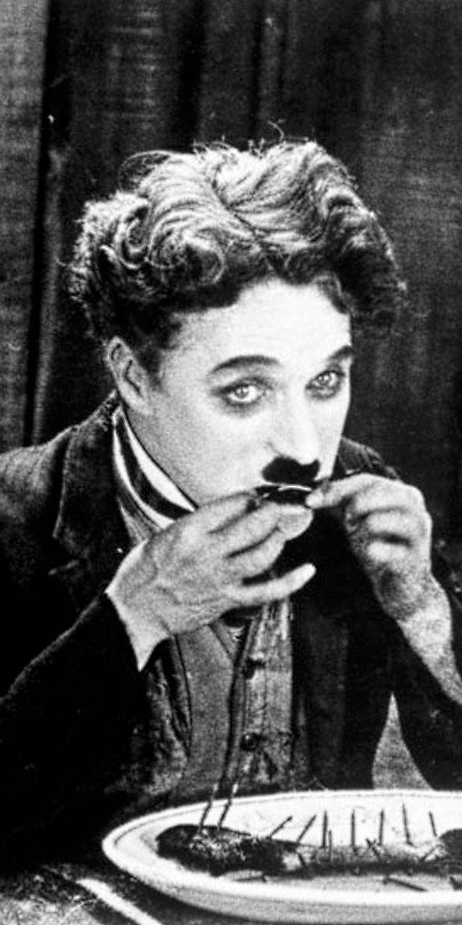
What are the Tramp’s traits? How are these traits substantiated visually or narratively?
Is the narrative restricted or unrestricted, particularly in relation to the Tramp? How does this effect how you feel about/relate to him?
Who or what is the prime mover of the narrative? Who or what precipitates the action, is the engine of the plot?
How does the story resolve? What does this tell us?
In what ways is The Gold Rush an example of classical Hollywood cinema? Are there any aspects that seem to be remaining from the cinema of attractions?

Slide 8
