Slide 1
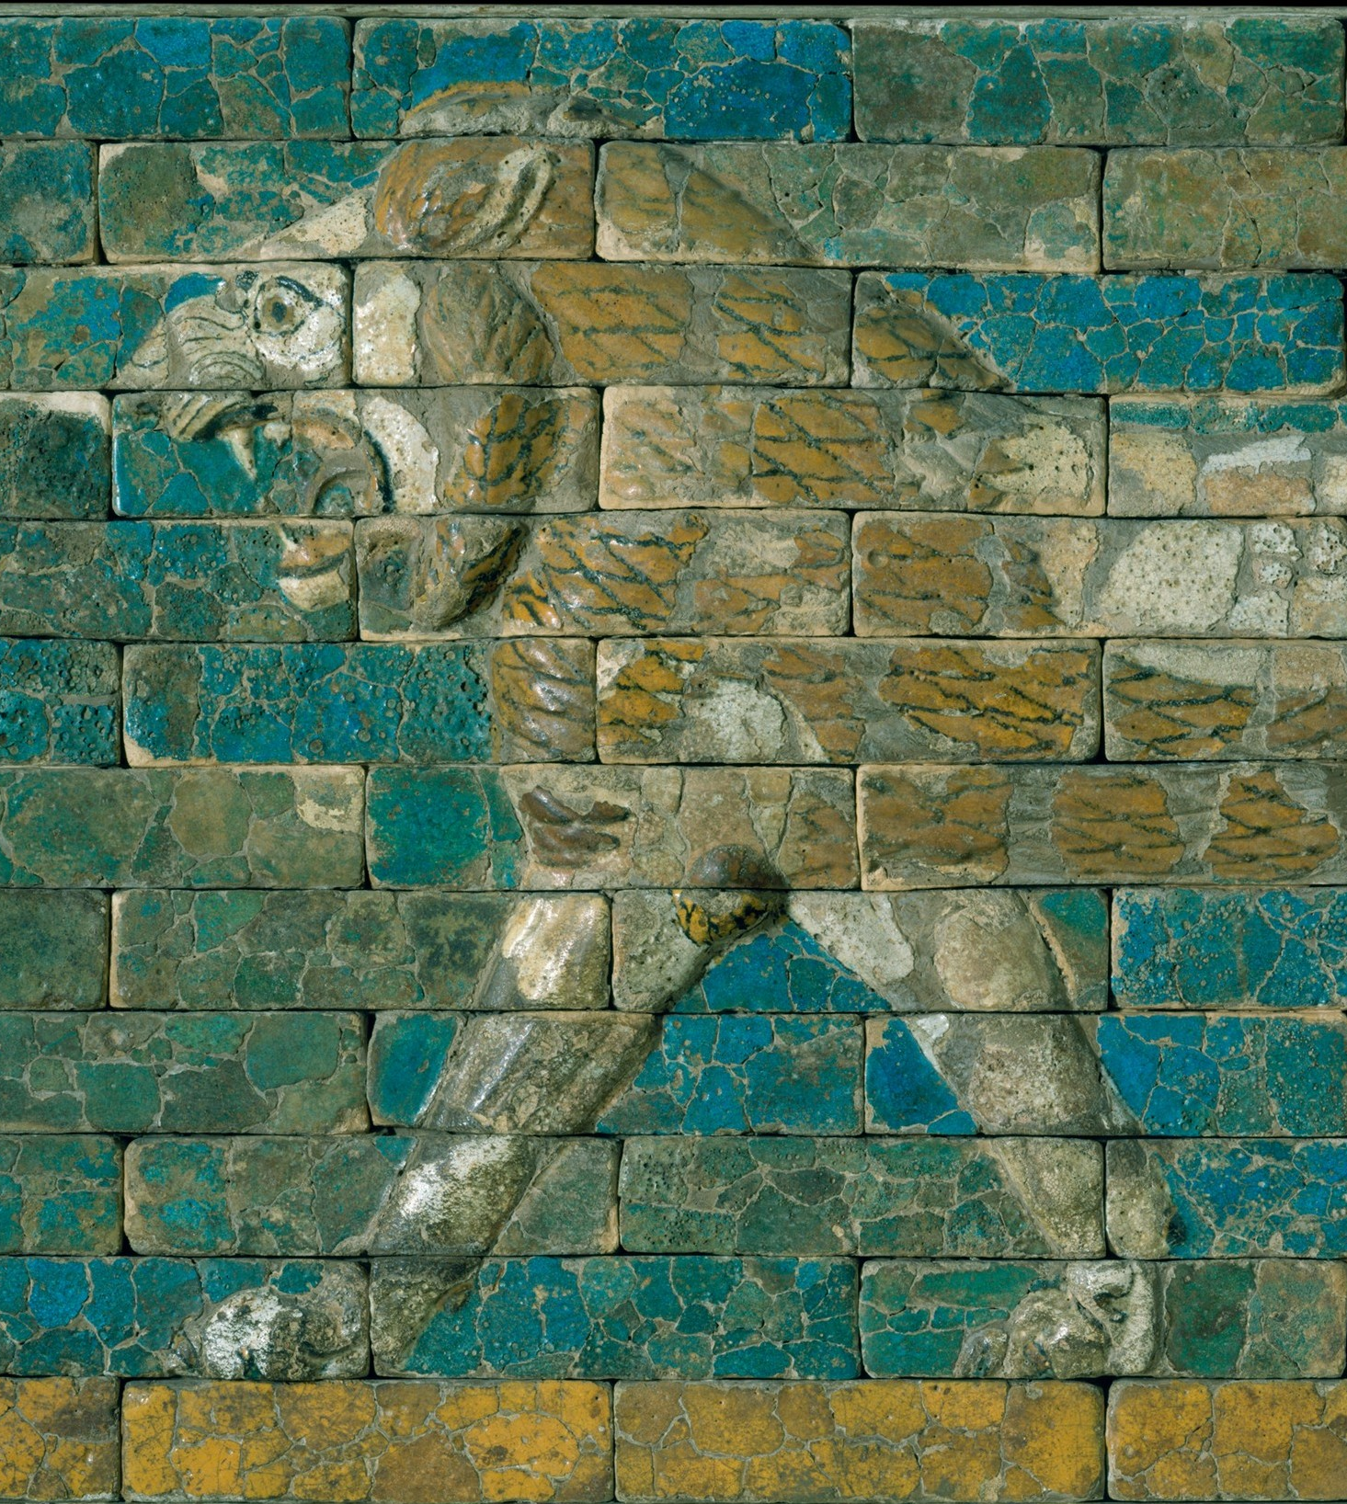
Archaeology and Colonialism
ARCH B101 – Archaeology of the Ancient Near East and Egypt
Fall 2026
September 2

Slide 2
Looking Ahead
Mon 9/7: Labor Day (no class)
Wed 9/9 and Fri 9/11: Grass
Fri 9/18: Discussion sections begin and Map Quiz 1
  Study map is on Moodle

Slide 3
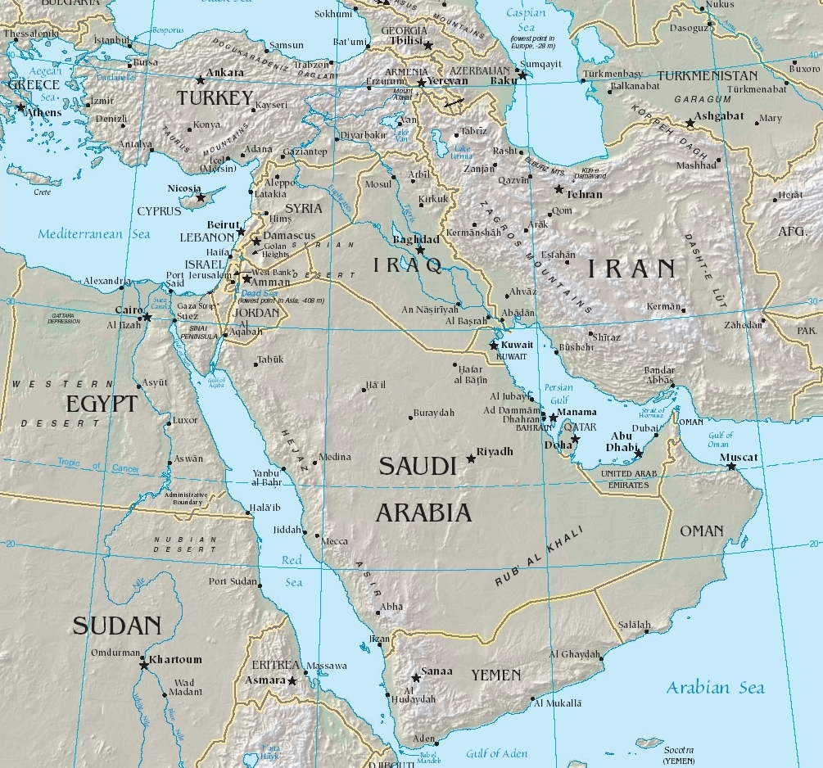

Slide 4
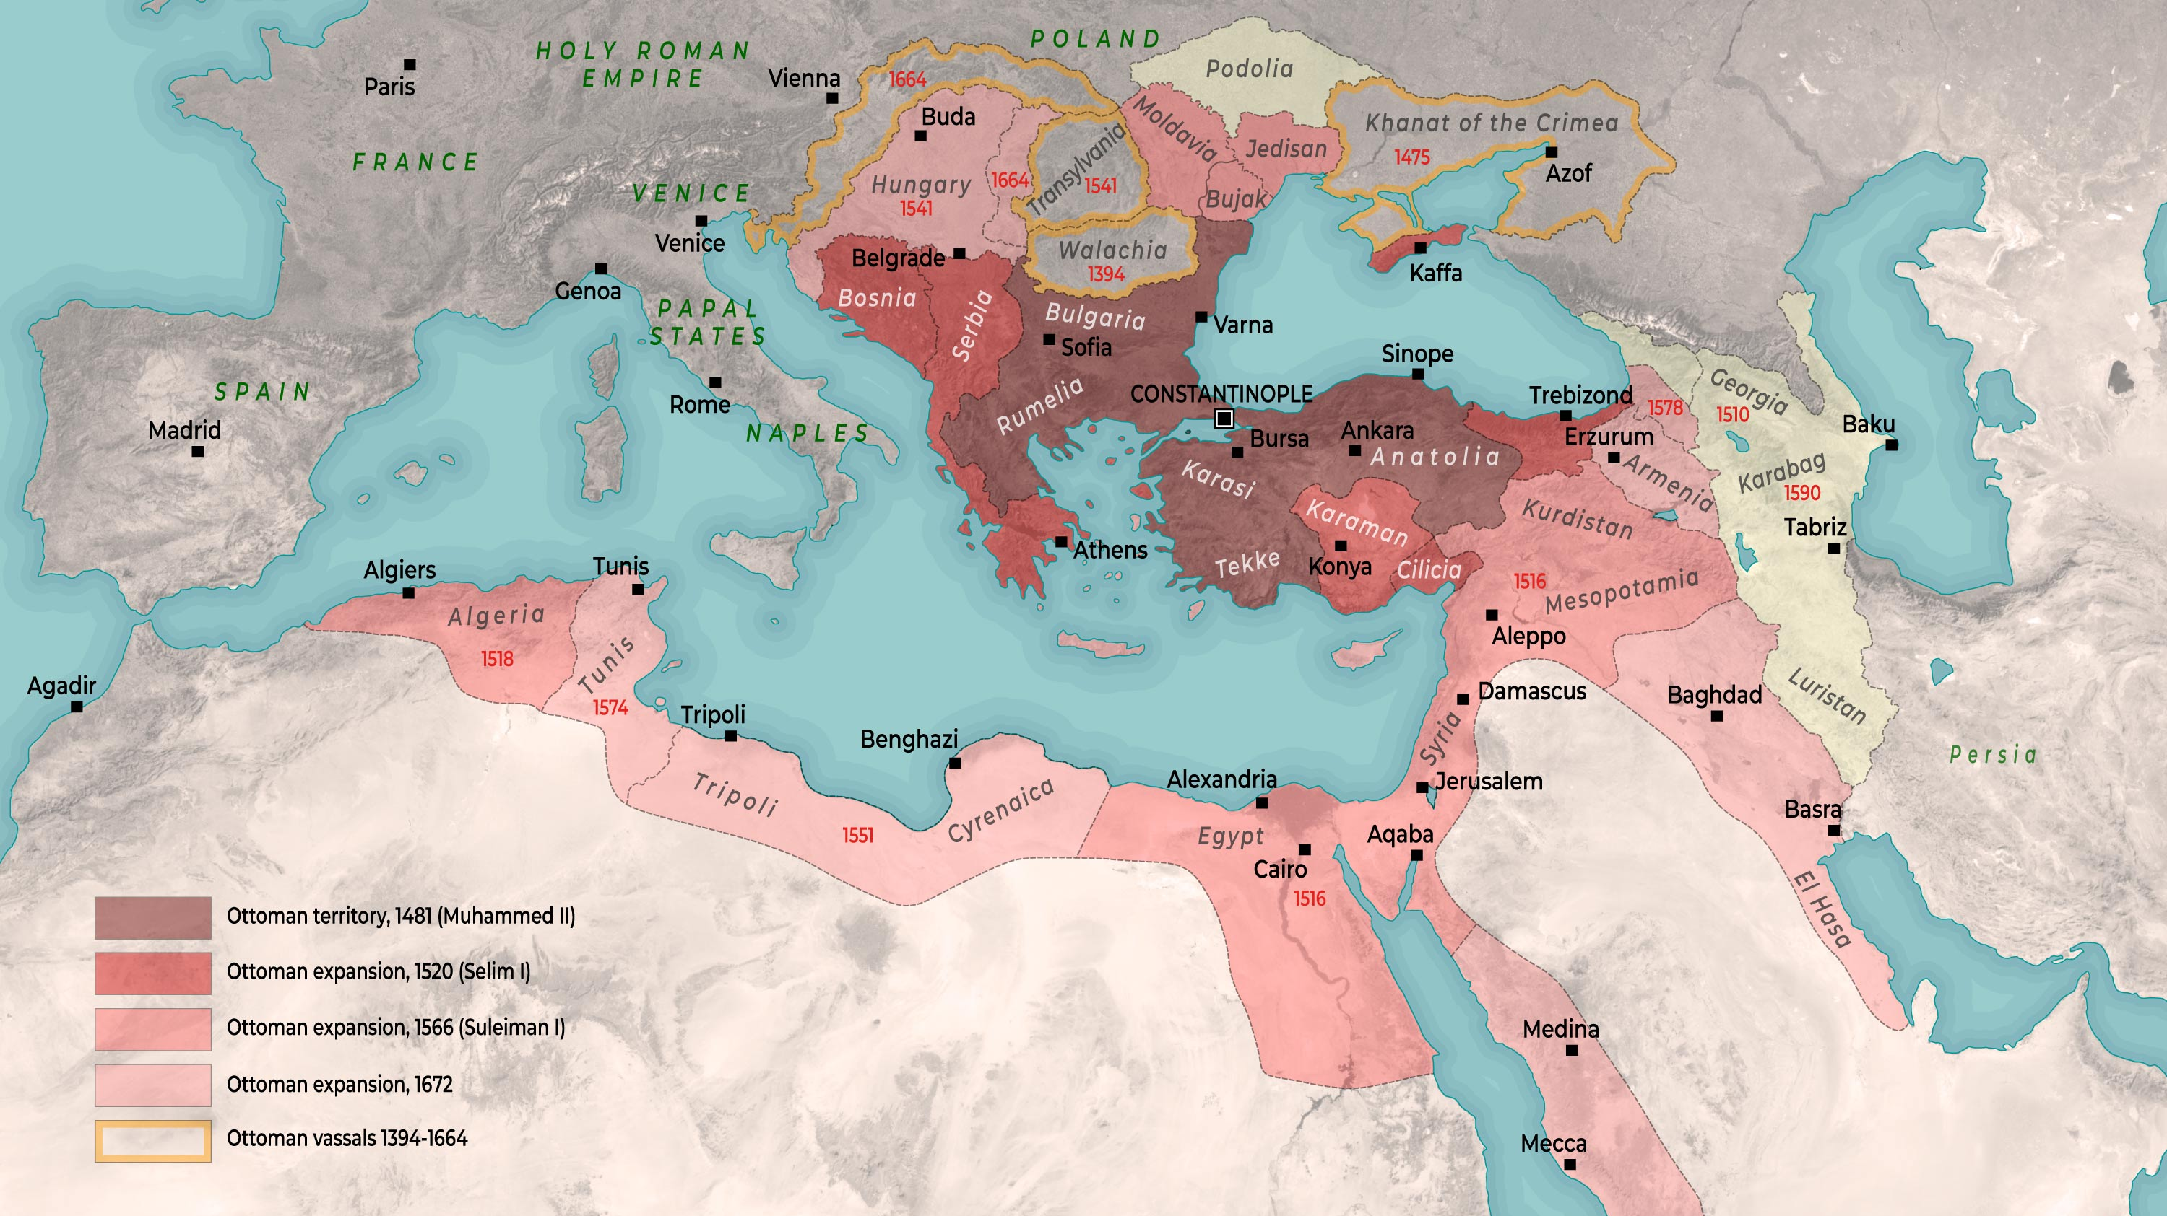

Slide 5
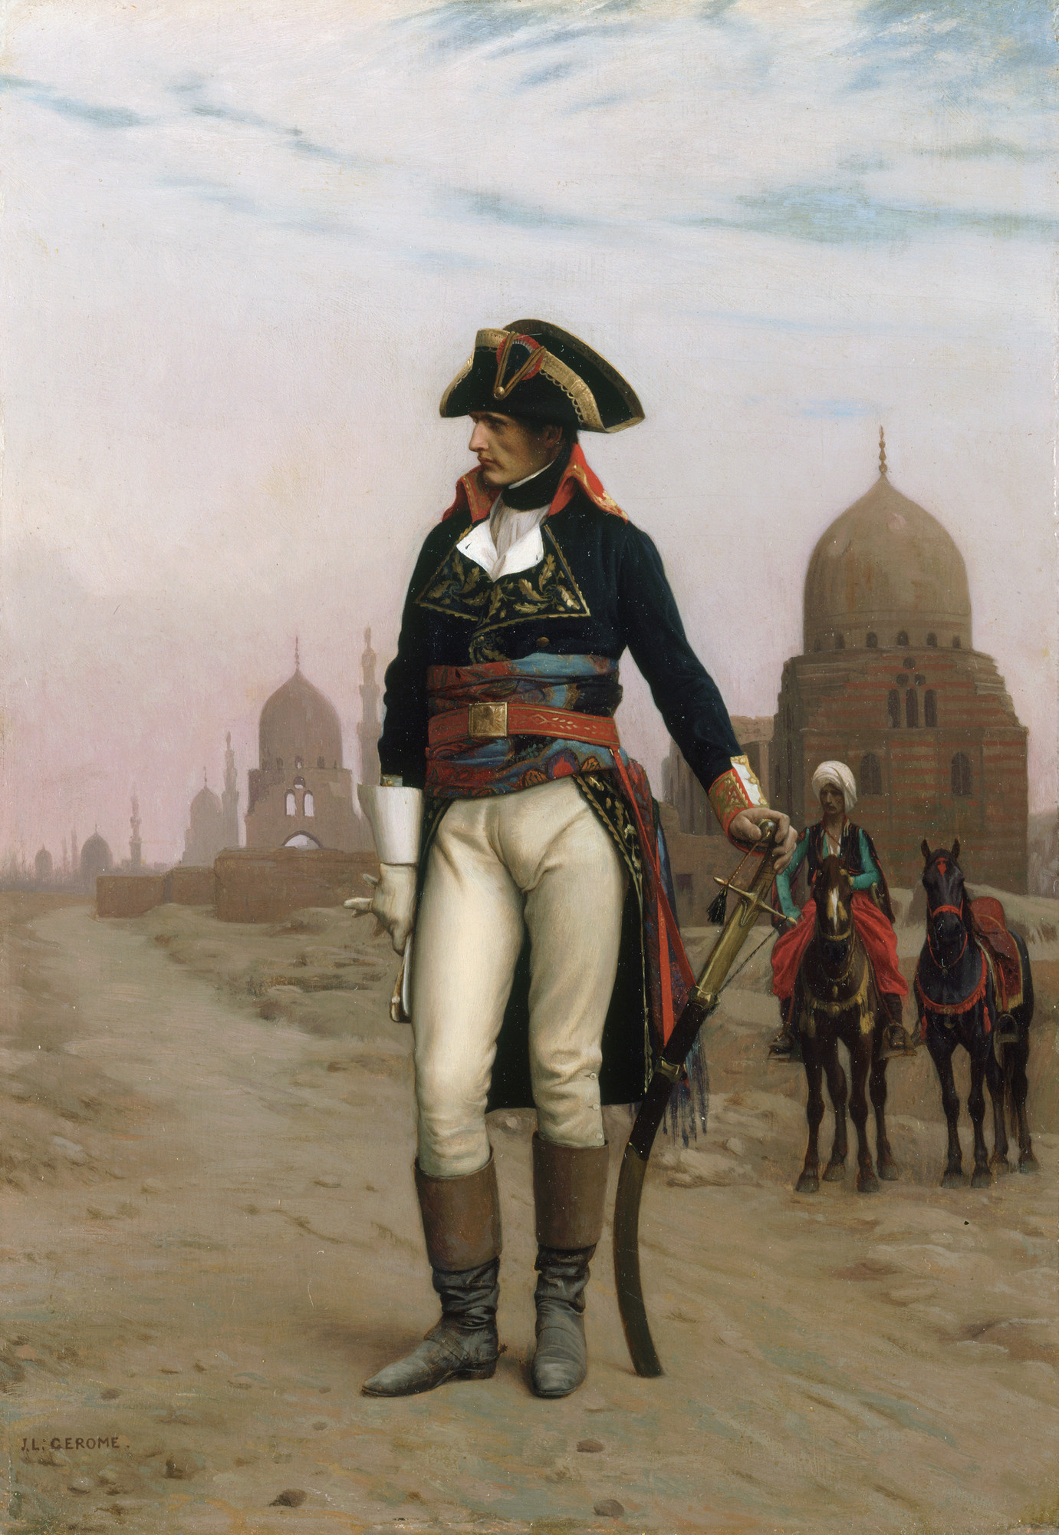
Napoleon
1767-1821
French revolutionary, general, dictator (1799-1804) and emperor (1804-1815)
As a high-ranking general in Revolutionary France he launched an invasion of Egypt in 1798
Jean-Léon Gérôme, Napoleon in Cairo (19th cen.)

Slide 6
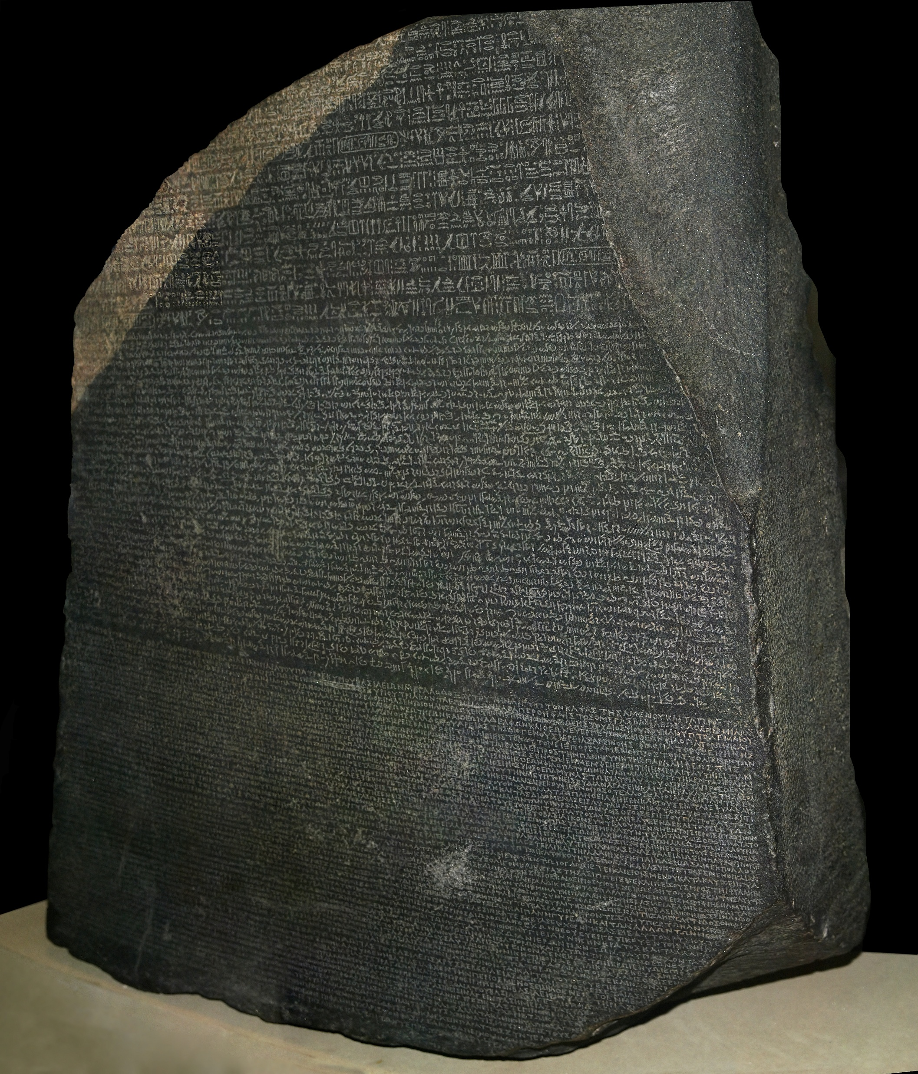
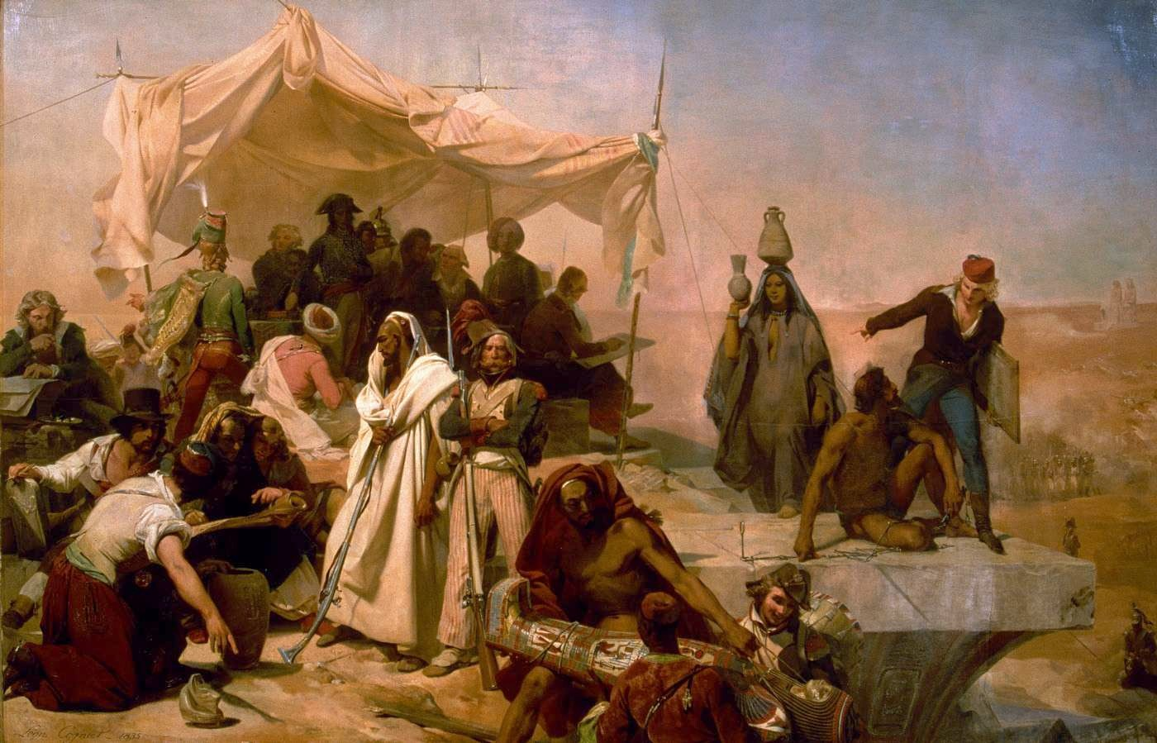
Napoleon’s Savants
Léon Cogniet, The Egyptian Expedition under the orders of Bonaparte (early 19th cen.)
The Rosetta Stone, 196 BCE

Slide 7
The Rosetta Stone
Granodiorite stele containing a decree of Ptolemy V, 196 BCE
  Decree is written in hieroglyphic and demotic Egyptian and in Greek
Discovered at Rosetta (modern Rashid), 65 km east of Alexandria
Seized by the British after the French defeat
  Now in the British Museum
Basis for Jean-François Champollion’s decipherment of hieroglyphics
The Rosetta Stone, 196 BCE

Slide 8
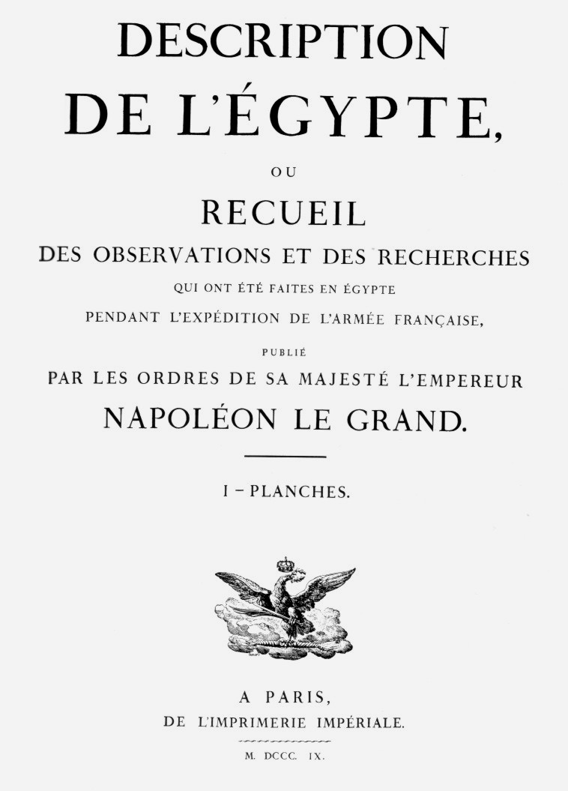
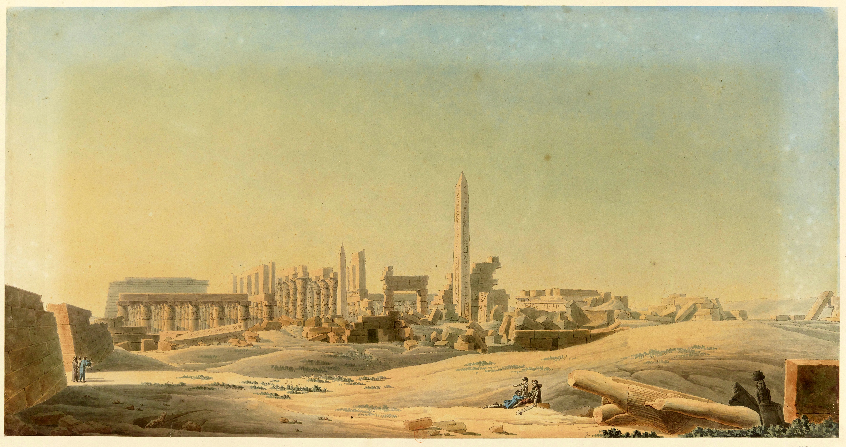
Illustration of Karnak Temple in the Description de l’Égypte
Title page of the first edition (1809)

Slide 9
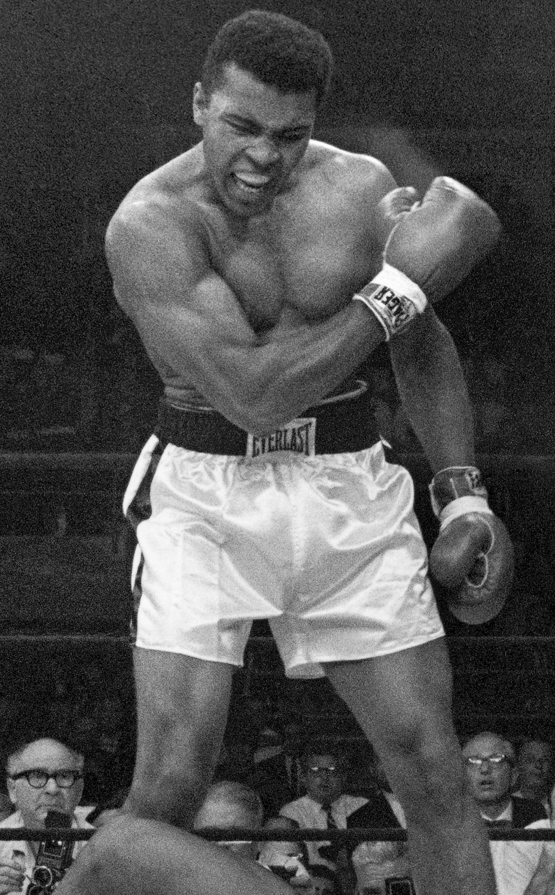
Muhammad Ali
Albanian soldier and tax-collector sent to re-occupy Egypt after the French withdrawal
Appointed governor by the Ottomans in 1805
Put down a rebellion in Arabia, conquered Sudan, and fought against Greek rebels on behalf of the sultan
Rebelled against Ottoman rule in 1831
  Invaded the Levant and Anatolia
  Only stopped by European intervention in 1833
  Appointed hereditary governor of Egypt
Founded a dynasty that ruled Egypt until 1952

Slide 10
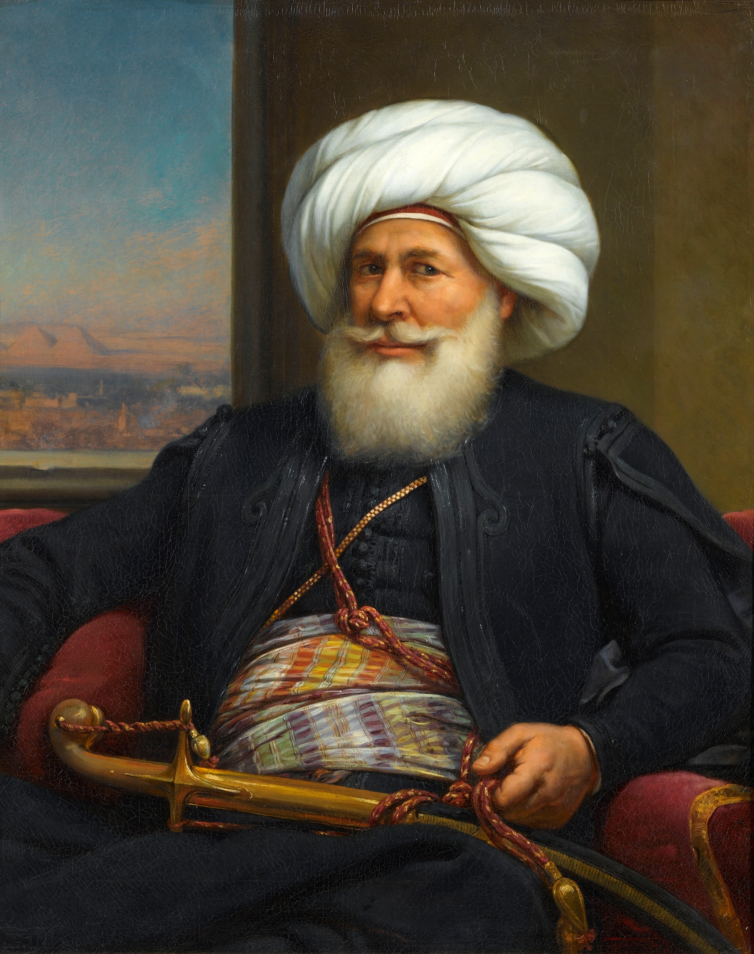
Muhammad Ali
Albanian soldier and tax-collector sent to re-occupy Egypt after the French withdrawal
Appointed governor by the Ottomans in 1805
Put down a rebellion in Arabia, conquered Sudan, and fought against Greek rebels on behalf of the sultan
Rebelled against Ottoman rule in 1831
  Invaded the Levant and Anatolia
  Only stopped by European intervention in 1833
  Appointed hereditary governor of Egypt
Founded a dynasty that ruled Egypt until 1952
Portrait by Auguste Couder (1840)

Slide 11
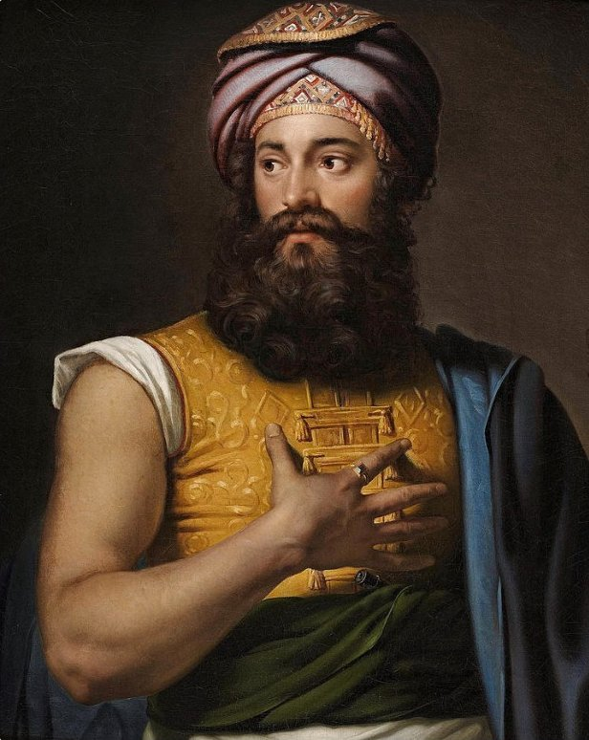
Giovanni Belzoni
1778-1823
Barber, petty criminal, Freemason, circus performer, inventor, and arguably the first Egyptologist
Went to Egypt in 1815 to sell Muhammad Ali a pump design
  Muhammad didn’t buy it
Launched three expeditions to collect Egyptian antiquities between 1816 and 1819
Died on an expedition to Timbuktu in 1823
Jan Adam Kruseman, Portrait of Belzoni (1824)

Slide 12
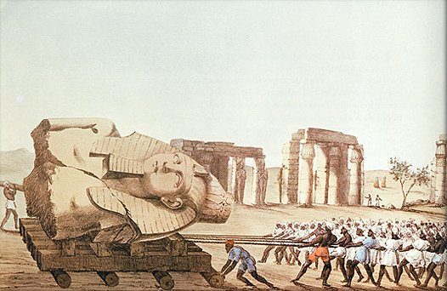
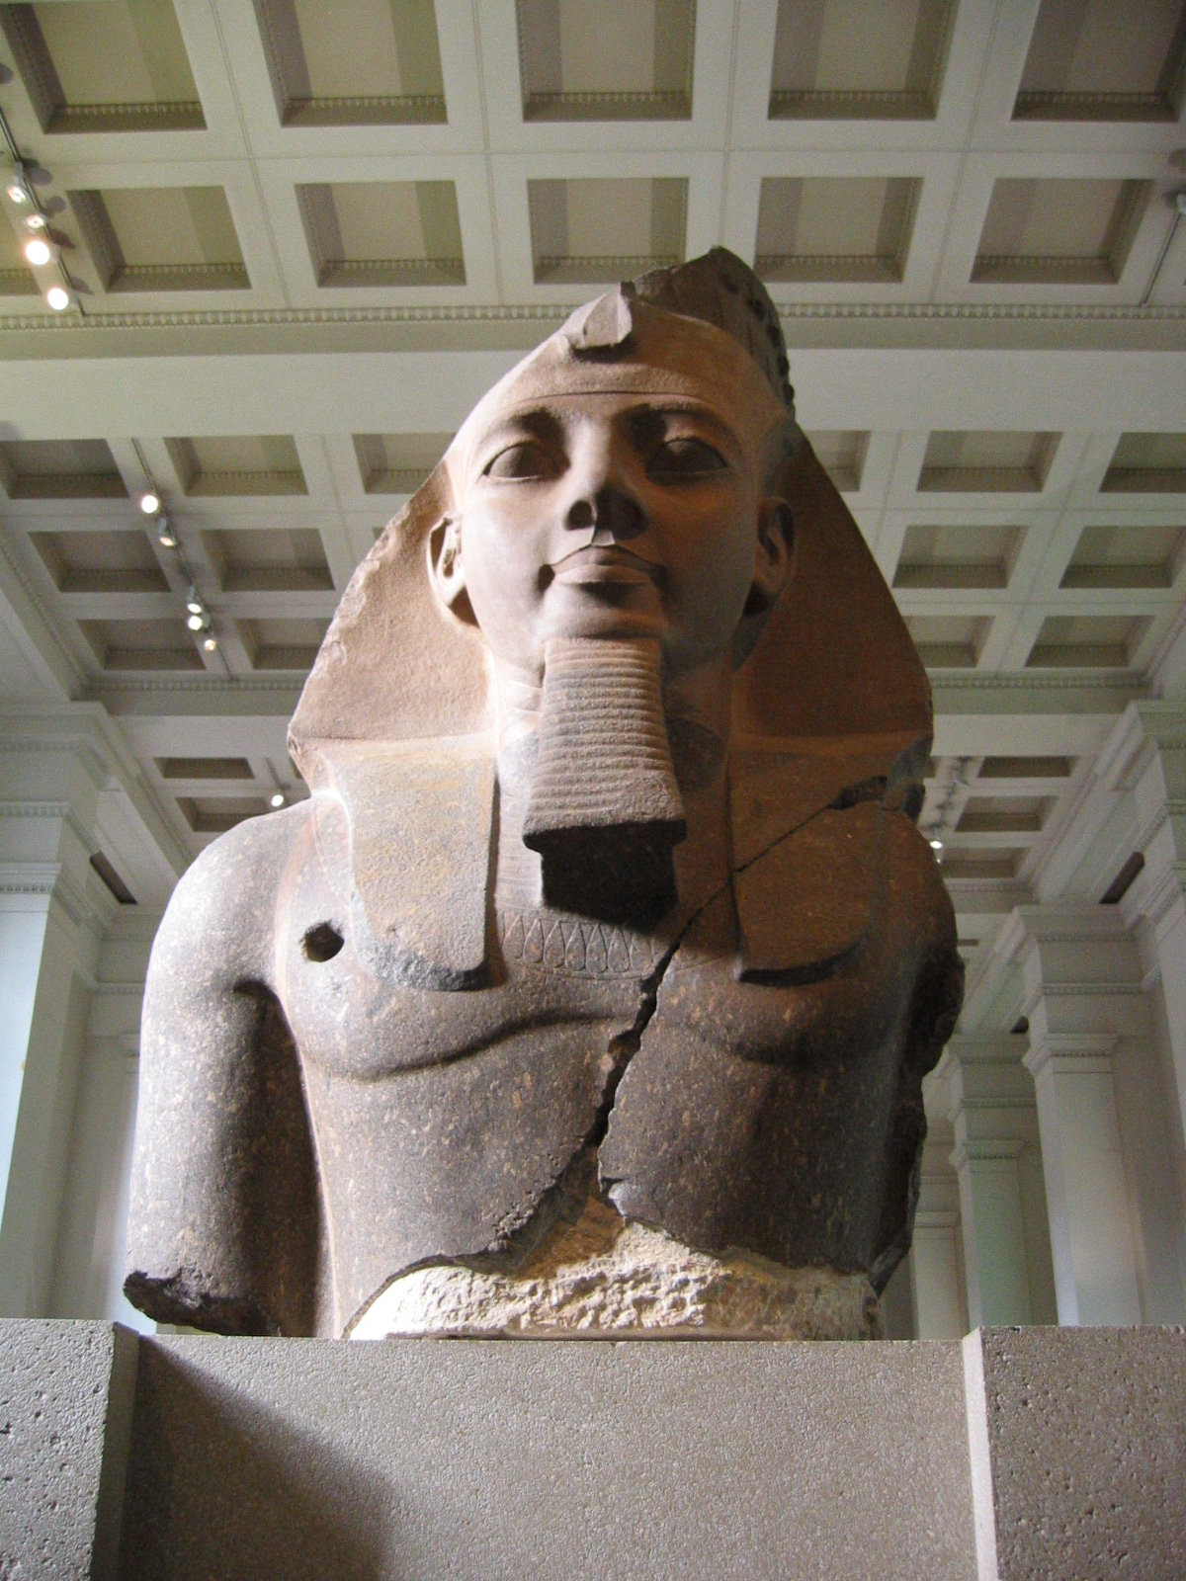
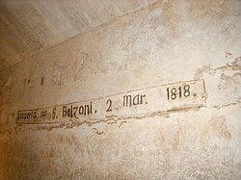
Top: Head of Ramesses II under transport by Belzoni
Right: Head of Ramesses II in the British Museum
Left: Belzon’s graffiti in the Pyramid of Khafre at Giza

Slide 13
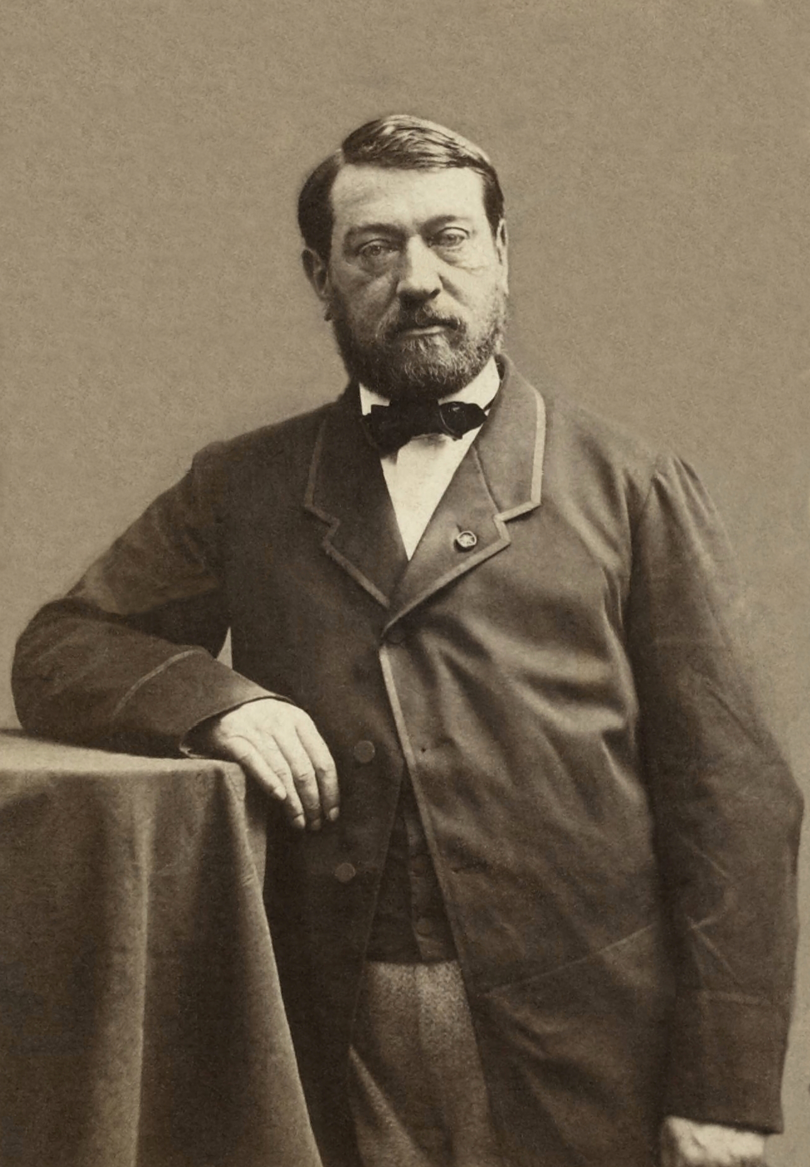
Auguste Mariette
1821-1881
French draftsman, Egyptologist and costumier
Became an Egyptologist when his cousin Nestor L’Hôte died in 1848, leaving Marette to sort his papers, which included Champollion’s
Appointed to the Louvre in 1849; sent to Egypt in 1850 to buy manuscripts
  He failed to buy any, so he hired Bedouins to dig up the ruins at Saqqara
This resulted in Sa’id Pasha (son of Muhammad Ali) appointing him the first Director of Antiquities in 1858
In 1860 alone he started 35 new excavations in Egypt
Created the costumes for the premier of Verdi’s Aida
In 1881 he secured the appointment of Gaston Maspero, another Frenchman, as his successor

Slide 14
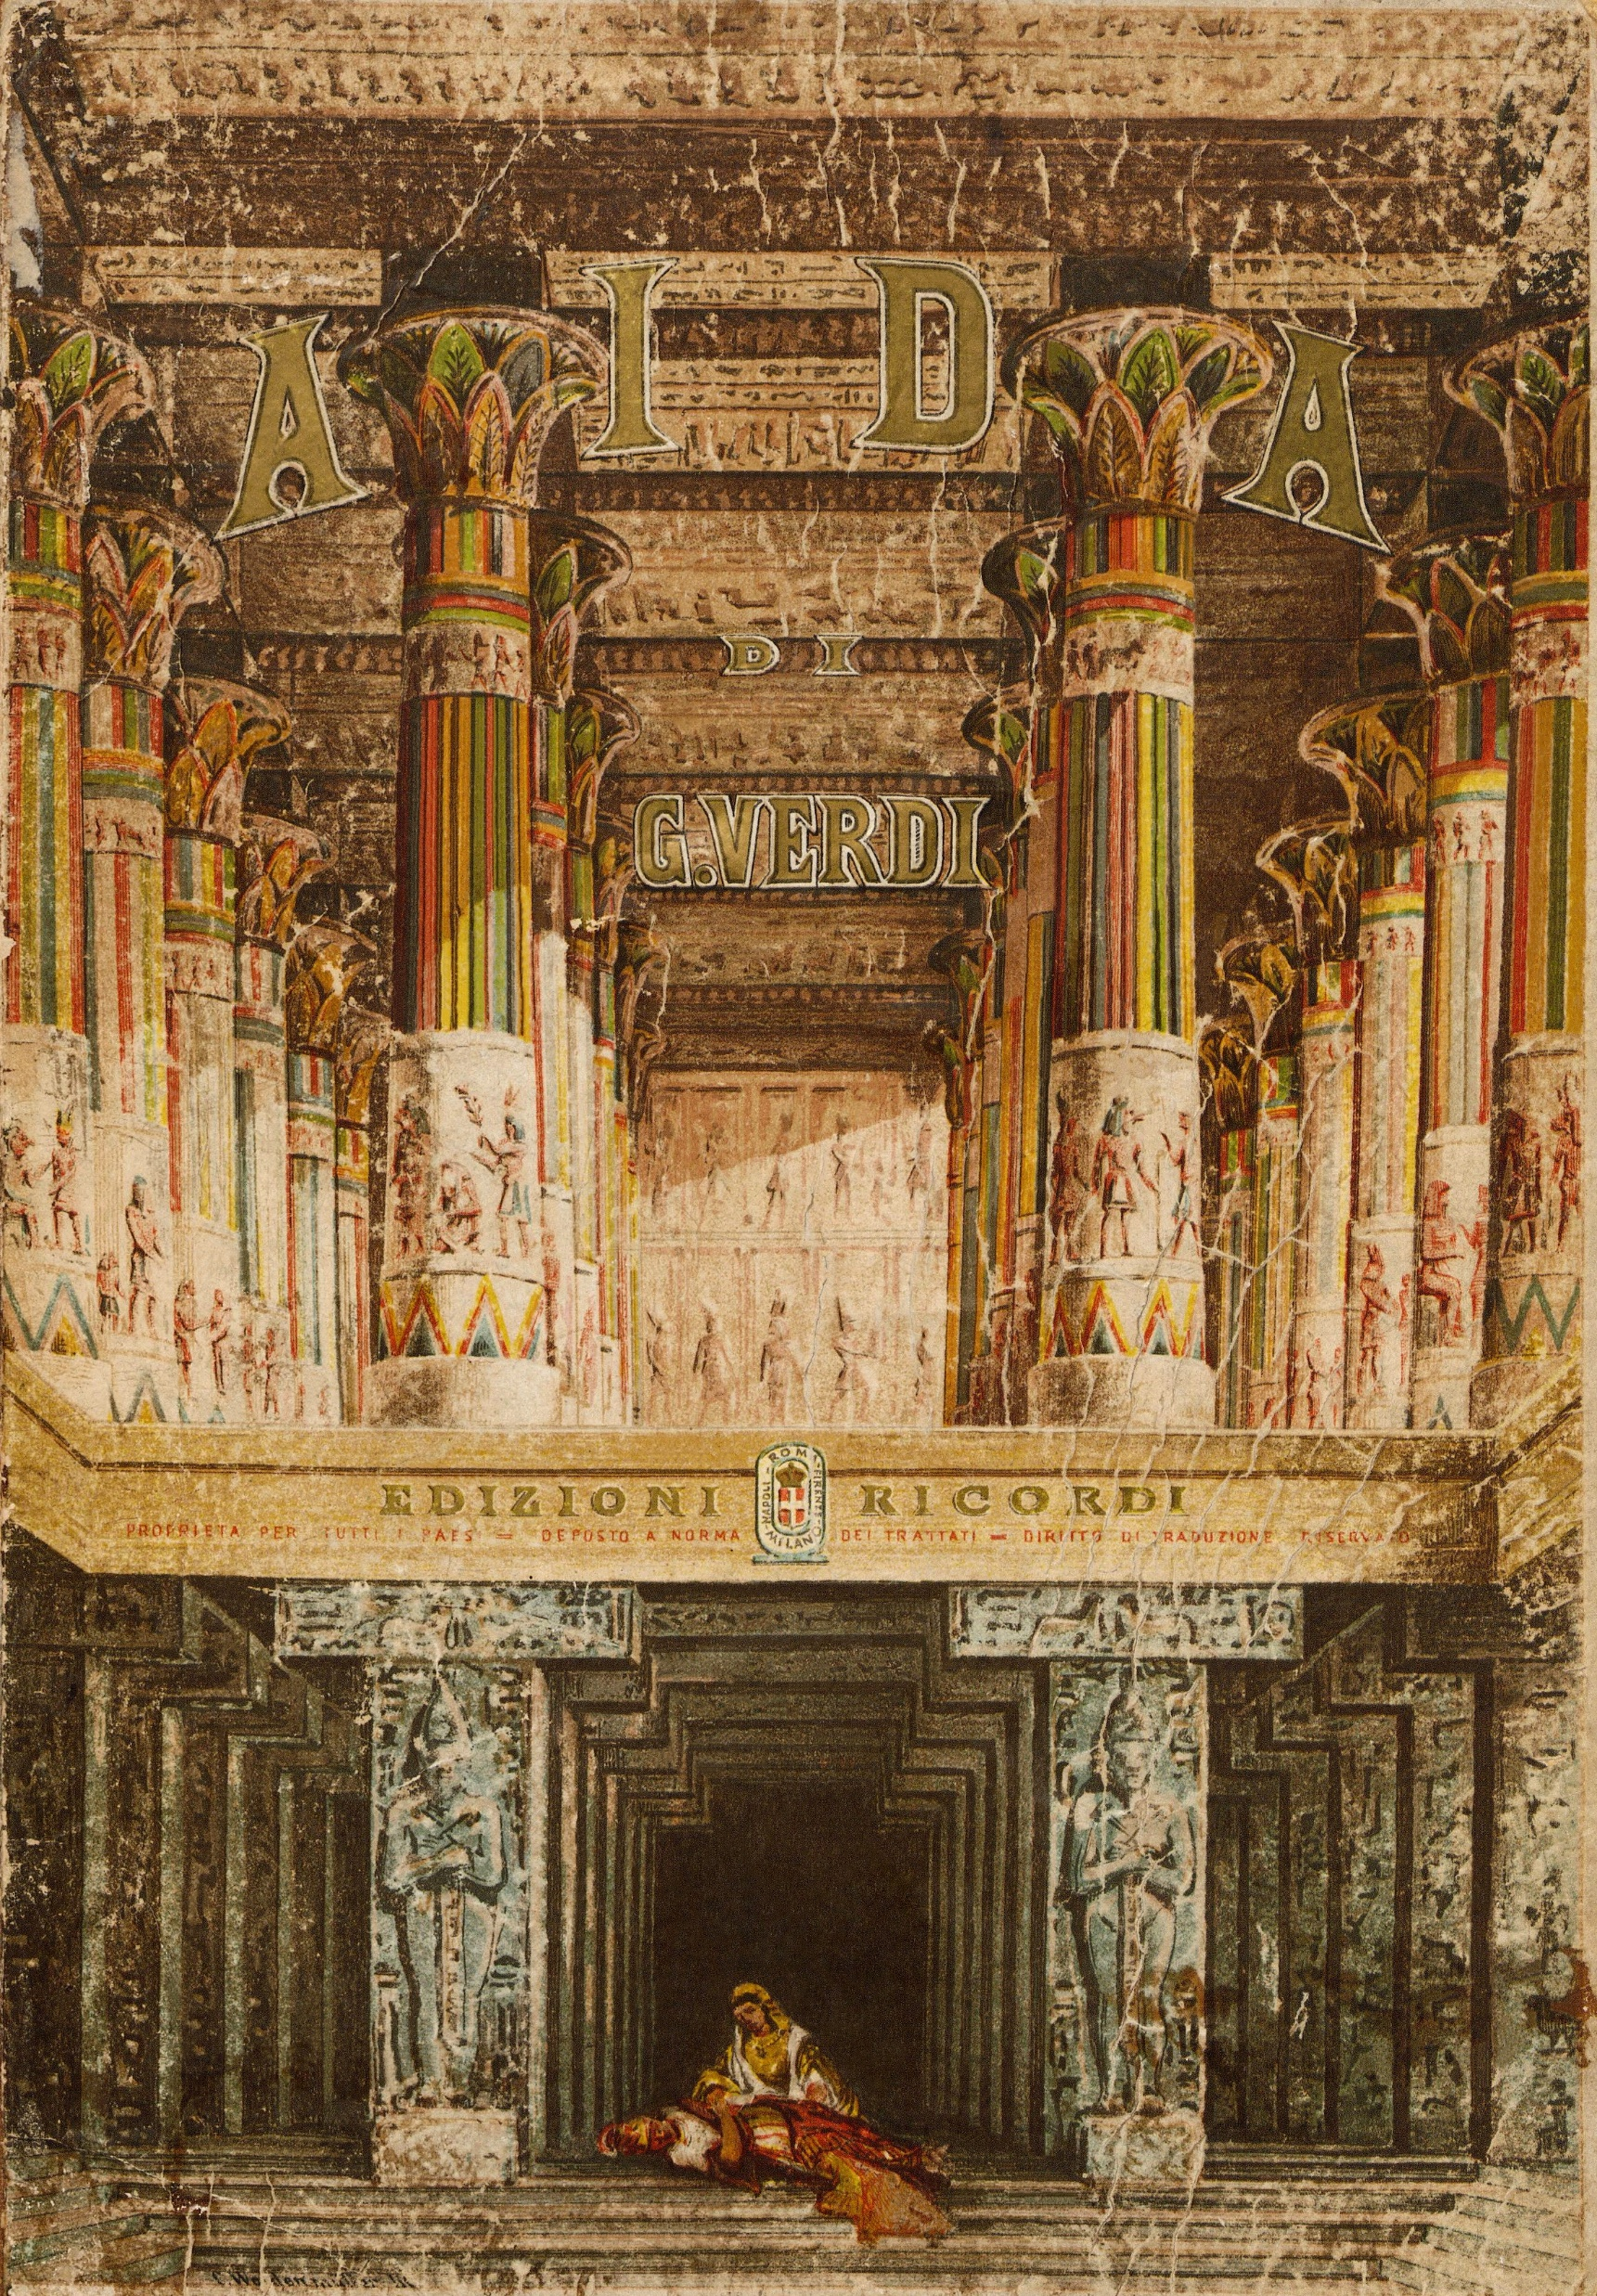
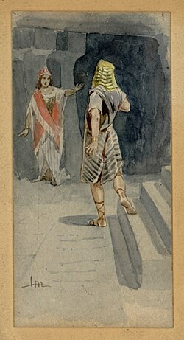
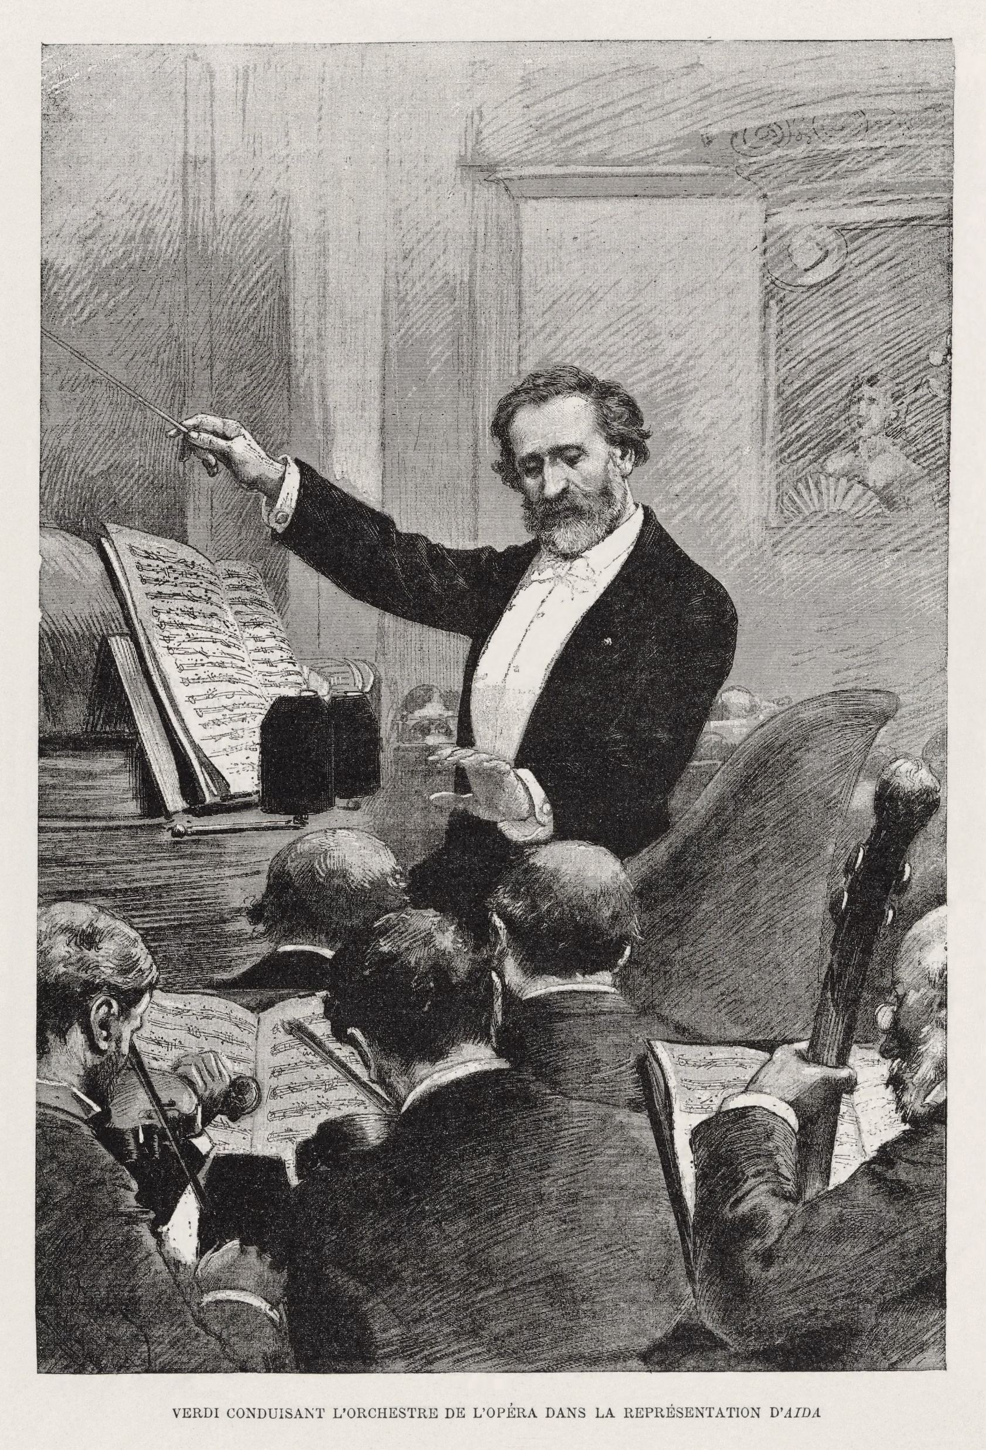

Slide 15
The Egypt Exploration Fund
Now the Egypt Exploration Society
Founded by Amelia Edwards in 1882
First excavation it sponsored was at Tell el-Maskhuta (ancient Pithom) in 1883
“Therefore they set taskmasters over them to oppress them with forced labour. They built supply cities, Pithom and Rameses, for Pharaoh.” (Exodus 1:11)

Slide 16
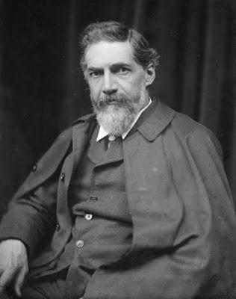
Flinders Petrie
1853-1942
English surveyor and archaeologist
Went to Egypt in 1880 to survey the Giza pyramids
Appointed the first Edwards Professor of Egyptology at University College London in 1892, despite his lack of formal education
Excavated all over Egypt and later in Palestine
  Frequent in absentia
  Trained workmen from Quft and Lahun in his methods
  Quftis and Lahunis still dominate Egyptian archaeology today
    Which is why it’s so bad…
Developed the technique of pottery seriation
Paid workmen for finds
Definitely a racist

Slide 18
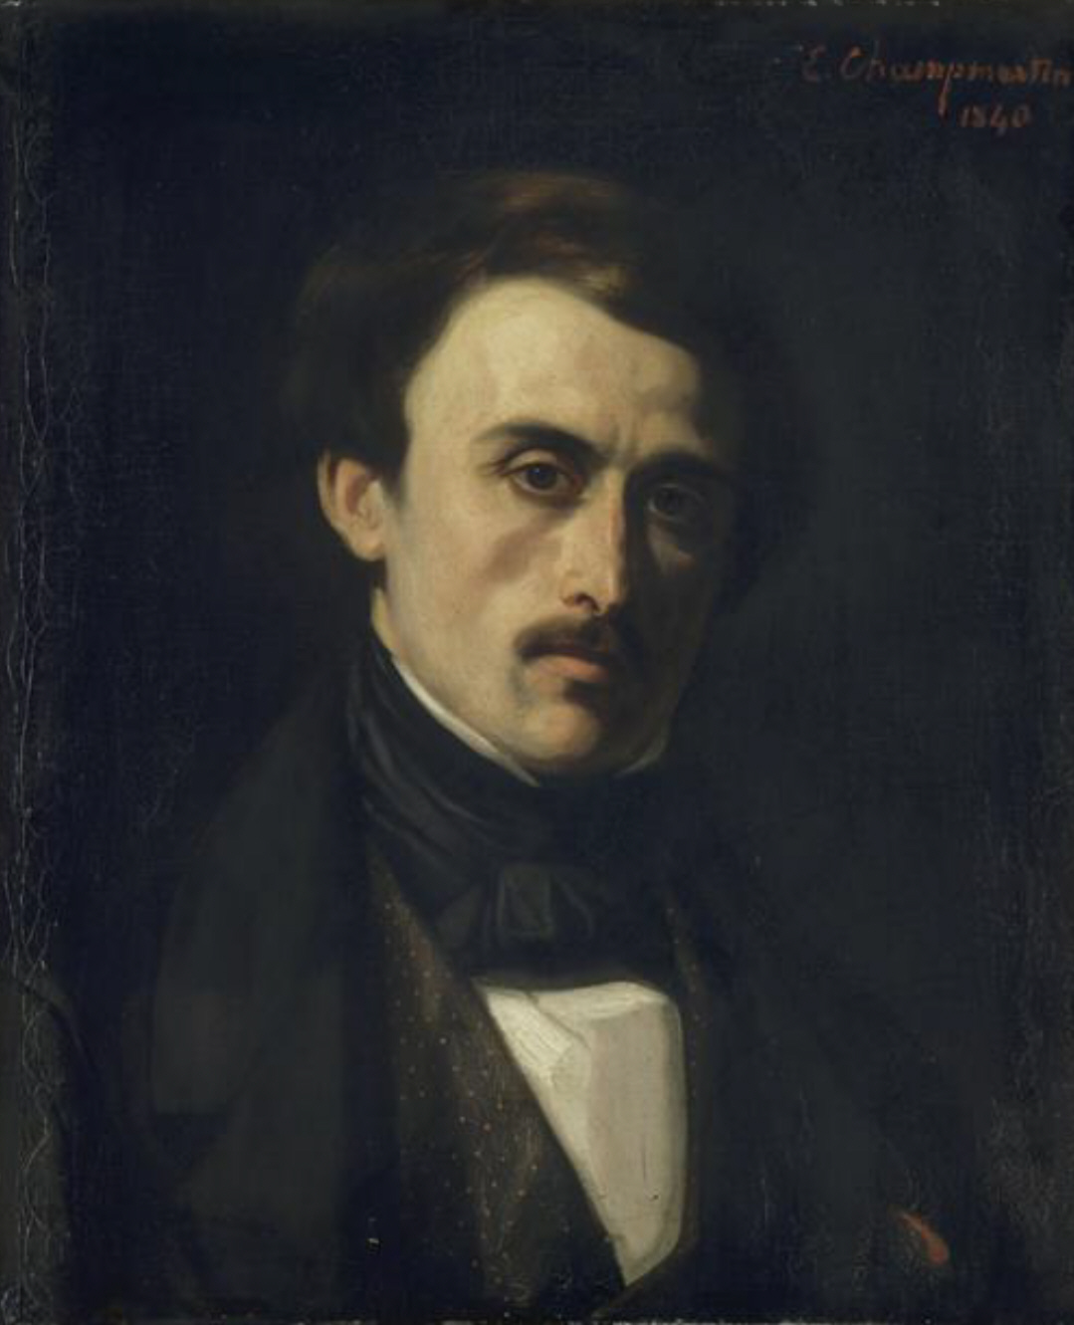
Paul-Émile Botta
1802-1870
Italian-born French naturalist, diplomat and archaeologist
Appointed French consul at Mosul at the instigation of Julius von Mohl, who wanted him to explore the ruins documented by earlier travelers
Excavated at Nineveh and Khorsabad
Charles-Émile-Callande de Champmartin, Paul-Émile Botta (1840)

Slide 19
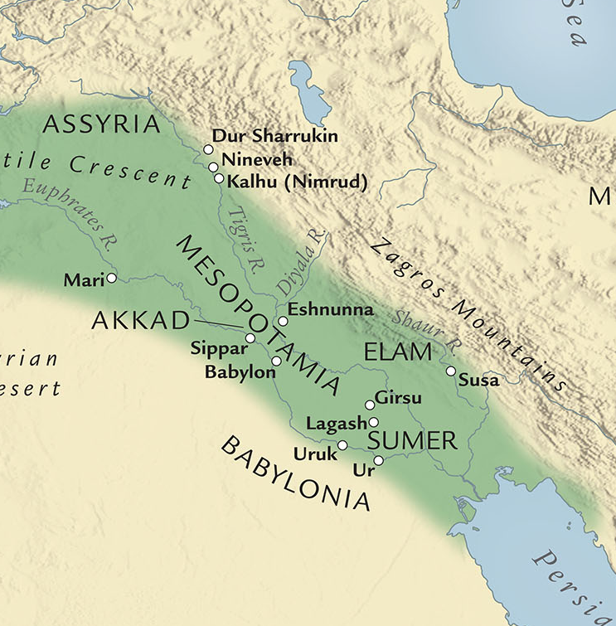

Slide 20
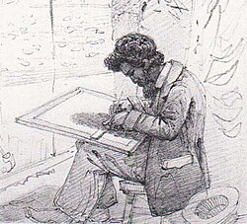
Austen Henry Layard
1817-1894
French-born British archaeologist, politician and diplomat
Hung out in Constantinople doing odd jobs for the British ambassador Sir Stratford Canning
Inspired in part by Botta and encouraged by Canning, went to Mosul in 1845
Excavated at Nineveh and Nimrud, 1845-7 and 1849-51
Discovered the library of Ashurbanipal at Nineveh
Solomon Caesar Malan, Layard at Kuyunjik (1850)

Slide 21
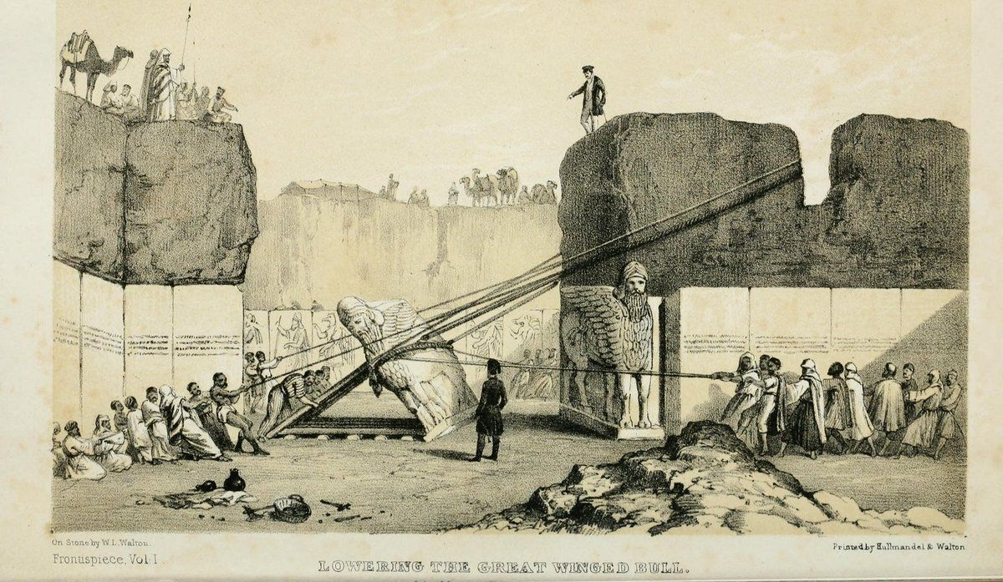

Slide 22
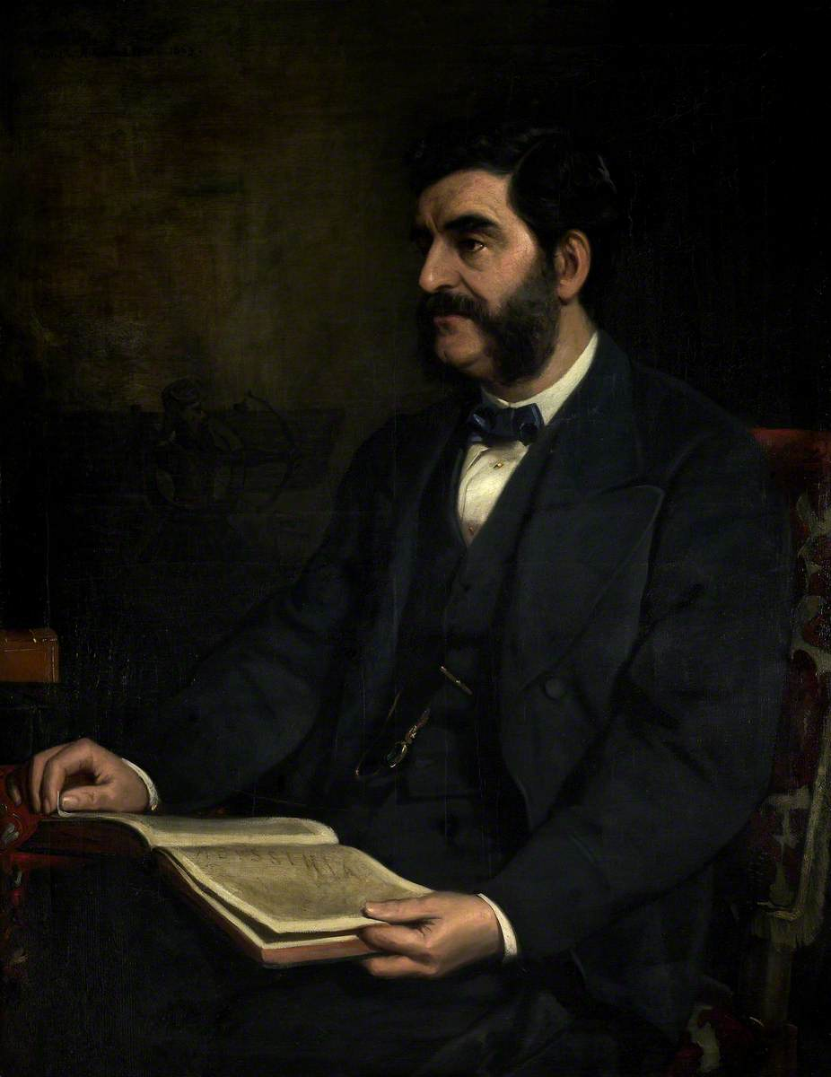
Hormuzd Rassam
1826-1910
Iraqi-British archaeologist and diplomat from Mosul
Worked for Layard at Nimrud
  So impressed him that Layard took Rassam to England to study at Oxford
Joined Layard’s second expedition, 1849-51
Remained in Iraq excavating on behalf of the British Museum until 1854
Served as a British emissary to Ethiopia, 1866-8
Excavated at several sites, including Babylon, 1877-1882

Slide 23
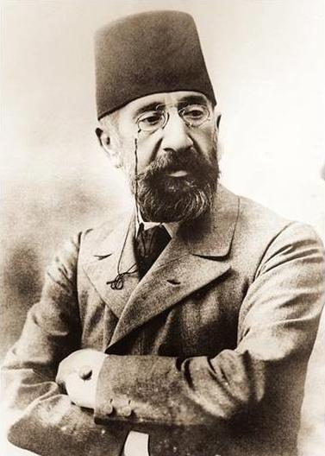
Osman Hamdi Bey
1842-1910
Ottoman artist, archaeologist and museum curator
Studied art in Paris for nine years
Appointed the first curator of the Imperial Museum (now the Istanbul Archaeology Museums) in 1881
In 1884 he oversaw the implementation of the first law prohibiting the removal of artifacts from the Ottoman Empire
Excavated at Nemrut Dağı, Lagina and Sidon

Slide 24
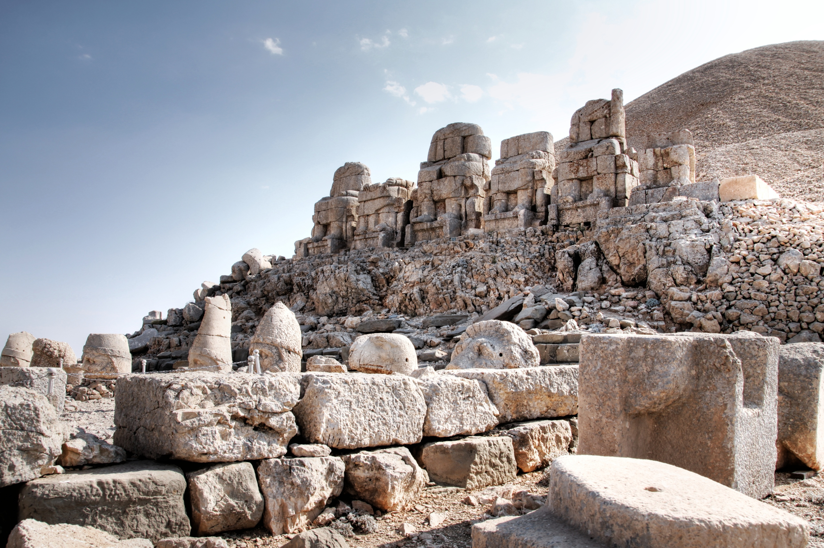

Slide 25
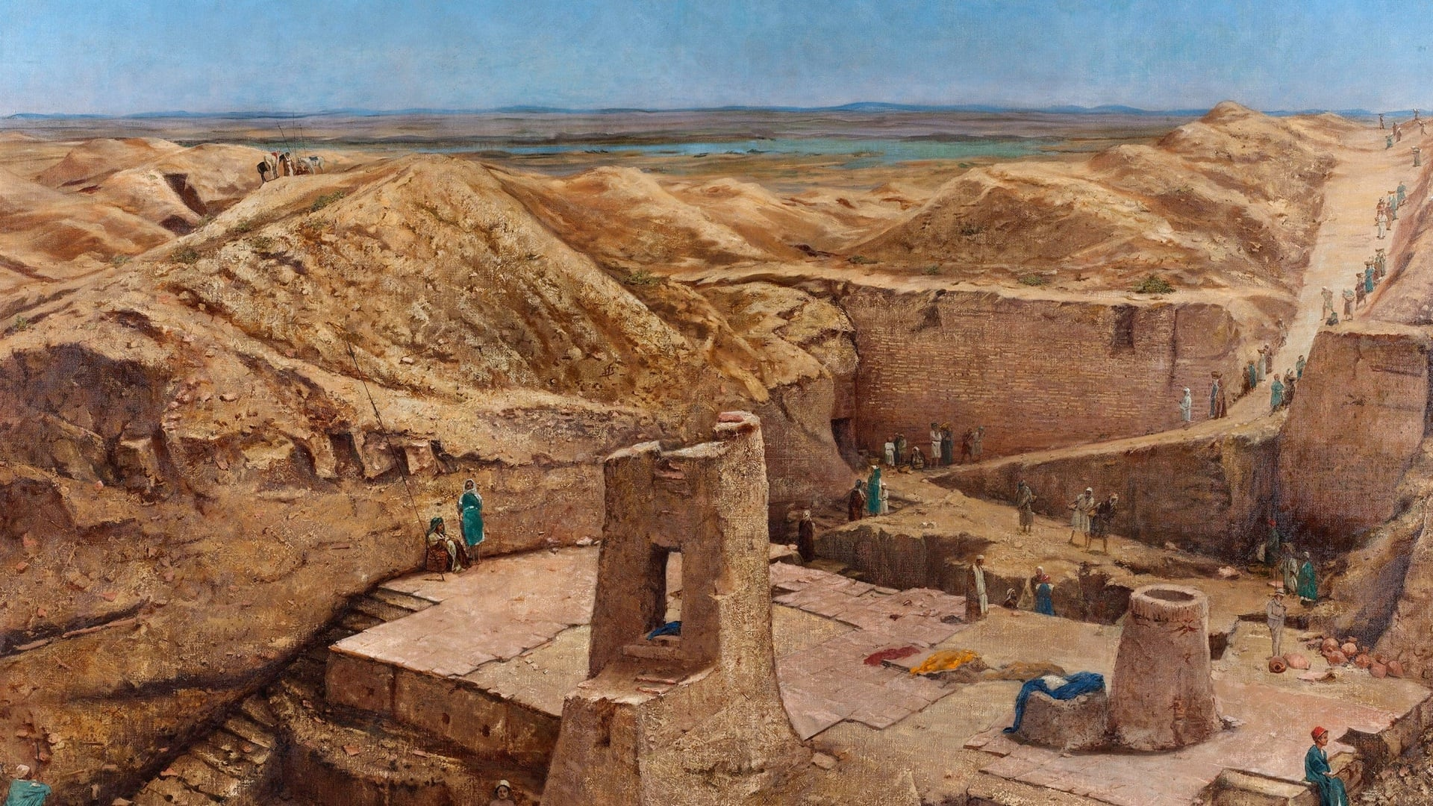

Slide 26
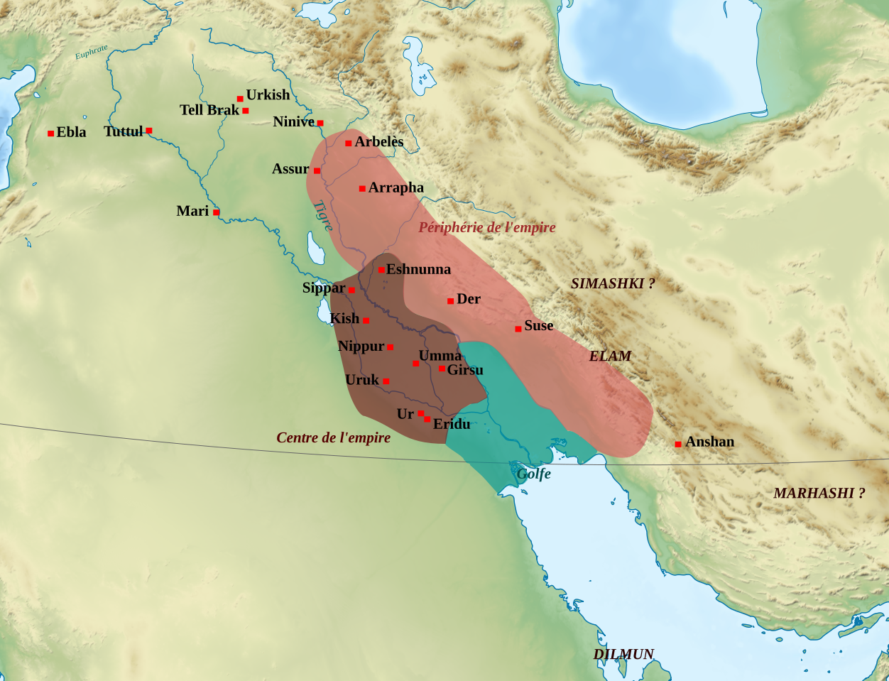
Nippur

Slide 27
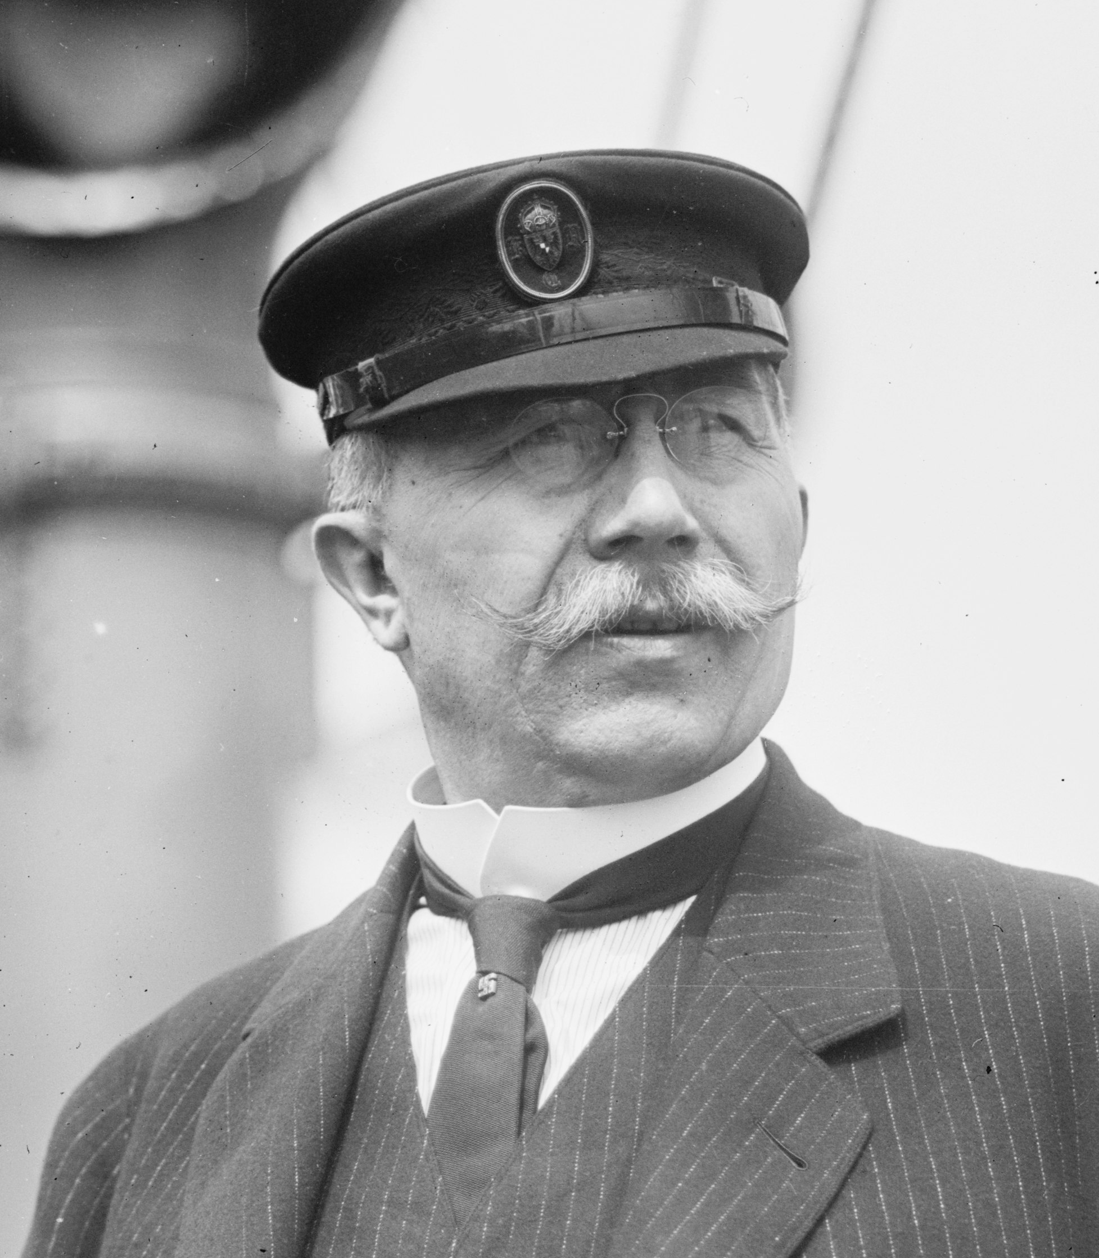
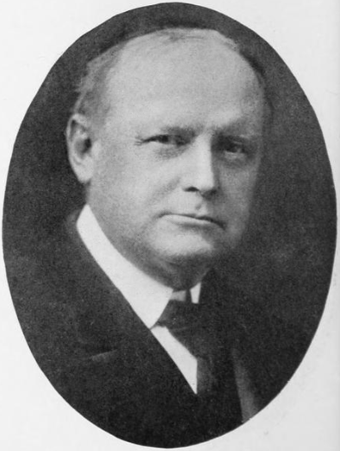
Nippur
“The excavations… were conducted primarily for the purpose of securing inscribed objects, for that was naturally the constant demand of the home committee, and by the discovery of these, or failure to discover them, the success of our Expedition would be judged.”
- John Punnett Peters
Hermann von Hilprecht and John Punnett Peters, excavators of Nippur

Slide 28
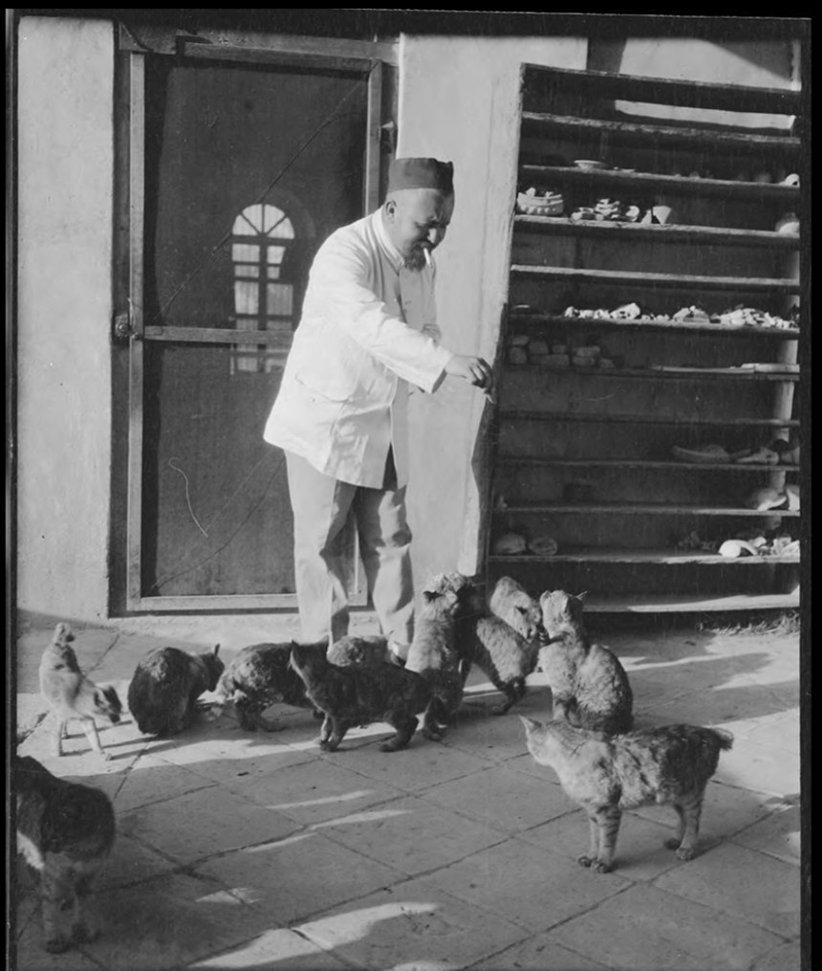
Deutsche Orient-Gesellschaft
German Oriental Society
Founded in 1898; received royal patronage from Kaiser Wilhelm II in 1901
Sponsored excavations at:
  Babylon (1899-1917)
  Ashur (1903-1914)
  Hattusa (1906-1911)
  Uruk (1912-1913)
  Abusir (1902)
  Amarna (1911-1914)
Feeding cats at Babylon

Slide 29
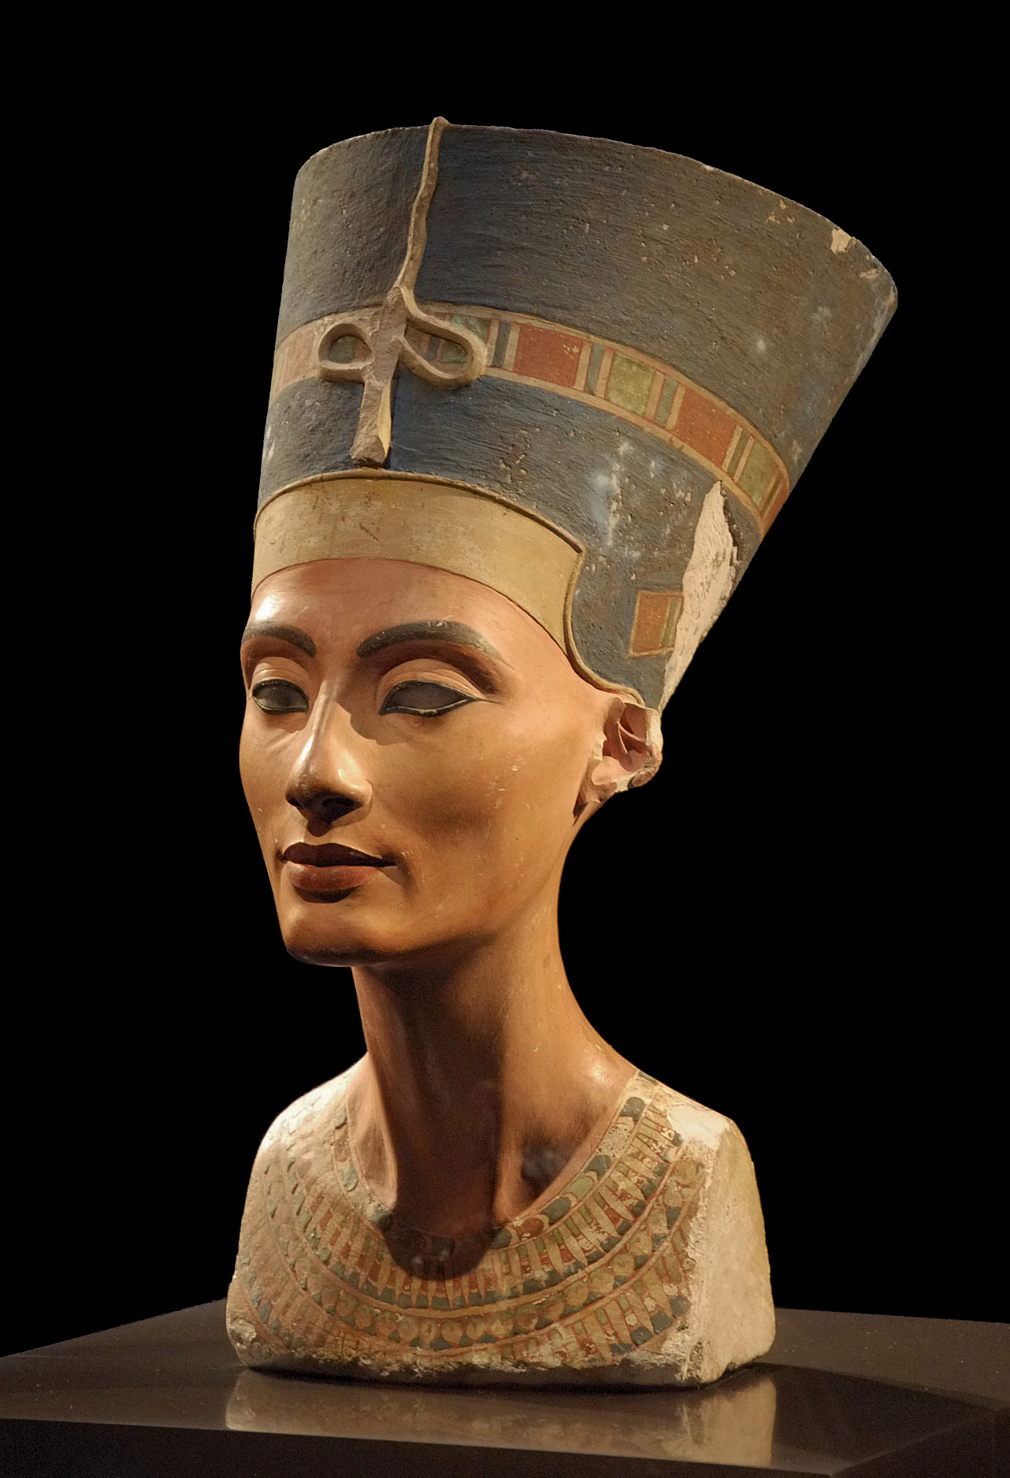
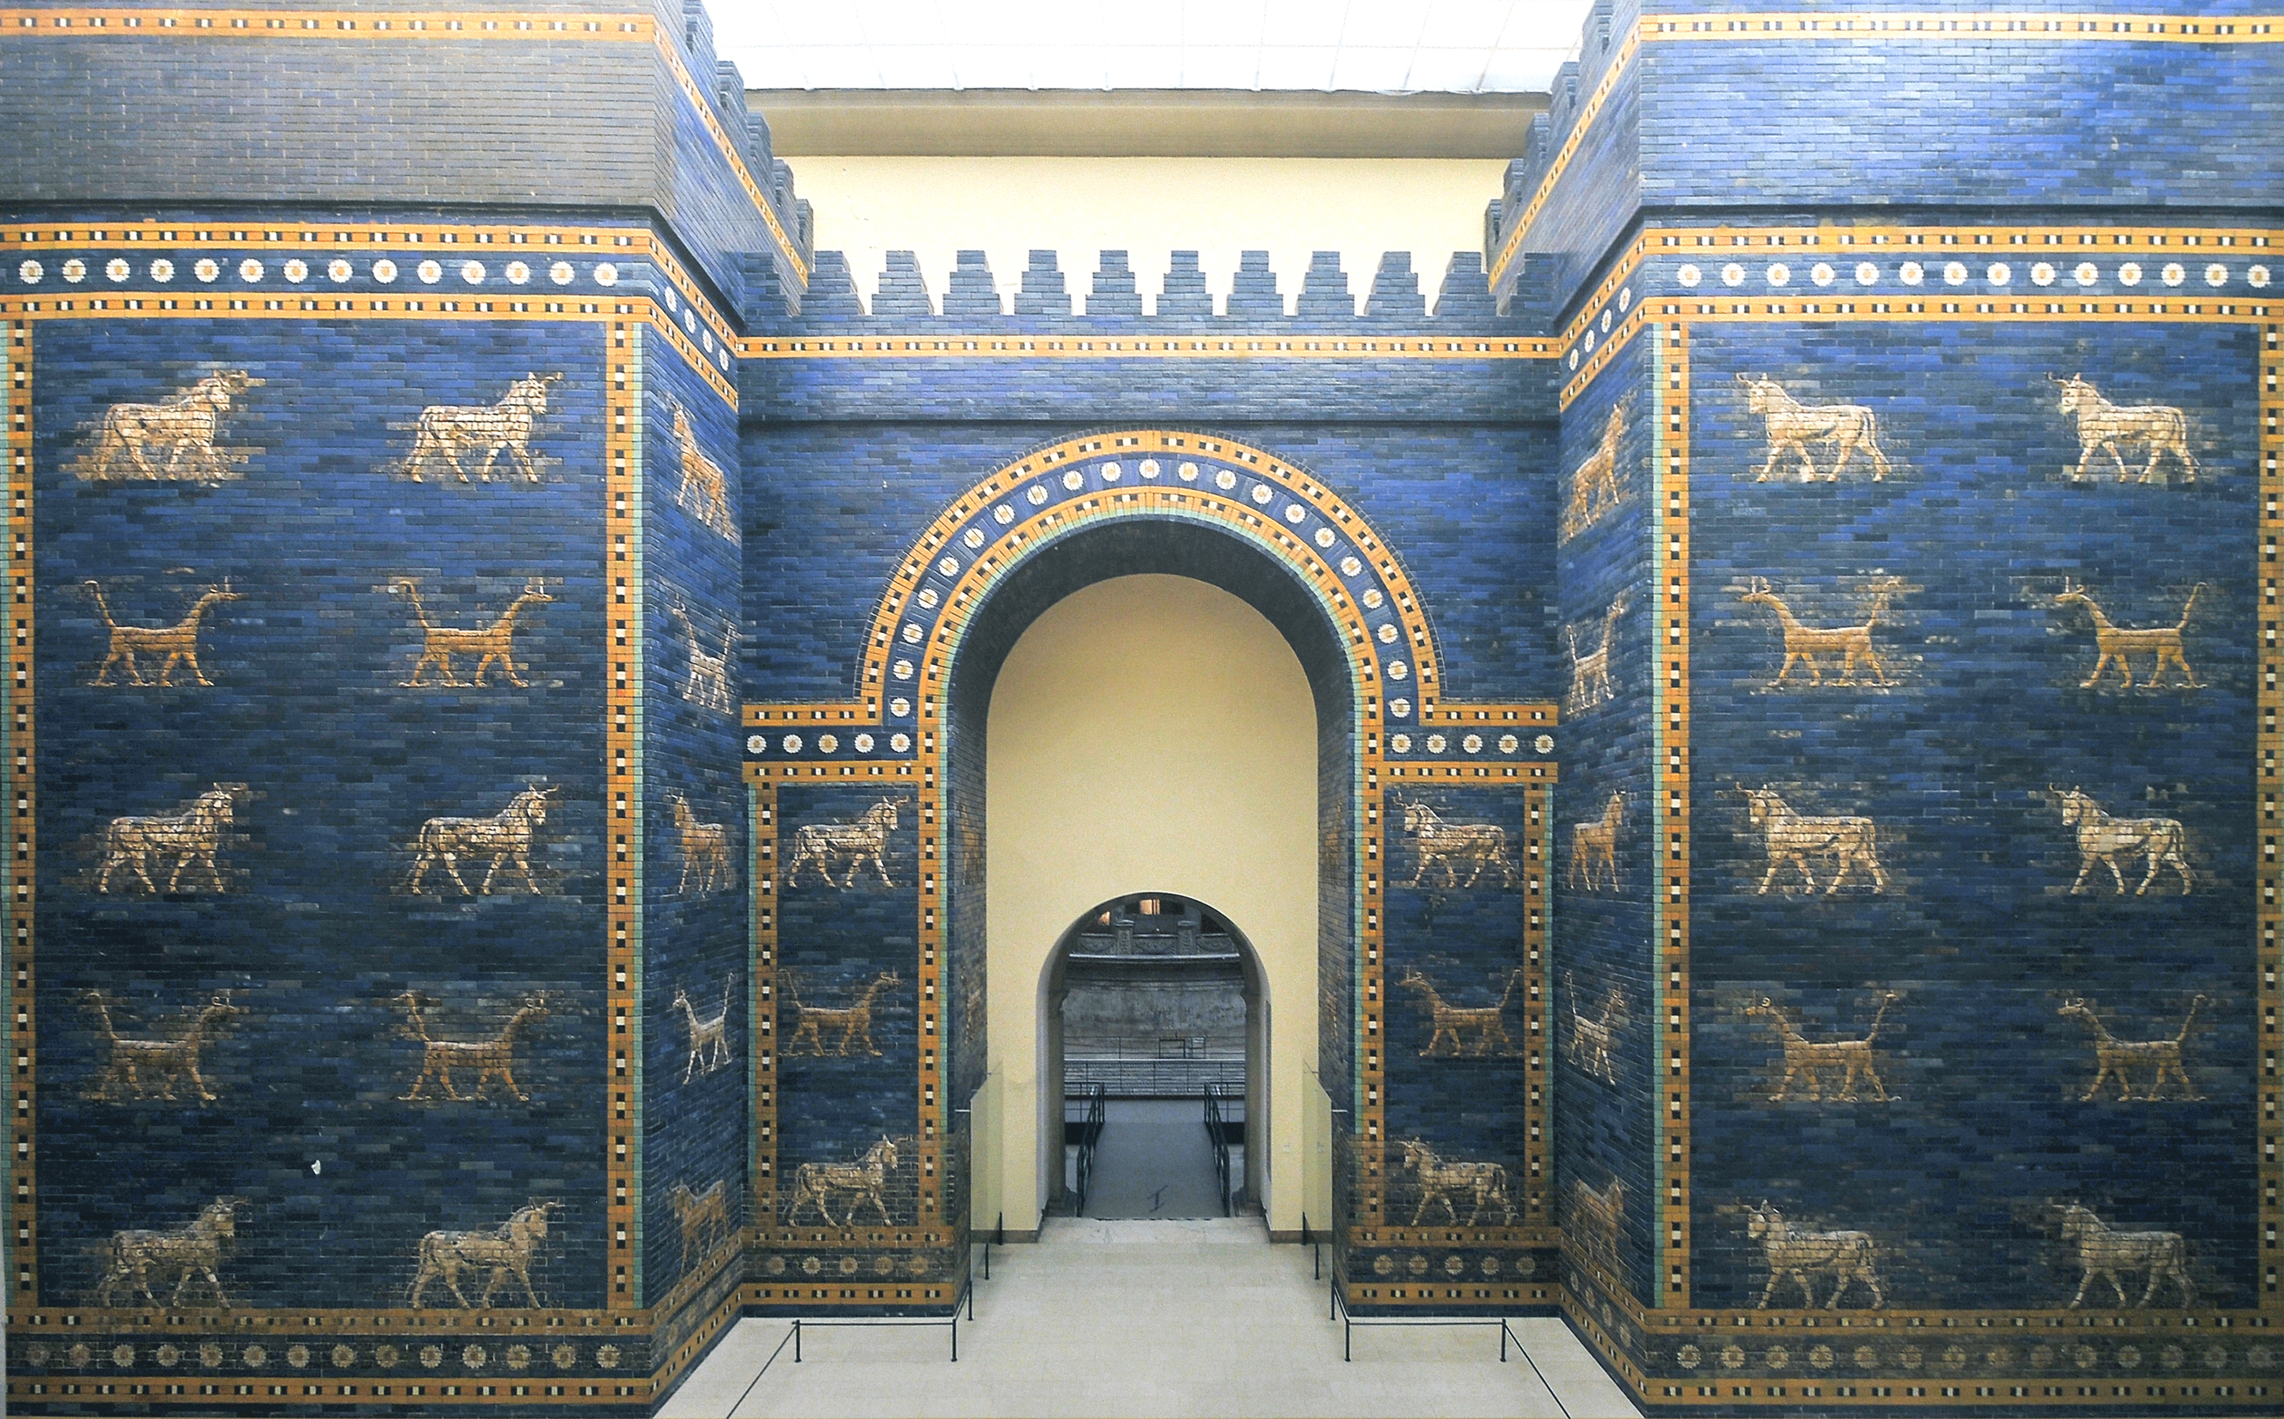
Above: The Ishtar Gate from Babylon
Left: Bust of Nefertiti from Amarna

Slide 30
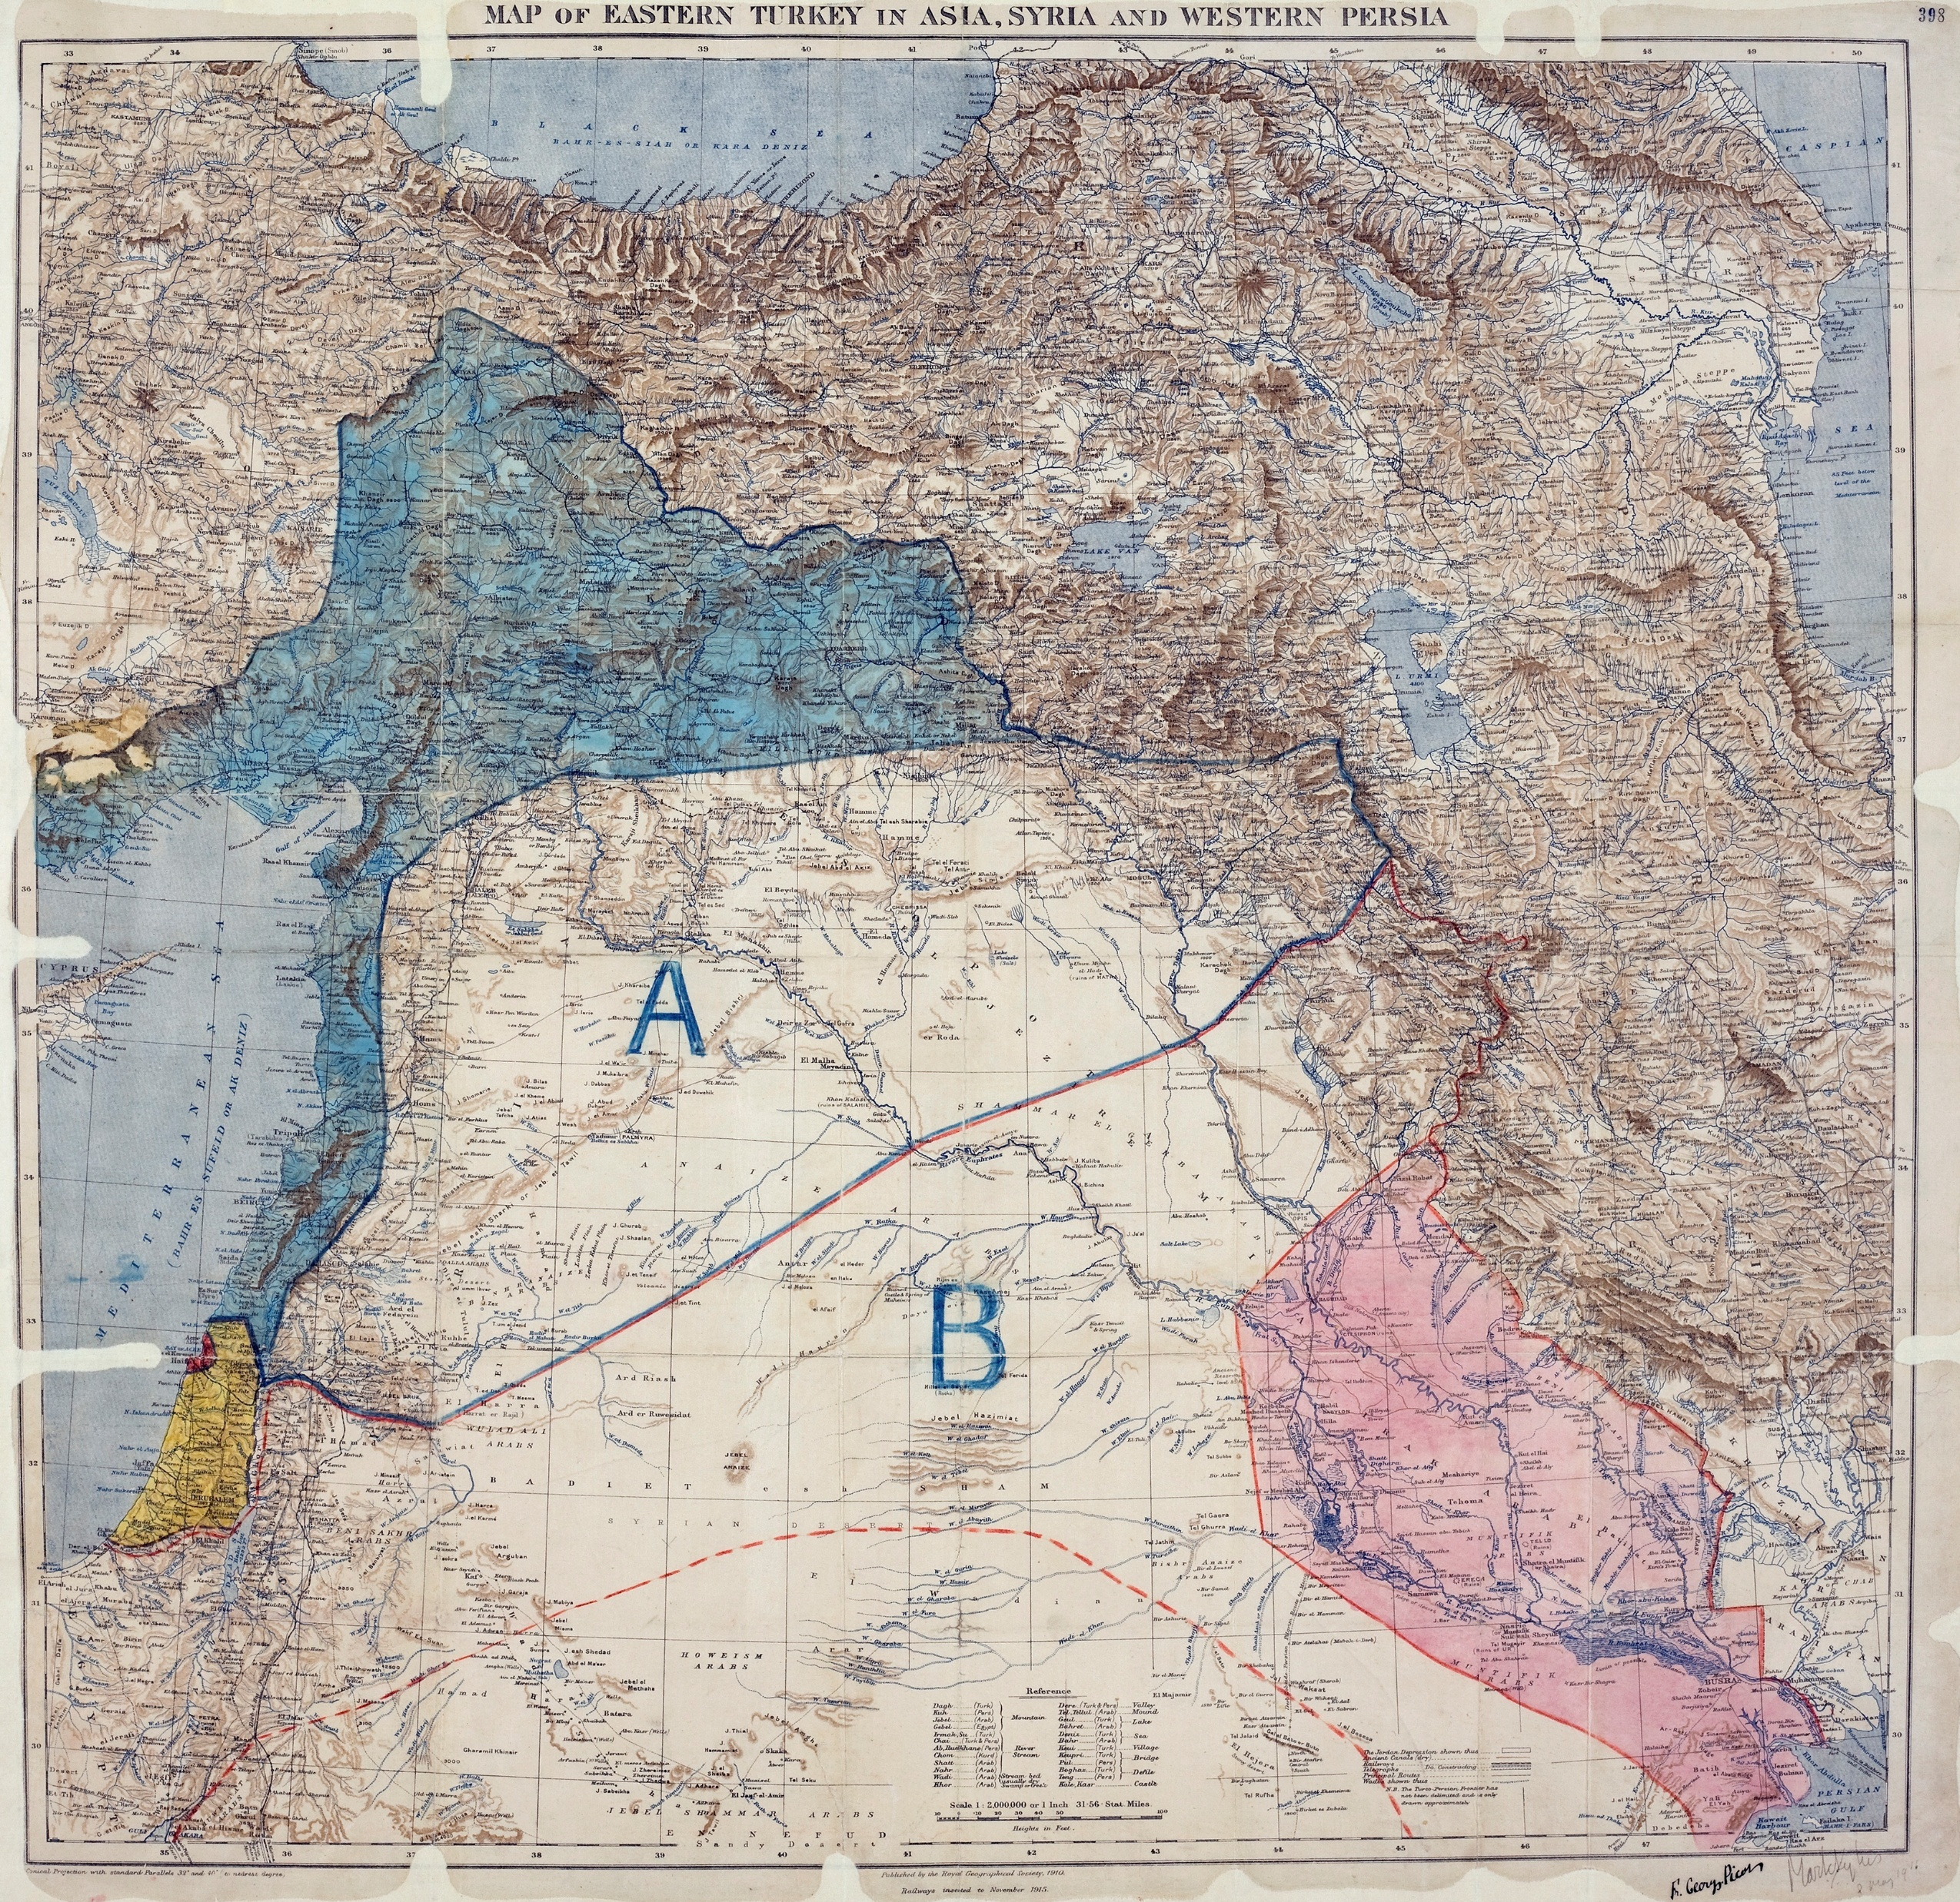
Sykes-Picot Agreement
Secret treaty between France and Britain to determine spheres of influence in the Middle East
Drawn up in 1916
Blue = French mandate
Pink and yellow= British mandates
A = French sphere
B = British sphere

Slide 31
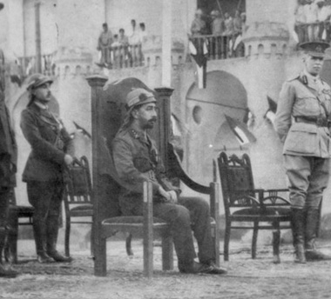
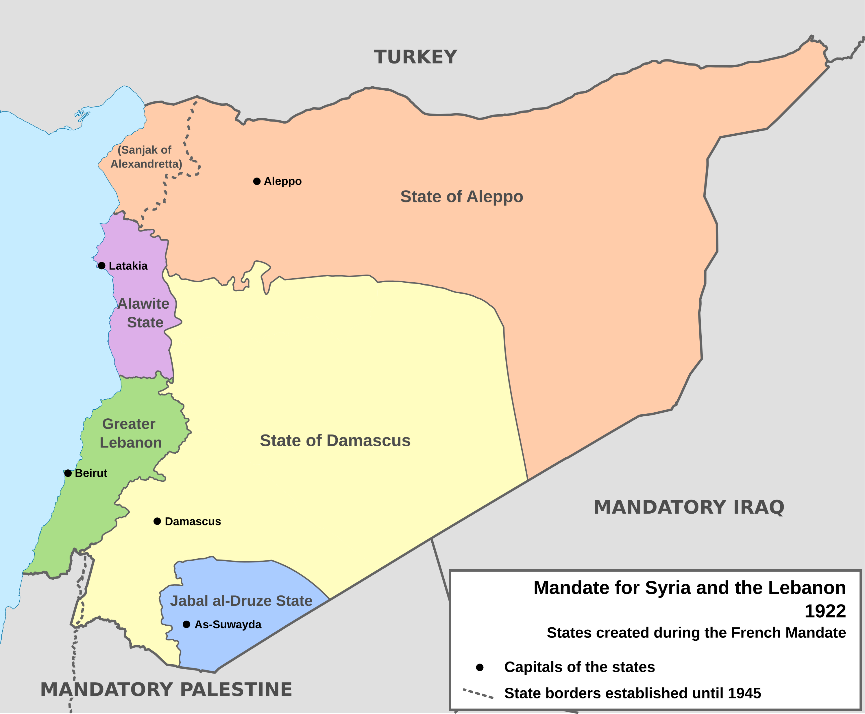
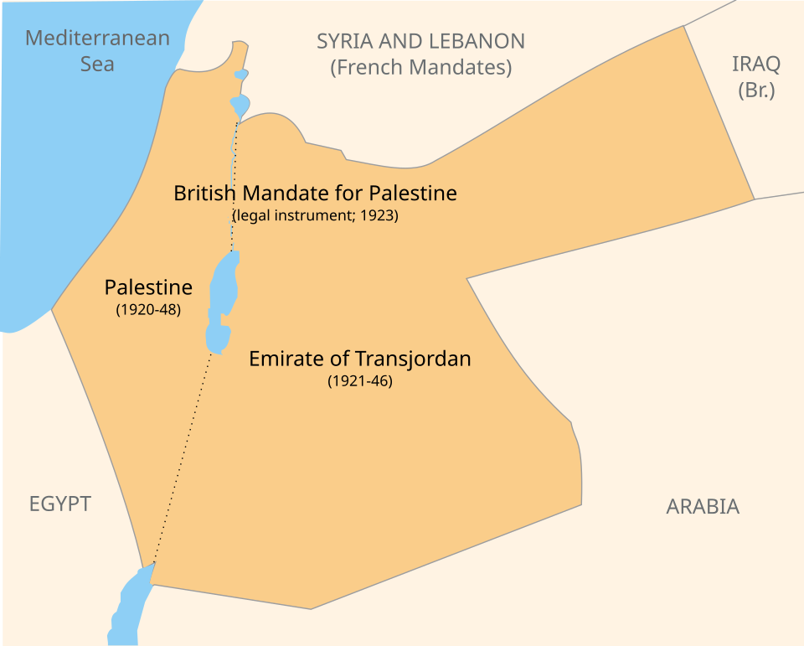
League of Nations Mandates
The coronation of King Faisal of Iraq (1921)

Slide 33
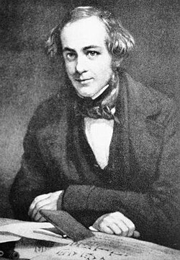
Henry Rawlinson
1810-1895
Officer in the British East India Company Army, diplomat, politician and archaeologist
Studied the Bisitun Inscription between 1836 and 1838
  This became the basis for the decipherment of cuneiform
Served as British political agent in Baghdad, 1847-55

Slide 34
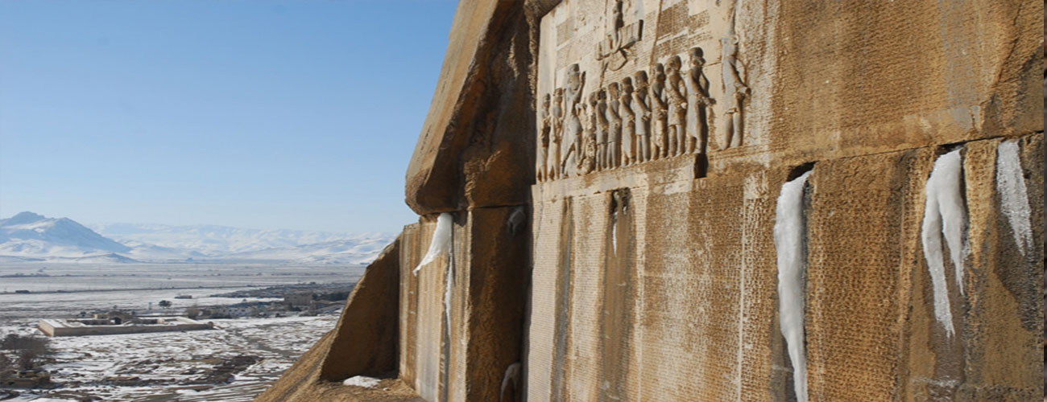
The Bisitun Relief

Slide 35
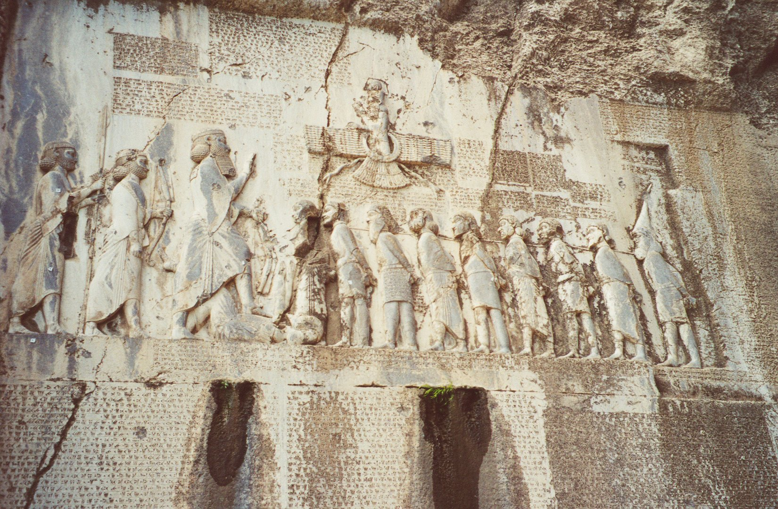
*

Slide 36
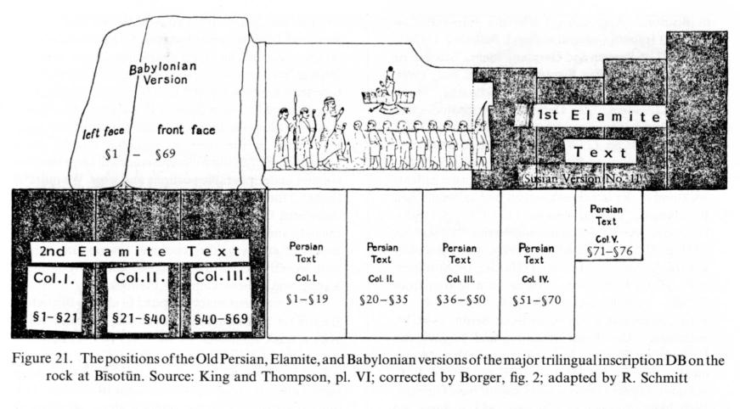
The Bisitun Monument
ca. 520 BCE
Inscription in Old Persian, Elamite and Akkadian
Describes the various revolts against Darius and his quashing thereof
Key for deciphering Old Persian and Elamite

Slide 37
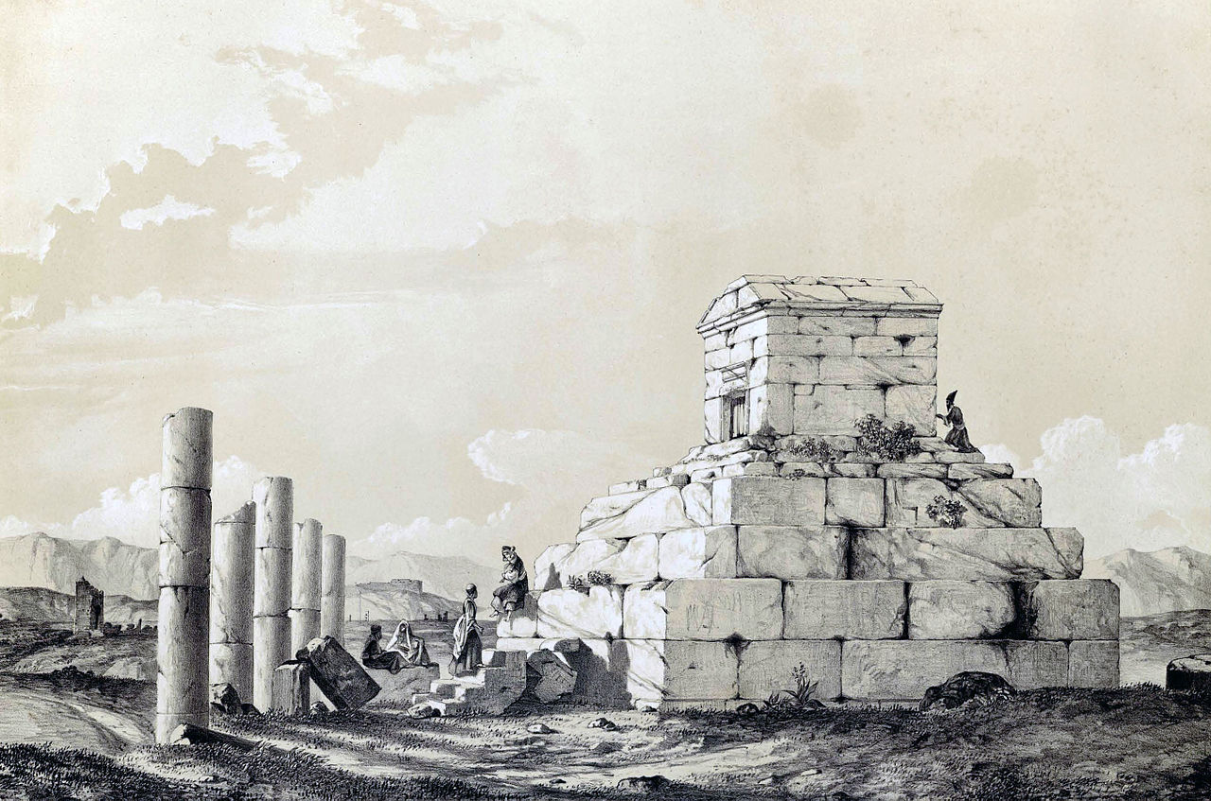
Eugène Flandin and Pascal-Xavier Coste
1787-1879 (Coste) and 1809-1899 (Flandin)
French painter (Flandin) and architect (Coste) who traveled in Persia in 1839-41
Published a lavishly illustrated account of their travels, which provided Europeans with the first accurate images of Iranian sites and monuments
Tomb of Cyrus at Pasargadae

Slide 38
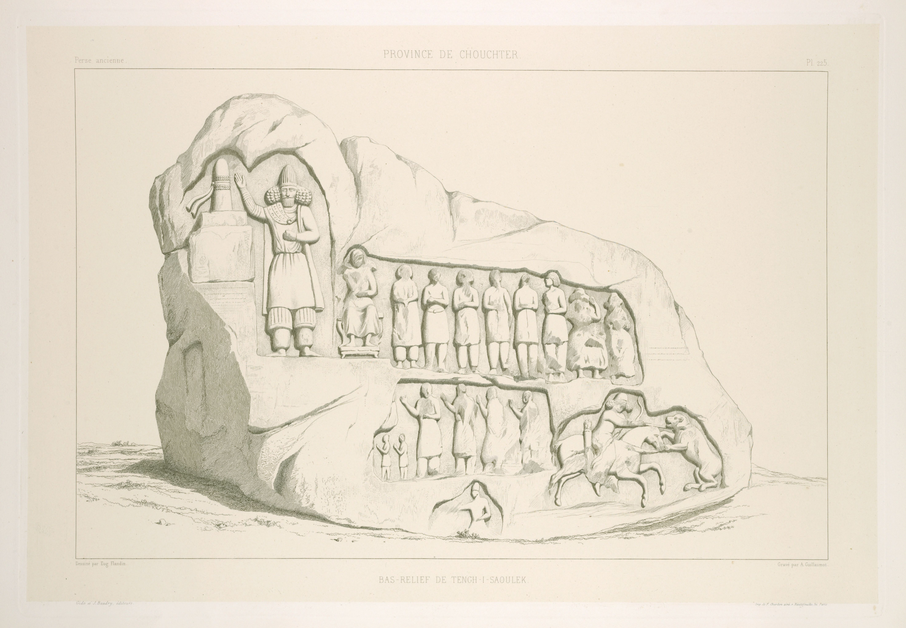
Parthian Reliefs at Tang-e Sarvak, published by Flandin and Coste

Slide 39
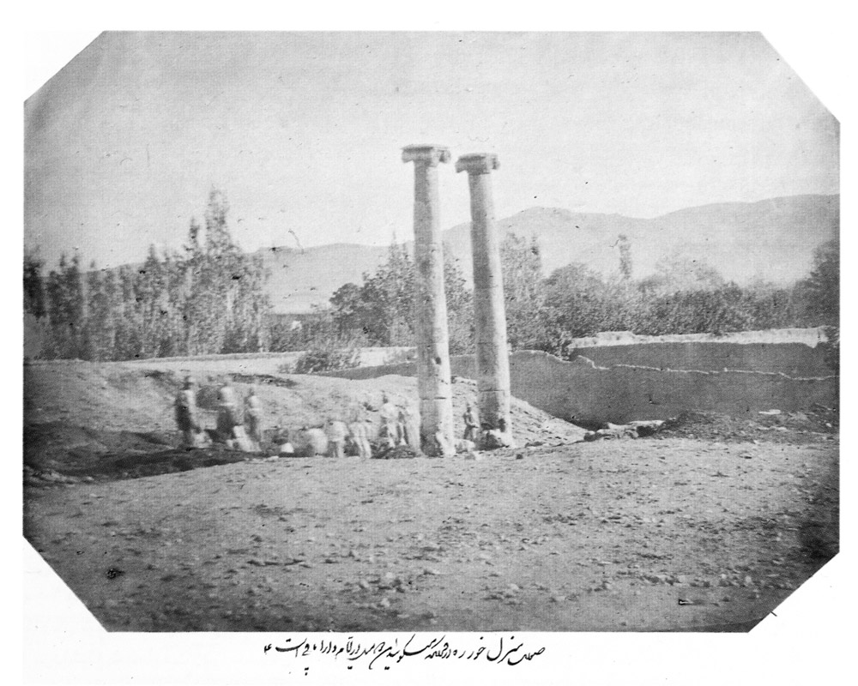
The first archaeological photograph taken in Iran by Āqā Rezā in 1859 at Khorheh

Slide 40
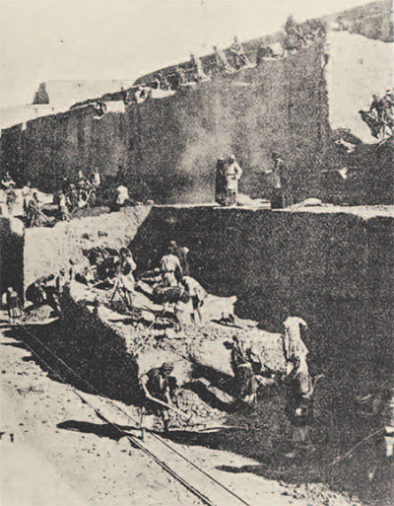
French Monopoly
1884-1927
French archaeologists had a monopoly on excavation guaranteed by the Persian government
  Directed initially by Marcel-Auguste Dieulafoy, Jacques de Morgan and Roland de Macquenem (all engineers)
But they mostly only excavated at Susa!
De Morgan’s Grande Tranchée at Susa; 6 meters wide by 90 meters long

Slide 41
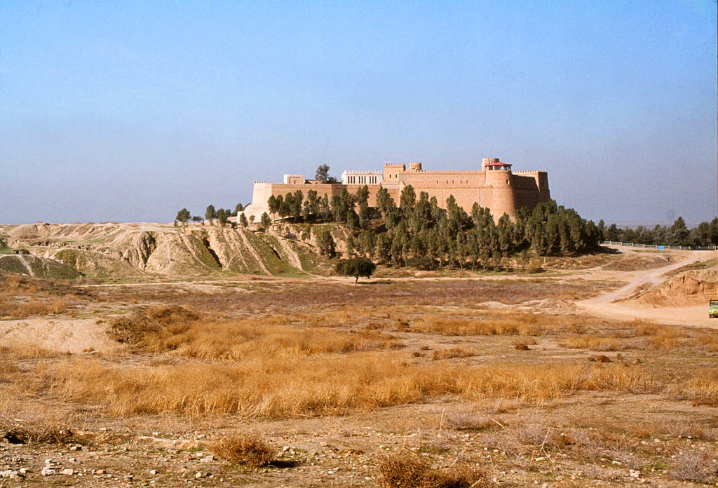
Susa
Mudbrick castle built by Marcel Dieulafoy in 1885

Slide 42
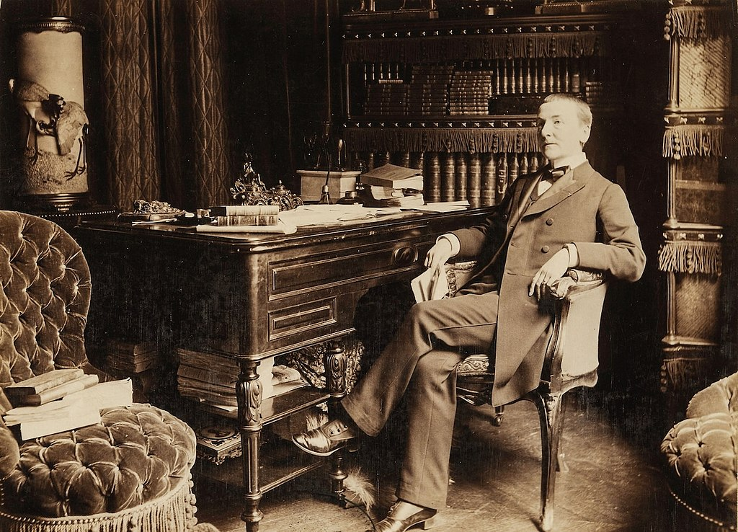
Jane Dieulafoy late in life

Slide 43
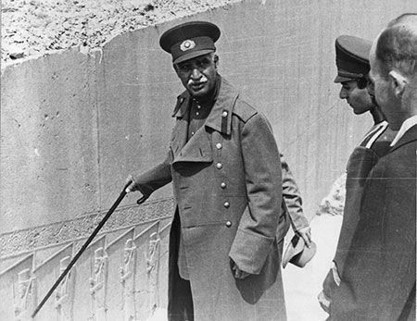
Reza Shah Pahlavi
Shah of Iran from 1925 to 1941
Persian military officer who became Minister of War in 1921 with British support
Overthrew the Qajar dynasty and became shah in 1925
Promoted a secular, nationalist Iran, which he considered to be a direct successor to the ancient Persian empires
Became increasingly sympathetic to Germany in the 1930s and was deposed after the Anglo-Soviet invasion of Iran in 1941
Reza Shah at Persepolis

Slide 44
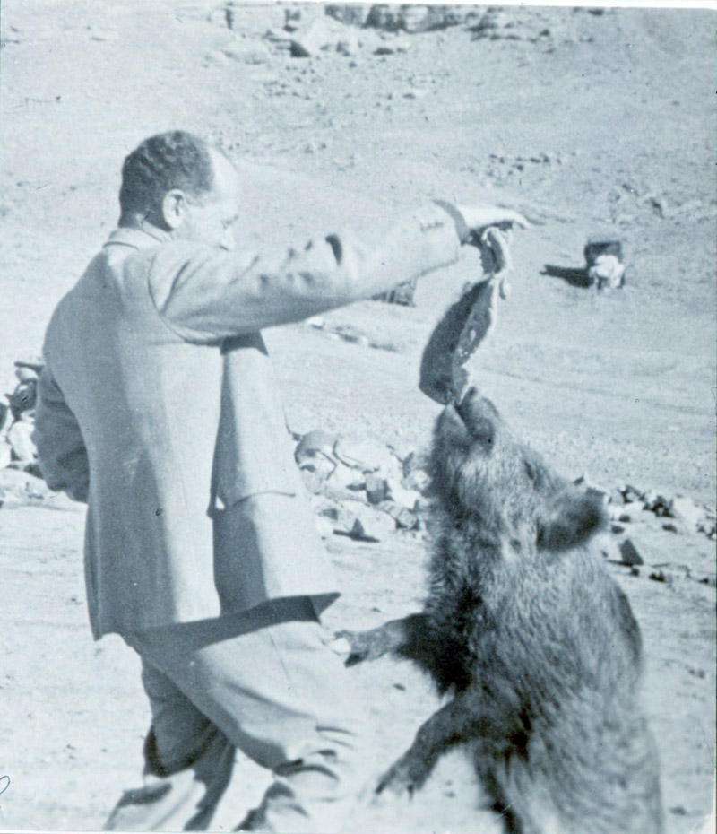
Ernst Herzfeld
1879-1948
Architect and archaeologist who traveled extensively in Iraq and Iran
Helped to break the French monopoly and draft the first Iranian antiquities laws
Collected, bought and sold antiquities for himself and for museums
Excavated at Persepolis 1931-34
Expelled from Iran in 1934, most likely due to Nazi pressure
Herzfeld feeding his pet warthog

Slide 45
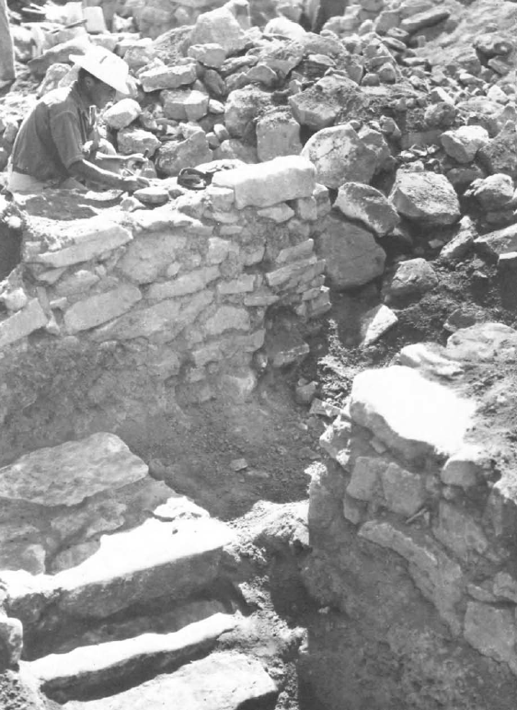
Foreign Era
1927-1939
Handful of foreign excavation projects, mostly sponsored by museums
  University of Pennsylvania Museum, the Louvre, Metropolitan Museum of Art, Oriental Institute of the University of Chicago, Museum of Fine Arts, Boston, etc.
Sites include Persepolis, Tepe Hissar, Qasr-e Abu Nasr, Sialk
Erich Schmidt in Luristan

Slide 46
Key Terms
Austen Henry Layard
Flinders Petrie
Henry Rawlinson
Hormuzd Rassam
League of Nations Mandate
Osman Hamdi Bey
Ottoman Empire

