Slide 1
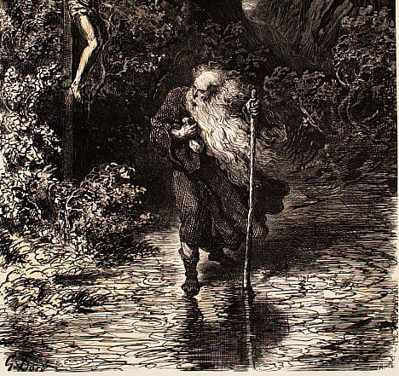

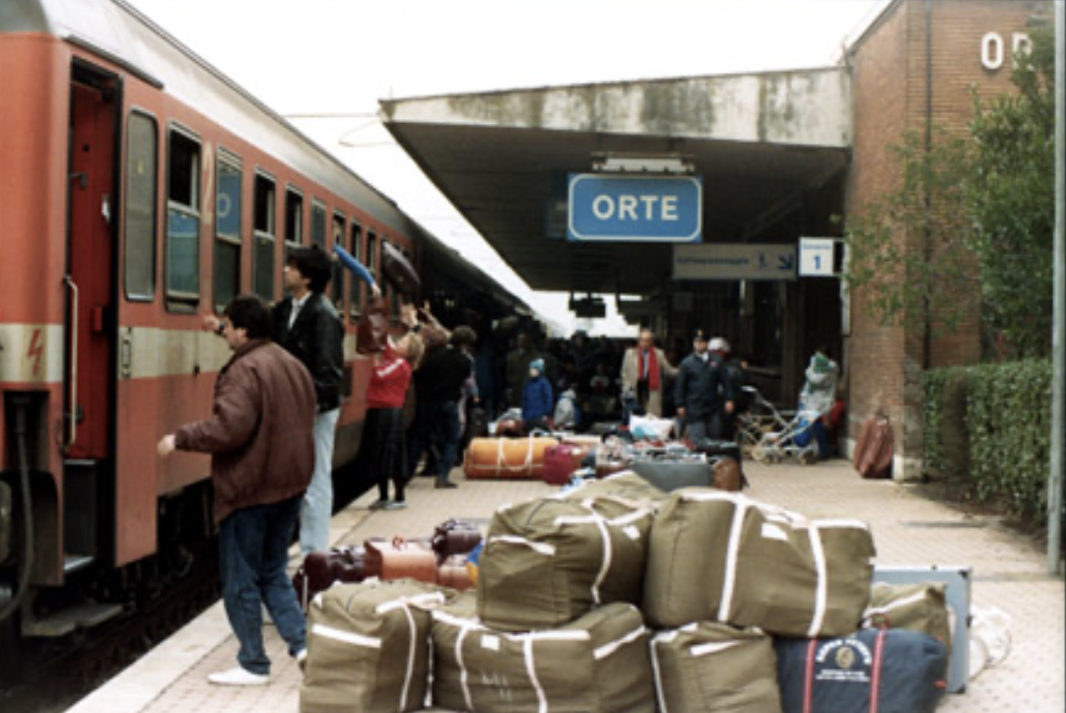
Mobility and Modernity
A Jewish History of Migration

Slide 2
Introductions
Name?
Major/Discipline-of-Interest?
Hometown?
What is your favorite way to travel?
Why did you decide to take this class?
Pronouns?

Slide 3
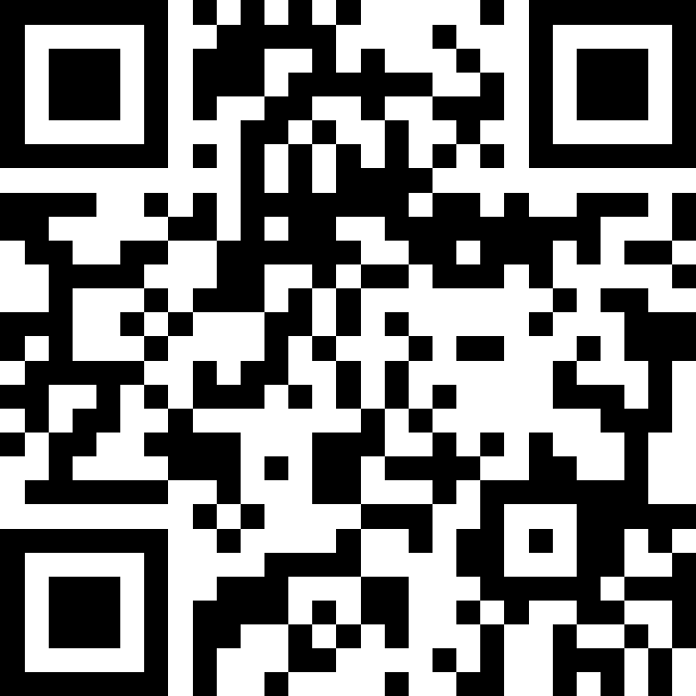

Why do people move?

Slide 4
Why study history?
History = The Study of Change/Time

Slide 5
Why study history?
“When an apple has ripened and falls, why does it fall?
Because of its attraction to the earth, because its stalk withers, because it is dried by the sun, because it grows heavier, because the wind shakes it, or because the boy standing below wants to eat it?
Nothing is the cause. All this is only the coincidence of conditions in which all vital organic and elemental events occur. And the botanist who finds that the apple falls because the cellular tissue decays and so forth is equally right with the child who stands under the tree and says the apple fell because he wanted to eat it and prayed for it.”
    -Leo Tolstoy

Slide 6
Why study migration?
Migration is associated with major events in world history:
Revolution, empire, economic expansion, and political change
On one hand, migration is a product of persecution, a point of conflict, and a method of exploiting labor
On the other, it inspires innovation and cultural collaboration, stimulates economies, and bridges communities
Migration has always existed and always will exist.

Slide 7
Why study the history of migration through a Jewish lens?
Who are Jews? For the purposes of this class, Jews are individuals who identify as Jews religiously and/or nationally, or individuals whom a state identifies as Jewish.
Jews have lived under and migrated between various regimes, all of which administer the movement of peoples in their own way. By studying Jews, we can peer into each one.
Jews serve as our anchor, our “control” for understanding how citizens and subjects in particular states, empires, and colonies, moved or were moved.
Much of Jewish identity and culture developed out of experiences of migration

Slide 8

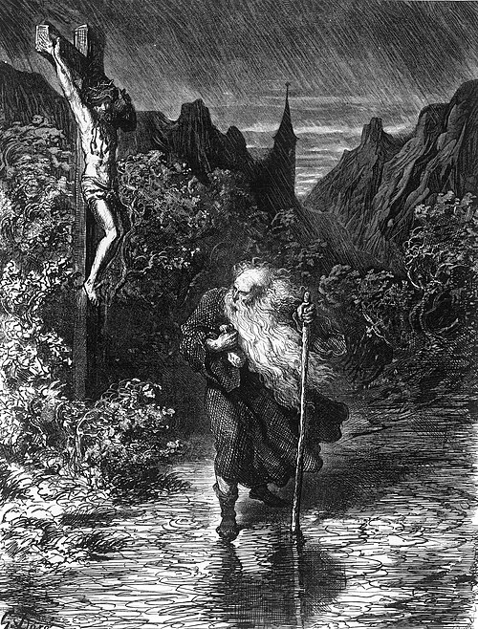
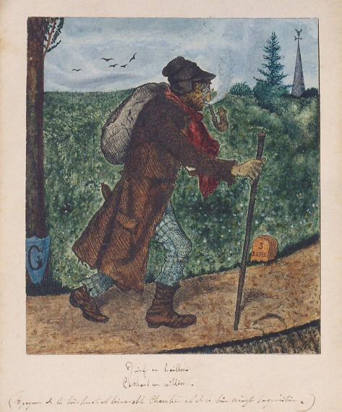
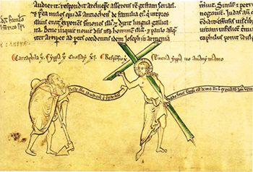
The Myth of the Wandering Jew

Slide 9
Vocabulary for the Course
Emigration:
  The process of exiting a state
Immigration:
  The process of entering a state
International Migration:
  The process of migrating across state borders
Internal Migration:
  Movement of people within a country
Sephardic Jews:
  Jews who originated from modern-day Spain and Portugal and spent centuries scattered across the Ottoman Empire and Italy
Ashkenazi Jews:
  Jews who originated in Central-Europe

Slide 10
Syllabus Review
Required Texts:
Carol Issacs, The Wolf of Baghdad: Memoir of a Lost Homeland (2020)
Leslie Page Moch Moving Europeans: Migration in Western Europe since 1650 (2003)
Primo Levi, Survival in Auschwitz, (1947)

Slide 11
Syllabus Review
Attendance
Because this course is a discussion-based seminar and meets only twice a week, consistent attendance is of the utmost importance. Students are permitted one excused absence per semester. Students must provide the instructor with at least two weeks’ notice. If you were absent due to an emergency, please contact the instructor at your earliest convenience to discuss a makeup assignment.
If you are more than five minutes late to class three times, I will count this as an absence

Slide 12
Syllabus Review
Participation
Your ideas, questions, and even gut reactions are always worth sharing with your instructor and classmates. This seminar course will be predominantly rooted in debate and discussion and will require students to volunteer their thoughts and observations on each week’s readings. Use this course as an opportunity to engage in collective knowledge building, taking advantage of the expertise of your instructor and fellow students. A significant part of your participation grade derives from your daring to ask questions and share your ideas. Moreover, I would like to emphasize that your participation grade does not emanate from your ability to provide a “correct” answer, but from your determination to publicly consider difficult questions.

Slide 13
Syllabus Review
Weekly Responses:
Students will spend the first twenty minutes of each Thursday class session hand-writing a 300-word response to the assigned readings for that week. Most importantly, in these responses, students must outline an argument that puts the week’s assigned sources (primary and secondary) in dialogue with one another. Students should contemplate how the week’s source illuminate a particular mode of Jewish migration and how that mobility fits into a broader historical context. Students are welcome to use a prepared index card that contains notes, relevant information, or ideas concocted before class.

Slide 14
Syllabus Review
What is your AI policy?
AI should not be used in any capacity for assigned readings or written course work. If I notice that you have used AI to create an essay, outline, or discussion post, I will schedule a meeting with you to discuss how I can better assist you with reading comprehension and writing practices. If I note continued use of AI after such a meeting, I will consider it a form of plagiarism and report it accordingly.
What is your extension policy?
Every student has three “extension days” that they can use throughout the semester on any chosen assignment. You do not need to let your instructor know when you choose to use them. She will keep track.
What is your technology policy?
I would love to say that this is a no technology classroom, but I do not have that power. What I will say, is that many universities are starting to move to a no-tech policy for humanities, and I encourage you to do the same. I encourage you to print out assigned articles and takes notes on paper. If you have any financial concerns regarding printing, please speak with me, and I will help ☺

Slide 15
Reading Secondary Sources
Background Information: Who is the author? What is their discipline? What year was the article written?
Framing: What questions is the author asking? What context are they providing?
Argument: What is the argument?
Body: What evidence does the author use? What case studies do they draw on?
Conclusion: What are avenues for future research?

Slide 16
Throughout the article
What words or terms do I not know?
What claims do I find suspect?
What questions do I still have after reading this?

Slide 17
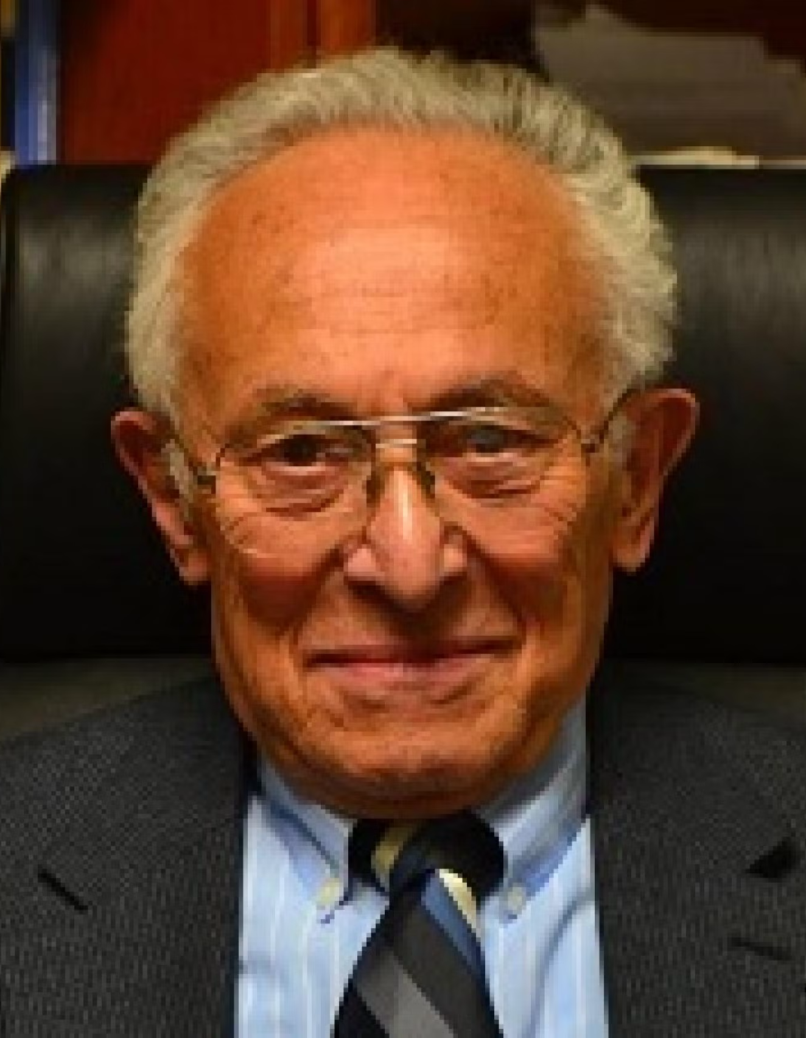

William Safran. "Diasporas in Modern Societies: Myths of Homeland and Return." Diaspora: A Journal of Transnational Studies 1, no. 1 (1991): 83-99

