Slide 1
COLD WAR AND GERMANY · WEEK 1
Introduction to
International Relations
Potsdam, Division, and the Four-Power Problem · Wednesday 3 September
Notes:
90 minutes. Opening 2 · Board work I 5 · Power 6 · Concepts 15 · Board work II 5 · Security 5 · Concepts 29 · Theories 15 · Application 6 · Closing 2.

Slide 2
OPENING
What this discipline asks
How do political communities recognising no common superior manage to coexist — through war, trade, negotiation, empire, alliance and law?
Almost every term today is contested. There is no agreed definition of power and there never has been. Hold these as positions in an argument, not as facts.
The vocabulary was built by people explaining the century you are studying. Carr wrote in 1939 as the peace collapsed; Morgenthau published in 1948 as a refugee from the regime he was trying to explain.
So this is not theory bolted onto history. It is the theory this history produced.
Notes:
2 minutes, no longer. The session lives on the board work, not on the lecture.

Slide 3
1
Board work I
What is power? · Everyone at the board · 5 minutes
Notes:
Hand out the markers BEFORE giving the instruction — one per person — or the first minute goes on distribution. The board has two zones: DEFINITIONS above, DIMENSIONS below.

Slide 4
BOARD WORK I · WRITE
2 min
Your own definition, then the kinds.
1
Take a marker — one each, not one per pair.
2
In the upper zone, each of you writes your own definition of power. One sentence, your own handwriting.
3
In the lower zone, each of you writes at least two dimensions of power. Words or short phrases — several words are fine. Include one that cannot be counted.
Don't read your neighbours' answers before you have written yours. Don't try to be right.
Notes:
Write nothing yourself. Do not correct, do not comment, do not nod approvingly — every reaction steers the next sentence written. Quiet individual prompts if someone stalls: Finish this sentence — power is the ability to … / Is a state with a huge army but no allies powerful? / Why does everyone in this room speak English?

Slide 5
BOARD WORK I · ROUND
3 min
Everyone says one thing.
1
Stay where you are. We go along the board and every single person speaks.
2
Your definition, or one of your dimensions. One sentence, no explanation, no comment from anyone else.
3
If yours has already been said, give the one word that makes yours different.
Roughly eight seconds each. Keep it moving.
Notes:
Go along the board in order so nobody is skipped. WHILE the round runs, mark each entry in the lower zone silently with 1, 2, 3 or 4. Do not explain the numbers — if asked, say: in a moment. Borderline entries get two numbers; that is a finding, not a mistake. If nothing lands in column 3, ask: when two states sign a trade agreement, someone wrote the template — is writing the template a form of power?

Slide 6
NAMING WHAT YOU WROTE
Four dimensions of power
1
HARD POWER
2
SOFT POWER
Coercion and material inducement.
Military — forces, weapons, budgets, the threat of force.
Economic — GDP, trade routes, resources, sanctions.
Getting others to want what you want (Nye).
Cultural reach — film, music, language, ways of living.
Political values — the appeal of your own system.
Foreign policy — seen as legitimate and consistent.
3
INSTITUTIONAL & NORMATIVE
4
DEMOGRAPHIC & GEOGRAPHIC
Rule-setting — shaping standards, law and trade rules inside the UN, EU, WTO.
Agenda-setting — deciding which issues count as urgent, and which are never raised at all.
Human capital — a large, young, educated population as the base of future capacity.
Position — straits, trade routes, rare earths, or simply where you sit on the map.
Notes:
Sit them down first — the point is to look at the board from a distance. Only now write the four headings in the margin, pointing at the students' own entries as you name each one. 6 minutes for this slide and the next.

Slide 7
TWO THINGS WORTH NOTICING
What each dimension does — and doesn't
HARD POWER CHANGES OPTIONS, NOT WANTS
SOFT POWER IS NOT OWNED BY ITS OWNER
Both branches — military and economic — work the same way. They change what the other side can do, or what an option costs it.
Neither changes what the other side wants. That is the whole distance between force and persuasion, and it is why occupations are so much harder than victories.
It exists only in the perception of others.
So your own behaviour can destroy it overnight, and you cannot spend it like a budget. A state can build an aircraft carrier on schedule. It cannot decide to be admired.
Notes:
The slow dimension, number four, is worth one extra sentence: it moves over decades, gets ignored in short-term analysis, and regularly turns out to be decisive.

Slide 8
THE LINE THAT CARRIES THE TERM
What is not in this document — and who decided that?
Hard power leaves traces in a text: armies, threats, concessions. You can point at the sentence.
Institutional and normative power shows up as absence — it determines what nobody bothered to write down, because nobody thought to raise it.
Notes:
Say this slowly. It is the reading instruction for the whole term and it returns on the final slide.

Slide 9
CONCEPT 1
International system
The set of political units that interact often enough that each must take the others into account.
STRUCTURE — how many great powers, and how is capability distributed? Europe 1815–1914 multipolar; 1947–1989 bipolar; after 1991 nobody agrees, and the disagreement is itself informative.
MEMBERSHIP — historically variable. The UN had 51 members in 1945 and has 193 today. That growth is decolonisation, and it changed what the system is.
ASK If a unit is affected by everything the great powers do but cannot affect them in return, is it a member?
Notes:
9 minutes for this block of three concepts.

Slide 10
CONCEPT 2
Sovereignty
The claim to be the final authority within a territory and to answer to no higher authority outside it.
A CLAIM, NOT A FACT — it can be asserted, denied, recognised, withdrawn. A state exists internationally partly because others treat it as existing.
HISTORICALLY MADE — textbooks date it to Westphalia 1648, but the treaties say much less about it than the myth suggests. The principle consolidated gradually and was then presented as timeless.
UNEVENLY DISTRIBUTED, AND SUSPENDABLE — formal equality alongside vast inequality of autonomy. A territory can be governed by outside powers without being annexed: statehood on paper, no government to exercise it.
ASK Is a state that cannot control its borders, currency or courts still sovereign? What work is the word doing?
Notes:
The central concept of the session. Do not cut.

Slide 11
CONCEPT 3
Anarchy and self-help
Anarchy does not mean chaos. It means only that there is no authority above states — no world government, no compulsory court, no police force to send.
SELF-HELP follows: since no one is obliged to guarantee your survival, you must ultimately provide for it yourself. This is the founding assumption of most IR theory.
Yet anarchy is compatible with much order — trade flows, embassies function, most treaties are kept. Hedley Bull: an anarchical society, no ruler but rules.
The question is not whether anarchy produces disorder, but how much order it can produce and by what means.
ASK Domestic law is enforced by the state. What enforces international law — and does that mean it isn't really law?

Slide 12
CONCEPTS 4 AND 5 · ORDER BY DISTRIBUTION
Balance of power and spheres of influence
BALANCE OF POWER
SPHERES OF INFLUENCE
Peace preserved not by trust or law but by distribution: if no single state can dominate, none will try.
Balancing — joining against the strongest. Bandwagoning — joining the strongest, which weak states often do because resistance is suicidal.
Vienna 1815 is the deliberate construction; the alliance system of 1914 the classic failure. Note the moral cost: smaller states become weights on a scale.
A region where one great power's preferences are decisive and the others acquiesce. Balance of power made geographical.
Usually tacit — writing them down would contradict the principles everyone publicly professes. So you read them off practice, or off what an agreement quietly permits.
Monroe 1823 · Anglo-Russian Convention 1907 · Berlin Conference 1884–85.
Notes:
6 minutes. Ask the group: why do spheres of influence almost never appear under that name in the documents that create them?

Slide 13
2
Board work II
What is security? · Everyone at the board · 5 minutes
Notes:
Same method as before, so no time is lost explaining it. Second board or a cleared area, same two zones.

Slide 14
BOARD WORK II · WRITE
2 min
What is security?
1
Markers again, one each. Each of you writes your own answer. One sentence.
2
There is a trap in the question — so answer two things explicitly inside your sentence.
3
Then each of you adds at least two dimensions of security. Several words are fine.
Security of whom — the state, the government, the population, you personally? And: security from what?

Slide 15
BOARD WORK II · ROUND
3 min
Everyone says one thing.
1
Your definition, or one dimension.
2
Before we start, decide in your head: are these security issues, yes or no?
3
A cyberattack that shuts down a hospital. · A drought that destroys a harvest. · A foreign disinformation campaign before an election.
If you have a firm answer to one of them, say that instead of your definition.
Notes:
Number silently again, 1 to 6. If almost everything lands in 1 and 2 — which is common — do not add the rest yourself. Call the hard cases: who said the hospital is not a security issue, defend it. Who said yes to the drought? The remaining four dimensions grow out of that disagreement.

Slide 16
NAMING WHAT YOU WROTE
Six dimensions of security
1
MILITARY
2
POLITICAL
3
ECONOMIC
Territory protected against external attack; deterrence through capability and alliances, so the attack is never attempted.
Constitutional order and institutions against overthrow, terrorism, unrest; sovereignty against blackmail and interference.
Access to energy, raw materials, food; trade routes and supply chains against blockade; currency and financial stability.
4
CYBER & TECHNOLOGICAL
5
SOCIETAL & CULTURAL
6
ENVIRONMENTAL
Critical infrastructure — grids, hospitals, banks. Data sovereignty against espionage, ransomware, theft of intellectual property.
Cohesion, language, religious and cultural identity — against both fragmentation and forced assimilation.
The existential consequences of warming; and clean foundations for life — water, air, soil, biodiversity.
Notes:
Label the entries and name the six briskly. The three consequences on the next two slides are worth more than the list itself — if you are behind, compress the list rather than the consequences.

Slide 17
THREE THINGS THAT FOLLOW
The list is not neutral
More important than the six categories is what they tell you about the concept itself.
THIS LIST HAS A HISTORY — for decades, security meant dimension one and part of dimension two. Nothing else counted. Three to six were argued into the field from the 1970s on, each contested at the time.
So when we read documents from the 1940s, we are reading a narrow concept of security. Do not import ours into them.
SECURITY OF WHOM? — every dimension works at the level of the state and of the individual, and the two often conflict. A government can make the state safer by making its citizens less so; that is what a police state is. The UNDP named the alternative in 1994: human security.
Notes:
Do not cut. This is the analytical yield of the exercise.

Slide 18
WHERE THE TWO BOARDS MEET
Deciding what counts as security is itself an exercise of power.
Name something a security threat and it moves out of ordinary politics: budgets are freed, debate is shortened, emergency measures become defensible. That is why states fight so hard over whether migration, or climate, or a disease is a security question.
Notes:
Point at both boards: category three on the left was agenda-setting; this list is the result. Closing question: who has the power to declare something a matter of security — and who has never had it?

Slide 19
CONCEPTS 6 AND 7 · ORDER BY GUARANTEE AND BY THREAT
Collective security and deterrence
COLLECTIVE SECURITY
DETERRENCE
The opposite of balancing: all states guarantee each other, and aggression against one is treated as aggression against all.
Founding idea of the League (1920) and the UN (1945). It requires agreement on who the aggressor is — when the great powers disagree, nothing happens. Manchuria 1931, Abyssinia 1935.
Not the same as collective defence. NATO's Article 5 is a group guaranteeing each other against outsiders — that is balance of power in institutional form.
Persuading an adversary not to act by convincing them the costs exceed the gains.
It operates entirely in the adversary's mind, so it depends on credibility — on what they believe, not on what is true.
By punishment (I will destroy you afterwards) or by denial (your attack will simply fail). Once both sides have a survivable second strike, the logic becomes mutual. Failures are invisible until they happen; successes cannot be proven.
Notes:
6 minutes. The collective security / collective defence distinction is confused constantly — make it explicit.

Slide 20
CONCEPT 8 · THE KEY MECHANISM
The security dilemma
Measures a state takes to make itself safer necessarily make others less safe — because others cannot observe intentions, only capabilities.
Those states respond. The first reads the response as proof of hostility and redoubles. Spiral. John Herz named it in 1950, describing what he had just watched happen.
THE DEVASTATING IMPLICATION — nobody has to be malevolent. You can construct a descent into confrontation in which every actor behaves defensively and reasonably, and the outcome is still an arms race or a war.
Sharper when offensive and defensive weapons look alike. Milder when defence is visibly distinguishable — a fortress threatens nobody. The naval race before 1914 and the nuclear arms race after 1949 both read this way.
ASK Take any confrontation you know. Two sentences — how it looks from each side. Are both defensible?
Notes:
If only one concept survives the session, make it this one.

Slide 21
CONCEPT 9
Status quo and revisionist powers
A status quo power benefits from the existing order and wants it preserved; a revisionist power wants it changed.
The distinction sounds descriptive and is almost always polemical. Everyone claims to be defending something. Carr's uncomfortable point in 1939: the satisfied powers called their satisfaction peace, without noticing that the order they defended had been created by their own earlier violence.
The hard cases are moments when the old order has collapsed and no new one exists. Then the question of which arrangement counts as the status quo has no neutral answer — and that is precisely when major wars start, or fail to be avoided.
ASK Who is the status quo power when the previous order no longer exists?
Notes:
First thing to cut if the clock is against you.

Slide 22
CONCEPTS 10 AND 11 · VOICE
Nationalism and self-determination
NATIONALISM & NATIONAL INTEREST
SELF-DETERMINATION
Nationalism: the claim that humanity divides into nations and each should govern itself. Historically recent — Anderson's imagined communities, constructed through print, schooling, conscription.
National interest: the assertion that a state has objective purposes above domestic politics. Treat it as a claim to be examined. Ask which domestic coalition benefits, and who inside the nation was not consulted.
Interests are not stable objects. They change when the government changes — sometimes mid-negotiation.
Peoples should choose their own political status. Atlantic Charter 1941, UN Charter 1945, GA Resolution 1514 in 1960.
It contains an unanswered question that has caused enormous violence: who counts as a people, and who decides? Every answer creates new minorities inside the new unit.
Note the asymmetry: used to redraw Europe after 1918 while withheld from the colonies of the same powers. And population transfers have been justified in its name.
Notes:
10 minutes for this block including communism on the next slide.

Slide 23
CONCEPT 12
Communism as an IR theory
Not only a domestic economic system, but a rival account of what world politics actually is.
The fundamental units are classes, not states. States are instruments of the dominant class. Wars between capitalist powers arise from competition over markets and investment outlets — Lenin, 1916.
So a communist government arrives at a negotiation with a different understanding of what is being negotiated: where the other side sees a solvable dispute between states, doctrine sees a phase in a structural conflict.
Whether a given communist state acted on doctrine or on ordinary great-power calculation is one of the field's permanent arguments.
ASK What would each explanation — ideology or ordinary great-power interest — predict differently?

Slide 24
CONCEPTS 13 AND 14 · THE MECHANICS OF THE TABLE
Why the text looks the way it does
ISSUE LINKAGE / PACKAGE DEAL
VETO / UNANIMITY RULE
Negotiators rarely settle one question at a time. They tie separate issues together so a concession on one can be paid for with a gain on another, and the result is accepted or rejected whole.
So the structure of a text encodes the trades. Two provisions sitting side by side were often each other's price.
Helsinki 1975: post-war borders accepted in exchange for human rights commitments, with both sides believing they had won.
A rule requiring the consent of all. It protects the powerful from being outvoted — and lets any single member freeze the whole body.
The liberum veto paralysed a state out of existence. The League's Council required unanimity and could not act. The UN gave five powers a veto, which is why it survived where the League did not, and why it is regularly paralysed.
Institutions are not neutral containers. A body designed for unanimity among rivals produces deadlock as its normal state.
Notes:
6 minutes.

Slide 25
3
Five theories
Not prediction machines — arguments about what matters most
Notes:
15 minutes, three per theory: core claim, one application, blind spot. The blind spot matters — students should treat theories as perspectives, not as positions to adopt.

Slide 26
THEORY 1 OF 5
Realism — power explains
States are the principal actors, the system is anarchic, and states pursue security and power. What states say matters far less than what they can do.
Carr 1939 · Morgenthau 1948 · Waltz 1979 relocates the cause from human nature to system structure
KEY NAMES
Recurrence — why alliances form and dissolve, why balances re-emerge, why the strong do what they can.
STRONGEST AT
Cannot explain why states bother with law and institutions at all, and treats identity and ideology as noise.
BLIND SPOT

Slide 27
THEORY 2 OF 5
Liberalism — institutions explain
Anarchy is manageable. Institutions reduce the cost of cooperating, interdependence raises the cost of conflict, and a state's internal constitution shapes its external behaviour.
Kant 1795 as ancestor · Keohane & Nye 1977 · Doyle 1983 on the democratic peace
KEY NAMES
Explaining the cooperation realism says should not exist — and the reformist premise behind occupation and state-building: change a state's internal order and you change how it behaves abroad.
STRONGEST AT
Difficulty explaining why the same actors build institutions and violate them.
BLIND SPOT

Slide 28
THEORY 3 OF 5
Constructivism — meanings explain
Material facts do not speak. Interests are produced by shared understandings and identities. Anarchy is what states make of it (Wendt 1992).
Wendt 1992 · the standard illustration: British and North Korean nuclear weapons are the same object and mean entirely different things
KEY NAMES
Change without material change — how allies become enemies, how conquest went from normal to unthinkable. Its sharpest question: what does this text construct as a fact?
STRONGEST AT
Very good at showing things could have been otherwise; weaker at explaining why they went the way they did.
BLIND SPOT

Slide 29
THEORY 4 OF 5
Postcolonialism — the periphery explains
The standard story is written from the centre. For most of humanity the defining fact was not anarchy among equals but hierarchy: being ruled by someone else.
Said 1978 · Westad's global history of the Cold War is the application you are reading this week
KEY NAMES
Who was not at the table, and how their absence shaped what the table produced. Sovereignty was a privilege, not a general condition — and European order at home was secured by empire abroad.
STRONGEST AT
Powerful as critique; less specific about causal mechanisms.
BLIND SPOT

Slide 30
THEORY 5 OF 5
Marxism — class and capital explain
States are not the ultimate units; classes and modes of production are. Conflict is driven by the dynamics of accumulation.
Lenin 1916 · dependency theory from the 1950s · Wallerstein 1974 on world-systems
KEY NAMES
Ownership and distribution, which other theories treat as background. Who controls productive capacity, and who benefits from a given settlement?
STRONGEST AT
Consistently underestimates nationalism, which repeatedly proves stronger than class solidarity — including between communist states.
BLIND SPOT

Slide 31
4
Application
Reading the Potsdam Protocol · 6 minutes
Notes:
Everything specific to the course text is gathered here, so that the concepts stand on their own. Point back at both boards as you work through it.

Slide 32
BEFORE WE READ THE PROTOCOL · 1 OF 3
The outcome, drawn
Four occupation zones and a jointly administered capital inside the Soviet zone. Territory east of the Oder and Neisse placed under Polish administration; the northern part of East Prussia to the Soviet Union.
France holds a zone but was not at the conference. Its boundary was carved out of the British and American zones after the fact.
Nothing on this map was drawn by a German.
Notes:
Show the map first. Ask before you explain anything: which of the four kinds of power on our first board produced these lines? Students reach for hard power — the armies stood roughly where the colours are. Then push: who decided that Germany should be divided at all, and where is that decision recorded?

Slide 33
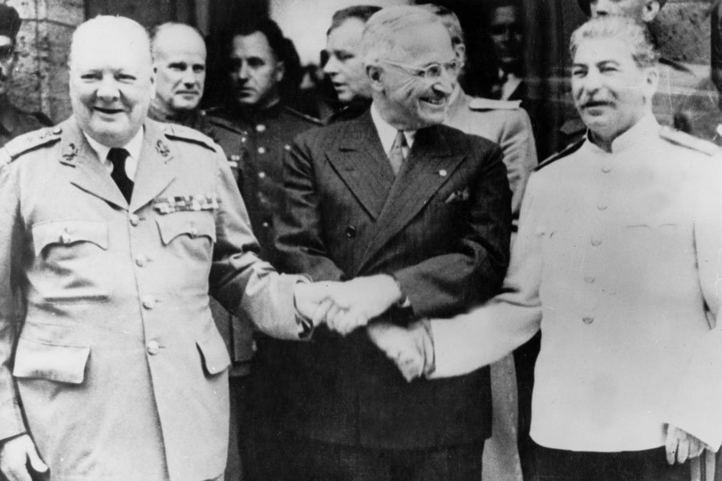
BEFORE WE READ THE PROTOCOL · 2 OF 3
The three who decided
Churchill, Truman, Stalin at Cecilienhof, July 1945. Within days one of them was gone: the election results of 26 July replaced Churchill with Attlee mid-conference. National interests change when the delegation changes.
Notes:
Useful for national interest and for the levels-of-analysis question. Ask: if you swap these three men for three others, does the Cold War still happen? Realists say yes, the structure decides. That disagreement is the whole individual-versus-system debate in one photograph.

Slide 34
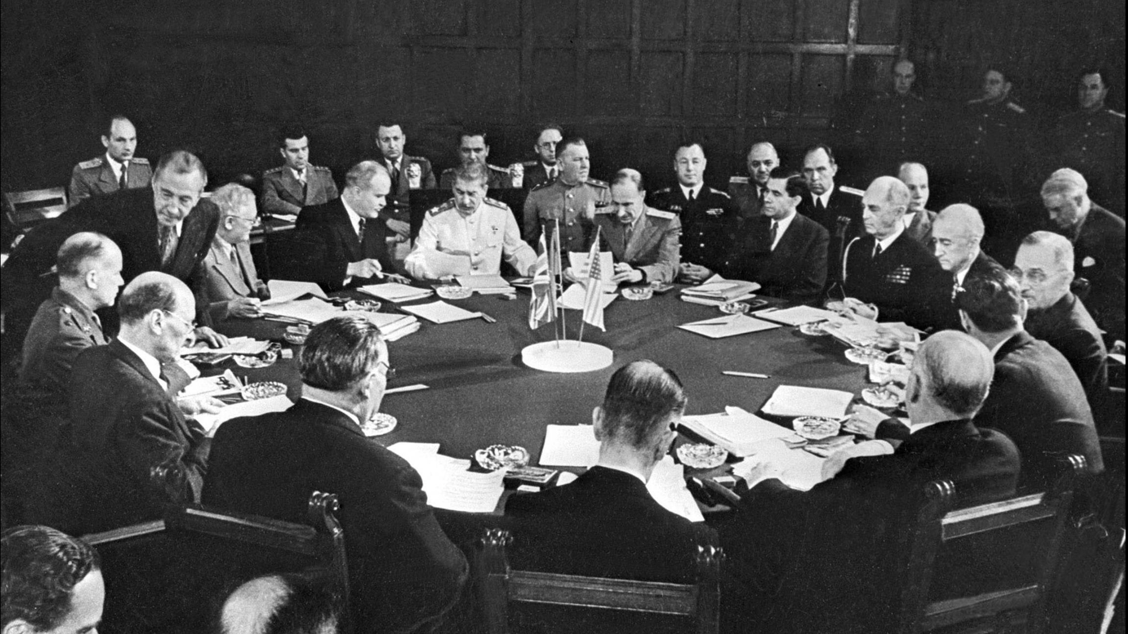
BEFORE WE READ THE PROTOCOL · 3 OF 3
The table itself
Three delegations, one round table. No seat for Germany, none for France, none for Poland, whose borders were being moved. Ask what the Protocol would say if the missing parties had been in the room.
Notes:
This is the slide the whole session has been building towards. Point back at category three on the power board: agenda-setting is visible here as an empty chair. Hold the image for a moment before moving on — let them count the uniforms.

Slide 35
APPLICATION 1
Power at Potsdam
17 July to 2 August 1945. Three delegations. No Germany and no France in the room.
HARD POWER — the Red Army holds eastern and central Europe; no protocol undoes that. On 16 July, the day before the conference opens, the Trinity test succeeds; on 24 July Truman mentions a new weapon to Stalin.
INSTITUTIONAL POWER — the conference argued about reparations, zones and administration. It did not argue about whether Germany should be occupied, whether these powers were entitled to decide, or whether anyone affected should be consulted.
Those questions were settled before anyone sat down — and that is exactly why they are not in the document.
ASK Your reading task is not what did they decide. It is: what did they not have to decide?

Slide 36
APPLICATION 2
Security at Potsdam
Of the six dimensions on the second board, the Protocol recognises one and a half.
Military security, and the political security of the occupying powers. Food supply appears — but as an administrative problem, not as a security question.
The security of Germans, of displaced persons, of the millions about to be moved westward, is not a category the document has.
That is not an oversight. It is the vocabulary of 1945.
ASK Read these texts in their own concepts — and keep ours for the questions they cannot ask.

Slide 37
APPLICATION 3
The concepts in the text
WHAT THE PROTOCOL DOES
WHAT IT CANNOT SEE
Sovereignty suspended — on 5 June 1945 the four powers assumed supreme authority, stating explicitly that this was not annexation. Germany continued to exist; what it lacked was a government able to speak for it. No German signature appears on the Protocol.
Spheres of influence, unnamed — the reparations settlement, each power drawing from its own zone, is the moment a joint occupation becomes four separate ones. Nobody writes the phrase; the arrangement produces the thing.
Issue linkage — zonal reparations and the Oder-Neisse line are two halves of one bargain.
The security dilemma — Soviet control of eastern Europe looks like security in Moscow after 1941 and like expansion in Washington. Rebuilding German industry looks like economic sense in London and like rearming an invader in Moscow.
Self-determination, withheld — millions are transferred under the section on population movement. The vocabulary legitimates the redrawing; it is not extended to the people redrawn.
The veto — the Control Council decided by unanimity. From autumn 1945 France, absent from Potsdam, blocked the central administrations. That is the Four-Power Problem: structural, not personal.
Notes:
The veto point is the session title. Germany's fragmentation was not only an East-West product — it was built into the decision rule, and the first sustained user of the veto was an ally.

Slide 38
CLOSING
Historiography is theory in disguise
These five arguments map onto the debates you will meet in your reading this week.
Accounts explaining the Cold War through Soviet expansion are realist in structure; accounts foregrounding American economic and strategic reach borrow from Marxism.
Accounts built on the security dilemma — conflict produced by structure, without anyone fully intending it — are the post-revisionist synthesis. That is roughly where Gaddis sits.
So when you read a historian, you are not reading neutral narration. You are reading a position.
ASK Ask which position — and ask what it makes invisible.

Slide 39
Read the Protocol for four things.
What is traded for what — issue linkage leaves fingerprints in the structure.
What is constructed as a fact — what does the text simply assume into existence?
What is left deliberately open — ambiguity in a treaty is a decision, not an oversight.
Who is not there — and what would be in the text if they were.
Bring one sentence you can attack with one of today's concepts.
Notes:
Final slide. Closes the circle with the line from board work I.

