Slide 1
COLD WAR AND GERMANY
From Potsdam to
the Marshall Plan
The ground · the document · the circle · what came next
Notes:
105 minutes in four parts. Slides replace the board throughout — nothing here needs to be written up.

Slide 2
TODAY
Four parts
1
THE GROUND
2
THE DOCUMENT
Borders, rivers, coal. What Germany lost — and what happened to the people who lived there when the borders moved. · 11 min
Was the Potsdam Agreement a peace treaty? Who was in the room, who was not, and who had to accept it anyway. · 19 min
3
THE CIRCLE
4
WHAT CAME NEXT
Twelve people who were not at Cecilienhof, six arguments they could never have had. · 35 min
Why the Ruhr cannot be moved. Europe in 1947, the counter-example of 1923, and an offer made in the expectation that it would be refused. · 46 min
Notes:
Show this once and move on. It is orientation, not content.

Slide 3
1
The ground
Borders, rivers, coal · 11 minutes
Notes:
No image for the first three minutes. Take short answers, one word each, and keep it moving. You are working towards 'somebody drew them' — do not supply it.

Slide 4
PART I · BEFORE THE DOCUMENT
3 min
Three questions about the ground.
1
What gives a state its borders? Not what should — what does, in fact.
2
Which rivers matter in this part of Europe? Name them.
3
And where is the coal? Because everything else in this course follows from that question.
There are two rivers called Neisse. The difference between them is about two hundred kilometres, and it was one of the things argued about at Potsdam.
Notes:
Rhine, Elbe, Oder, Neisse, Vistula, Danube. Note as they come that the Rhine and the Oder are political objects, not just water.

Slide 5
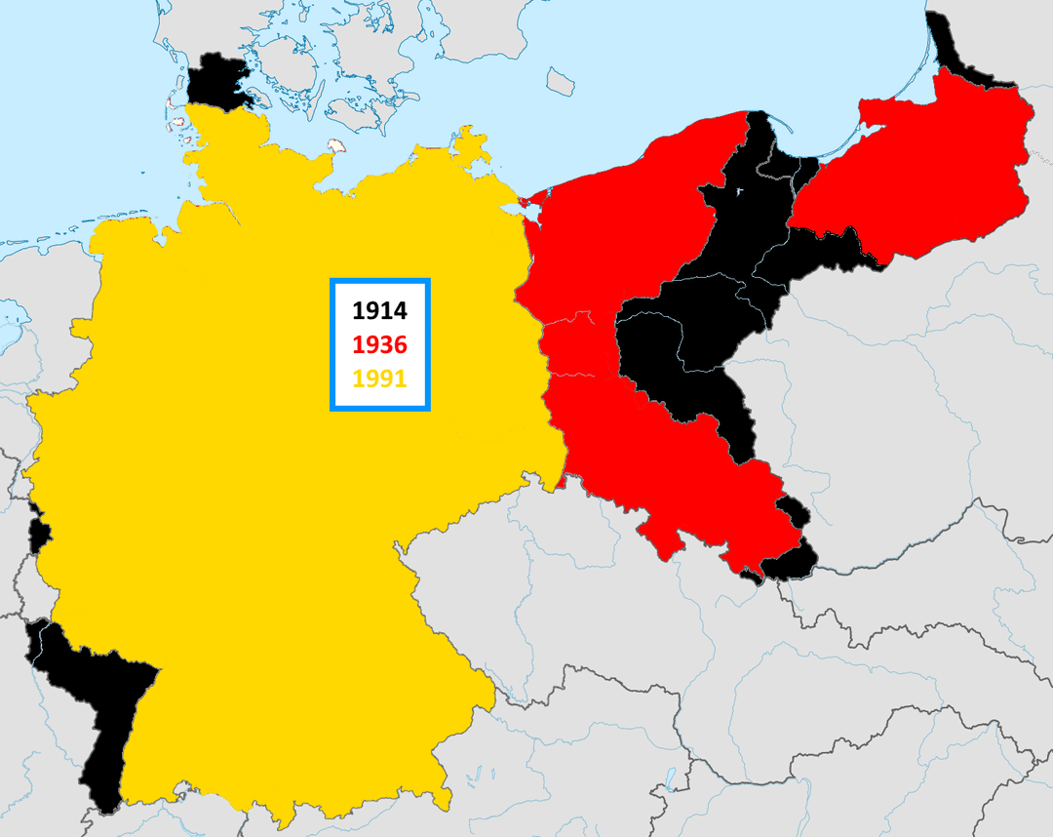
PART I · WHAT GERMANY LOST
Three outlines, seventy-seven years apart
Black is 1914. Red is 1936. Yellow is 1991.
The difference between black and red in the west is Alsace and Lorraine; in the east, what went to Poland after the First World War.
Everything red and not yellow was German territory in 1936 and is not German today: East Prussia, most of Pomerania, Silesia. Around a quarter of the territory of the 1937 state.
Notes:
Then ask the question on the next slide and wait for it. Students who have not met this before usually assume the population stayed and changed nationality — that is what happened to Alsace in 1919, and it is the intuition to break.

Slide 6
GERMANY LOST THAT MUCH TERRITORY
What happened to the people who lived there?
In 1919 the borders were moved and most of the people stayed where they were. Alsatians became French, and lived in the same houses.
In 1945 the borders were moved and the people were moved to fit them. Around twelve million Germans went west, and Poles from territory annexed by the Soviet Union came into the space they left.
That was not an accident of the fighting. It was written into the Protocol, in a section requiring that the transfers be orderly and humane.
Notes:
The single most important contrast of the session. It returns in Part IV, when Versailles comes back a third time.

Slide 7
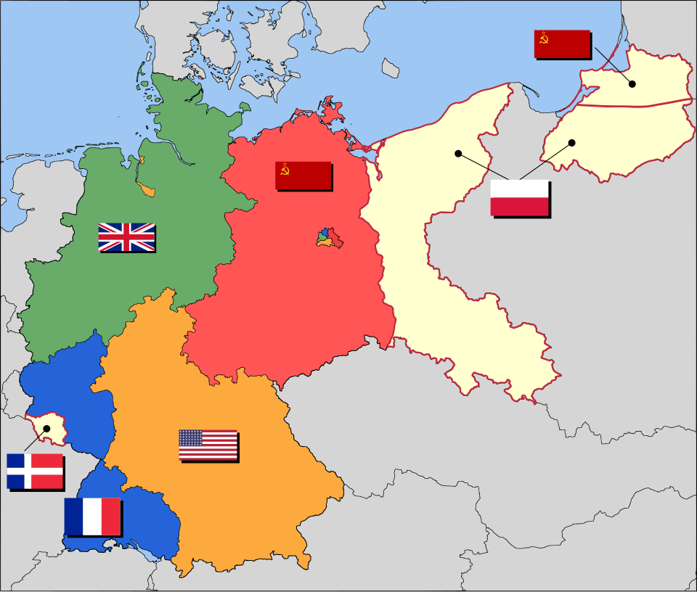
PART I · THE ARRANGEMENT
Four zones, a divided capital, and a fifth colour
A capital divided inside the Soviet zone, and territory in the east that is not an occupation zone at all but land placed under Polish administration.
Notes:
Count the flags with them: five, and one of them belongs to a power that was not at the conference.

Slide 8
2
The document
What kind of document is this? · 19 minutes
Notes:
Last time we built a vocabulary and read the Protocol through it. Today something narrower and stranger: we ask what kind of document it actually is. That sounds technical. Almost every conflict over Germany for the next forty-five years runs back to it.

Slide 9
PART II · ASK BEFORE ANYTHING ELSE
Was the Potsdam Agreement a peace treaty?
Yes or no — and what would you need to know in order to decide?
Notes:
Take three or four answers cold. Students usually split. The productive move is not to settle it but to ask what a peace treaty requires, and to collect the criteria they name.

Slide 10
PART II · THE TEST
What a peace treaty has — and what Potsdam had
1
CONCLUDED BETWEEN THE BELLIGERENTS
2
SIGNED BY ALL OF THEM
Including the defeated party.
Potsdam: three signatures. No German signature, because there was no German government to provide one.
Potsdam: a Protocol of the Proceedings, signed by Truman, Attlee and Stalin on 2 August 1945.
3
RATIFIED
4
TERMINATES THE STATE OF WAR
By the constitutional organs of each state.
Potsdam: ratified by no legislature anywhere.
And settles its consequences.
Potsdam: sets up an occupation regime and a Council of Foreign Ministers to prepare peace treaties later.
Notes:
So: not a peace treaty. What is it instead? An agreement between three governments about how they will exercise powers they had already assumed on 5 June 1945 — authority that does not come from German consent.

Slide 11
WHAT THE TEXT DOES WITH THE HARDEST QUESTIONS
It does not answer them. It defers them.
Territory east of the Oder and Neisse is placed under Polish administration pending the final peace settlement. That formula, or something like it, recurs.
Ambiguity in a treaty is a decision, not an oversight. Here you can watch the decision being taken.
Notes:
Then ask: if the hardest questions are postponed to a peace conference, what happens when that conference never meets? Answer: peace treaties with Italy, Romania, Hungary, Bulgaria and Finland in Paris, February 1947. With Germany, never — until the Two Plus Four Treaty of September 1990.

Slide 12
PART II · THE ROOM
Who was there, and who was not
1
IN THE ROOM
2
IN THE BUILDING
3
NOT INVITED AT ALL
Three delegations: the United States, the Soviet Union, and the United Kingdom — whose delegation changed identity mid-conference when the election results of 26 July replaced Churchill with Attlee.
A Polish delegation was received and heard on the border question.
Being heard is not the same as deciding.
France, which nonetheless got a zone and a veto. China, named in the separate declaration on Japan. Czechoslovakia, from whose territory the transfers were authorised. And Germany, which had no government to invite.
Notes:
Then ask: who had to accept this agreement for it to work — and did any of them get to say no?

Slide 13
PART II · CONSENT
Who had to accept it, and who could refuse
Four answers, and none of them is simple.
GERMANY could neither accept nor refuse. There was no state organ to do either. Acceptance was not required because consent was not the basis of the obligation.
FRANCE was not a party — and from autumn 1945 used its veto in the Control Council to block the central German administrative departments the Protocol had envisaged. A power that was not in the room prevented the agreement from being carried out.
POLAND received the territory and the burden but not the signature. The border stayed formally provisional until November 1990.
THE TWO GERMAN STATES had to work out whether they were bound by a document they had not signed and could not have signed. That question was never resolved. It was overtaken.
ASK Binding on those who made it, decisive for those who did not, blockable by a power that was not there. Is that a defect in the drafting?
Notes:
It is what happens when supreme authority over a state is exercised by other states.

Slide 14
PART II · BEFORE THE COMPARISON
1 min
Which of these do you know?
1
Vienna, 1815.
2
Versailles, 1919.
3
Munich, 1938. · And Potsdam, 1945.
Ninety seconds. It tells you what you are working with.
Notes:
Expect Versailles and Munich to be known and Vienna to be vague. Fill gaps in one sentence each. Vienna: the powers reorganise Europe after Napoleon. Munich: four powers award Czechoslovak territory to Germany, and Czechoslovakia is not present.

Slide 15
PART II · FOUR CONFERENCES
A ladder going downwards
Vienna 1815
Versailles 1919
Munich 1938
Potsdam 1945
Was the affected state present?
Yes — France sat at the table and shaped the outcome
Present, but excluded from the negotiations
Absent. Informed of the result
No state existed that could be present
Did it sign?
Yes
Yes, under protest — a dictated peace
No
There was nobody to sign
A peace treaty?
A Final Act plus treaties
Yes, ratified
No — four powers about a fifth country
No — three occupiers about a fourth state
What legitimated it?
Great-power agreement plus consent
Victory, formalised by signature
Great-power agreement alone
Supreme authority already assumed
Notes:
Vienna: the defeated power negotiates and gets a settlement that lasts. Versailles: present, signs, is not heard — and spends twenty years saying so. Munich: not in the building. Potsdam: no government left to exclude. But it is not a straight line of decline — ask which is more dangerous, a settlement the defeated party signs but rejects, or one it is never asked about.

Slide 16
3
The circle
Twelve people who were not there · 35 minutes
Notes:
Chairs in a circle, twelve seats, no table. You sit in the circle and draw a card too — that signals that nobody is observing from outside. Seat each duelling pair facing each other across the circle.

Slide 17
PART III · THE RULES
3 min
Three rules, and the first is the important one.
1
You are not inventing feelings out of nothing. The card gives you facts. If you find yourself saying something the card does not support, say instead: I don't know what she would have felt, and here is why it is hard to say.
2
First person — but you represent an interest, not a personality. No accents, no impersonation.
3
You will disagree with the person opposite. Argue the interest. Do not argue about who suffered more; that is a competition nobody wins and it is not what the conference was deciding.
None of the twelve cards in this round is a politician. Not one of these people was in the room at Cecilienhof.
Notes:
Deal cards 1 to 12, seating each pair opposite as you go. Take number 9 yourself, the Welsh miner — the least emotionally loaded of the twelve, and it lets you model the format without occupying the centre.

Slide 18
PART III · THE SIX DUELS
Cards 1 to 12 — no politicians
Statement
Reply
The axis
D1
3 Farmer's wife in Lower Silesia
12 Polish settler from the east
The same farm, the same sentence in the same document, opposite directions.
D2
5 Wehrmacht prisoner in Soviet hands
7 Soviet forced labourer
Forced labour in both directions. He is in her country against his will; she was in his.
D3
1 Survivor of the German resistance
6 Jewish survivor in Bavaria
“There was another Germany.” She is best placed to test that claim.
D4
2 Returning Communist functionary
4 Widow clearing rubble in Berlin
Liberation — in whose uniform?
D5
8 Survivor of the Warsaw Uprising
10 Soldier of the British Indian Army
Two people who served the Allied cause and were not consulted about the peace.
D6
9 Coal miner in South Wales
11 Viet Minh activist in Hanoi
A welfare state at home, and British troops restoring French authority in Indochina.
Notes:
D2, D3 and D4 need the most care. In each, the axis is what the document does, not whose suffering counts. If an exchange slides into a competition of grief, intervene with one question: what does the Protocol actually give each of you?

Slide 19
PART III · PREPARATION
5 min
Prepare with the person you will argue against.
1
How does this person feel about the war, and about the way it ended? Not the facts — the feeling.
2
What do they expect from this conference? Not what they deserve. What they expect, and whether they expect anything at all.
3
What is their attitude to Germany — and, separately, to Germans? Keep those two apart.
Then together: where exactly does your case collide with theirs? Find the sentence in the Protocol where the collision happens, if you can.
Notes:
Deliberately with your opponent, so nobody is ambushed in front of the room and the exchange is about substance rather than surprise. Circulate; call first on a pair that has found a real incompatibility.

Slide 20
PART III · EACH DUEL
3:30
Four turns. Both of you speak twice, for exactly the same time.
1
STATEMENT — 60 seconds each, one after the other. Who you are. How you feel about the war and the way it ended. What you expect from this conference. Your attitude to Germany, and to Germans.
2
REPLY — 45 seconds each, in the same order. Answer the person opposite. Not a second speech: an answer. Why they cannot have what they ask, or what it would cost you if they got it.
3
And in your 45 seconds, name one provision of the Protocol you would change.
Sixty, sixty, forty-five, forty-five. Neither of you gets more time than the other.
Notes:
Write down each provision as it is named; you need the list for the debrief. If a reply turns into a second statement, stop it: 'Answer them.' If someone concedes too fast, ask what their card loses by accepting.

Slide 21
PART III · DEBRIEF
Cards down. You are yourselves again.
Nobody in this circle had a seat at Cecilienhof. Not one of you had a government that could have asked for one. Six arguments, twelve people — and none of them could have happened in 1945, because these people were never in the same room.
Which of these changes could have been granted together? Find two that are compatible, then two that are not. The second is easy and the first is hard — that asymmetry is the whole conference.
In at least one pair, the two of you wanted partly the same thing for opposite reasons. A shared demand is not a shared interest.
Several exchanges were between people on the same side of the war. Does the word 'the Allies' survive this exercise? Does the word 'the Germans'?
ASK What would be in the Protocol that is not in it, if the twelve of you had been at the table?
You have just produced, out loud, a list of what is missing from this document. Was the absence of these people a failure of the conference — or the conference working exactly as intended?
Notes:
Do not answer the last question. Leave it open going into Part IV, where it returns in a different form — this time about who was invited and who declined.

Slide 22
4
What came next
Coal, hunger, and an offer expected to be refused · 46 minutes
Notes:
Two years after Potsdam, something formally different happens: an offer, not a treaty, addressed explicitly to every country in Europe including the Soviet Union. Keep two questions running. Who was allowed to accept it? And does an invitation make the decision less one-sided, or only less visible?

Slide 23
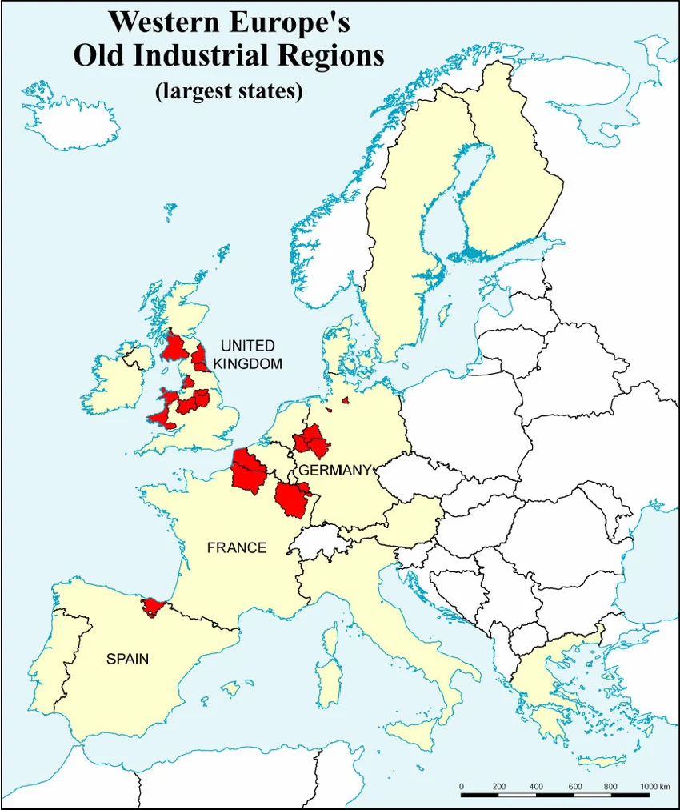
PART IV · WHERE THE INDUSTRY IS
A cluster, not a distribution
The Ruhr, the Saar, Nord-Pas-de-Calais, Wallonia, South Wales, the Midlands — and off this map to the east, Upper Silesia.
Europe's industrial power sits in a band a few hundred kilometres wide, straddling the border between France and Germany.
Every European war since 1870 has been fought partly over these red patches. The European Union begins in 1951 as an agreement about exactly them.
Notes:
Ask the question on the next slide before explaining anything.

Slide 24
PART IV · THE QUESTION THE MAP DOES NOT ANSWER
Why can nobody build one somewhere else?
Four things have to coincide, and they have to coincide in one place.
COAL IN THE GROUND — and not any coal. Steel needs coking coal, which is geologically specific.
IRON ORE, or cheap transport to it. WATER AND RAIL — the Rhine and the Ruhr are working rivers, and the rail density here in 1939 was among the highest in the world.
PEOPLE — several generations of miners, foundrymen and toolmakers, and the engineering schools that trained them.
ASK What makes an industrial region? Why is it here and not two hundred kilometres away?
Notes:
Collect the ingredients from the room before showing this slide.

Slide 25
THE CONSEQUENCE THAT GOVERNS EVERYTHING ELSE
Industrial capital of this kind cannot be moved.
You can bomb the plant and it can be rebuilt. You can dismantle the machinery and ship it east, and the French and the Soviets did exactly that.
But the coal seam, the river, the track and the workforce stay where they are — and that makes the region a permanent political object.
Notes:
Say this slowly. It is the hinge of Part IV.

Slide 26
PART IV · THE RUHR IN 1947
Everyone needs it. Everyone is afraid of it.
Coal, coke, steel, chemicals, heavy engineering. Before the war, the great majority of German hard coal and steel — and it now sits in the British zone.
European steel requires coking coal. European railways, power stations and factories require coal. Belgium, the Netherlands, France and Italy had all drawn on Ruhr output before the war and cannot restart without it.
German industrial production in 1945 is under a fifth of the pre-war level, and the Allied level-of-industry plan of March 1946 caps permitted output at roughly half the 1938 figure.
THE BIND — the countries most afraid of German industrial revival are precisely the ones that most need its output.
ASK So what is the position of a French government in 1947?
Notes:
Three ways out, each somebody’s policy in 1947: take the region away from Germany, reduce it permanently, or restart it and bind it into something larger. The third is what happens.

Slide 27
PART IV · ASK FIRST
The war ended in May 1945. Why was it worse in 1947?
The answer is not physical destruction. It is dislocation.
The American undersecretary of state put it to Marshall in May 1947 in almost those terms: they had estimated the physical destruction correctly and had failed to reckon with the effects of economic dislocation.

Slide 28
PART IV · EUROPE 1945–1947
Five things wrong at once
1
THE DOLLAR GAP
2
COAL
3
FOOD
Europe must import food, coal, cotton, machinery — almost all from the only economy with a surplus. To pay you must export; Europe had nothing to export and had already sold its foreign assets.
The winter of 1946–47. In Britain the coal stocks fail in February: power cut to industry, factories closed, unemployment briefly in the millions.
Rations at or below subsistence in the occupied zones. A poor 1946 harvest, a winter that killed the seed, a drought in the summer of 1947.
4
MONEY NOBODY TRUSTED
5
A TRADE SYSTEM CUT IN HALF
6
AND THEN THE POLITICS
Why sell your crop for paper you cannot spend? So you hold it. The cities starve while food sits in the countryside. Cigarettes become the currency.
Eastern agriculture against western industry, with Germany at the hinge. The new border ran through the circuit; the zones cut the hinge.
Communist parties are not a fringe. They are governing parties in France and Italy and the largest party in Czechoslovakia. The numbers are on the next slide.
Notes:
Card 4 is the one worth spelling out: it explains why goods can exist and still reach nobody, and why the currency reform of June 1948 worked overnight. The goods had not been produced overnight; they had been waiting for a currency worth accepting.

Slide 29
PART IV · FOLLOW THE CHAIN
No coal → a fuel crisis → a fiscal crisis → the Truman Doctrine.
On 21 February 1947 the British government informed Washington that it could no longer bear the cost of supporting Greece and Turkey. Three weeks later, Truman went to Congress.
The American entry into the eastern Mediterranean begins with a cold winter and an empty coal bunker.
Notes:
This chain is worth putting on the board even though the slides replace it. Students remember causal chains they can point at.

Slide 30
PART IV · AND THEN THE POLITICS
How the elections actually went
Communists
Others
In government?
France
legislative, Nov 1946
PCF 28% — the largest single party in the National Assembly
MRP c. 26%, Socialists c. 18%
Yes. Communist ministers in the cabinet until May 1947
Italy
Constituent Assembly, June 1946
PCI just under 19%
Christian Democrats 35%, Socialists 21% — a left bloc within reach
Yes. Excluded at the end of May 1947
Czechoslovakia
free election, 1946
KSČ 38% — the largest party in the country
No bloc close to it
Yes. The prime minister is a Communist
Notes:
The point is that none of this was a coup. These were free elections with high turnout, and the parties in question had a real record: they had been in the resistance while much of the old elite had not. That is what Washington was reading.

Slide 31
PART IV · WHAT WASHINGTON WAS LOOKING AT
Not an army massing. An electorate that is cold, hungry, and about to vote.
The gravest threat to western interests in Europe, as Washington read it, was not a Soviet invasion. It was that Europeans would vote for their own communists — legally, and with good reason.
And notice what Marshall names in the Harvard address as a cause of the paralysis: that two years on, no peace settlement with Germany or Austria had been agreed. That is the first half of this session, appearing in his speech as an economic diagnosis.

Slide 32
PART IV · VERSAILLES, A THIRD TIME
Reparations, 1919
We have met this treaty twice today — as a border settlement, and as a legal form. Now on a third axis: money.
Article 231 established German responsibility and became the legal foundation for the bill. In 1921 the Reparation Commission fixed the sum at 132 billion gold marks.
Keynes had already resigned from the British delegation. His argument was mechanical, not moral: Europe is a single economic organism, and you cannot wreck the productive capacity of its largest industrial economy without damaging everything attached to it.
THE ARITHMETIC NOBODY SOLVED — Germany could pay only in goods or foreign currency; to earn currency it had to export; the creditors raised tariffs against German exports. They demanded payment and blocked the only mechanism by which payment could be made.
ASK Whose interest was served by a reparations bill that could not be paid?
Notes:
Add the circuit: American loans into Germany, German reparations to Britain and France, debt payments back to America. When American credit stopped in 1929, the circuit stopped with it.

Slide 33
PART IV · THE COUNTER-EXAMPLE
The Ruhr, 1923
Germany falls behind on deliveries of coal and timber. France responds with what it calls a productive pledge: if the Germans will not pay, France will take the payment directly.
French and Belgian troops occupy the Ruhr — the region we looked at at the start of this part. The German government cannot fight, so it calls for passive resistance and pays the strikers by printing money.
By November 1923 the exchange rate is measured in trillions of marks to the dollar. Savings, pensions, insurance policies — gone inside a year, not through bombing but through a monetary decision taken in response to an occupation.
That autumn: a communist rising in Saxony and Thuringia, another in Hamburg, and in Munich in November an attempted putsch by a party nobody had heard of, led by a man nobody had heard of.
ASK What is the lesson an American policymaker draws from this in 1947?
Notes:
Not 'be nice to Germany'. Something instrumental: coercive extraction from a broken economy does not produce payment, and a destitute population is a political danger. A security argument, not a humanitarian one.

Slide 34
PART IV · THE RESULT OF 1923
Complete military success. Neither the money nor the security.
France used the most direct instrument of coercion available, against a disarmed neighbour, and obtained a wrecked German currency, a radicalised German electorate, and the disapproval of Britain and the United States.
Passive resistance was abandoned in September 1923; French troops left by 1925.
Notes:
If a student objects that 1945 was not 1918 — agree. The objection is right. The Americans in 1947 were not being generous; they had concluded that punishment did not work, which is a different thing.

Slide 35
PART IV · MARCH 1947
The Truman Doctrine
Britain is not withdrawing from Greece and Turkey out of strategy. It is withdrawing because it is broke — partly because of the coal crisis.
12 March 1947: Truman asks a joint session of Congress for four hundred million dollars for two countries in a specific emergency.
He could have asked for exactly that. Instead he said it must be the policy of the United States to support free peoples resisting attempted subjugation by armed minorities or by outside pressures.
NO GEOGRAPHY. No country, no region, no time limit. A request for aid to two Mediterranean states has become an open-ended global commitment.
ASK Why would you write it that way?
Notes:
The answer is domestic. A Republican Congress elected in 1946 on a promise to cut spending; Vandenberg's advice that the only way to get the money was to frighten the country. The universalism is a fundraising strategy — which does not stop it becoming policy.

Slide 36
PART IV · THE TRUMAN DOCTRINE, IN ONE SENTENCE
American support for any people resisting subjugation, anywhere, with no limit of place or time.
It names an enemy — not by name, but by function — and divides the world between free peoples and their subjugators.
Three months later the same administration produces a second document that names no enemy at all, and offers money to the states it has just described as subjugators.
Notes:
This is the sentence to make them write down. Everything else in Part IV plays against it.

Slide 37
PART IV · JUNE 1947
Marshall's three moves
1
NOT AGAINST A COUNTRY OR A DOCTRINE
2
THE INITIATIVE MUST COME FROM EUROPE
3
JOINT, NOT PIECEMEAL
The policy is directed against hunger, poverty, desperation and chaos.
That is what allows the plan to be offered to the Soviet bloc without contradicting itself — and it is the exact inverse of the sentence Truman used in March.
The United States will not draw up a programme unilaterally.
A programme the Europeans have written is harder to reject as an imposition. And it forces the European states to sit down with each other, which is part of the object.
Not a series of bilateral rescues as each crisis arrives, but one programme agreed by many nations at once.
Roughly twelve to thirteen billion dollars over four years — about 1.5% of American GDP a year.
Notes:
The conditions looked light: cooperate, open your books, accept American officials in the allocation. Most of it bought American goods — the plan stimulated the economy that funded it. Use the editors' fourth question here.

Slide 38
PART IV · WHERE THE IDEA CAME FROM
Kennan's telegram, February 1946
THE DIAGNOSIS — WHAT EVERYONE REMEMBERS
THE PRESCRIPTION — WHAT BECOMES THE PLAN
Soviet hostility is generated internally. It does not come from anything the West has done and cannot be removed by anything the West offers. The regime needs an encircling enemy because that is what justifies the dictatorship.
Therefore concessions will not be reciprocated, and negotiating on an assumption of good faith is naïve.
But he also says the Soviet Union is far weaker, that it withdraws when it meets resistance, and that all of this can be handled without war.
Kennan compares world communism to a parasite that feeds only on diseased tissue. If that is right, the response is not primarily military. It is to make the tissue healthy.
Solving your own society's problems is worth more than any number of diplomatic notes. The West must put before other nations a more positive picture of the world it wants — and if it does not, the Russians will.
That is the Marshall Plan, written down eighteen months early by a man who had not been asked for a policy.
Notes:
Marshall later told Kennan to produce one, with a single instruction: avoid trivia. Worth one sentence: Kennan objected to what was made of his argument, opposed the universalism of the Truman Doctrine, and was moved out of policy planning by 1949.

Slide 39
PART IV · THE HARDER HALF
The premises behind the plan
Gaddis sets them out, and they are not humanitarian.
The gravest danger was hunger and despair driving Europeans to elect communists. American money would produce a psychological effect first and a material one later.
THE SOVIET UNION WOULD NOT ACCEPT SUCH AID and would not permit its satellites to accept it — which would strain Moscow's relations with them.
And the United States would then hold both the geopolitical and the moral initiative. Gaddis's formulation: the plan was a trap designed to make Stalin build the wall that would divide the continent.
ASK The offer went to everyone, and half of Europe was expected to refuse.
Notes:
Molotov went to Paris with a large delegation, then withdrew; the east Europeans were allowed to stay, then forbidden. The Czechs, who wanted in, had their leaders summoned to Moscow. Westad reports Gottwald came out shaking.

Slide 40
PART IV · THE QUESTION THIS SESSION HAS BEEN CIRCLING
If an offer is made in the expectation that it will be refused, is it still an offer?
Take two or three answers. Do not adjudicate.
And one complication in the other direction: Stalin's central anxiety was Germany. He feared that integrating the western zones into the plan would make western control permanent. He was not wrong — the currency reform of June 1948, the blockade, two German states by 1949.
Notes:
This is the empty chairs again, in friendlier packaging.

Slide 41
PART IV · THE COMPARISON
Two ways of treating a defeated economy
Versailles 1919 · Ruhr 1923
Marshall Plan 1947
Which way do resources move?
Out of the defeated economy
Into it
Legal form
A treaty with a responsibility clause, binding
An offer. No obligation to accept
Who writes the programme?
The victors impose it
The Europeans are told to draft it
What happens on refusal?
Occupation of the Ruhr
Exclusion — a cost, but a different kind
Germany's status
Debtor
Recipient and participant
Assumption about the defeated
Capacity must be reduced
Poverty produces extremism
The result
Hyperinflation, radicalisation, French isolation
Recovery — and a divided Europe
Notes:
Build the rows with them. Then take the table apart on the next slide, or they leave with a fable.

Slide 42
PART IV · BEFORE YOU WRITE THAT DOWN
Three objections
1
THE AID WAS NOT DISINTERESTED
2
THE RECIPIENTS WERE NOT FREE
3
THE EFFECT CANNOT BE MEASURED
Most of it bought American goods. It solved a European dollar shortage and an American export problem in the same transaction.
They opened their economies to outside inspection and accepted American officials in the allocation decisions. Communist dockworkers in Marseilles and Naples physically blocked the unloading of American ships.
Westad's judgement: some growth would probably have come anyway, and the psychological effect may have mattered more than the money. Production grew by roughly half between 1947 and 1951 — how much the plan caused is disputed.
Notes:
If someone asks whether Germany was rewarded for starting the war: take it seriously, it was asked loudly in France and the Netherlands at the time. The plan was not a judgement about desert but a calculation about consequences. Then ask whether that distinction would have satisfied the cards they held an hour ago.

Slide 43
CLOSING
March named an enemy. June named hunger.
Both were true statements of American policy, three months apart, from the same administration. The Truman Doctrine got the money out of Congress; the Marshall Plan got it into Europe.
Whether that is hypocrisy or competent politics is a question you should be able to argue on both sides.
Notes:
Then the second closing point on the next slide, which sets up the following session.

Slide 44
FOR NEXT TIME
Two documents that cannot both be right
Kennan writes in February 1946 that the Soviet Union cannot be reasoned with. The Soviet ambassador writes in September 1946 that the United States is striving for world supremacy. Neither had read the other.
REQUIRED — Marshall's commencement address, Harvard, 5 June 1947: the excerpt, the editors' introduction, and the four discussion questions. Come with an answer to at least two.
SUPPLEMENTARY — Kennan, the Long Telegram, February 1946, and in particular the five practical deductions at the end. If you read one page, read the one where he says what the United States should do.
Each is a coherent account of a hostile counterpart, and both cannot be right in the way they are written. That is the security dilemma from our first session, in two documents.
ASK Find the sentence in Marshall's address that made it possible to offer the plan to Moscow. Then decide whether the offer was real.
Notes:
Then answer it on the next slide before they leave.

Slide 45
THE ANSWER
The sentence, and the conditions
WHAT MADE THE OFFER SAYABLE
WHAT MADE REFUSAL NEAR-CERTAIN
The sentence is the one that says the policy is directed not against any country or doctrine, but against hunger, poverty, desperation and chaos.
Remove it and the plan cannot be offered east of the Elbe without contradicting itself. With it, Marshall can address the Soviet Union and its neighbours without naming them as the problem — which is exactly what Truman had done three months earlier.
Look at what came attached. Cooperate with the other recipients. Open your national accounts to outside reporting. Accept American officials in the allocation decisions.
For a state whose economic planning was a state secret, those were not administrative details.
So: the sentence made the offer sayable, and the conditions made refusal near-certain. An offer with conditions, or a filter dressed as an offer? Both readings are supported by the same document. Gaddis takes the second.
Notes:
This is the whole session in miniature, and it is where the empty chairs of Part III come back. Do not resolve it for them — but make sure they see that the two halves are in the same speech.

