Slide 1
Welcome to
Laboratory in Environmental Science
ENVS B201

Slide 2
Dr. Brian Donnelly- Info & background
What to call me?
Lots of options, but…
Dr. Brian, Dr. Donnelly, really anything…
How to get ahold of me?
bdonnelly2@brynmawr.edu

Slide 3
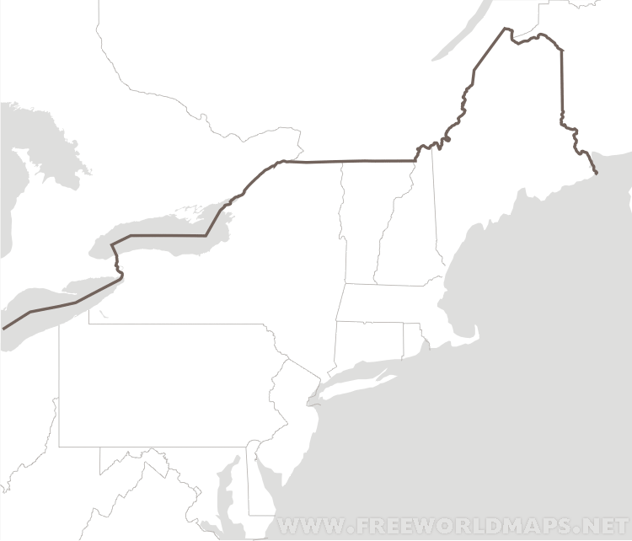
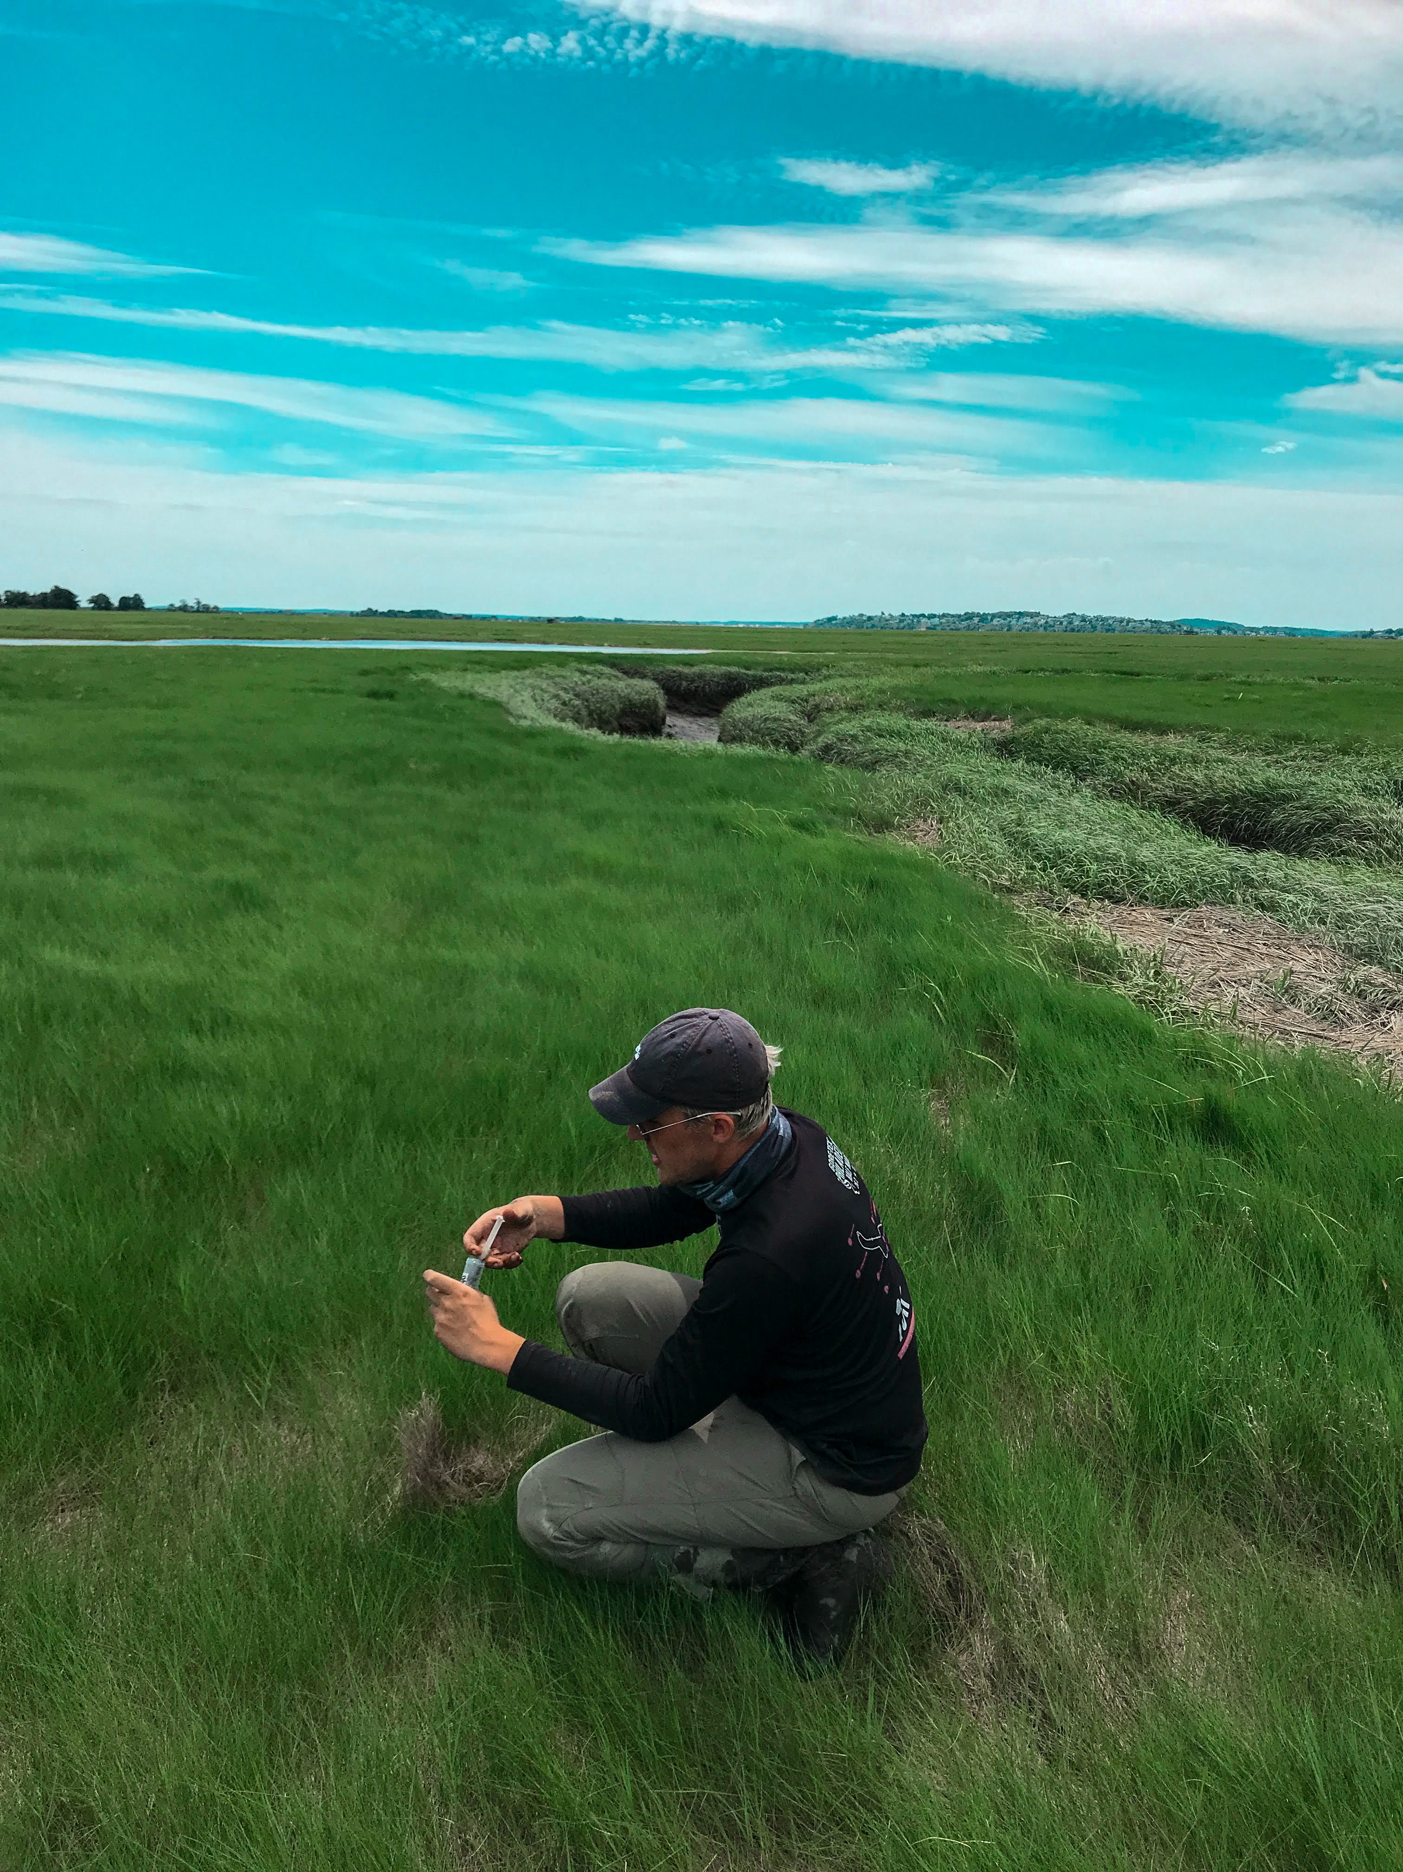
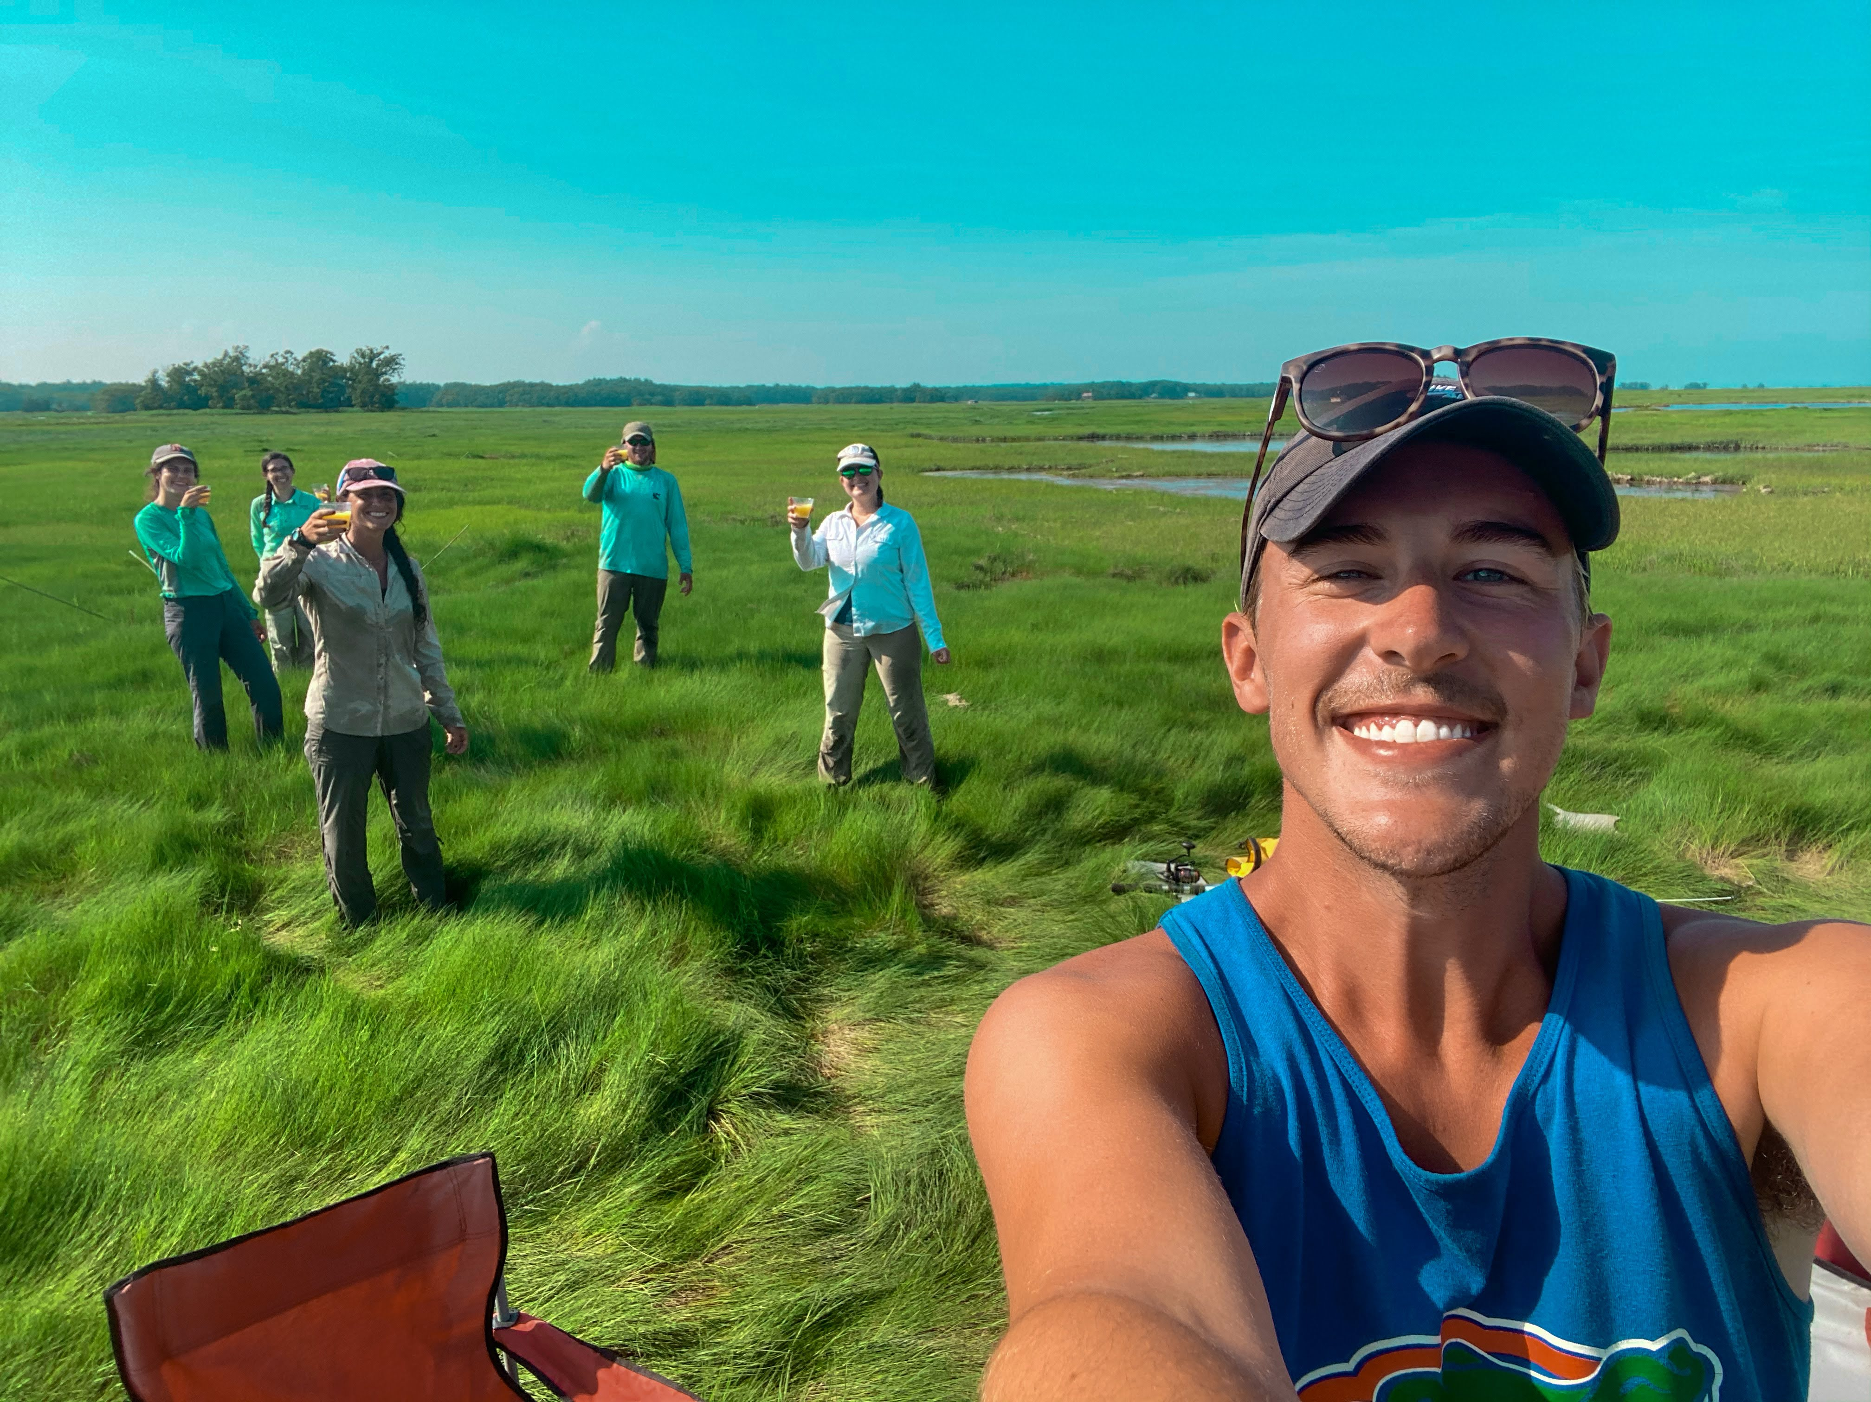
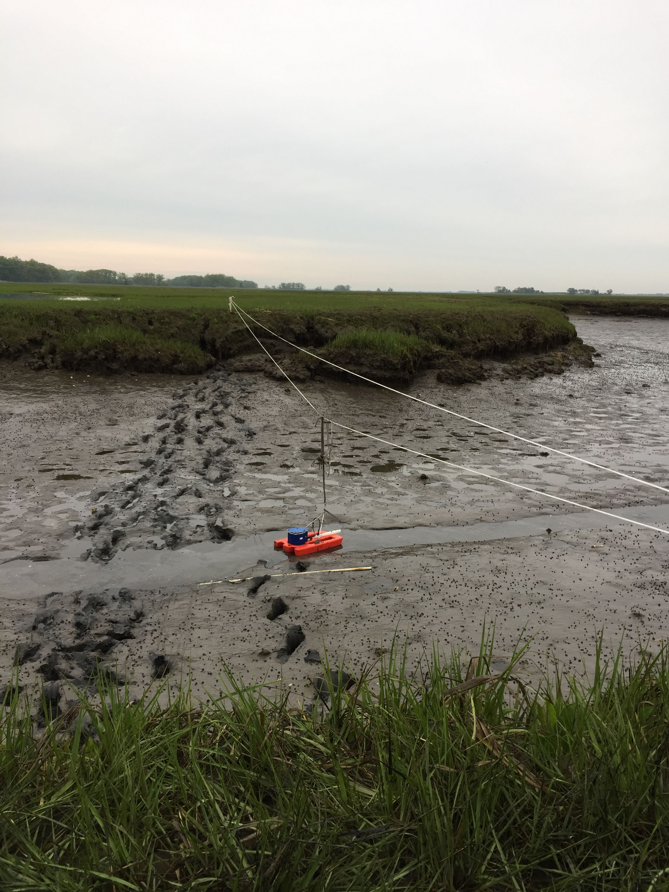
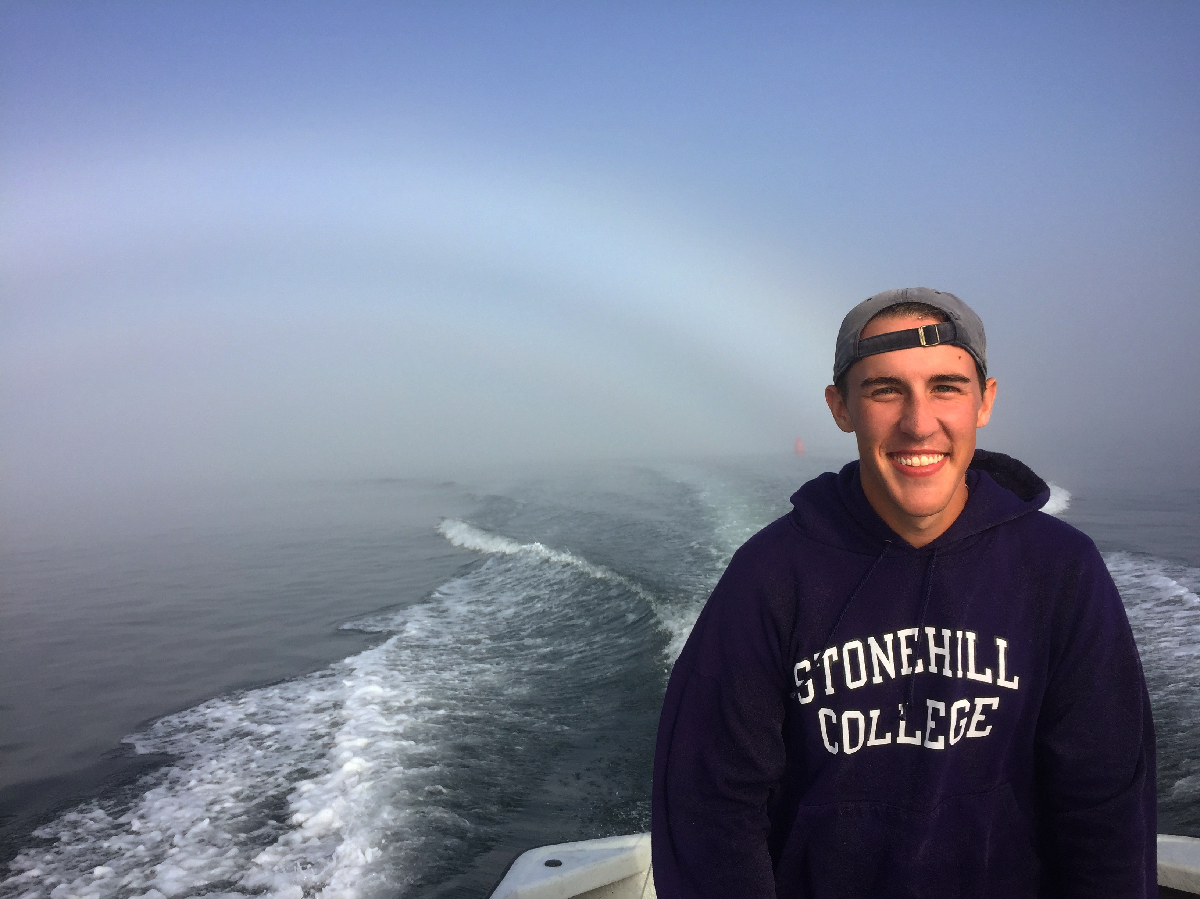
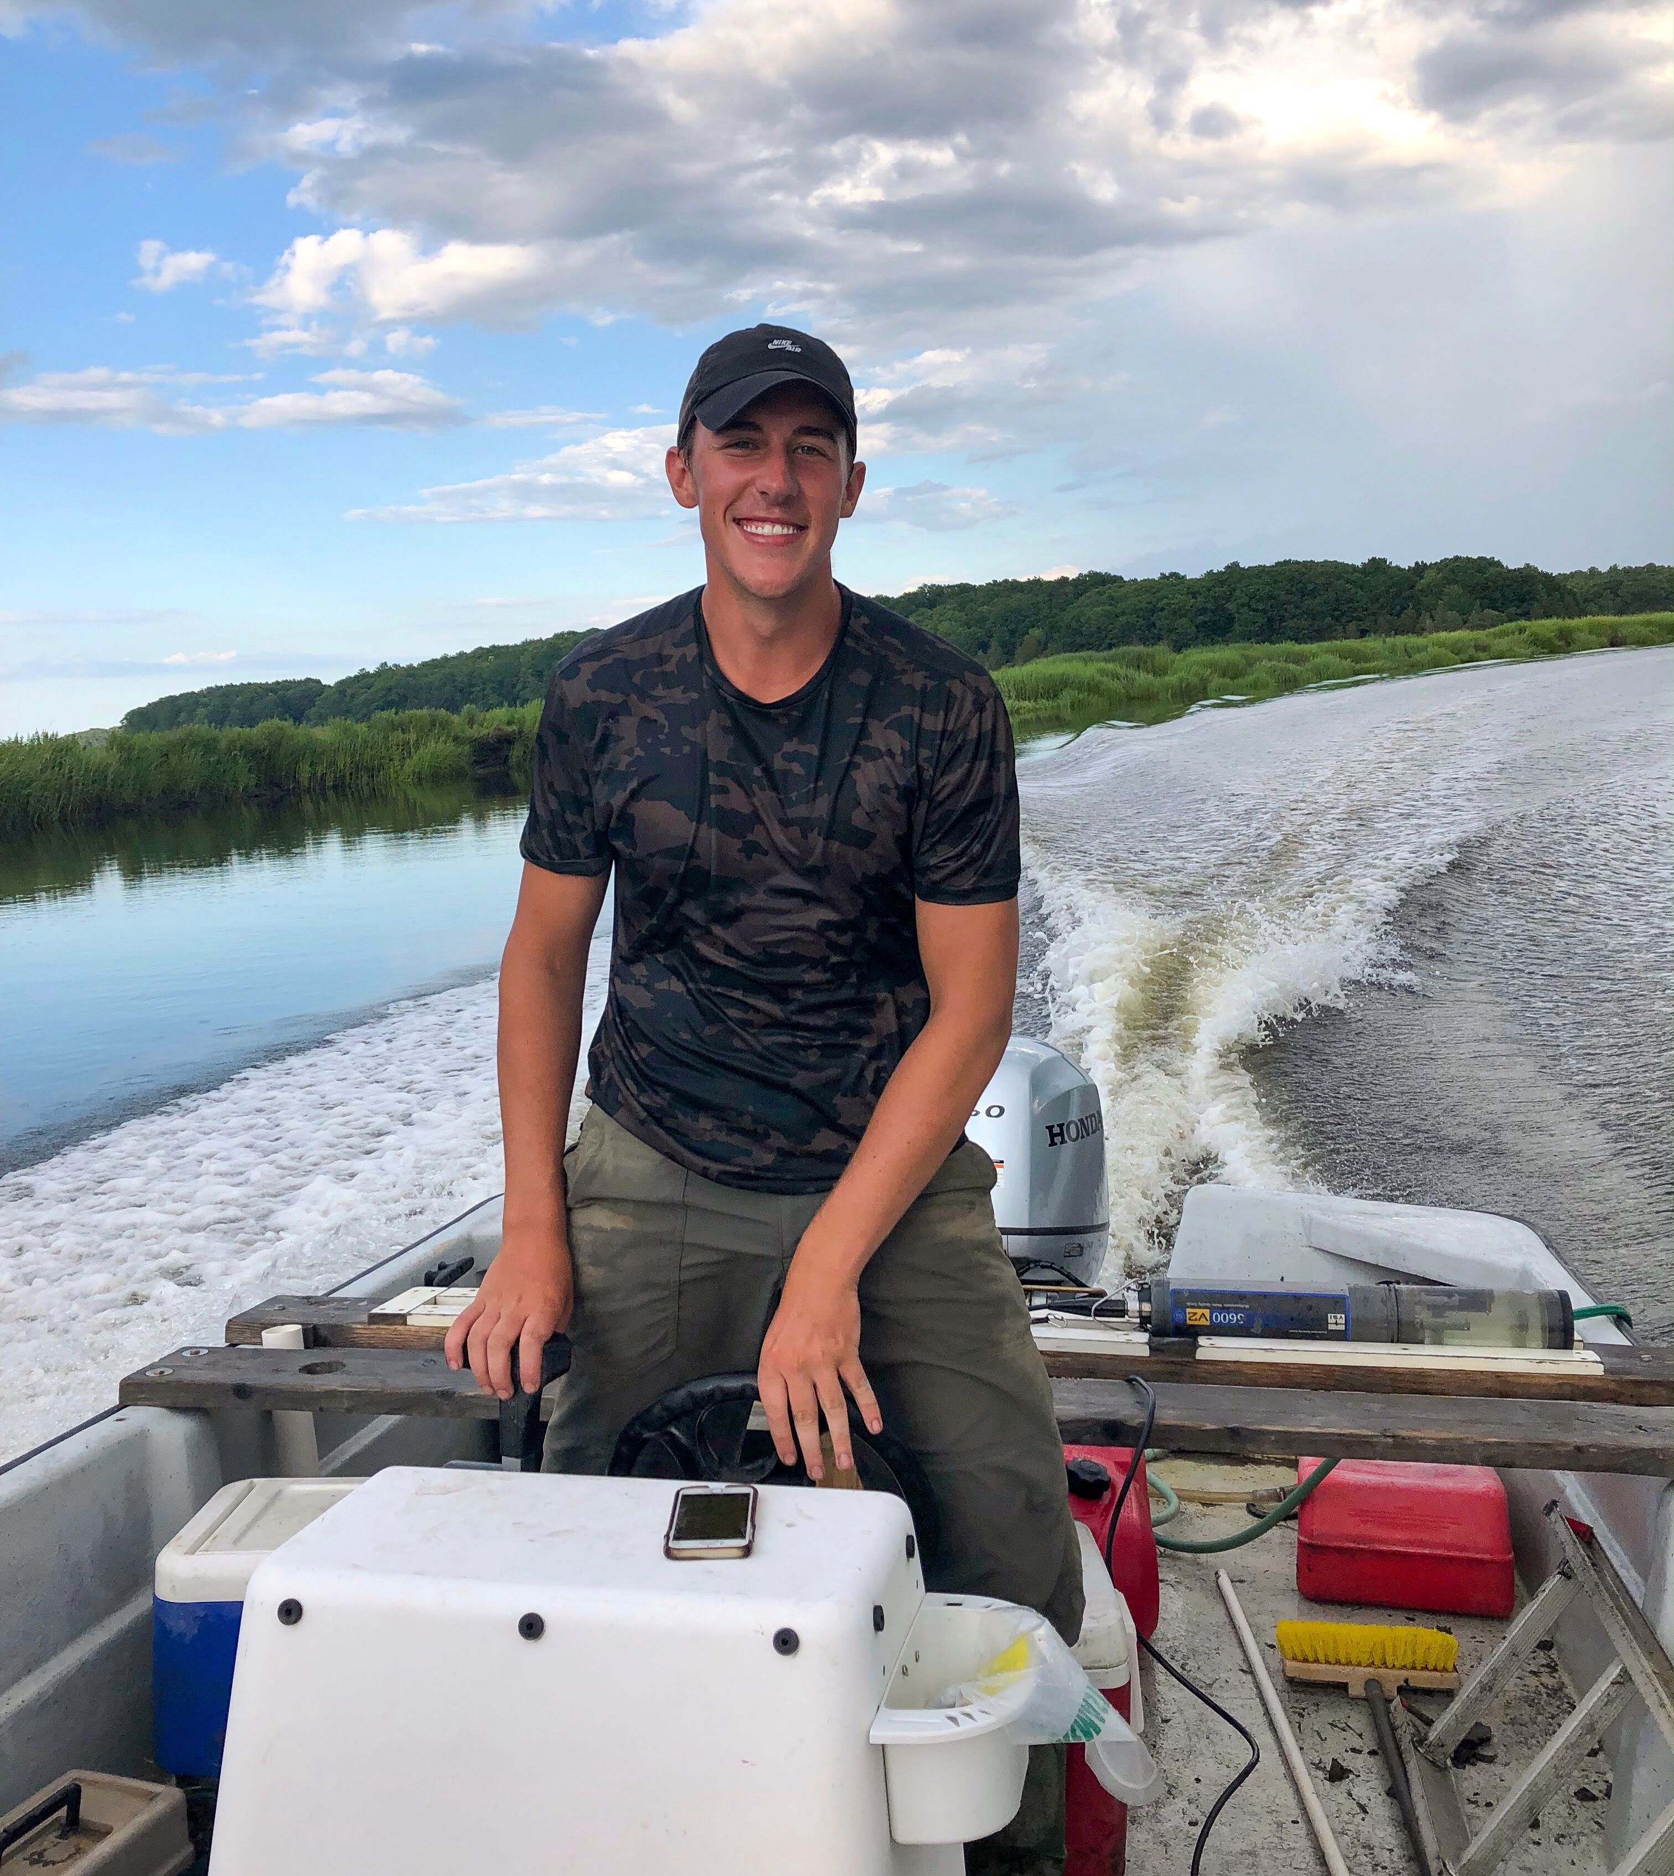
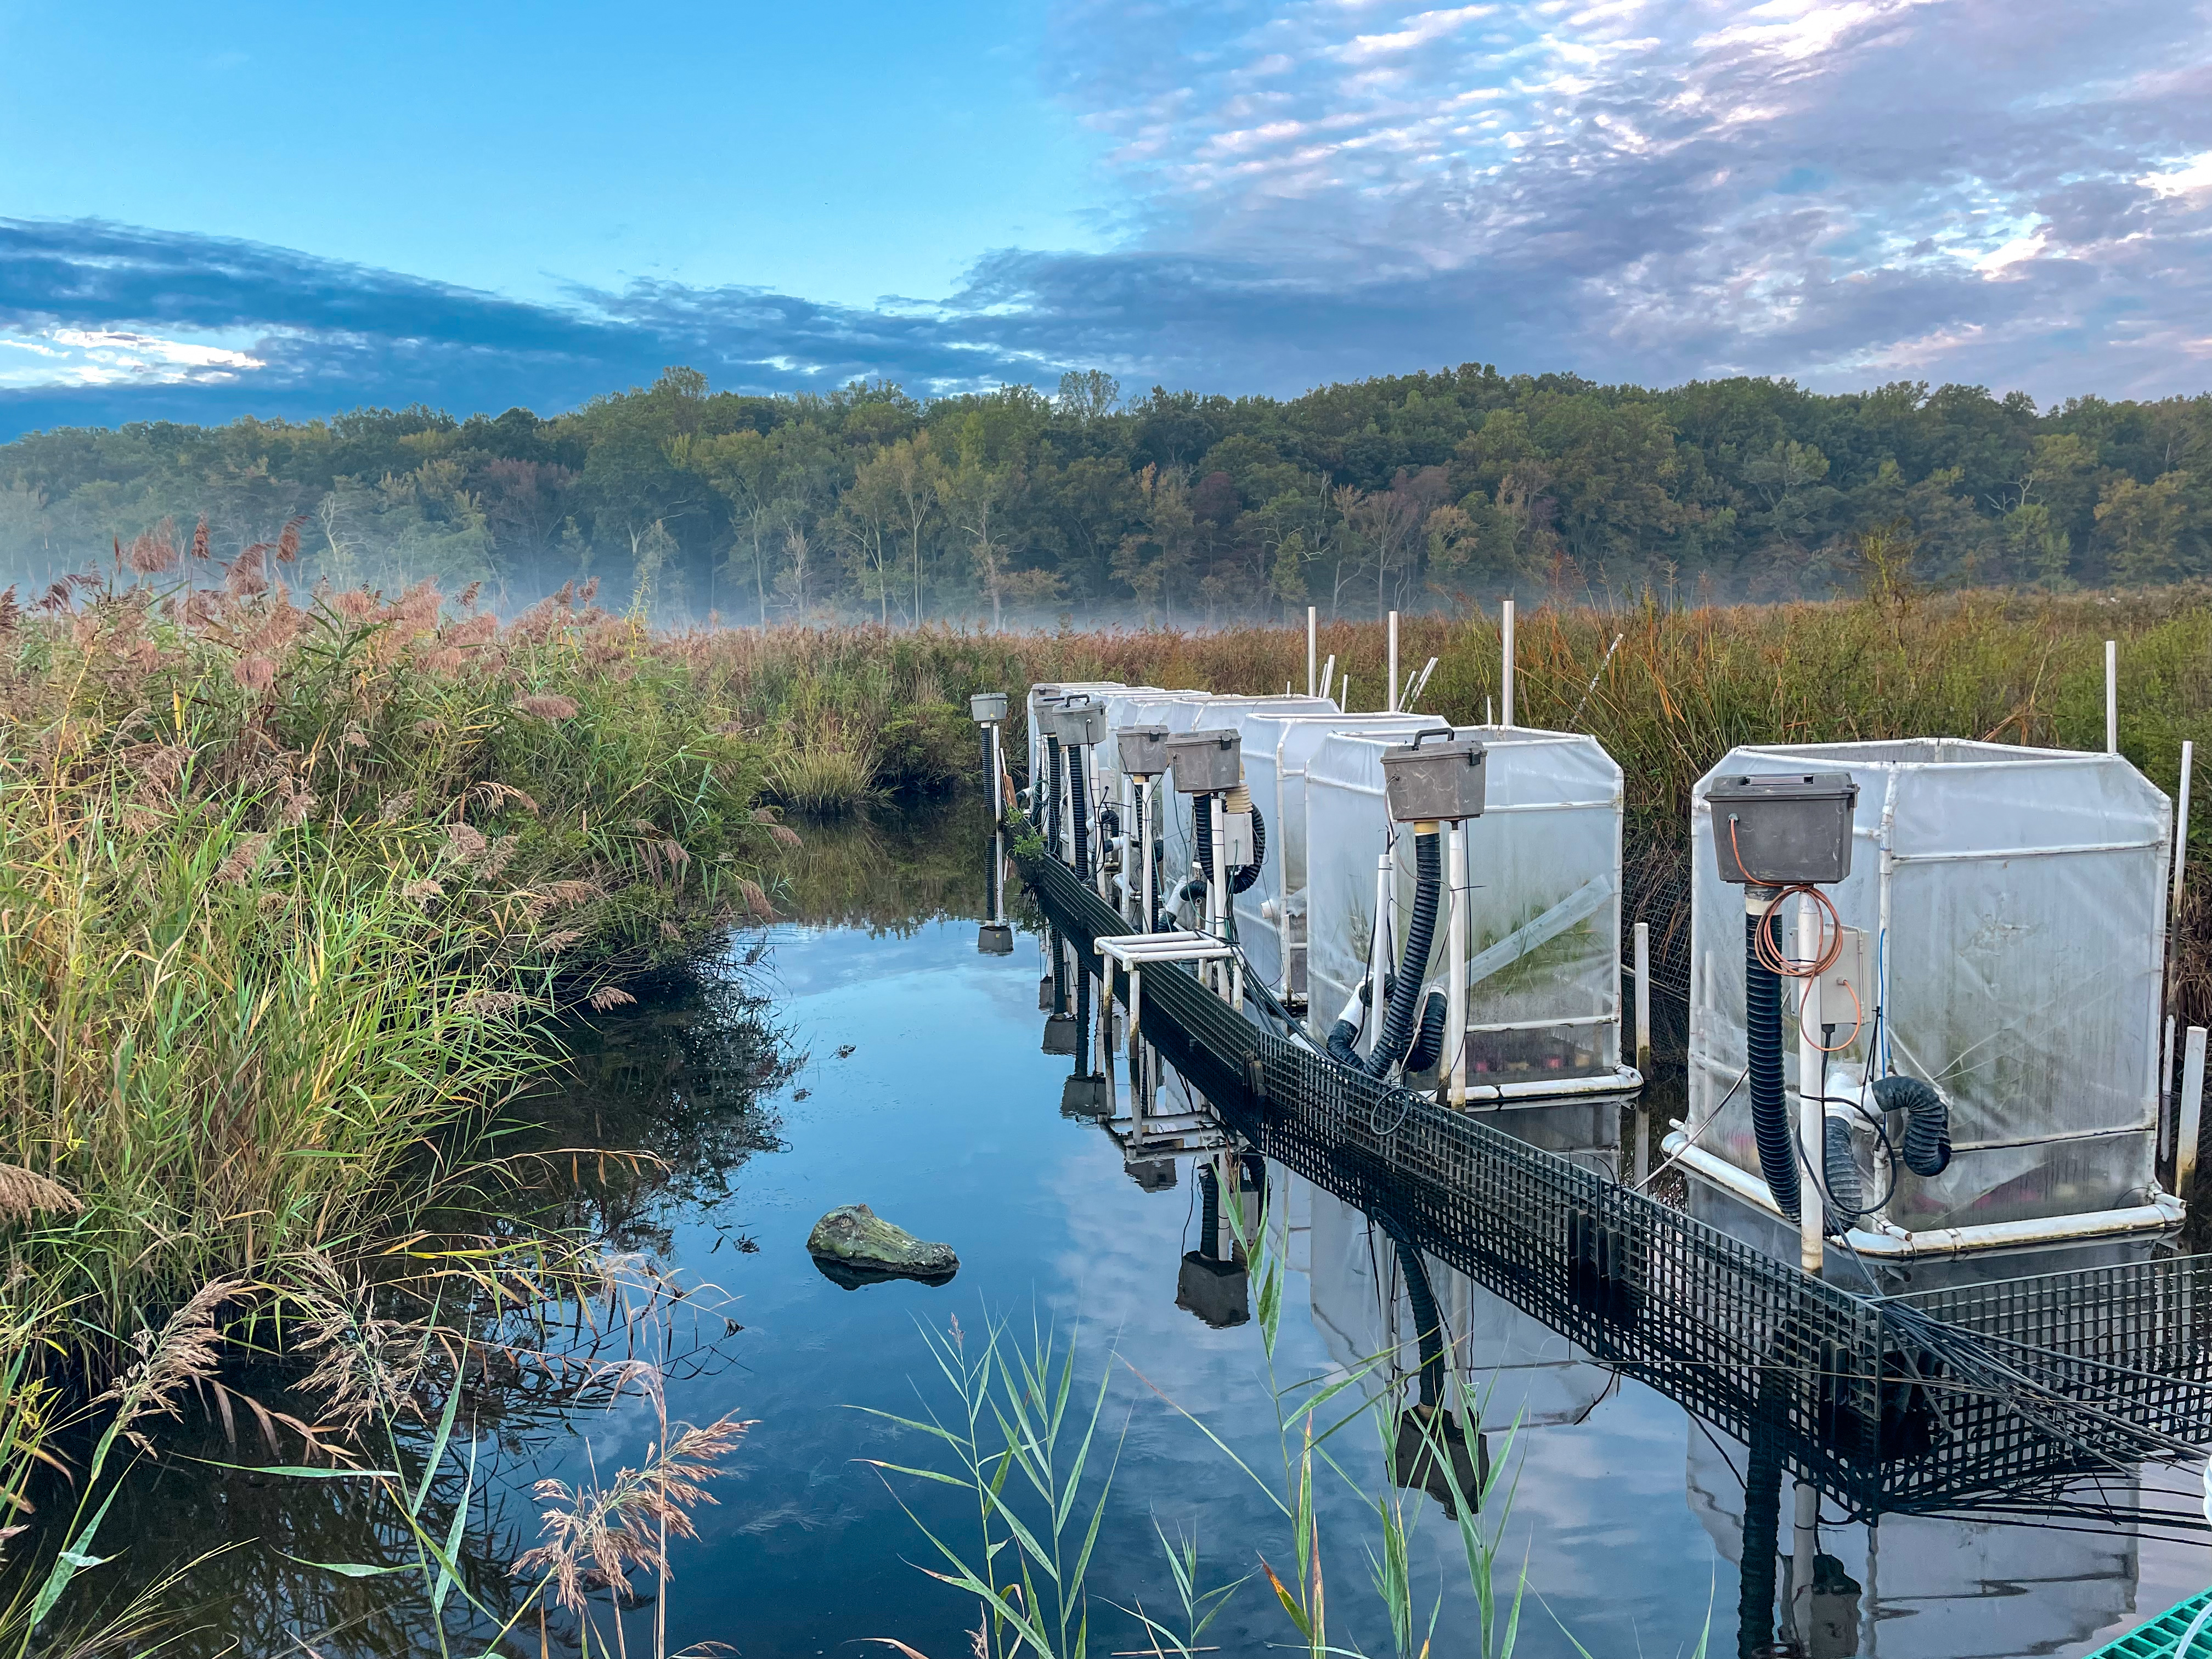
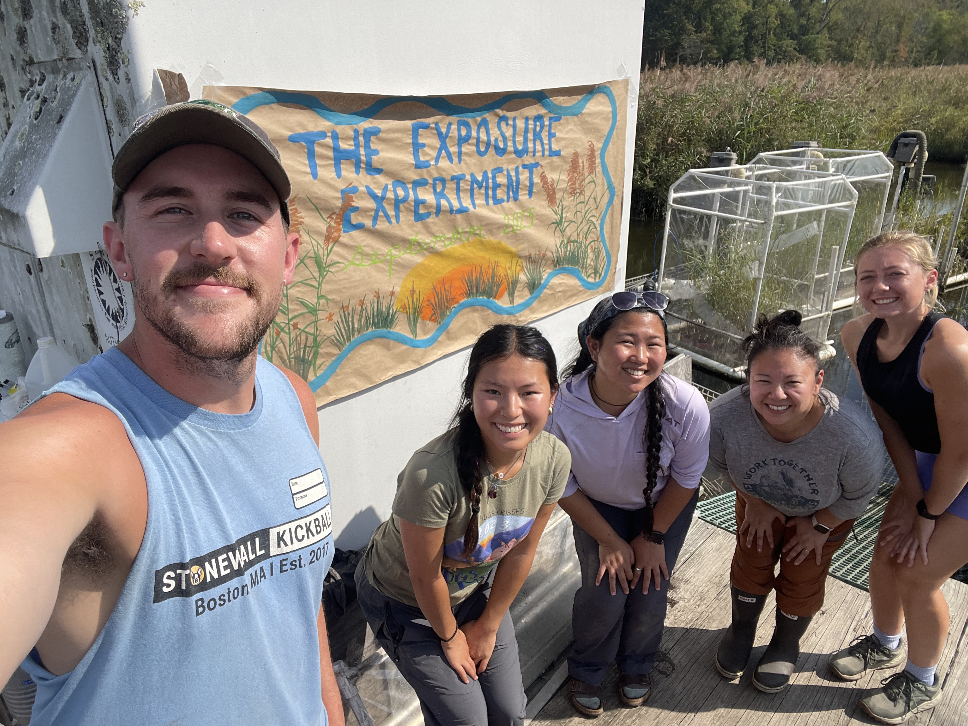
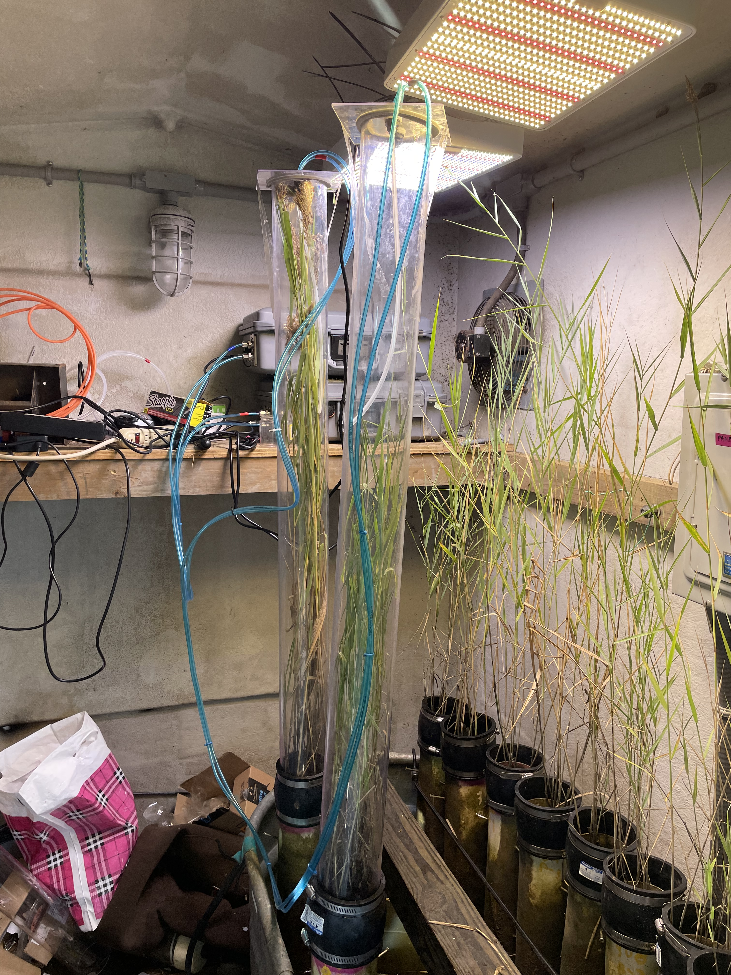
Biography
Coastal Wetland Research in
Plum Island, MA
Grew up in Beverly, MA
Ph.D. in Marine Science from
Northeastern University
BS in Environmental Science and
Laboratory Technician at Villanova University
Postdoctoral Researcher at
Bryn Mawr College

Slide 4
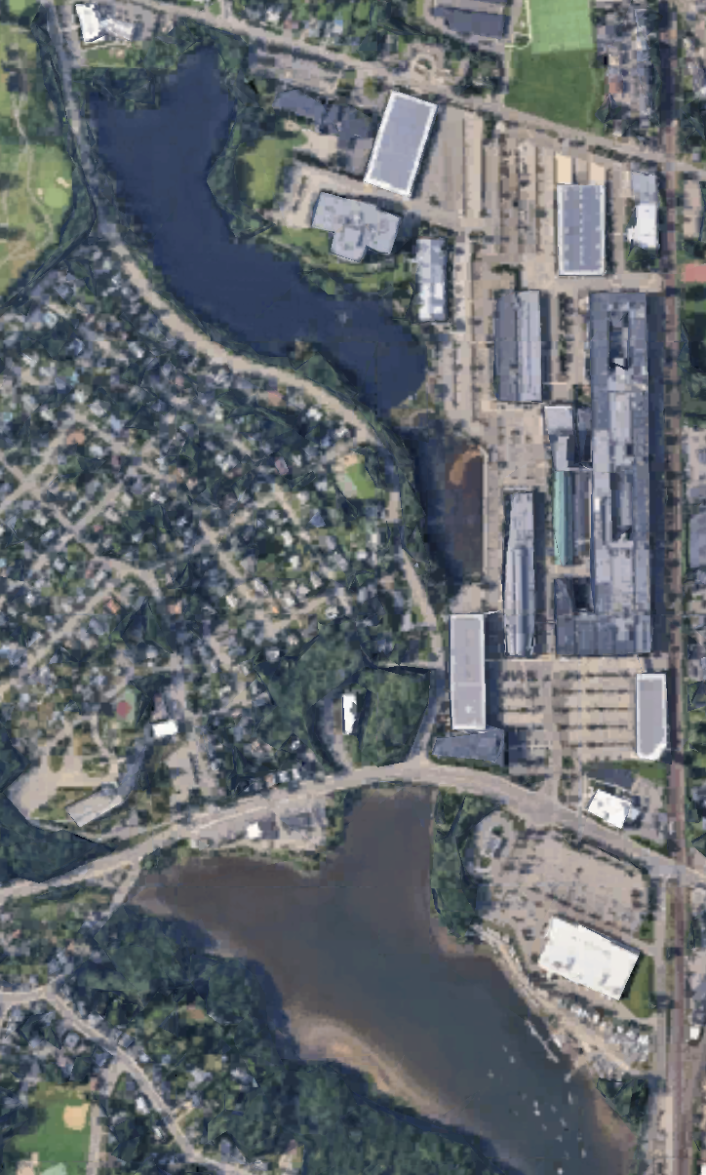
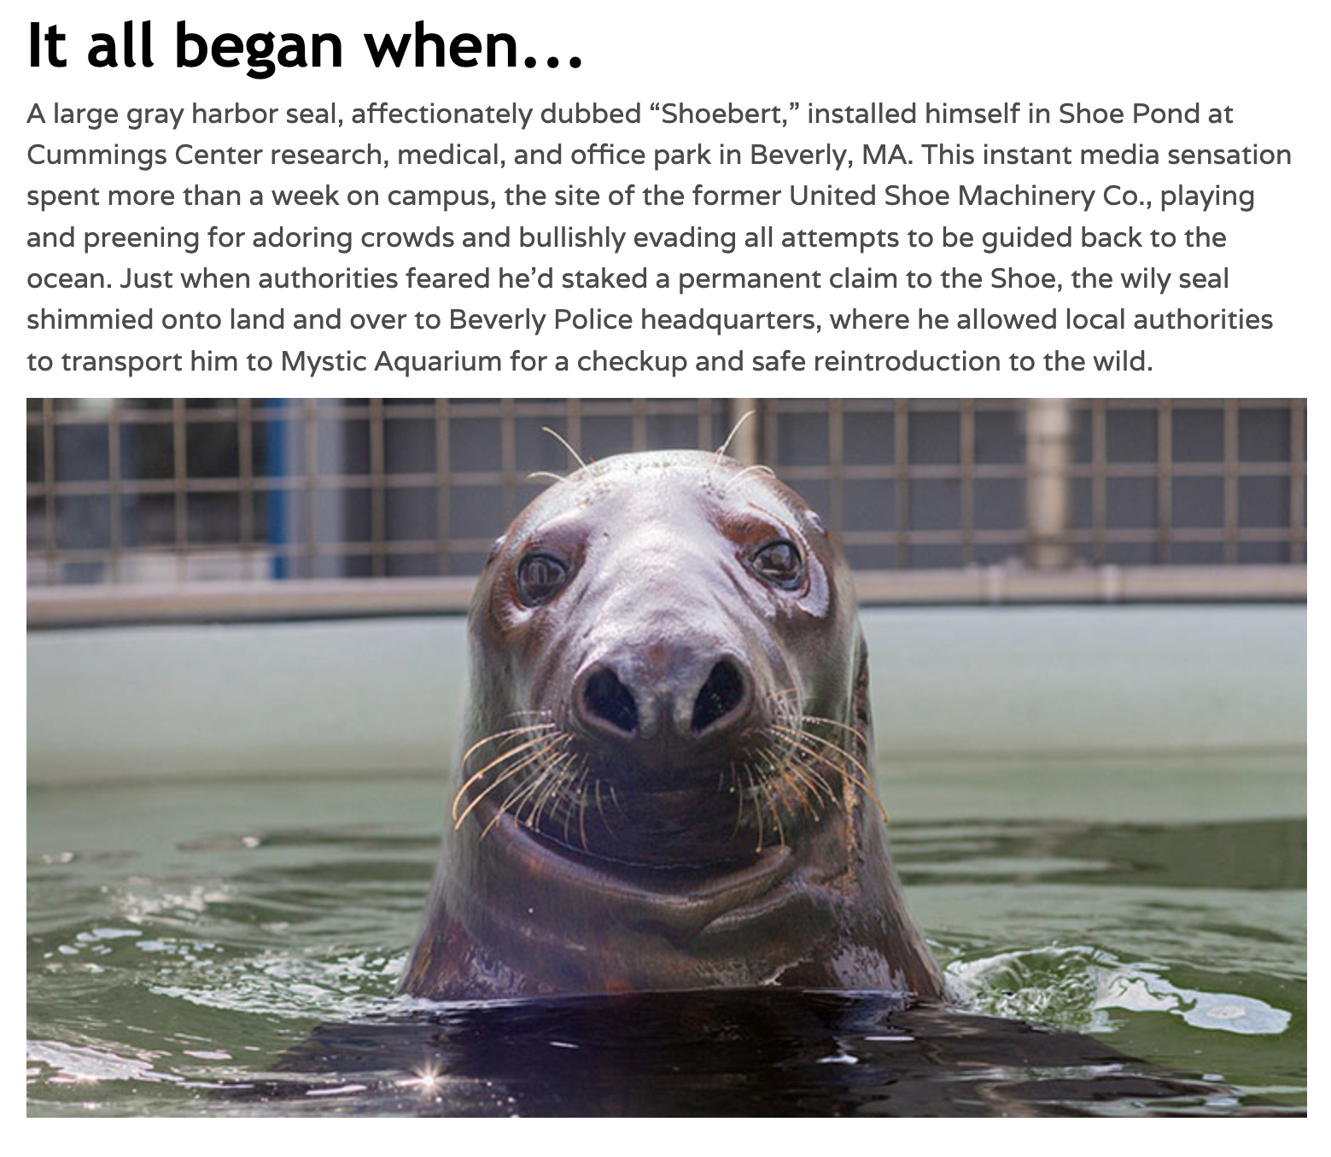
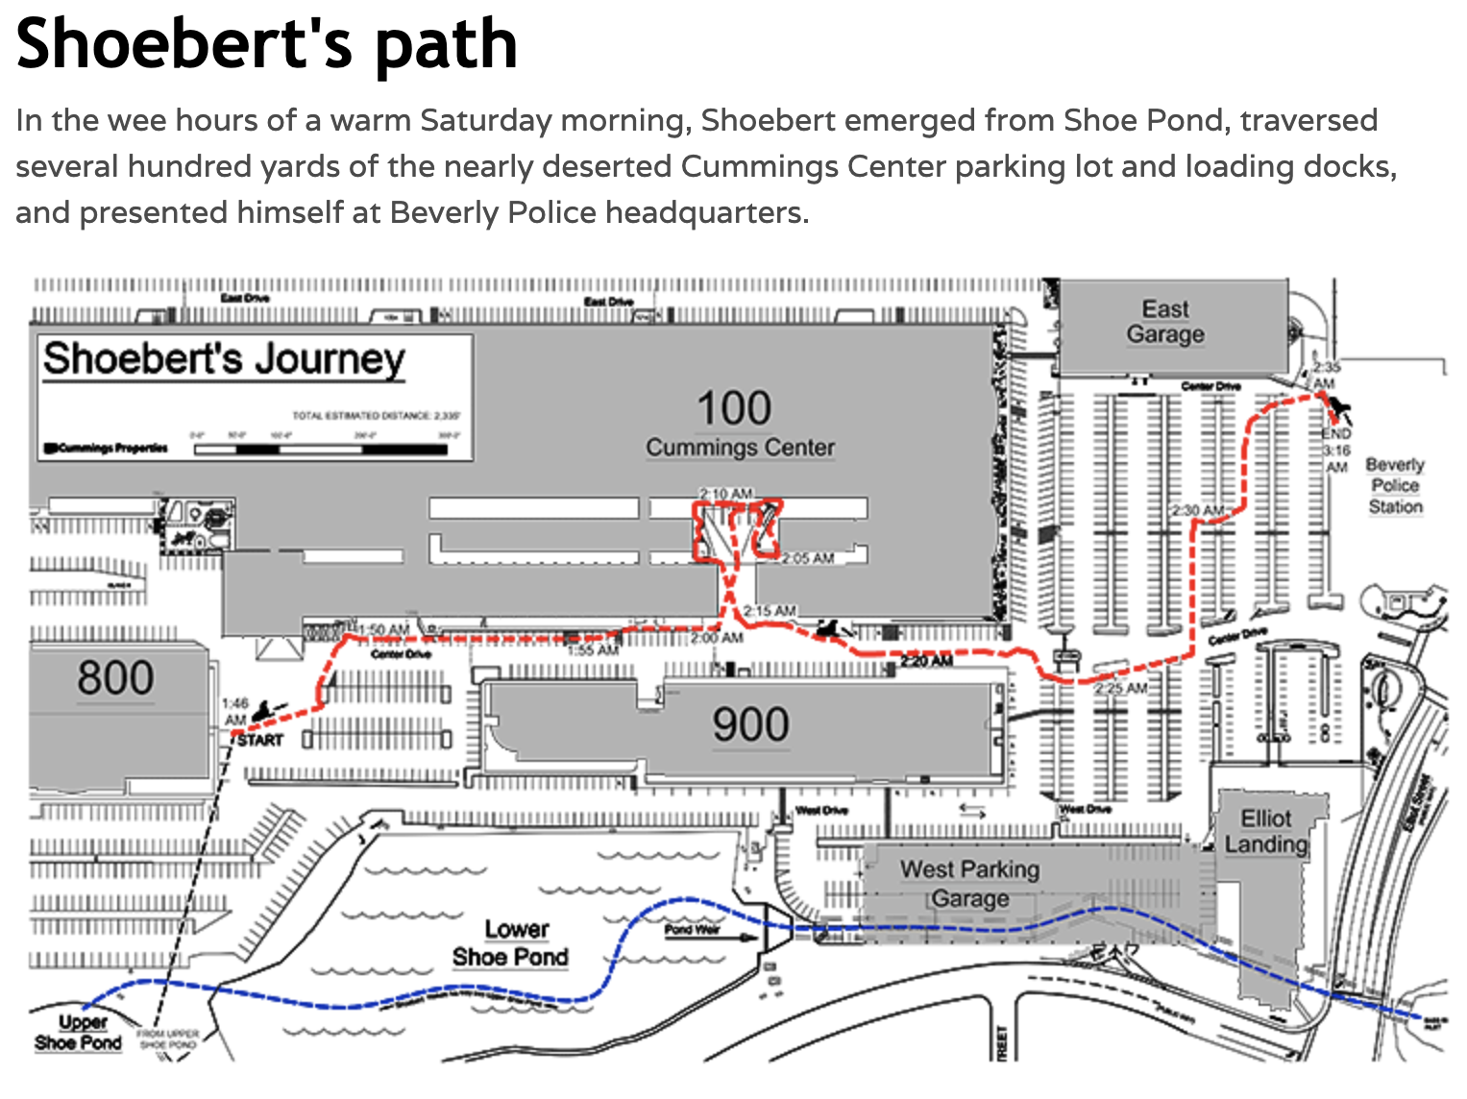
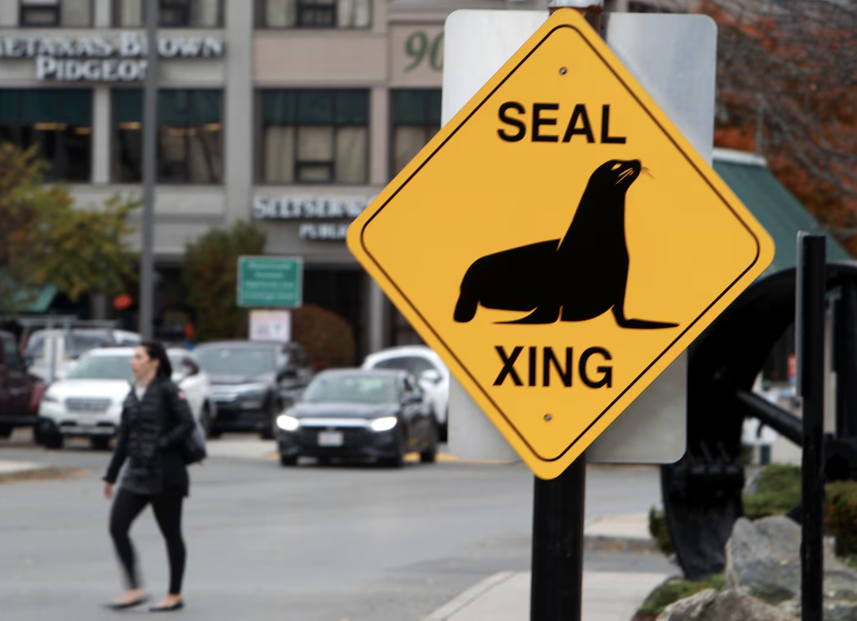
Let’s get to know you!
Name (First and Last)?
Pronouns?
Class Year/Major?
Hometown?
Something funny or uniquely weird
about your hometown?

Slide 5
Class Overview &
Review Syllabus

Slide 6
Basic Info
Time: Lecture: Tu/Th 10:10am-11:30am in Park 159
Lab: M 1:10pm-4:00pm in Park 100 (Scheduling conflicts before/after lab?)
Website: Moodle
Office Hours: Wednesdays 12pm-2pm in Park 103 (or by appointment)
Textbook: Environmental Science: Systems and Solutions 6th Edition by McKinner, Schoch, Yonavjak and Mincy. Jones & Bartlett Learning. 2019.

Slide 7
Learning Objectives
Identify the breadth of fields that are necessary to tackle the challenges facing the global environment.
Quantitatively describe the chemical, physical, and ecological underpinnings of important environmental challenges.
Assess the various perspectives held on environmental challenges and recommend actions to counter misperception and move toward solutions.
Understand the scientific method from idea generation, data collection, data analysis, and scientific writing

Slide 8
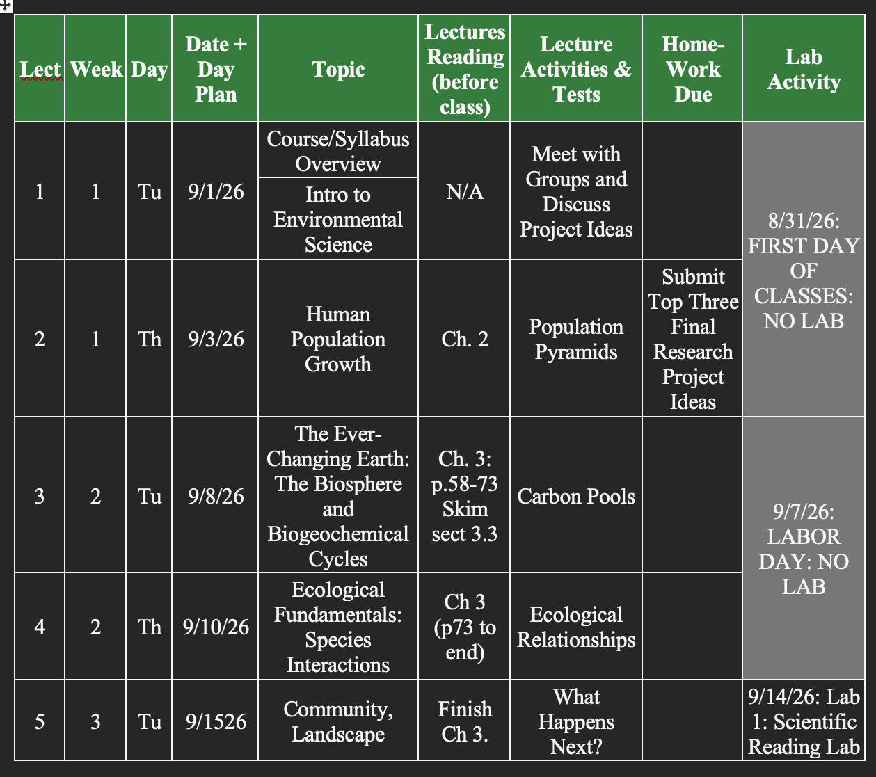
Class Schedule

Slide 9
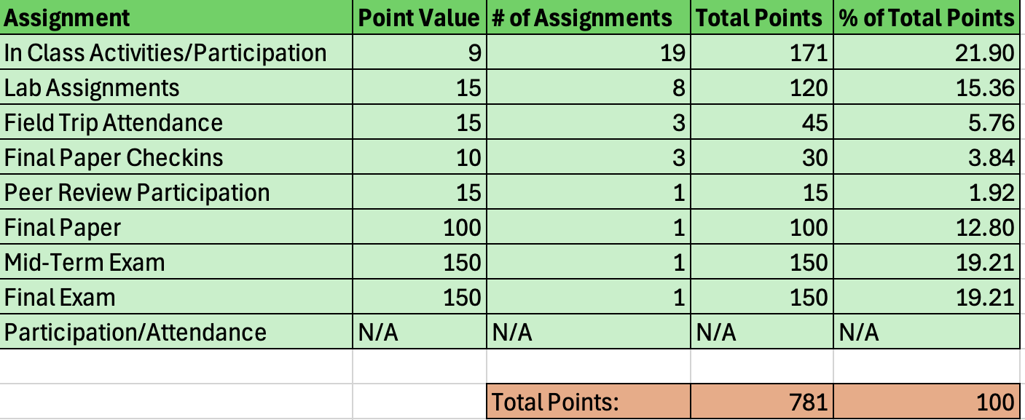
Grading Criteria
Grading Scale: Minimum letter grades are guaranteed for the following percentage points (but an upward curve is always possible):
B+ 87% C+ 77% D+ 67%
A 94% B. 84% C 74% D 64%
A- 90% B- 80% C- 70% D- 60%

Slide 10
Typical Lecture
Welcome
Discussion Question based on Reading
Lecture
Group Activity
Typical Lab
Variable
Field Work, Case study, Debate, Field Trips, etc.

Slide 11
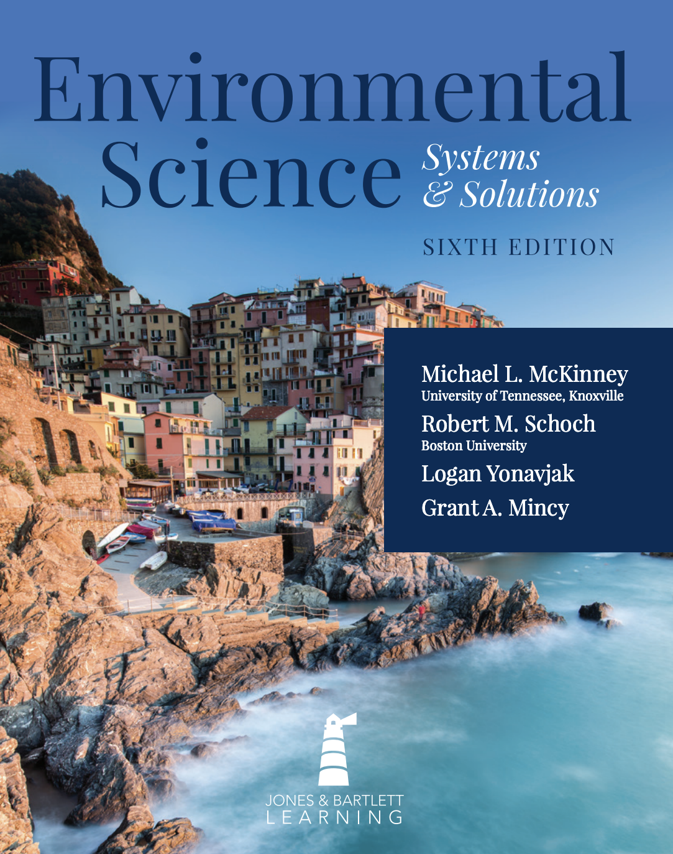
Reading Check-ins
Why would you do this to us?!?!?!?!
Benefit?
When?
Must be in person
Format: Discussion question
Points: 9
Total: 9pts x 19 = ~180 pts or 22% of grade

Slide 12
Lectures
Try to keep to under an hour to allow time for questions
Feel free to raise your hand and interrupt if you need more clarification
Focus
  Key information from chapter
  Current events

Slide 13
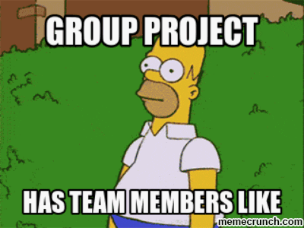
Lecture Group Activities
What are they?
Work in teams
1 grade for whole team
  Participation
Due at end of class, really at midnight
More on teams in a bit

Slide 14
Exams
2 exams: 1 midterm, 1 final
Format
Midterm: 150 pts, ~18% of grade
Final: 150 pts, ~18% of grade, semi-cumulative
Info for students with disabilities

Slide 15
Missed Exams: There will be no make ups for missed exams, except in the case of an emergency. If you miss an exam due to an emergency, please contact me immediately. If you know that you will miss an exam due to a university-related activity you must let me know at least two weeks prior to the exam.
Students are expected to attend all lectures and attendance will be taken via discussion question participation at the beginning of each lecture. Attendance to lab periods will be critical to student success as the skills learned in these sections will be directly applicable to their semester-long group projects.

Slide 16
Late & Absence policy
Mandatory attendance -
why?
2 free lates -
what does this mean

Slide 17
How to study for this class... and maybe all classes
Get organized
Maintain productivity - Pomodoro Technique
Fight procrastination - Break up large tasks. Start with small, single task.
Perfectionism and the 90 /10 rule
Active reading & note taking

Slide 18
Other thoughts
Manage your mental health
  Mental check-ins
  Find techniques that work for you to help you relax and destress
  Adequate sleep is strongly linked to better mental health
Secrets to College?
  Take advantage of extracurricular activities - YOU are already paying for them.
  Connect with students outside your normal sphere
  Do some type of independent research or project with faculty
Come to me for anything

Slide 19
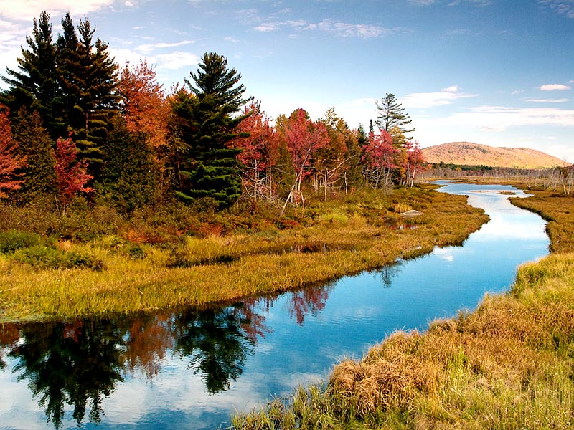
Chapter 1
Environmental Science: an Overview

Slide 20
Introduction
What is Environmental Science?
Environmental Science
An interdisciplinary field that combines knowledge from biology, chemistry, geology, and other sciences.
How does this differ from:
  Biology: Study of organisms
  Ecology: relationship between organisms & their environment
It is also very helpful to have a background in overlapping disciplines such as politics, ethics, economics, and others in order to better understand the societal component of environmental problems and solutions.

Slide 21
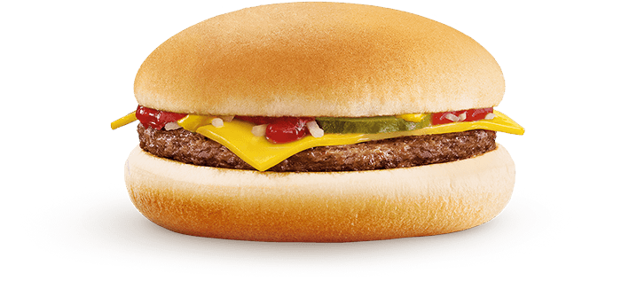
What is sustainability?
Sustainability
meeting the needs of the current generation without sacrificing the needs of future generations.
What does this really mean?
How much does a McDonalds Cheeseburger cost?
What are the actual costs?
Notes:
2022 - Walmart ground beef: $4.48/lb. McD burger patty = 0.1 lb. patty = $0.45/patty
Beef: from U.S, although they import a small percentage from suppliers in Australia and New Zealand
Cost: $1 - $2.79

Slide 22
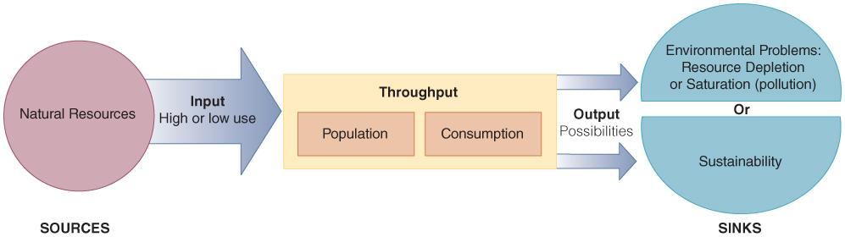
The Two Causes of
Environmental Problems
Environment is a source and sink for the matter and energy that flow through society.
Population and consumption accelerate the flow, leading to resource depletion and pollution.
Notes:
Figure 01.04: People use resources from the natural environment and deposit wastes back into the natural environment.

Slide 23
What Is Environmental Impact?
Environmental impact refers to the alteration of the natural environment by human activity.
Impact = Population x Consumption
I = P x C
Rates of population growth, resource consumption, pollution generation all affect impact.
Environmental impact is exponential with increasing population and industrial development.

Slide 24
History of Environmental Impact
Five basic stages of environmental interaction
  Gathering and hunting (low population; localized impact)
  Agriculture and conservationism (increased population size; widening impact)
  Industry and environmentalism (faster population growth; increased pollution)
  Transition and sustainability (current stage; increased awareness of underlying issues)
  Post-industrial stage—the future (sustainability or overshoot?)

Slide 25
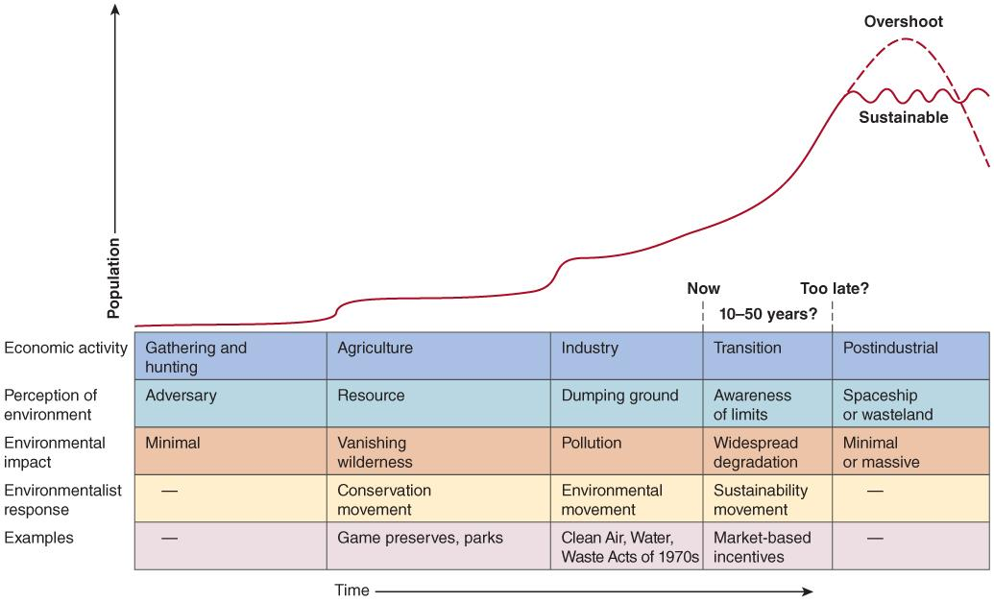
Examining Impact
?

Slide 26
Population Trends Show
Increasing Impact
Currently the world population experiences a net gain of 77 million people (equivalent to one-third U.S. population).
Over the last 50 years world population has grown more than in the entire history of human existence.
Even if world population stabilizes by 2050, the increase will be approximately 30% more than the 2011 population, resulting in 9 billion people.
At the same time, Earth’s resources are being consumed at rates never before seen, which make consequences difficult to predict.

Slide 27
Strategies to Reduce Impact (I)
Impact (I) = Population (P) x Consumption (C)
Strategies to reduce consumption (C) include:
Reduce materials needed
Use less or more efficient technology to meet needs
Choose sustainable technology when possible
Strategies to reduce population (P) and its impact include:
  Economic development and education
  Paying the true costs of environmental services
  Paying the true costs of imported resources

Slide 28
Group Project and Assignments
Objective: Complete a semester long research project resulting in a final scientific paper where you will:
  Choose a topic
  Review the current literature to form a hypothesis
  Conduct the study by collecting data
  Analyze the data you collected using statistics and generate figures to display your data
  Synthesize the data and find broader impacts and next steps

Slide 29
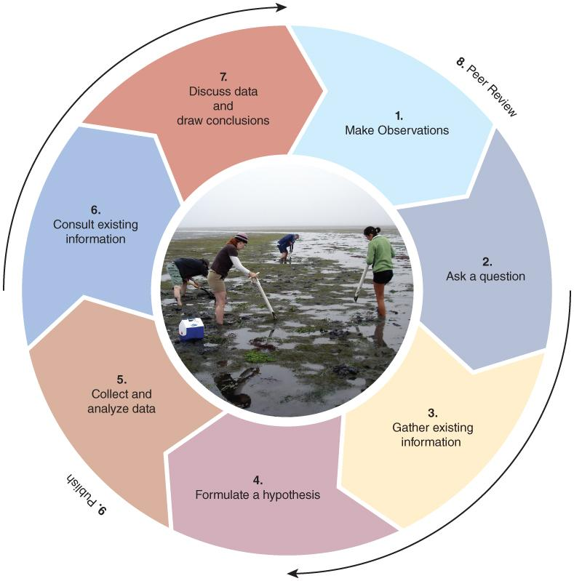
Scientific Method
The scientific method requires observation and the collection of evidence that is visible, reliable, and testable.
1. Beaver really change the landscape!
2. Could they store enough water to offset climate impacts?
3. Literature search
4. Hyp: Beaver can store water and cool streams
5. Beaver relocation study
6. Compare with what is already known
7. Data analysis
8. Peer review - check this out!
9. Beaver are amazing. Read all about it.

Slide 30
Randomly Assigned Groups
Group A: Nadav Gilad-Muth, Jason Zhou, Ariana Gaebe
Group B: Willa Hollinger, True Garcia, Isabelle Cervasio-Dyer
Group C: Mila Munoz-Mazurkiewicz, Olivia Celestin, Uma Garcia
Group D: Tarini Patel, Sam Clare, Jack McCurry, Abigail Reichart
Find your group and take some time to discuss what kind of research topics you’d like to study on/off campus.
By the end of class on Thursday, email me a list of four potential research projects ranked from most desired to least desired (bdonnelly2@brynmawr.edu)

Slide 31
Some potential ideas
Nutrient dynamics in local streams/BMC pond
Conductivity/salinity measurements over time in local streams/BMC pond
Bird populations on and around campus
De-icing salt usage across campus
Air Quality in the Greater Philadelphia area

