Slide 1
Introduction to Korean Culture and Society
Fall 2026
Hello!
안녕하세요!
[An-nyŏng-ha-seyo]

Slide 2
Reading Response #1
Now available on Moodle (Due Tuesday, September 8, at 11:59 PM)
Relational approaches to personal autonomy (2023)
5 Points
Please select at least three passages that resonate with you most. Post the selected passages on Moodle, along with a thoughtful comment for each passage explaining what resonates with you.

Slide 3
Korea in Context: People, Places & Geography

Slide 4
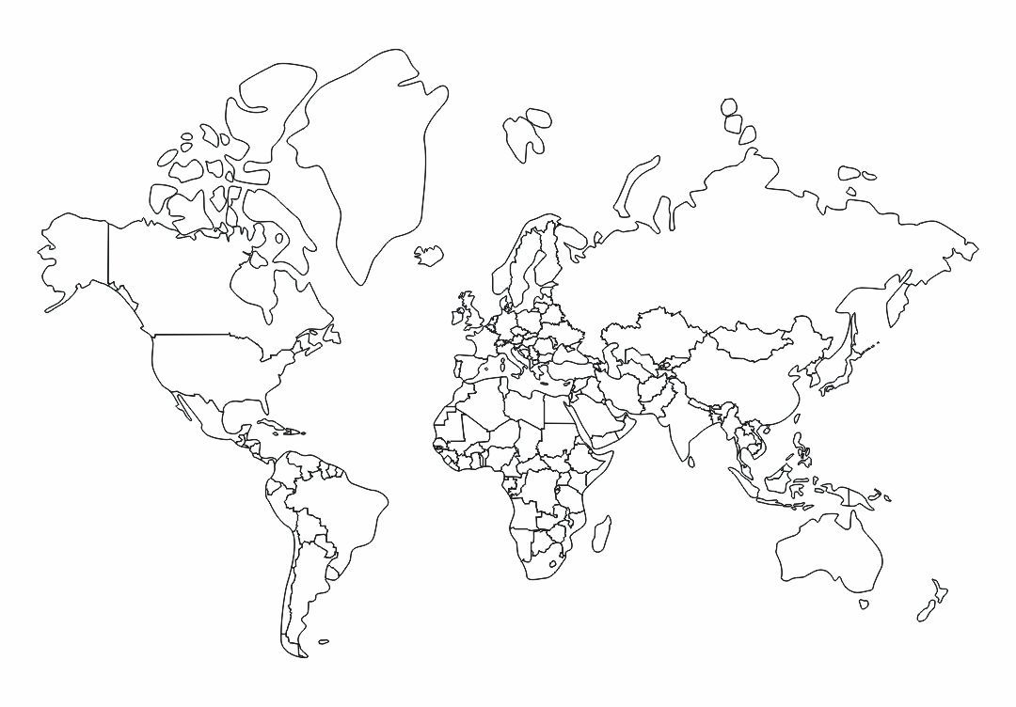

Slide 5
恨 (한, han)
sorrow, resentment

Slide 6
Arirang
https://en.wikipedia.org/wiki/Arirang

Slide 7
Arirang in Media
https://www.youtube.com/watch?v=0RtnG2oS41s

Slide 8
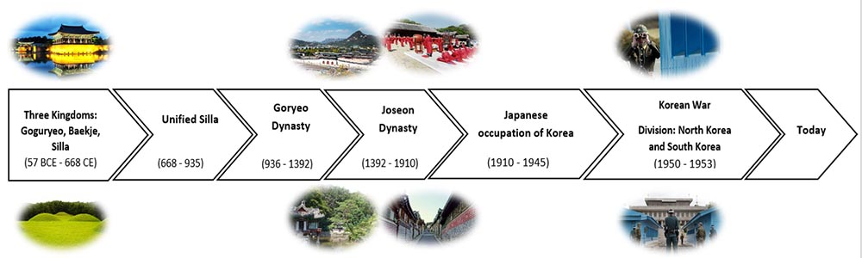
Timeline of Korean History

Slide 9
Imjin War (1592–1598)
Byeongjahoran (1636–1637)

Slide 10
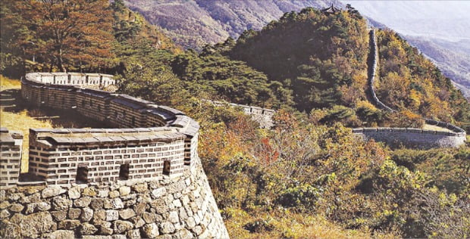
Namhansanseong Fortress
It is a mountain fortress built in the early 17th century near Hanyang (today’s Seoul) as a military stronghold. Inside the walls were government offices, military facilities, temples, and a temporary palace. In 2014, Namhansanseong was designated a UNESCO World Heritage Site for its exemplary representation of East Asian mountain fortresses and its significance in Korean history.

Slide 11
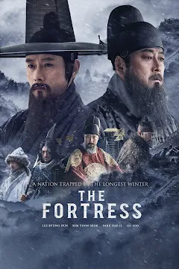
The Fortress (2017)
Beginning-6:00; 1:38:00-1:42:00; 1:58:50-End

Slide 12
The Fortress (2017)
Discussion
Q1. Do you think the decision to surrender was the right decision? Why or why not?
Q2. Throughout history, there have been many people who chose to fight until the end rather than surrender, even when the chances of victory were very small. Can we say that they made the wrong decision simply because surrender might have been more practical? Why or why not?
Beginning-6:00; 1:38:00-1:42:00; 1:58:50-End

