Slide 1
Introduction to Korean Culture and Society
Fall 2026
Hello!
안녕하세요!
[An-nyŏng-ha-seyo]

Slide 2
Reading Response #1
Now available on Moodle (Due Tuesday, September 8, at 11:59 PM)
Relational approaches to personal autonomy (2023)
5 Points
Please select at least three passages that resonate with you most. Post the selected passages on Moodle, along with a thoughtful comment for each passage explaining what resonates with you.

Slide 3
Short Essay #1: Due on Sunday (9/13) by 11:59 PM via Moodle
Option 1)
Describe a situation in your life when you had to choose between what seemed practical and what you believed was right or consistent with your principles. What did you decide, and why? Looking back, how do you evaluate that decision now? What did you learn from this experience, and what would you like your readers to understand from your experience?
Option 2)
People respond to change in different ways. Some people tend to actively embrace and adapt to change, while others tend to resist change and prefer stability and familiarity. Which type of person are you? What do you want your readers to understand about embracing change or resisting change? Use specific experiences from your own life to develop and support your argument.

Slide 4
Writing Criteria
● Length (1 point)
Your essay should have at least 3 paragraphs.
Paragraph should have at least 5 sentences.
● Argument (1.5 points)
● Personal relevance (1.5 points)
● Comment on 3 peers’ essays due on Wednesday (1 point)

Slide 5
Arirang
https://www.youtube.com/watch?v=CxxpFegNLik

Slide 6

The Fortress (2017)
Discussion
Q1. Do you think the decision to surrender was the right decision? Why or why not?
Q2. Throughout history, there have been many people who chose to fight until the end rather than surrender, even when the chances of victory were very small. Can we say that they made the wrong decision simply because surrender might have been more practical? Why or why not?
Beginning-6:00; 1:38:00-1:42:00; 1:58:50-End
Whiteboard
https://zoom.us/wb/doc/mSIbko9YT_WPQvJ1mcSIDA

Slide 7
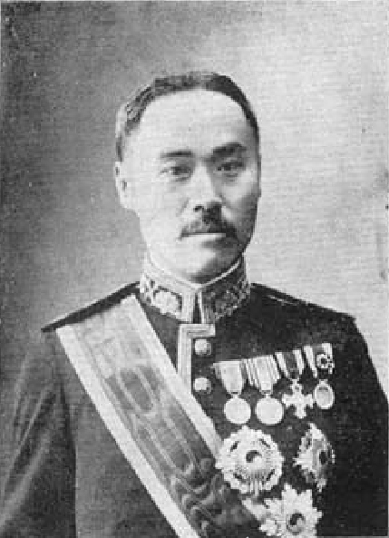
Yi Wanyong (1858-1926)
https://en.wikipedia.org/wiki/Yi_Wanyong
Yi Wan-yong: How Did an Opportunist Become a Traitor?
https://www.youtube.com/watch?v=IGApzI-M2VU
16:00-37:00; 40:00-45:00

Slide 8
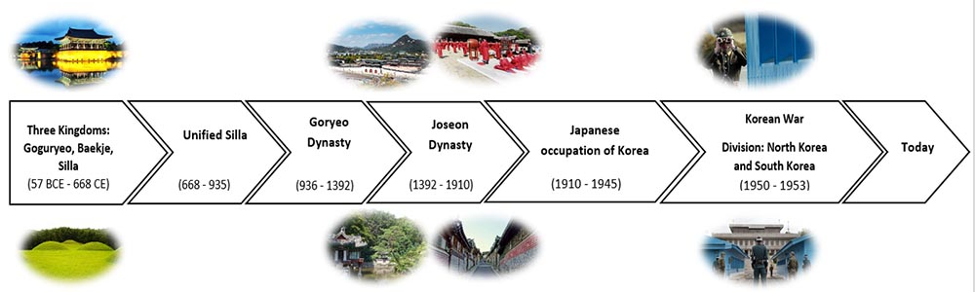
Korean Empire (1897-1910)

Slide 9
1897
Korean Empire
1910
Japan-Korea Annexation
First Sino-Japanese War
(25 Jul. 1894 – 17 Apr. 1895)
https://en.wikipedia.org/wiki/First_Sino-Japanese_War
Russo-Japanese War
(8 Feb. 1904 – 5 Sep. 1905)
https://en.wikipedia.org/wiki/Russo-Japanese_War

Slide 10
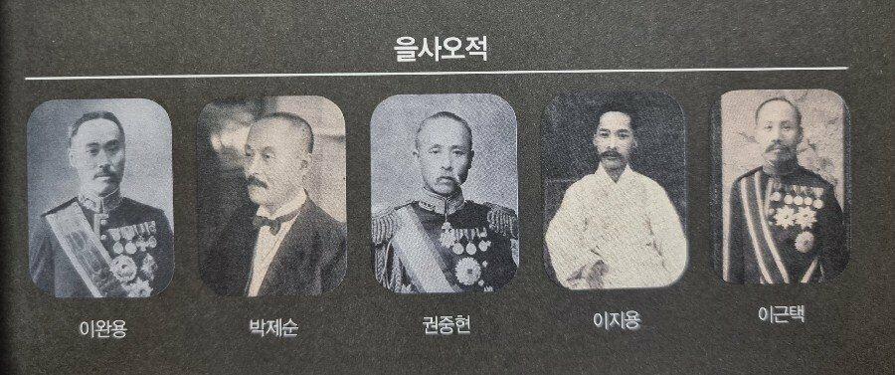
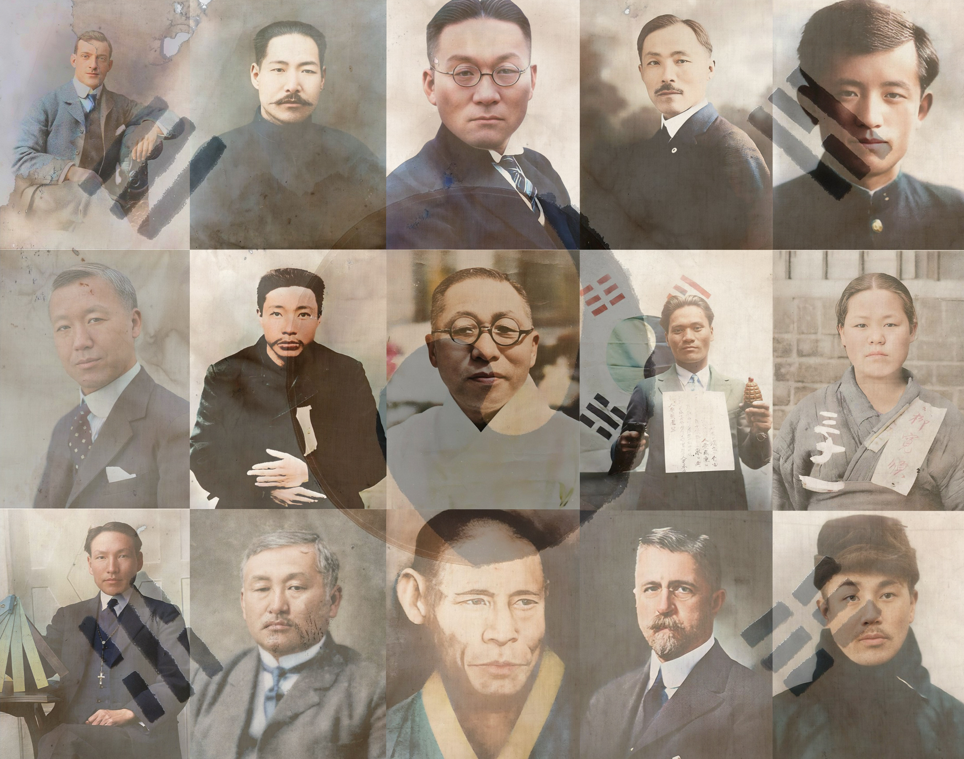
Pro-Japan / Anti-Japan

Slide 11
Yi Wanyong (1858-1926)
https://en.wikipedia.org/wiki/Yi_Wanyong
Q1. Yi Wanyong chose to cooperate with Japan, arguing that this was the most practical choice for Korea. Can a decision be justified because it seems practical or realistic? Why or why not?

