Slide 1
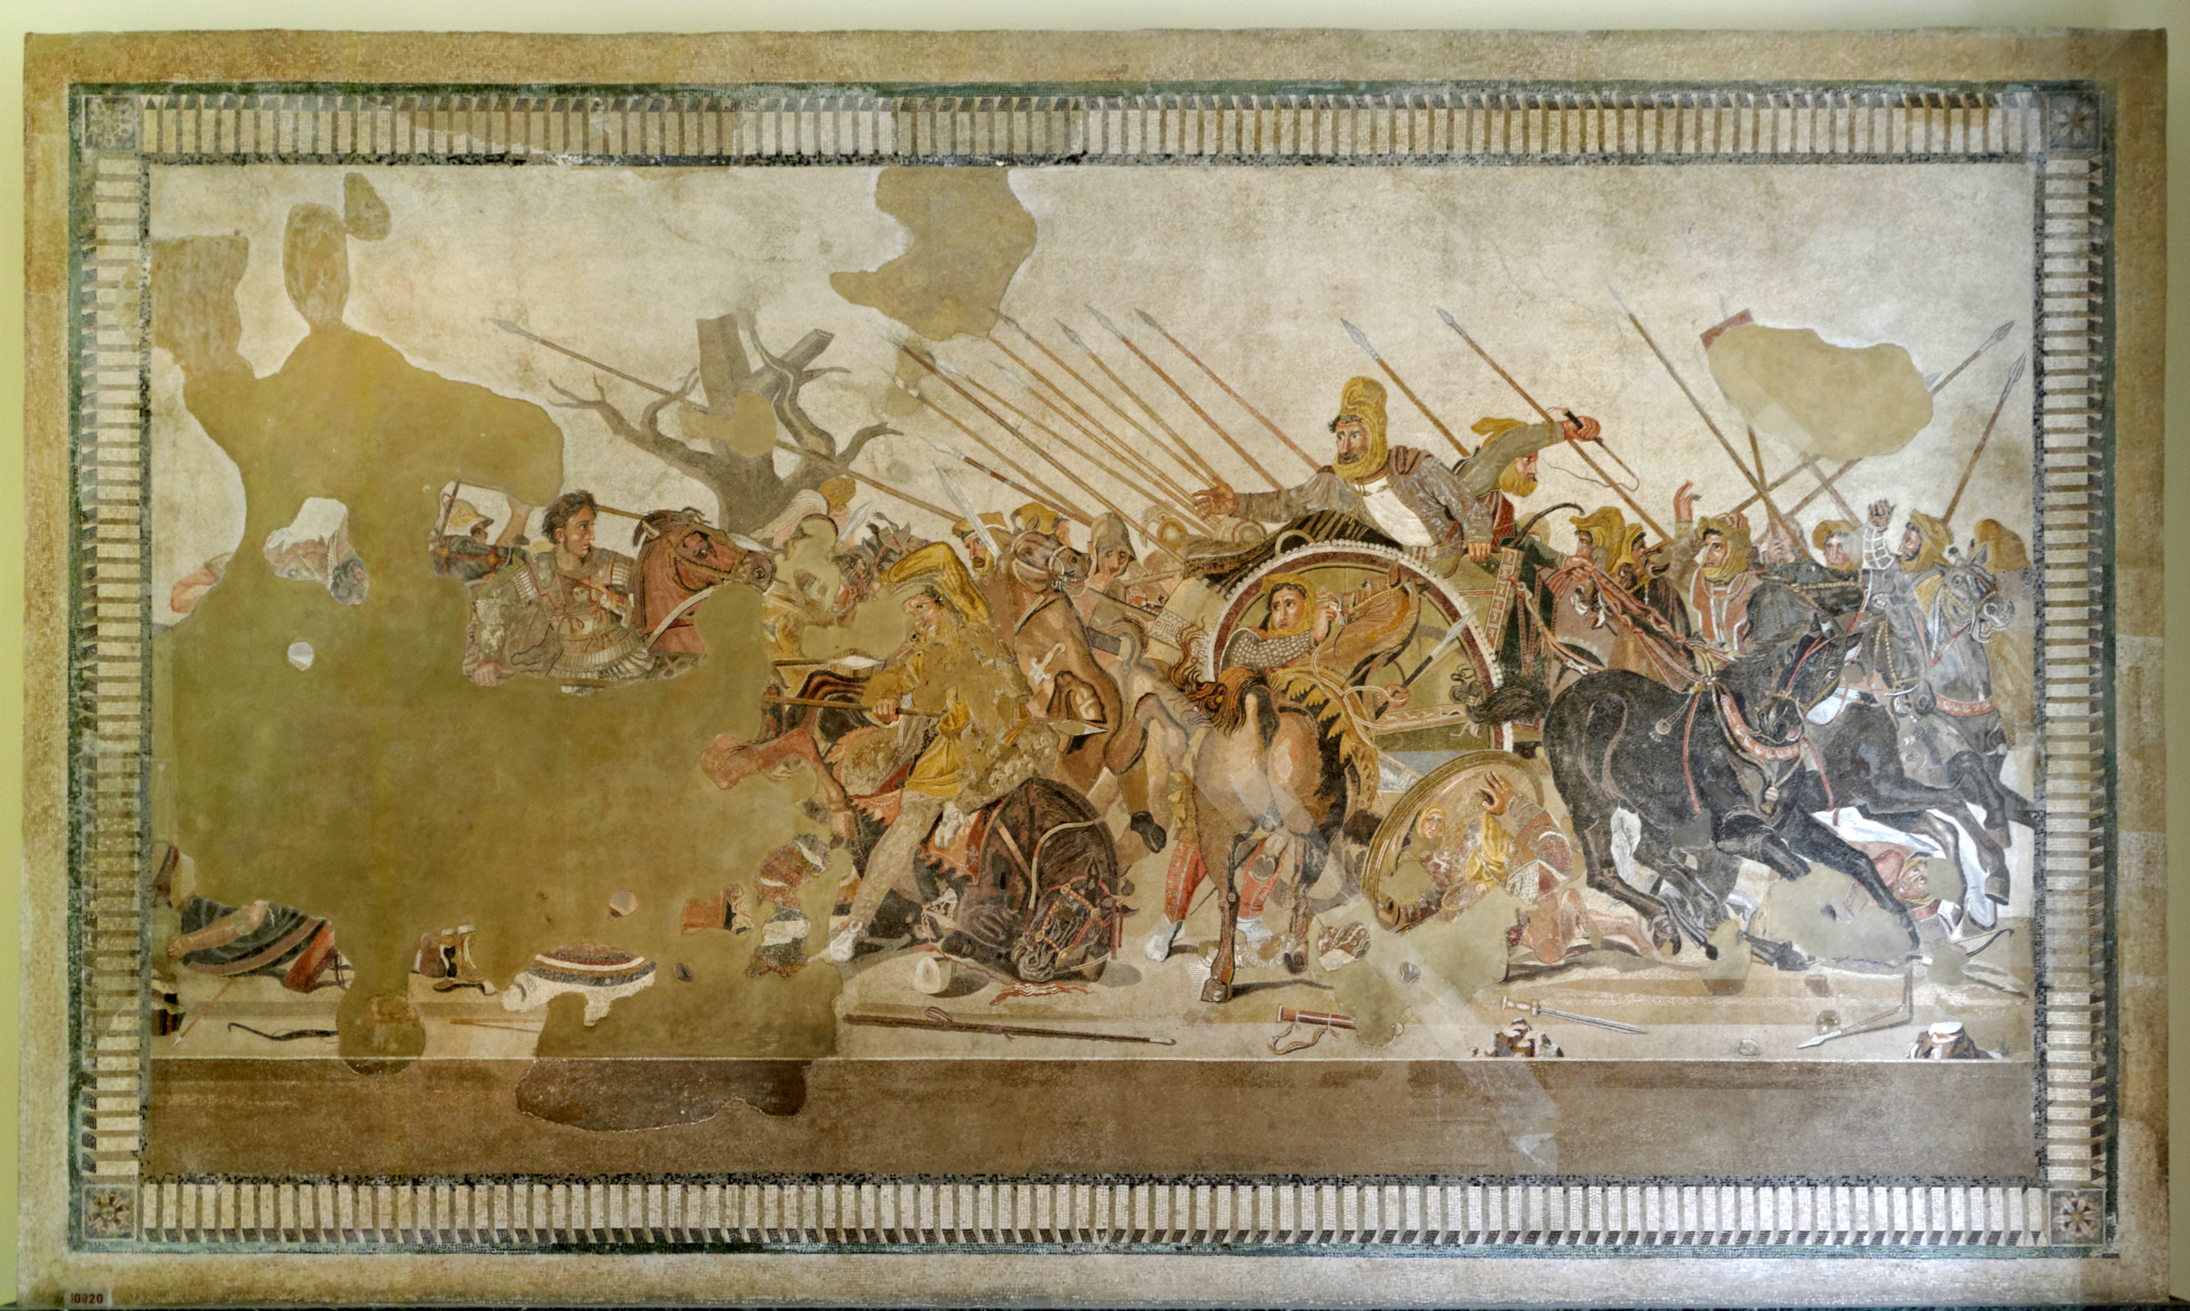
Alexander the Great and the Hellenistic World
ARCH B222 – The Age of Alexander
Fall 2026
September 2

Slide 2
Looking Ahead
Mon 9/7: Labor Day (no class)

Slide 3
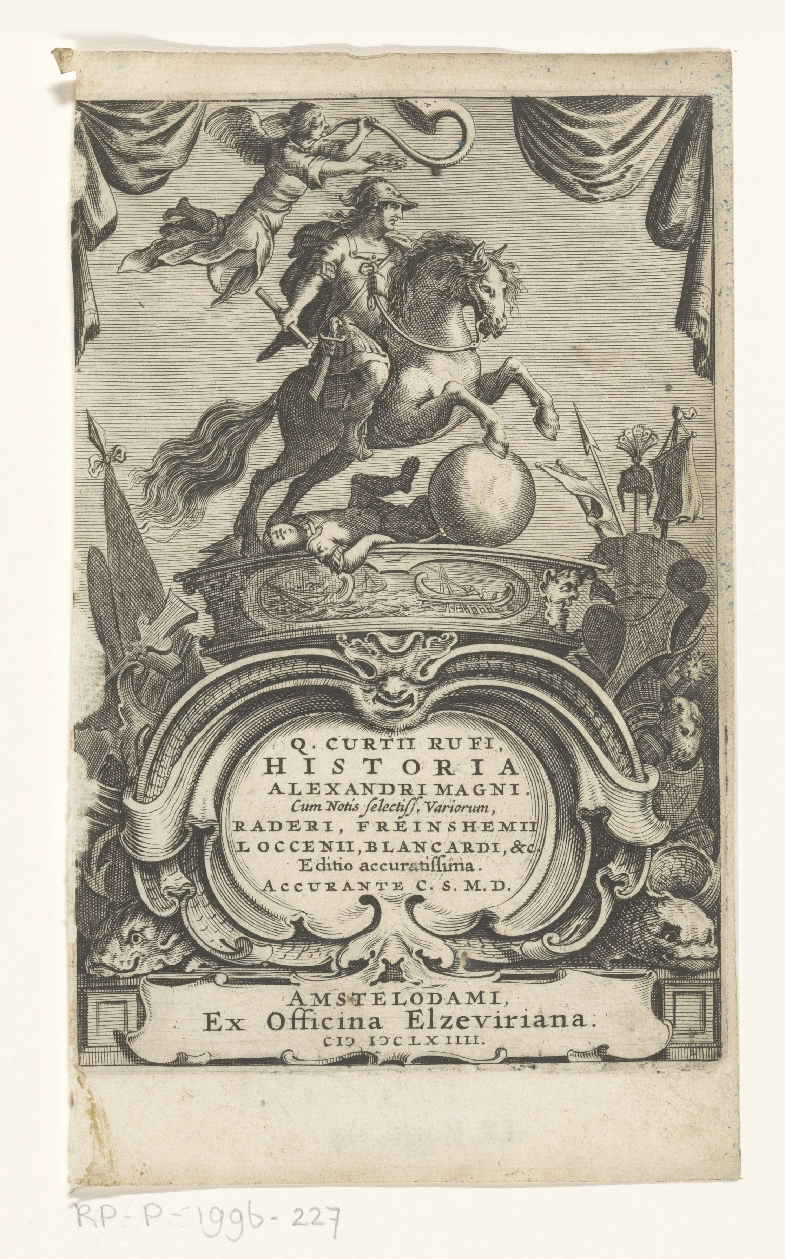
Sources for Alexander
Arrian
  ca. 86/89-146/160 CE
  From Nicomedia in Bithynia (in modern Turkey)
  Author Anabasis of Alexander (anabasis = “going upcountry”)
Plutarch
  ca. 50-120 CE
  Priest from Chaeronea in Greece
  Author of numerous biographies and essays, including a biography of Alexander
Quintus Curtius Rufus
  1st cen. CE
  Roman historian
  Author of Historiae Alexandri Magni (“Histories of Alexaner the Great”)

Slide 4
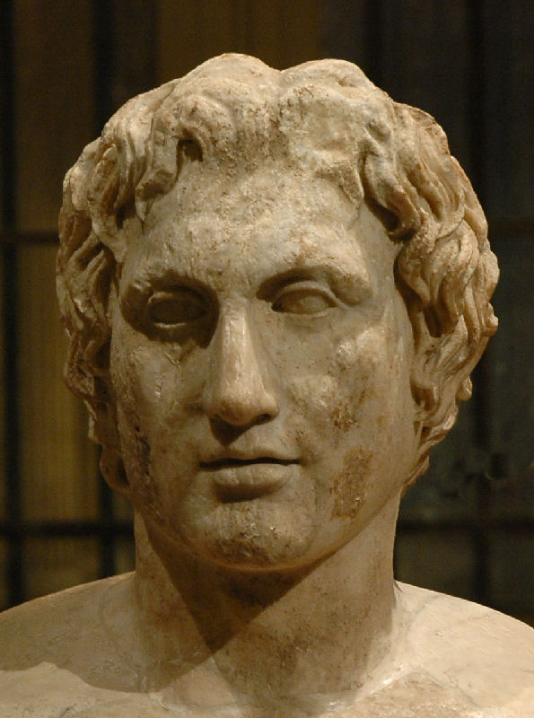
Alexander
*
356-323 BCE
Succeeded his father as king of Macedon in 336 BCE
Invaded the Persian Empire in 334 BCE
  Defeated the Persians at Granicus, Issus and Gaugemela
  Burned Persepolis
Went east to Afghanistan and India before returning to Babylon
The Azara Herm, with a Roman version of Lysippus’ statue of Alexander, ca. 335-320 BCE (Louvre)

Slide 5
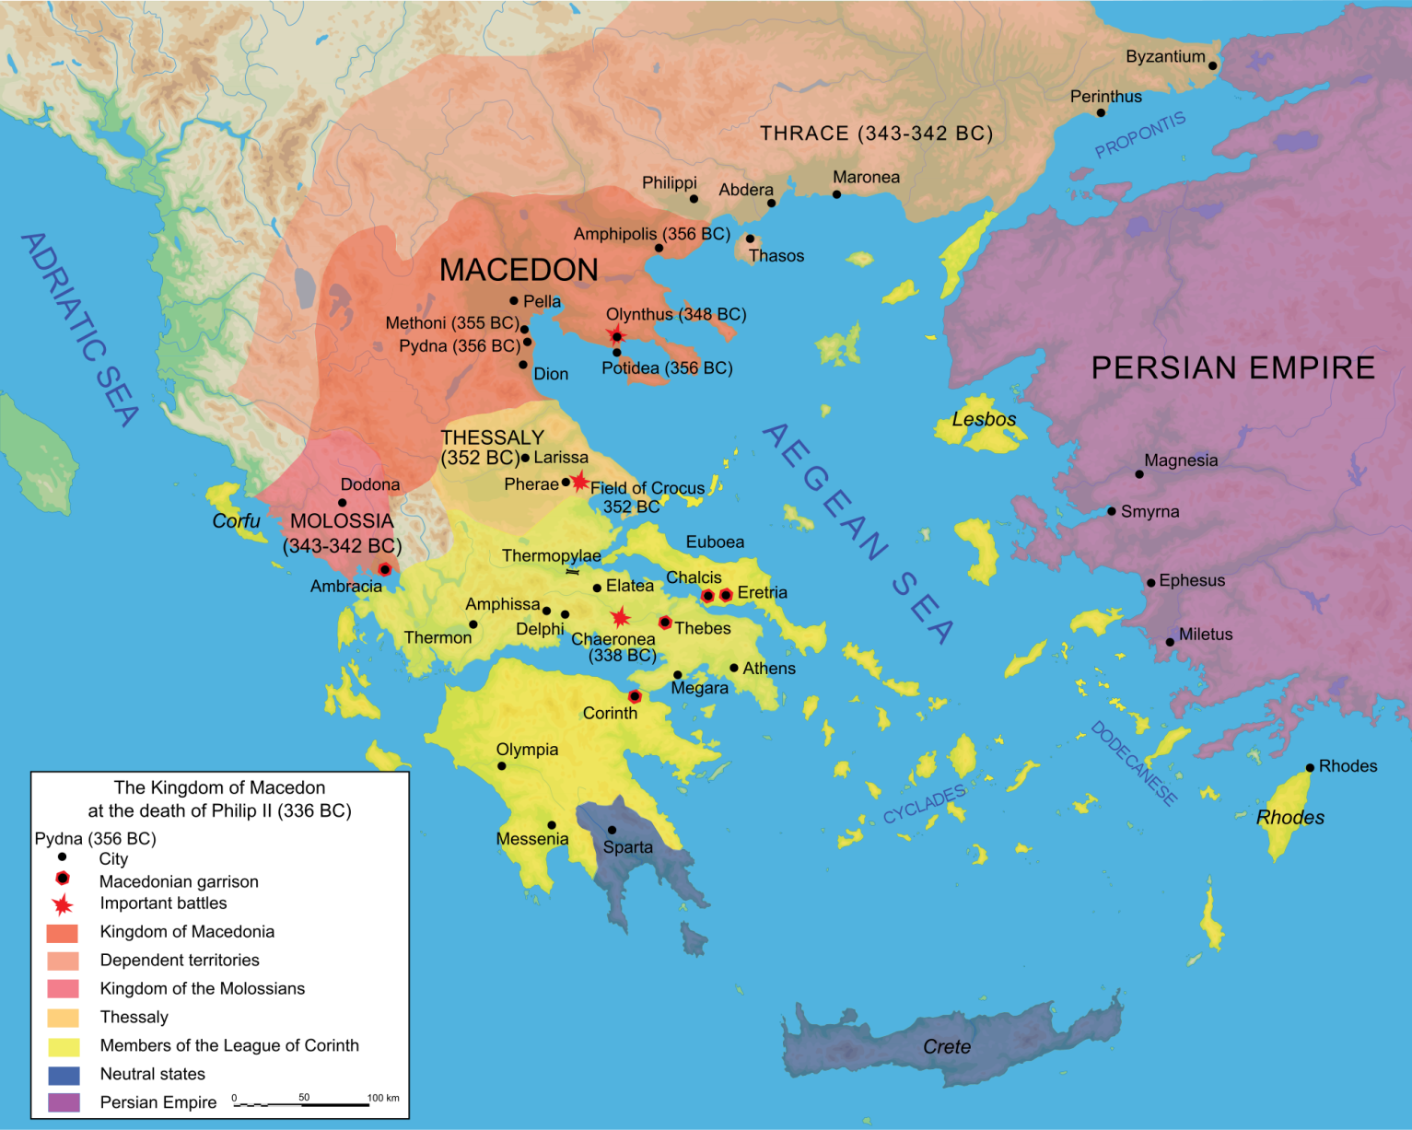
Macedon
Kingdom in the northern Greek mainland
Consisted of the plain around Pella and the mountains to the west
Beginning in the 7th cen. BCE kings in the plain began to conquer tribes to the east and west
Spoke a dialect of Greek
Considered themselves Greek, and kings claimed descent from Hercules

Slide 6
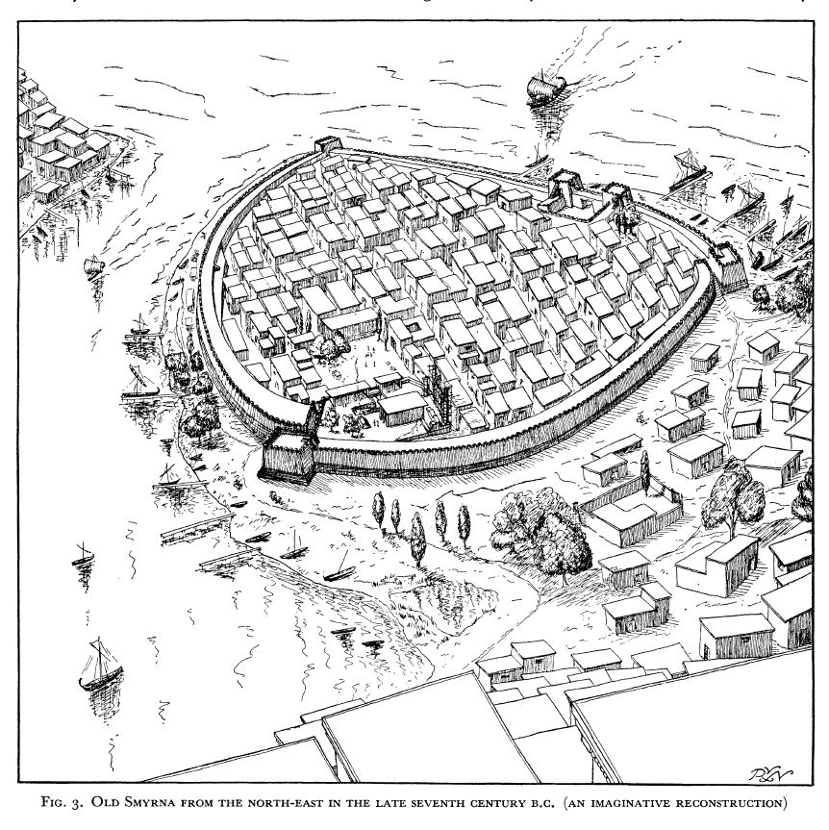
The Polis
Plural poleis (PO-lace)
City-state: a sovereign city that rules its own hinterland
Forms of government:
  Oligarchy
  Tyranny
  Democracy
Defended by citizen militias of hoplites
Agora: centralized meeting area for trade and governance

Slide 7
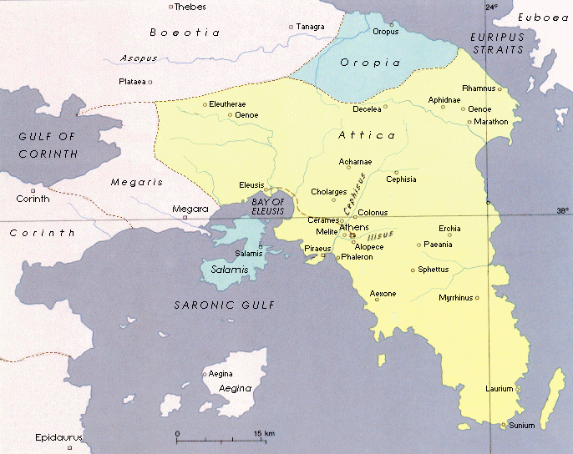
Attica: territory of Athens
Megaris: territory of Megara
Oropia: territory of Oropus
Aegina: island and city
Corinthia: territory of Corinth

Slide 8
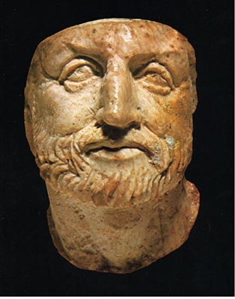
Philip II of Macedon
ca. 383-336 BCE
King of Macedon, 360-336
Expanded his kingdom to the east and west
  Wounded in the leg by a lance in 339 BCE, making him lame; lost an eye to an arrow at the siege of Methone in 355/4
Made numerous political marriages and had many children, including Alexander
Planned an invasion of the Persian Empire, but was assassinated in 336 BCE
Ivory bust that may depict Philip, from Vergina, c. 350-300 BCE

Slide 9
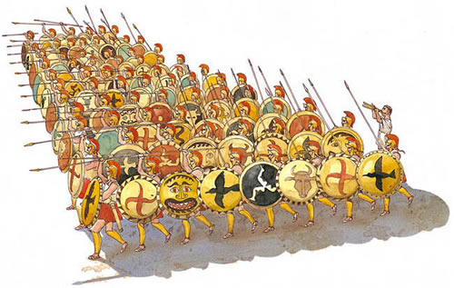
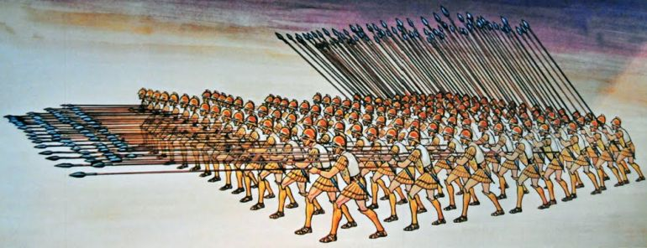
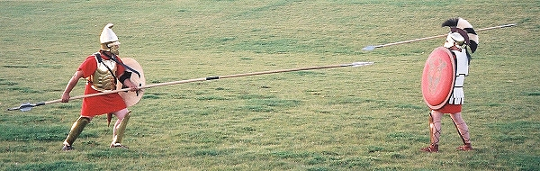
The Sarissa
Typical Greek phalanx
Macedonian phalanx armed with the ‘sarissa,’ a very long spear

Slide 10
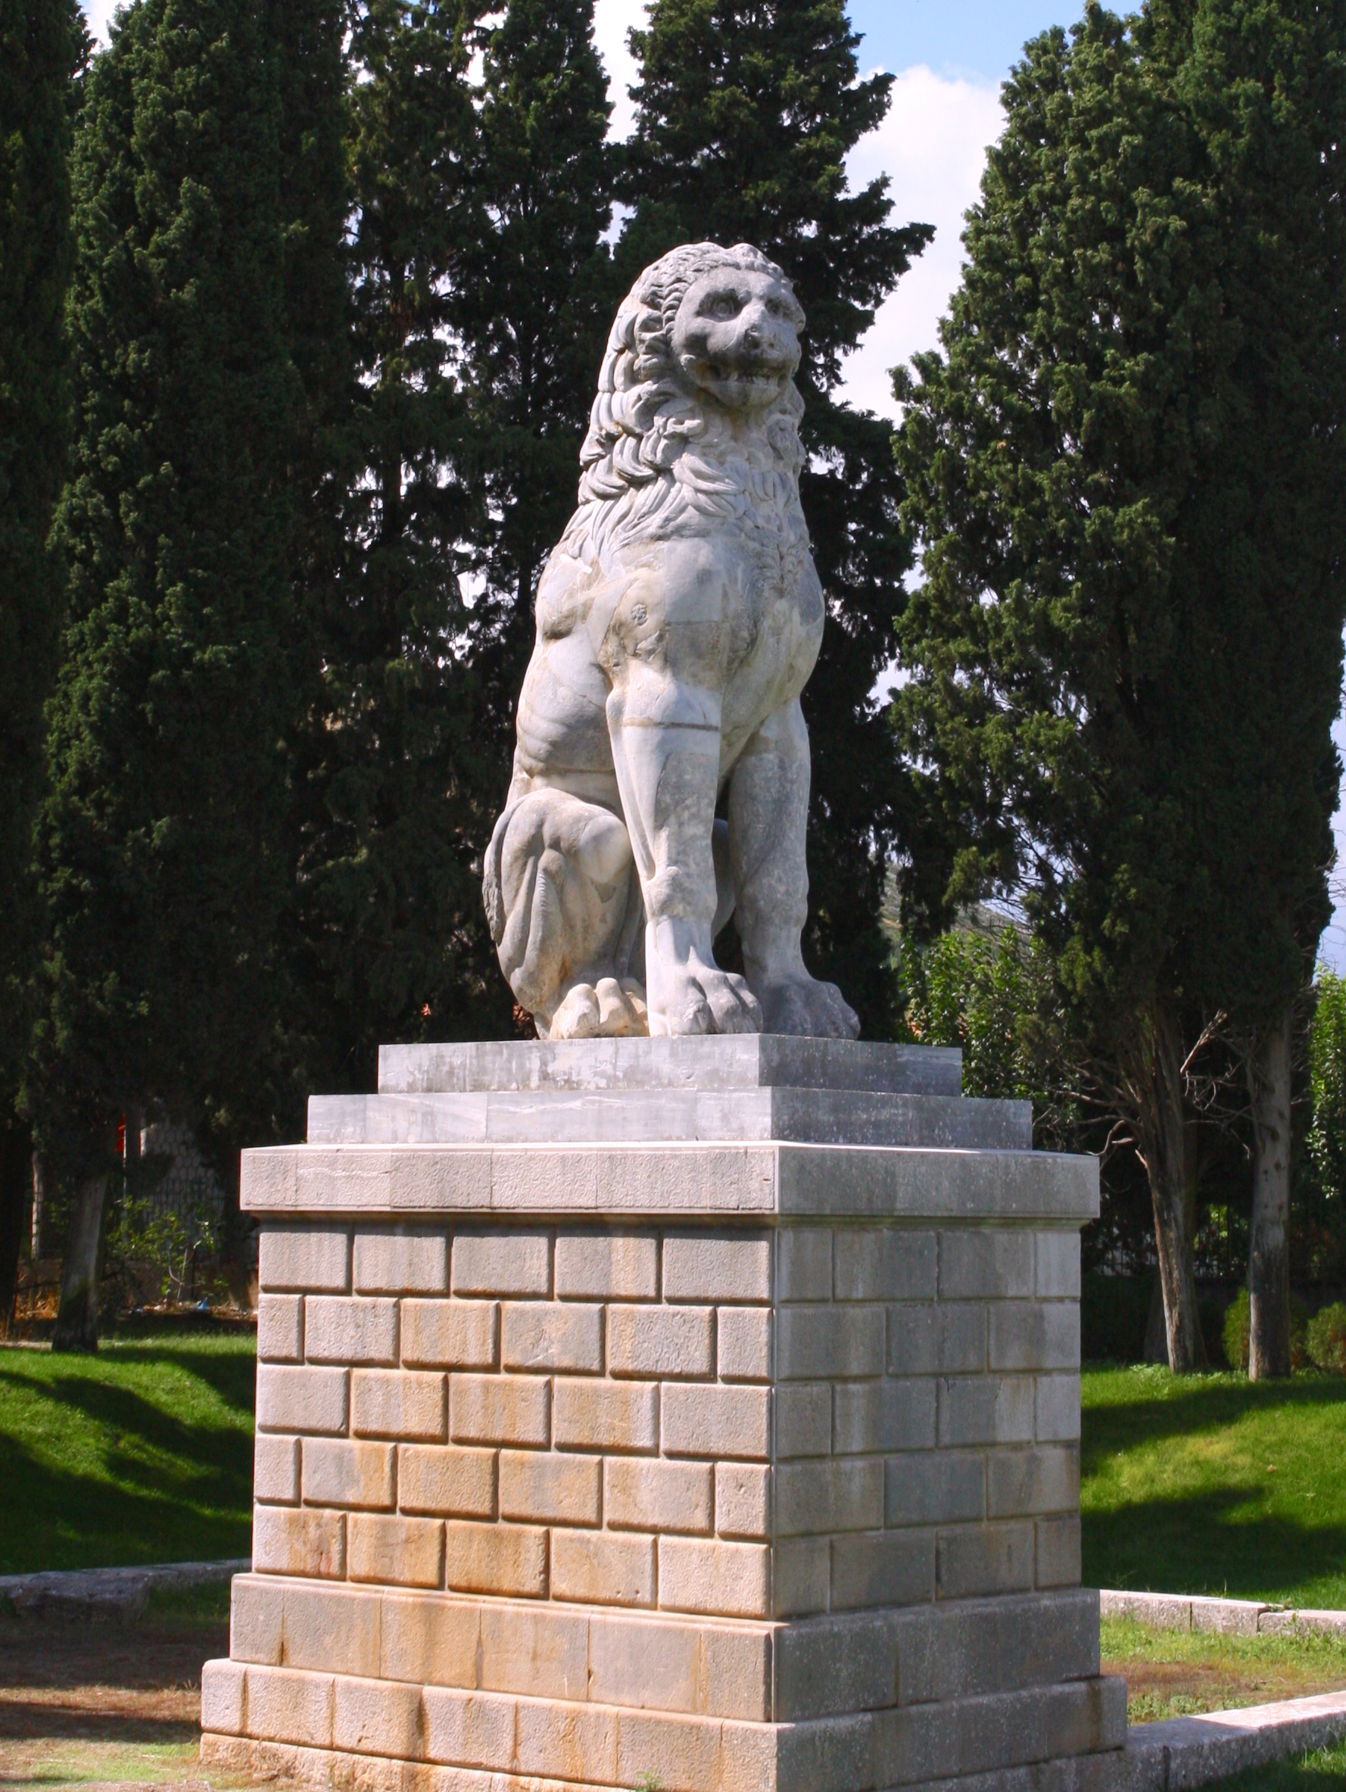
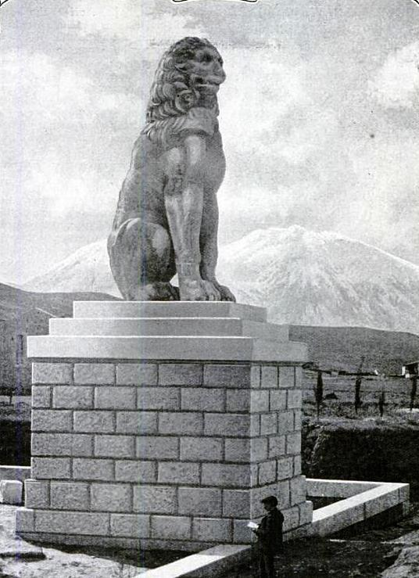
Battle of Chaeronea
338 BCE
Athenians opposed Macedonian expansion; after Philip took control of Thessaly
Demosthenes convinced them to form an alliance with the Thebans
Macedonians defeated this alliance at Chaeronea in Boeotia
Thebans later erected the Lion of Chaeronea
  Excavations discovered the skeletons of 254 men laid out in seven rows
  The casualties of the Sacred Band?
After this no one remained in Greece who could oppose Philip
League of Corinth was formed as a panhellenic alliance with Philip as its leader, with the goal of invading the Persian Empire
The Lion of Chaeronea in 1914

Slide 11
Macedon
Kingdom in the northern Greek mainland
Consisted of the plain around Pella and the mountains to the west
Beginning in the 7th cen. BCE kings in the plain began to conquer tribes to the east and west
Spoke a dialect of Greek
Considered themselves Greek, and kings claimed descent from Hercules

Slide 12
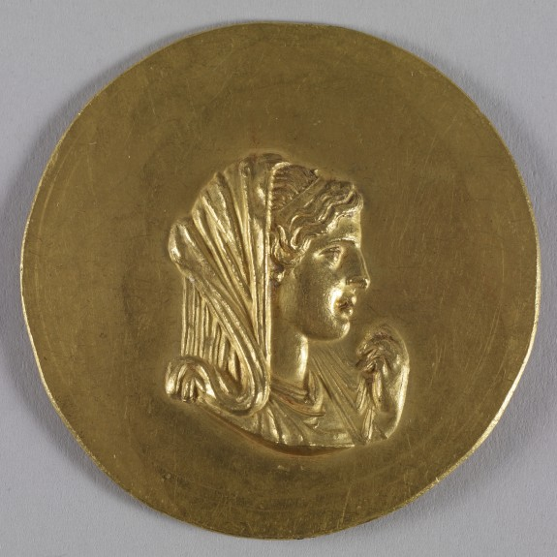
Olympias
Mother of Alexander
Daughter of the king of the Molossians
One of Philip’s seven wives
Roman medallion depicting Olympias
(Museum of Thessaloniki)

Slide 13
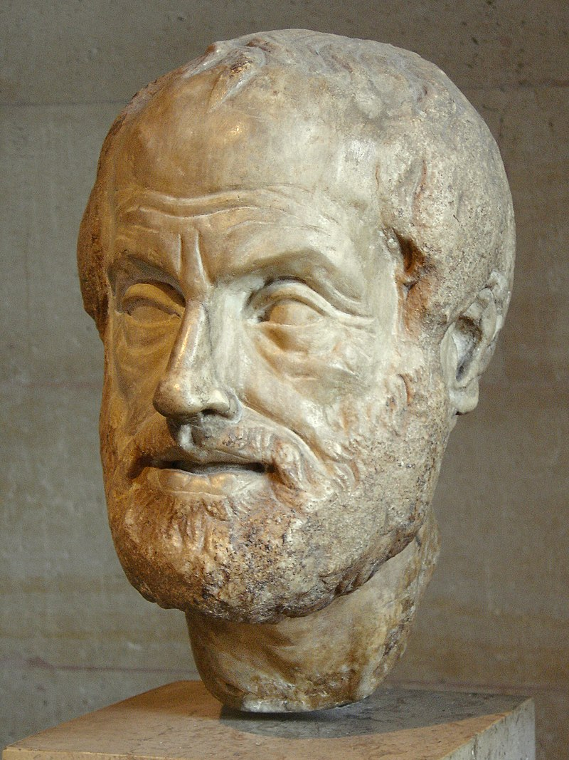
Aristotle
384-322 BCE
Born in northern Greece
Studied with Plato at the Academy
His research covered a vast range of topics, including physics, geology, meterology, biology, zoology, metaphysics, logic, ethics, aesthetics, poetry, theater, music, rhetoric, psychology, linguistics, economics, politics, government
Invited to Macedonia to teach Alexander in 343/2 BCE
Roman bust of Aristotle, 1st-2nd cen. CE
(Louvre)

Slide 14
Let’s All Go Fight the Persians
“I assert that it is incumbent upon you to work for the good of the Hellenes, to reign as king over the Macedonians, and to extend your power over the greatest possible number of the barbarians. For if you do these things, all men will be grateful to you: the Hellenes for your kindness to them; the Macedonians if you reign over them, not like a tyrant, but like a king; and the rest of the nations, if by your hands they are delivered from barbaric despotism and are brought under the protection of Hellas.”
- Isocrates, Letter to Philip 154

Slide 15
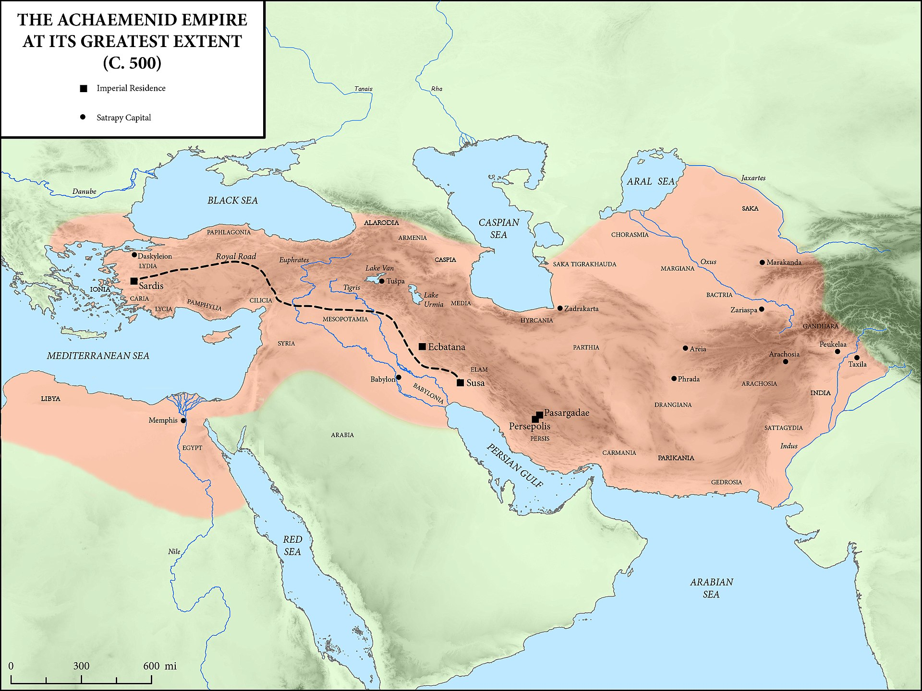
Cyrus (r. ca. 559-530 BCE)
Cambyses (r. 530-522 BCE)
Darius I (r. 522-486 BCE)
Xerxes (r. 486-465 BCE)
Artaxerxes I (r. 465-424)
Darius II (r. 423-404)
Artaxerxes II (r. 404-359)
Artaxerxes III (r. 359-338)
Artaxerxes IV (r. 338-336)
Darius III (r. 336-330)
Ecbatana
Babylon
Susa
Persepolis

Slide 16
The Burning of Thebes
Revolted against Alexander in 335 BCE
Alexander ordered the League of Corinth to condemn them for ‘joining’ the Persians in 480
The entire city was burned down

Slide 17
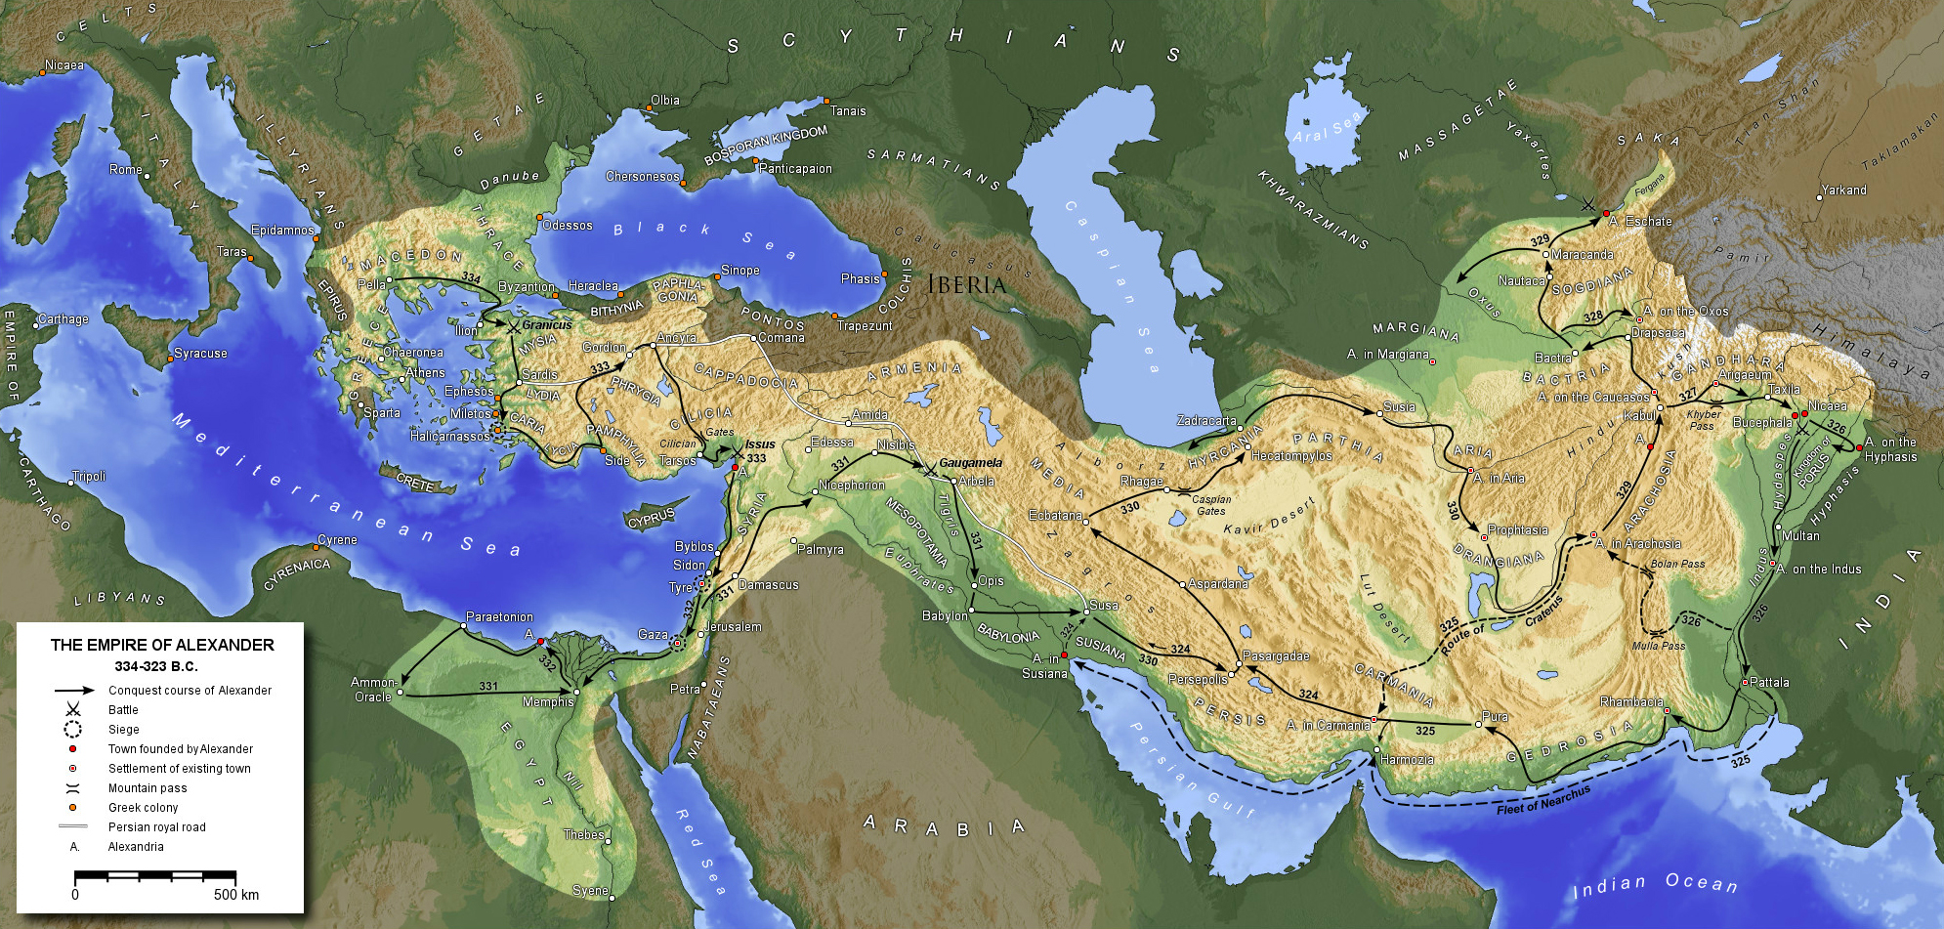

Slide 18
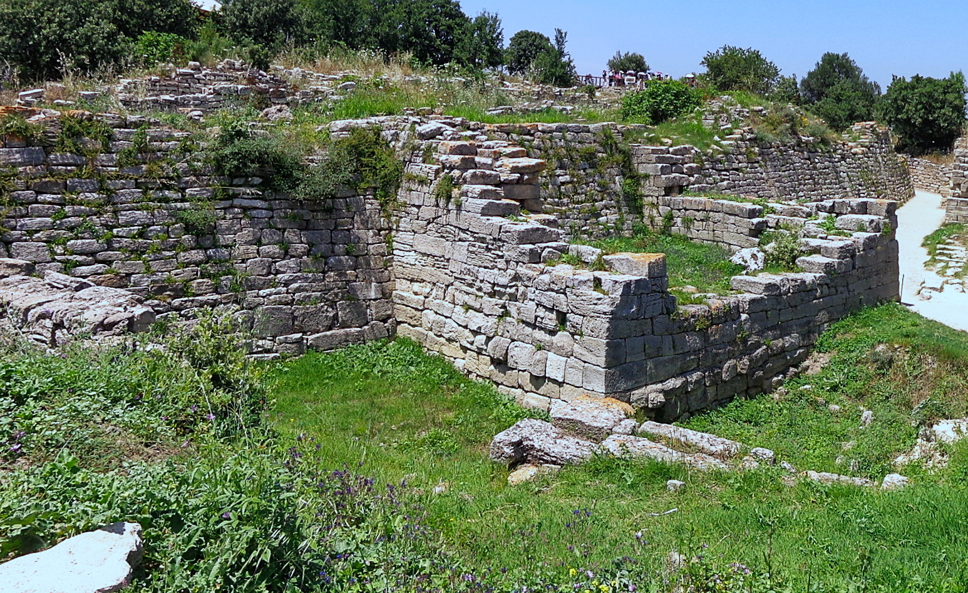
Troy
Upon crossing the Hellespont, Alexander threw a spear into Asia and declared it a gift from the gods
Stopped at Troy to make offerings to Protesilaus
  “The first man who dared to leap ashore when the Greek fleet touched the land of Troy” (Pausanias 4.2.5)
  And the first Greek to die there
  Also sacrificed to Achilles and Patroclus
The walls of Troy VI, destroyed ca. 1280 BCE?

Slide 20
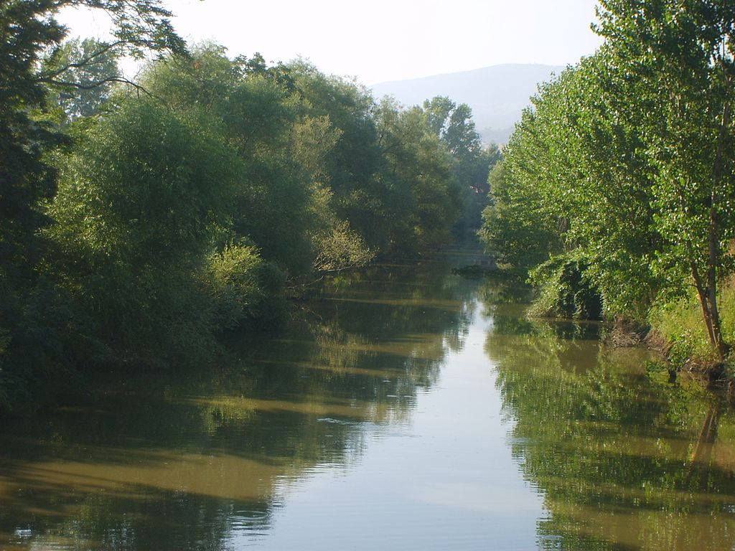
The Battle of the Granicus
334 BCE
First major battle of Alexander’s invasion
Competing accounts of the battle
Persians held the high ground on the east bank of the Granicus River
Greeks used a feint to divert Persian attention while crossing
Alexander nearly killed in battle
The Biga Çayı in Turkey

Slide 21
The Sarissa
Typical Greek phalanx
Macedonian phalanx armed with the ‘sarissa,’ a very long spear

Slide 22
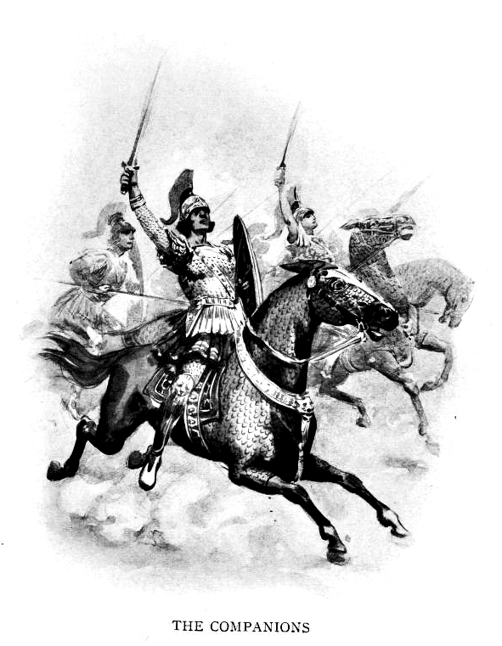
The Companion Cavalry
‘Companions’ = Macedonian nobleman
Cavalry unit commanded by Alexander
Forces also included Thessalian cavalry
  Unlike the rest of Greece, Macedonia and Thessaly had large tracts of grazing land for horses

Slide 23
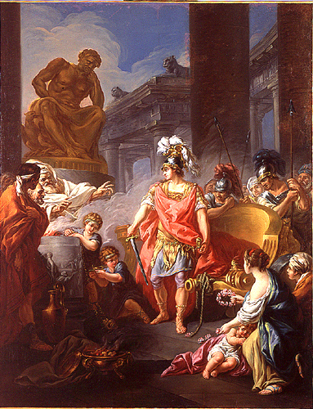
The Gordian Knot
Phrygian myth
Intricate knot at Gordion
Oracle had declared that whoever untied it would rule all Asia
So Alexander cut it in half with his sword
Jean-François Godefroy, Alexander Cutting the Gordian Knot (1767)

Slide 25
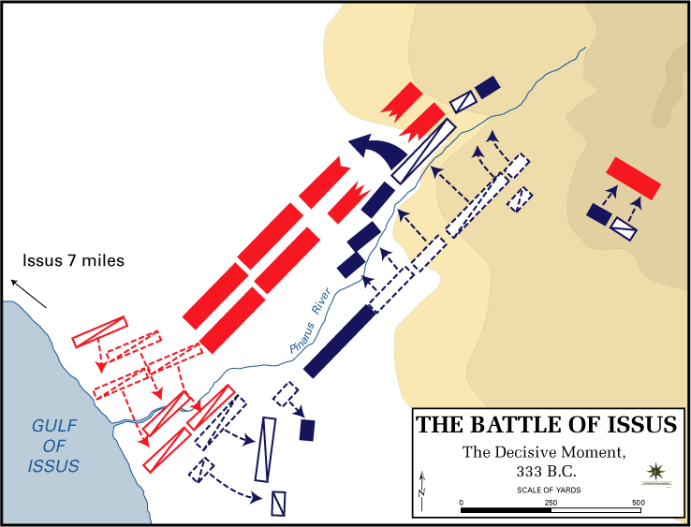
The Battle of Issus
333 BCE
Near modern Iskenderun, Turkey
Persian army was commanded by Darius III
Darius outflanked Alexander and cut off his supply lines
Alexander moved north to meet Darius
Parmenion held the Greek left flank while Alexander charged with the right

Slide 26
*
Roman mosaic from Pompeii, ca. 100 BCE, depicting the Battle of Issus

Slide 28
Tyre and Gaza
Tyre
Gaza
City in Phoenicia (modern Lebanon)
Originally an island off the coast; Alexander built a causeway to it
Besieged the city for seven months before capturing it
Crucified two thousand of its inhabitants
Coastal city in the Gaza Strip
Besieged by Alexander for two months
Dragged the commander of the Persian garrison to his death behind a chariot

Slide 30
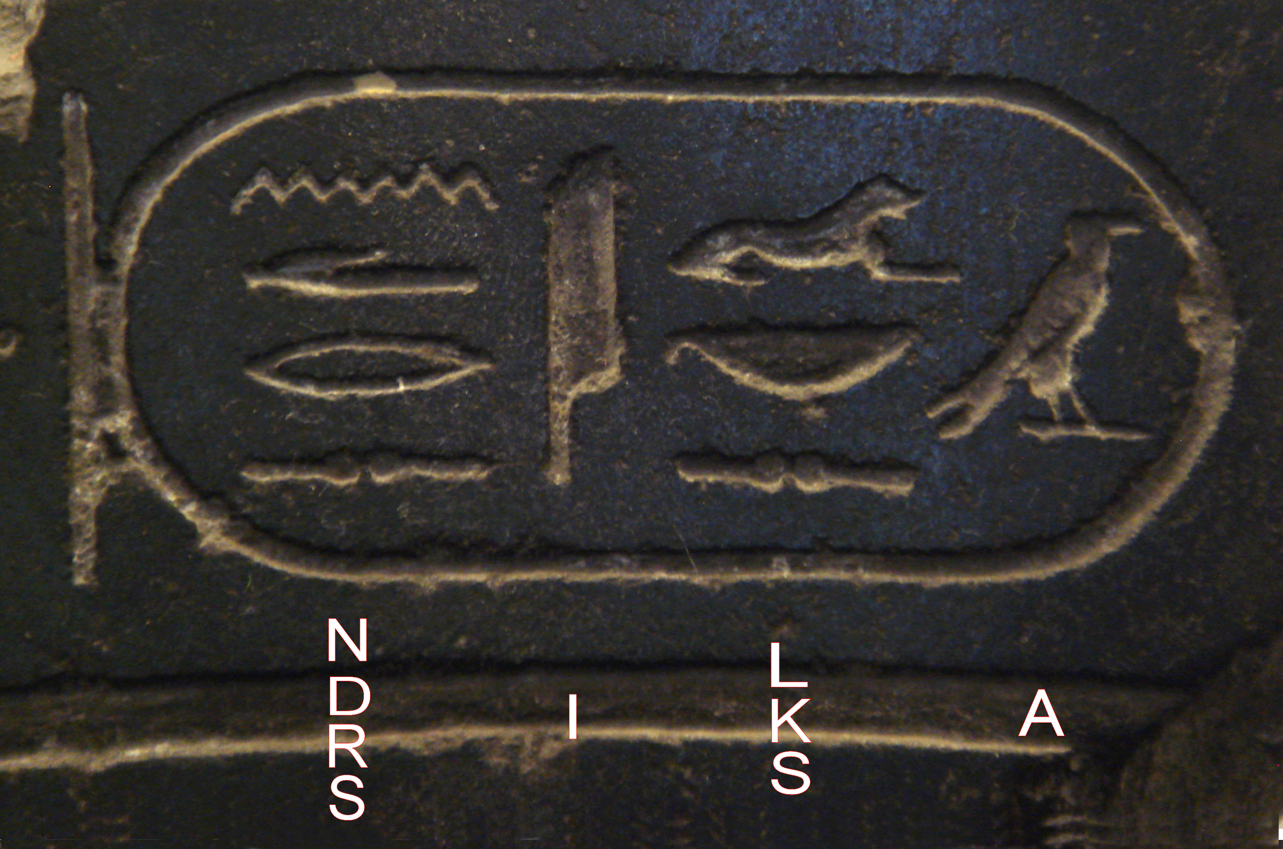
Alexander in Egypt
Entered Egypt in 332 BCE
Persians surrendered without a fight because the garrison had been defeated at Issus
Alexander went to the Temple of Amun in the Siwa Oasis
  Greeted as ‘son of Amun’ by the priests
  This is how all pharaohs were addressed
  But the Macedonians didn’t care for it

Slide 31
Amun
“At this point Alexander was seized with a longing to visit Ammon in Libya; his intention was to consult with the god, as the oracle of Ammon was reputed to be truthful and it was said that Perseus and Heracles had consulted it…Alexander wanted to rival Perseus and Heracles, since he was descended from them both, and was also seeking to trace his birth back to Ammon, just as mythology traces that of Heracles and Perseus back to Zeus. He therefore set out for Ammon in this frame of mind, with the intention of finding out more exactly about his origins, or of claiming he had found out.”
- Arrian, Anabasis 3.3

Slide 33
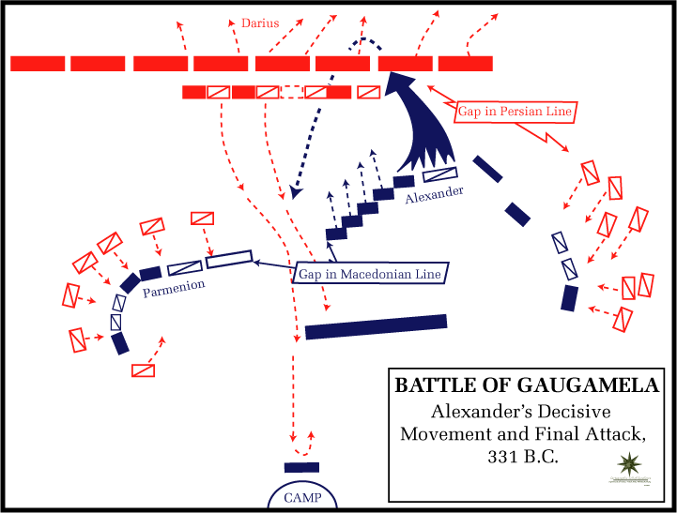
Gaugamela
October 1, 331 BCE
Near modern Arbela, Iraq
Persians had numerical superiority and attempted to encircle the Greek army
Parmenion held off the Persians long enough for Alexander to penetrate their lines

Slide 35
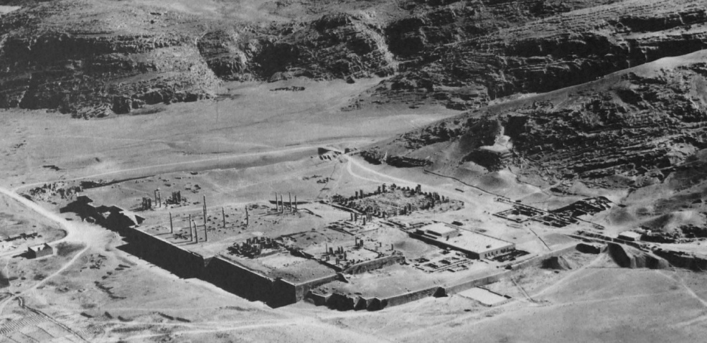
Persepolis
Aerial view of Persepolis
Notes:
-Imperial capital and administrative center
Character as a residential city remains unknown
Previous work focused exclusively on the Takht (seen here), where there are monumental buildings such as palaces and pavilions
Recent work has focused on areas off the Takht
They show much promise but are as yet inconclusive on this topic
This paper introduces PFS corpus as evidence for the residential nature of Persepolis

Slide 36
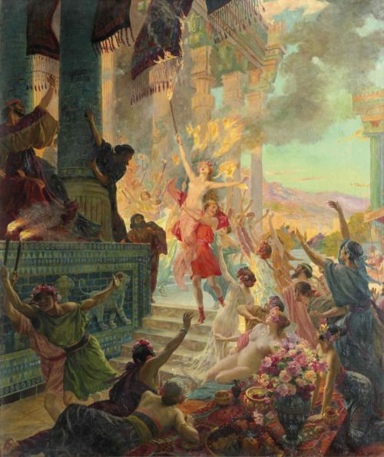
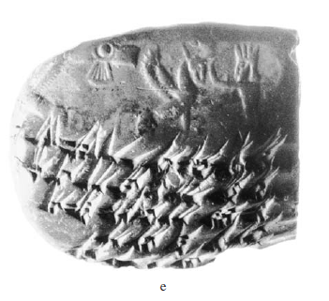
The Burning of Persepolis
Georges Rochegrosse, The Burning of Persepolis (1914)
Elamite tablet from the Persepolis Fortification Archive, bearing the impression of a cylinder seal

Slide 37
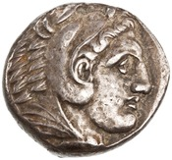
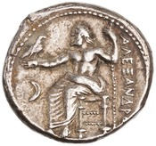
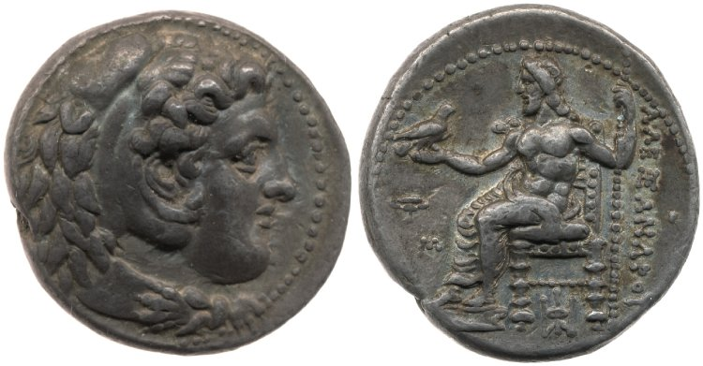
Coins of Alexander
Silver tetradrachm of Alexander, Amphipolis, Macedonia, ca. 336-323 BCE; obv.: head of Herakles r.; rev.: Zeus seated on throne l., holding eagle; legend: ‘of Alexander’
Silver tetradrachm of Alexander, Babylon, Mesopotamia, ca. 325-323 BCE; obv.: head of Herakles r.; rev.: Zeus seated on throne l., holding eagle; legend: ‘of Alexander’

Slide 38
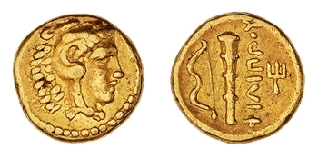
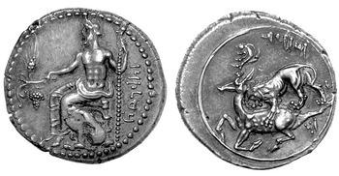
Models for Alexander’s Coins
Gold ¼ stater, Pella, Greece, ca. 359-336 BCE; head of Herakles; rev.: club and bow; legend: ‘of Philip’
Silver stater, Tarsus, Cilicia, ca. 361-333 BCE; obv.: Baal sitting l. holding grape cluster, grain ear, and scepter; legend (Aramaic): Baal of Tarsus; rev.: lion attacking stag l., within linear circle; legend (Aramaic): Mazaeus

Slide 40
(Some) Alexandrias
Alexandria in Troas (modern Dalyan, Türkiye)
Alexandria by the Latmus (near modern Karpuzlu, Türkiye)
Alexandria at Issus (modern İskenderun, Türkiye, formerly known as Alexandretta)
Alexandria in Egypt (still called Alexandria)
Alexandria Susiana (Jabal Khayabar in southern Iraq)
Alexandria Asiana and Alexandria Carmania (both in eastern Iran)
Alexandria Arachosia (modern Kandahar, Afghanistan)
Alexandria Paropamisadai (near modern Begram, Afghanistan)
Alexandria on the Indus (modern Uch, Pakistan?)
Alexandria the Furthest (near modern Khujand, Tajikistan)

Slide 41
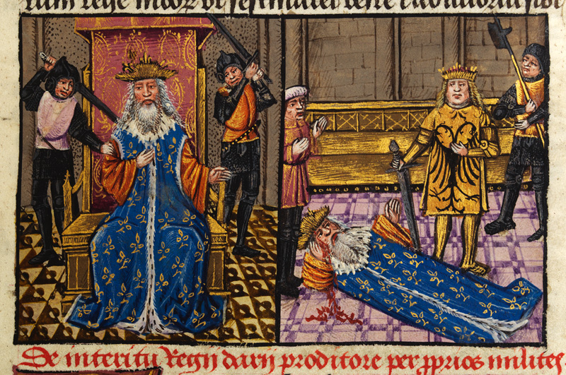
The Death of Darius III
After Gaugamela Darius retreated eastward into Iran with Bessus, satrap of Bactria (Afghanistan)
Murdered by Bessus in 330 BCE and left by the side of the road
Bessus set himself up as the legitimate successor to Darius
The death of Darius III as depicted in a 15th cen. manuscript

Slide 43
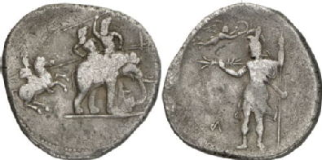
The Battle of the Hydaspes
Alexander demanded submission of all former Persian territories in the east
Defeated King Poros of the Punjab at the Hydaspes River (modern Jhelum) in 326 BCE
His army refused to go further east, so he returned to Persia
*
Silver ‘Porus Medallion’ (decadrachm) of Alexander, ca. 323 BCE; obv.: cavalryman attacking elephant with mounted warriors r.; rev.: Macedonian standing l. holding long spear and thunderbolt being crowned by Nike

Slide 44
Mutiny!
“Sir, if there is one thing above all others a successful man should know, it is when to stop. Assuredly for a commander like yourself, with an army like ours, there is nothing to fear from any enemy; but luck, remember, is an unpredictable thing, and against what it may bring no man has any defense.”
- Arrian, Anabasis 5.28

Slide 46
The Susa Weddings
“Then he also celebrated weddings at Susa, both his own and those of his companions. He himself married Barsine, the eldest of Darius’ daughters, and, according to Aristobulus, another girl as well, Parysatis, the youngest of the Daughters of Artaxerxes III. He had already married previously Roxane, the daughter of Oxyartes of Bactria.”
“Similarly he gave to the other companions the noblest daughters of the Persians and Medes, some 80 in all. The marriages were celebrated according to Persian custom.”
“And as for all the Macedonians who had already married Asian women, Alexander ordered a list of their names to be drawn up; they numbered over 10,000 and Alexander offered them all gifts for their wedding.”
- Arrian, Anabasis 7.4

Slide 47
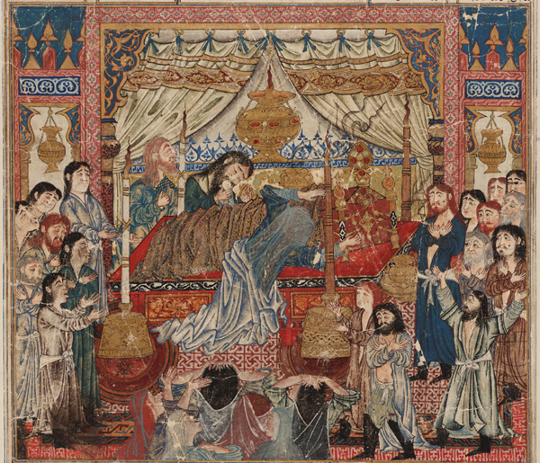
The Death of Alexander
June 10, 323 BCE in Babylon
Died of a fever
Could have been murdered, but we have no way of knowing
The death of Iskander (Alexander) as depicted in a manuscript of the Shahnameh by Firdowsi

