Slide 1
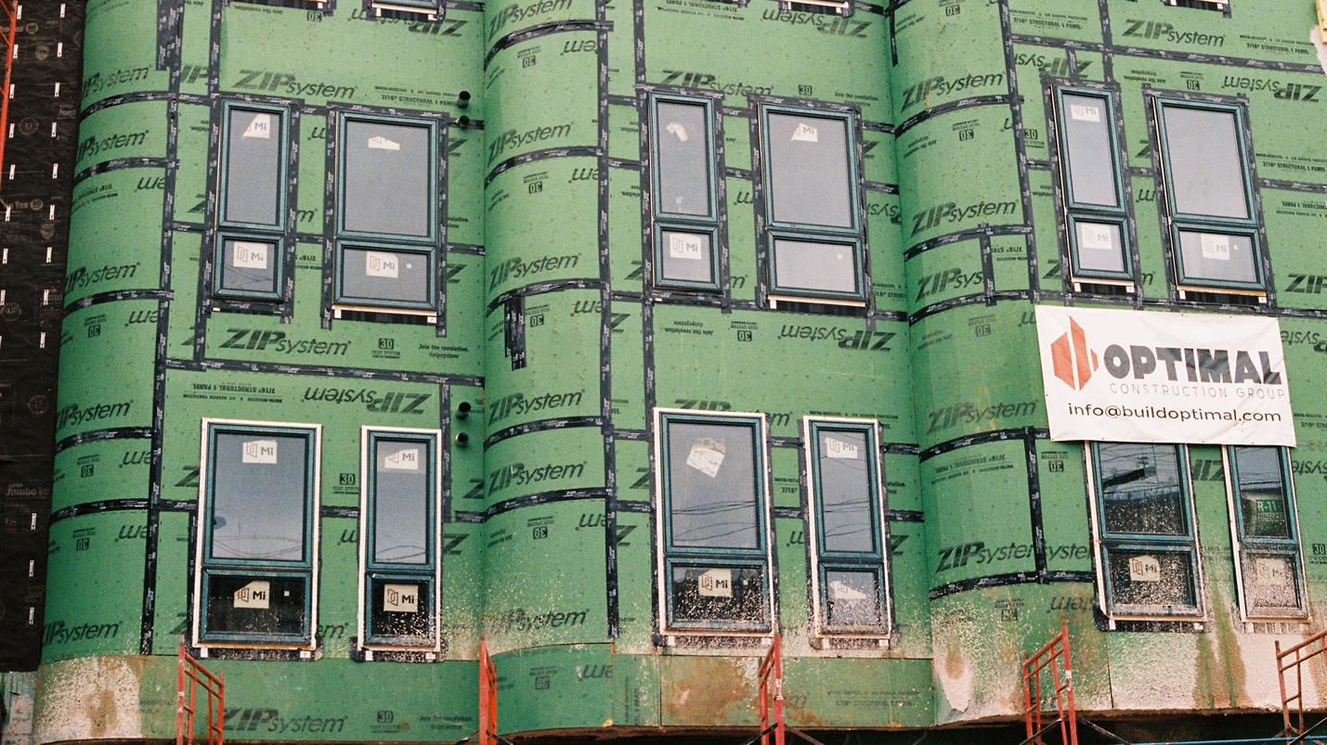
Gentrification (CITY B207)
Dr. Stanley Collins, Ph.D.

Slide 2
Agenda
Check-in/recap: Accessing Moodle; What does it mean to be a member of this community?
Warm up
Ruth Glass
London: The 1960s
Using the Note-Taking Guide
For Next Class

Slide 3
What does it mean to be a member of this community?
Listening and paying attention
Being respectful of everyone’s respective starting points
Being curious about what someone has to say
Explaining jargon
Asking questions
Taking into account what others have said, while also letting what others have said influence you/your thinking
Contributing various tasks while in small groups (e.g., writing, brainstorming)

Slide 4
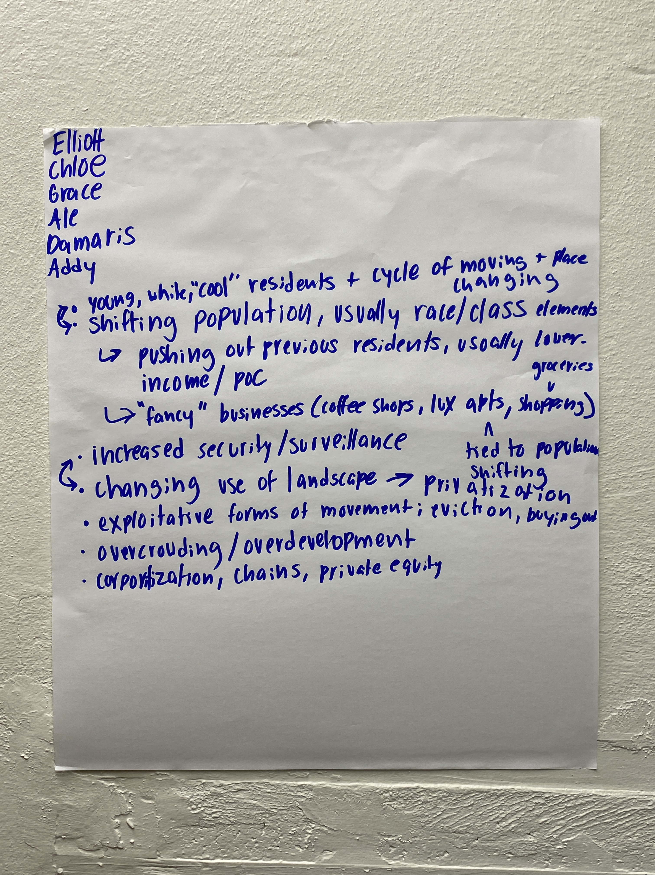
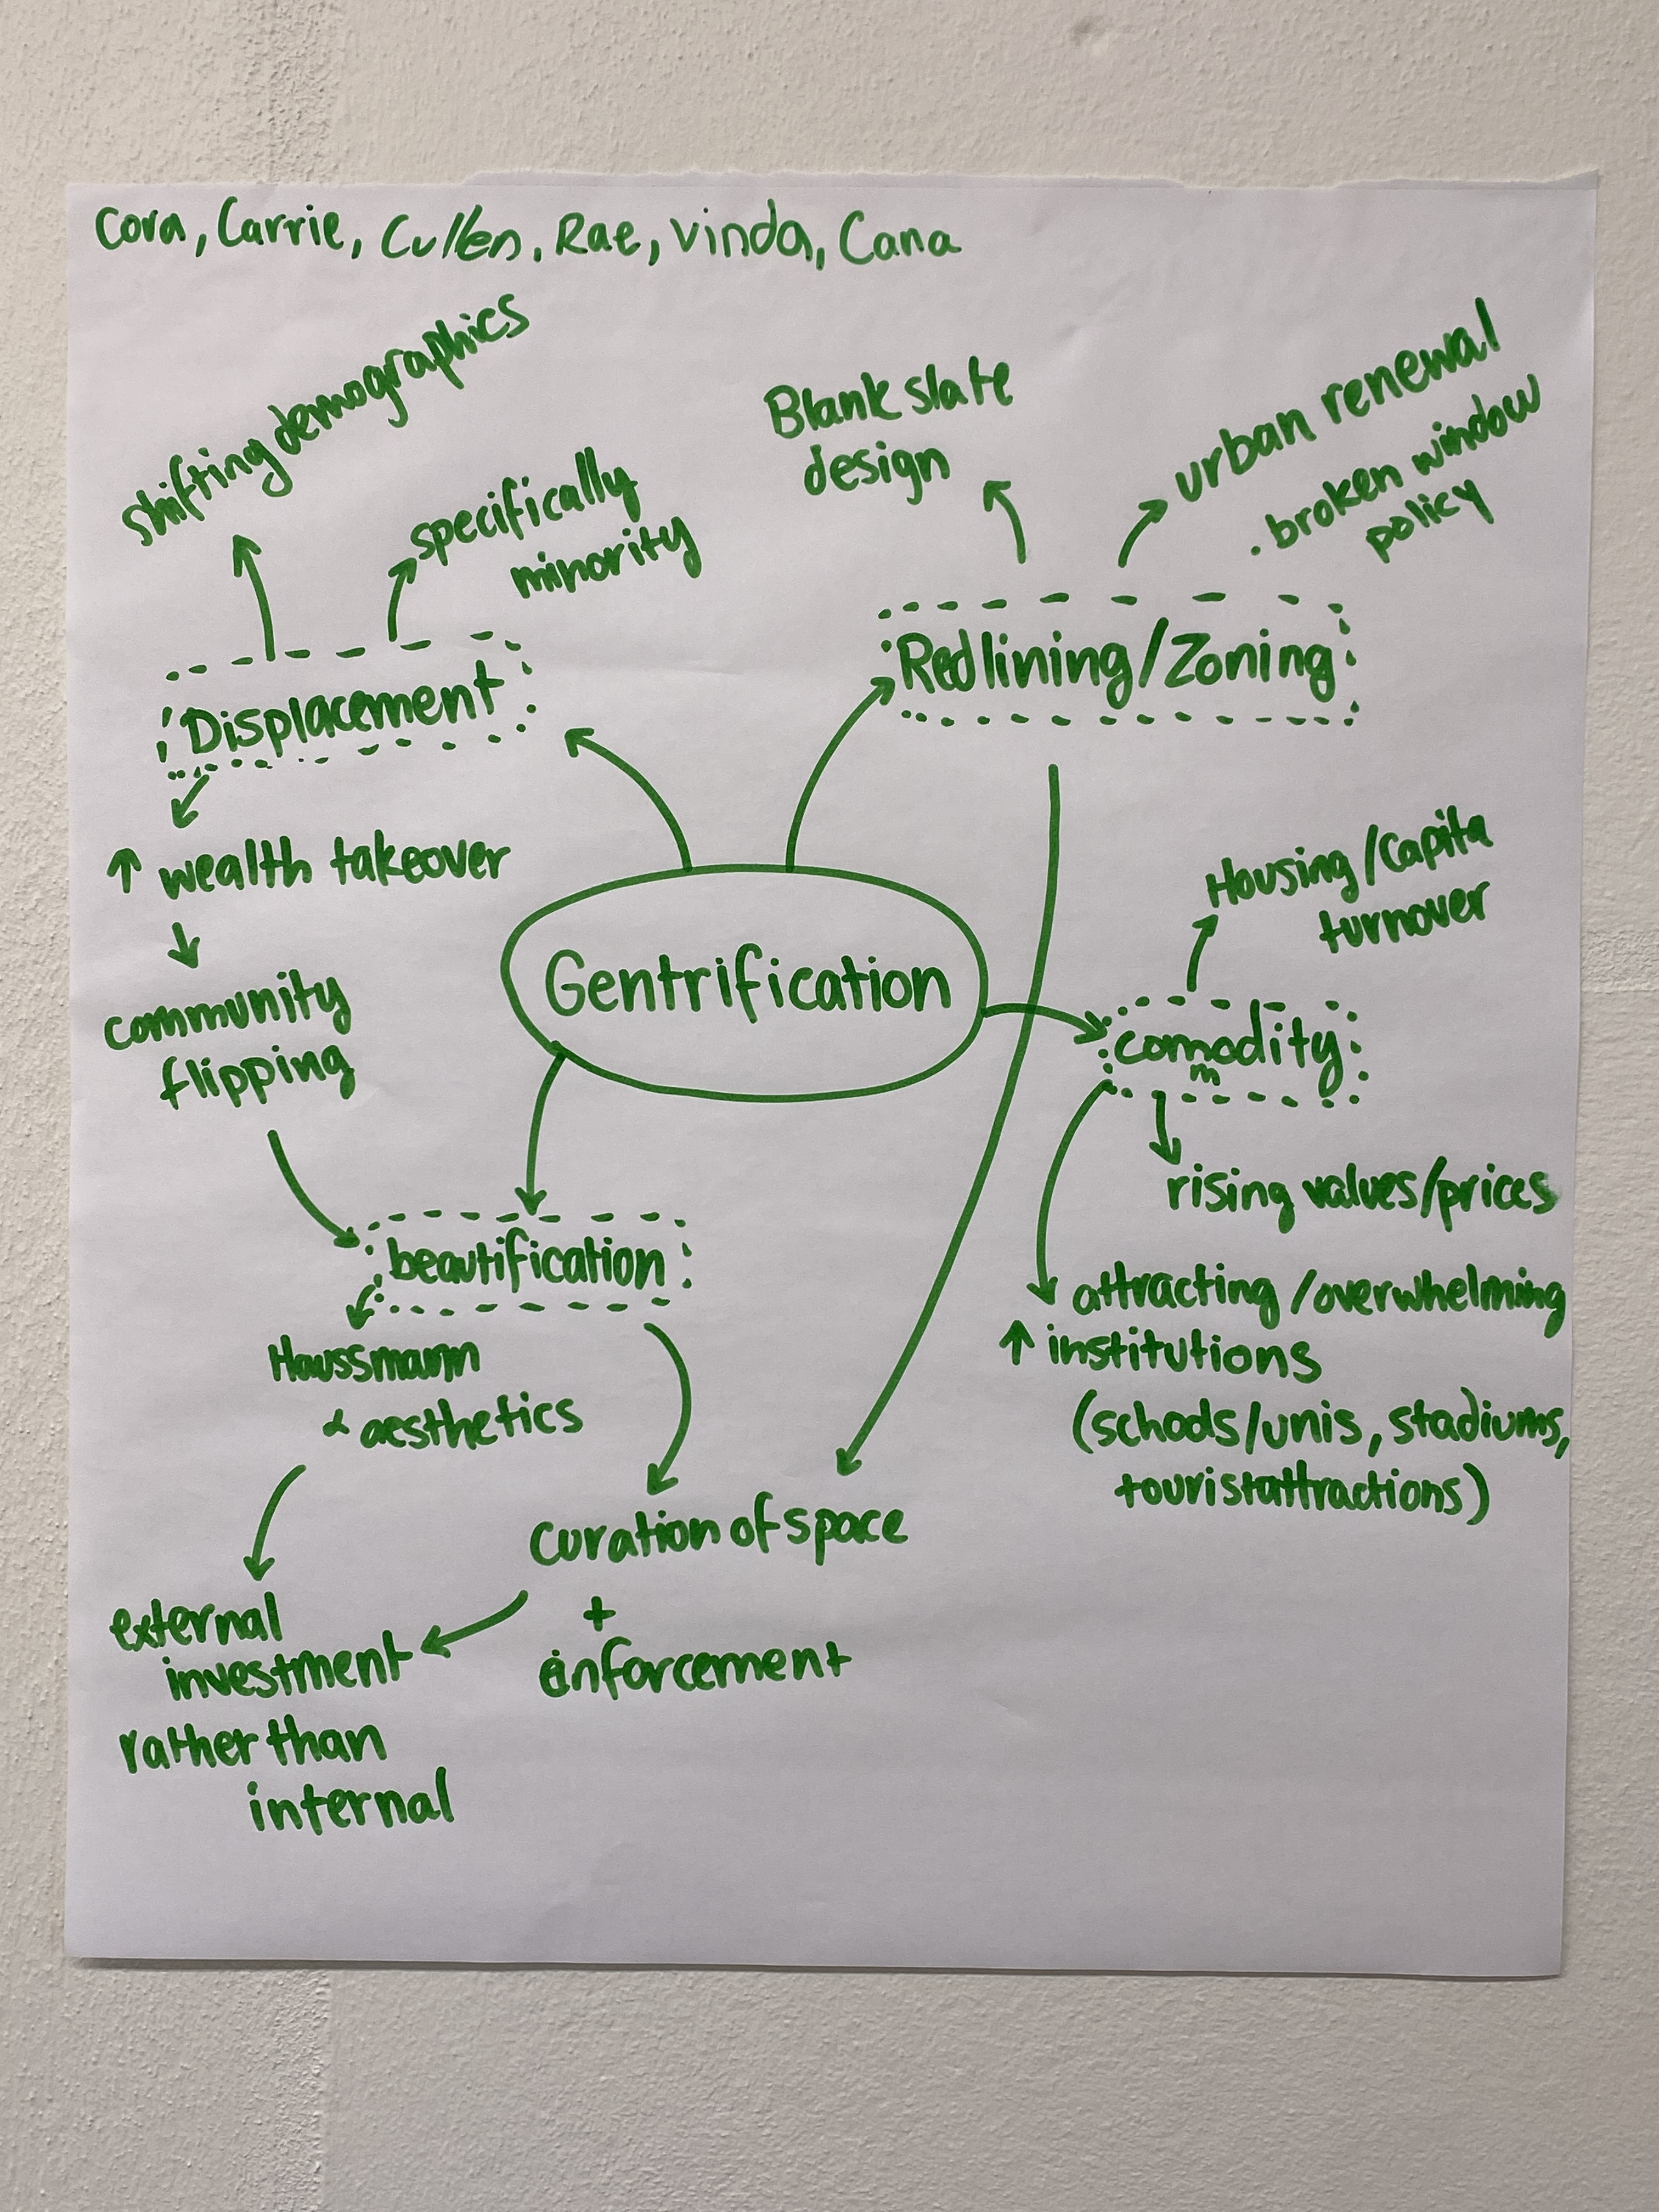
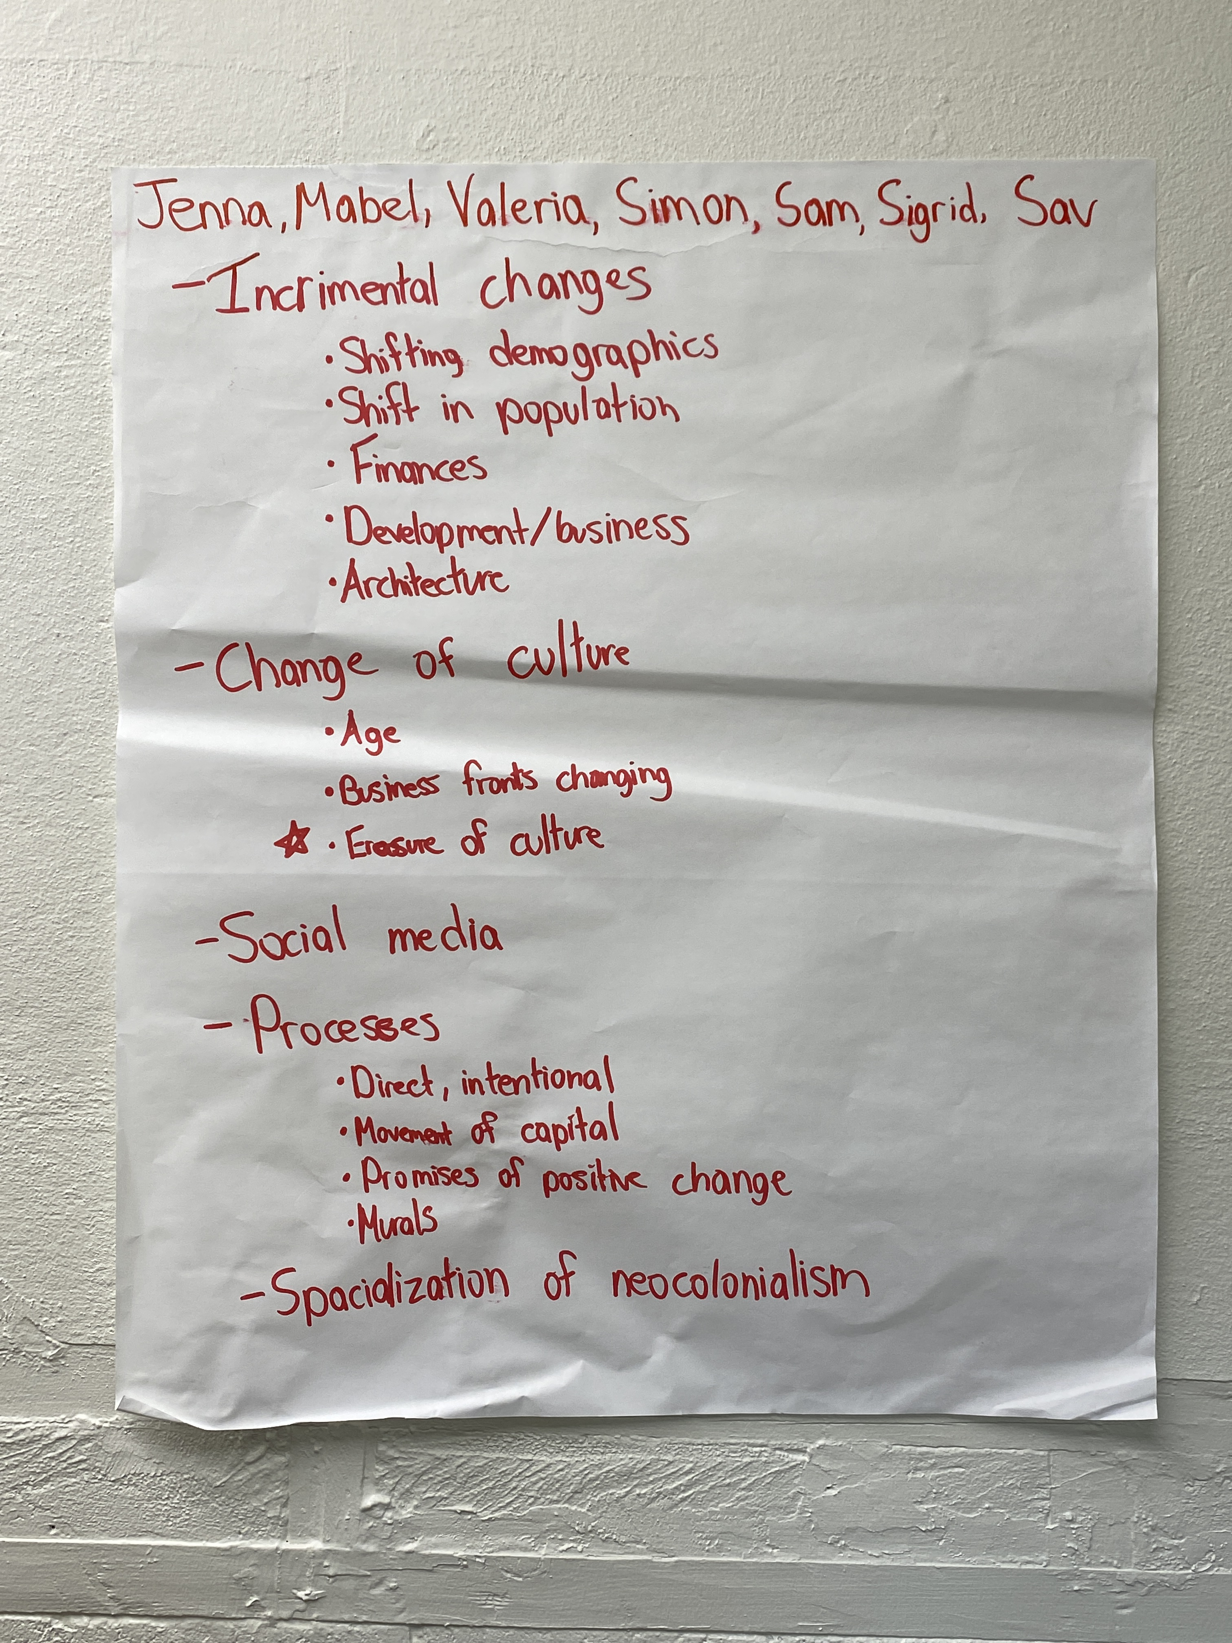
Recap
Notes:
Process, displacement, race (depends on how you look at it), class, age (not necessarily), external investment (sometimes its the government), how a neighborhood is framed

Slide 5
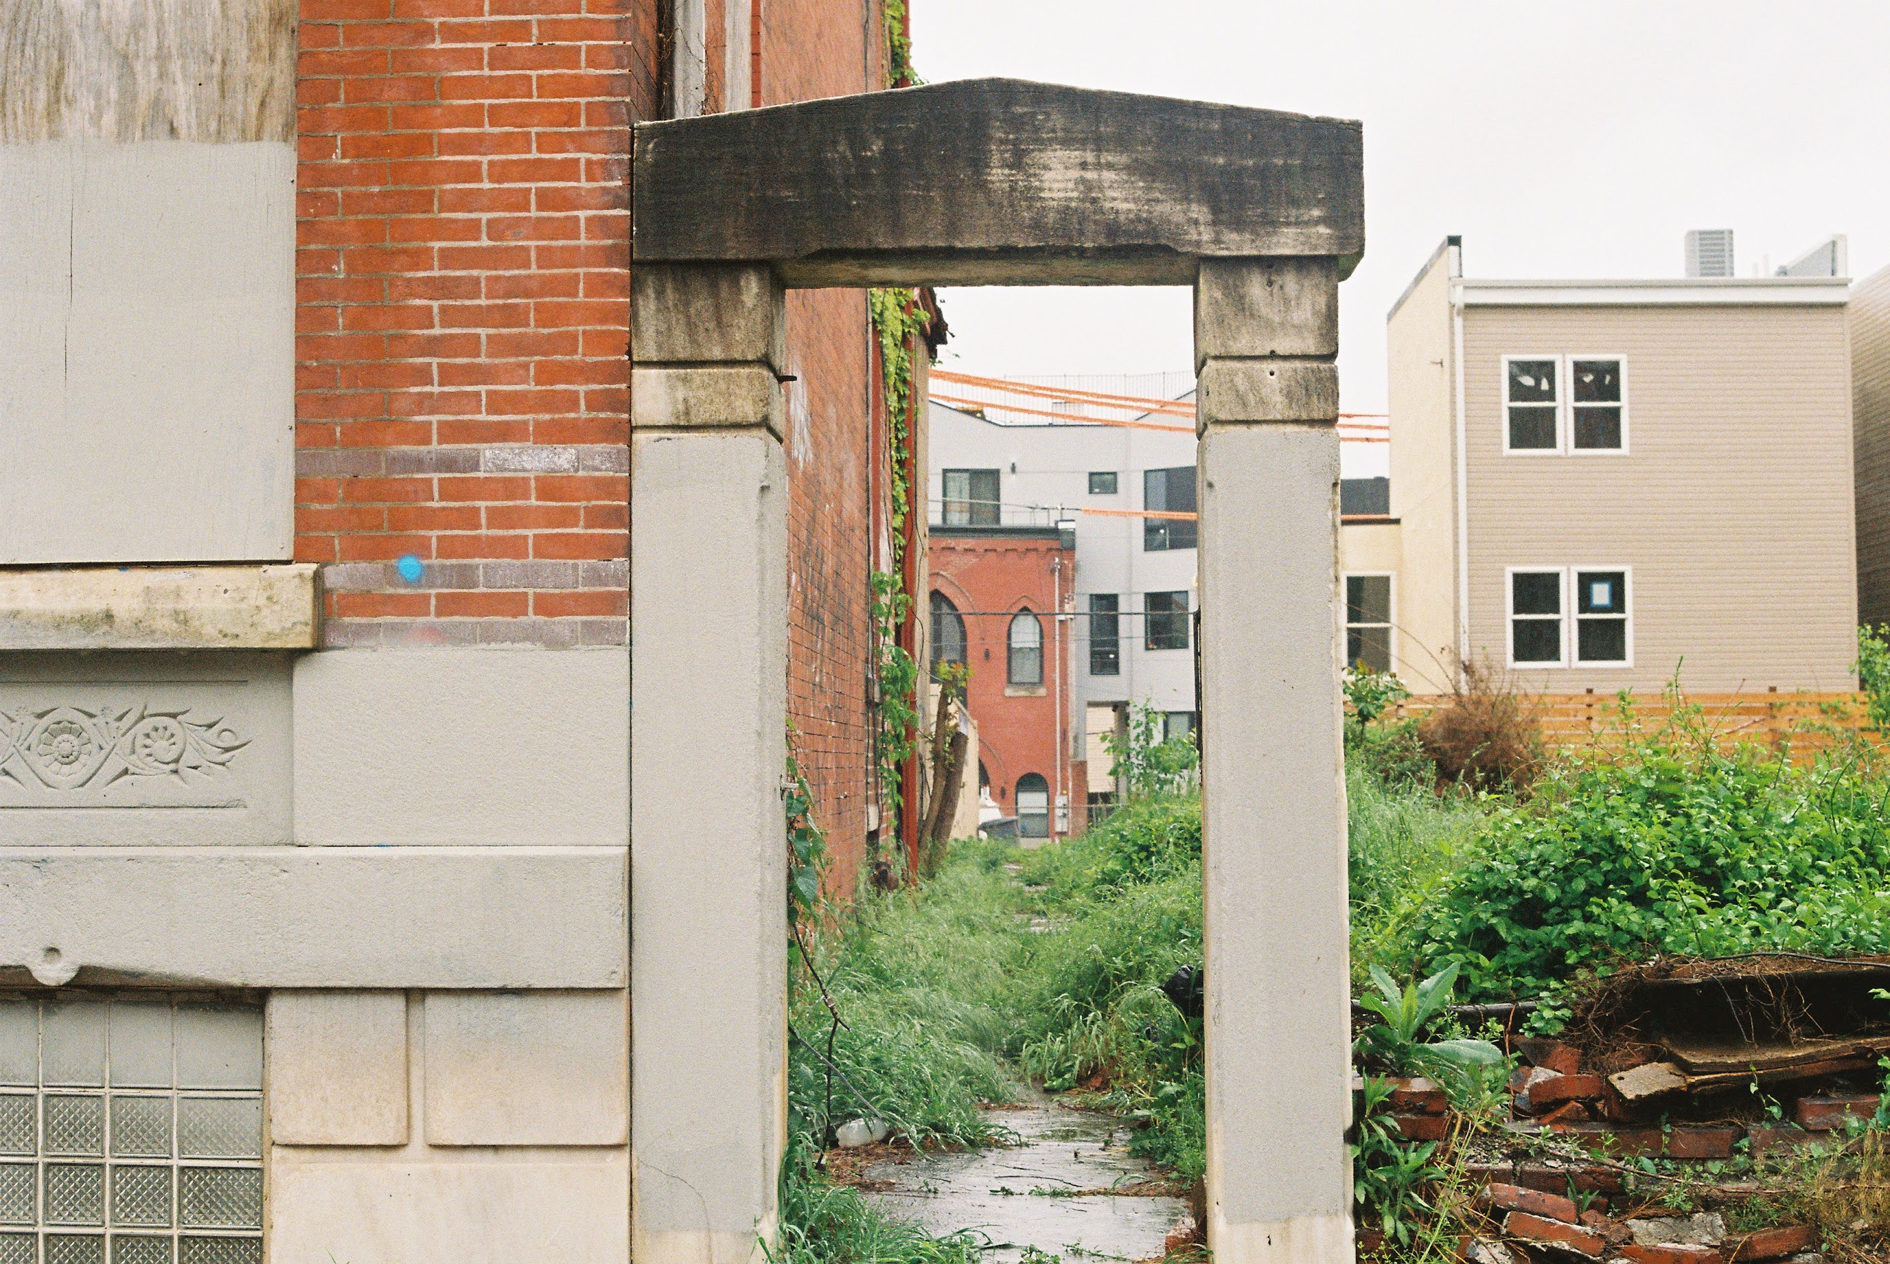
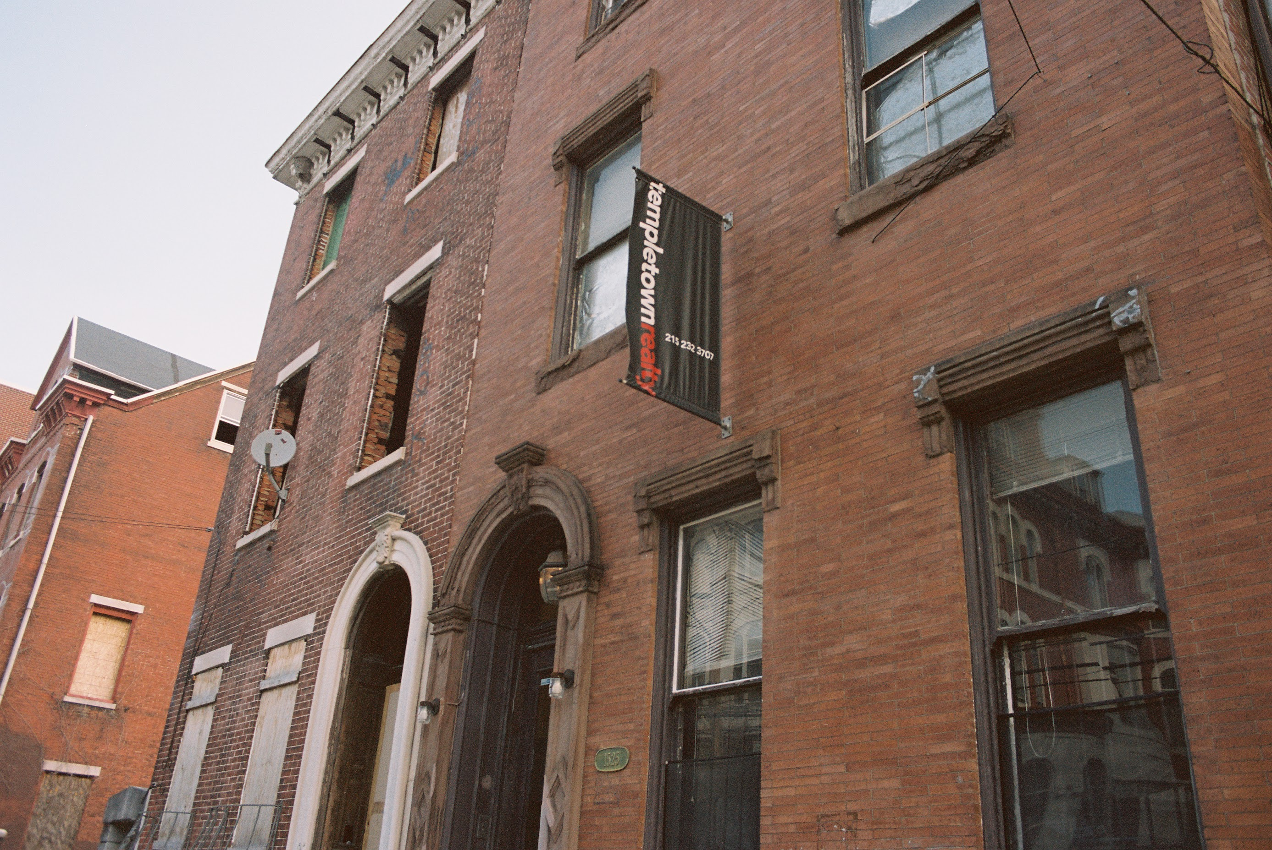
Warm up:
What is my relationship to gentrification?

Slide 6
Warm up
What is your relationship to gentrification?

Slide 7

Ruth glass
German-born British Sociologist and Planner (1912 – 1990)
Founder, Centre for Urban Studies, University College of London
London: Aspects of Change (1964)
Portmanteau: a word or part of a word made by combining the spellings and meanings of two or more other words or word parts
“gentry”: people of high social standing “fication”: process of making or becoming

Slide 8
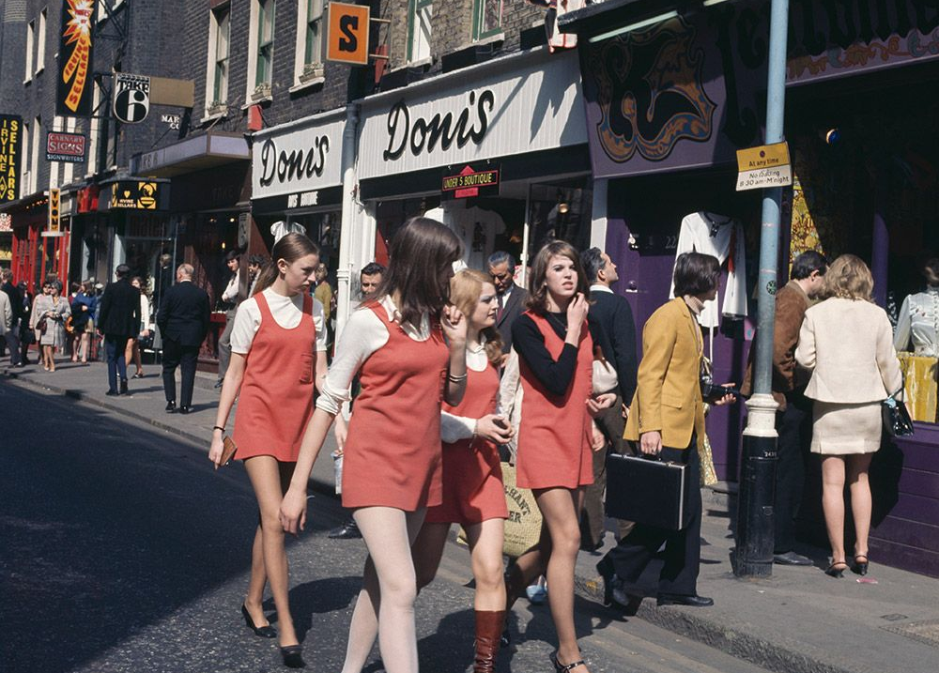
London: the 1960s
Postwar Period: the era following World War II
What sets the stage for gentrification?
Laissez-faire: policy of minimum governmental interference in the economic affairs of individuals and society
  Individualism, freedom, and liberty were depicted as opposed to the stifling bureaucratic ineptitude of the state apparatus and oppressive trade union power (Harvey 2005)
  “Development rights have been de-nationalized, development values have been unfrozen; real estate speculation has thus been ‘liberated.’ In conjunction with the relaxation of rent control have given the green light to the continuing inflation of property prices” (Glass 1964)
“Gleam of affluence in Central London and many of its suburbs: abundance of goods, gadgets, cars, and new buildings; glossiness”
The Swinging Sixties

Slide 9
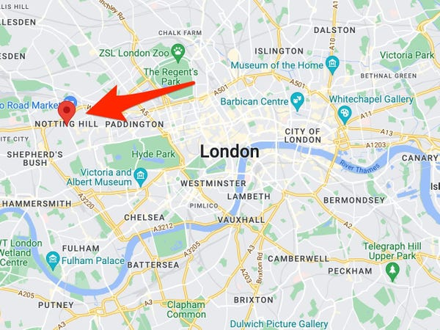
London: The 1960s
As wealth is increasingly limited in its social geography, so, too, does the density of poverty and blight become; places that have been left for/to decay.
“Here are immigrants from other parts of Britain or overseas who nowadays can find hardly any open doors – especially if their skin is coloured – and who have to take the left-overs of accommodation, however dingy, however expensive”
The Mangrove 9

Slide 10
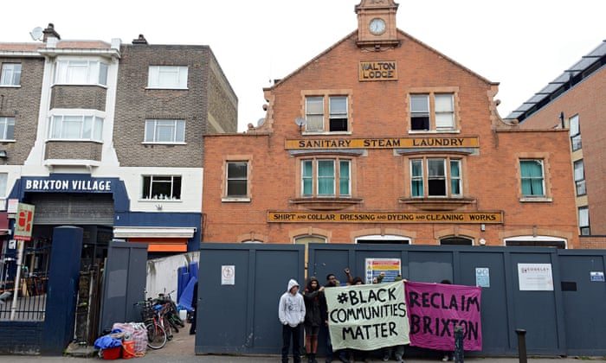
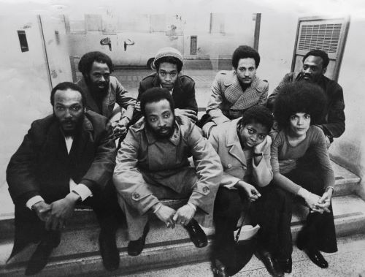
London: the 1960s
Notes:
https://www.amazon.com/gp/video/detail/B08J155YY8?qid=1788404358163&pageTypeId=B08J1FPN6C&pageTypeIdSource=ASIN&sr=1-1&ref_=atv_sr_fle_c_sra5ba81_1_1_1

Slide 11
Using the Note-taking Guide
Goal of Article/Book/Chapter:
  Glass is seeking to address the rapid changes in London, namely the displacement of the original working-class occupiers as “the whole social character of some districts” is changing, while the remaining pockets of blight are becoming denser
Question/Problem Being Addressed:
  A changing London is unfolding before Glass. A new, postwar iteration that is glossier and wealthier; more inefficient and socially isolated
Argument:
  Glass suggests that gentrification is guided by the middle-class’ shifting ideological orientations toward the city → “One by one, many of the working-class quarters of London have been invaded by the middle classes – upper and lower”

Slide 12
Using the Note-taking Guide
Conclusions:
  London has grown in a conservative fashion, by a process of aggregation…in the course of expansion, the old social boundaries have been perpetuated and extended
  There are shifts in the orientation of the upper and middle classes themselves: their anti-urban bias has been substantially modified
Key Quote:
  “Once this process of ‘gentrification’ starts in a district, it goes on rapidly until all or most of the original working-class occupiers are displaced, and the whole social character of this district is changed”

Slide 13
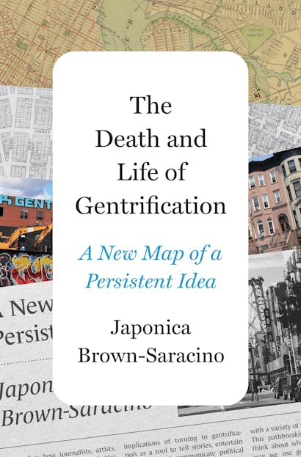
For next class
Required Reading:
The Death and Life of Gentrification: A New Map for A Persistent Idea (Introduction)

