Slide 1
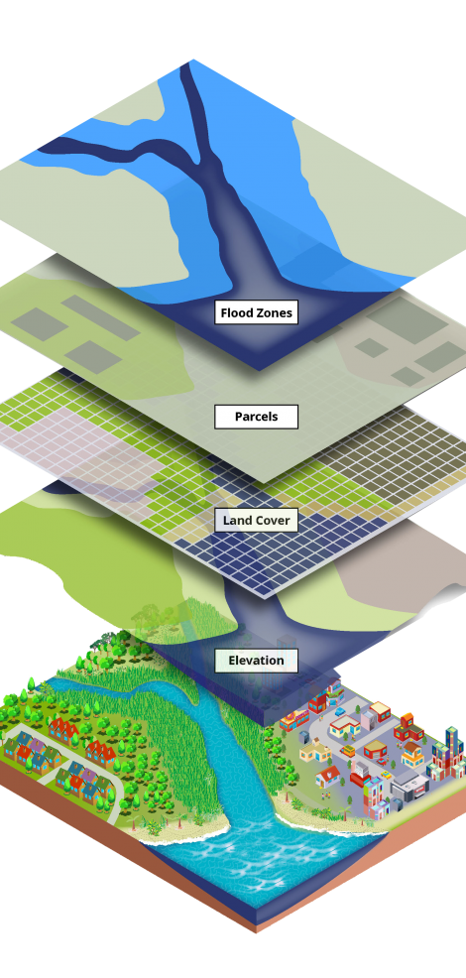
Intro to GIS for Social and Environmental Analysis
FALL 2026, WEEK 1
Dr. Dirk Kinsey
dkinsey@brynmawr.edu
Office Hours: Wed 11am-12pm/ Thurs 1-2pm

Slide 2
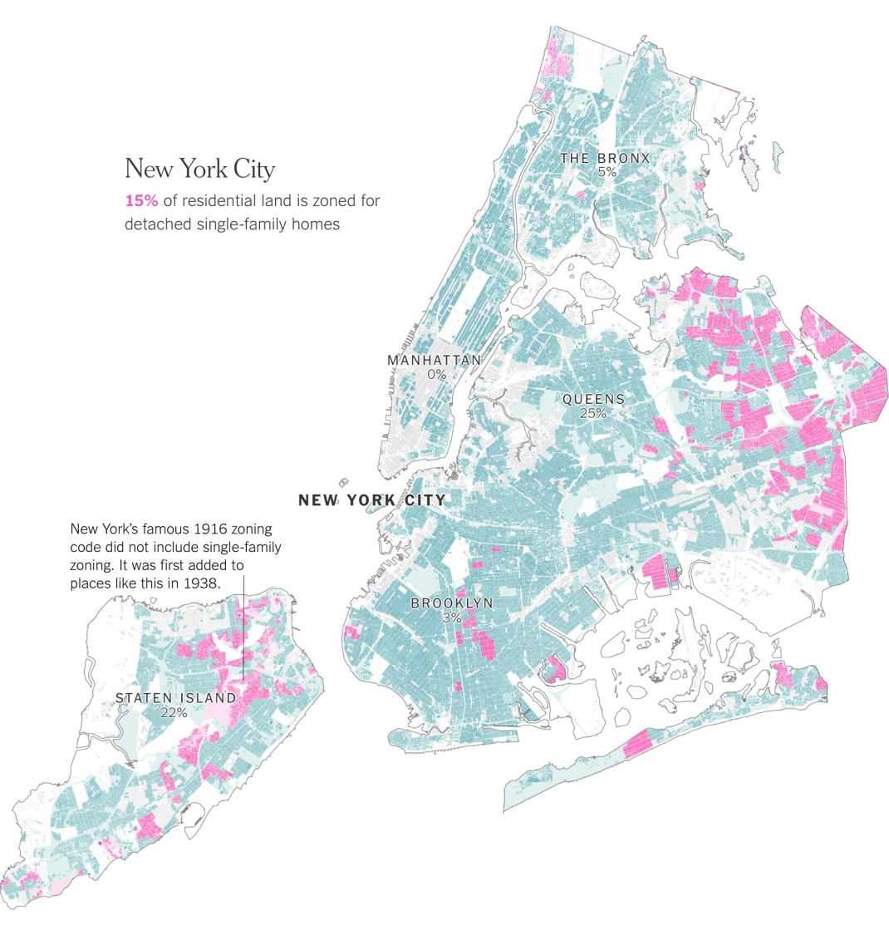

Slide 3
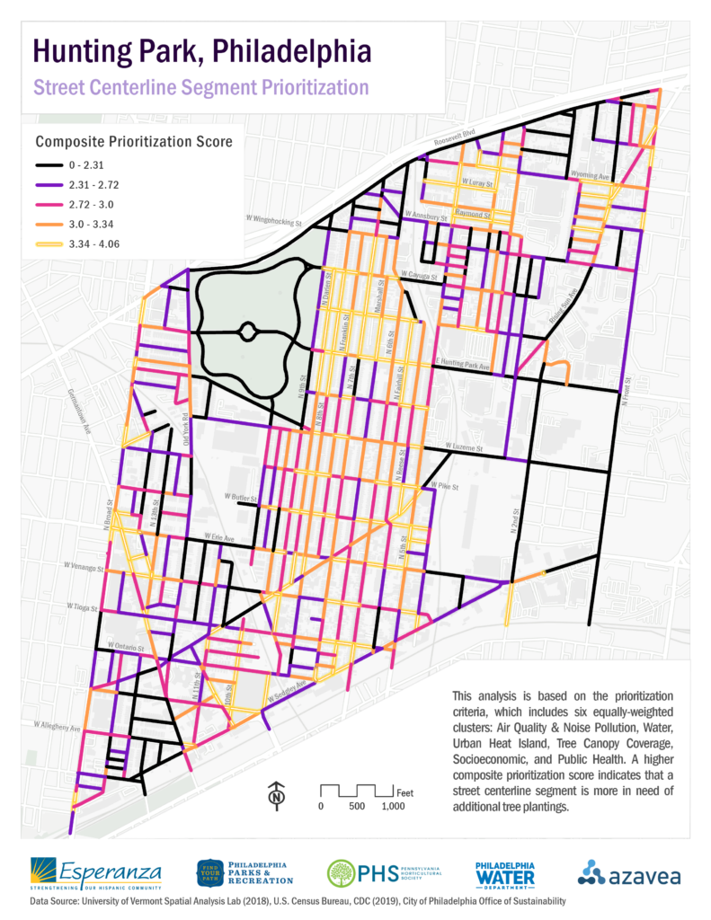

Slide 5
What is GIS?
Geographic
  pertaining to the surface of the earth
Information
  collection of data, source of knowledge
System
  model based on interrelated components
*GIS can also stand for Geographic Information Science

Slide 6
What is GIS?
Collection, organization, maintenance, analysis, and output of spatially-referenced information
“WHAT” “WHERE”

Slide 7
What is GIS?
Alternate Definitions
Component-Based Definitions:
  Hardware
  Software
  Data
  People
  Organizational/Institutional Context
Function-Based Definitions:
  Data input
  Data management (storage/retrieval)
  Data manipulation/analysis
  Data output

Slide 8
What is GIS?
Two main types of data in GIS:
  Spatial data
    Think MAPS
  Attribute data
    Think TABLES
    (and metadata too…)

Slide 9

What is GIS?
Think of sandwich. But a weird sandwich where you can ask questions about each individual ingredient and the relationships between the different ingredients.
What % of tomato overlaps cheese?
How many pieces of carrot are touching how many pieces of onion?
What’s the total area of lettuce?
How recently was each cucumber slice cut?

Slide 10
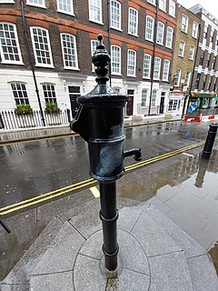
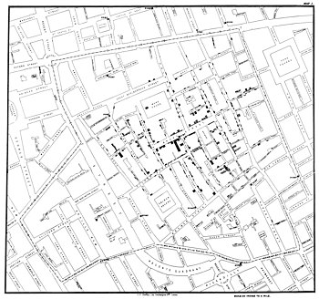

Brief History of GIS:
John Snow and the 1854 Broad Street cholera outbreak
Repetitive outbreaks from 1845-1860 – 1854 outbreak claimed 616 lives
Soho District in London did not have a sewer system
Debate over cause of cholera: miasma theory (commonly accepted) vs. germ theory (novel)
Snow, a physician, was seeing a pattern in the patients who were sick. He hypothesized that cholera was spread by an agent in contaminated water (unconventional at the time)
Through his research, he was able to identify a single water pump on Broad Street was responsible for the outbreak

Slide 11
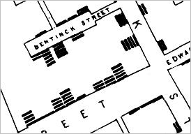
Original map by John Snow showing the clusters of cholera cases (indicated by stacked rectangles) in the London epidemic of 1854.
Notes:
This map is produced by Native Land Digital, a Canadian Indigenous led non-for-profit. It’s meant to reflect the fact that borders don’t always function the same as the simplified maps imply when it comes to indigenous history; there is a lot more movement, overlap, and complexity than one nation on each chunk of land."

Slide 12
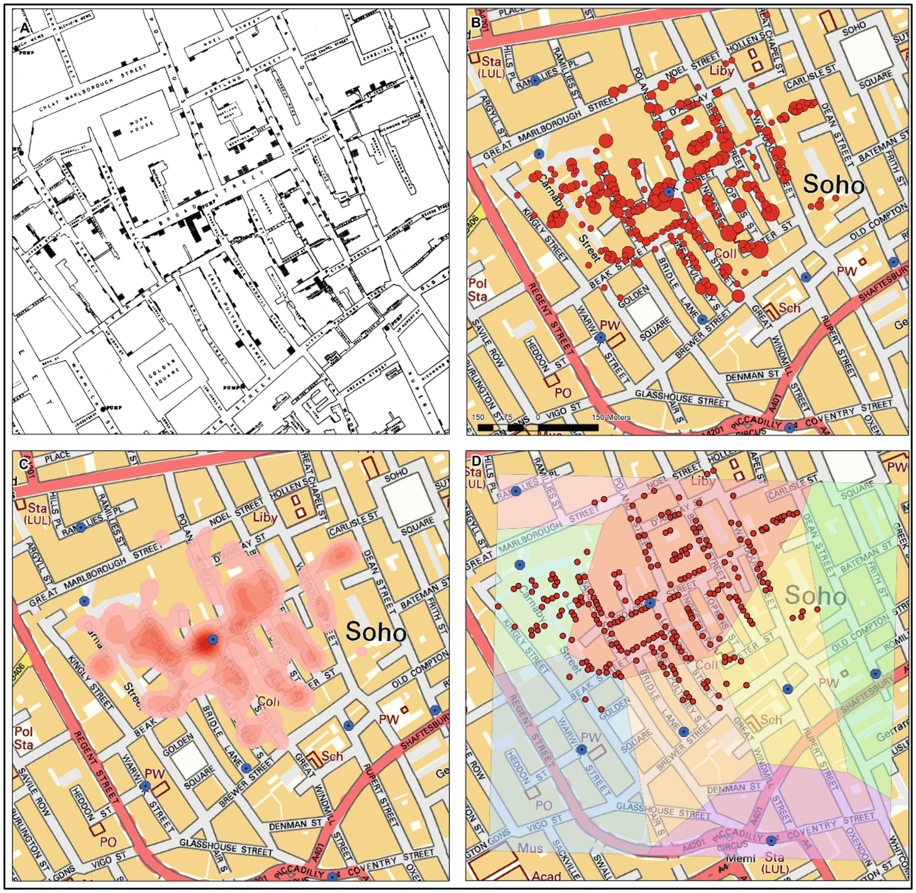
Updating Snow’s
Map
A: Original
B: Proportional Symbol (size of circle proportional to the number of cases)
C. Heat Map (displays the density of cases)
D. Thessian Polygons (identifies clusters of cases)

Slide 13
Brief History of GIS
“Quantitative Revolution” in Geography
  Push to develop new forms of positivist “spatial science” where in spatial forms and patterns could be quantified and analyzed.
  Emphasis on Geography as a nomothetic (law making, concerned with the general) discipline as opposed to ideographic (concerned with the specific and unique).
Between 1960 to 1975 three major technological advancements in new computer technology led to modern GIS.
  The ability to output map graphics using line printers;
  Advances in data storage
  The processing power of mainframe computers.
  We now had the ability to record coordinates as data inputs and perform calculations on those coordinates.

Slide 14

Brief History of GIS
1960s: individual development efforts
  Canada GIS (Roger Tomlinson / Canada Land Inventory)
  Harvard Lab for Computer Graphics (and 70s)
    Early GISs: SYMAP, GRID, ODYSSEY
  1969 Jack Dangermond founds ESRI (Environmental Systems Research Institute)

Slide 15
Brief History of GIS
1970s: The federal government
  United States Geological Survey (USGS)
  US Census
1980s and 1990s: A GIS industry
  Commercial vendors, GIS on the desktop
  Rapid adoption of GIS technologies
2000 and beyond….
  Ubiquitous geospatial technologies
  Integration with mainstream database and web technologies

Slide 16
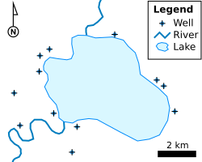
Shapefile, your new best friend
What Is a Shapefile?
A shapefile is a geospatial vector data format for representing geographic features. It combines a spatial representation of something in the world with descriptive information.
Geometry: Represents features as points, lines, or polygons.
  Points: Individual locations, such as schools, wells, or landmarks
  Lines: Linear features, such as roads, rivers, or pipelines
  Polygons: Areas, such as neighborhoods, lakes, or property boundaries
Attributes: Each geographic feature can have associated information stored in an attribute table. For example, a neighborhood polygon might include its name, population, area, or zoning type.
Coordinate Reference System (CRS): Defines how the geographic coordinates relate to locations on Earth, allowing features to be correctly positioned and displayed with other spatial data.

Slide 17
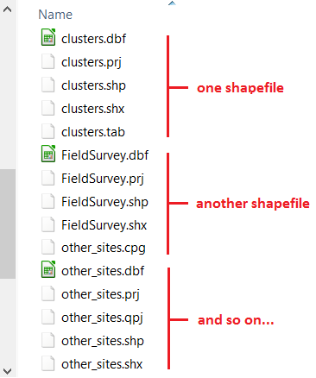
Shapefile, your new best friend
Despite the name, a shapefile is not a single file. It is a group of files that work together. The most important components are:
Mandatory files:
  .shp — shape format; the feature geometry itself
  .shx — shape index format; a positional index of the feature geometry
  .dbf — attribute format; columnar attributes for each shape, in dBase IV format
Optional files (most common):
  .prj — projection format; the coordinate system and projection information.
  .sbn and .sbx — a spatial index of the features.
  .cpg — for identifying the character encoding to be used.

Slide 18
Other File Types you might encounter
Geopackage (.gpkg)
Geopackage is essentially a mini database in the form of one single file. It can contain several layers of different geometries, and also raster layers. In addition to that it offers some of the capabilities of databases like relantionships, advanced constraints and triggers.
Keyhole Markup Language (.kml)
KML is a XML file that was originally developed for use within Google Earth back in 2004. KML allows to store more than one geometry per file, and even rasters if we use the compressed version of it – KMZ. Contrary to shapefiles, a KML file is composed of only one file, but on the other hand the alphanumeric information associated to the geometries (i.g. the attribute table) is not as easy to manage as in the case of shapefiles.
GPS eXchange Format (.gpx)
Another common GIS data format is the GPS eXchange Format (.gpx), also an XML schema designed specifically for exchange data between GPS devices.
Comma Separated Values (.csv)
Comma Separated values (.csv) is not a format specific to GIS but rather a general purpose format that allows to carry data in tabular format using commas or other pre-defined separator like semi-colon or Tab to delimitate columns.
Tagged Image File (.tif)

Slide 19
Why GIS?
What is GIS used for?
  Paul Bolstad discusses a number of them in Chapter 1
  Another Example:
https://www.cbpp.org/research/housing/interactive-map-where-voucher-households-live-in-the-50-largest-metropolitan-areas

Slide 20
Why GIS?
Who:
Government
Industry
Academics
What:
Transportation
Hydrology
Real Estate
Demographics
Crime
Public Health
Archaeology
Resource Management
Environmental Assessment
Biology
Urban Planning
Land Use Planning

Slide 21
Let’s get started

