Slide 1

Ch 2. Human Population Growth

Slide 2
The global human population is now over 8 billion people. Is the number of people on Earth itself the main environmental problem, or is something else more important? Explain your reasoning.

Slide 3
Recall
I = P x C
Environmental Impact = Population x Consumption

Slide 4
Introduction
Although the world population growth rate has declined recently, world population continues to grow due to population momentum.
Central theme in environmental science:
How will we meet the needs of 8.1 billion while:
- preserving resources for future generations?
- preserving nature & natural values?
Notes:
Population Momentum: A population may decrease its fertility rate to, or below, replacement level (generally considered 2.1 children per woman), but if the initial population is composed of many young people, as the population ages it will continue to increase in size as women reach their reproductive years and bear offspring.

Slide 5
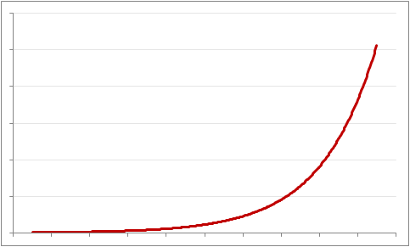
World Population
Changes Over Time
Demography is the study of the size, growth, density, distribution, and other characteristics of human populations.
Historically, human population grew slowly,
→ then exponentially.
As human population grew,
population pressure progressively modified the environment.

Slide 6
Studying Trends in Population Growth
Survivorship curves are graphs that can reveal trends in populations by indicating the portion of living individuals of each age.
Population Ecology and Survivorship curves
  Provides an understanding of species’ needs.
  Offer insight into resource management.
Many species follow distinct survivorship patterns.

Slide 7
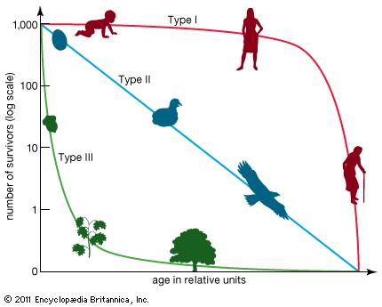
Survivorship curves

Slide 8
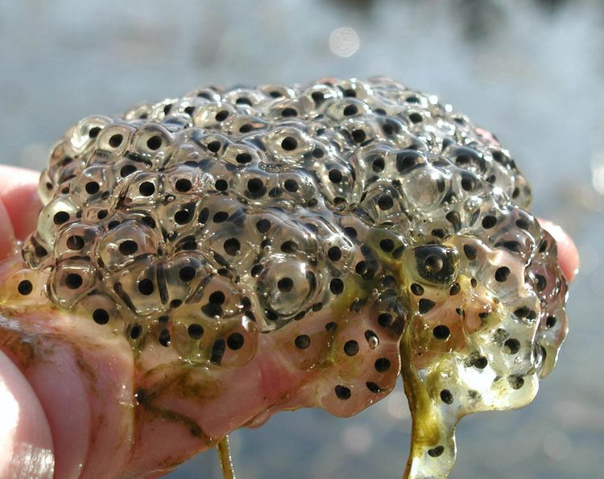

Three types of survivorship curves
Type III
  many offspring, minimal parental involvement; few offspring survive to reach old age
  Mortality highest in younger generations (e.g., fish, insects, invertebrates, plants).

Slide 9

Three types of survivorship curves
Type II
  Moderate number offspring
  Mortality equally probable among juveniles, middle-aged, or older individuals (e.g., birds or small mammals).

Slide 10

Three types of survivorship curves
Type I
  Few offspring, spend significant years caring for offspring
  Mortality highest in older individuals (e.g., humans and other large vertebrates).

Slide 11
Survivorship Patterns
Type I
Mortality highest in older individuals
(e.g., humans and other large vertebrates that spend significant years caring for offspring).
Type II
Mortality equally probable among juveniles, middle-aged, or older individuals
(e.g., birds or small mammals).
Type III
Mortality highest in younger generations
(e.g., fish, insects, invertebrates with many offspring, minimal parental involvement; few offspring survive to reach old age).

Slide 12
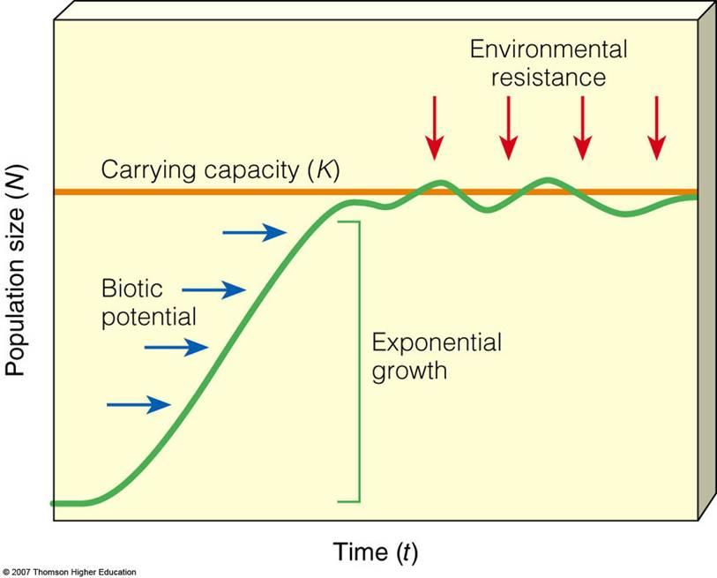

Food availability,
Disease,
Predation pressure
Notes:
Food availability, disease, predation pressure

Slide 13
Food availability,
Disease,
Predation pressure
Notes:
Food availability, disease, predation pressure

Slide 14
Food availability,
Disease,
Predation pressure
Notes:
Food availability, disease, predation pressure

Slide 15
Population Dynamics
All species populations undergo three distinct phases during existence:
  Growth
Resources exceed number of individuals exploiting resources.
  Stability:
Population growth levels off as environment becomes saturated with individuals of the population.
  Decline:
Decrease of abundance that leads to extinction
Overshoot
occurs when a population exceeds resources.

Slide 16
Exponential or
Logistic Population Growth
Two types of population growth
Exponential growth
occurs when the number of new individuals is proportional to the size of the population.
    When plotted on a graph, a J-shaped curve results.
Logistic growth
occurs when the population growing exponentially is slowed by diminishing resources over time.
    When plotted on a graph, an S-shaped curve results.
Carrying capacity (k)
The maximum individuals a particular habitat can support, which affects population growth.

Slide 17
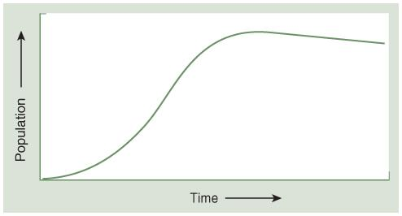
Typical Population Growth Curve
Slow growth (the lag phase) is indicated in the early stages of population growth, followed by exponential growth phase.
Population growth slows as limits are reached until there is a leveling off of the population.
Human populations follow this pattern; globally population is still in the rapid growth phase.

Slide 18
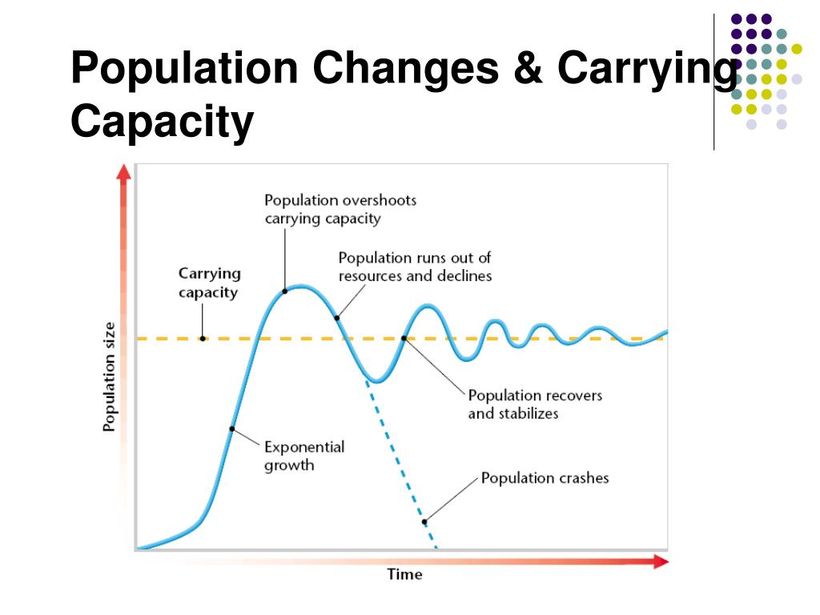
Food availability,
Disease,
Predation pressure

Slide 19

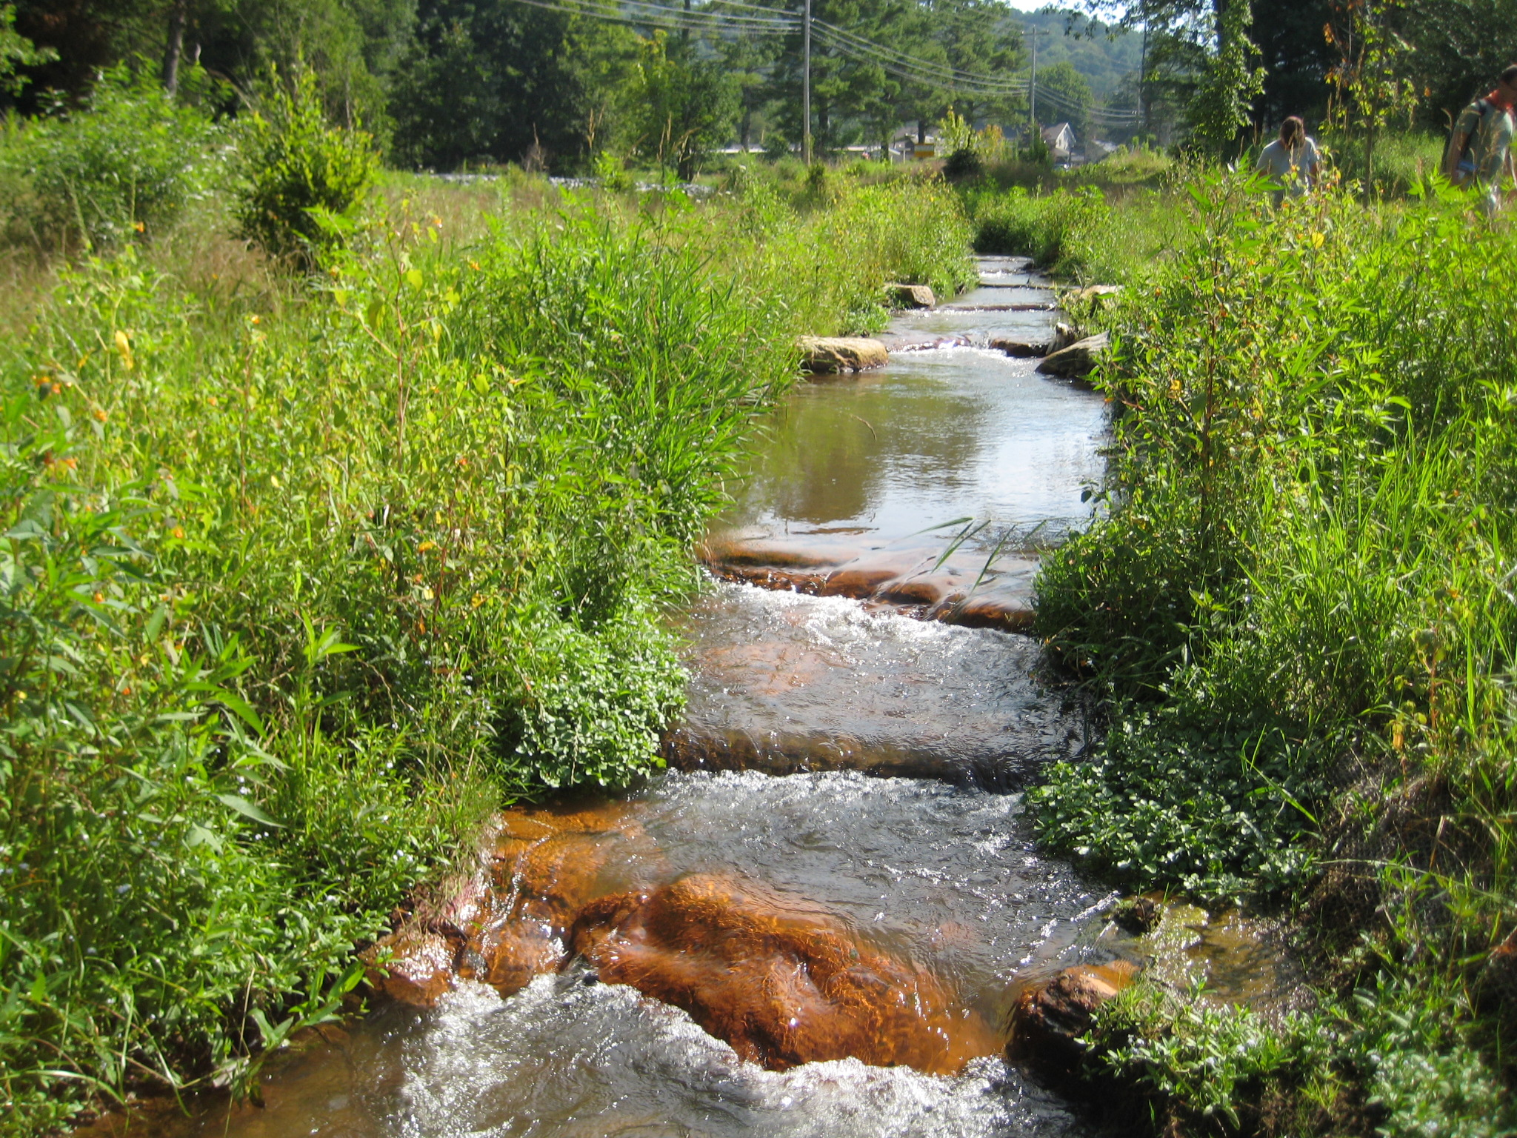

Ecosystem Engineers

Slide 20
How do ecosystem engineers affect K?
ecosystem engineers
No/little engineering

Slide 21
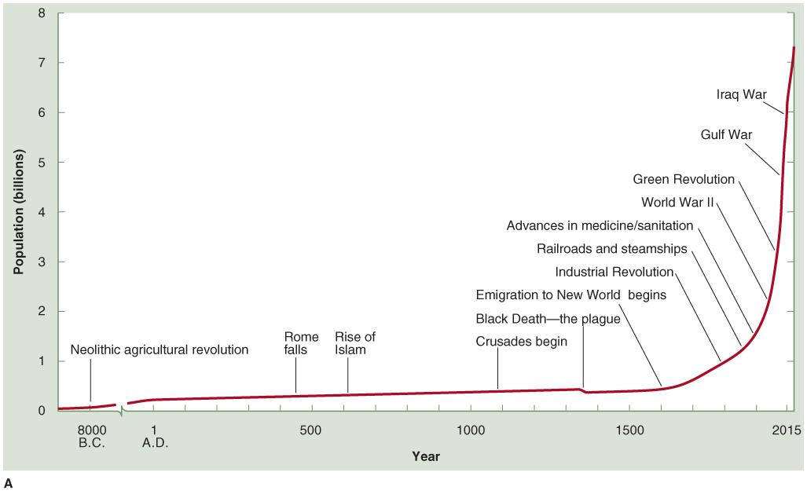
World human population changes over time
World population reached:
  1 billion in ~1800
  2 billion in 1930 (130 years later)
  3 billion in 1960 (30 years later)
  4 billion in 1974 (14 years later)
  5 billion in 1987 (13 years later)
  6 billion in 1999 (12 years later)
  7 billion in 2013 (14 years later)
  8 billion in 2022 (9 years later)
World population may reach:
  Current: 8.3 billion (<4 years later)
  10 billion in 2100 (59 years later)
(a) Data from U.S. Census Bureau, International Programs Center, 2001.
Notes:
(Figure 02.02A)

Slide 22
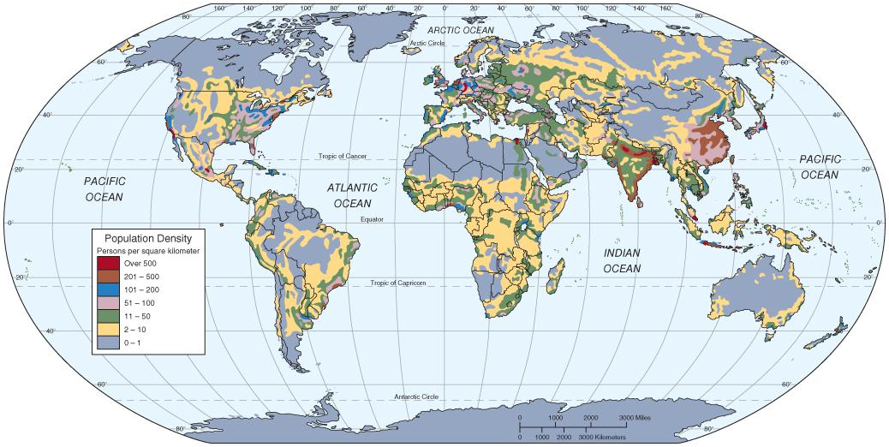
Distribution and Density of Human Population
Notes:
Figure 02.04 Map of world population densities.

Slide 23
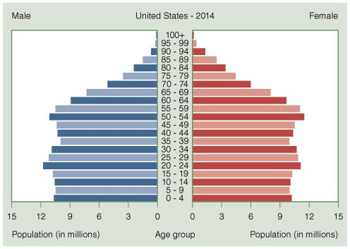
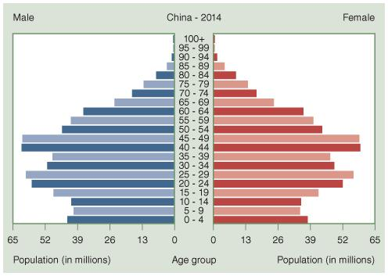
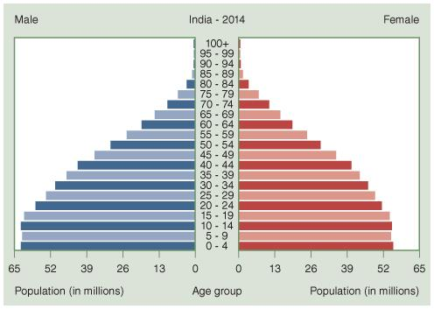
Population Age Profiles
(Age Structures)
Age Structures provide a snapshot of the age structure of a population at a particular instant in time.
Allows for comparisons across countries
Will change over time
Figure 02.06 Examples of age structure profiles in (a) the U.S., (b) China, (c) India
Courtesy of Central Intelligence Agency. (n.d.). The world factbook. Retrieved from https://www.cia.gov/library/publications/the-world-factbook/fields/2010.html.

Slide 24
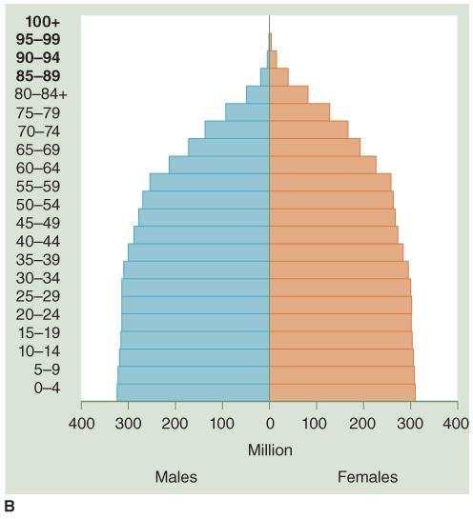
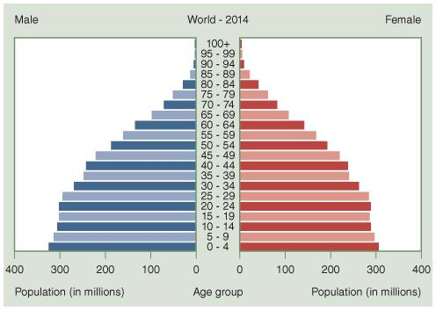
Projection of World Age Structure
Figure 02.07 Age structure profiles of the world as a whole in (a) 2014 and (b) 2050.
(a) Courtesy of Central Intelligence Agency. (n.d.). The world factbook. Retrieved from https://www.cia.gov/library/publications/the-world-factbook/fields/2010.html. (b) Reproduced from United Nations Population Division, World Population Prospects:The 2004 Revision, February 2005.

Slide 25
World human population changes over time
World population reached:
  1 billion in ~1800
  2 billion in 1930 (130 years later)
  3 billion in 1960 (30 years later)
  4 billion in 1974 (14 years later)
  5 billion in 1987 (13 years later)
  6 billion in 1999 (12 years later)
  7 billion in 2013 (14 years later)
  8 billion in 2022 (9 years later)
World population may reach:
  Current: 8.3 billion (<4 years later)
  10 billion in 2100 (59 years later)
(a) Data from U.S. Census Bureau, International Programs Center, 2001.
Notes:
(Figure 02.02A)

Slide 26
How did we get to ~8 B people?
Human Population and
Exponential Growth
Domestication and agriculture about 10,000 years ago led to sharp rise in human birth rate.
2. Full plant and animal domestication in the Old World (8000 to 5000 B.C.) gave rise to a dramatic increase in human population.
Factors in this increase included:
  Settlement on farms
  Need for increased family size
  Weaning of offspring possible earlier with softer food
  Development of cities, specialization

Slide 27
Where are we? ...and what about K?
?

Slide 28
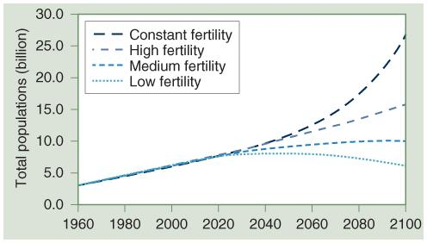
World human population
projections through 2050.
Figure 02.02B
Fertility Rate: # children / mother in a given area
(b) Reproduced from Population Division of the Department of Economic and Social Affairs of the United Nations Secretariat, World Population Prospects: The 2012 Revision.

Slide 29
More Developed Countries and
Less Developed Countries
More Developed Countries
  exhibit a flat growth curve overall
(ex: the countries in North America, Europe, and the Former Soviet Union, as well as New Zealand, Japan, and Australia
  Europe has the slowest growth rate of 0.03%.
Less Developed Countries
have a sharply rising growth curve.
(ex. many in Africa, and Asia (China and India))
  China and India combined are responsible for about a third of the world’s population growth.
  Only 10 countries account for 60% of world population growth.

Slide 30

Education of Women
One of the best ways to decrease the growth rate of a particular population is to increase the average educational and societal status of women.
Improved education results in better healthcare and nutrition, increased choices, status and prestige, which has a positive community impact.
(b) © Avatar_023/Shutterstock.

Slide 31
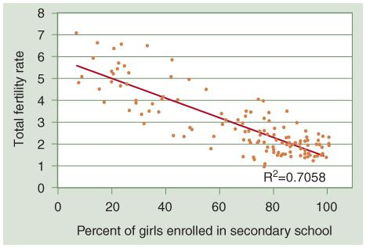
Correlation of Total Fertility Rate to Female Access to Education
(a) Reproduced from Earth Policy Institute. (2011). Education leads to lower fertility and increased prosperity. Retrieved from http://www.earth-policy.org/data_highlights/2011/highlights13.

Slide 32
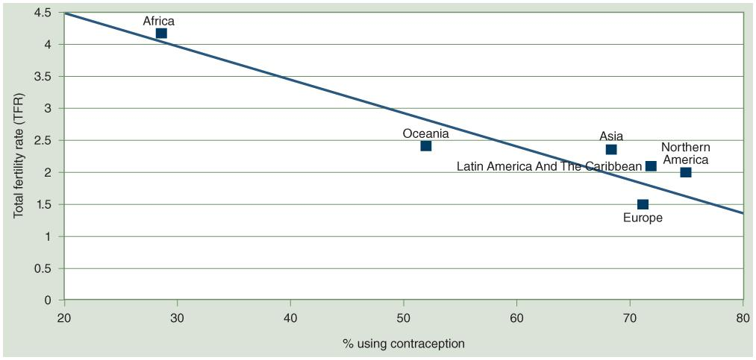
Family Planning
More than 100 million women in the developing world have indicated “unmet needs” for contraception.
Lack of access to available and affordable contraception contribute to 50,000 to 100,000 female deaths annually from unsafe and/or illegal abortions.
Contraceptive use by women strongly correlates with decreased fertility rates (based on a study of 50 countries).
(a) Reproduced from United Nations, Department of Economic and Social Affairs, Population Division. (2015). Trends in contraceptive use worldwide, 2015. (ST/ESA/SER.A/349). New York, NY: United Nations.

Slide 33
Challenges of a
Growing Human Population
Is population the problem? Remember I = P x C
Human population growth increases the burden on the Earth’s natural resources and environment.
Resources that take millennia (soils) to hundreds of millions of years (ores) to accumulate,
are being consumed and dispersed on time-scales of centuries (fuels, ores) to decades (water, soils, species).
Most developed nations create a much bigger per capita impact on the environment than persons in least developed countries.

Slide 34
Demographic Transition Model
Theory indicates that population growth will level off as a population undergoes technological and economic development.
This theory has challenges:
  Degradation: Most developed nations achieved development by degrading their environments and exploiting resources from other parts of the world.
  Limited resources: The Earth does not have sufficient resources to permit the developing nations to reach the developed nations’ level of affluence.

Slide 35
Reducing Population—Challenges
There does not appear to be a necessary causal relationship between development, industrialization, and fertility rates.
Partial or stalled development leaves countries with populations growing faster than the nations’ resources can support.
Evidence suggests that declines of fertility rate are caused primarily by rising levels of education, nutrition, and infant survivorship.
….But, over-consumption is the elephant in the room
END

Slide 36
The global human population is now over 8 billion people. Is the number of people on Earth itself the main environmental problem, or is something else more important? Explain your reasoning.

Slide 37
End of Lecture
Before you go:
NO LAB MONDAY! Have a nice long weekend!
Is anyone van certified?
Group Project Topics:
  Group A (Ariana, Nadav, Jason): Bird Population Diversity at BMC vs Haverford (maybe one more site?)
  Group B (Isabelle, True, Willa): Soil Health of BMC Community Garden vs Haverfarm
  Group C (Olivia, Uma, Mila): Water Quality of BMC Pond vs Haverford Pond
  Group D (Sam, Jack, Tarini, Abby): Macroinvertebrate Diversity and Abundance in Local Streams

Slide 38
Social Effects of Overpopulation
Rapid population growth and overpopulation lead to increased urbanization, increased unemployment, and spreading poverty, as well as putting the earth under increasing strain.
Projections indicate that 69% of the world’s population will live in urban areas by 2050.
Increasing population pressures lead to political instability and political and civil rights abuses.
Worldwide, 75% of the more than 21 million deaths from war since 1945 were related to domestic civil wars.

Slide 39
World’s Most Populous Cities
City | Population in millions
Tokyo, Japan | 38
Delhi, India | 25
Mexico City, Mexico | 21
Mumbai, India | 21
Sao Paulo, Brazil | 21
Osaka, Japan | 20
Beijing, China | 19.9
New York, USA | 18.5
Data from United Nations, Department of Economic and Social Affairs, Population
Division (2014), World Urbanization Prospects: The 2014 Revision, Highlights, (ST/ESA/SERA/352).

Slide 40
Economic Incentives and Government Regulation of Childbearing
Governments have implemented economic incentives and disincentives to promote population control.
Increasing accessibility to modern birth control methods and family planning information without mandating the number of children a family may have is another policy strategy in use.
Strict government policies have been mandated at times; (in 1979 China implemented a one child per couple policy).
In developed countries 3–5 children was the norm in the 1990s and early 2000s; 60 countries currently have a fertility rate at or below replacement levels.

