Slide 1

CHAPTER 2
High-Energy Society

Slide 2
  All forms of energy fall into the general
  categories of kinetic energy and potential energy.
  Kinetic energy can be viewed as energy in use
  and is often described as the energy of motion.
  Potential energy is energy that has not been used,
  such as water in a reservoir on top of a hill, or chemical
  energy in a battery, or unburned fuel oil.
  Like anything with mass, the water is subject to the effect of gravity. The higher the water’s elevation above some base level, the greater its potential energy. As the water is released to flow downhill through a penstock and spin a turbine, its potential energy is converted to kinetic energy.

Slide 3
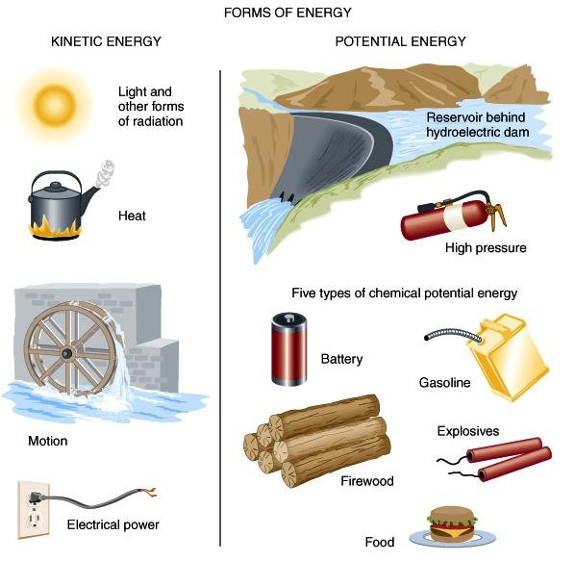

Slide 4
Kinetic energy can be transferred from one place to another by
three processes: conduction, convection, and radiation.
  Conduction is the movement of heat through a substance
  without net movement of the molecules of the substance.
  Conduction is most effective in solid materials, but it can also be important in relatively dense and stable fluids.
  Convection is the transfer of heat by the mixing or flow of a fluid. Unlike conduction, convection is accomplished by displacement (movement) of molecules of a substance.
  Of the three energy transfer mechanisms, Radiation is the only one that can be propagated without a transfer medium.
  Unlike conduction or convection, the transfer of energy by radiation can occur through empty space. Electromagnetic radiation (e.g., sunlight) has characteristics of both waves and particles.

Slide 5
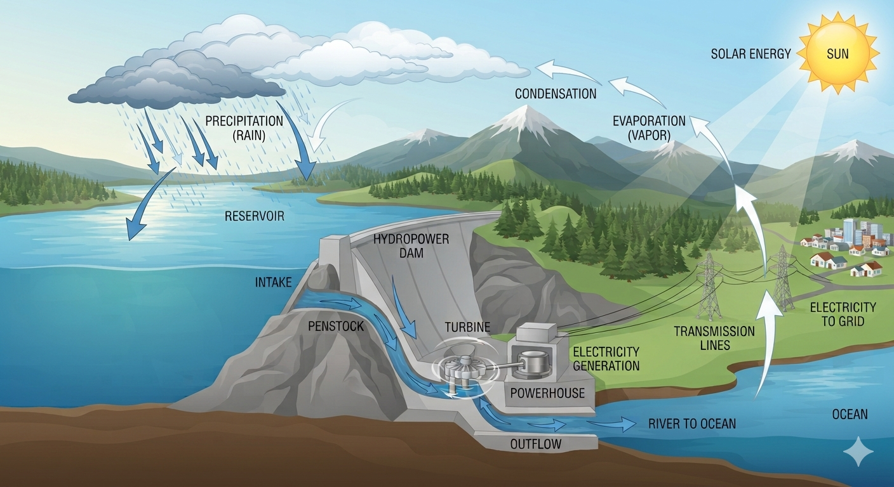
Notes:
Potential and kinetic energy.
Gravitational potential energy of the water above dam in reservoir becomes kinetic energy as it flows through hydroelectric dam, is converted to electricity, which flows through grid to do work.

Slide 6
Energy is defined as “the ability to do work.”
Work is Force x Distance, or, force applied along some path.
The International System (SI) standard unit of energy is
the Joule (J).
Power is the rate at which energy is released, transferred, or received… i.e., power indicates how much energy is needed to get a certain amount of work done within a certain amount of time.
The SI unit of power is the Watt (W) = 1 Joule per second
Note that power (W) = energy per unit time (J/s)

Slide 7
Energy and Power - analogy to water-use measures
A quantity of Energy is akin to a volume of water:
gallons, Liters, cubic feet, cubic meters.
Power is more comparable to measures of water flow rate:
gallons per day, Liters per minute,
cubic feet per second (cfs), m³/sec.

Slide 8
Energy and Power units we will (try to) use:
Quantities of Energy can be reported many ways: Joules, kilocalories, BTU, metric tons of oil equivalent, etc. In this class, we’ll use kilowatt hours, kWh.
Since we’ve abandoned the SI units (Joules) for energy in favor of kWh, we might sometimes refer to Power in terms of kiloWatt hours per day, kWh/d.
When describing power requirements of humans, we might employ kWh/d per person. When considering whole countries, and/or longer time periods, instead of kilo (10³) Watt hours, it is easier to use larger magnitude prefixes such as Mega (10⁶), Giga (10⁹), Tera (10¹²), e.g., TeraWatt hours per year.

Slide 9
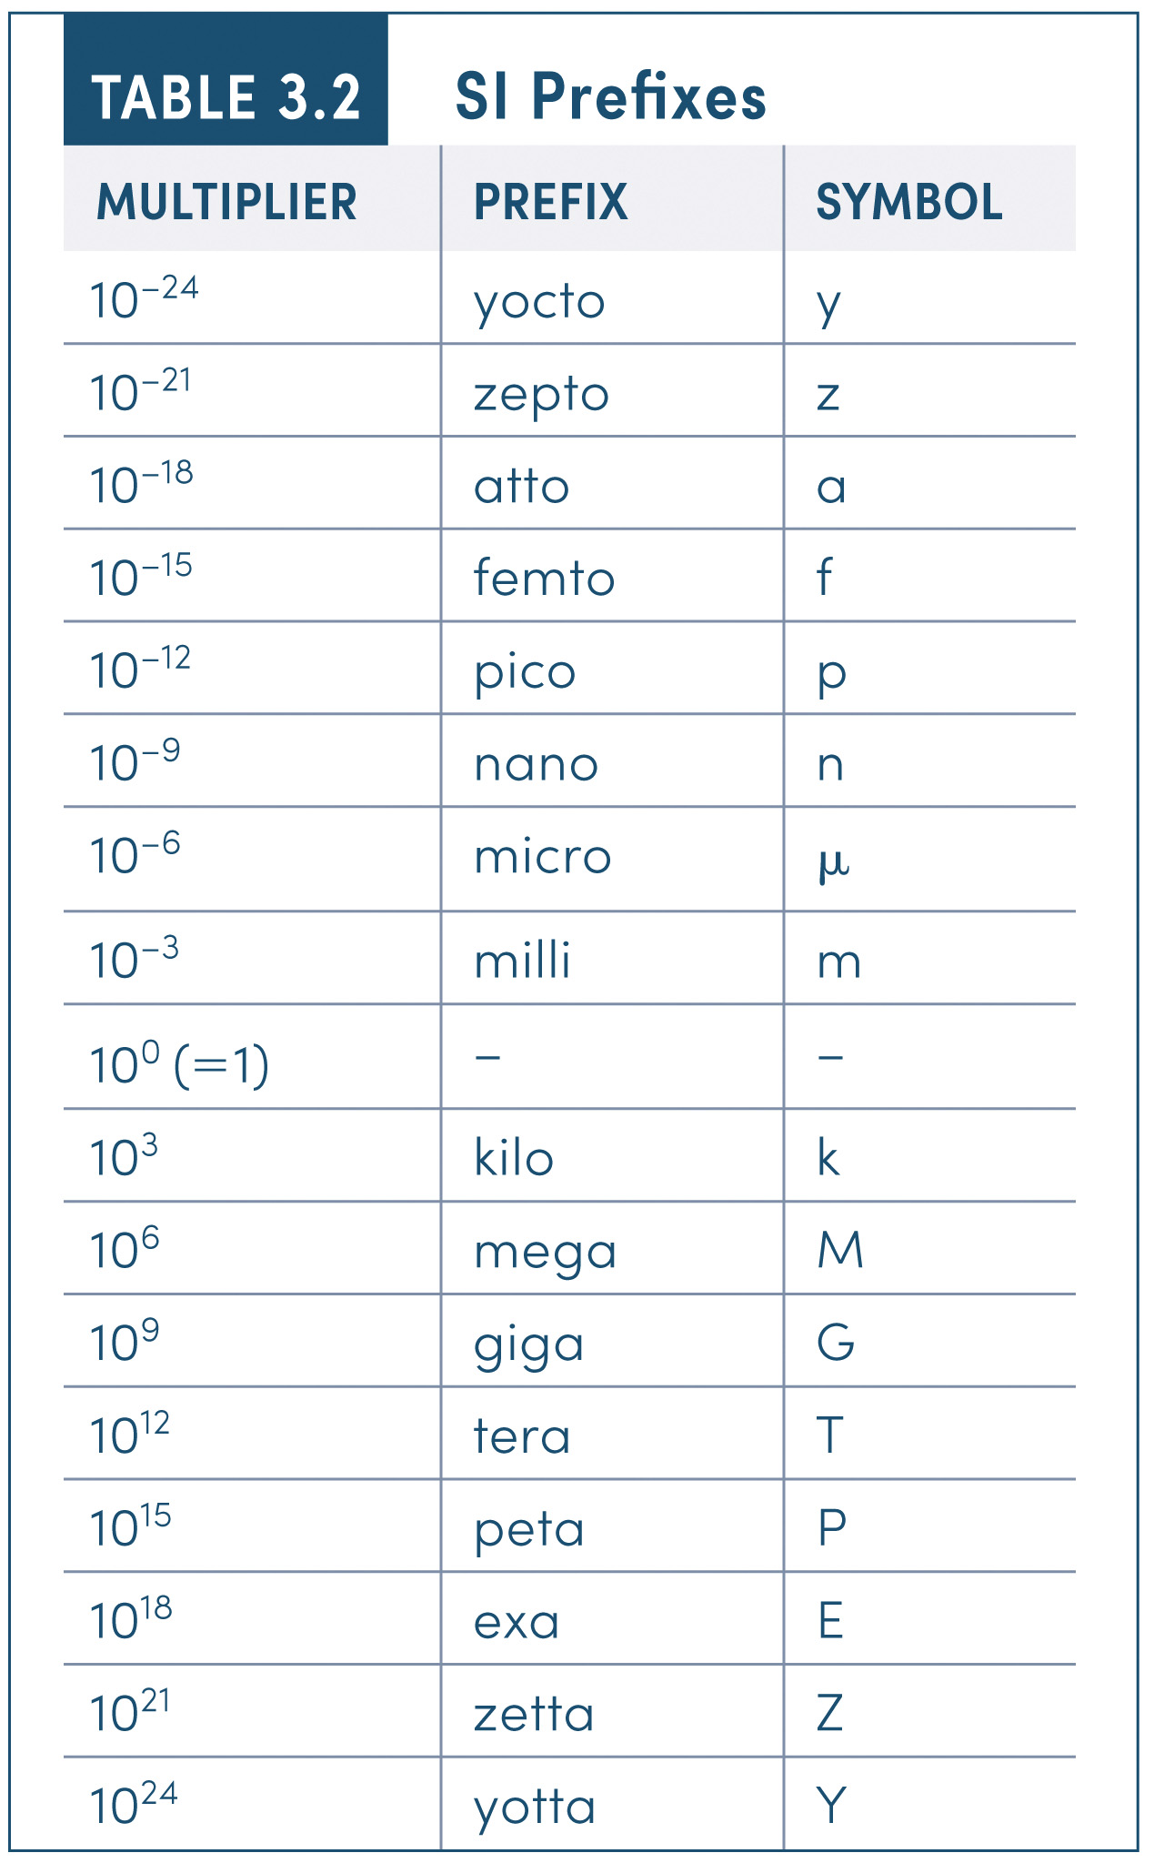
SI Prefixes
MULTIPLIER | PREFIX | SYMBOL
10 ^{–24} | yocto | y
10 ^{–21} | zepto | z
10 ^{–18} | atto | a
10 ^{–15} | femto | f
10 ^{–12} | pico | p
10 ^{–9} | nano | n
10 ^{–6} | micro | μ
10 ^{–3} | milli | m
10 ⁰(=1) | – | –
10 ³ | kilo | k
10 ⁶ | mega | M
10 ⁹ | giga | G
10 ¹² | tera | T
10 ¹⁵ | peta | P
10 ¹⁸ | exa | E
10 ²¹ | zetta | Z
10 ²⁴ | yotta | Y
Notes:
TABLE 3.2 SI Prefixes

Slide 10
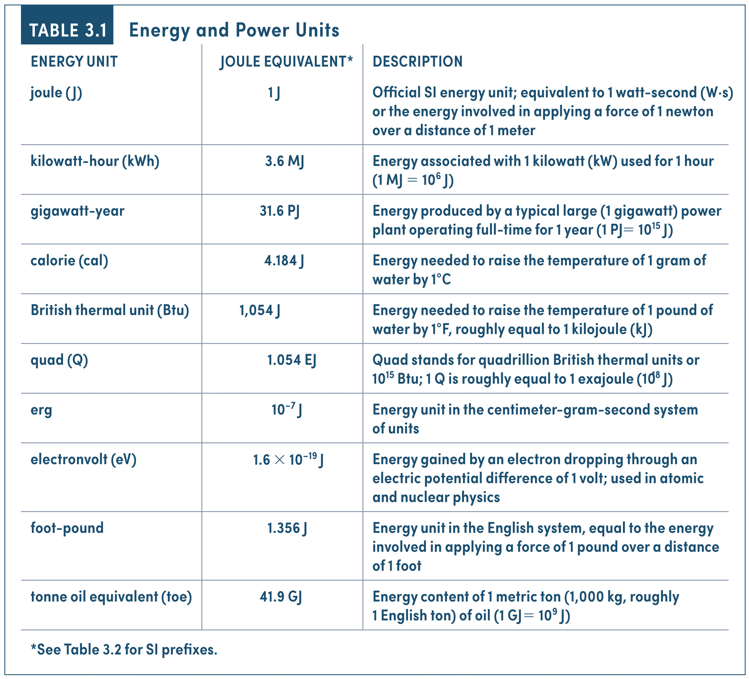
Energy and Power Units
ENERGY UNIT | JOULE EQUIVALENT* | DESCRIPTION
joule ( J) | 1 J | Official SI energy unit; equivalent to 1 watt-second (W·s) or the energy involved in applying a force of 1 newton over a distance of 1 meter
kilowatt-hour (kWh) | 3.6 MJ | Energy associated with 1 kilowatt (kW) used for 1 hour (1 MJ = 10 ⁶ J)
gigawatt-year | 31.6 PJ | Energy produced by a typical large (1 gigawatt) power plant operating full-time for 1 year (1 PJ = 10 ¹⁵ J)
calorie (cal) | 4.184 J | Energy needed to raise the temperature of 1 gram of water by 1°C
British thermal unit (Btu) | 1,054 J | Energy needed to raise the temperature of 1 pound of water by 1°F, roughly equal to 1 kilojoule (kJ)
quad (Q) | 1.054 EJ | Quad stands for quadrillion British thermal units or 10 ¹⁵ Btu; 1 Q is roughly equal to 1 exajoule (10 ¹⁸ J)
erg | 10 ^{–7} J | Energy unit in the centimeter-gram-second system of units
electronvolt (eV) | 1.6 × 10 ^{–19} J | Energy gained by an electron dropping through an electric potential difference of 1 volt; used in atomic and nuclear physics
foot-pound | 1.356 J | Energy unit in the English system, equal to the energy involved in applying a force of 1 pound over a distance of 1 foot
tonne oil equivalent (toe) | 41.9 GJ | Energy content of 1 metric ton (1,000 kg, roughly 1 English ton) of oil (1 GJ = 10 ⁹ J)
*See Table 3.2 for SI prefixes.
Notes:
Energy and Power Units (Part 1)

Slide 11
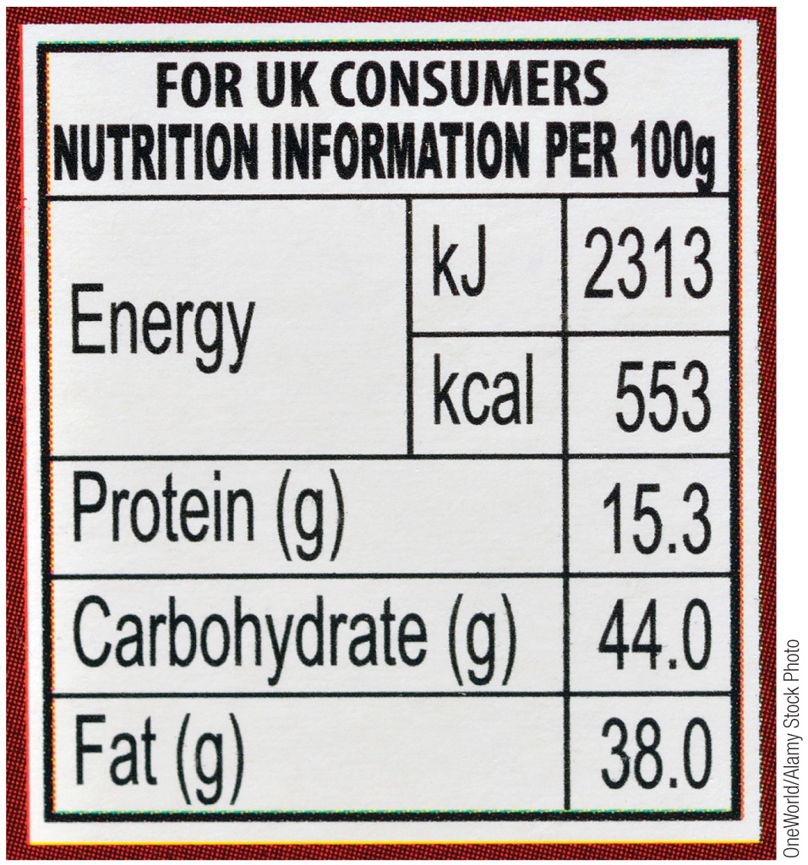
Notes:
A food label from the United Kingdom lists the energy content in both kilojoules (kJ) and kilocalories (kcal). This makes clear that joules and calories measure the same thing—namely, stored chemical energy.

Slide 12
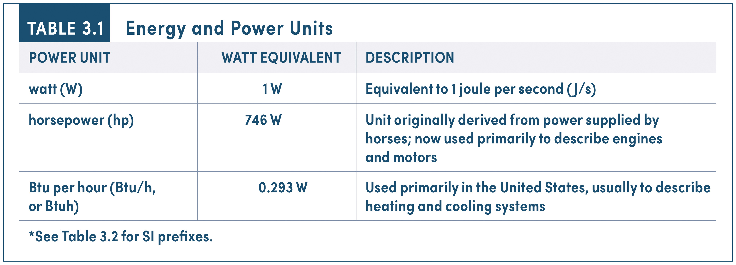
Energy and Power Units
POWER UNIT | WATT EQUIVALENT | DESCRIPTION
watt (W) | 1 W | Equivalent to 1 joule per second ( J/s)
horsepower (hp) | 746 W | Unit originally derived from power supplied by horses; now used primarily to describe engines and motors
Btu per hour (Btu/h, or Btuh) | 0.293 W | Used primarily in the United States, usually to describe heating and cooling systems
*See Table 3.2 for SI prefixes.
Notes:
Energy and Power Units (Part 2)

Slide 13
Chemically reduced carbon fuels, are the terminal form of stored energy consumed by most of human civilization, as well as for most of the non-plant organisms on Earth, including Homo sapiens.
By ‘terminal form’ we mean that reduced-carbon fuel is the form of stored energy that we eat or burn for the purpose of doing work and/or to produce heat.
  What is(are) the original source(s) of energy used in the creation of reduced carbon fuels?
  Hint: How is oxidized carbon (e.g., CO₂) converted into reduced molecular forms (e.g., C₆H₁₂O₆)?

Slide 14
Humans oxidize fuel and use (and store) energy
(CHO)_{n}, (CH₂)_{n}, (CHN)_{n} + O₂ → CO₂ + H₂O + energy released
Carbohydrates, Fats, Proteins
Energy (Calories) consumed = Energy (Calories) Used + Energy Stored
  Energy Used = exercise/movement + basal metabolism + waste heat (not all wasted; some used for body temperature regulation)
  Energy Stored = construction of body tissue: fat + glycogen (muscles/liver)

Slide 15
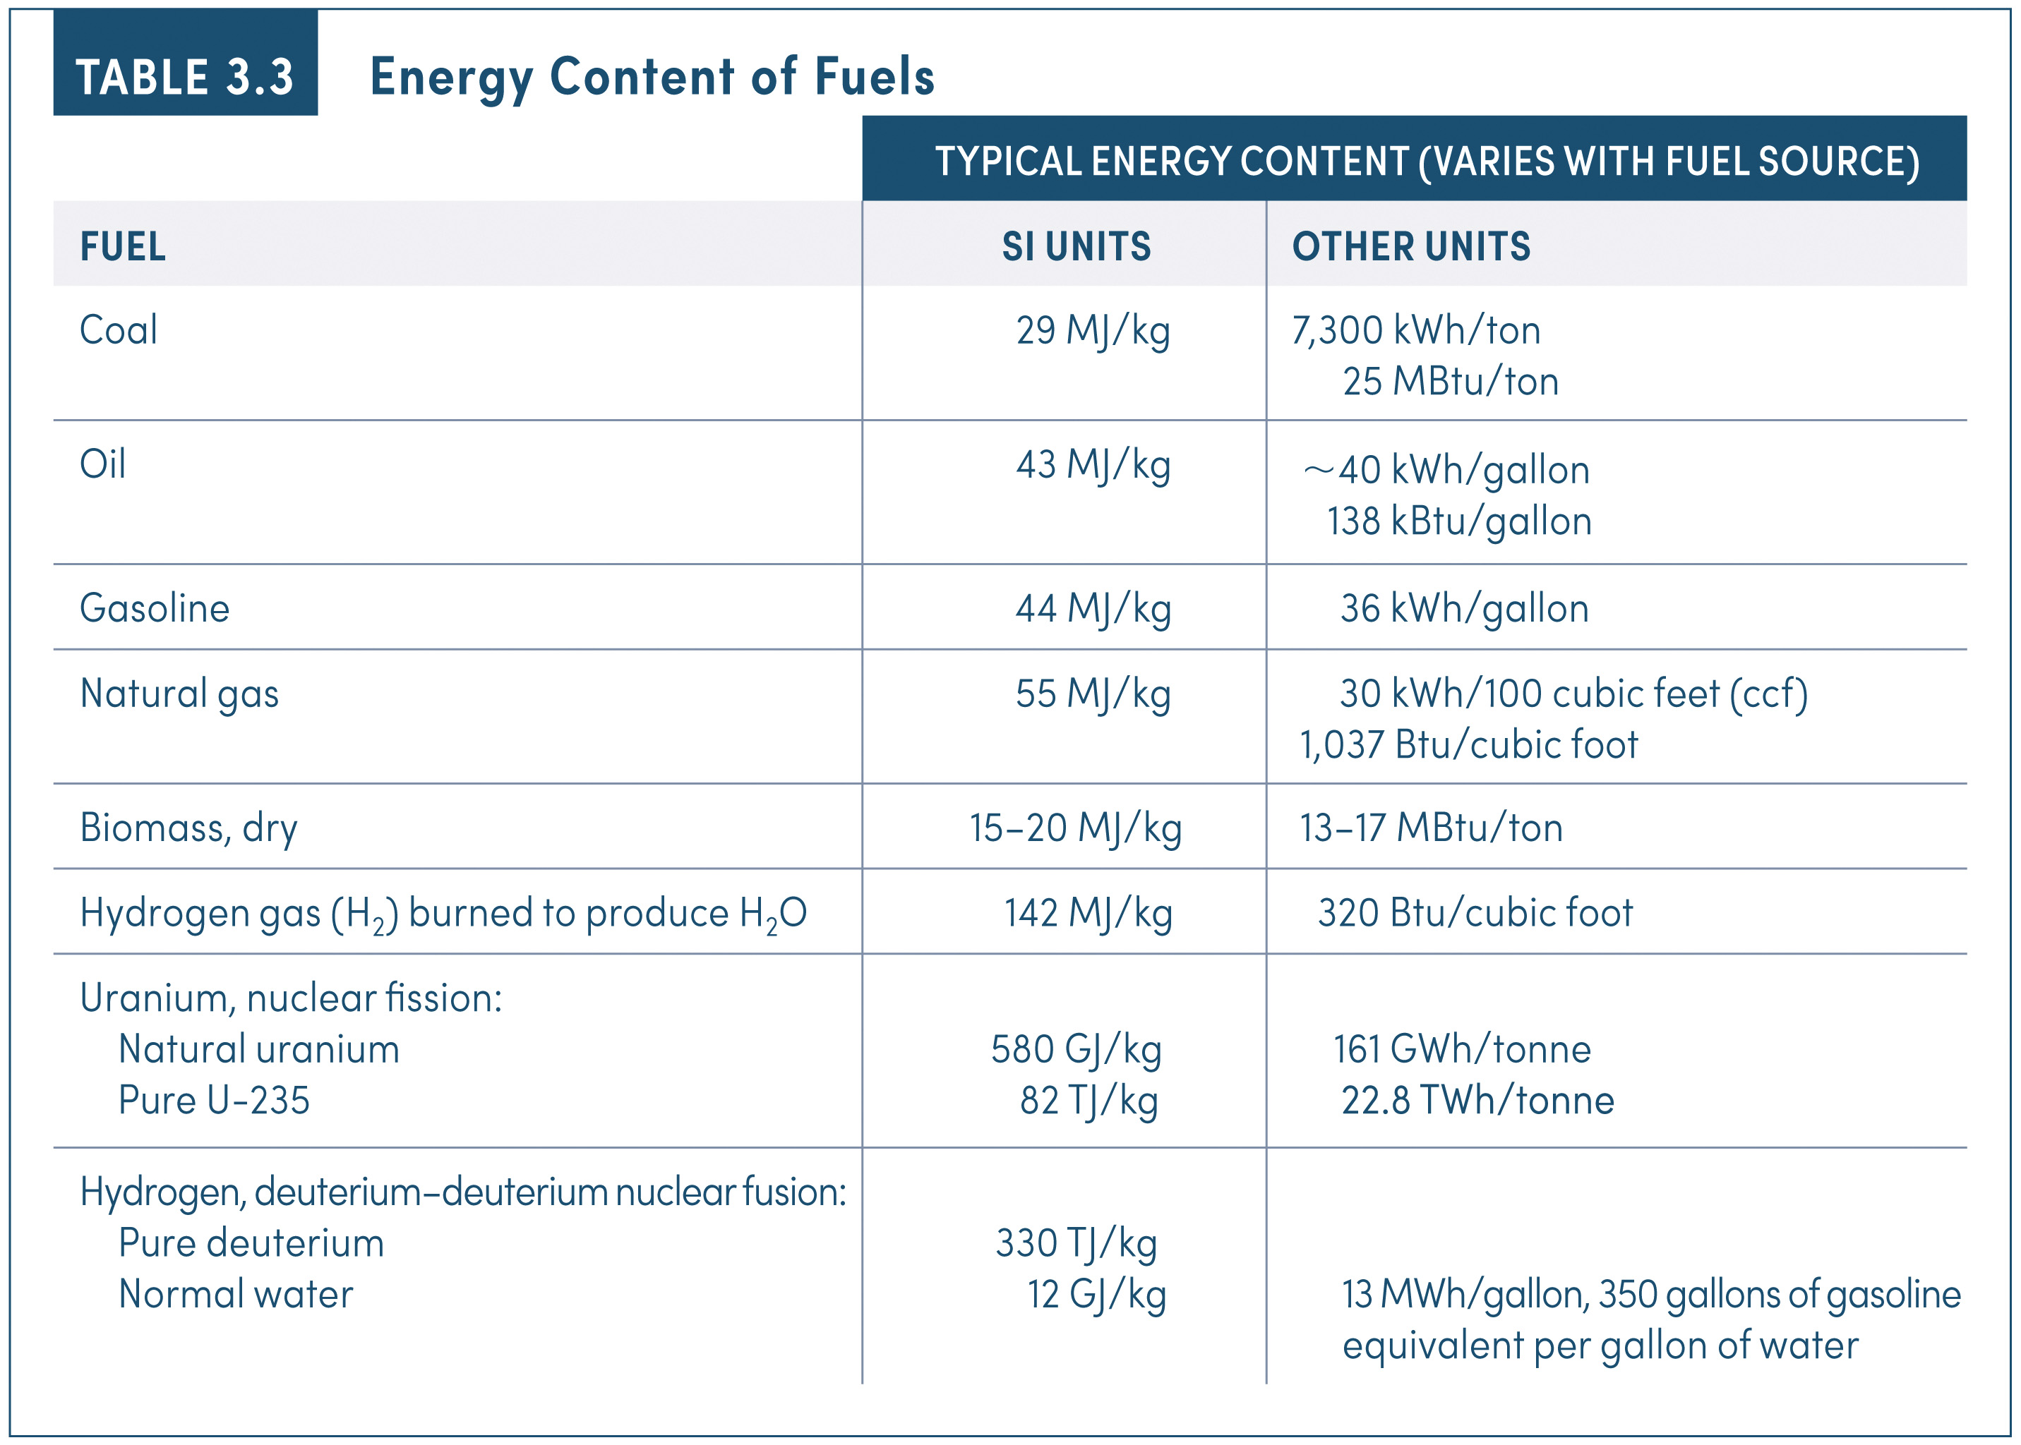
Energy Content of Fuels
 | TYPICAL ENERGY CONTENT (VARIES WITH FUEL SOURCE)
FUEL | SI UNITS | OTHER UNITS
Coal | 29 MJ/kg | 7,300 kWh/ton 25 MBtu/ton
Oil | 43 MJ/kg | ∼40 kWh/gallon 138 kBtu/gallon
Gasoline | 44 MJ/kg | 36 kWh/gallon
Natural gas | 55 MJ/kg | 30 kWh/100 cubic feet (ccf) 1,037 Btu/cubic foot
Biomass, dry | 15–20 MJ/kg | 13–17 MBtu/ton
Hydrogen gas (H 2 ) burned to produce H 2 O | 142 MJ/kg | 320 Btu/cubic foot
Uranium, nuclear fission: Natural uranium Pure U-235 | 580 GJ/kg 82 TJ/kg | 161 GWh/tonne 22.8 TWh/tonne
Hydrogen, deuterium–deuterium nuclear fusion: Pure deuterium Normal water | 330 TJ/kg 12 GJ/kg | 13 MWh/gallon, 350 gallons of gasoline equivalent per gallon of water
Notes:
Energy Content of Fuels

Slide 16
Cars oxidize fuel and use energy to move
(CHO)_{n} , (CH₂)_{n} + O₂ → CO₂ + H₂O + energy released
Ethanol, Octane
Energy released _{auto} = mechanical power (to drivetrain) + waste heat

Slide 17
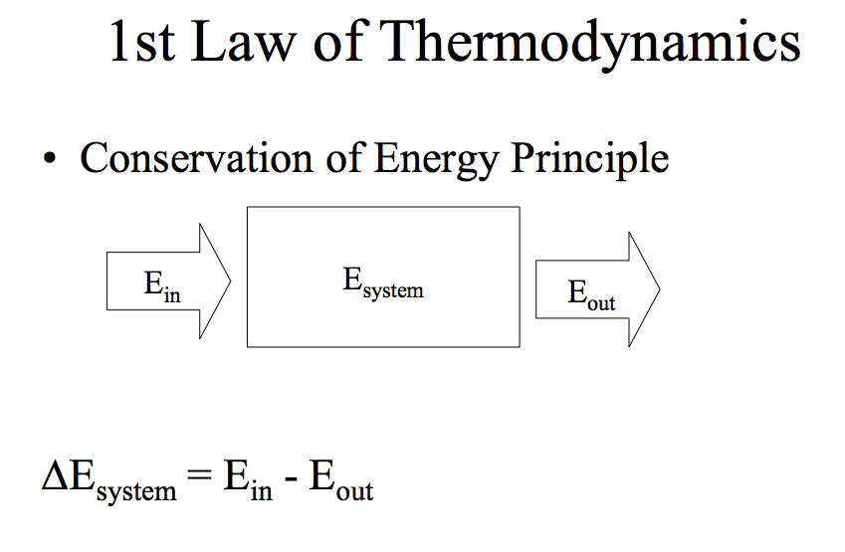
Example: the change in the system’s energy (ΔE_{system}) may be an increase in its temperature due to absorption and retention of some of the heat added to it.

Slide 18
Steady-State Condition
Under steady-state conditions, there is no change in energy of the system.
∆E_{system} = 0 = E_{in}- E_{out}
or E_{in}= E_{out}

Slide 19
Energy quality
Determined by the temperature: the higher the temperature, the higher the quality
While the quantity of energy is conserved, the quality or work potential is not
When thermal energy flows from high T to low T, energy quality is degraded.

Slide 20
Second law
In all transformations of energy, some of it is degraded
All physical processes entail a decrease in the average quality of the energy involved
No process is possible whose sole result is the transfer of energy from a colder body to a hotter one
No process is possible whose sole result is the conversion of a given quantity of thermal energy into an equal quantity of mechanical work (always some degradation)
Order tends to disorder, concentration tends to dispersion

Slide 21
1st Law Efficiency
also called “Thermal Efficiency”
Efficiency = what you can get out (net Work)
what you have to pay for (total energy put in)
η_{I} = 1st Law (or Thermal) Efficiency
η_{I} = W_{net} / Q_{input} = (Q_{high}- Q_{low}) / Q_{high}

Slide 22
Cars oxidize fuel and use energy to move
(CHO)_{n} , (CH₂)_{n} + O₂ → CO₂ + H₂O + energy released
Ethanol, Octane
Energy released _{auto} = mechanical power (to drivetrain) + waste heat

Slide 25
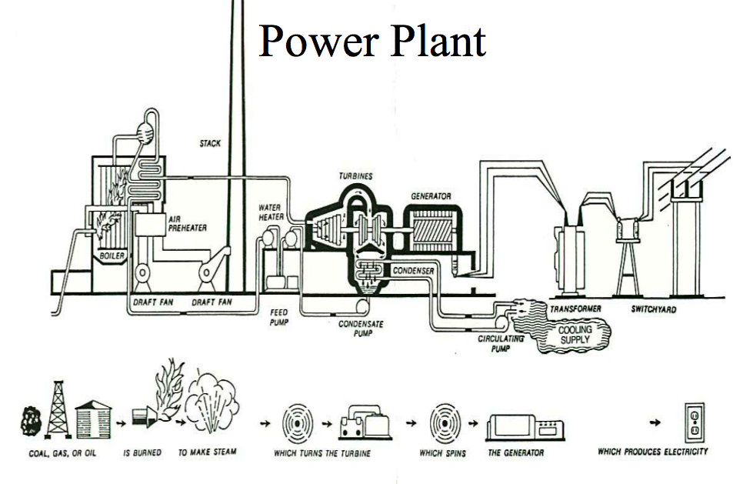

Slide 26
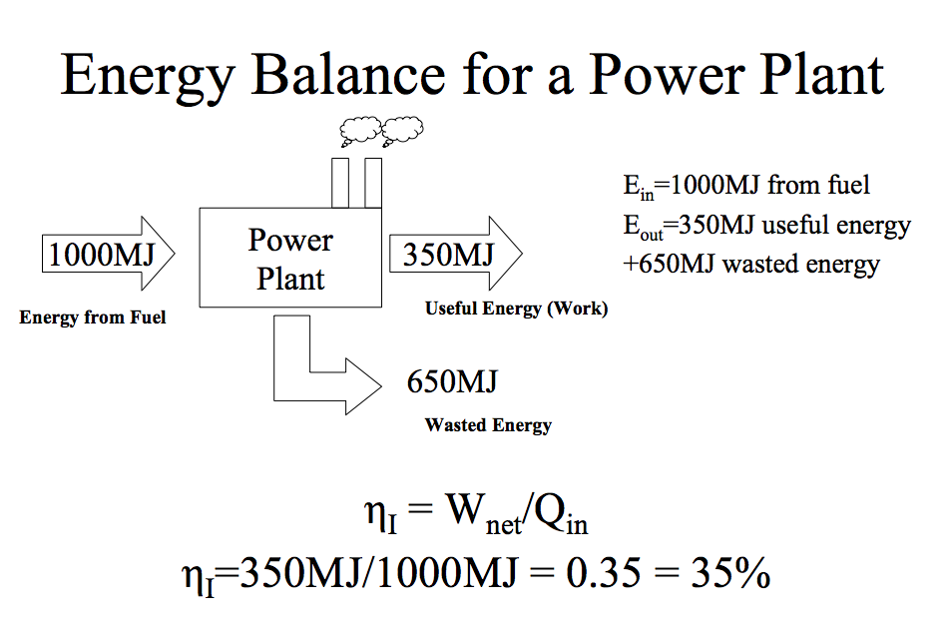

Slide 27
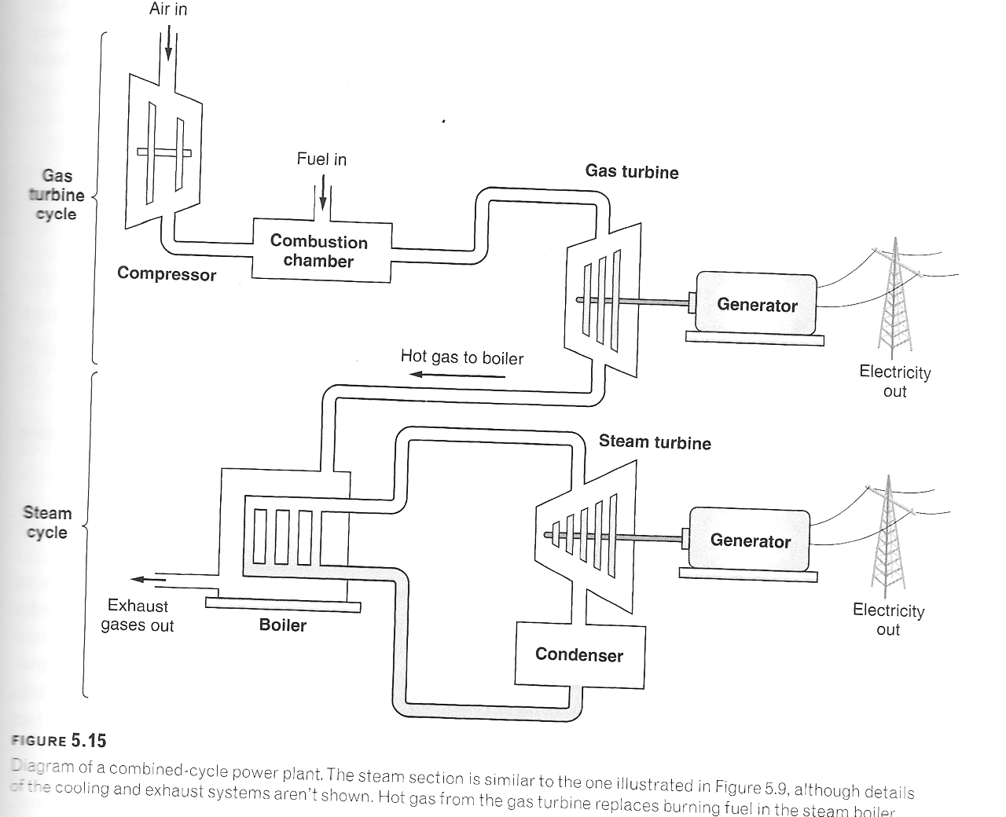
Combined-cycle electrical power plant

Slide 30
Total End-user Cost of Electricity: $0.13729 / KWh

Slide 31
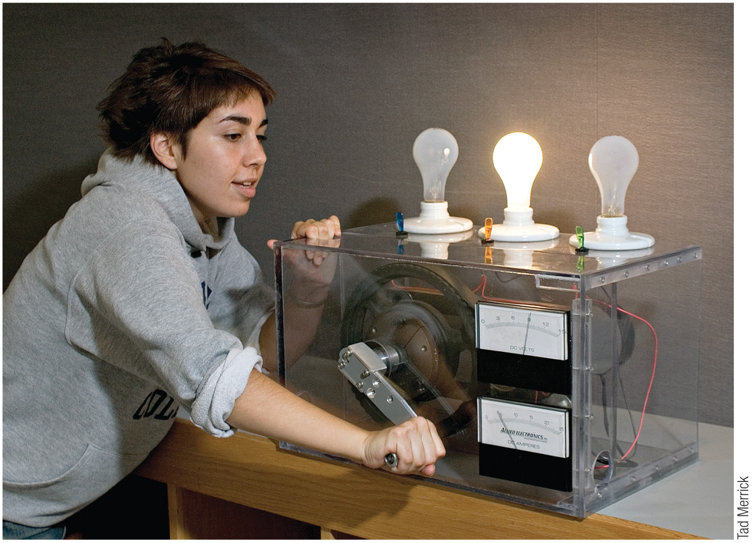
Notes:
FIGURE 2.1
Turning a hand-cranked electric generator, the average person can sustain a power output of about 100 W. Here the energy ends up lighting a 100-W incandescent lightbulb.

Slide 32
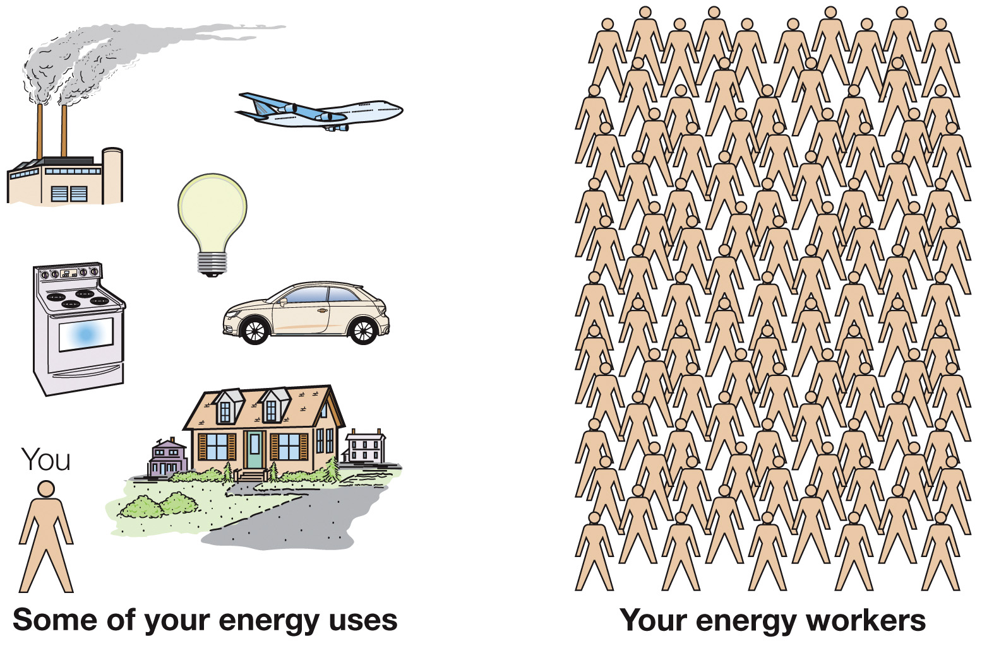
Notes:
FIGURE 2.2
It would take 100 workers laboring around the clock to supply the energy needs of the average American.

Slide 33
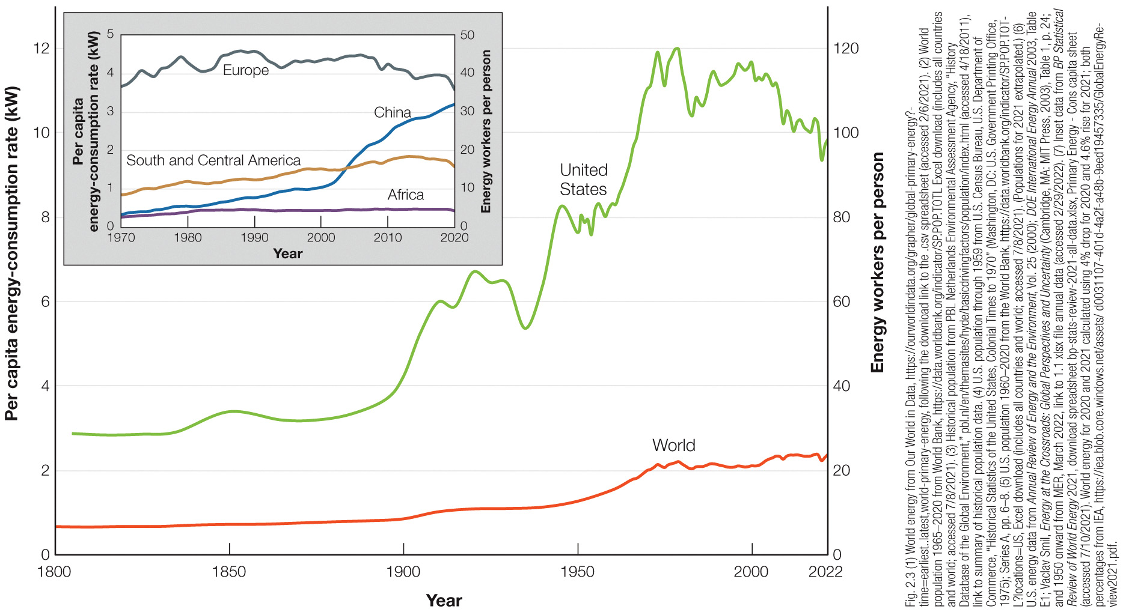
Notes:
FIGURE 2.3
Per capita energy-consumption rates since 1800. Energy consumption in the United States is now just over 10 kW per capita, equivalent to some 100 energy workers laboring around the clock. This is more than 4 times the world average. The inset shows recent data for several world regions, making clear that the distribution of energy use is far from equitable. The sharp downturn in 2020 is due to the COVID-19 pandemic, and as the graph shows, it did not last.

Slide 34
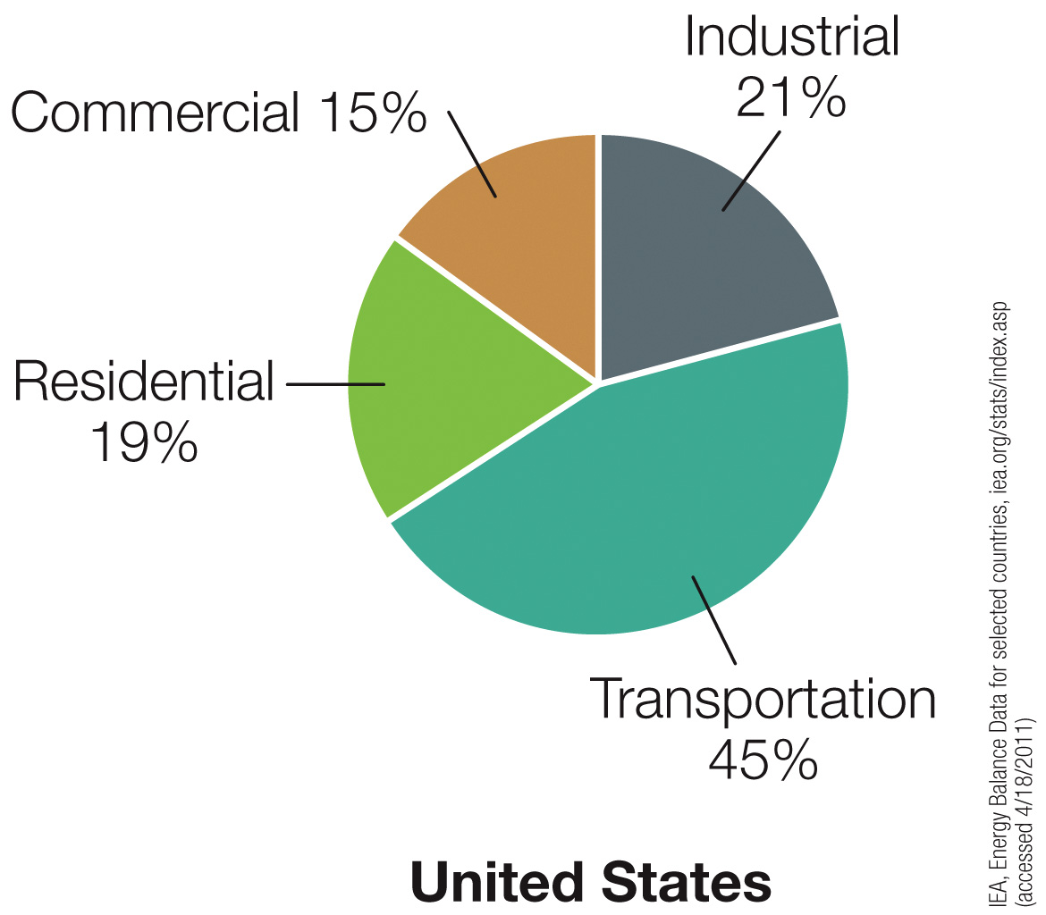
Notes:
FIGURE 2.4a
End-use energy consumption, by sector, for three countries in the early twenty-first century.

Slide 35
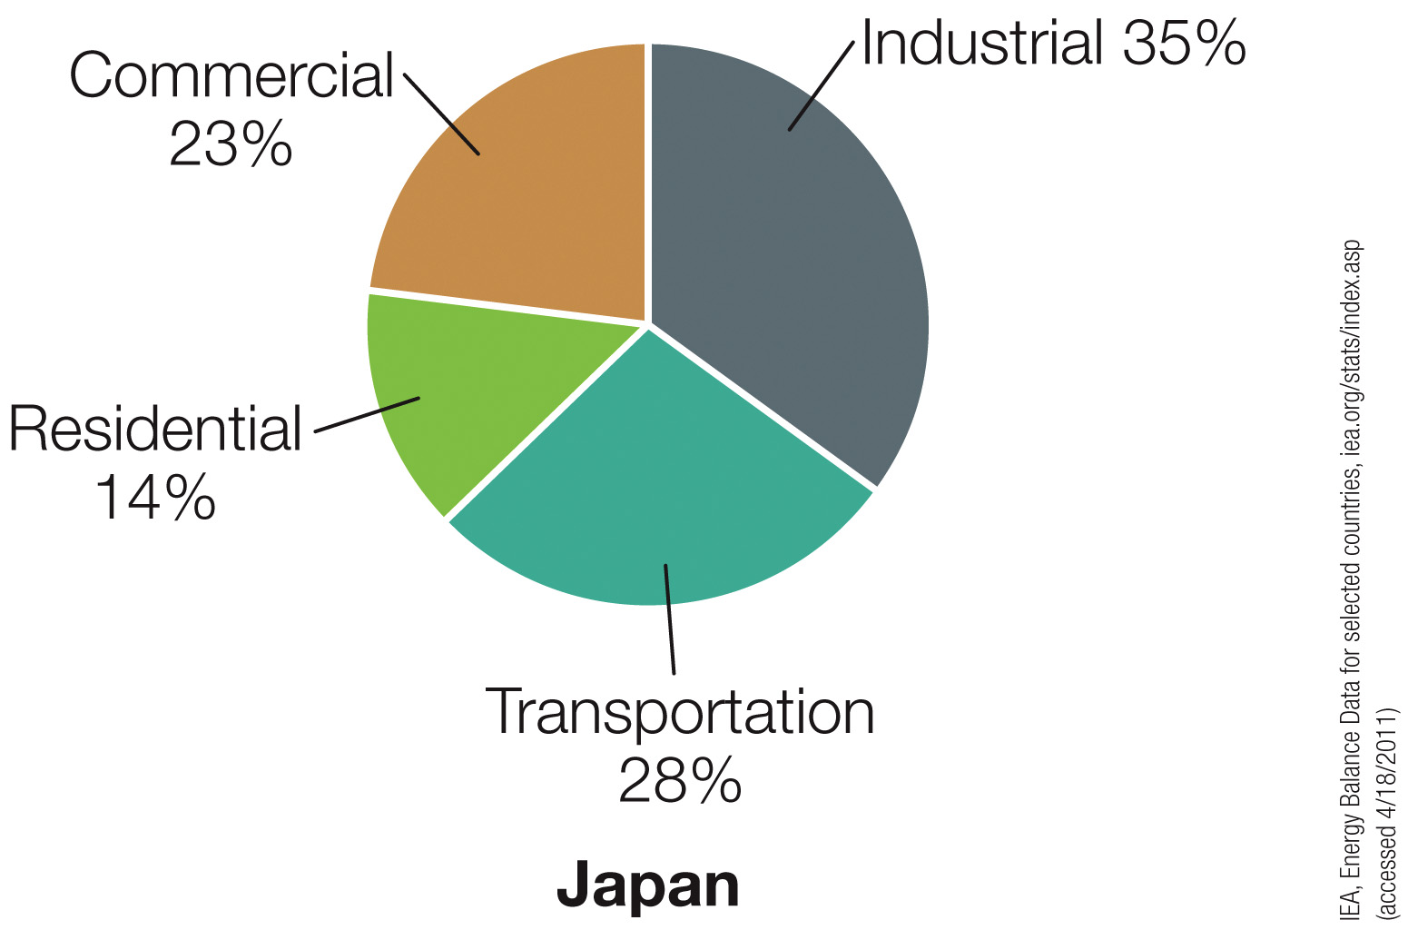
Notes:
FIGURE 2.4b
End-use energy consumption, by sector, for three countries in the early twenty-first century.

Slide 36
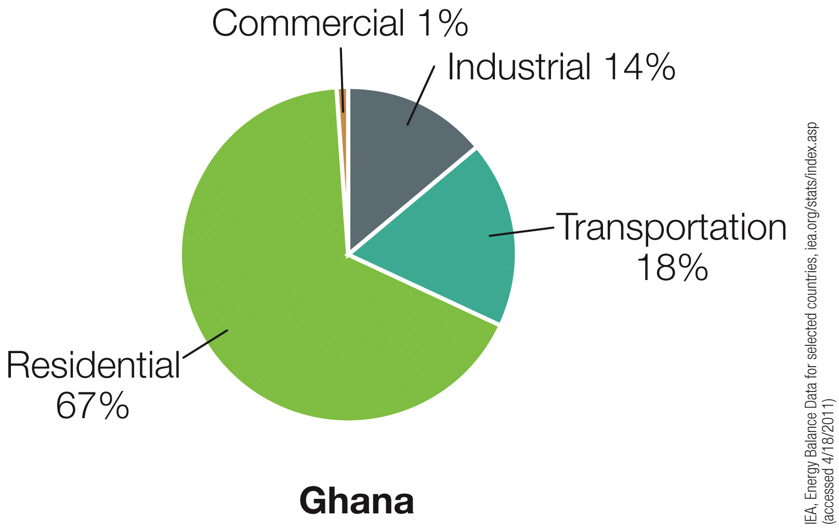
Notes:
FIGURE 2.4c
End-use energy consumption, by sector, for three countries in the early twenty-first century.

Slide 37
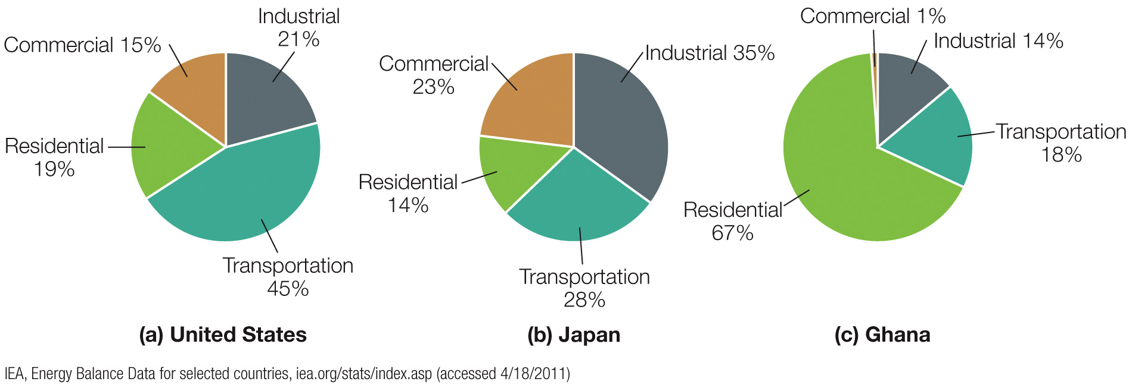
Notes:
FIGURE 2.4
End-use energy consumption, by sector, for three countries in the early twenty-first century.

Slide 38
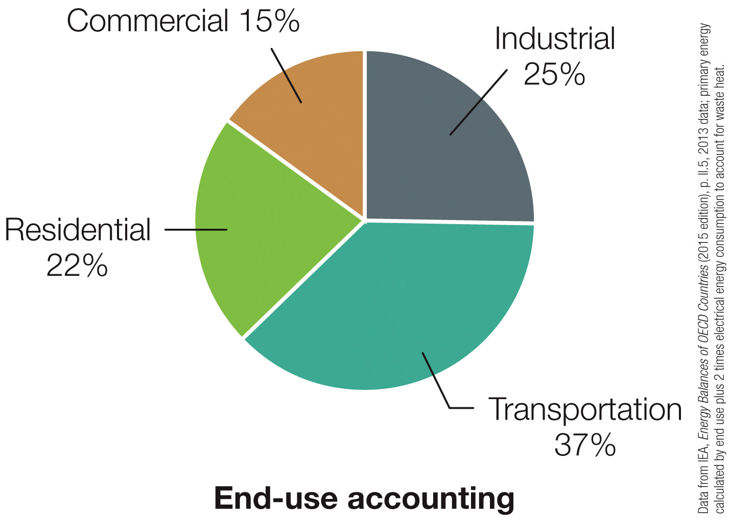
Notes:
FIGURE 2.5a
Energy consumption by sector for the 34 countries that constitute the Organization for Economic Cooperation and Development (OECD), with (a) end-use accounting and (b) accounting for primary energy. Inefficiencies in electric power generation explain most of the difference. In this and some other pie charts, percentages don’t add to precisely 100% due to rounding.

Slide 39
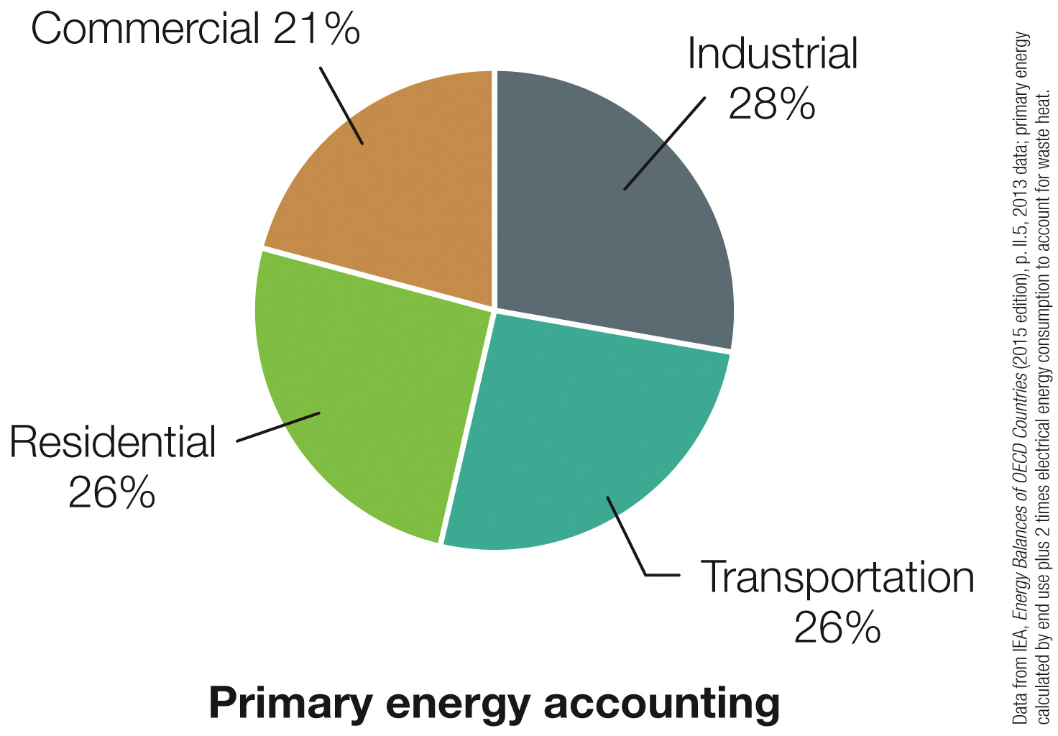
Notes:
FIGURE 2.5b
Energy consumption by sector for the 34 countries that constitute the Organization for Economic Cooperation and Development (OECD), with (a) end-use accounting and (b) accounting for primary energy. Inefficiencies in electric power generation explain most of the difference. In this and some other pie charts, percentages don’t add to precisely 100% due to rounding.

Slide 40
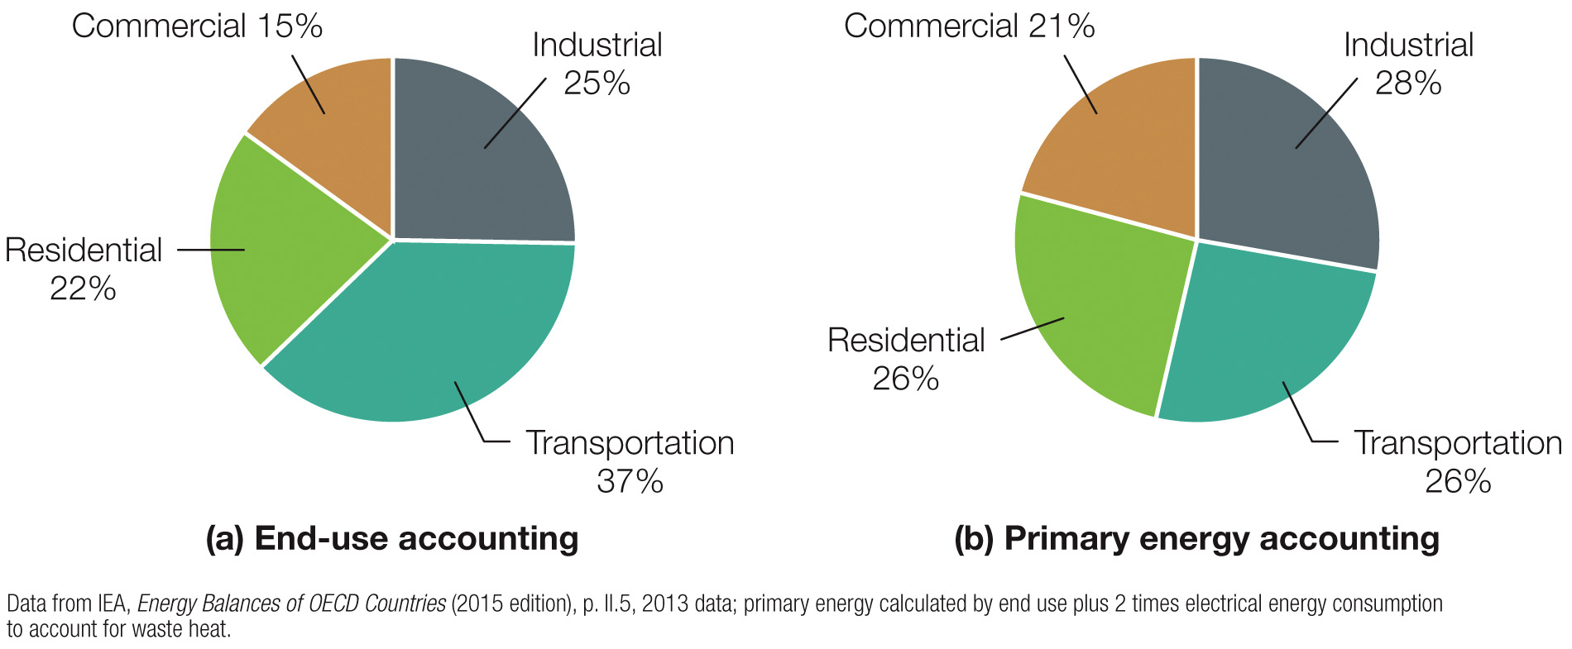
Notes:
FIGURE 2.5
Energy consumption by sector for the 34 countries that constitute the Organization for Economic Cooperation and Development (OECD), with (a) end-use accounting and (b) accounting for primary energy. Inefficiencies in electric power generation explain most of the difference. In this and some other pie charts, percentages don’t add to precisely 100% due to rounding.

Slide 41
Estimated U.S. Energy Consumption in 2010
98 Quads
Solar
Net electricity imports
0.029
Residential
https://flowcharts.llnl.gov/
0.130
0.012
13
12
Nuclear
8.4
Electricity
8.40
generation
2.5
40
Hydro
27
2.5
0.
1
1
Commercial
4.9
4
Rejected
W
ind
0.92
8.5
energy
0.92
0.037
0.44
1.1
7.5
60
4.9
Geothermal
0.15
0.00079
4.5
3
0.21
0.019
3.2
7.6
0.07
0.
1
1
0.65
5.6
Natural gas
Industrial
25
8.3
0.0042
0.016
24
3.3
4.7
19
Energy
19
1.5
8.2
services
Coal
38
21
1.6
Biomass
0.46
1
3.5
22
26
5.8
T
ransportation
Petroleum
27
36
QAe7543
Notes:
This slide contains a series of animations to display different parts of the information, therefore it is best to view in view as a slide show presentation in Powerpoint. If you encounter difficulties, please let me know.

Slide 42
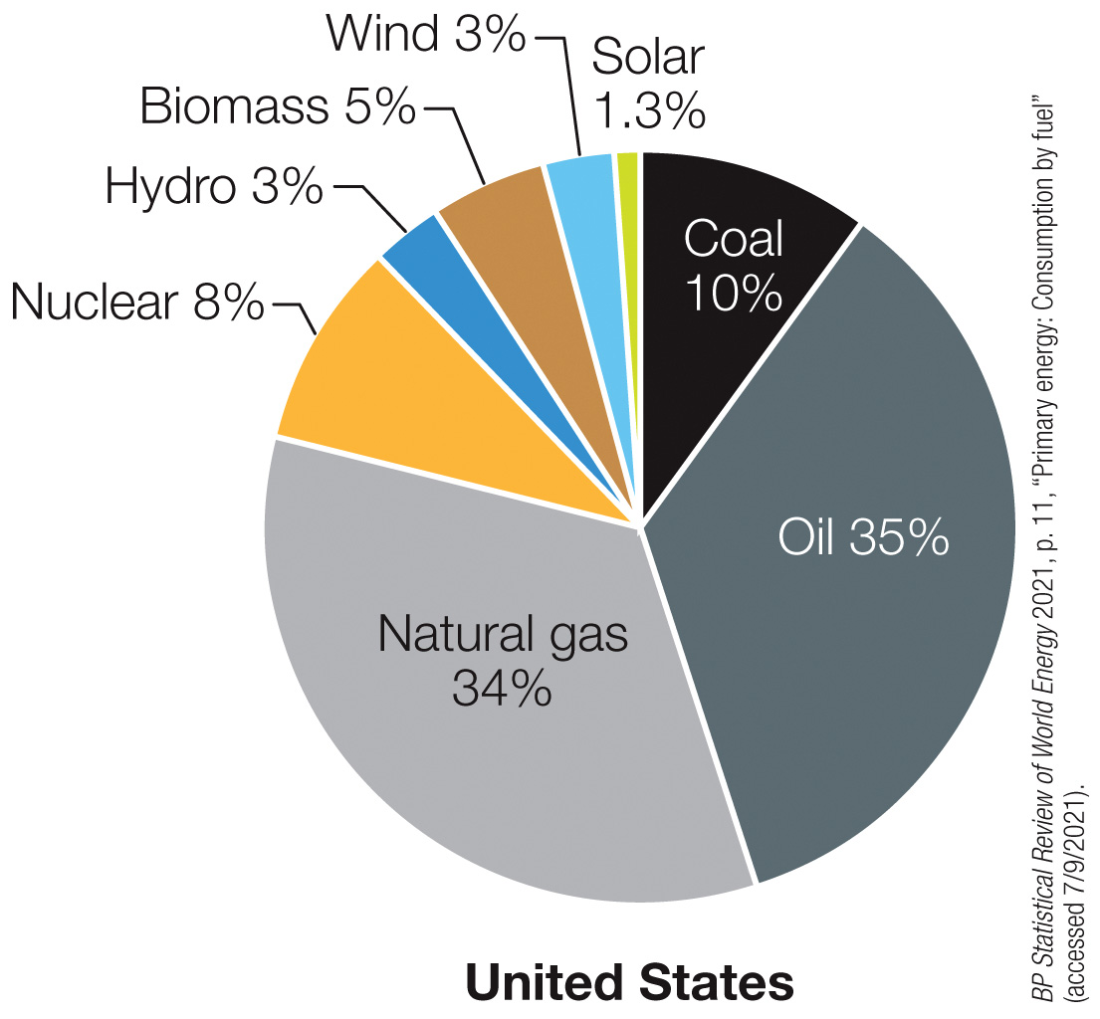
Notes:
FIGURE 2.6a
Sources of primary energy in 2020, shown as percentages.
(a) Nearly 80% of U.S. energy comes from fossil fuels.

Slide 43
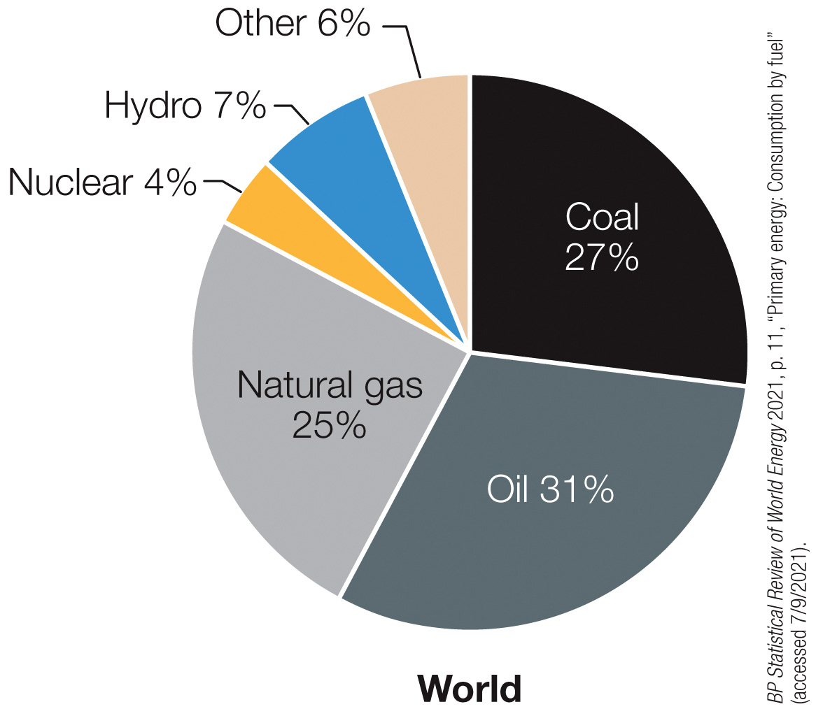
Notes:
FIGURE 2.6b
Sources of primary energy in 2020, shown as percentages.
(b) Fossil fuels supply about 83% of the world’s energy. Here the “Other” category includes solar, wind, biomass, and geothermal energy.

Slide 44
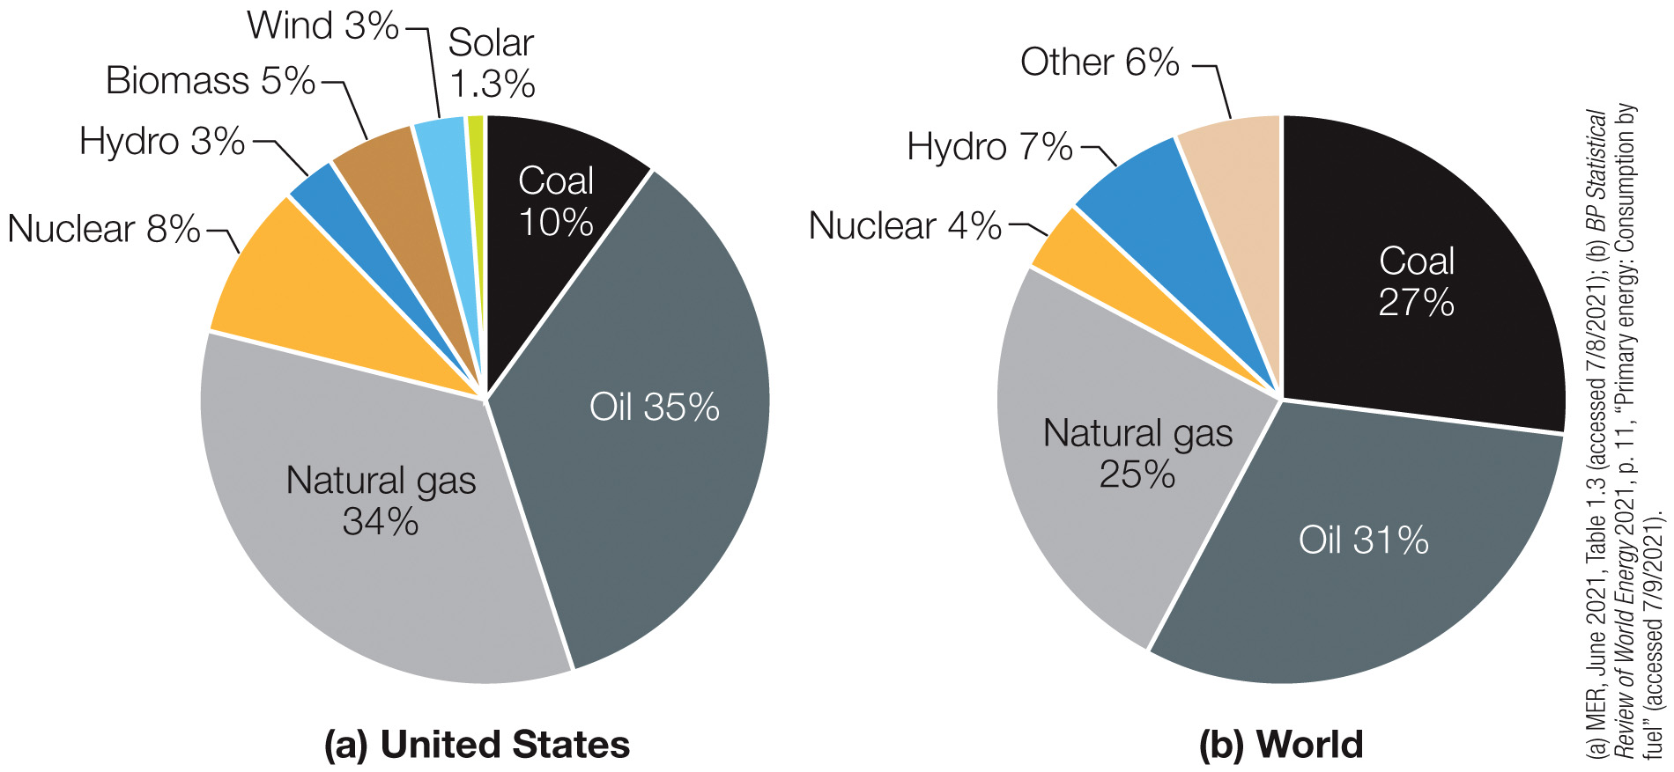
Notes:
FIGURE 2.6
Sources of primary energy in 2020, shown as percentages.
(a) Nearly 80% of U.S. energy comes from fossil fuels.
(b) Fossil fuels supply about 83% of the world’s energy. Here the “Other” category includes solar, wind, biomass, and geothermal energy.

Slide 45
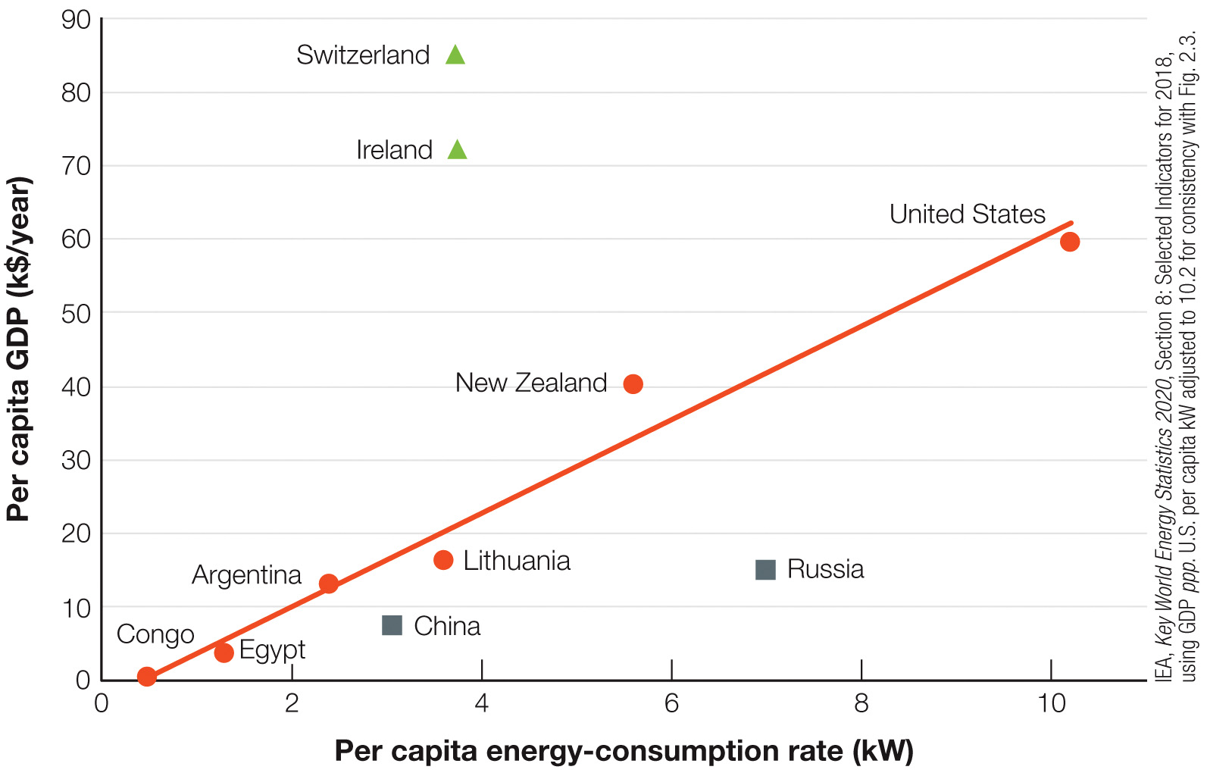
Notes:
FIGURE 2.7
Per capita GDP (in thousands of U.S. dollars per year) versus per capita energy consumption for 10 countries. The six countries that fall near the straight line (marked with circles) have approximately the same energy intensity, or energy consumed per unit of GDP (GDP figures used here are what economists call GDP ppp, for “purchasing power parity”). Ireland and Switzerland (triangles) are more efficient in their use of energy, while Russia and China (squares) are less efficient. Multiplying the numbers on the horizontal axis by 10 gives the number of energy workers per capita.

Slide 46
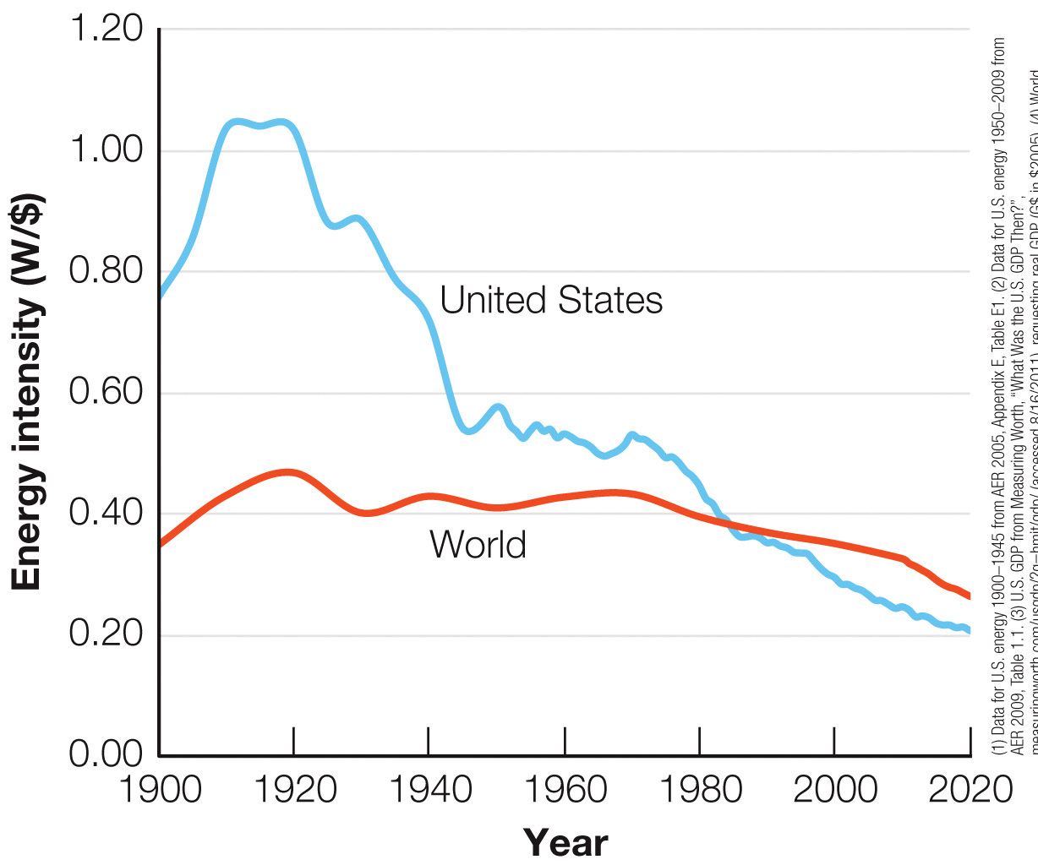
Notes:
FIGURE 2.8
Energy intensity in the United States (and in many industrialized countries) has fallen substantially since 1900. For the world as a whole, a more modest decrease began in the late twentieth century. Energy intensity is measured in watts of average power needed to produce $1 of GDP each year.

Slide 47
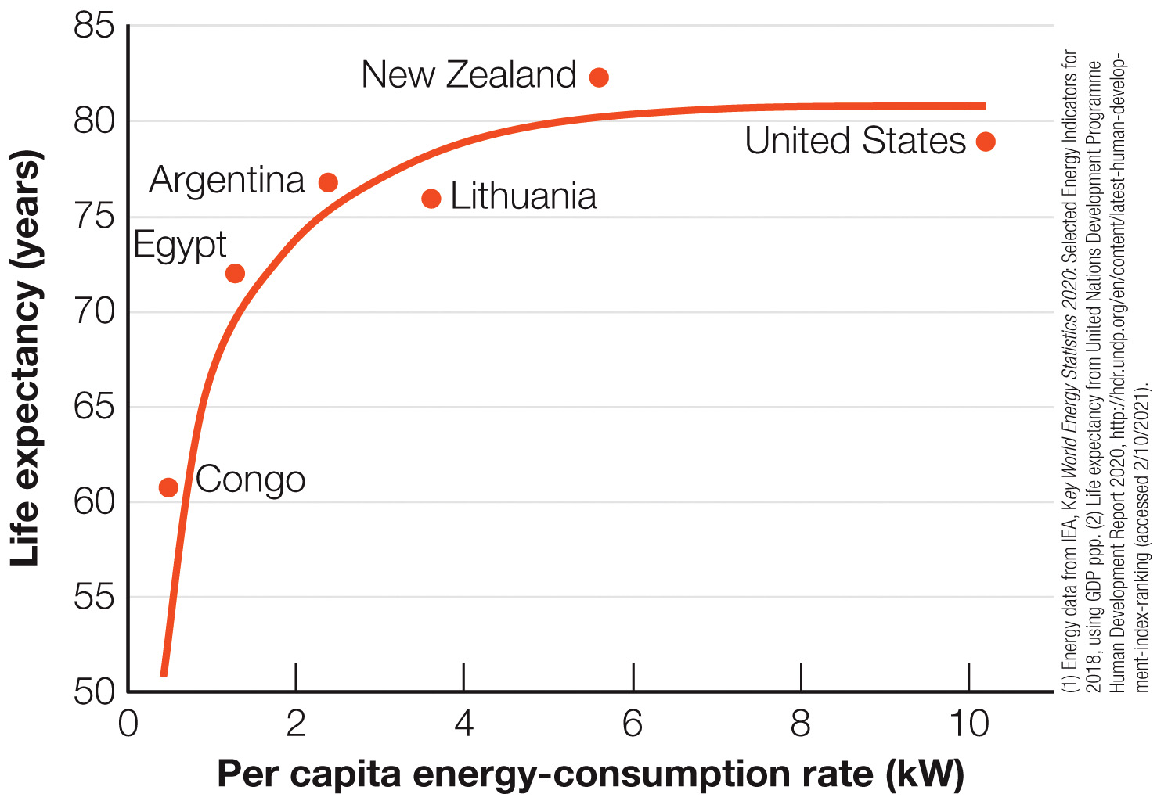
Notes:
FIGURE 2.9
Life expectancy versus energy consumption for the six countries that lie near the line in Figure 2.7. Only at very low energy-consumption rates is there a correlation; at higher energy-consumption rates, the life expectancy curve saturates. Many other quality-of-life indicators show similar behavior in relation to energy consumption.

