Slide 1
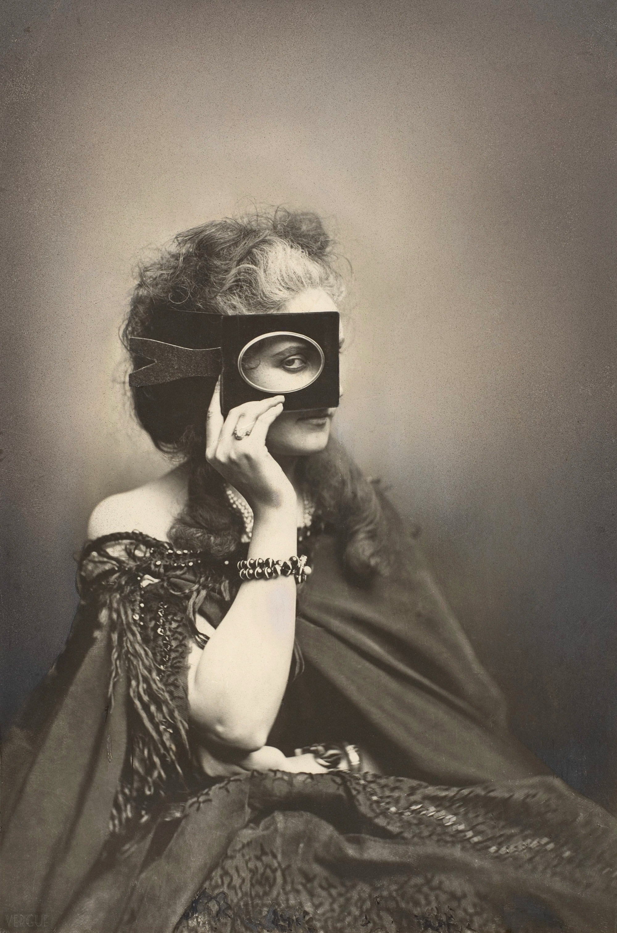
ESEM-016: What is Photography?
Room: Dalton 6
11:40 – 1:00 p.m.
Dr. Meg Hankel
Pierre Louise-Pierson, The Countess of Castiglione, ca. 1863-66

Slide 2
WELCOME
TO
BRYN MAWR!

Slide 3
WELCOME
TO
✨
✨
ESEM!

Slide 4
Today’s Agenda:
Introductions
  Name tents
  Intake forms
  Icebreakers
Syllabus Review
  Learning Goals
  What to expect
Group Activity: The ingredients of a photograph

Slide 5
Introductions

Slide 6
Syllabus Review
A digital copy of the syllabus can be found on our Course Moodle page

Slide 7
(a time machine thought exercise)
THE
INGREDIENTS
OF A
PHOTOGRAPH

Slide 8
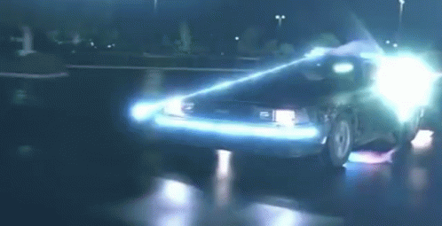
Let’s take a hop into our time machine…

Slide 9
The year is 1826.
You have the sudden and spontaneous urge to create a picture we now know to be a “photograph.”
It is a picture that reproduces the appearance of the world exactly as we see it and far exceeds the detail and precision of any handmade painting or drawing.
What materials would you need in order to make such an image?

Slide 10
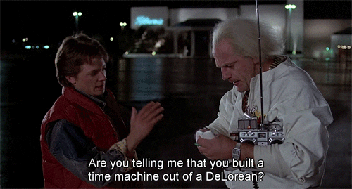

Slide 11
Thursday, September 3, 2026
ESEM-016: What is Photography?
Room: Dalton 6
11:40 – 1:00 p.m.
Dr. Meg Hankel

Slide 12
Agenda
Announcements
Check-in
Tuesday Recap
Lecture on early photography and the daguerreotype
Reflect & Discuss: Niepce, Daguerre, and Poe

Slide 13
Check In
In the past week, what is one new thing you have learned about Bryn Mawr?

Slide 14
Tuesday Review
What are the ingredients of photography?
Light
Light-sensitive material
Camera
Chemistry to stop the absorption of light (called a “fixer”)

Slide 15
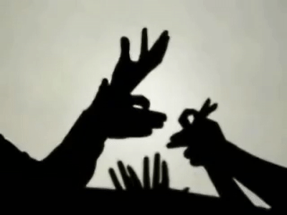
Light & Light-Sensitivity

Slide 16
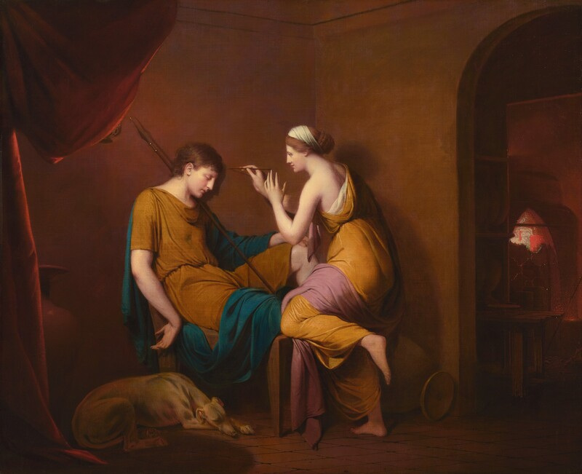
“The Corinthian Maid,” a story (likely a myth) penned by historian Pliny the Elder in 77 CE.
In the story, a young maid traces the outline of her lover’s shadow before he departs for a prolonged absence.
Her father, an artist, then modeled the face of her lover in clay, thus “inventing” the first relief sculpture.
The narrative is often referenced as an origin story for the birth of sculpture and painting.
More recently, photo historians have examined it as an early example of photography.
Joseph Wright, The Corinthian Maid, 1782-84, oil on canvas

Slide 17
A Brief Timeline of Photography’s Invention
330 BCE, Greek philosopher Aristotle observes projection of light through leaves
5th century BCE, Chinese philosopher Mo Ti discovers pinhole camera

Slide 18
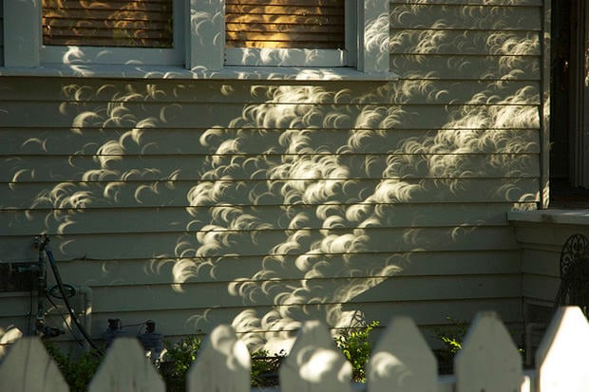
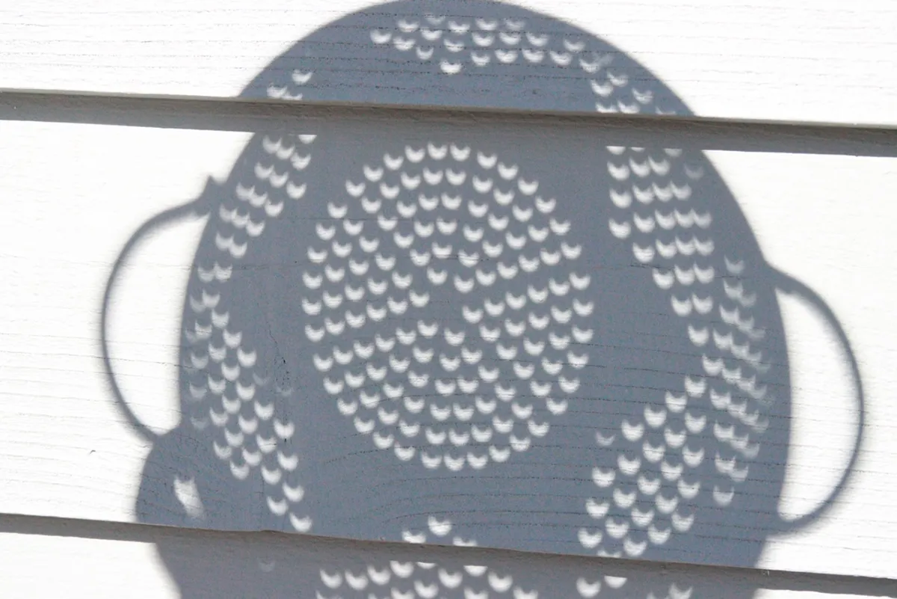
Cresent-shaped light as seen through trees (left) and a colander (right) during a solar eclipse.

Slide 19
A Brief Timeline of Photography’s Invention
330 BCE, Greek philosopher Aristotle observes projection of light through leaves
5th century BCE, Chinese philosopher Mo Ti discovers pinhole camera
10th century CE, mathematician and astronomer Alhazen discovers aperture diameter determines sharpness

Slide 20
A Brief Timeline of Photography’s Invention
15th century CE, linear perspective (a drawing technique) is codified in Italy, artist and inventor Leonardo DaVinci uses camera obscura
330 BCE, Greek philosopher Aristotle observes projection of light through leaves
5th century BCE, Chinese philosopher Mo Ti discovers pinhole camera
10th century CE, mathematician and astronomer Alhazen discovers aperture diameter determines sharpness

Slide 21
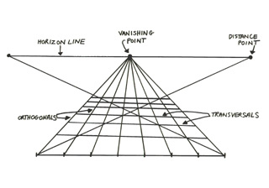
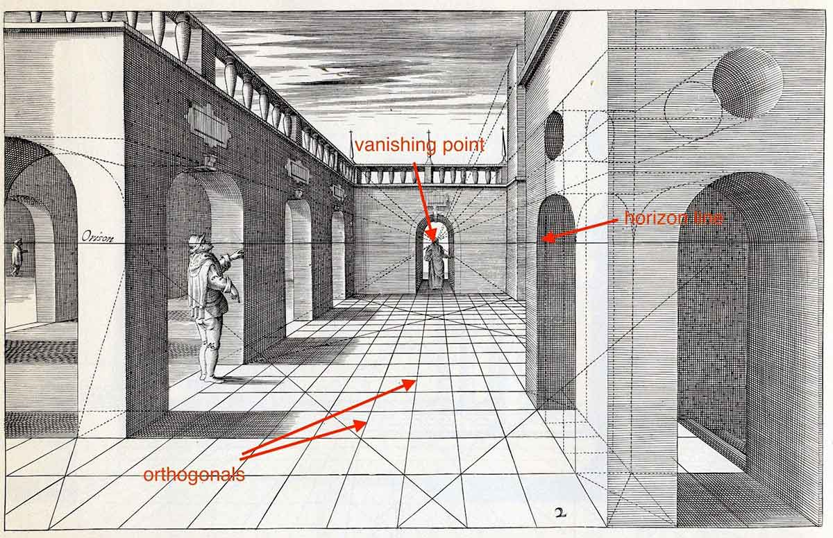
Linear Perspective:
A drawing technique popularized during the Renaissance that created an illusion of three-dimensional space on a two-dimensional surface.
With this technique, artists would render objects along a series of diagonal lines (called “orthogonals”) that converge at a distant vanishing point located on the horizon.
Linear perspective produced pictures that closely mimicked the appearance of the real world.
The camera obscura’s image is also a perspective image, and the device was soon utilized as an artistic tool.

Slide 22
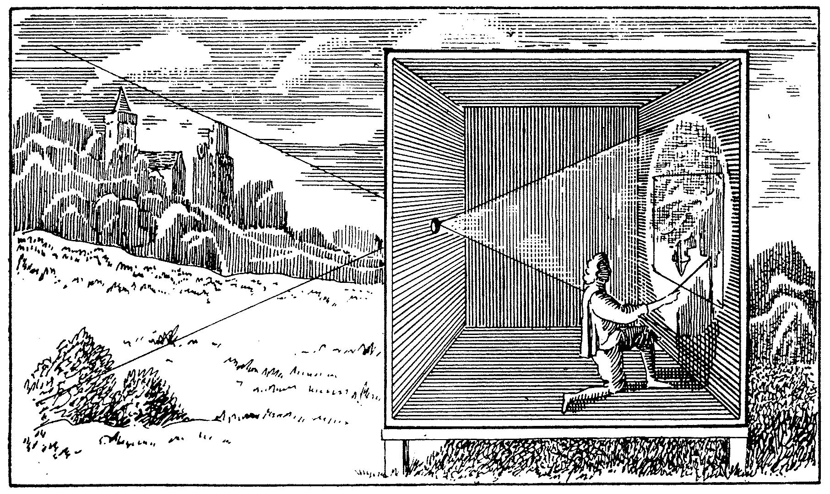
Camera Obscura
Camera, from Latin meaning “chamber” or “vaulted room”
Obscura, from Latin meaning “dark”
17th Century illustration of a camera obscura

Slide 23
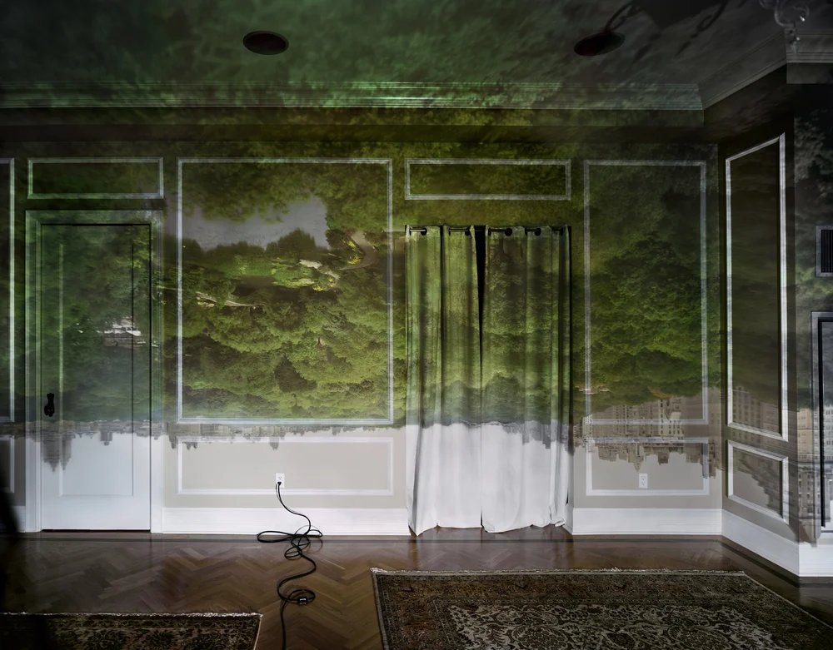
Abelardo Morrell, Camera Obscura – View of Central Park Looking North, Spring, 2010

Slide 24
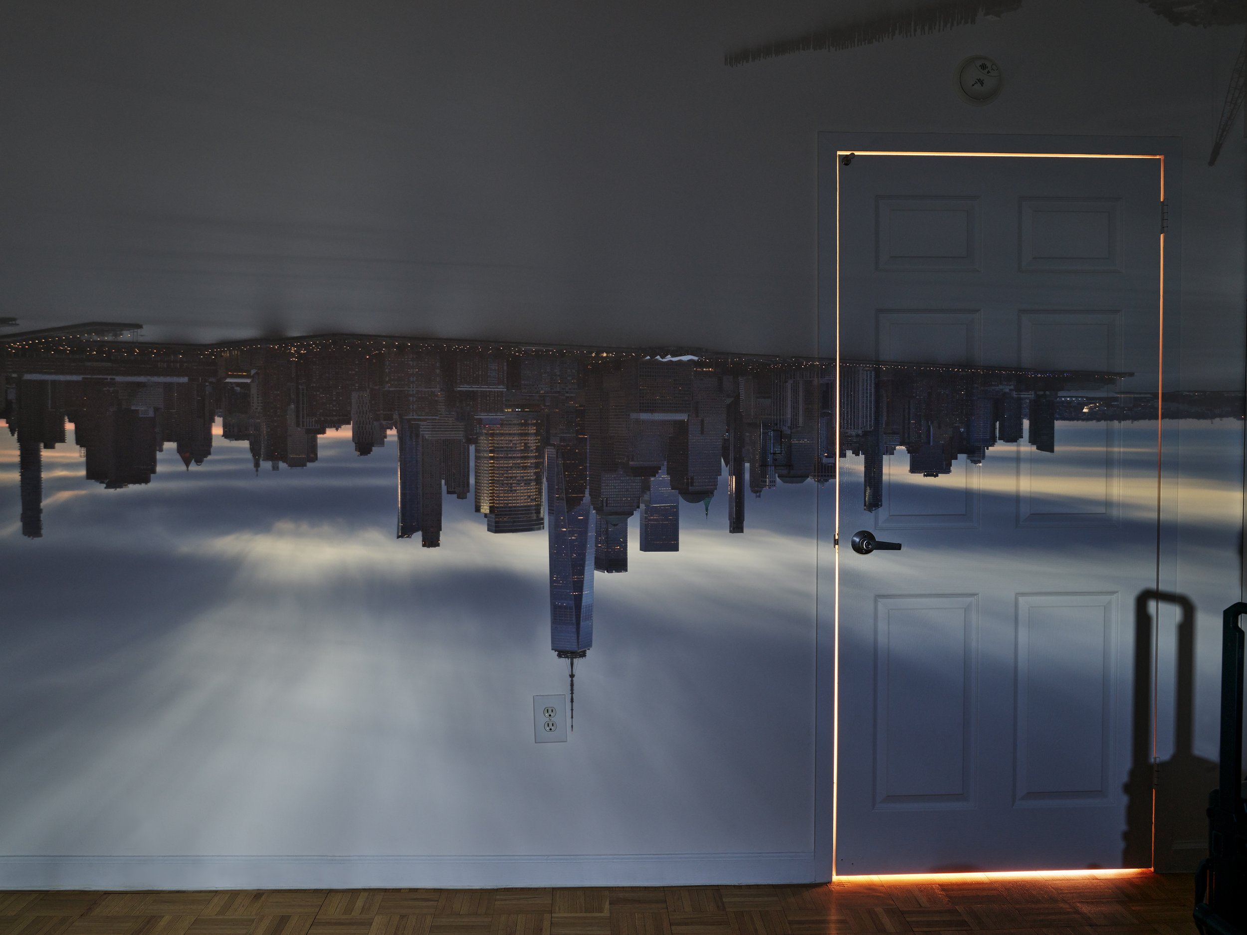
Abelardo Morrell, Camera Obscura – View Lower Manhattan, Sunrise, 2022

Slide 25
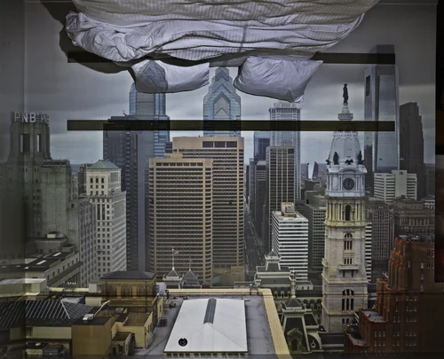
Abelardo Morrell, Camera Obscura – View of Philadelphia from Loews Hotel Room 3013 With Upside Down Bed, 2014

Slide 26
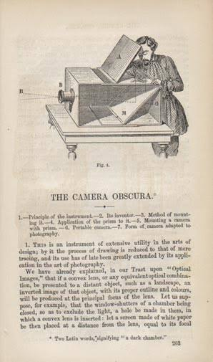
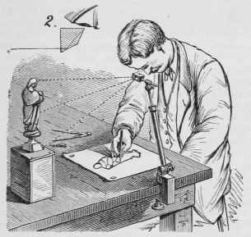
Drawing Aids in the 18th and 19th Centuries
Camera lucida
Camera obscura

Slide 27
A Brief Timeline of Photography’s Invention
330 BCE, Greek philosopher Aristotle observes projection of light through leaves
15th century, linear perspective is codified in Italy, artist and inventor DaVinci uses camera obscura
5th century BCE, Chinese philosopher Mo Ti discovers pinhole camera
10th century, mathematician and astronomer Alhazen discovers aperture diameter determines sharpness
1790s, Thomas Wedgewood and Humphry Davy experiment with light sensitivity of silver nitrate

Slide 28
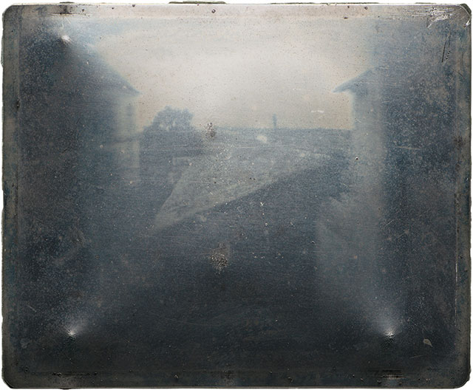
Nicéphore Niépce (1765-1833)
A printmaker who began collaborating with his brother, Claude, on using light and light-sensitive chemistry as a printmaking technique.
Eventually, they combined these experiments with the camera obscura and produced what is now regarded as the earliest surviving photograph.
This image was produced on a photo-sensitive plate of pewter, treated with bitumen and lavender oil, and took approximately 10-12 hours to expose.
Niépce, View from the Window at Le Gras, around 1826-27, heliograph

Slide 29
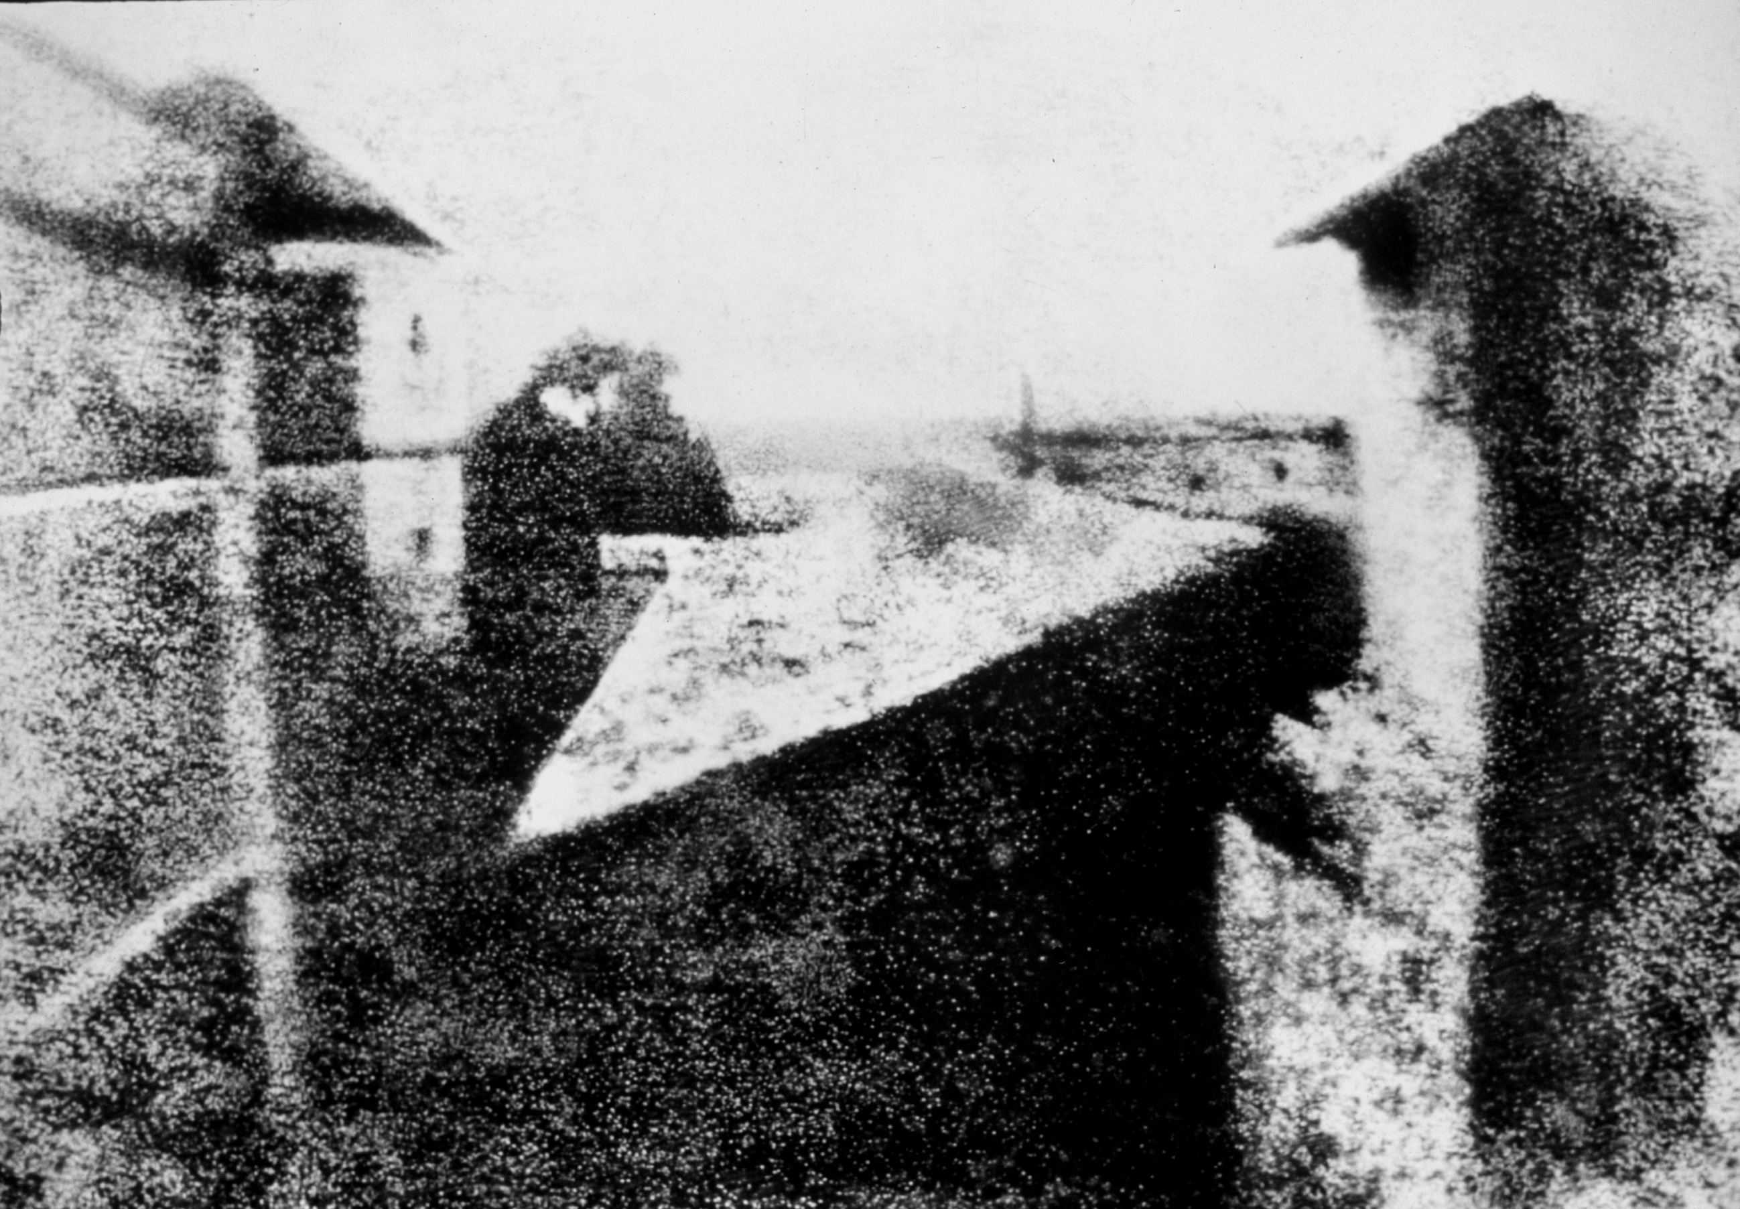
Niépce, View from the Window at Le Gras, around 1826-27, heliograph

Slide 30
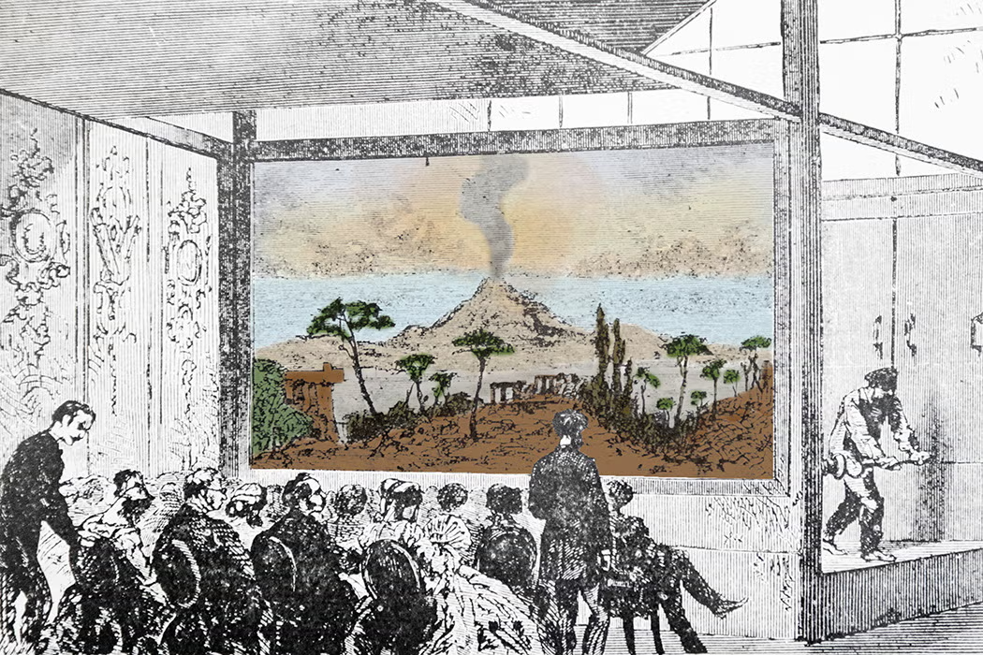
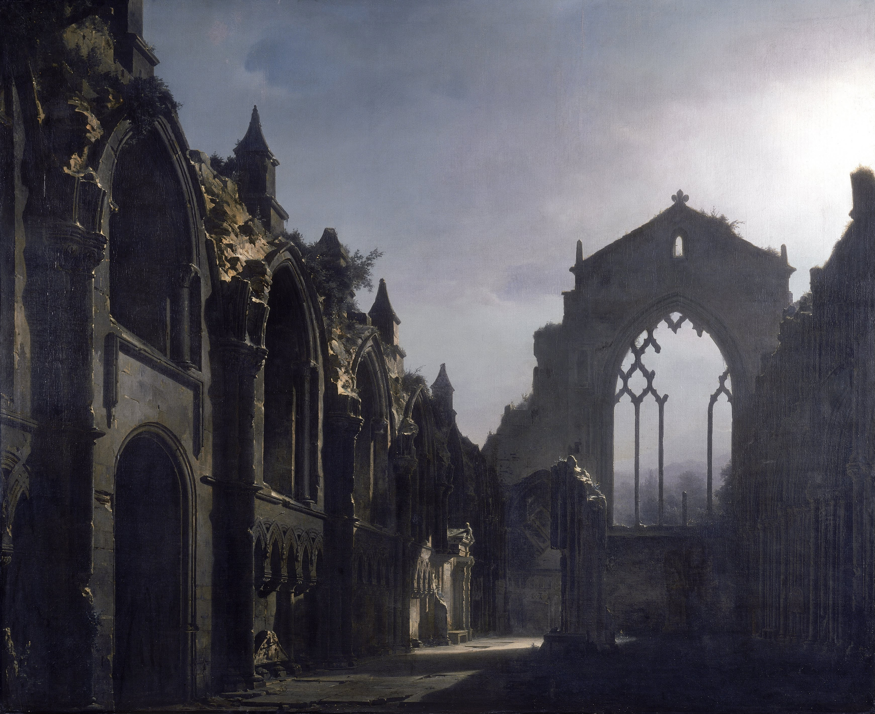
Louis Daguerre (1787-1851)
Around 1825, an artist named Daguerre contacted Niepce about collaborating with him on these experiments.
Daguerre was painter of dioramas, a type of theatrical visual spectacle that combined large-scale painting with visual lighting effects and music.
Daguerre and Niepce began working together to improve Niepce’s discovery and shorten the exposure time of photography.
Niepce dies in 1833 of a stroke and leaves behind a son who continues to work with Daguerre.
By 1839, Daguerre perfected the process to significantly reduce exposure times to 3 to 15 minutes outside and under the bright sunlight.
An example of a diorama
Louis Daguerre, The Ruins of Holyrood Chapel, 1824, oil on canvas, 83.1 × 100.9 in

Slide 31
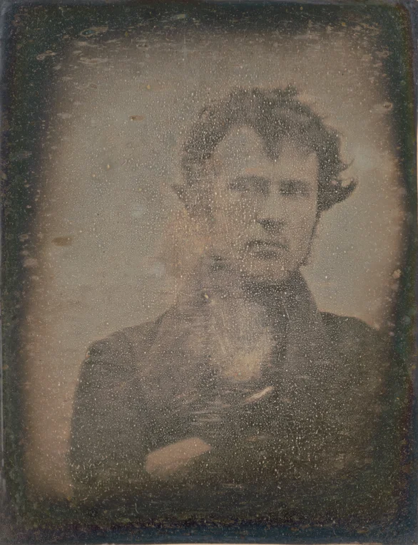
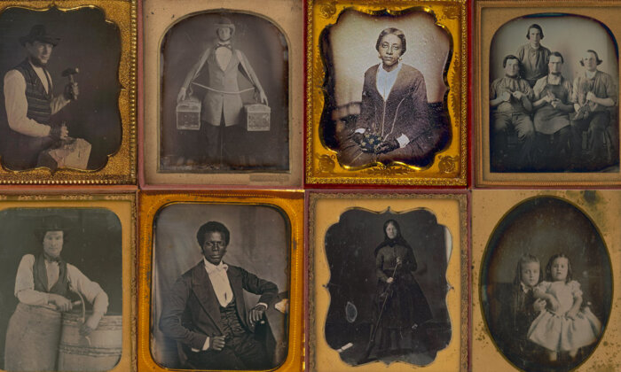
The Daguerreotype
Examples of daguerreotypes
Robert Cornelius, Self Portrait, 1839, daguerreotype

Slide 32
Looking at a Daguerreotype: https://www.youtube.com/watch?v=_J8A-YQmrFc
V&A Museum: How Daguerreotypes are made: https://www.youtube.com/watch?v=DAPgdo5H7ZY

Slide 33
Close Reading: Think, Pair, Share
Step 1: For ten minutes, independently review Niépce, Daguerre, and Poe’s essays and pay close attention to how they each describe and discuss photography. Consider the following questions:
What words or phrases do they use to describe photography? What names do they give the technology? What is most impressive to them about it? How do they describe photography materially? How do they explain how photography works?
Step 2: With a partner, compare notes. Together, craft several sentences characterizing the collective attitude about photography at the moment of its invention.
Step 3: Share as a Group!

