Slide 1
Q-center: https://www.brynmawr.edu/inside/offices-services/q-center/q-center-schedule
Office Hours: M 1:30pm – 3:00pm
(in Park 169) W 11:00am – 12:00pm
or by appointment (email me)
or just email me with questions!
TA Hours w/ Dana: Th 6:00pm – 7:00pm
(in Park ____) F 4:30pm – 6:00pm
Unit Conversion
Brief History of Atomic Theory
9/4/2026
No recitation this afternoon.
Achieve HW #1 due Wednesday 9/9 at 10:00am
Quiz #1 in Recitation next Friday (9/11)

Slide 2
Learning Objectives
Perform basic unit calculations and conversions in the metric and other unit systems
Explain the dimensional analysis (factor label) approach to mathematical calculations involving quantities
Use dimensional analysis to carry out unit conversions for a given property and computations involving two or more properties
Apply the law of conservation of matter
Define and give examples of atoms and molecules
Outline milestones in the development of modern atomic theory
Summarize and interpret the results of the experiments of Thomson, Millikan, Rutherford, and Chadwick
Write and interpret symbols that depict the atomic number, mass number, and charge of an atom or ion

Slide 3
Unit Conversion
Given one or more quantities, convert them into different units.
Units are multiplied, divided, and canceled like any other algebraic quantities.
Always write every number with its associated unit!!! No shortcuts!!

Slide 4
Some conversion factors
You will always be provided with any unit conversion factors needed for a problem.
You do not need to memorize unit conversion factors. (i.e. 1 kg = 2.205 lb)
You do need to memorize conversion factors for the unit prefixes (i.e. 1 kg = 10³ g) indicated a few slides ago.

Slide 5
Problem Solving Using the Factor-Label Method
Conversion factor: A term that converts a quantity in
one unit to a quantity in another unit.
original
quantity
desired
quantity
x
conversion factor
=
Conversion factors are usually written as equalities.
2.21 lb = 1 kg
To use them, they must be written as fractions.

Slide 6
Solving Problems Using Conversion Factors
Factor-label method: Using conversion factors to manage a complex problem involving many units. Also called Dimensional Analysis.
units are treated like numbers
make sure all unwanted units cancel
all quantities in the calculation have units labeled!
To convert 130 lb into kilograms:
1.3×10² lb
x
conversion factor
? kg
=
original
quantity
desired
quantity

Slide 7
How many kg in 1.3×10² lb ?
2.21 lb = 1 kg
2.21 lb
1 kg
1.3×10² lb
x
or
1 kg
2.21 lb
=
59 kg
Set up the conversion factor with original unit in the bottom of the fraction.
The unwanted unit lb cancels.
The desired unit kg does not cancel, and is on the top of the fraction
→ final unit is kg

Slide 8
Solving Multistep Unit Conversion Problems
Each step should have a conversion factor set up to cancel the units of the previous step
Example: How many km are there in 1.2x10⁴ ft?
1 foot = 0.3048 m

Slide 9
Conversion with Units Raised to a Power
Example: converting cm³ to in³
1 in = 2.54 cm
Must cube both sides of the equality to obtain the proper conversion factor.
How many cubic inches in 251 cm³?
Notes:
Insert equations from page

Slide 10
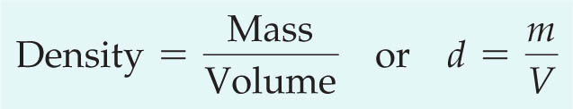
Density
The density of a substance is the ratio of its mass to its volume.
Water has a density of 1.0 g/mL (or 1.0 g/cm³)
Things that are less dense (like oil) will float in water.
Things that are more dense (like CH₂Cl₂) will sink.

Slide 11
Calculating Density
Example: a sample of liquid has a volume of 22.5 mL and a mass of 27.2 g.
Assuming this liquid is not miscible with water (that is, they will separate like oil and water and not mix), will this liquid float or sink in water?

Slide 12
Density as a Conversion Factor
We can use the density of a substance as a conversion factor between the mass of the substance and its volume.
For a liquid substance with a density of 1.32 g/cm³, what volume in liters should be measured to deliver a mass of 68.4 g?
Notes:
Convert to equation object

Slide 13
A 23.5 kg sample of ethanol is needed for a large scale reaction. What volume in liters of ethanol should be used? The density of ethanol is 0.789 g/cm³.
Conversion factors: 1 cm³ = 1 mL

Slide 14
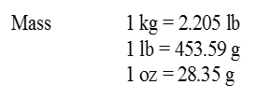
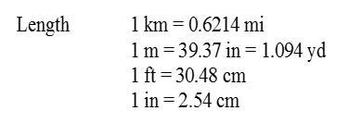
Convert 2.6 lb/in³ to g/ml .

Slide 15
Law of Conservation of Mass
There is no new matter.
  Matter is neither created nor destroyed in a chemical reaction.
    In a nuclear reaction, significant changes in mass can occur.
  During physical and chemical changes, the total amount of matter remains constant.

Slide 16
Ex: Conservation of Mass
Butane + Oxygen → Carbon Dioxide ­+ Water
58 g 208 g 176 g 90 g
Example: 12 g of natural gas combines with 48 g of oxygen in a flame. The chemical reaction produces 33 g of carbon dioxide and how many grams of water?
Natural gas + oxygen → carbon dioxide + water
12 g 48 g 33 g ?

Slide 17
Early Ideas About Atoms
ca. 400 BCE: Ancient Greek philosophers Leucippus and Democritus
All matter is made of irreducible “building blocks” that couldn’t be divided further
“atomos” = “indivisible”
Empedocles (and Aristotle) believed matter was composed of four “elements:”
Notes:
Water, earth, fire, air. Long ago, the four nations lived together in harmony. Then….

Slide 18
Atomic Theory
1808 CE: John Dalton’s Atomic Theory expanded on the centuries-old Greek philosophies…
1. All matter is composed of atoms.
2. For a given element, all atoms have the same mass and other properties.
3. Different elements have atoms with different properties.
4. A compound consists of atoms of two or more elements combined in whole-number ratios.
Example: Water H₂O has 2 atoms of hydrogen for every 1 atom of water
5. Atoms are not created or destroyed in a chemical change. They rearrange to make new compounds (with new ratios of atoms).
Notes:
In between – Jabir ibn Hayyan (ca. 800CE) was cooking like mad, still on the Grecian 4 elements paradigm. But no one really knew what each other was saying in the alchemy world and experiments were often not reproducible. The theory was far from cohesive but a lot of experiential knowledge of substances came about (ie strong acids, metallurgy, sulfur and mercury, etc).

Slide 19
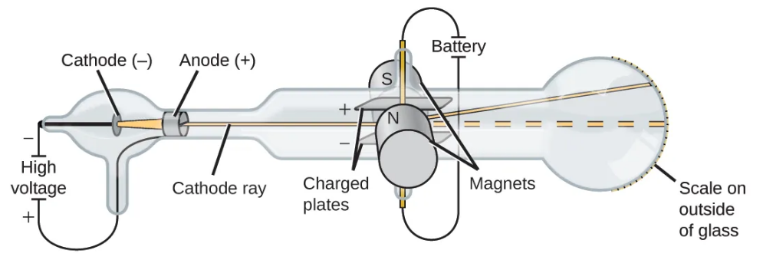
Revising Dalton’s Atomic Theory
1897 CE: J.J. Thompson built on (and challenged) Dalton’s atomic theory
Electricity applied in a vacuum generates a beam of negatively charged particles.
Experimentation allowed calculation of the mass-to-charge ratio of these particles.
They were negatively charged, and much lighter than any atoms that had been observed!
Atomic theory was revised to account for new observations.

Slide 20
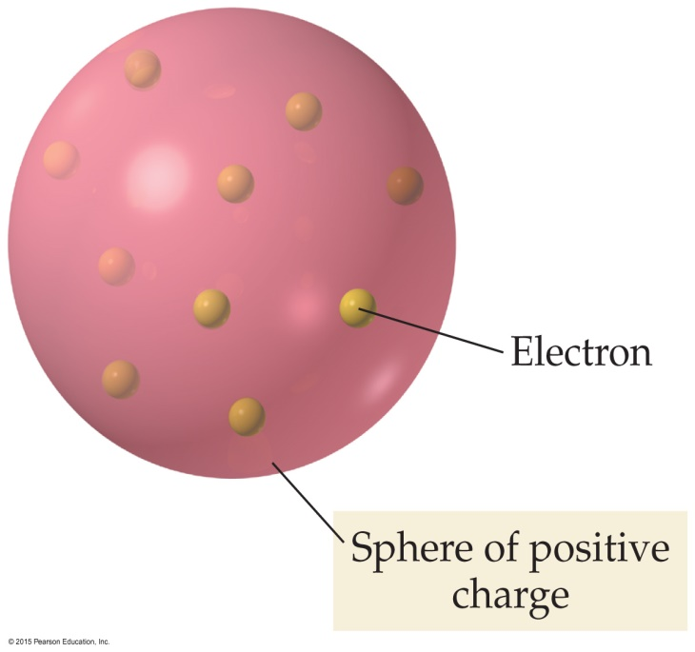
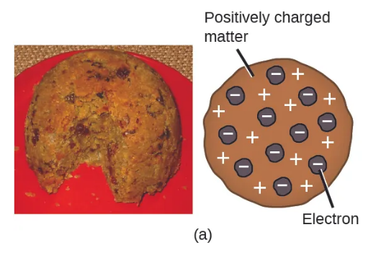
Plum Pudding Model of the Atom
Atoms were known to be neutral so there must be positive charges to balance these negatively charged “electrons”
1904 CE: “Plum Pudding Model”
Atom is a sphere of positive charge with negative particles (electrons) mixed in

Slide 21
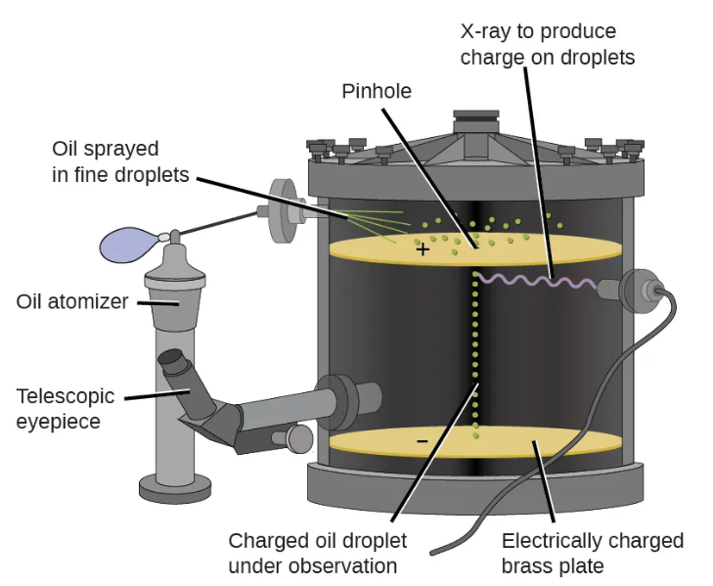
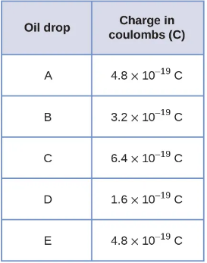
Millikan’s Oil Drop Experiment
1909 CE: Further investigation into negatively charged electrons.
Experiments produced tiny oil droplets with slight negative charges
Observed that charge on droplets was always a multiple of the same number!
Determined the smallest unit of negative charge must be 1.6 x 10⁻¹⁹ C
Combined with Thompson’s data, allowed calculation of mass of one electron

Slide 22
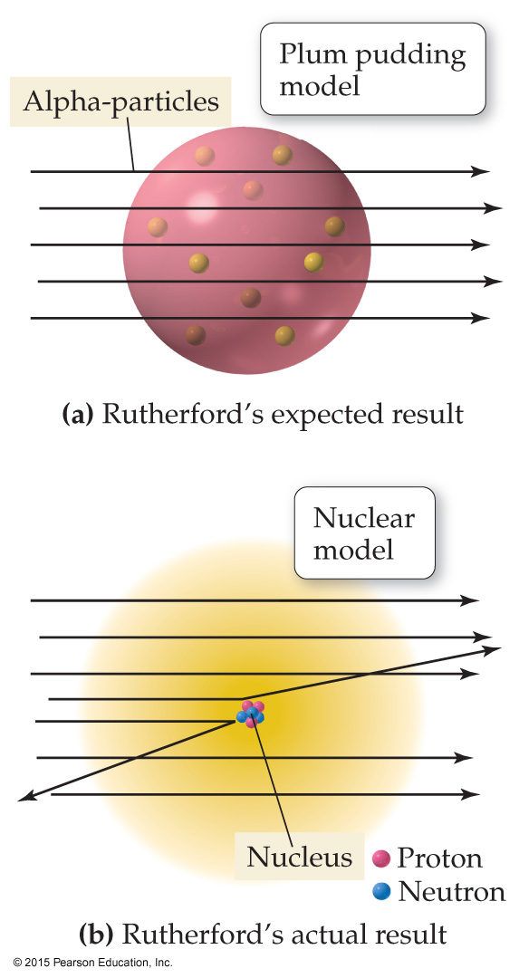
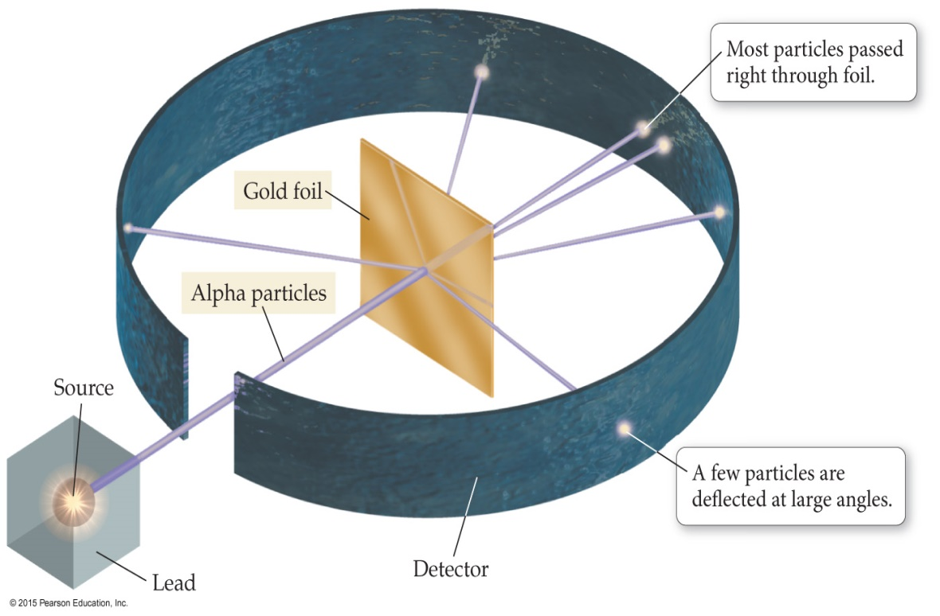
Rutherford’s Gold Foil Experiment
ca. 1909 CE: Ernest Rutherford and co. tried to confirm Thompson’s Plum Pudding Model
Tiny alpha-particles were directed at a thin sheet of gold foil.
Most of the particles passed directly through the foil.
A few were deflected, some of them at sharp angles.

Slide 23
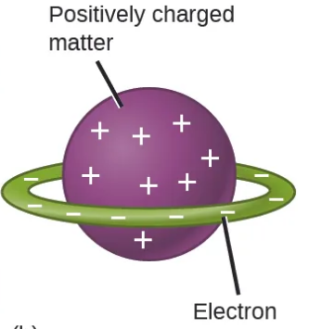
Nuclear Theory of the Atom (1911 CE)
a) Rutherford’s Expected result:
Alpha-particles should pass through gold foil with minimal deflection.
Deflections should be roughly uniform.
(b) Actual result:
A small number of alpha-particles were deflected or bounced back.
Supported Hantaro Nagaoka’s “planetary” model of the atom (1903)
“Plum Pudding” model
“planetary” model
Notes:
Nagaoka had abandoned his idea by 1908!

Slide 24
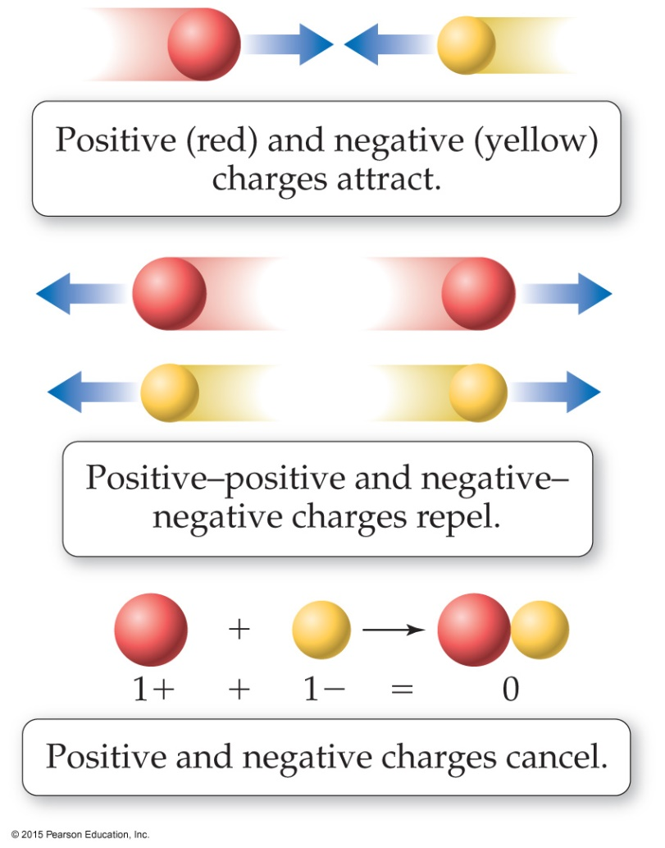
Nuclear Theory of the Atom (1911 CE)
1. Most of atom’s mass and positive charge is contained in a small central core called the nucleus
2. Atom is mostly ___________ __________, with small negatively charged electrons interspersed.
3. Amount of positive charge = amount of negative charge (atom is neutral)
Experiments showed that nuclei of all elements contained Hydrogen nuclei as “building blocks”
Rutherford named this building block of nuclear mass and positive charge the “proton.”

Slide 25
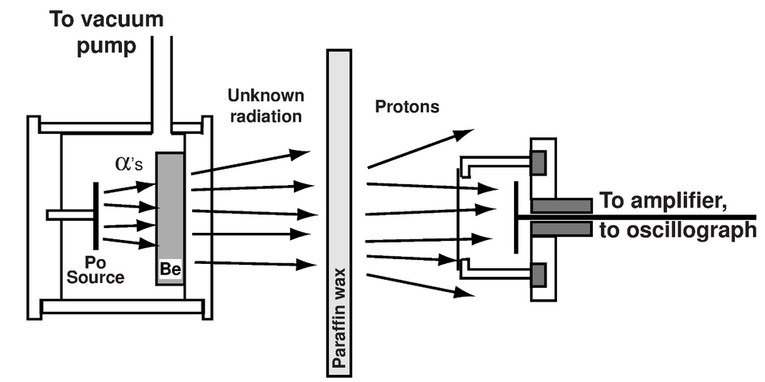
James Chadwick and the Neutron
Experiments to this point had determined:
  Atoms contain negatively (-) charged e⁻
  which have very little mass.
  Most of an atom’s mass is in the nucleus
  The nucleus contains positive (+) charged protons
  An atom of Helium is 4x as heavy as Hydrogen,
  but the nucleus only has 2x as much (+) charge.
Data suggested there was a ___________ particle contributing to the nucleus mass!
1932 CE: James Chadwick discovered a new type of radiation.
Particles had similar mass to a Hydrogen nucleus, but no charge.

Slide 26
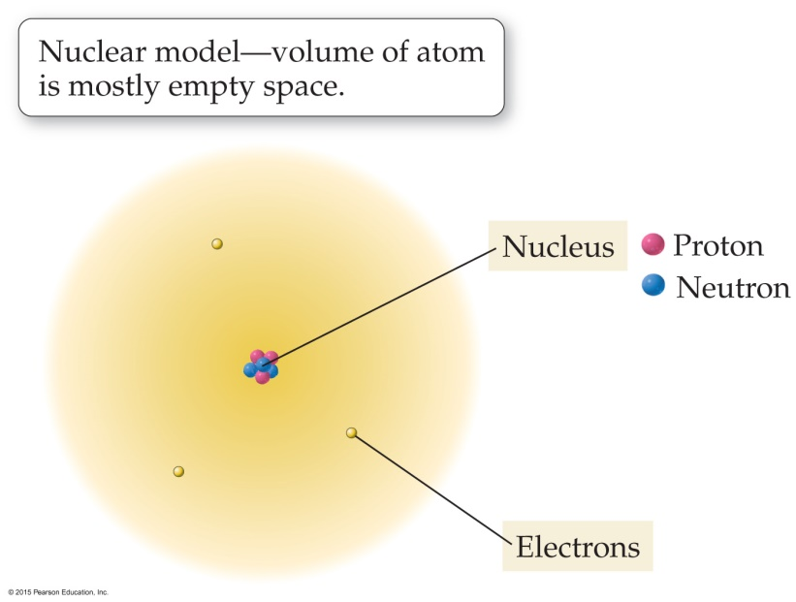
Protons, Neutrons, & Electrons (Subatomic Particles)
Protons (+ charge) and neutrons (neutral) make up nucleus (99.9% of atom’s mass)
Electrons (- charge): cloud of negatively charged particles around nucleus; very little mass
Atomic mass unit (amu): convenient unit for the mass of subatomic particles
1 amu = 1.66x10⁻²⁷ kg
Based on 1/12 mass of a ¹²C atom.
amu is also called ______________ , especially
by _________________.

Slide 27
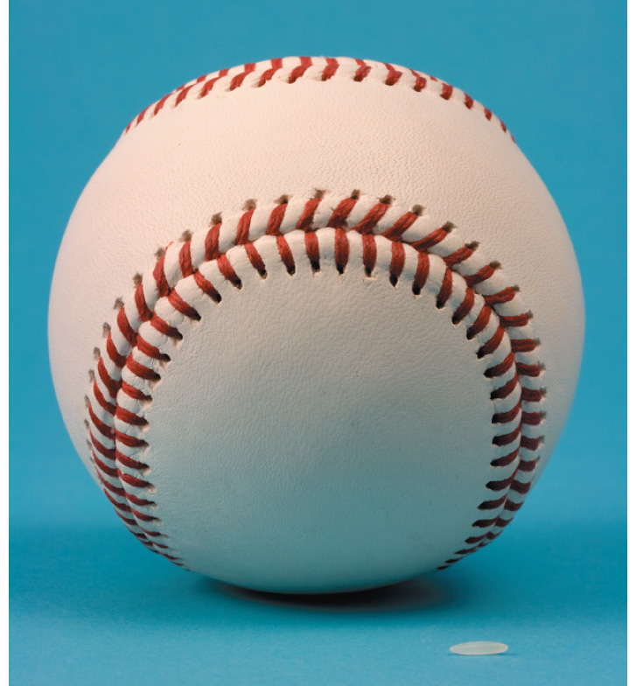
Subatomic Particles
 | Mass (kg) | Mass (amu) | Charge
Proton | 1.67273 x 10⁻²⁷ | 1.0073 | +1
Neutron | 1.67493 x 10⁻²⁷ | 1.0087 | 0
Electron | 9.1 x 10⁻³¹ | 0.00055 | -1
If a proton had the mass of a baseball,
an electron would have the mass of a grain of rice.
A proton is nearly 2000 times more massive than an electron.

Slide 28
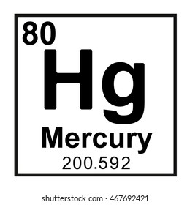
Atomic Numbers & Symbols
Elements are defined by their number of protons
Atomic Number (Z) = number of protons
Chemical symbol = abbreviation for an element
Example: Carbon (C), Silicon (Si), Lead (Pb), Mercury (Hg)
Some symbols are based on the Latin names

Slide 29
Atomic Numbers & Symbols
2 = Atomic Number (Z)
He = Chemical Symbol
4.00 = Atomic Mass (in amu)
Helium = Name

