Slide 1
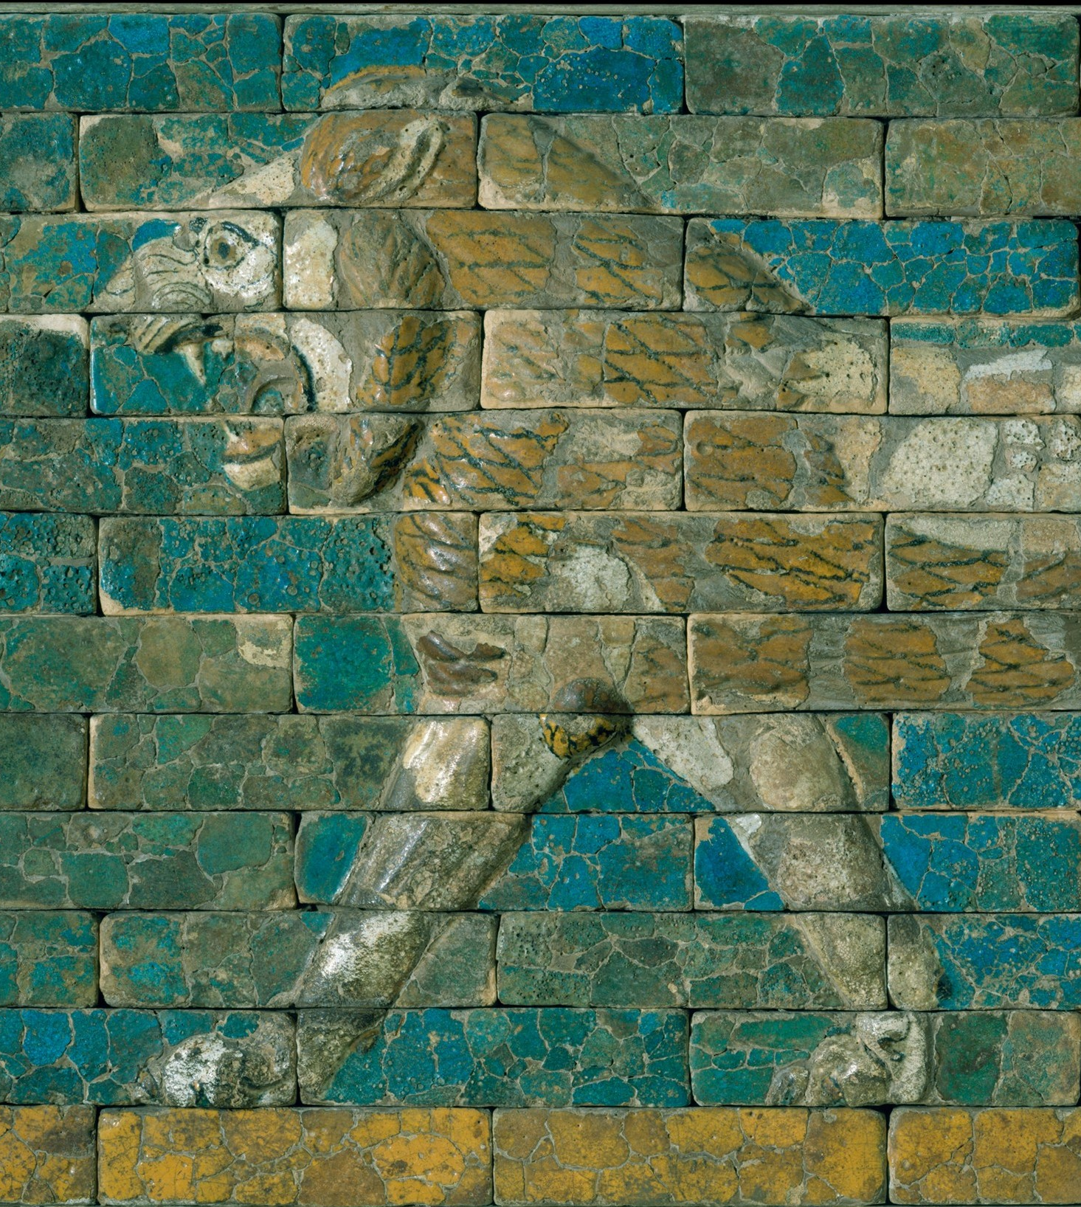
The Landscape of the Near East
ARCH B101 – Archaeology of the Ancient Near East and Egypt
Fall 2026
September 4

Slide 2
Looking Ahead
Mon 9/7: Labor Day (no class)
Wed 9/9 and Fri 9/11: Grass
Fri 9/18: Discussion sections begin and Map Quiz 1
  Study map is on Moodle

Slide 3
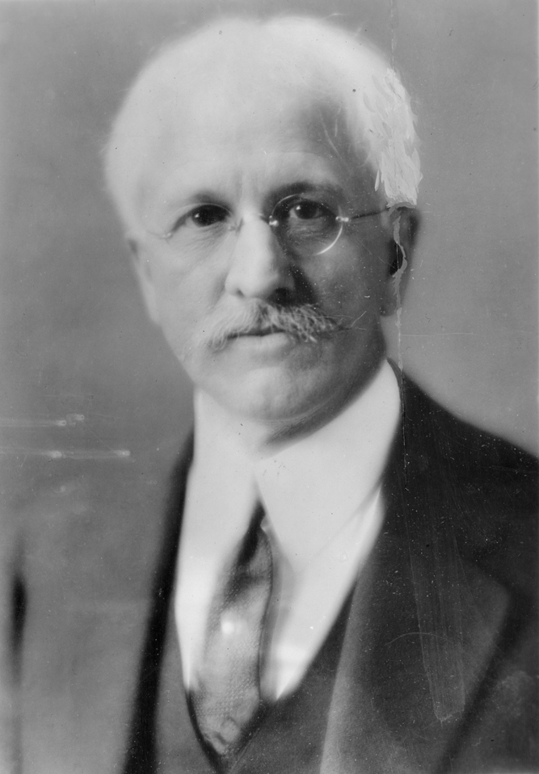
The Fertile Crescent
Term coined by J. H. Breasted in 1914 to describe Mesopotamia and the Levantine coast of the Mediterranean
So-called ‘Cradle of Civilization’
But civilization begins in a lot of places…
James Henry Breasted in 1928, looking blurry

Slide 4
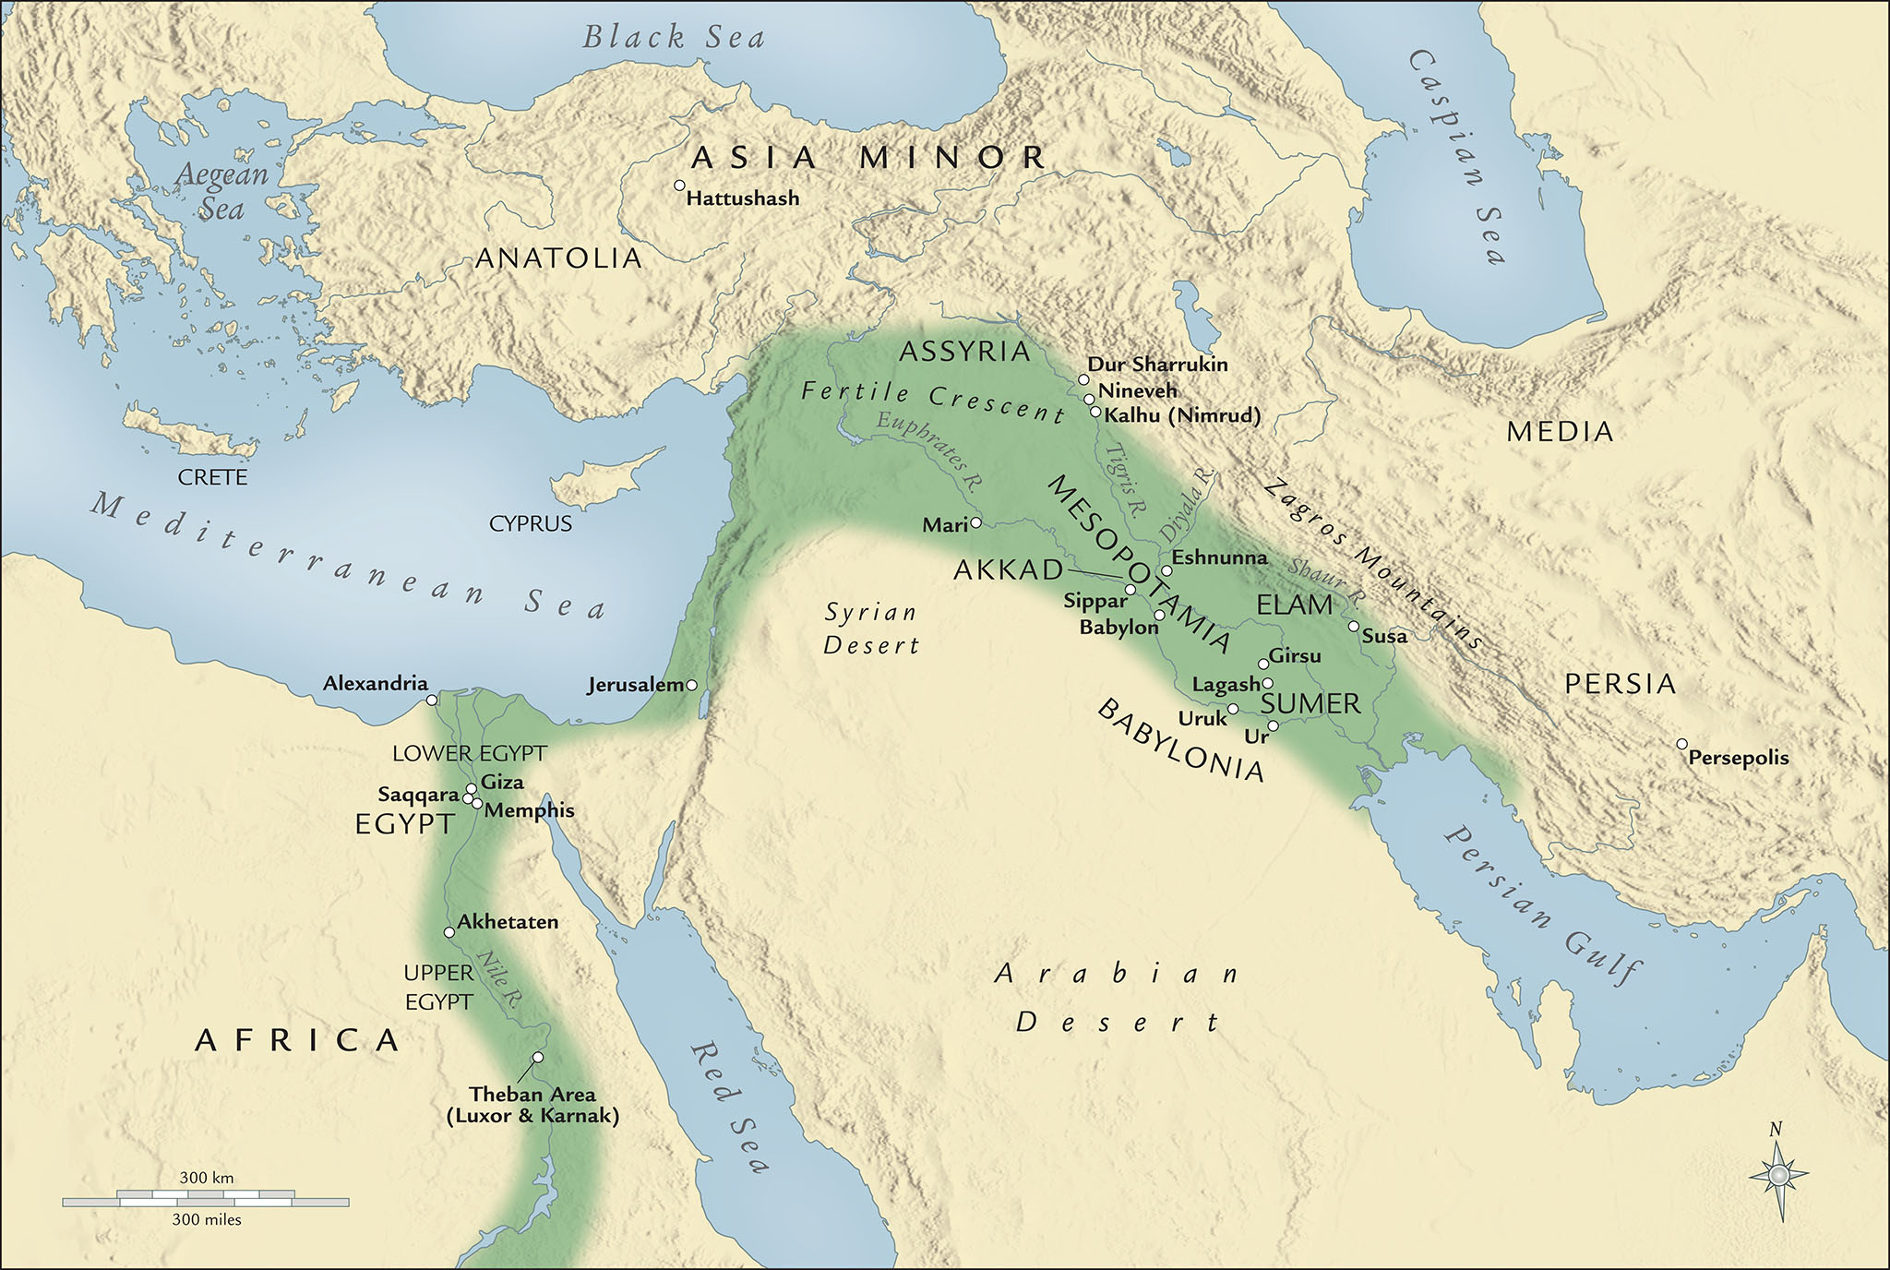

Slide 5
Anatolia
Mesopotamia
Persia/Iran
Egypt

Slide 6
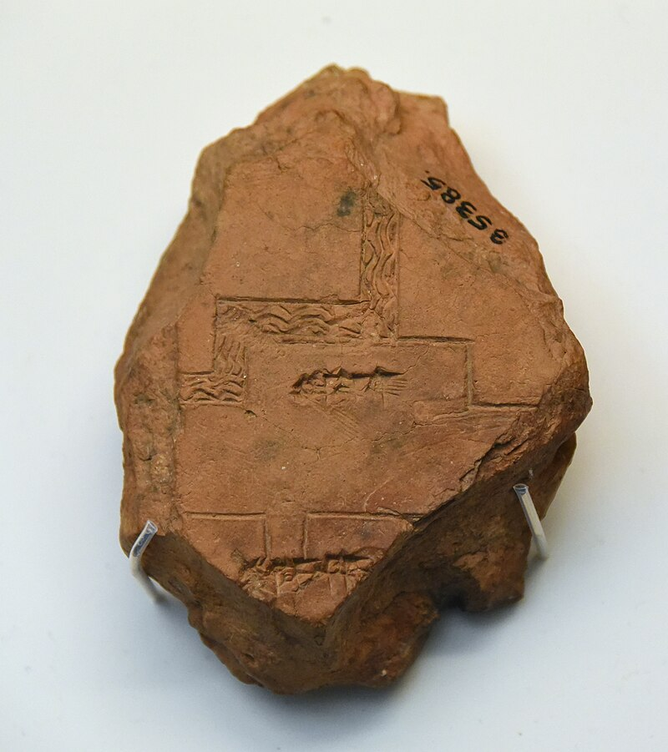
Mesopotamia
Greek for ‘land between the rivers’
  Tigris and Euphrates
  Possibly a translation of Hebrew Aram Naharayim (‘Aram of the two rivers’) or of Akkadian māt birītim (‘land of the [river]bend’)
Subregions:
  Sumer (southern Mesopotamia)
  Babylonian (central Mesopotamia around Baghdad)
  Assyria (northern Mesopotamia)
Clay tablet depicting the Euphrates, ca. 660-500 BCE (British Museum)

Slide 7
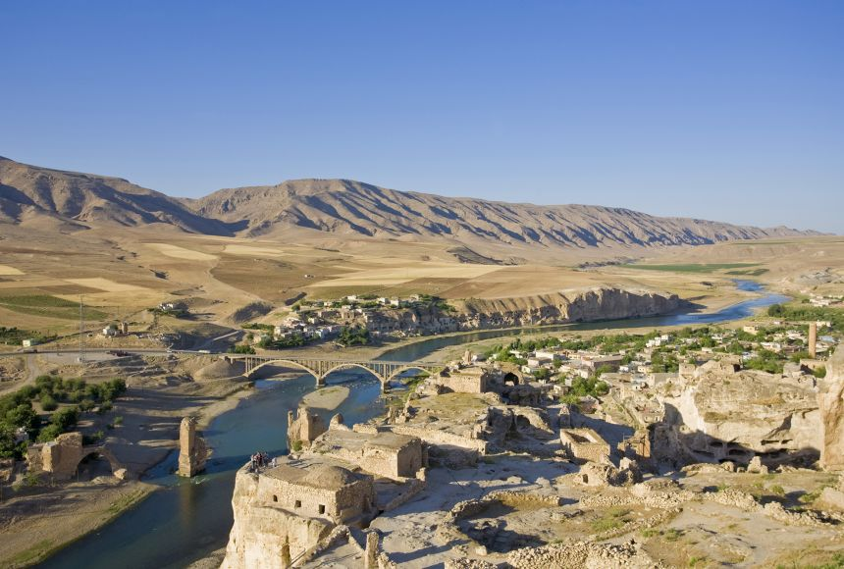
The Tigris River at Hasankeyf, Turkey

Slide 8
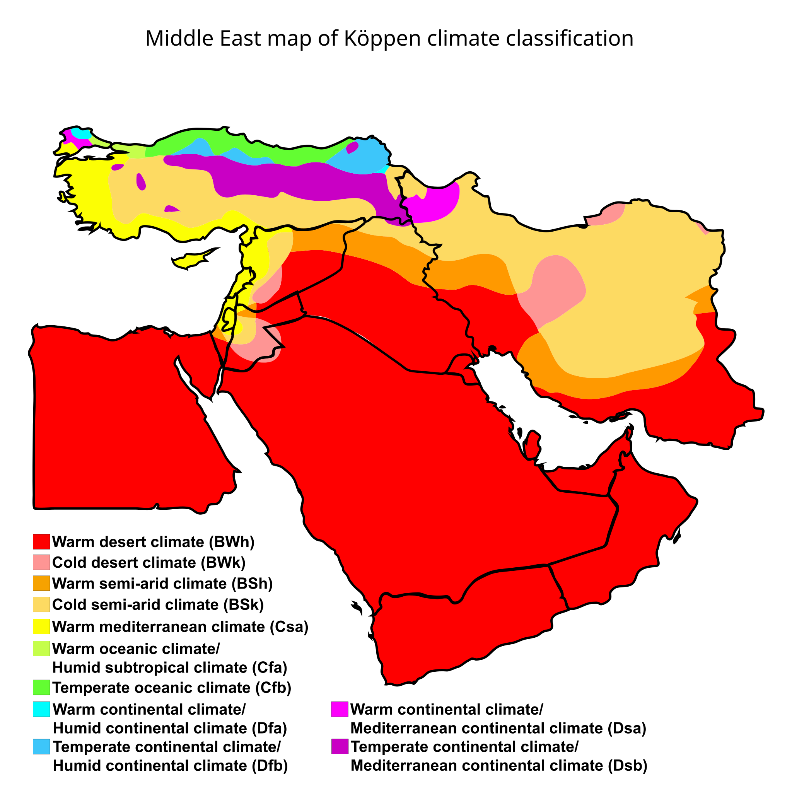

Slide 9
Mesopotamian Agriculture
There is little rain in Assyria. This nourishes the roots of the grain; but it is irrigation from the river that ripens the crop and brings the grain to fullness. In Egypt, the river itself rises and floods the fields; in Assyria, they are watered by hand and by swinging beams. For the whole land of Babylon, like Egypt, is cut across by canals. The greatest of these is navigable: it runs towards where the sun rises in winter, from the Euphrates to another river, the Tigris, on which stood the city of Nineveh. This land is by far the most fertile in grain which we know. It does not even try to bear trees, fig, vine, or olive, but Demeter’s grain is so abundant there that it yields for the most part two hundred fold, and even three hundred fold when the harvest is best. The blades of the wheat and barley there are easily four fingers broad; and for millet and sesame, I will not say to what height they grow, though it is known to me; for I am well aware that even what I have said regarding grain is wholly disbelieved by those who have never visited Babylonia. They use no oil except what they make from sesame. There are palm trees there growing all over the plain, most of them yielding fruit, from which food is made and wine and honey.
- Herodotus 1.193

Slide 10
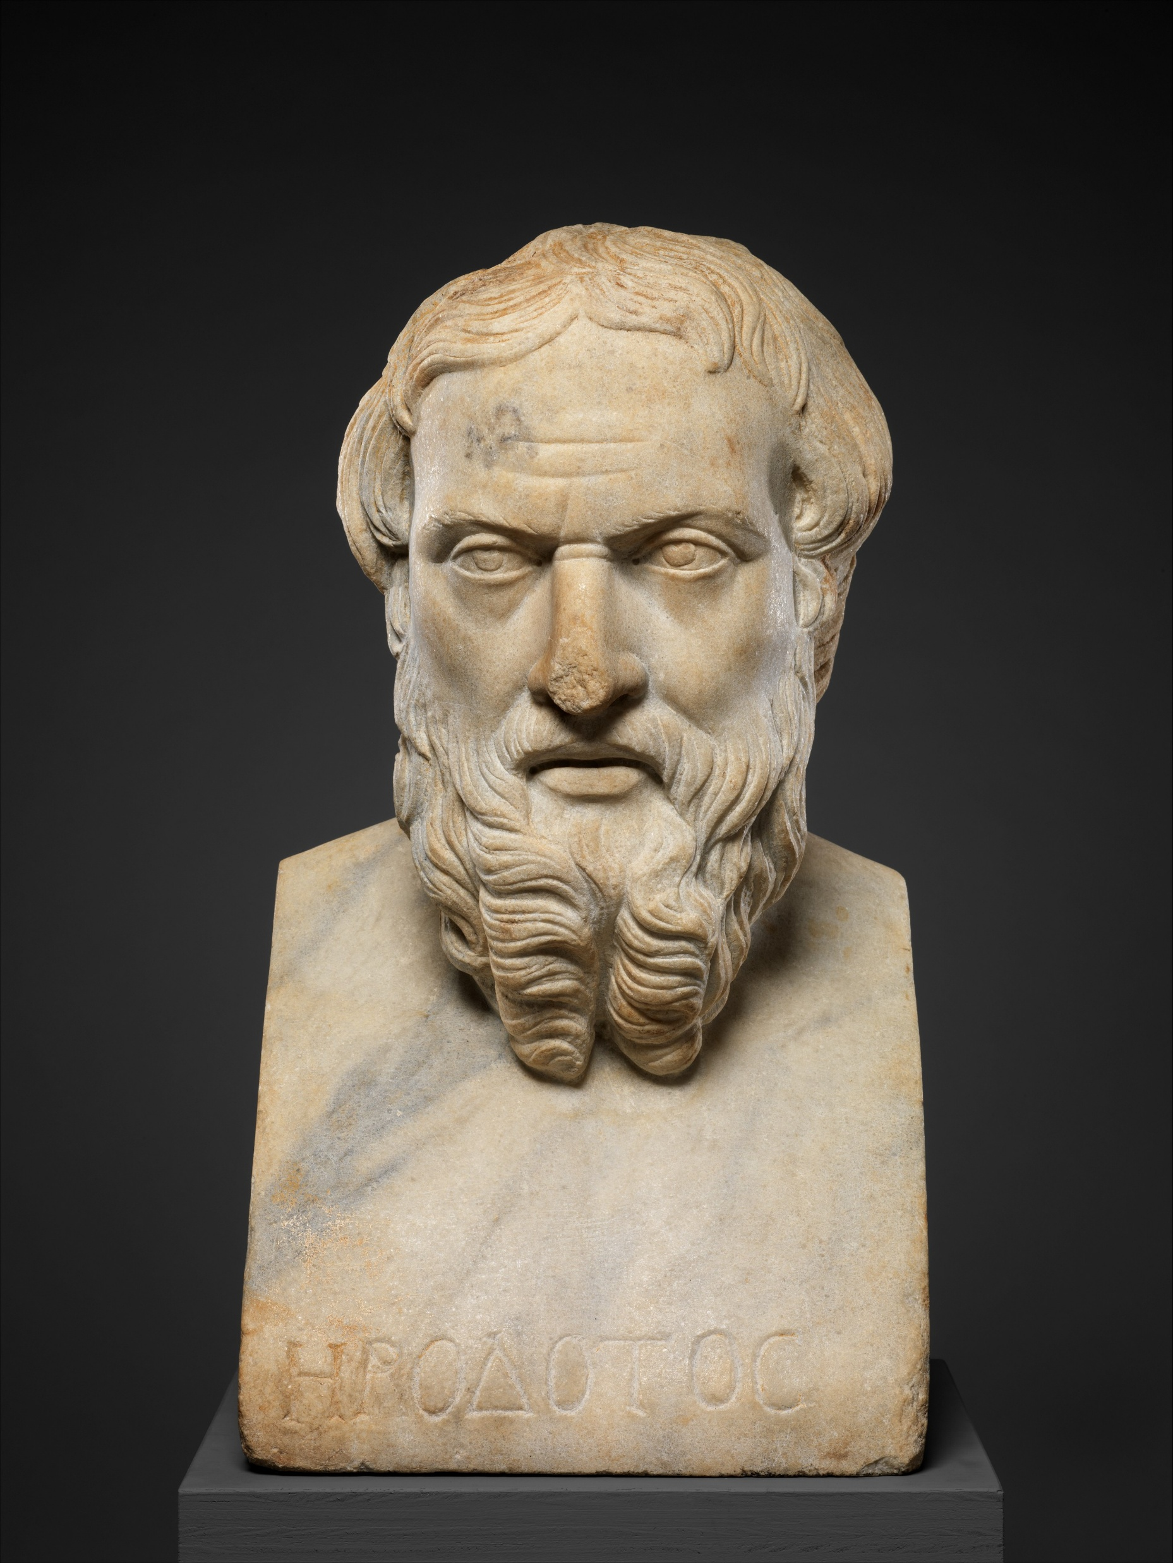
Herodotus
ca. 484-425 BCE
Greco-Carian historian and raconteur from Halicarnassus (modern Bodrum, Turkey)
Wrote a history of the Persian Wars (490 and 480-479)
  Also includes a great deal of information about the Near East and Egypt, of variable accuracy
  Called the “Father of History” by Cicero and the “Father of Lies” by Plutarch
  Arguably this was the first surviving work of oral history
What a Roman thought Herodotus looked like (2nd cen. CE)

Slide 11
Halicarnassus

Slide 12
Halicarnassus
Carian
Communities

Slide 13
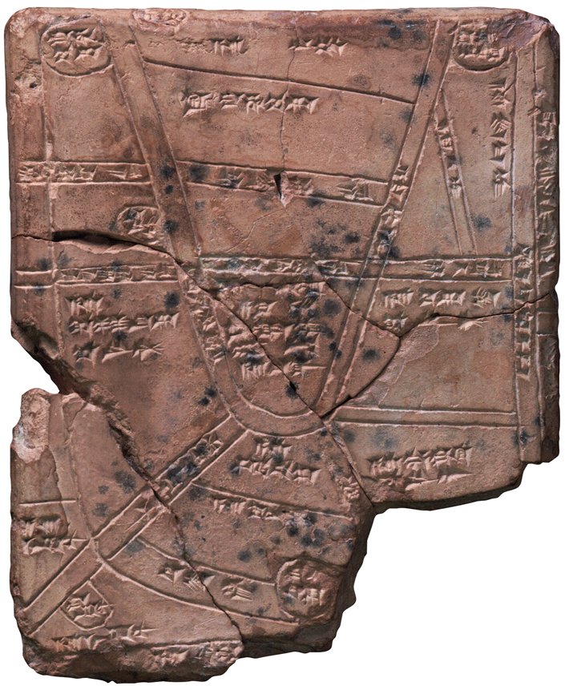
Mesopotamian Agriculture
Mesopotamia was extremely fertile
Dependent on irrigation in the form of canals
Major crops: wheat, barley, date palms
  Grain could be stored for long periods of time in dry conditions
  This made it a useful medium of exchange
  Also used to make beer
Tablet from Nippur diagramming irrigation canals, ca. 1500 BCE

Slide 14
Domestication
Plants (ca. 8000 BCE)
Animals (ca. 9000 BCE)
Emmer wheat
Einkorn wheat
Barley
Lentils
Peas
Chickpeas
Bitter vetch
Flax
Sheep
Goats
Cattle
Pigs
Horses (domesticated ca. 4000-3500 BCE and not widely introduced into the Near East until ca. 2000)

Slide 15
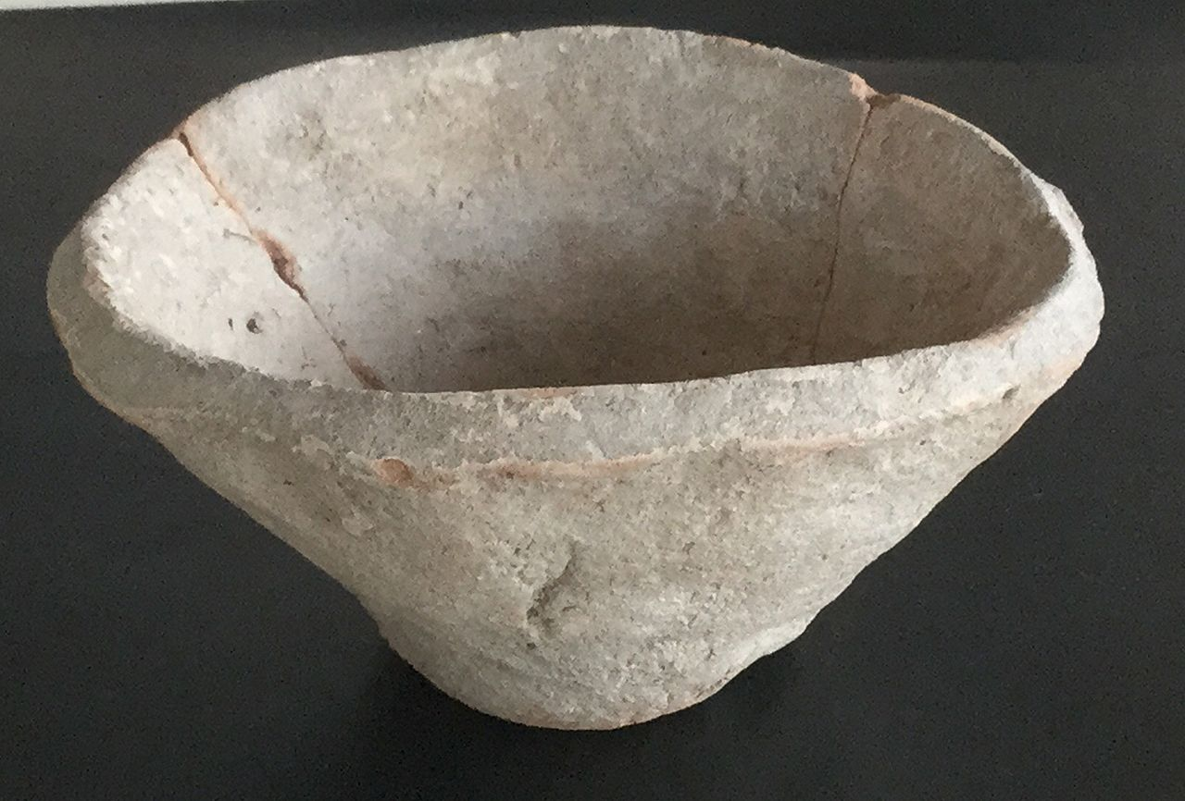
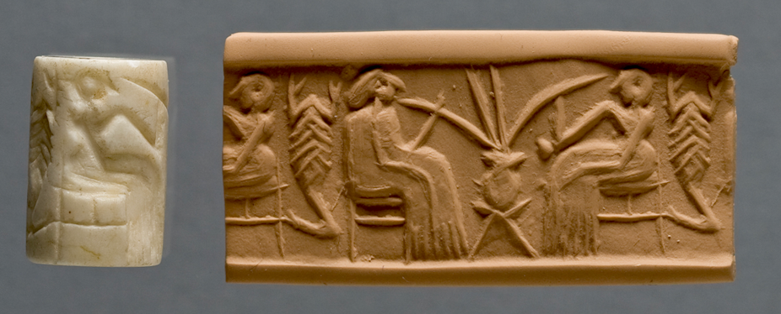
Mesopotamian Agriculture
Modern impression of a cylinder seal from Khafajeh depicting two people drinking beer from straws, ca. 2600-2350 BCE
Mass produced bowl from Habuba Kabira used to issue grain rations, ca. 3400-3200 BCE

Slide 17
Transportation
Their boats which ply the river and go to Babylon are all of skins, and round. They make these in Armenia, higher up the stream than Assyria. First they cut frames of willow, then they stretch hides over these for a covering, making as it were a hold; they neither broaden the stern nor narrow the prow, but the boat is round, like a shield. They then fill it with reeds and send it floating down the river with a cargo; and it is for the most part palm wood casks of wine that they carry down. Two men standing upright steer the boat, each with a paddle, one drawing it to him, the other thrusting it from him. These boats are of all sizes, some small, some very large; the largest of them are of as much as five thousand talents burden. There is a live ass in each boat, or more than one in the larger. So when they have floated down to Babylon and disposed of their cargo, they sell the framework of the boat and all the reeds; the hides are set on the backs of asses, which are then driven back to Armenia, for it is not by any means possible to go upstream by water, because of the swiftness of the current; it is for this reason that they make their boats of hides and not of wood. When they have driven their asses back into Armenia, they make more boats in the same way.
- Herodotus 1.194

Slide 18
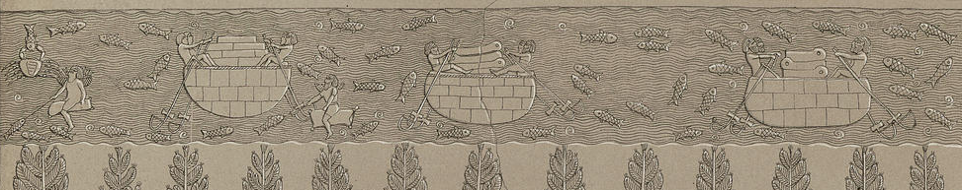
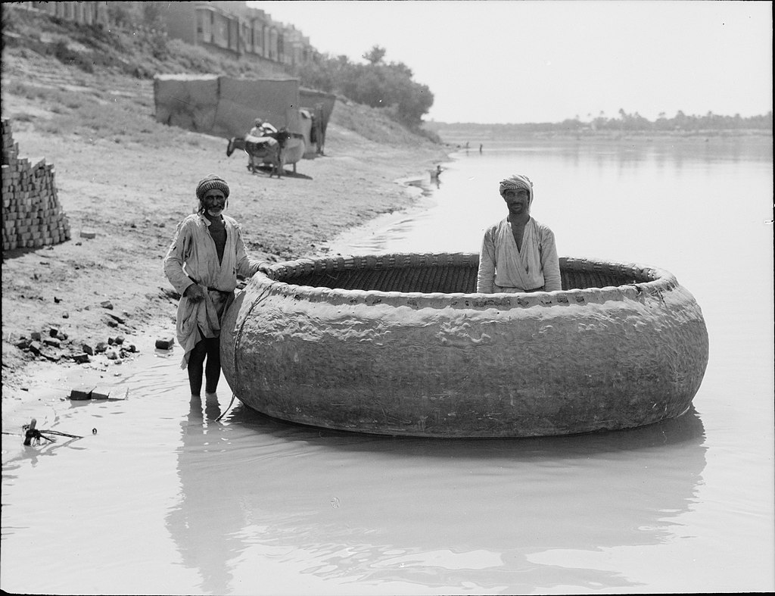
Transportation
Drawing of a relief from Nineveh depicting round boats on the Tigris, ca. 704-681 BCE
Round boat in Baghdad, 1932

Slide 19
The Tigris River at Hasankeyf, Turkey

Slide 20
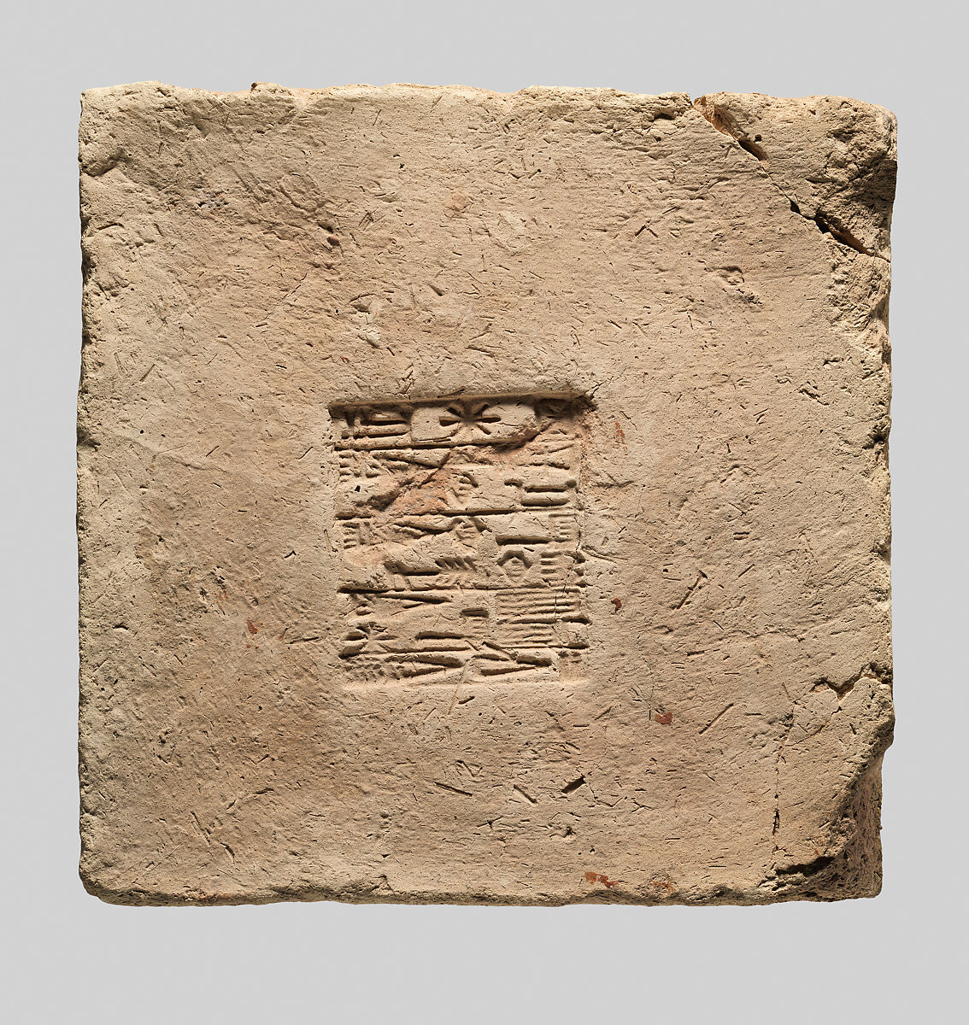
Mudbrick
Mudbrick = bricks made of mud, usually with straw for binding
Dried in the sun, not fired
Sometimes built on stone foundations
May have had thatched or timber roofs (but we’re not sure)
Mudbrick with a stamp naming King Ur-Nammu, ca. 2112-2095 BCE

Slide 21
Mudbrick
Ur-Nammu
the king of Ur,
the king of Sumer and Akkad,
(is) the one who built the temple of Enlil
Mudbrick with a stamp naming King Ur-Nammu, ca. 2112-2095 BCE

Slide 22
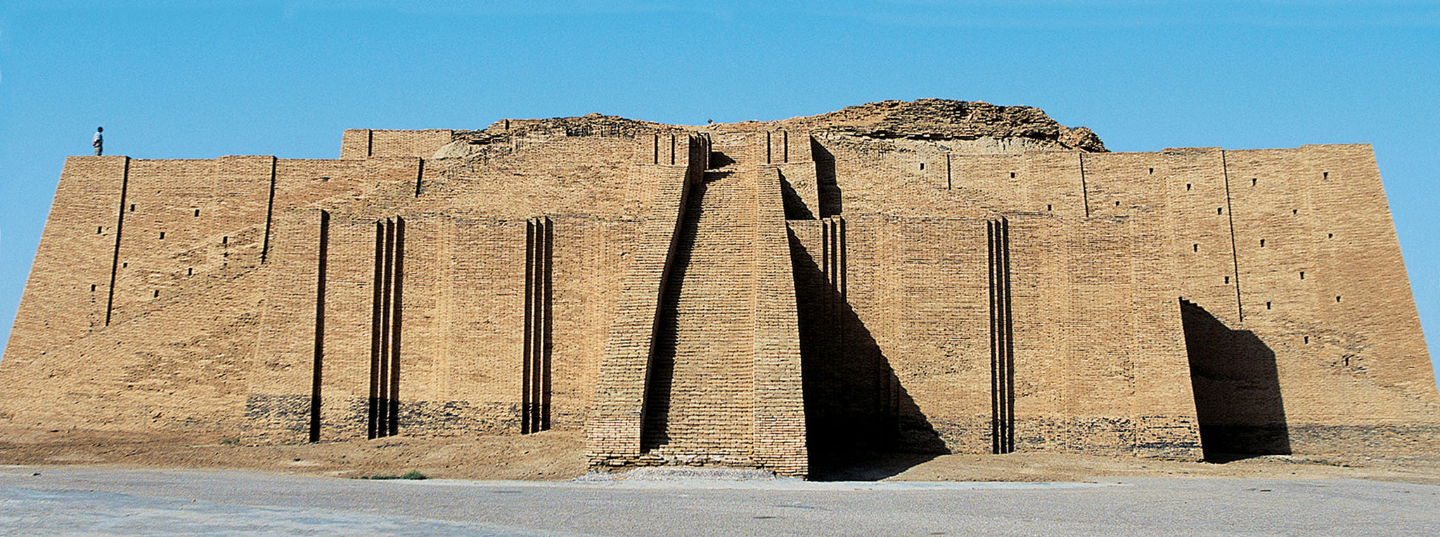
Nanna Ziggurat, Ur
Nanna ziggurat at Ur, built by King Urnammu of Ur, ca. 2100-2050 BCE, with much modern reconstruction; 62 x 43 m

Slide 23
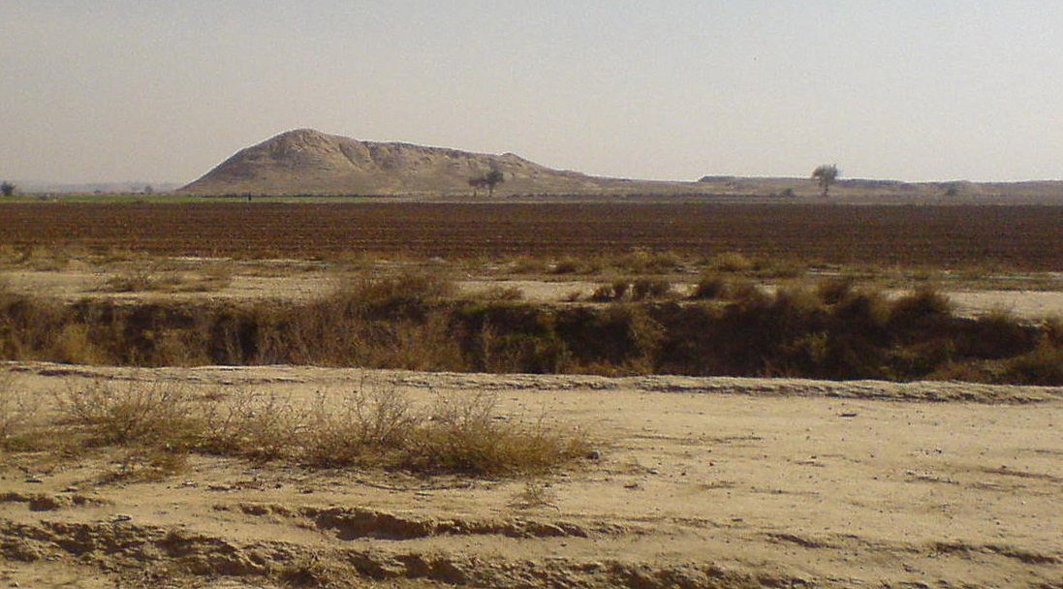
Tells/Tepes
Mounds made of decayed mudbrick
Flattened and used for new structures built
‘Tell’ in Arabic, ‘tel’ in Hebrew, ‘tepe’ or ‘höyük’ in Turkish, ‘tappeh’ in Persian
  Often appears in modern names of archaeological sites
The mound of Chogha Mish

Slide 25
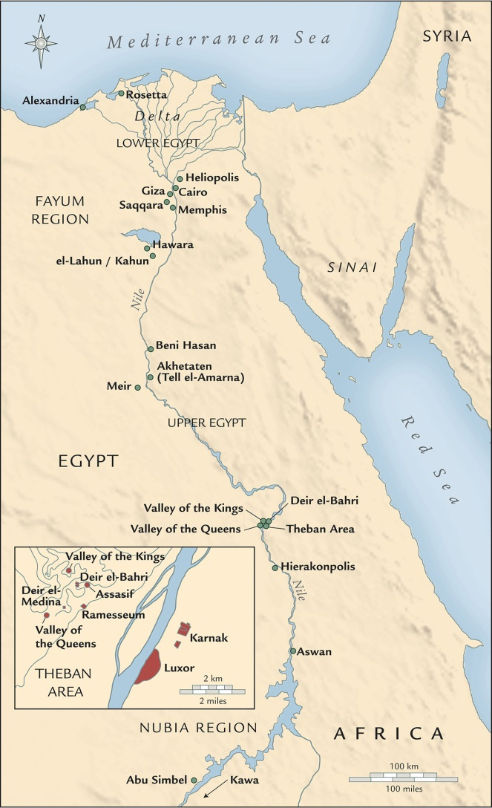
Egypt
Upper Egypt = south
Lower Egypt = north
Sea to the north, desert to the west and south, sea and desert to the east
Situated in the Nile river valley
  Nile flooded every year, leading to tremendous agricultural fertility

Slide 26
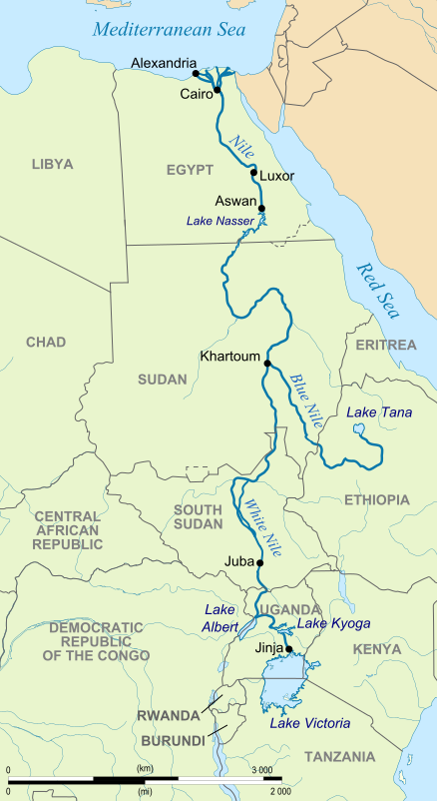
The Nile
6650 km long
Flooded every winter due to rainfall in the Ethiopian highlands along the Blue Nile
Deposited silt as well as providing water
No longer floods as a result of the Aswan Low Dam (1902) and High Dam (1970)

Slide 27
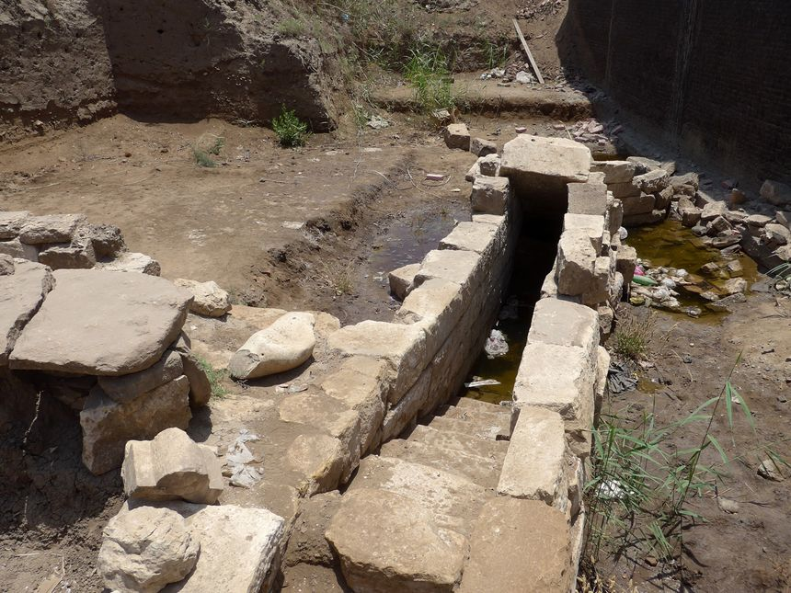
Nilometer = tool for measuring the height of the Nile flood
This in turn served as an economic forecast for the coming year
Nilometer at Thmuis, Egypt

Slide 28
Egyptian Agriculture
At present, of course, there are no people, either in the rest of Egypt or in the whole world, who live from the soil with so little labor; they do not have to break the land up with the plough, or hoe, or do any other work that other men do to get a crop; the river rises of itself, waters the fields, and then sinks back again; then each man sows his field and sends swine into it to tread down the seed, and waits for the harvest; then he has the swine thresh his grain, and so garners it.
- Herodotus 2.14

Slide 29
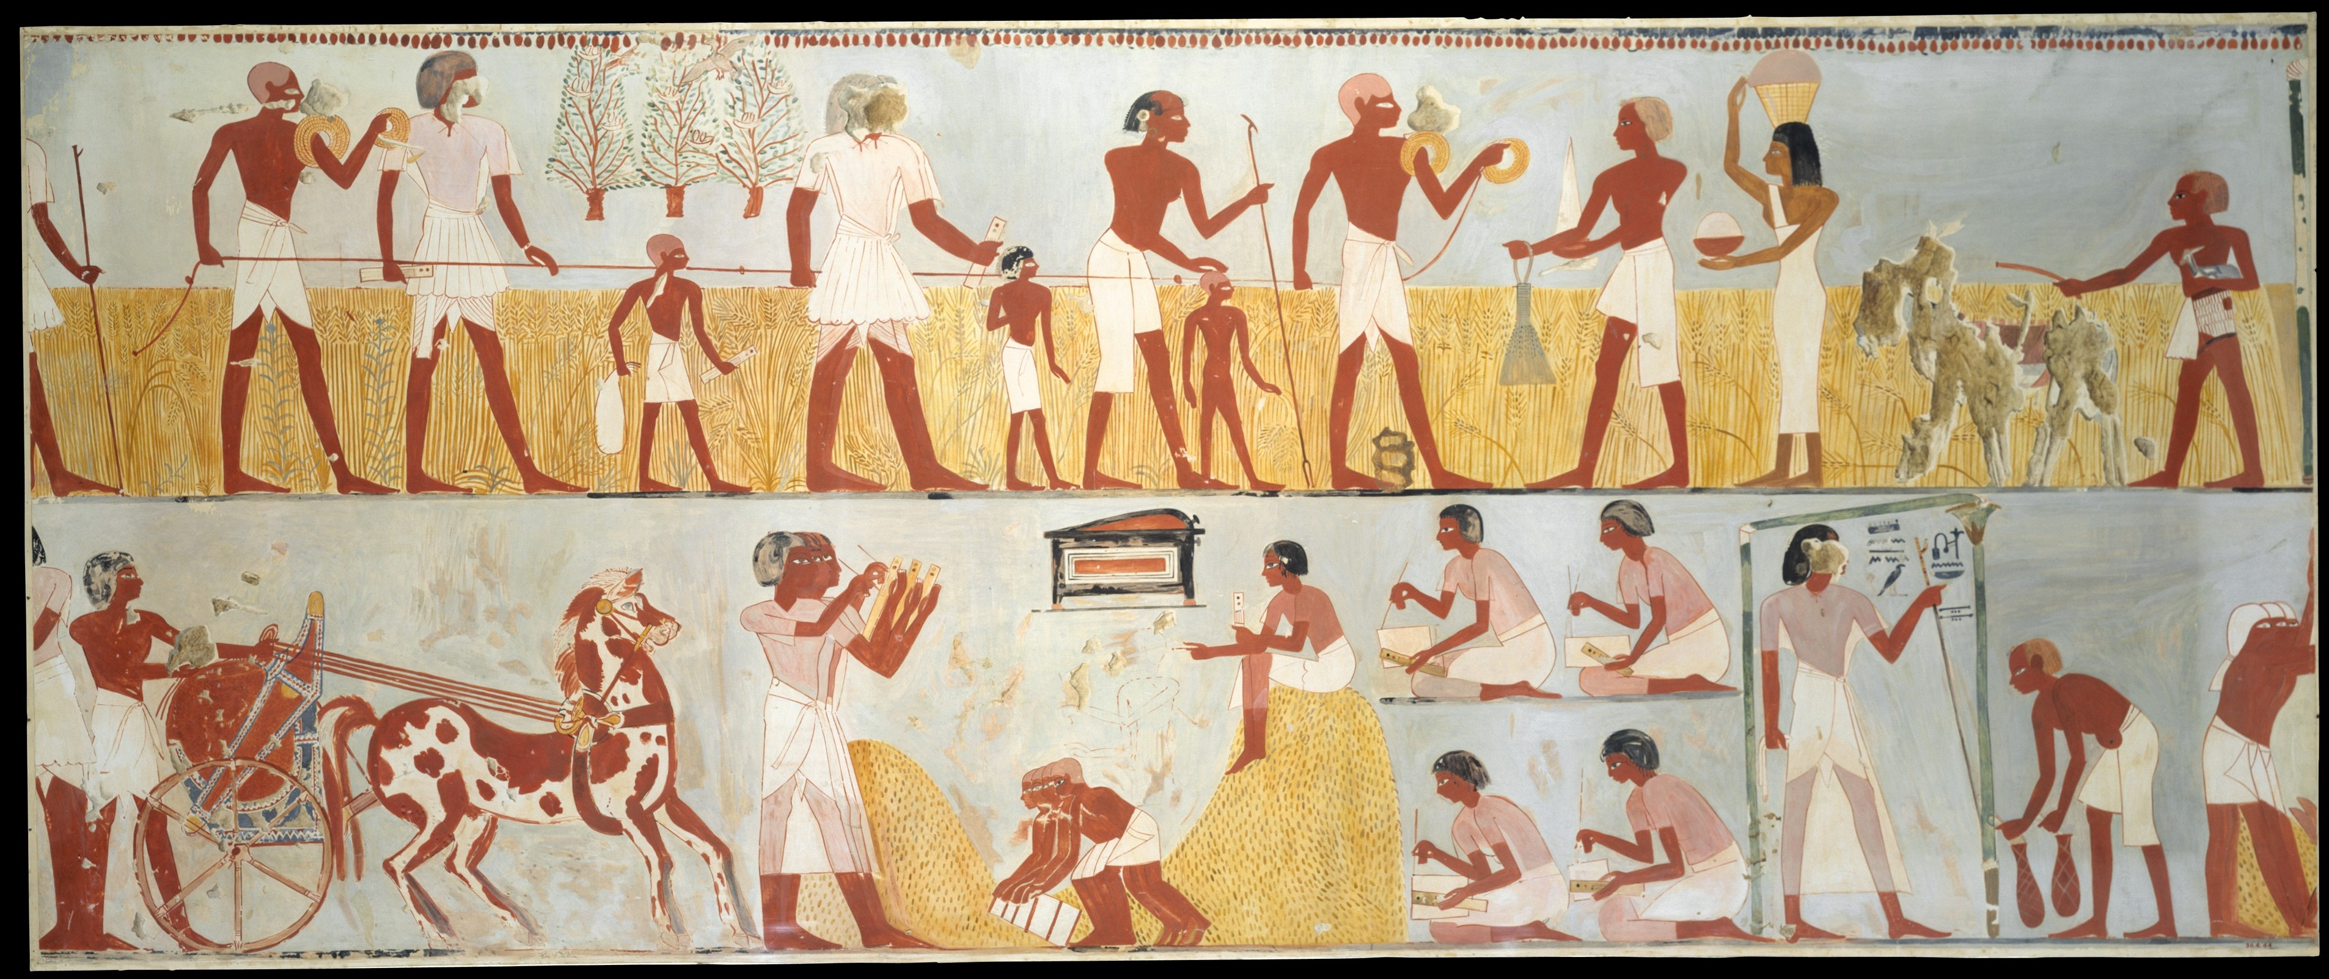
Modern facsimiles of ancient Egyptian wall paintings from the Tomb of Menna at Thebes, New Kingdom
Top: accessors measuring the height of the grain; bottom: storage and tallying of grain

Slide 30
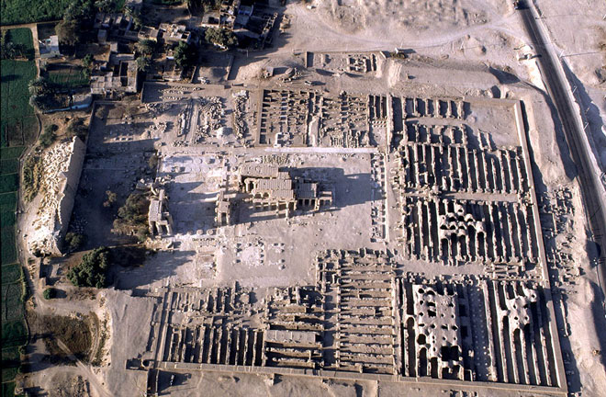
Grain
Barley and wheat primarily
Portion of the harvest paid in exchange for use of fields and water allotments
Grain stored and used to make pay institutional salaries
Also remitted to the king as tax
Mortuary temple of Rameses II, Medinet Habu, Egypt, ca. 13th cen. BCE

Slide 31
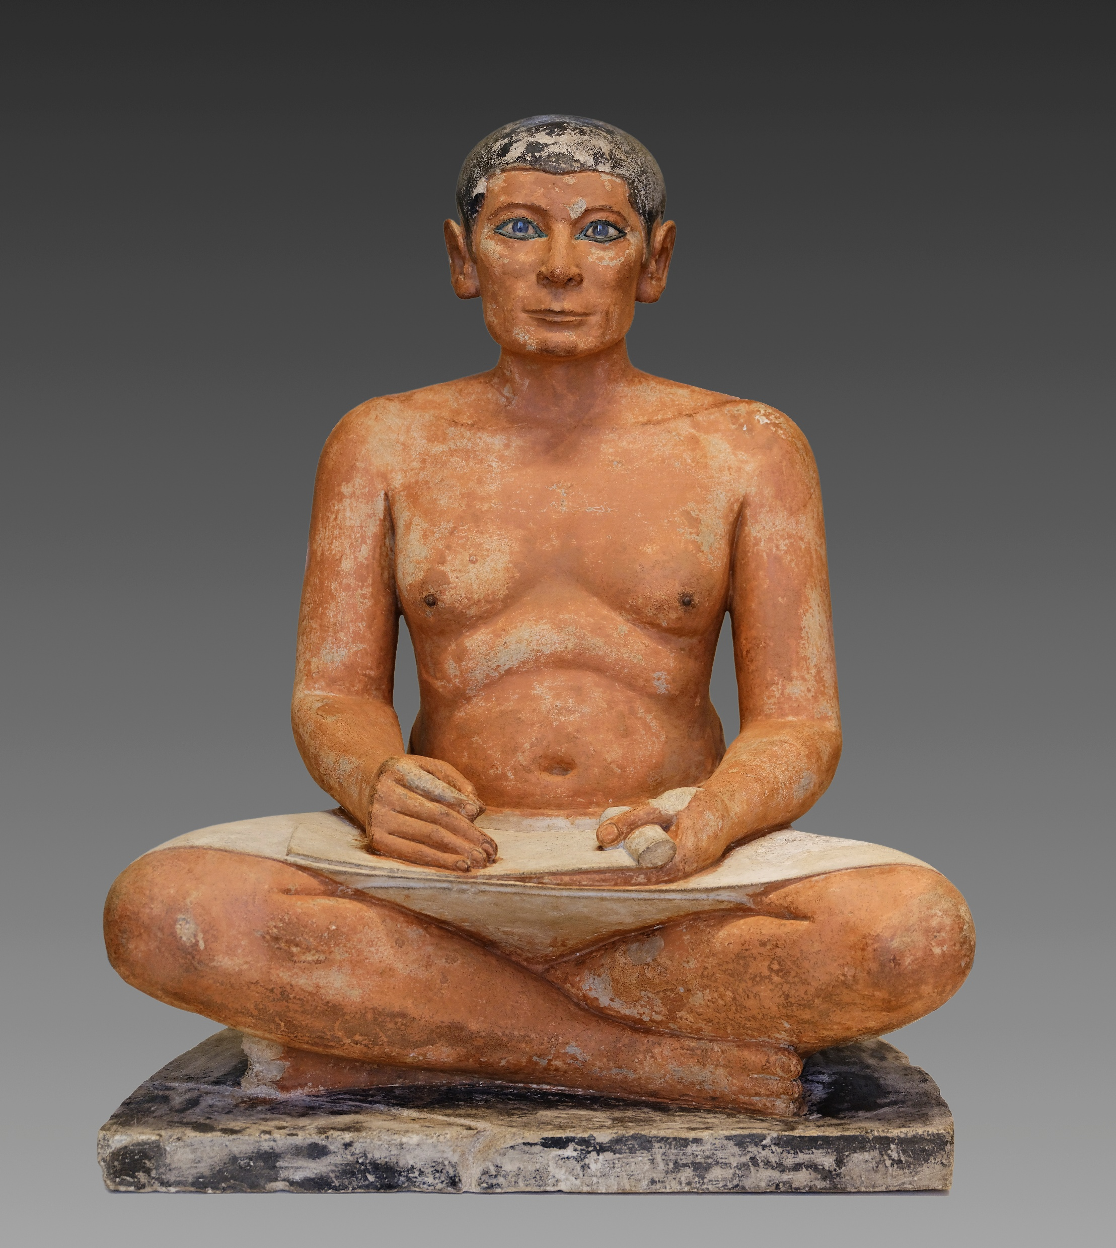
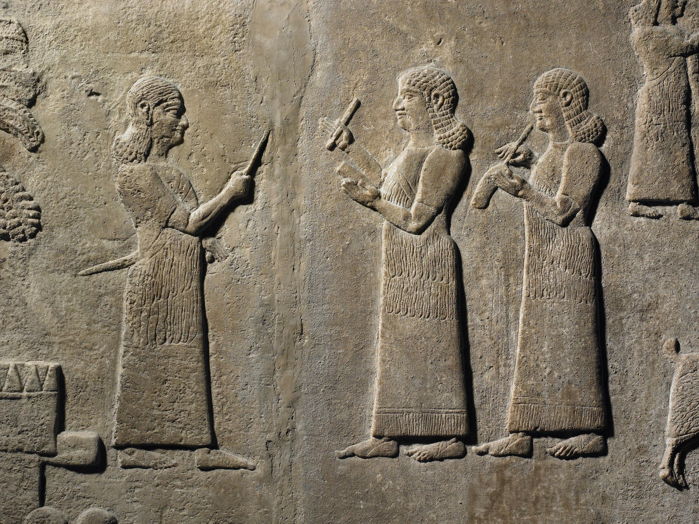
Surplus → Specialization
Relief from Nimrud depicting two Assyrian scribes at work (British Museum)
Statue of a seated scribe from Saqqara, Old Kingdom (Louvre)

Slide 32
The Nile
6650 km long
Flooded every winter due to rainfall in the Ethiopian highlands along the Blue Nile
Deposited silt as well as providing water
No longer floods as a result of the Aswan Low Dam (1902) and High Dam (1970)

Slide 33
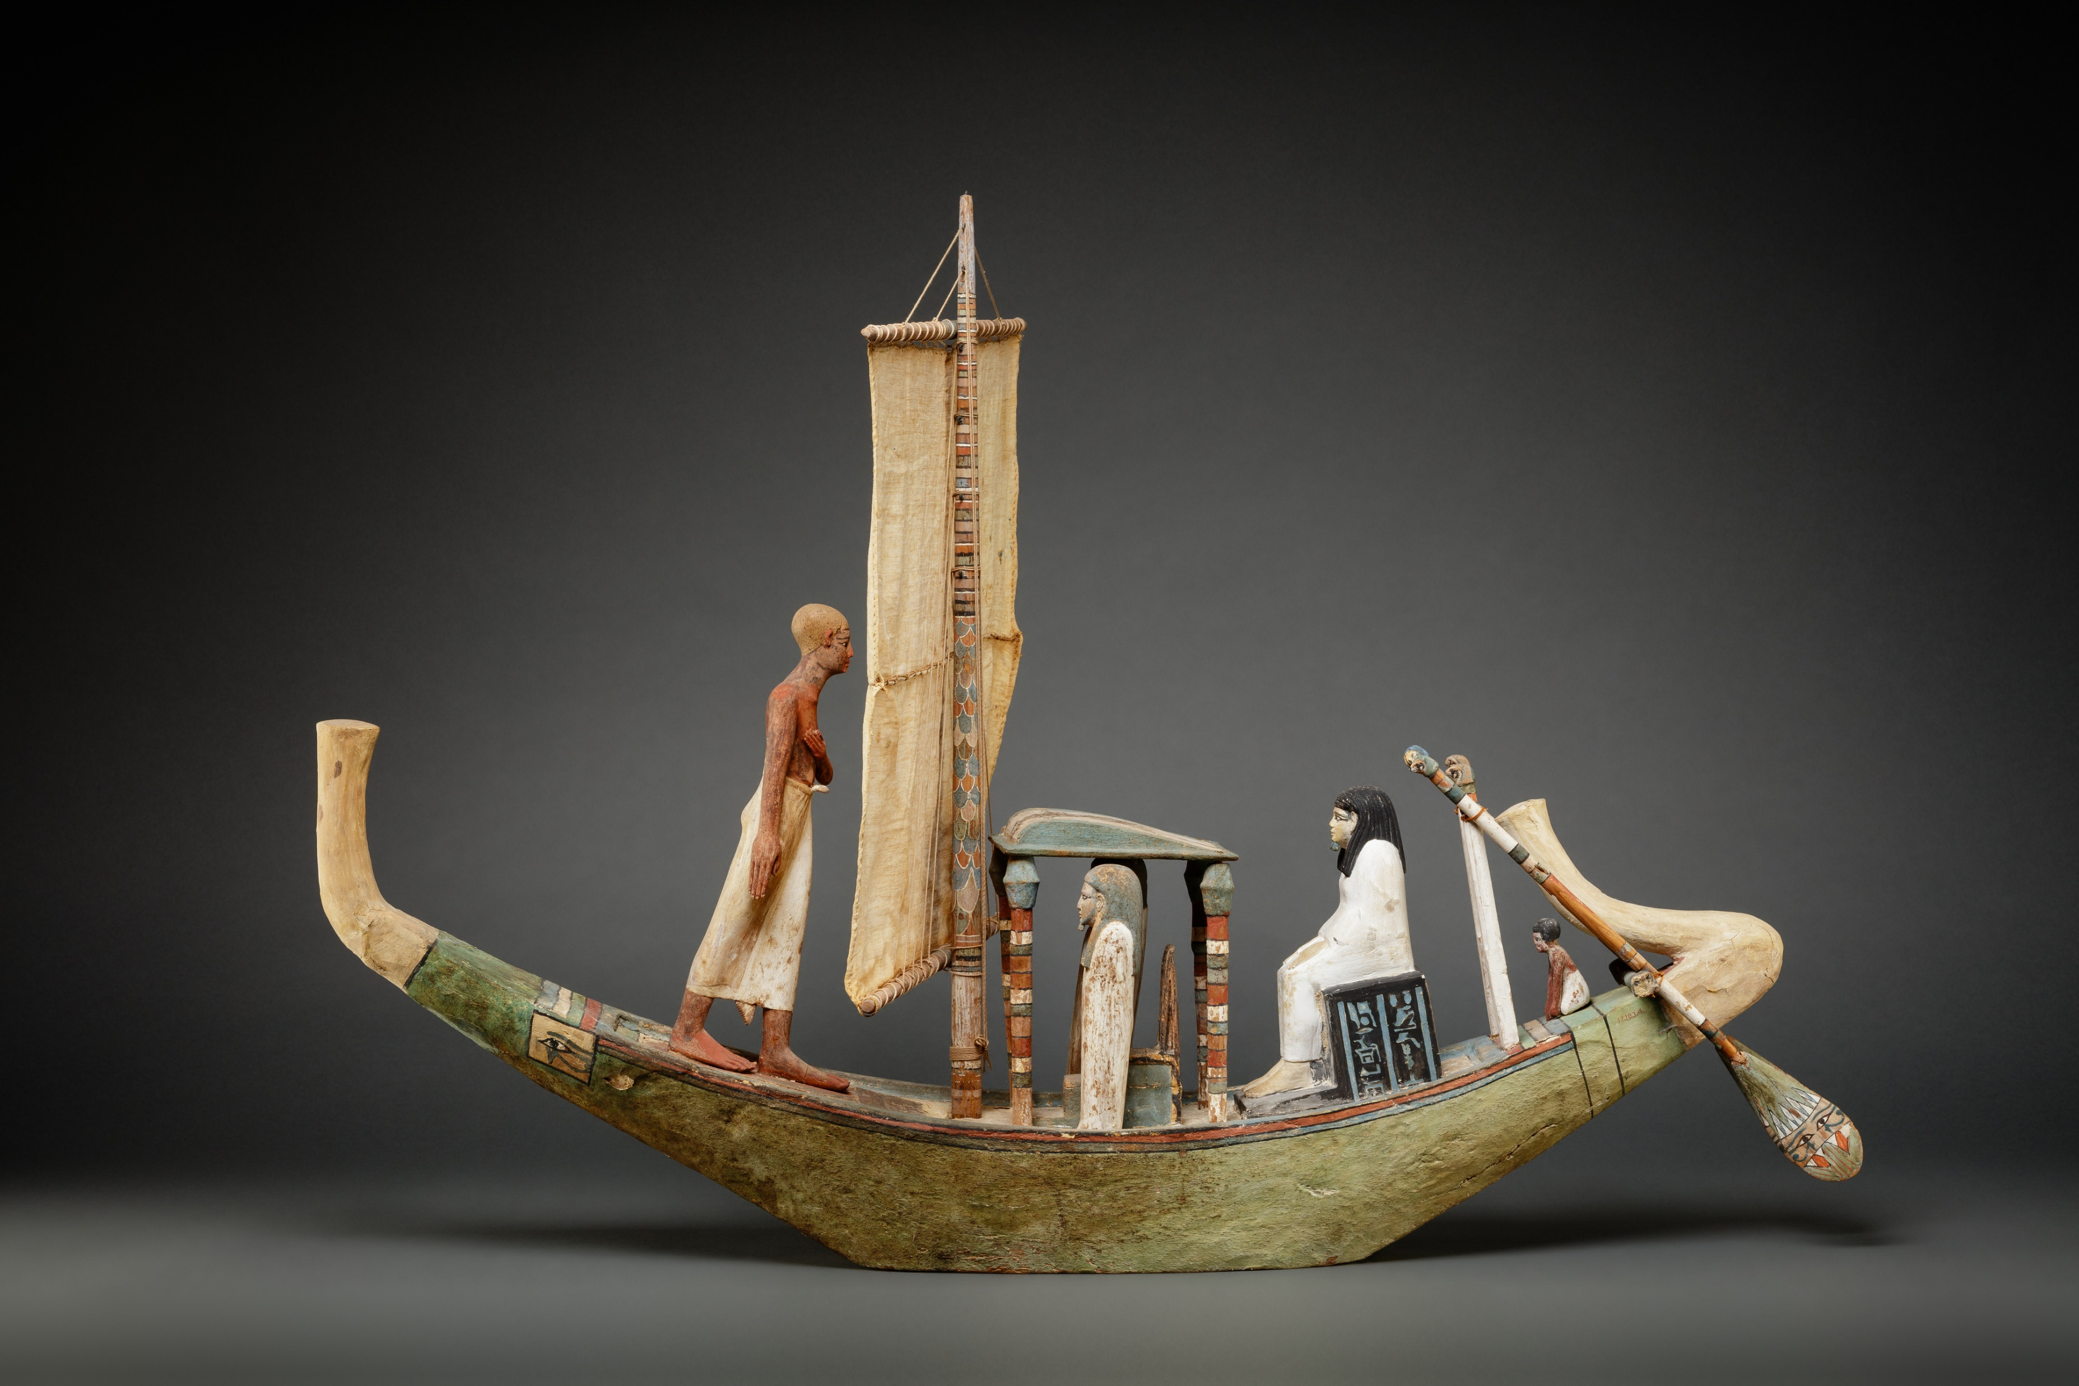
Transportation
𓊛 = go downstream
𓊝 = go upstream
The boats in which they carry cargo are made of the acacia, which is most like the lotus of Cyrene in form, and its sap is gum. Of this tree they cut logs of four feet long and lay them like courses of bricks, and build the boat by fastening these four foot logs to long and close-set stakes; and having done so, they set crossbeams athwart and on the logs. They use no ribs. They caulk the seams within with byblus. There is one rudder, passing through a hole in the boat’s keel. The mast is of acacia-wood and the sails of byblus. These boats cannot move upstream unless a brisk breeze continues; they are towed from the bank.
- Herodotus 2.96
Model boat, Middle Kingdom

Slide 34
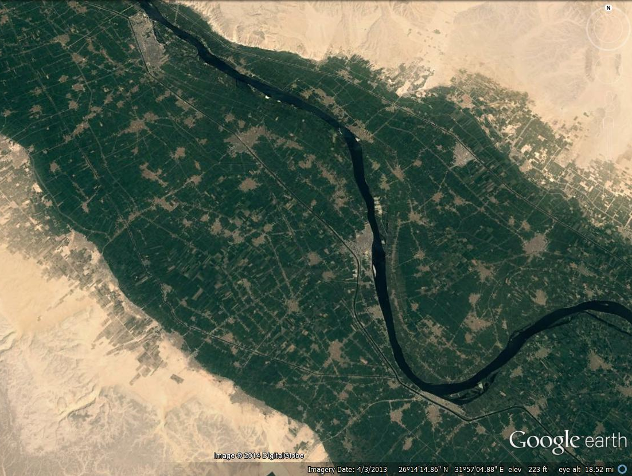
Egyptian settlement
Kemet:
‘The Black Land’
Cultivation and Settlement
Low Desert
High Desert
Notes:
Cannot study rural areas of Egypt in the traditional manner, i.e., by way of surface survey, because of geographic dynamics
In ancient and modern times settlement and cultivation are clustered along the banks of the Nile
Outside of that is low desert, where temples and tombs were built
Outside of that is high desert, mostly uninhabited

Slide 35
Human remains to follow

Slide 36
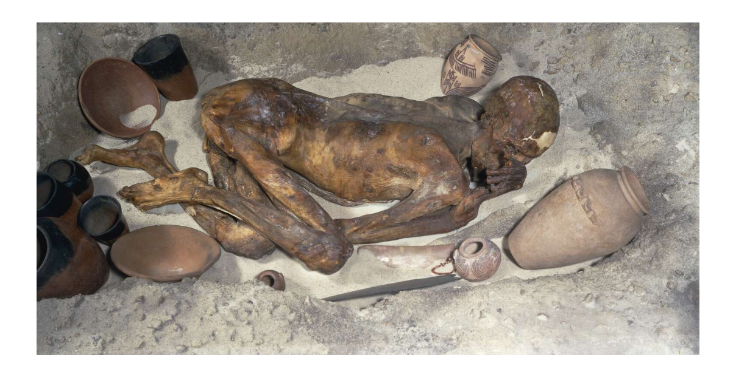
Natural Mummification
Aridity = desiccation of flesh
Desiccation = preservation
A contributing factor to the Egyptian focus on the afterlife?
Natural mummy from Gebelein, ca. 3400 BCE

Slide 37
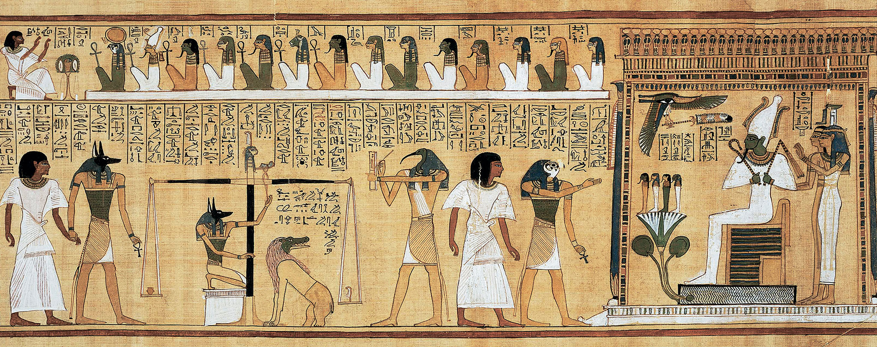
The Book of the Dead
Illustration from a Book of the Dead, ca. 1285 BCE (19th Dynasty, New Kingdom)

Slide 38
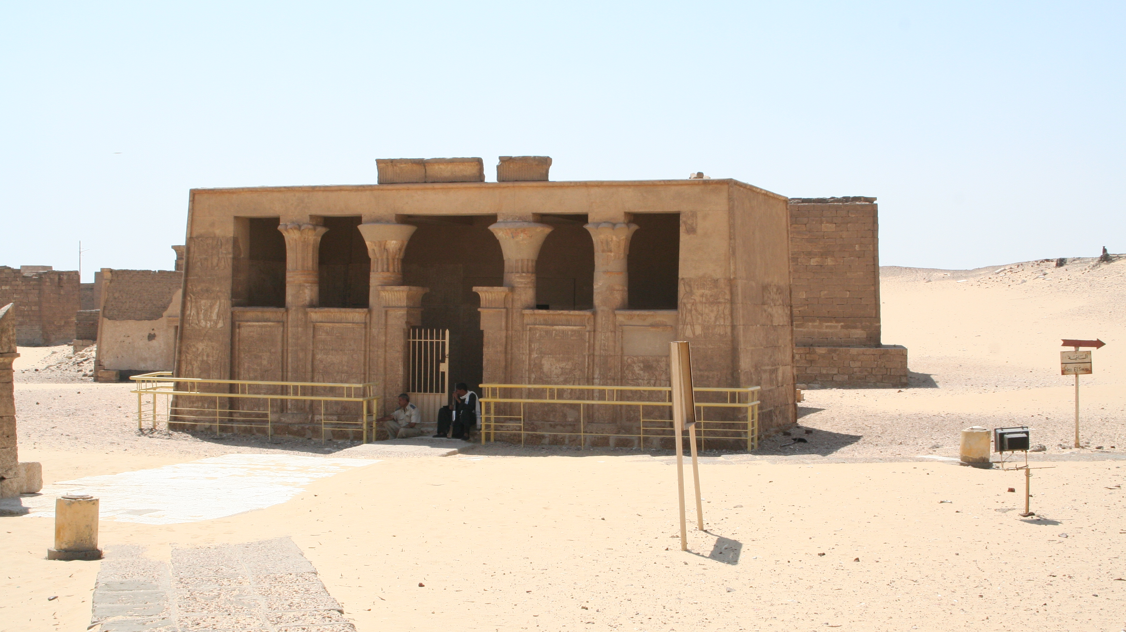
Tomb of Petosiris, Tuna el-Gebel

Slide 39
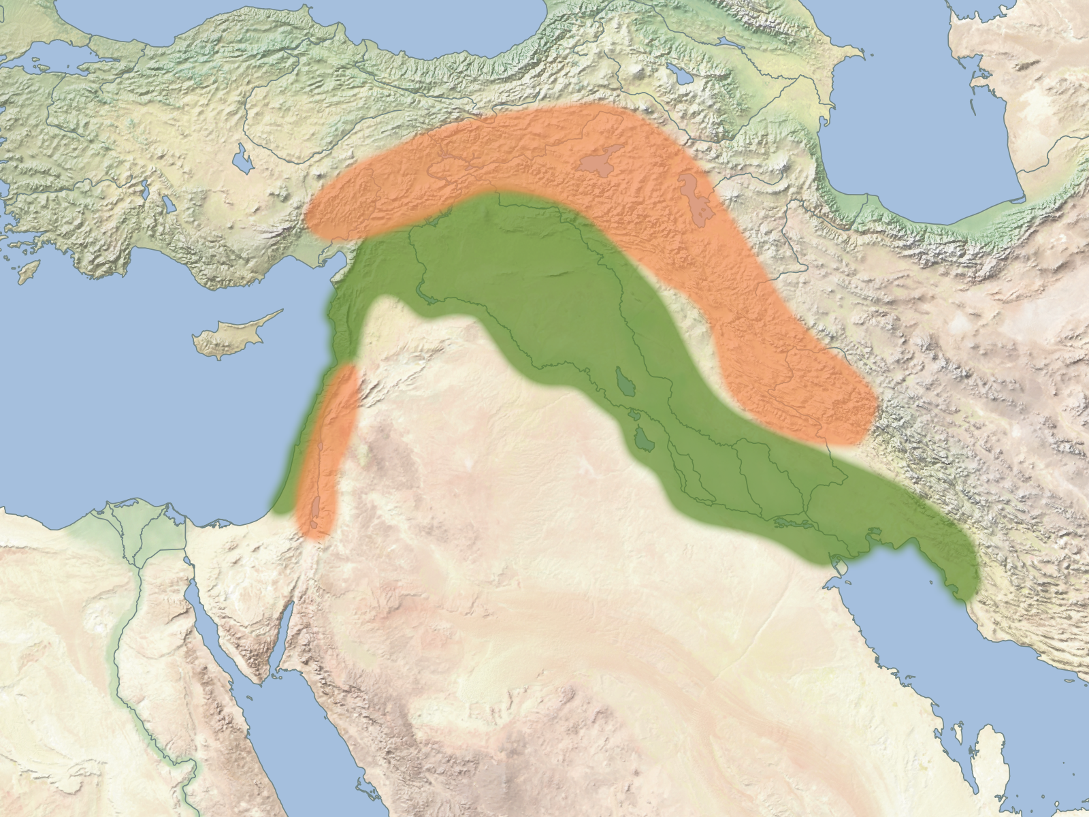
Taurus
THE HILLY FLANKS
Zagros

Slide 40
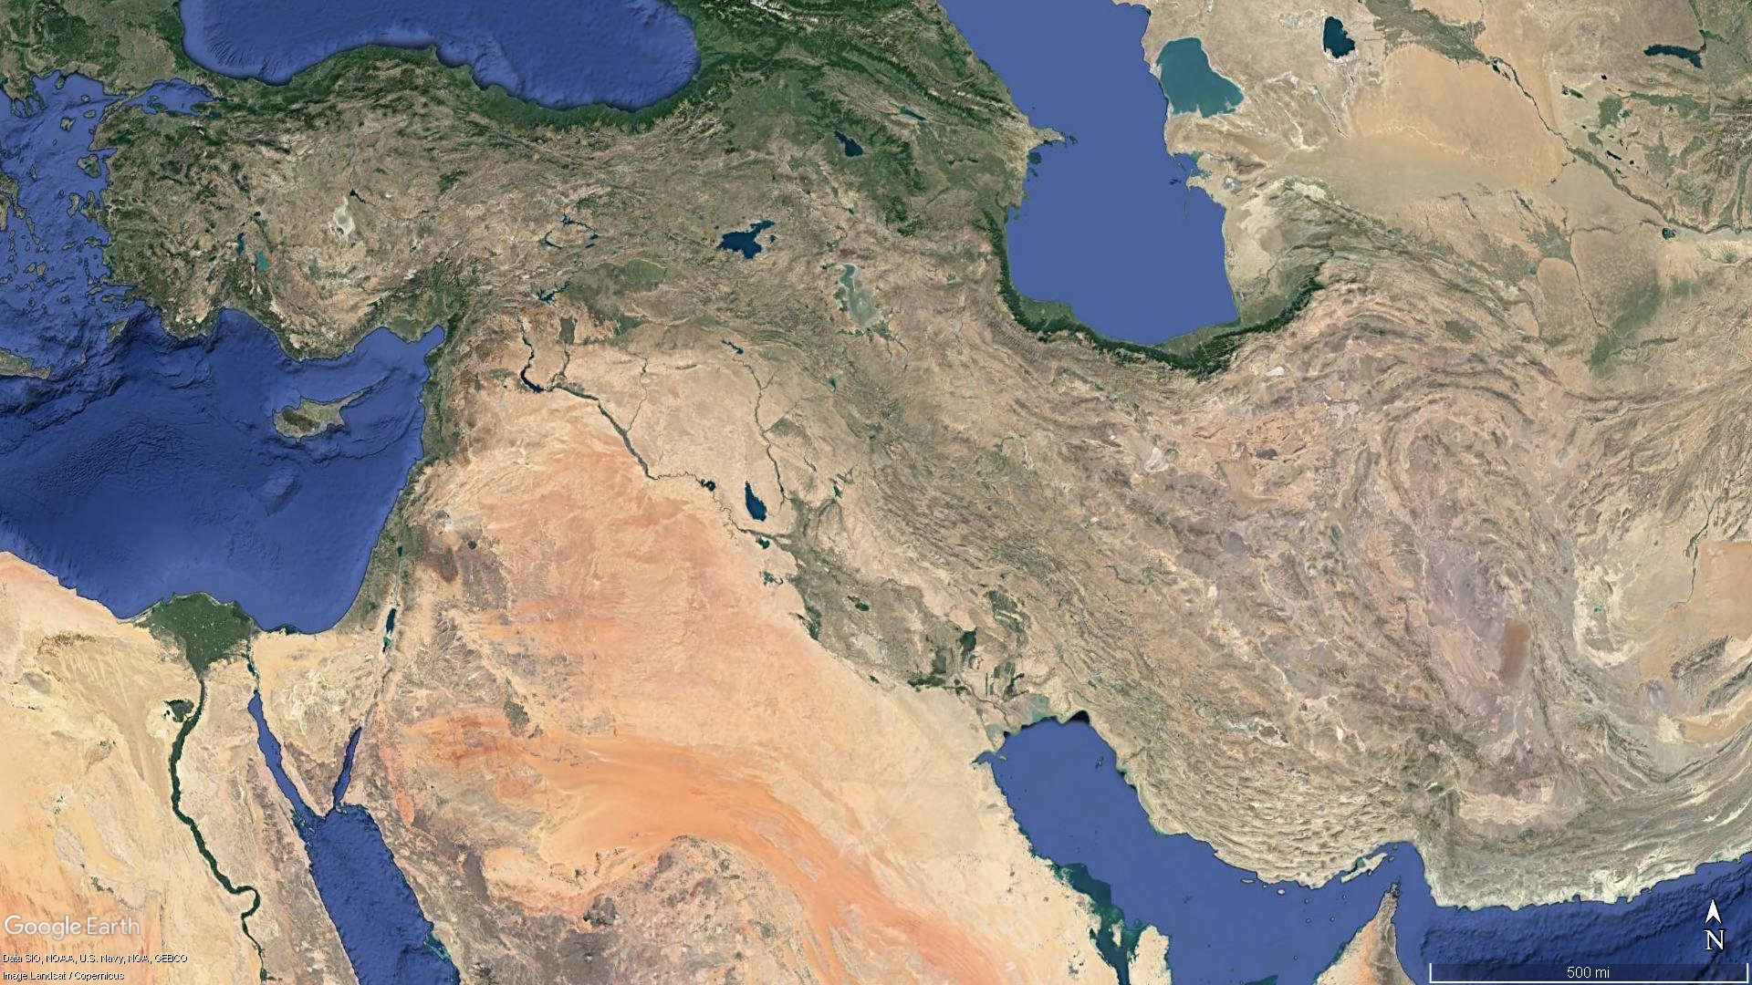

Slide 41
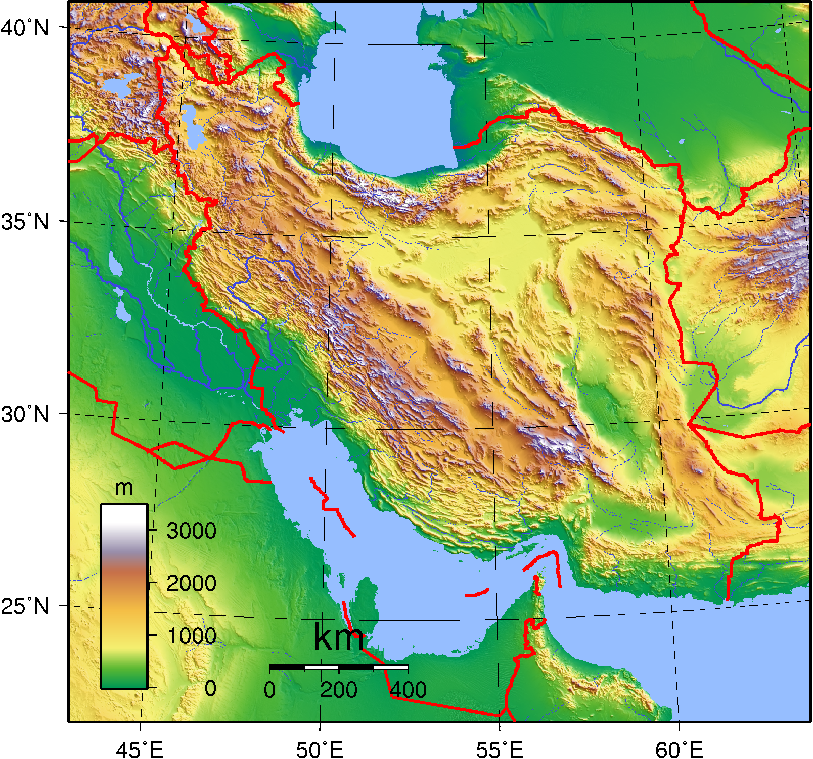

Slide 42
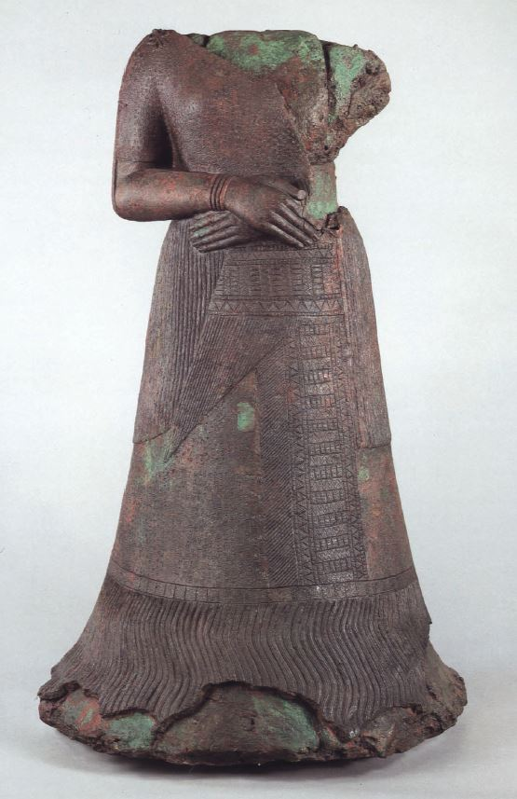
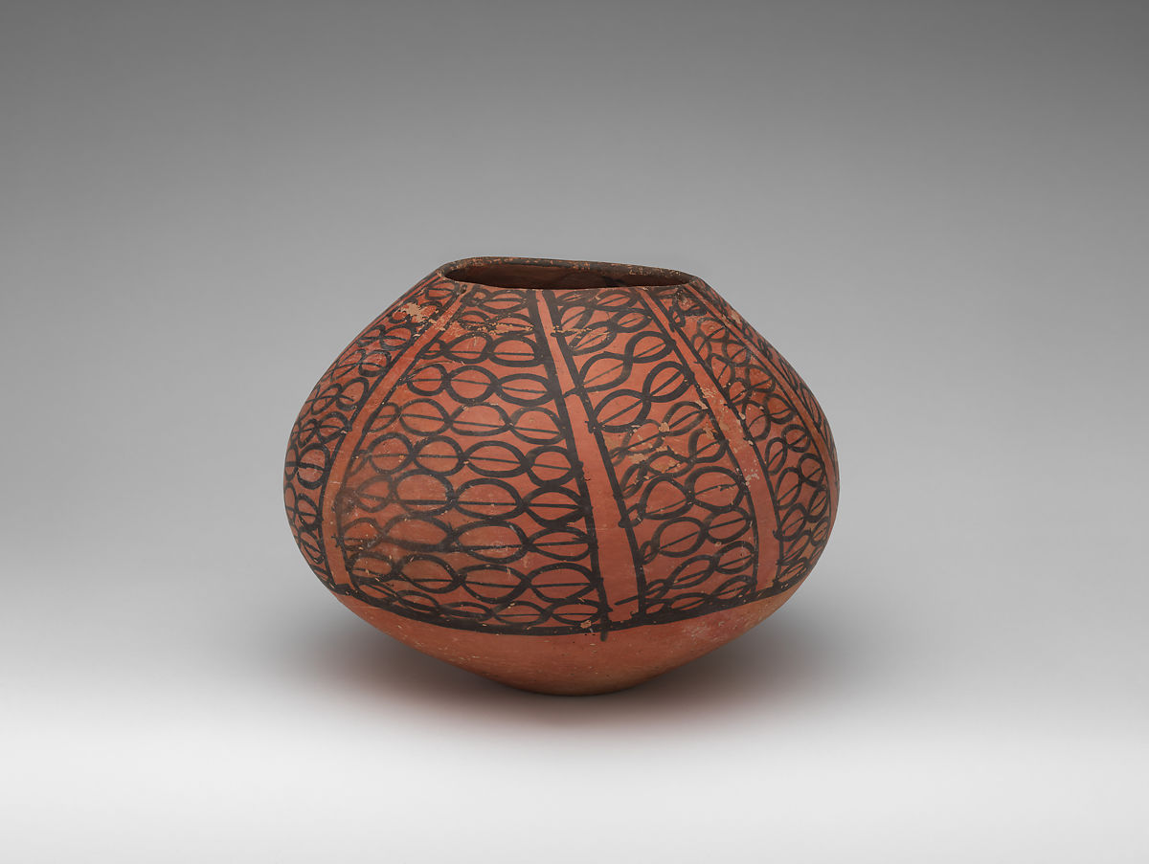
Cheshmeh Ali ware jar, ca. 5300-4300 BCE
Copper and bronze statue of Queen Napir-Asu from Susa, 14th cen. BCE

Slide 43
Secondary clay beds
Further from geological source
Coarse grain
Mud-colored
Many inclusions
Primary clay beds
Closer to geological source
Finer grain
Uniform color
Few inclusions

Slide 44
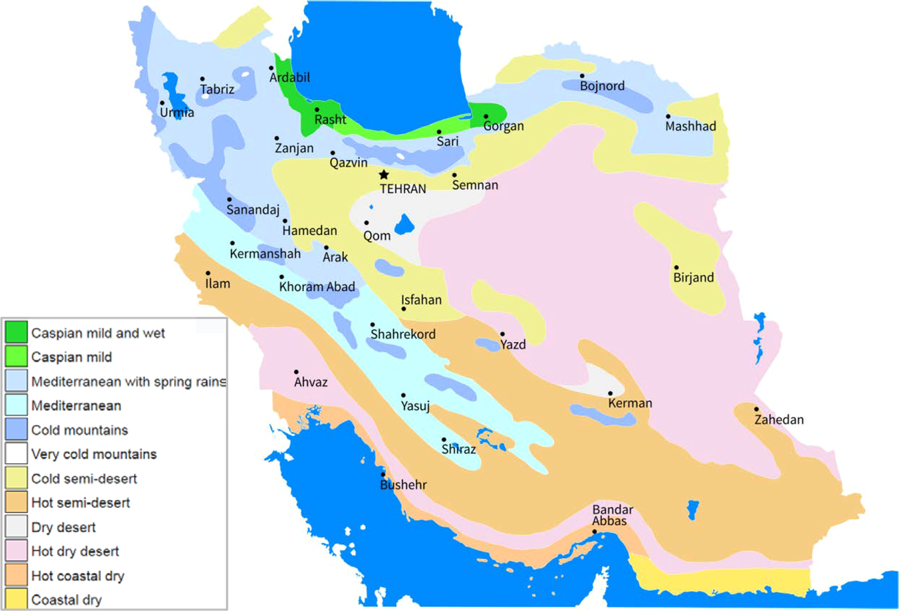

Slide 45
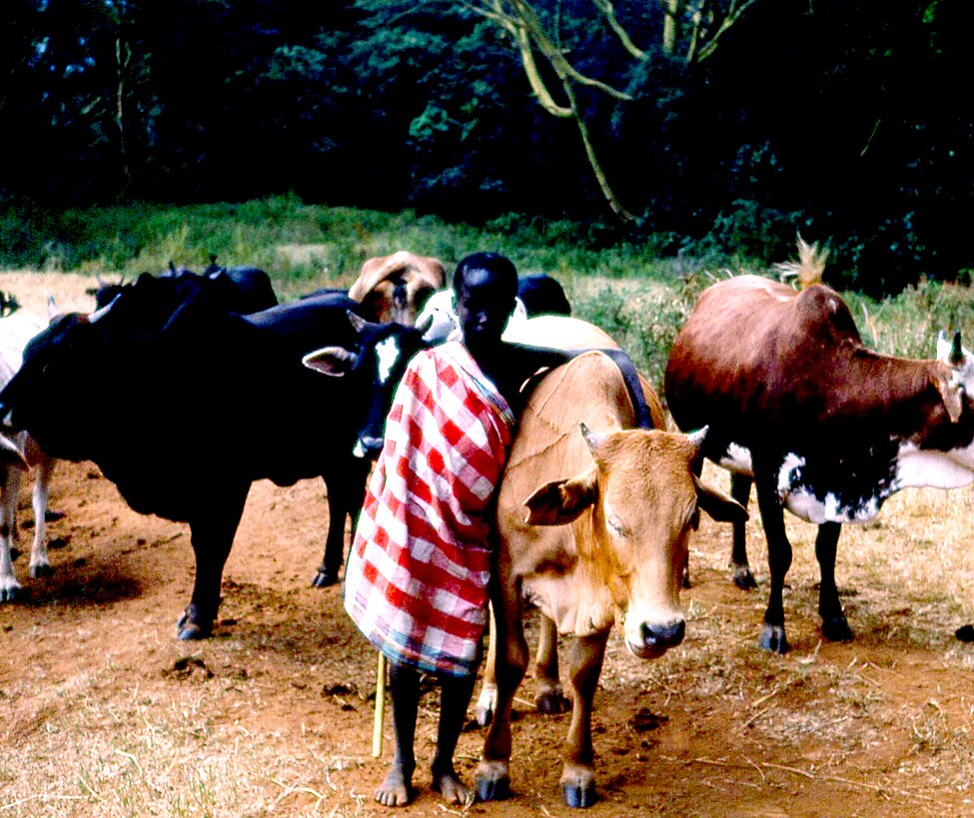
Pastoral Nomadism
Practice of moving animal herds long distances on a seasonal rotation to take advantage of favorable pasturage
Also called transhumance
Maasai youth herding cattle in Kenya, 1979

Slide 46
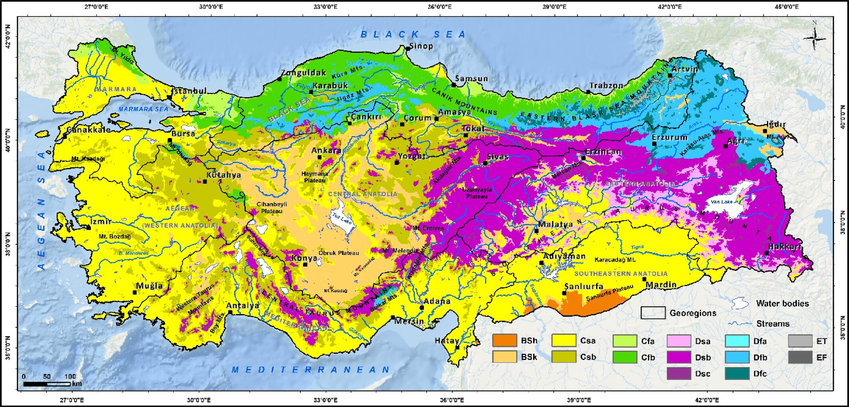

Slide 47
Key Terms
Anatolia
Domestication
Euphrates
Fertile Crescent
Herodotus
Lower Egypt
Mesopotamia
Nile
Pastoral nomadism
Tigris
Upper Egypt

