Slide 1
Q-center: https://www.brynmawr.edu/inside/offices-services/q-center/q-center-schedule
Office Hours: M 1:30pm – 3:00pm
(in Park 169) W 11:00am – 12:00pm
or by appointment (email me)
or just email me with questions!
TA Hours w/ Dana: Th 6:00pm – 7:00pm
(in Park 273) F 4:30pm – 6:00pm
Brief History of Atomic Theory
Atoms and the Periodic Table
9/9/2026
Achieve HW #2 due Monday 9/14 at 10:00am
Quiz #1 in Recitation Friday (9/11) – all material up through unit conversions

Slide 2
Learning Objectives
Outline milestones in the development of modern atomic theory
Summarize and interpret the results of the experiments of Thomson, Millikan, Rutherford, and Chadwick
Write and interpret symbols that depict the atomic number, mass number, and charge of an atom or ion
Describe the three subatomic particles that compose atoms
Define isotopes and give examples for several elements
Write and interpret symbols that depict the atomic number, mass number, and charge of an atom or ion
Define the atomic mass unit and average atomic mass
Calculate average atomic mass and isotopic abundance
Explain the organization of elements in the periodic table
Predict the general properties of elements based on their location within the periodic table
  # of valence electrons, and most common ion formed
Identify metals, nonmetals, and metalloids by their properties and/or location on the periodic table

Slide 3
Atomic Theory
1808 CE: John Dalton’s Atomic Theory expanded on the centuries-old Greek philosophies…
1. All matter is composed of atoms.
2. For a given element, all atoms have the same mass and other properties.
3. Different elements have atoms with different properties.
4. A compound consists of atoms of two or more elements combined in whole-number ratios.
Example: Water H₂O has 2 atoms of hydrogen for every 1 atom of water
5. Atoms are not created or destroyed in a chemical change. They rearrange to make new compounds (with new ratios of atoms).
Notes:
In between – Jabir ibn Hayyan (ca. 800CE) was cooking like mad, still on the Grecian 4 elements paradigm. But no one really knew what each other was saying in the alchemy world and experiments were often not reproducible. The theory was far from cohesive but a lot of experiential knowledge of substances came about (ie strong acids, metallurgy, sulfur and mercury, etc).

Slide 4
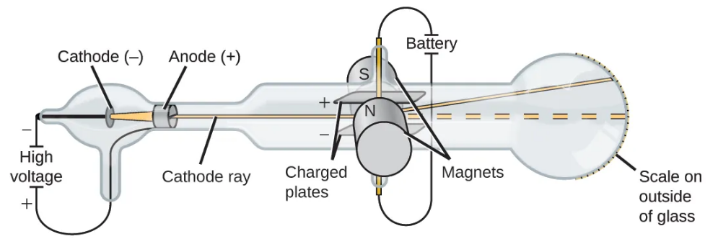
Revising Dalton’s Atomic Theory
1897 CE: J.J. Thompson built on (and challenged) Dalton’s atomic theory
Electricity applied in a vacuum generates a beam of negatively charged particles.
Experimentation allowed calculation of the mass-to-charge ratio of these particles.
They were negatively charged, and much lighter than any atoms that had been observed!
Atomic theory was revised to account for new observations.

Slide 5
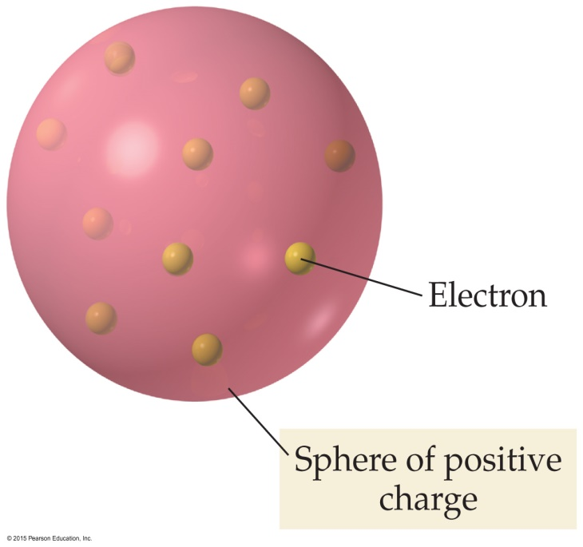
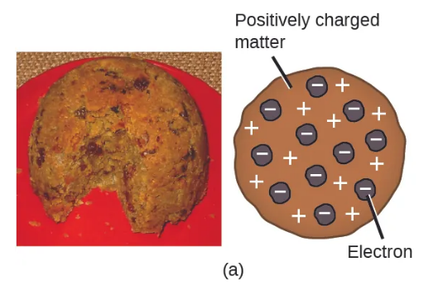
Plum Pudding Model of the Atom
Atoms were known to be neutral so there must be positive charges to balance these negatively charged “electrons”
1904 CE: “Plum Pudding Model”
Atom is a sphere of positive charge with negative particles (electrons) mixed in

Slide 6
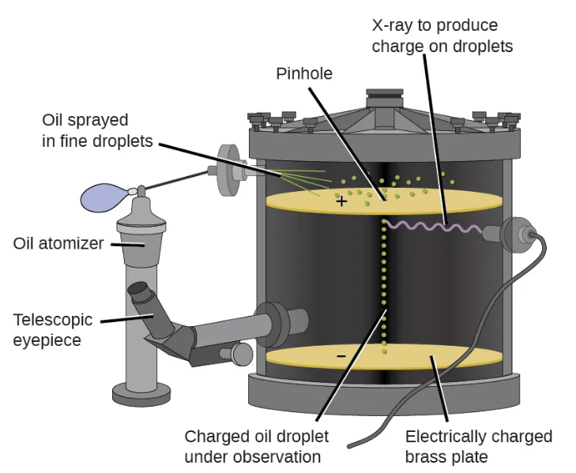
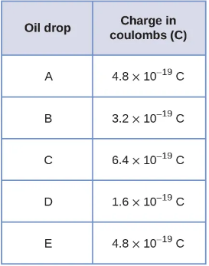
Millikan’s Oil Drop Experiment
1909 CE: Further investigation into negatively charged electrons.
Experiments produced tiny oil droplets with slight negative charges
Observed that charge on droplets was always a multiple of the same number!
Determined the smallest unit of negative charge must be 1.6 x 10⁻¹⁹ C
Combined with Thompson’s data, allowed calculation of mass of one electron

Slide 7
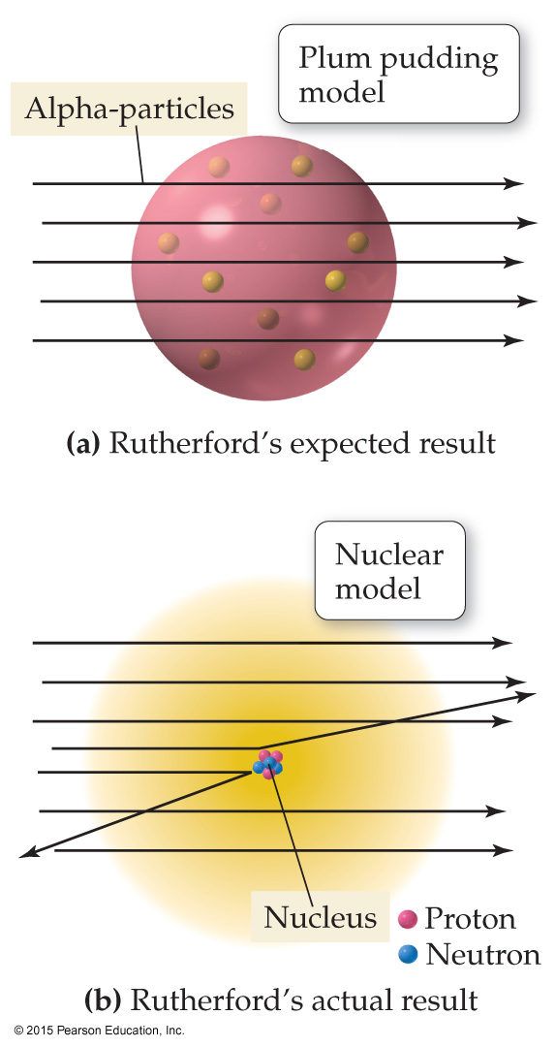
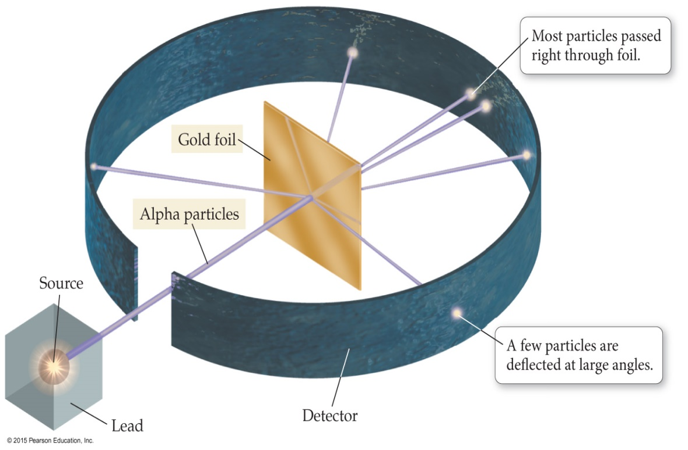
Rutherford’s Gold Foil Experiment
ca. 1909 CE: Ernest Rutherford and co. tried to confirm Thompson’s Plum Pudding Model
Tiny alpha-particles were directed at a thin sheet of gold foil.
Most of the particles passed directly through the foil.
A few were deflected, some of them at sharp angles.

Slide 8
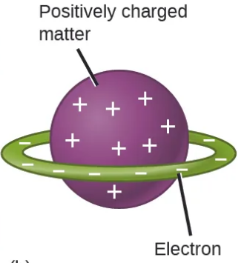
Nuclear Theory of the Atom (1911 CE)
a) Rutherford’s Expected result:
Alpha-particles should pass through gold foil with minimal deflection.
Deflections should be roughly uniform.
(b) Actual result:
A small number of alpha-particles were deflected or bounced back.
Supported Hantaro Nagaoka’s “planetary” model of the atom (1903)
“Plum Pudding” model
“planetary” model
Notes:
Nagaoka had abandoned his idea by 1908!

Slide 9
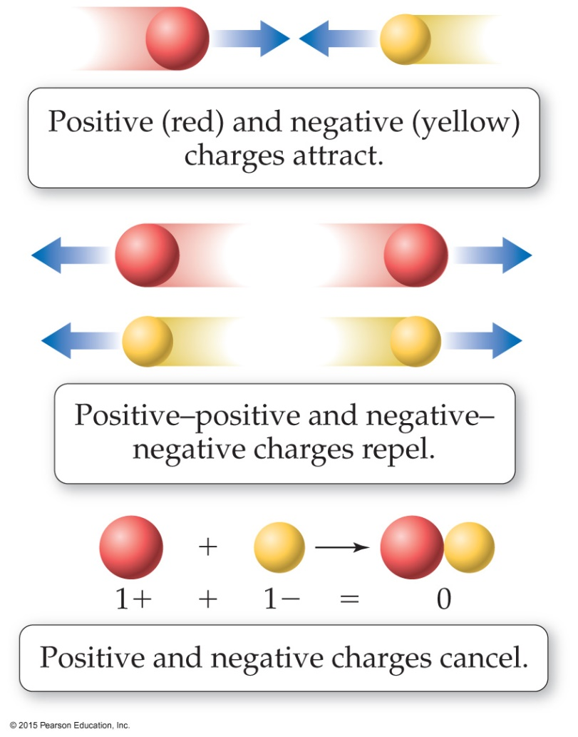
Nuclear Theory of the Atom (1911 CE)
1. Most of atom’s mass and positive charge is contained in a small central core called the nucleus
2. Atom is mostly ___________ __________, with small negatively charged electrons interspersed.
3. Amount of positive charge = amount of negative charge (atom is neutral)
Experiments showed that nuclei of all elements contained Hydrogen nuclei as “building blocks”
Rutherford named this building block of nuclear mass and positive charge the “proton.”

Slide 10
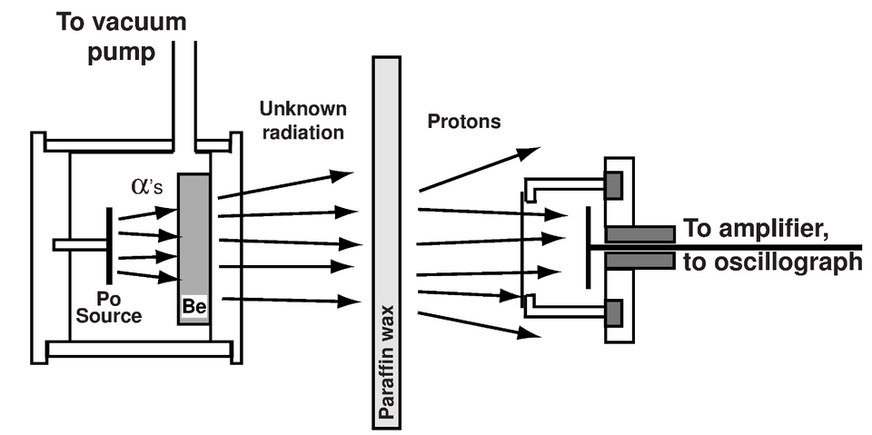
James Chadwick and the Neutron
Experiments to this point had determined:
  Atoms contain negatively (-) charged e⁻
  which have very little mass.
  Most of an atom’s mass is in the nucleus
  The nucleus contains positive (+) charged protons
  An atom of Helium is 4x as heavy as Hydrogen,
  but the nucleus only has 2x as much (+) charge.
Data suggested there was a ___________ particle contributing to the nucleus mass!
1932 CE: James Chadwick discovered a new type of radiation.
Particles had similar mass to a Hydrogen nucleus, but no charge.

Slide 11
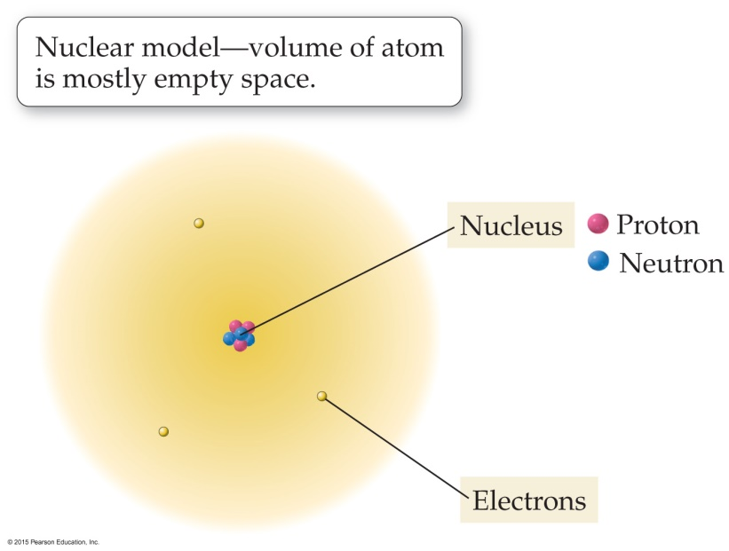
Protons, Neutrons, & Electrons (Subatomic Particles)
Protons (+ charge) and neutrons (neutral) make up nucleus (99.9% of atom’s mass)
Electrons (- charge): cloud of negatively charged particles around nucleus; very little mass
Atomic mass unit (amu): convenient unit for the mass of subatomic particles
1 amu = 1.66x10⁻²⁷ kg
Based on 1/12 mass of a ¹²C atom.
amu is also called ______________ , especially
by _________________.

Slide 12
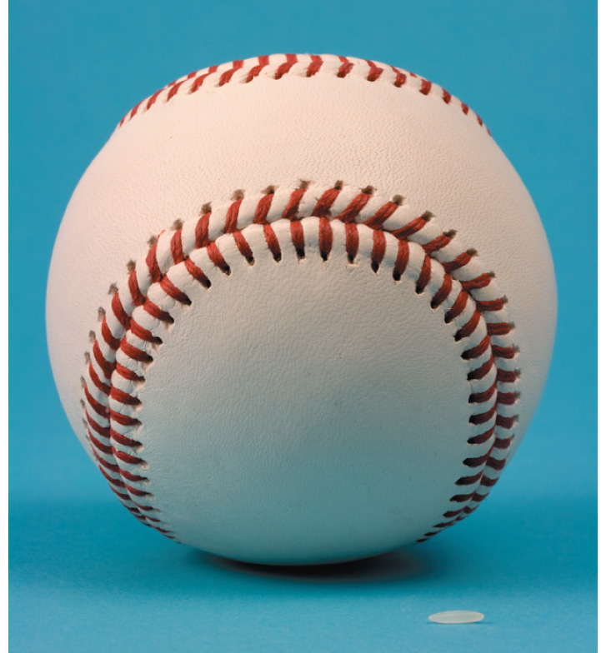
Subatomic Particles
 | Mass (kg) | Mass (amu) | Charge
Proton | 1.67273 x 10⁻²⁷ | 1.0073 | +1
Neutron | 1.67493 x 10⁻²⁷ | 1.0087 | 0
Electron | 9.1 x 10⁻³¹ | 0.00055 | -1
If a proton had the mass of a baseball,
an electron would have the mass of a grain of rice.
A proton is nearly 2000 times more massive than an electron.

Slide 13
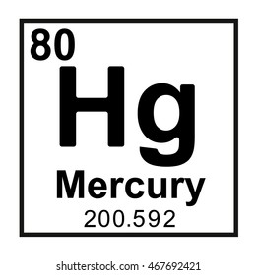
Atomic Numbers & Symbols
Elements are defined by their number of protons
Atomic Number (Z) = number of protons
Chemical symbol = abbreviation for an element
Example: Carbon (C), Silicon (Si), Lead (Pb), Mercury (Hg)
Some symbols are based on the Latin names

Slide 14
Atomic Numbers & Symbols
2 = Atomic Number (Z)
He = Chemical Symbol
4.00 = Atomic Mass (in amu)
Helium = Name

Slide 15
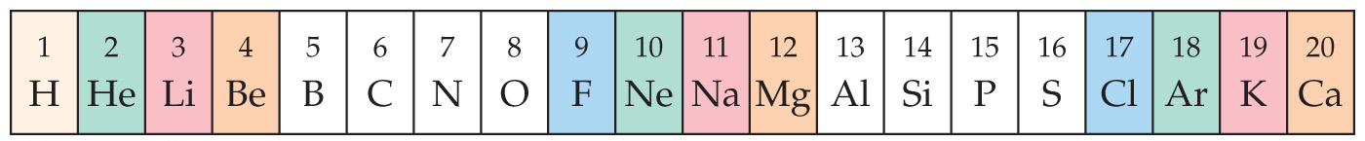
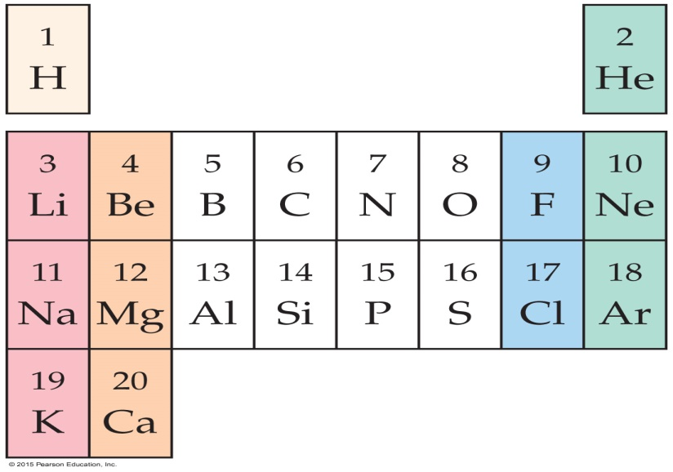
Periodic Table
Organized by Dmitri Mendeleev (1869)
When elements are arranged in order of increasing mass, certain sets of properties recur periodically
Arranged elements in rows so vertical columns share similar properties.

Slide 16
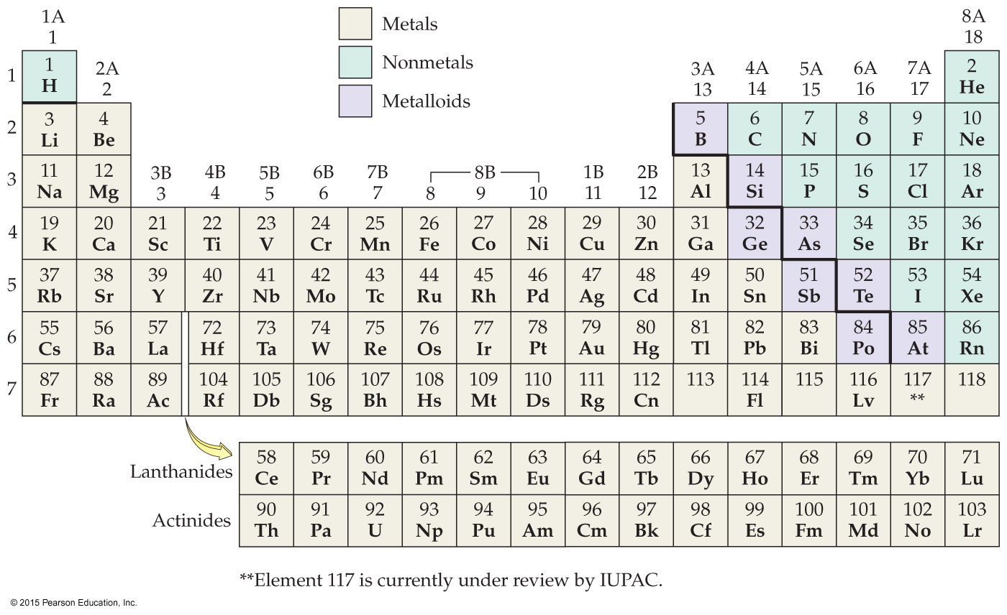
Locating Metals, Nonmetals, Metalloids

Slide 17
Metals
Nonmetals
Electrical - Conductive
Electrical - Insulator
Thermal - Conductive
Thermal - Insulator
Metallic gray luster
No luster
Most are solids**
All phases
Malleable - sheets
Brittle
Ductile – wires
Nonductile
Tend to form (+) ions
Tend to form (-) ions, but
(+) ions are not uncommon.
Notes:
13

Slide 18
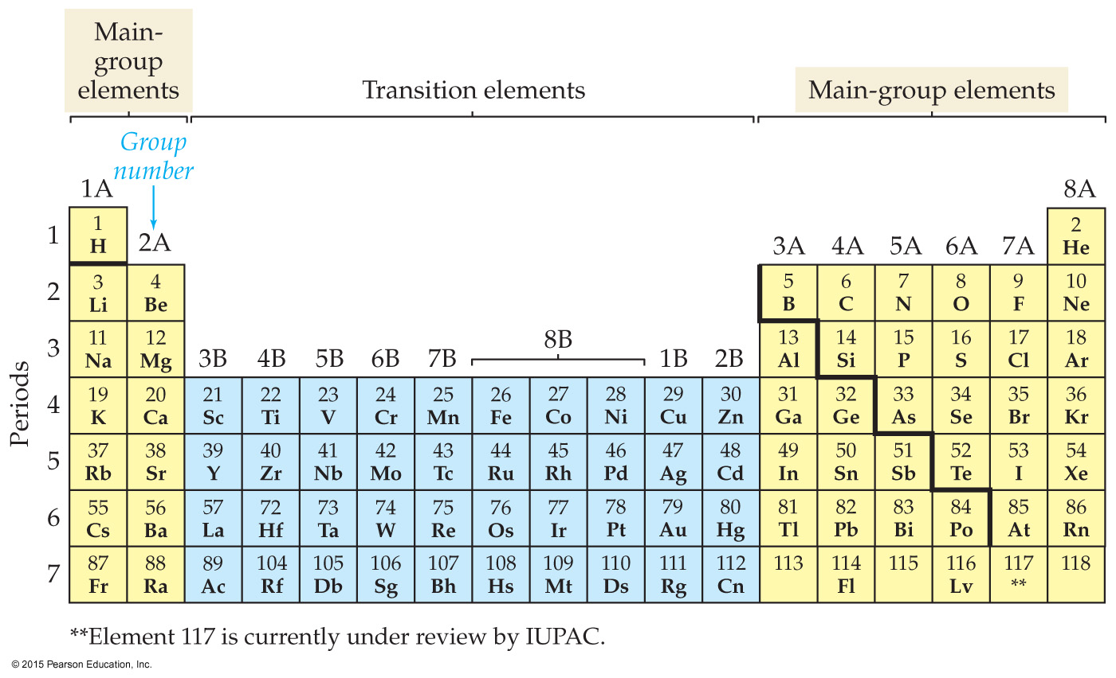
Main Group Elements and Transition Elements
For main group elements, properties can generally be predicted based on the element’s position.
Notes:
Left off here on Thursday

Slide 19
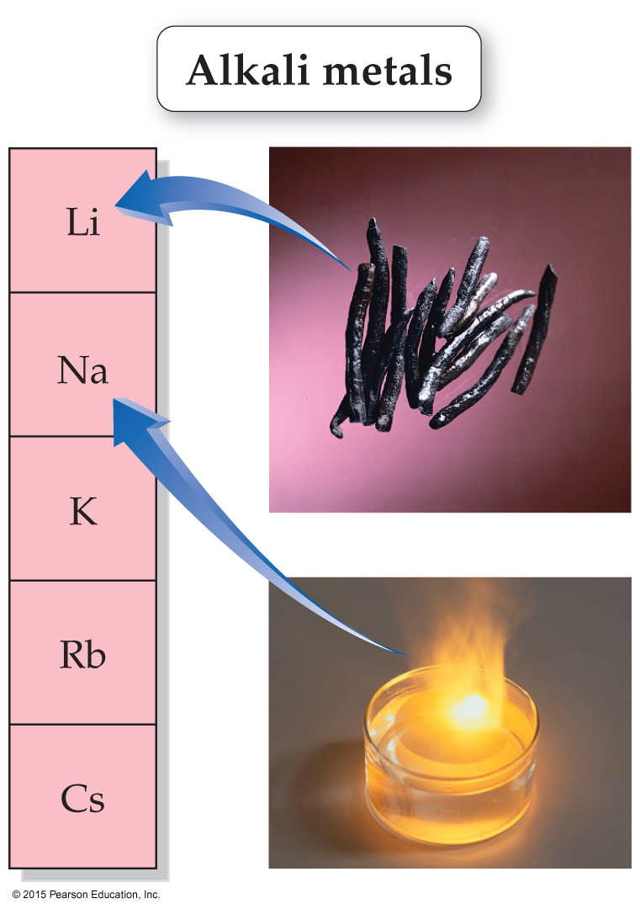
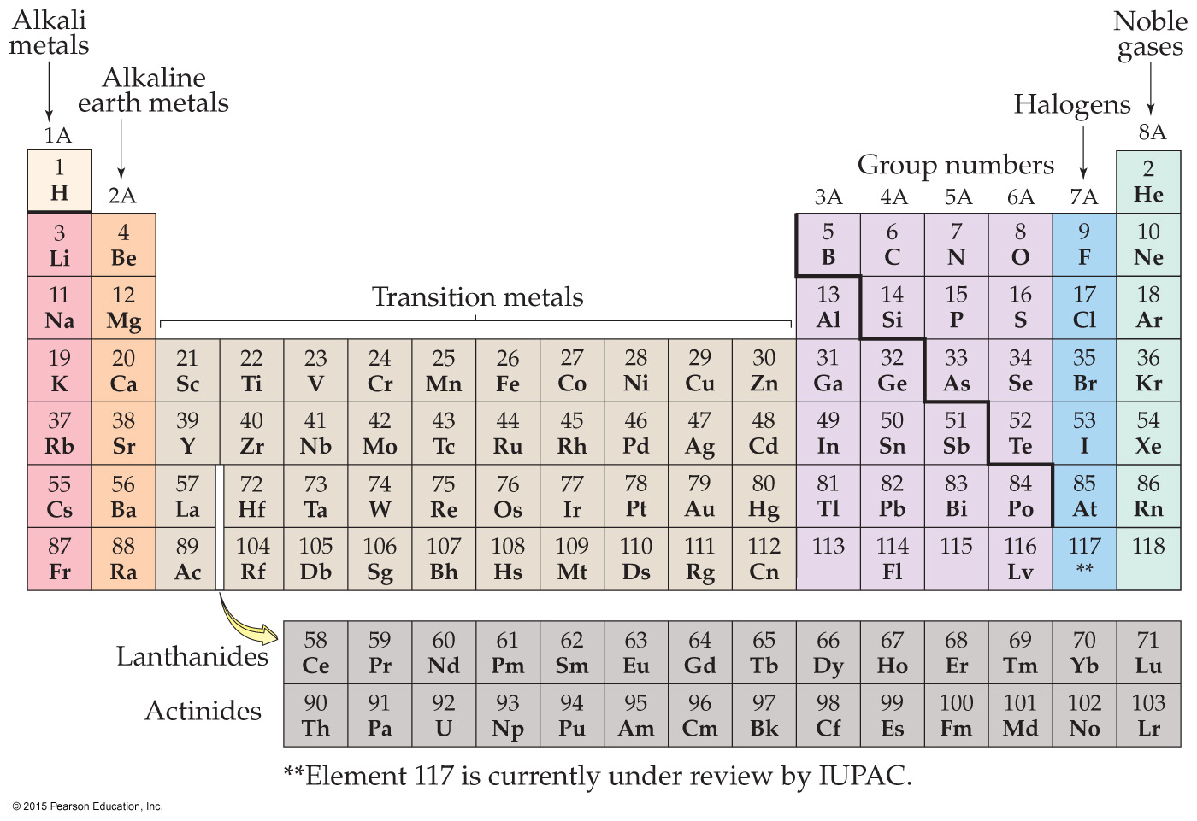
Groups 1A, 2A, 7A, 8A Highlighted

Slide 20
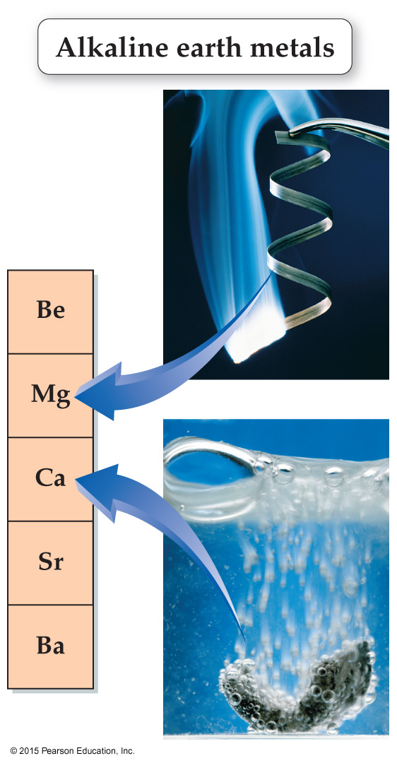
Groups 1A, 2A, 7A, 8A Highlighted
Notes:
Left off here Monday

Slide 21
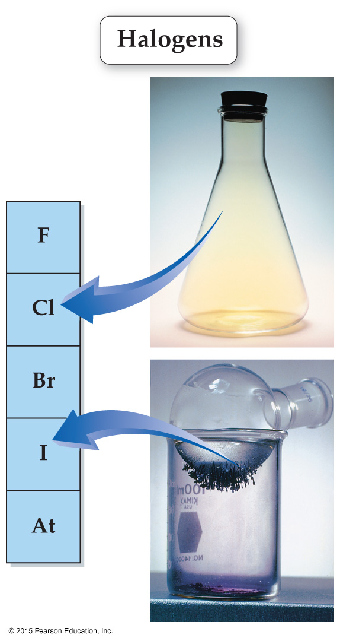
Groups 1A, 2A, 7A, 8A Highlighted

Slide 22
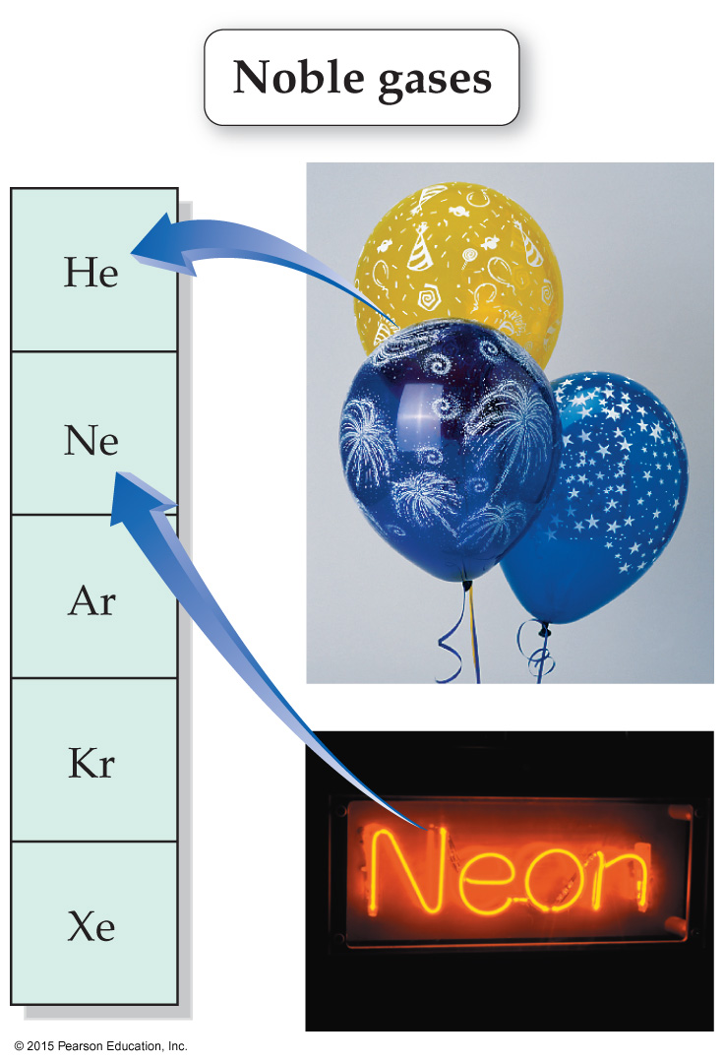
Groups 1A, 2A, 7A, 8A Highlighted

Slide 23
Valence Electrons
Valence electrons: located in the outer most shell of an atom.
have the highest energy of all electrons in an atom.
responsible for the reactivity and other properties of an atom.
Main Group Elements have same number of valence electrons as their group number (column)
  Li has 1 valence e⁻, Be has 2 valence e⁻, B has 3 valence e⁻, …

Slide 24
Atom
Protons, neutron and electrons
# Protons = # Electrons
Atoms are ___________ particles
Ion
Protons, neutron and electrons
# Protons ≠ # Electrons
Ions are ___________ particles

Slide 25
Cations vs Anions
Cation – positively charged particle (atom has lost one or more electrons)
  Ex: Li → Li⁺ + 1e⁻ Lithium ion charge = 1+
Anion – negatively charged particle (atom has gained one or more electrons)
  Ex: F + 1e⁻ → F⁻ Fluorine ion charge = 1-
Ion Charge = # protons - # electrons

Slide 26
Ions & Periodic Table
Main group elements tend to form ions that have the same number of valence electrons as the nearest noble gas.
  Li tends to lose 1 electron (become Li⁺)
  to become like He
  Be tends to lose 2 electrons (become Mg²⁺)
  to become like He
  F tends to gain 1 electron (become F⁻) to become like Ne
  O tends to gain 2 electrons (become O²⁻) to become like Ne

Slide 27
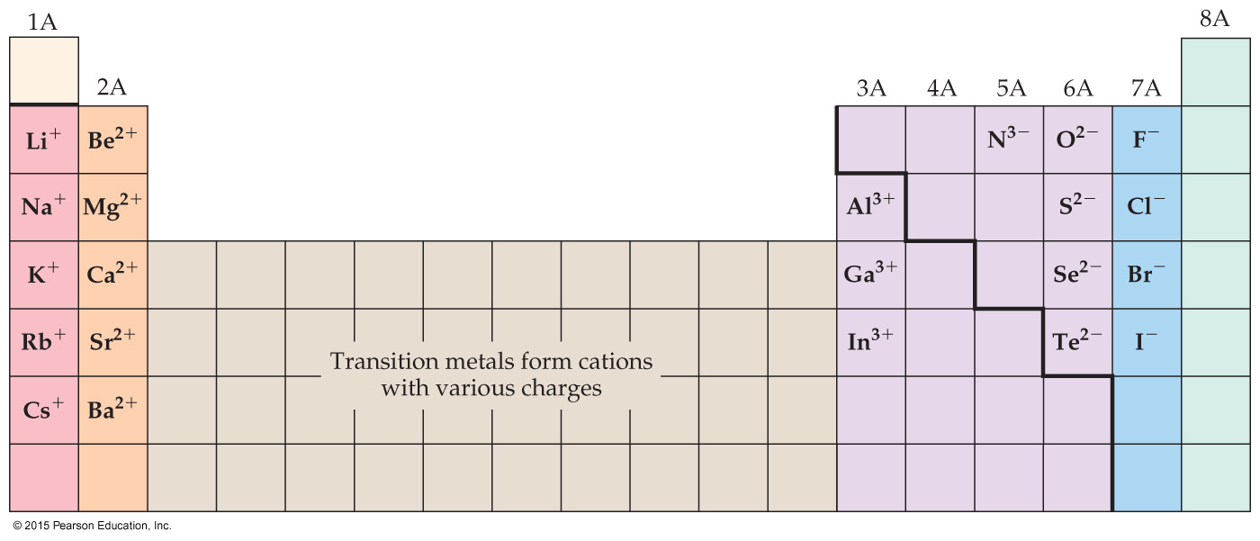
Ions and the Periodic Table
This is one of the most important slides in the entire class!!!
(memorize these charge rules ASAP, they will come up a lot)

Slide 28
(a) How many protons does potassium (K) have?
(b) What type of ion will K normally form?
(c) Write a reaction showing a K atom forming this ion.
(d) What group/family does K belong to?

Slide 29
Determine the charge of a magnesium ion with 10 electrons

Slide 30
Isotopes: When the Number of Neutrons Varies
All atoms of a given element have the same number of protons.
They do not necessarily have the same number of neutrons.
Atoms with the same number of protons but different numbers of neutrons are called isotopes.
All elements have their own unique percent natural abundance of isotopes.

Slide 31
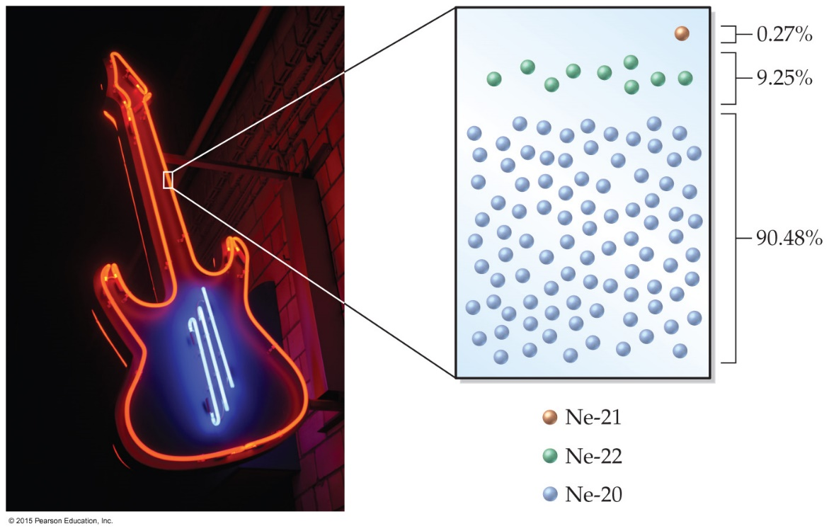
Isotopes: Natural Abundance of Isotopes in Neon
Naturally occurring neon contains three different isotopes:
 | # protons | # neutrons | Mass Number (A) | Percent Abundance
Ne-20 | 10 | 10 | 20 | 90.48%
Ne-21 | 10 | 11 | 21 | 0.27%
Ne-22 | 10 | 12 | 22 | 9.25%

Slide 32
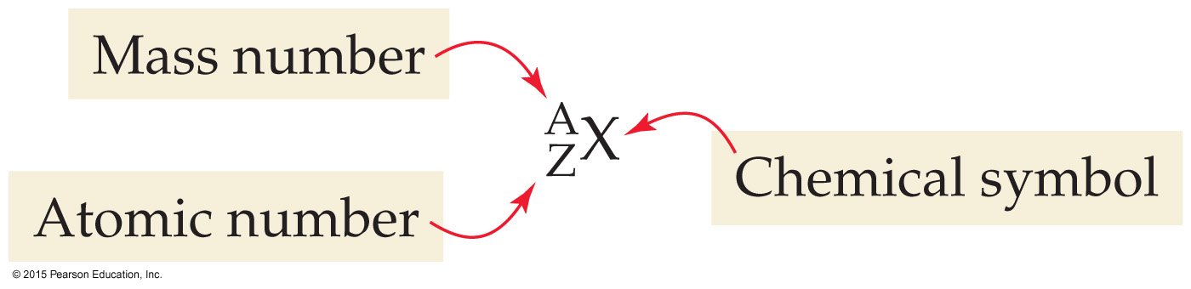

Isotope Symbol Notation
Isotopes of Neon:
Mass number (A) = # protons + # neutrons

Slide 33
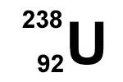
How many protons and neutrons are in this isotope of Uranium?

Slide 34
If an atom has a mass number of 32 and has 17 neutrons, it is an isotope of which element?
What is unique for each element?

Slide 35
What are the atomic number, mass number, and symbols for the chlorine isotope with 18 neutrons?

Slide 36
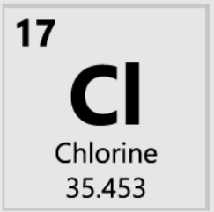
Atomic Mass
Atomic mass: mass of element listed in periodic table
Atomic mass on periodic table is a _______________ __________
based on the natural abundance of each isotope!
 | # protons | # neutrons | Mass Number (A) | Mass (amu) | Percent Abundance
Cl-35 | 17 | 18 | 35 | 34.45 amu | 75.77%
Cl-37 | 17 | 20 | 37 | 36.97 amu | 24.23%
Atomic mass = (75.77% x 34.45 amu) + (24.23% x 36.97 amu)
= (0.7577 x 34.45 amu) + (0.2423 x 36.97 amu) = 35.45 amu

Slide 37
Calculate the atomic mass of magnesium:
  isotope 1: 23.99 amu, 78.99% abundance
  isotope 2: 24.99 amu, 10.00% abundance
  isotope 3: 25.98 amu, 11.01% abundance
Atomic mass = (78.99% x 23.99) + (10.00% x 24.99) + (11.01% x 25.98)
= (0.7899 x 23.99) + (0.10000 x 24.99) + (0.1101 x 25.98)
= 18.9497 + 2.499 + 2.860398
= 24.309099 = 24.31 amu

