Slide 1

Drawing and Naming Organic Molecules
Q-center: https://www.brynmawr.edu/inside/offices-services/q-center/q-center-schedule
Office Hours: M 1:30pm - 3:00pm
(in Park 169) W 11:00am - 12:00pm
or by appointment (email me)
or just email me with questions!
TA Hours w/ Sodtugs: T&Th 7:00pm - 8:00pm
(in Park 273)
9/9/2026
Quiz 1 in Recitation on Friday

Slide 2
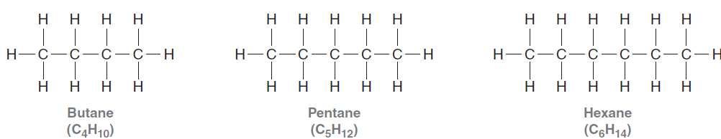
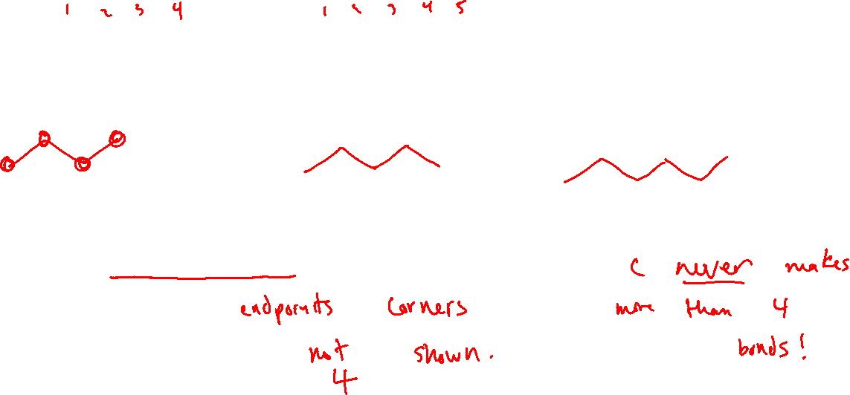
Drawing Molecules: Bond-Line Structures
The longest Carbon chain is drawn in a “zig-zag” format
Carbons are represented as ____________ or ____________ of lines.
Hydrogens attached to Carbons are _________ ___________
[Assume each Carbon makes a total of _____ bonds to determine the number of implied Hydrogens]

Slide 3
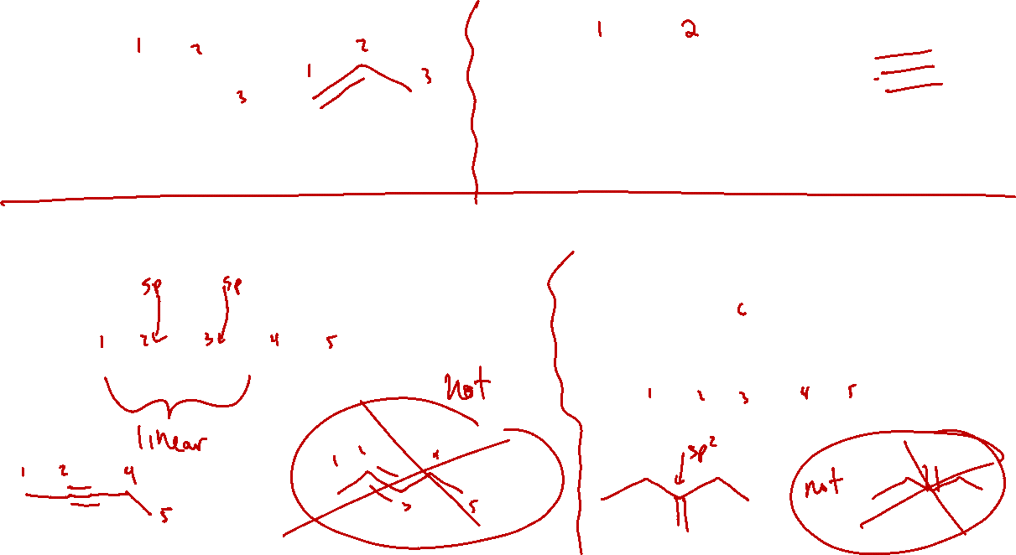
Carbon-Carbon multiple bonds are shown with multiple lines
The geometry of the bond-line structure should reflect the hybridization of each carbon! (VSEPR)

Slide 4
Heteroatoms (not C or H) are always drawn
Heteroatoms always have their number of H’s labeled clearly
Lone pairs are not shown in bond-line structures, but
Formal charges are always shown.

Slide 5
Nonzero formal charges: Carbon
Carbon never makes more than 4 bonds, but sometimes it makes fewer:

Slide 6
Nonzero formal charges: Nitrogen

Slide 7
Nonzero formal charges: Oxygen

Slide 8
Bond-line structures and 3D geometry
The longest chain of Carbons is drawn as a zig-zagging line
Substituents of sp³ carbons are often (but not always*) drawn with:
Wedges (bond is coming out of the plane of the paper, toward you)
&
Dashes (bond is going into the plane of the paper, away from you)
*much discussion of when these must be used and why is coming soon in Chapter 5 (lectures 8-9).

Slide 9
Bond-line structures and 3D geometry
Wedges and dashes are always drawn next to each other
Wedges and dashes point “away from” the rest of the chain in order to represent tetrahedral geometry

Slide 10
Practice (on your own – answers in annotated slides on Moodle)
Draw full (or condensed) structures w/lone pairs
Draw bond-line structures

Slide 11
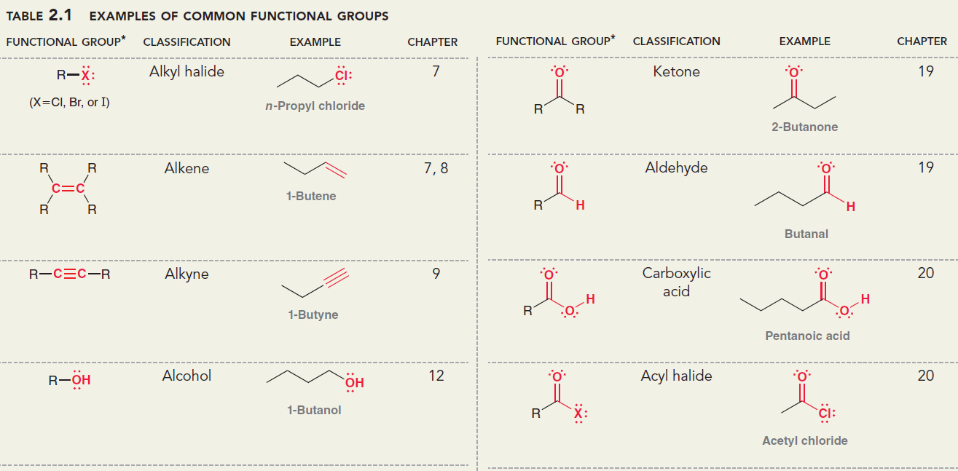
Functional groups (table 2.1 on page 56 in Klein)
Organic molecules are classified via certain bonding motifs among Carbon & friends (C, H, O, N, P, S, X)
Functional groups determine reactivity (in the lab & in the body)
Notes:
R = the rest of the compound (a hydrocarbon fragment), or in some cases, just an H
Know for next Friday: all except acyl halide

Slide 12
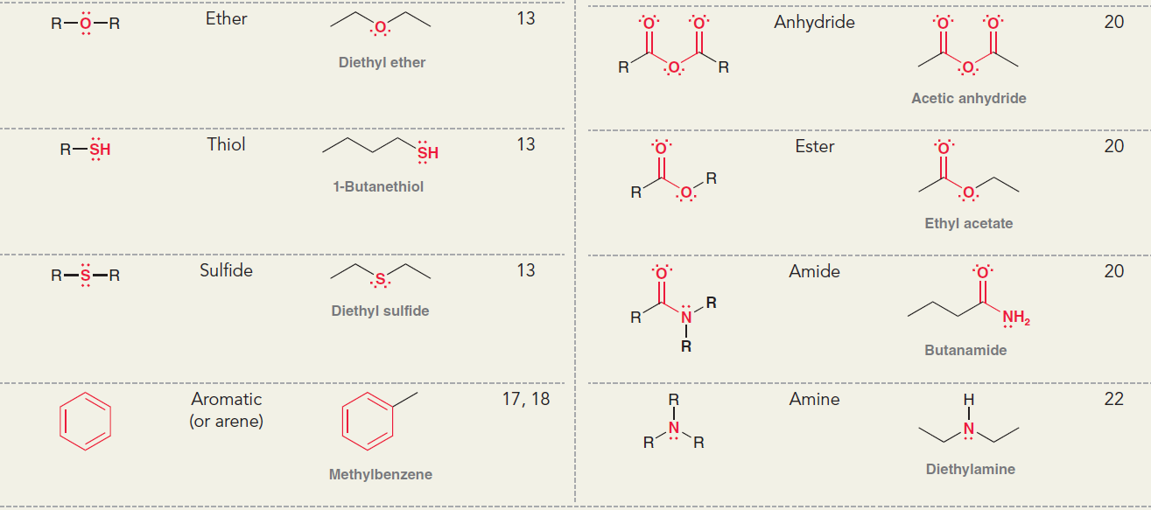
Notes:
Know for next Friday: ether, arene, ester, amide,a mine

Slide 13
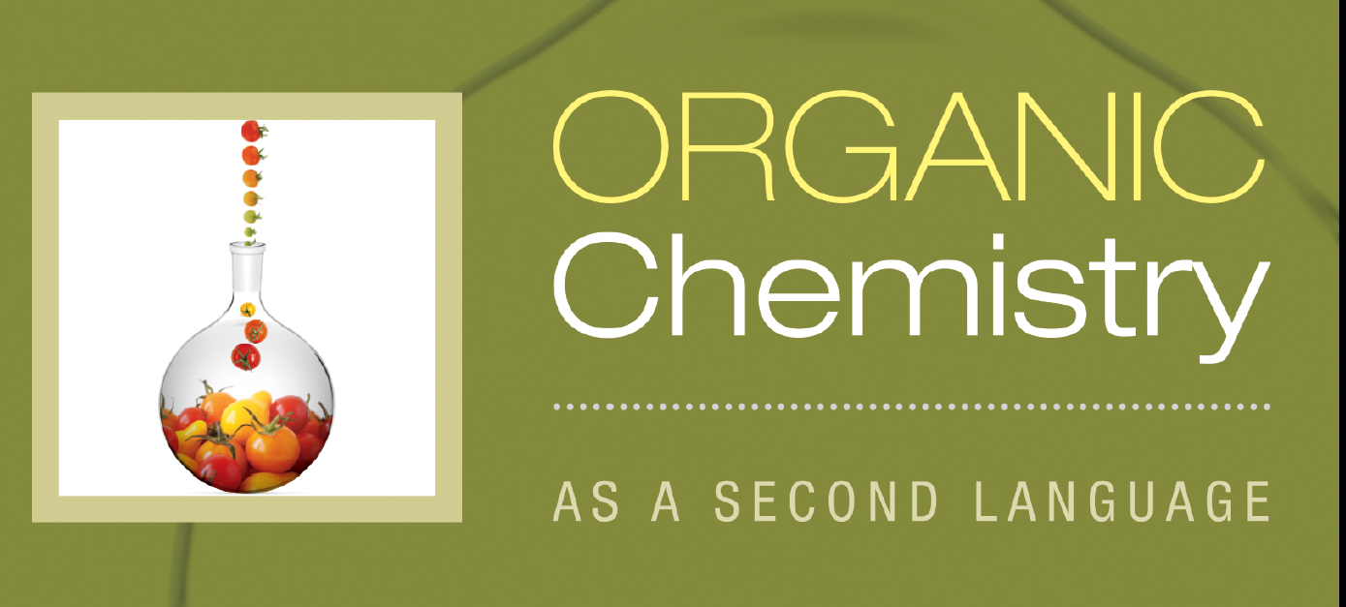
Pep talk about language and their respective specialities and previous degrees and experiences

Slide 14
Naming Alkanes

Slide 15
IUPAC systematic naming
Identify the longest carbon chain (the “parent chain”) in the molecule.
a. The prefix denotes the number of carbons in the parent chain.
b. The suffix for naming an alkane is “-ane”. Other functional groups will get their own suffixes.
# of Carbon atoms in chain | prefix | Name of alkane | Drawing
1
2
3
4
5
6
7
8
9
10
11
12

Slide 16
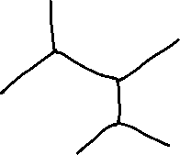

Slide 17
Poll
pollev.com/timcook653 or text timcook653 to 22333
Or use android/iphone app
The parent chain in this molecule is
hexane
heptane
octane
nonane

Slide 18
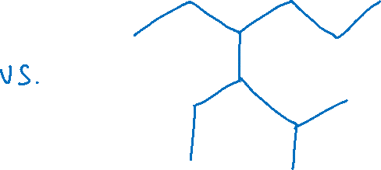
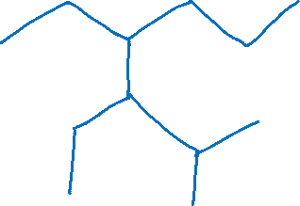
What if there are two possible “parent chains” that have the same length?
Choose the chain with the most substituents (groups that branch off the chain)

Slide 19



If the longest chain is a ring…

Slide 20
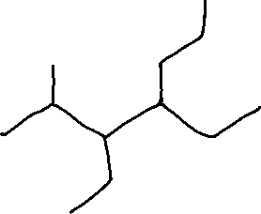

2. Name the substituents attached to the parent chain.
# of Carbon atoms in substituent | Name of substituent | Drawing
1
2
3
4
5
6
7
8
9
10

Slide 21
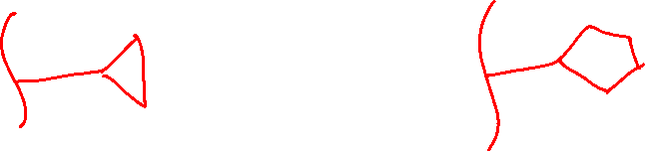
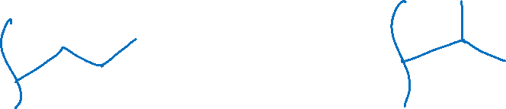
Other alkyl substituents
Cycloalkanes can be substituents:
The “propyl” group can have two different forms:

Slide 22
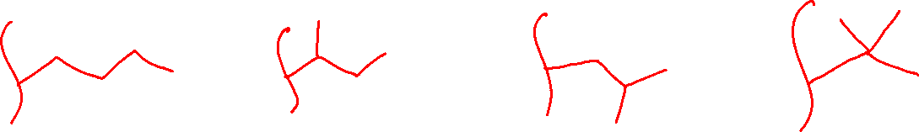
Other alkyl substituents
The “butyl” group has four different forms:

Slide 23
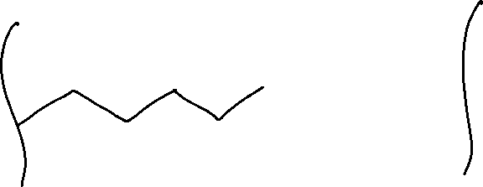


Other alkyl substituents
Pentyl has many different forms, but only two we will discuss:

