Slide 1
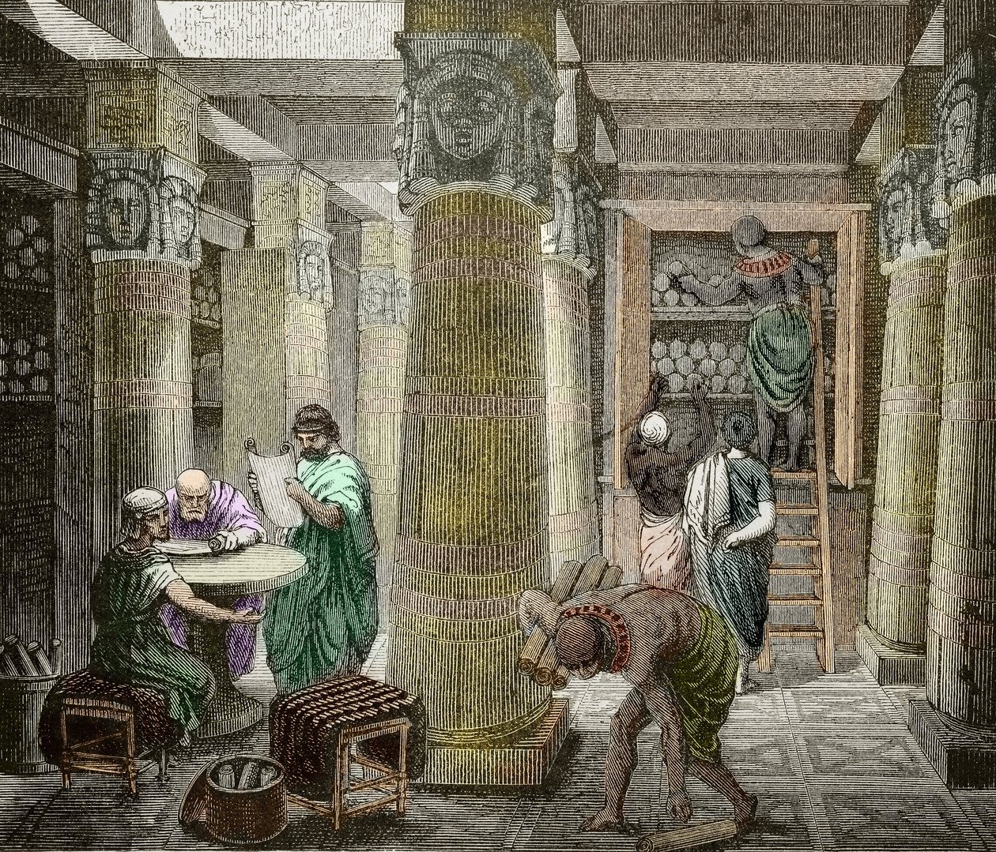
5,000 years of scrolling

Slide 2

the syllabus

Slide 3
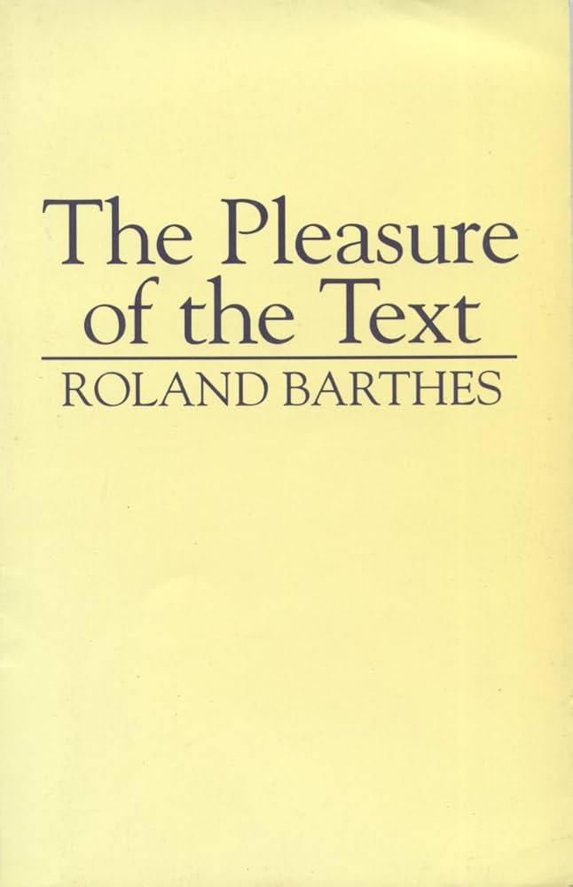
what is a text?

Slide 4

Lascaux Cave art, c. 20,000 years old

Slide 5

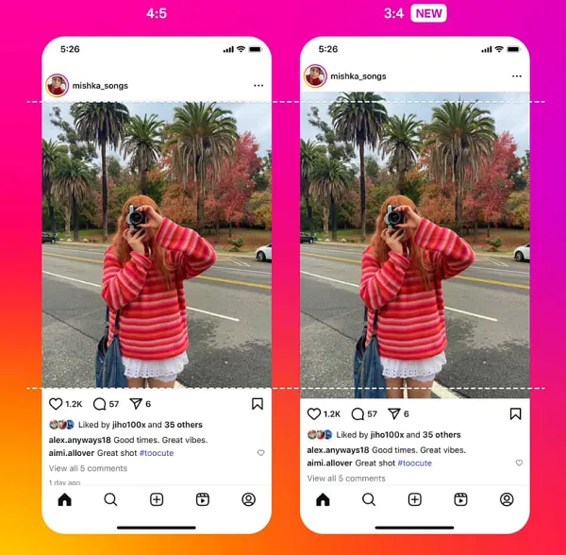
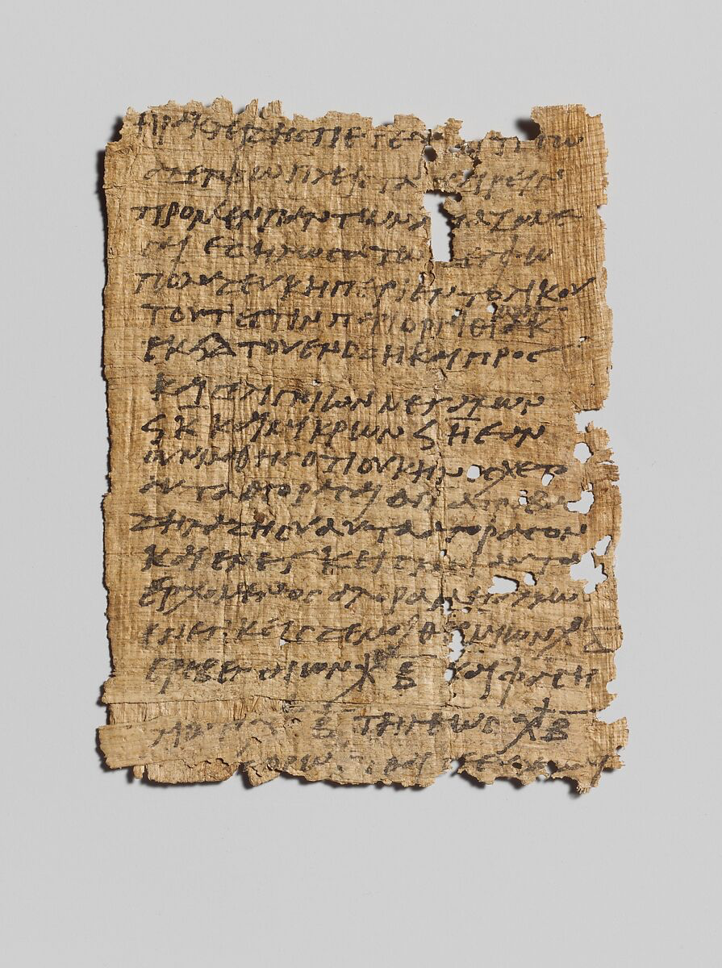

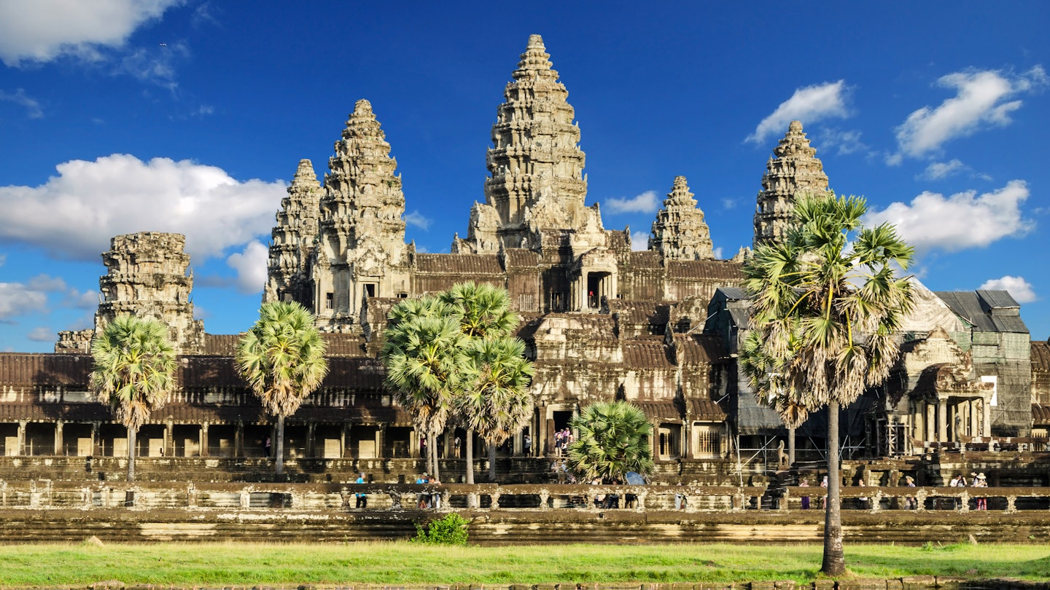
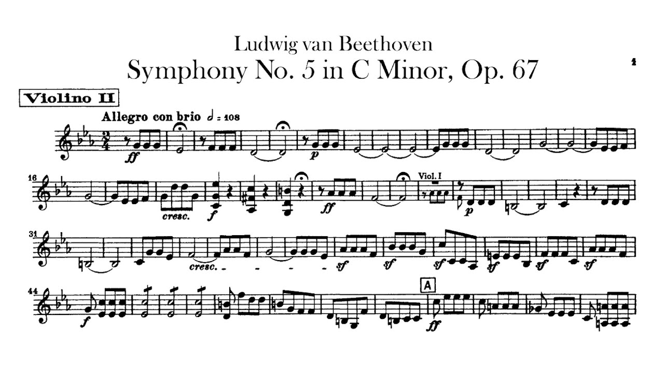
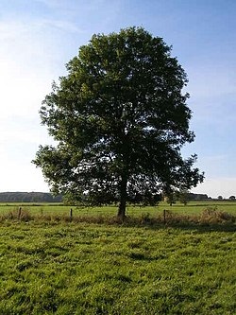

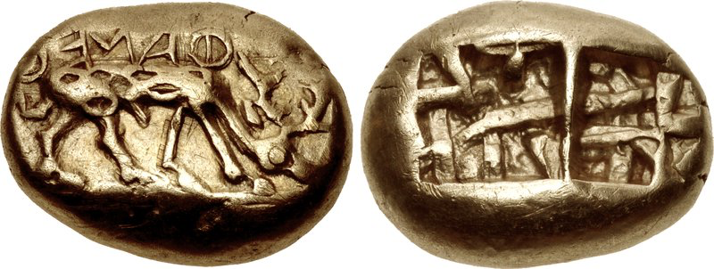

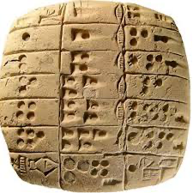
other exempla

Slide 6
why do we have what we have?
Someone wrote it down (or built it, minted it, etc.)
Someone copied it
  author? scribe?
Someone else copied it
  slave?
Several other people copied it
  In Europe, this usually means it made it to the ninth century
  monks? court clerics?
Someone printed it (15th century)
Someone scanned it (2010s)
  or, someone did spectral imaging and found an underlying text in a palimpsest
Something preserved it
Vulcanized, the dry climate in which it was stored preserved it, a bog, a shipwreck preserved it underseas, it was lost and later found
graffiti preserved by vulcanization or some other natural factor

Slide 7
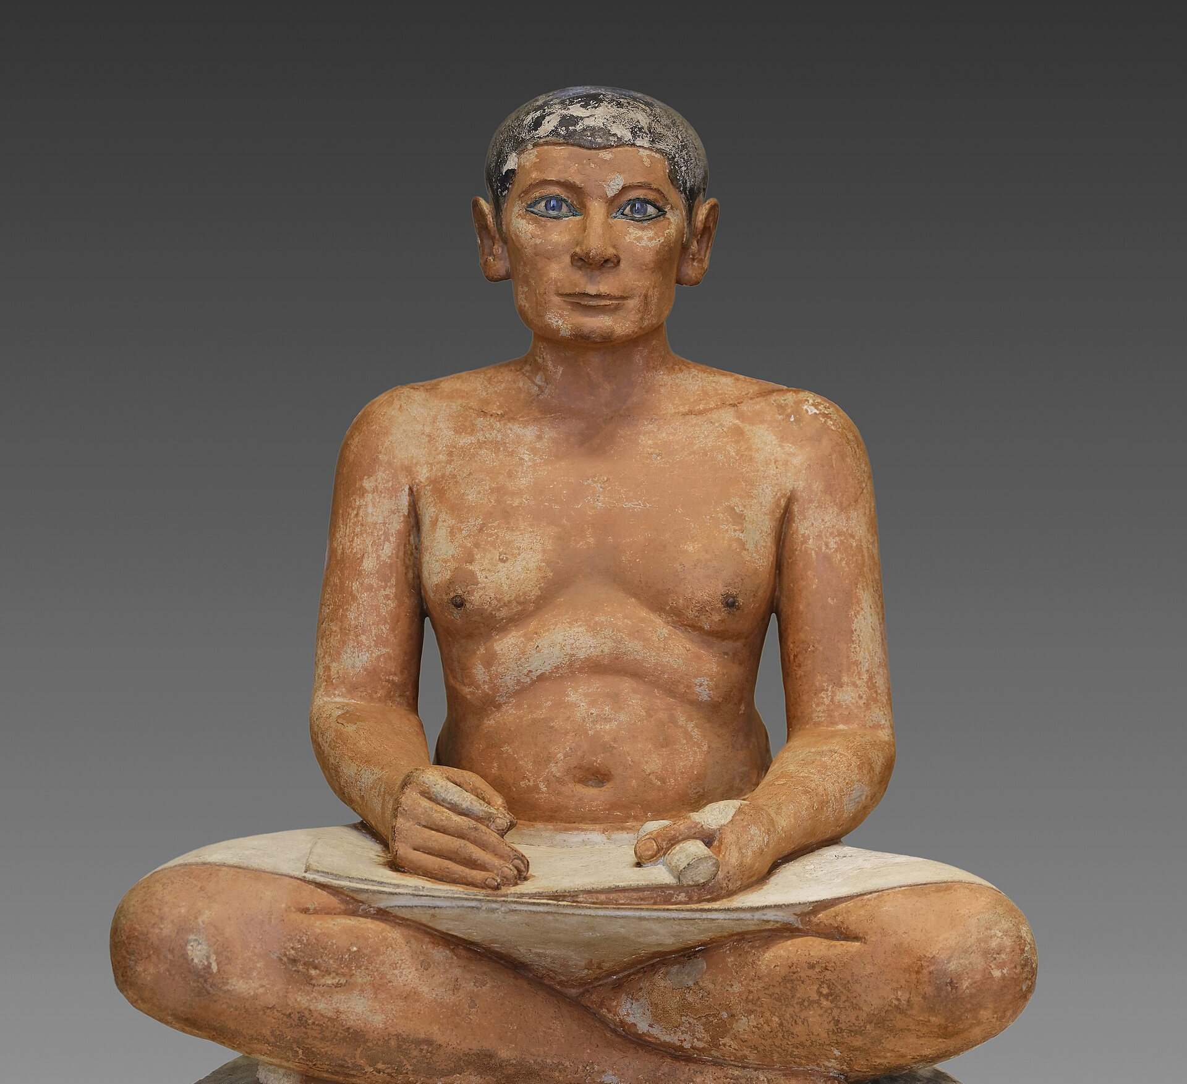
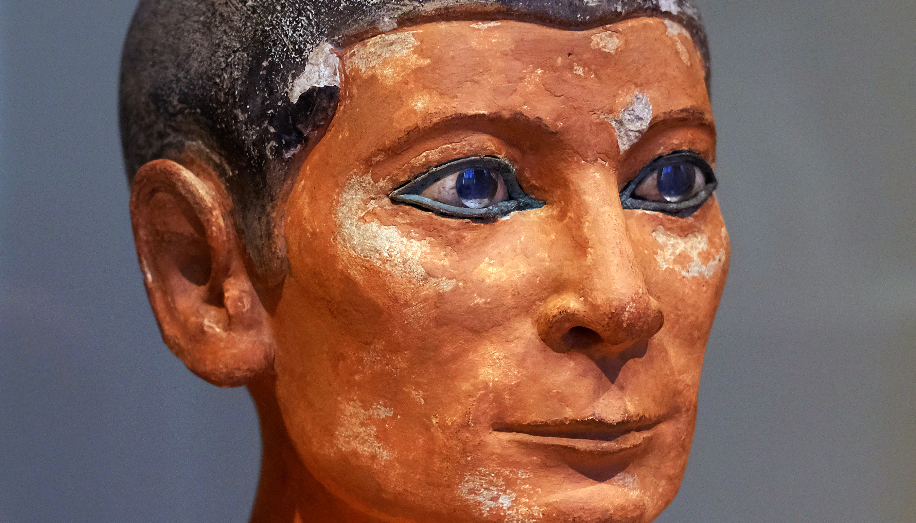
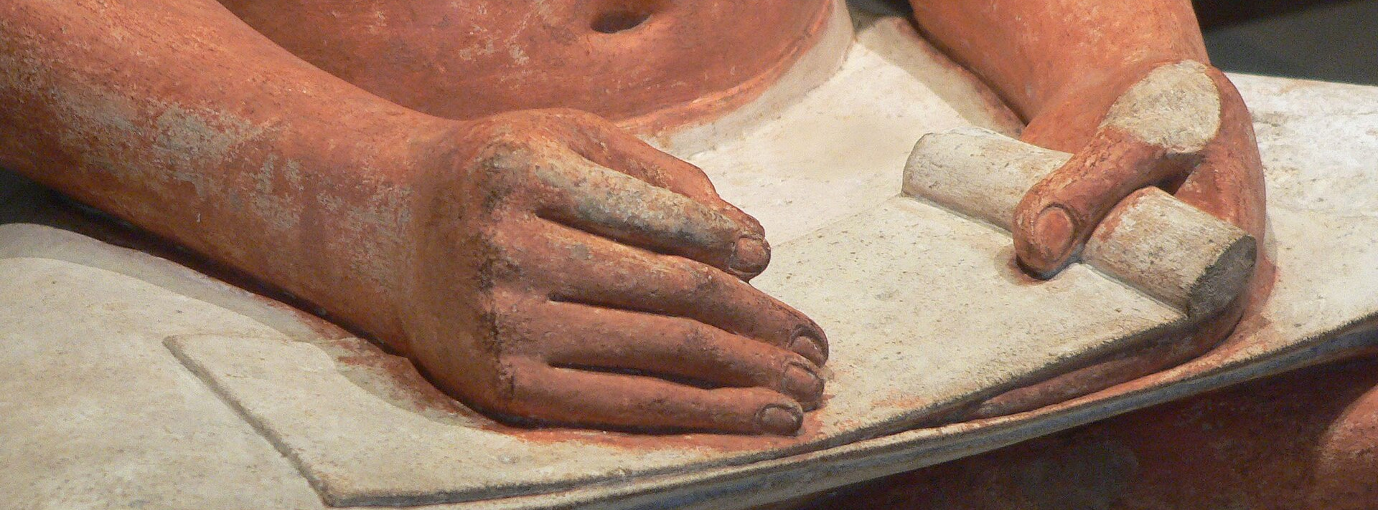
The Seated Scribe (Scribo Rosso). Old Kingdom, 5th Dynasty, c. 2450–2325 BCE. Louvre Museum, Paris.
Notes:
And these were there most important instrument, what Socrates called the “living tool,” the enslaved workers who copied, composed, emended, translated, recited, carried, and published poems.
click
Those scribes were there at the very beginning. This figure is Egyptian, impossibly ancient by Classicist’s standards. Greeks of course believed that writing originated in Egypt, and they weren’t exactly wrong, but we’ll come back to that

Slide 8
instrumenta scriptoria
Writing Instruments in Poetic Context
Instrument | Used On | Notes
Stylus (stilus) | Wax tablets | Pointed for writing; flat end for erasing wax
Reed pen (calamus) | Papyrus, parchment, ostraka | Standard literary writing instrument
Ink (carbon-based, atramentum) | Papyrus, parchment | Ubiquitous in antiquity
Knife or pumice stone (for scraping parchment) | Parchment and papyrus | Allowed correction of copied poetry
Notes:
Send around the Wax Tablet

Slide 9
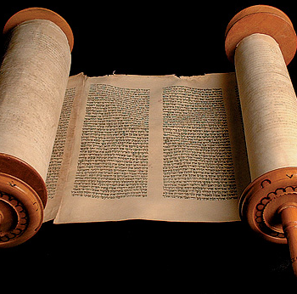
Papyrus codex
In use since Egypt, lasting from ~3000 BC to 1000 AD
“Our civilization, or at least our recollection, depends utterly upon the use of papyrus (chartae usu maxime humanitas vitae constet, certe memoria)” (Pliny, H.N. 13.21)
What constitutes a “book” (e.g. Iliad Book VI) is in fact what filled one scroll (βιβλίον, volumen).
On average, about 3-15m long, though the longest extant scroll (Egyptian) is 43m.
Notes:
When we say “book” in antiquity we generally mean this.
***Send around the papyrus***

Slide 10
how do we get more of it?
Find something in a library
Find something that’s been vulcanized
Use Artificial Intelligence to pull it apart, use a Humanist to interpret it

Slide 11

What is a classic?

Slide 12
What is classical?
classis (n): a group of troups, a rank; by extension, a class of person
classicus, classica, classicum (adj.): belonging to the first class
classical > classicus > classis
  but also class in school, now other kinds of “classic” (rock, coca-cola, etc)
Notes:
Stephanie’s question

Slide 13
For while caelum, or ‘sky,’ is always used in the singular, but mare, or ‘sea,’ and terra, or ‘land,’ not always, and pulvis, or ‘dust,’ ventus, or ‘wind,’ and fumus, or ‘smoke,’ not always, why did the early writers sometimes use indutiae, or ‘truce,’ and caerimoniae, or ‘ceremony,’ in the singular, but never feriae, or ‘holiday,’ nundinae, or ‘market day,’ inferiae, or ‘offering to the dead,’ and exsequiae, or ‘obsequies’? Why may mel, or ‘honey,’ and vinum, or ‘wine,’ and other words of that kind, be used in the plural, but not lacte (milk)?¹ All these questions, I say, cannot be investigated, unravelled, and thrashed out by men of affairs in so busy a city; indeed, I see that you have been delayed even by these matters of which I have spoken, being intent, I suppose, on some business. So go now and inquire, when you chance to have leisure, whether any orator or poet, provided he be of that earlier band—that is to say, any classical or authoritative writer, not one of the common herd—has used quadriga or harenae.”
Nam cum ‘caelum’ semper ἑνικῶς dicatur, ‘mare’ et ‘terra’ non semper, et ‘pulvis,’ ‘ventus’ et ‘fumus’ non semper, cur ‘indutias’ et ‘caerimonias’ scriptores veteres nonnumquam singulari numero appellaverunt, ‘ferias’ et ‘nundinas’ et ‘inferias’ et ‘exequias’ numquam? Cur ‘mel’ et ‘vinum’ atque id genus cetera numerum multitudinis capiunt, 14‘lacte’² non capiat? Quaeri, inquam, ista omnia et enucleari et extundi ab hominibus negotiosis in civitate tam occupata non queunt. Quin his quoque ipsis quae iam dixi demoratos vos esse video, alicui, 15opinor, negotio destinatos. Ite ergo nunc et, quando forte erit otium, quaerite an ‘quadrigam’ et ‘harenas’ dixerit e cohorte illa dumtaxat antiquiore vel oratorum aliquis vel poetarum, id est classicus adsiduusque aliquis scriptor, non proletarius.”
Attic Nights 19.8.15

Slide 14
key concepts
canon: The canon is the set of works considered most important, authoritative, or exemplary within a cultural or academic tradition. It requires cultures to select, which depends upon authority (the archon) and exclusion—hence why many progressives spent the last thirty years advocating for the removal of canons.
hegemony (see esp. Antonio Gramsci): Hegemony is the form of power where a dominant group maintains control not just through force, but by shaping cultural norms, values, and beliefs so that their worldview seems natural or common sense. (E.g., western hegemony, global north hegemony, etc.)
  ergo, hegemony is when the moves of the archon—the one who has the power to decide—are hidden by the archon. I.e., authority achieves hegemony when it looks like it happens naturally.
hermeneutics: Hermeneutics is the theory and practice of interpretation, especially the interpretation of texts (i.e. anything that signifies), traditions, and meaning.

Slide 15
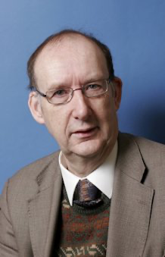
Charles martindale
Influential in bringing reception theory into Classics
Redeeming the Text (1993)
The Cambridge Companion to Virgil (1997)
From 2002-4 he was awarded a Leverhulme Major Research Fellowship to write a monograph Latin Poetry and the Judgement of Taste arguing for the importance of beauty and the aesthetic in our response to the arts, subsequently published by OUP.

Slide 16

Simon Goldhill
Anti-Martindale
Gathers a bunch of people to join him in being anti-Martindale (Edith Hall, Richard Edmunds, Brook Holmes, Marchella Ward)
It all boils over in a 2010 feud, but the canon smoke lingers.
  Theorizing Performance: Greek Drama, Cultural History, and Critical Practice

Slide 17
