Slide 1
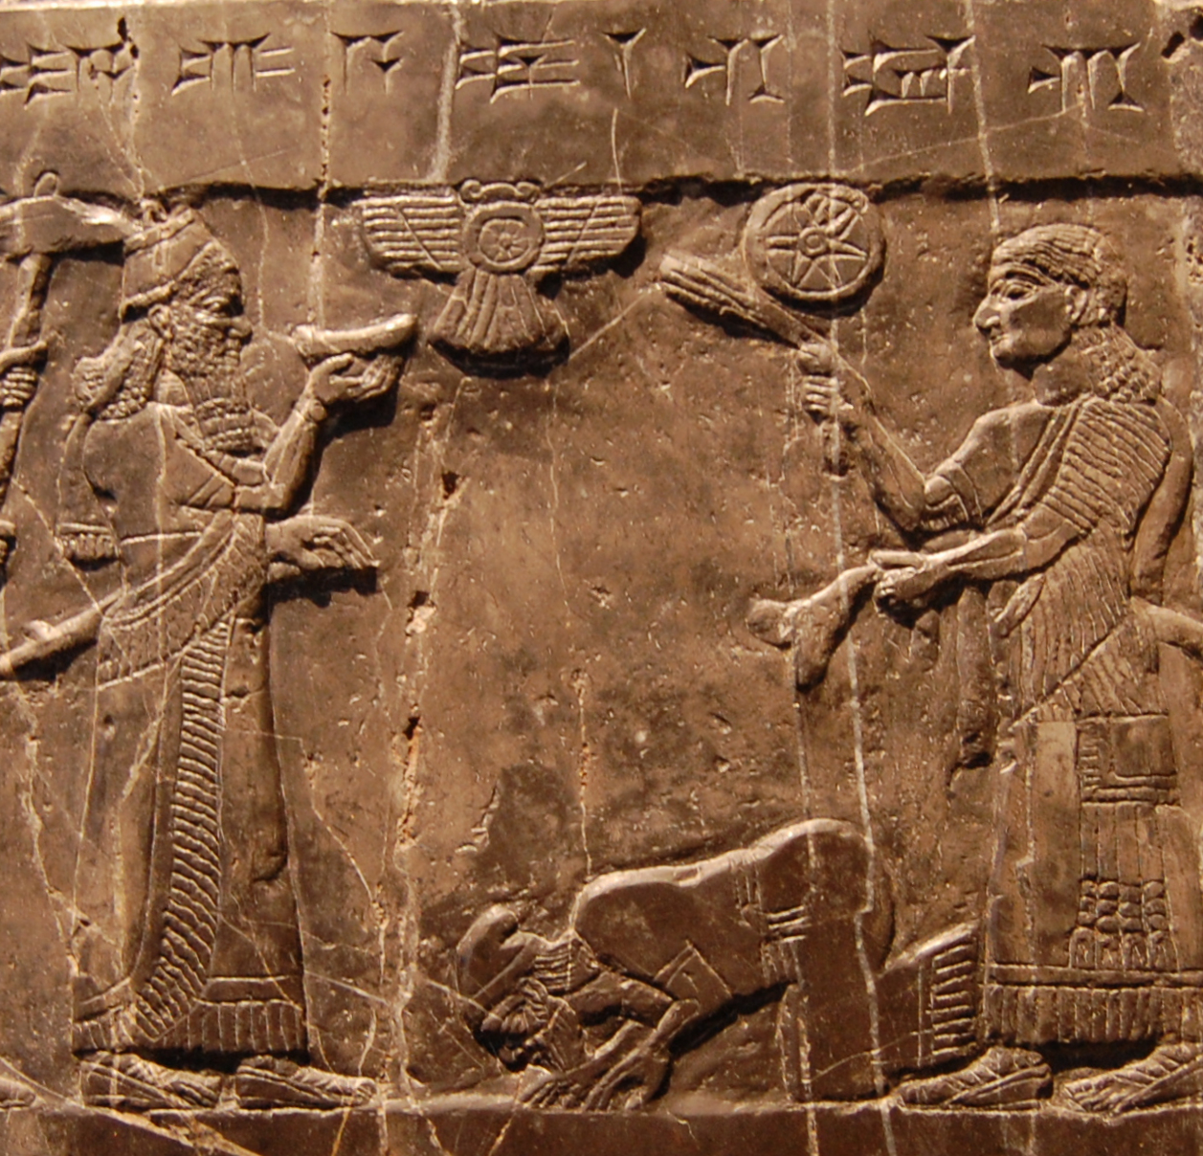
What Is an Empire?
(and How Do We Think about Them?)
ARCH B313/513 – The Archaeology of Ancient Near Eastern Empires
Fall 2026
September 4

Slide 2
Today’s Schedule
Introductions
How This Class Works
The Ancient Near East: Some Parameters
What Is an Empire (and Other Difficult Words)
Structure vs. Impact
Experience
Judgment

Slide 3
Introductions
Name
Interests
If you’re auditing the class or not (I want to know how much grading I have to do and how much time we’ll need for presentations at the end of term)

Slide 4
How This Class Works
We’ll start each class with a brief overview lecture
  This is your opportunity to ask questions about the empire in question
Then we’ll discuss the articles assigned to the undergraduates
  Grad students, please feel free to participate, but let’s make sure the undergrads get the opportunity to speak
  I will provide visuals as appropriate
The rest of the class will focus on the remaining reading assignments
  Although all grad students will be expected to read these, I will assign them to specific students for the purposes of leading discussion
  Undergrads should read at least one optional reading every week and be prepared to discuss it
  This will help you prepare for Paper 2
We will usually take a break in the middle of the class

Slide 5
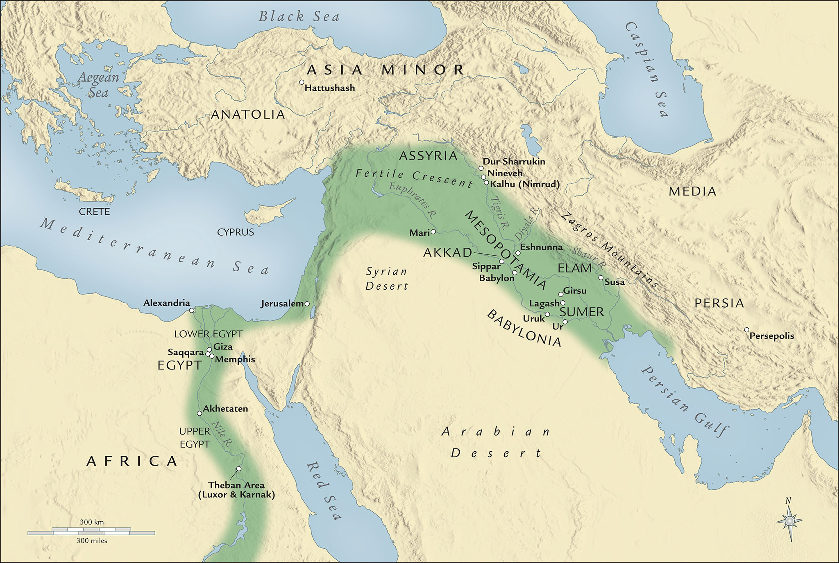

Slide 6
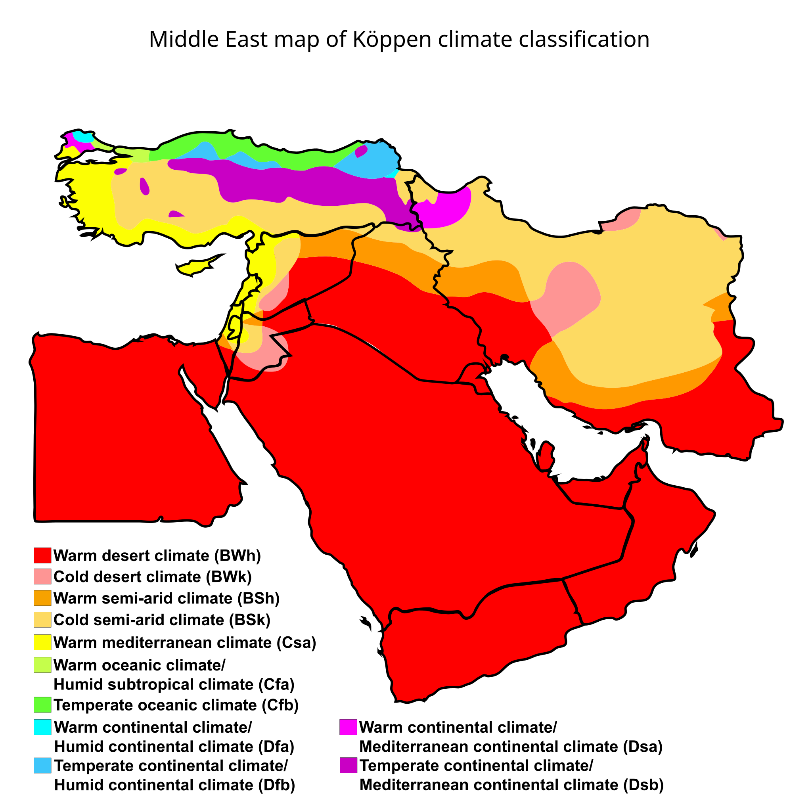

Slide 7
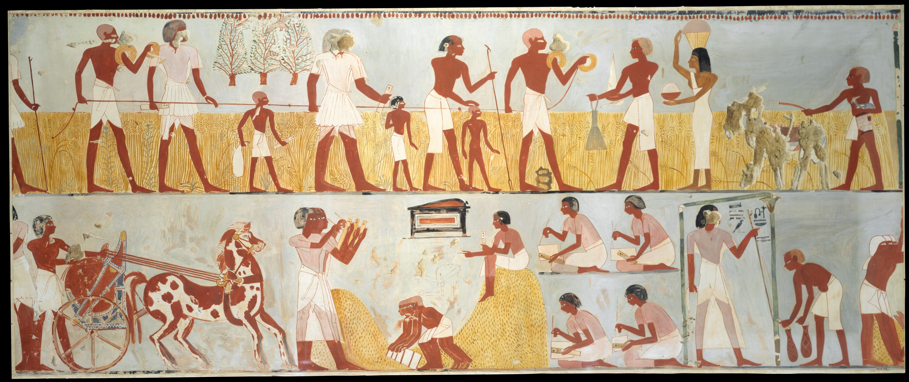
Modern facsimiles of ancient Egyptian wall paintings from the Tomb of Menna at Thebes, New Kingdom
Top: accessors measuring the height of the grain; bottom: storage and tallying of grain

Slide 8
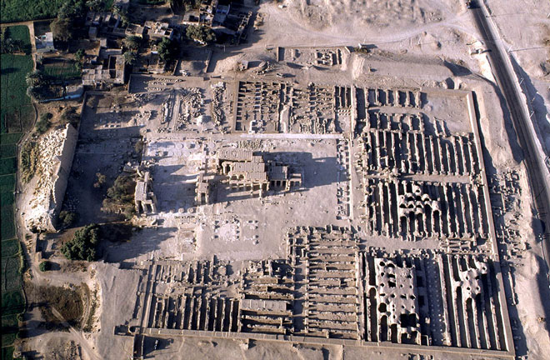
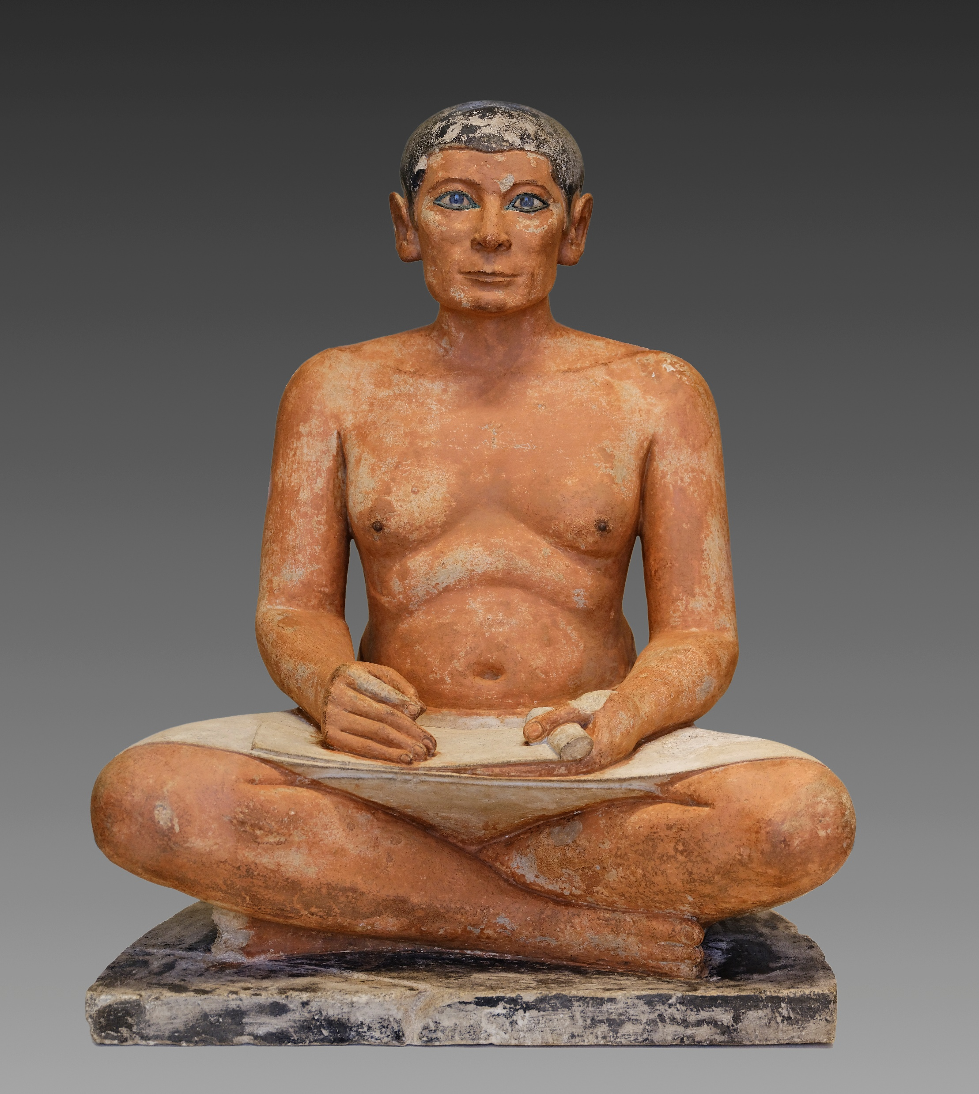
Statue of a seated scribe from Saqqara, Old Kingdom (Louvre)
Mortuary temple of Rameses II, Medinet Habu, Egypt, ca. 13th cen. BCE

Slide 9
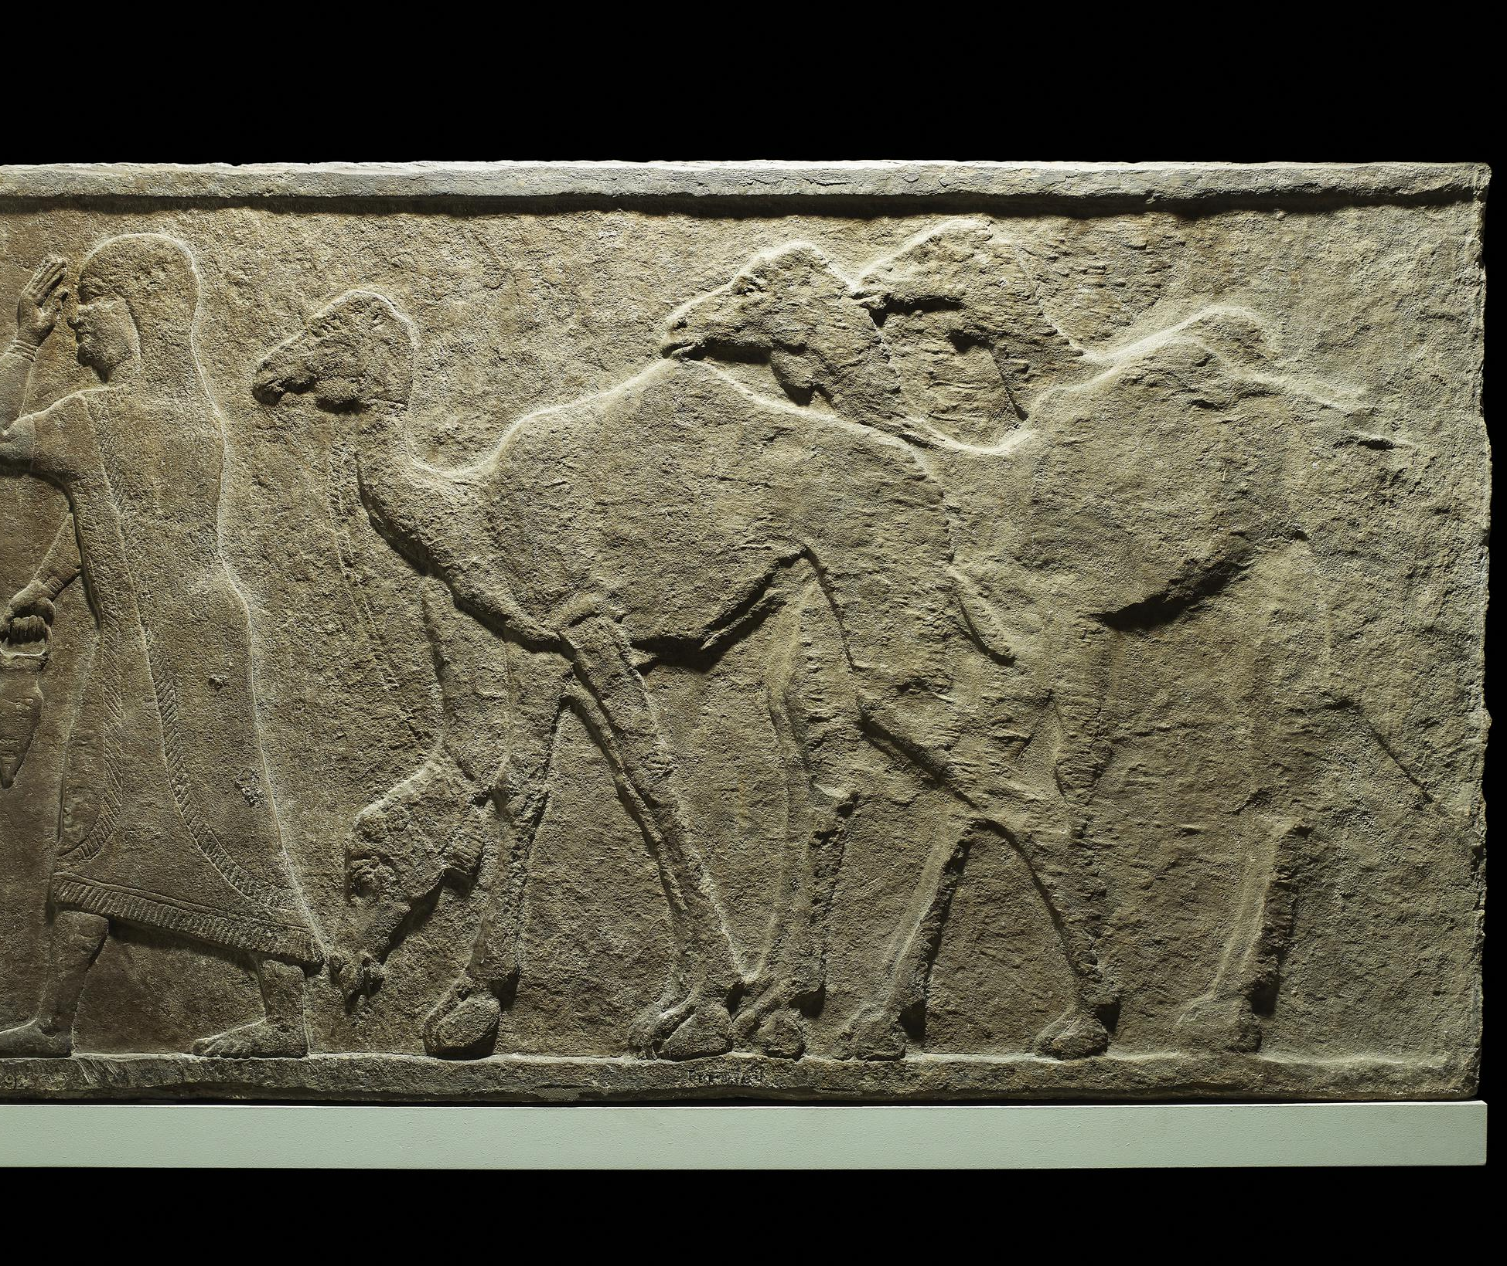
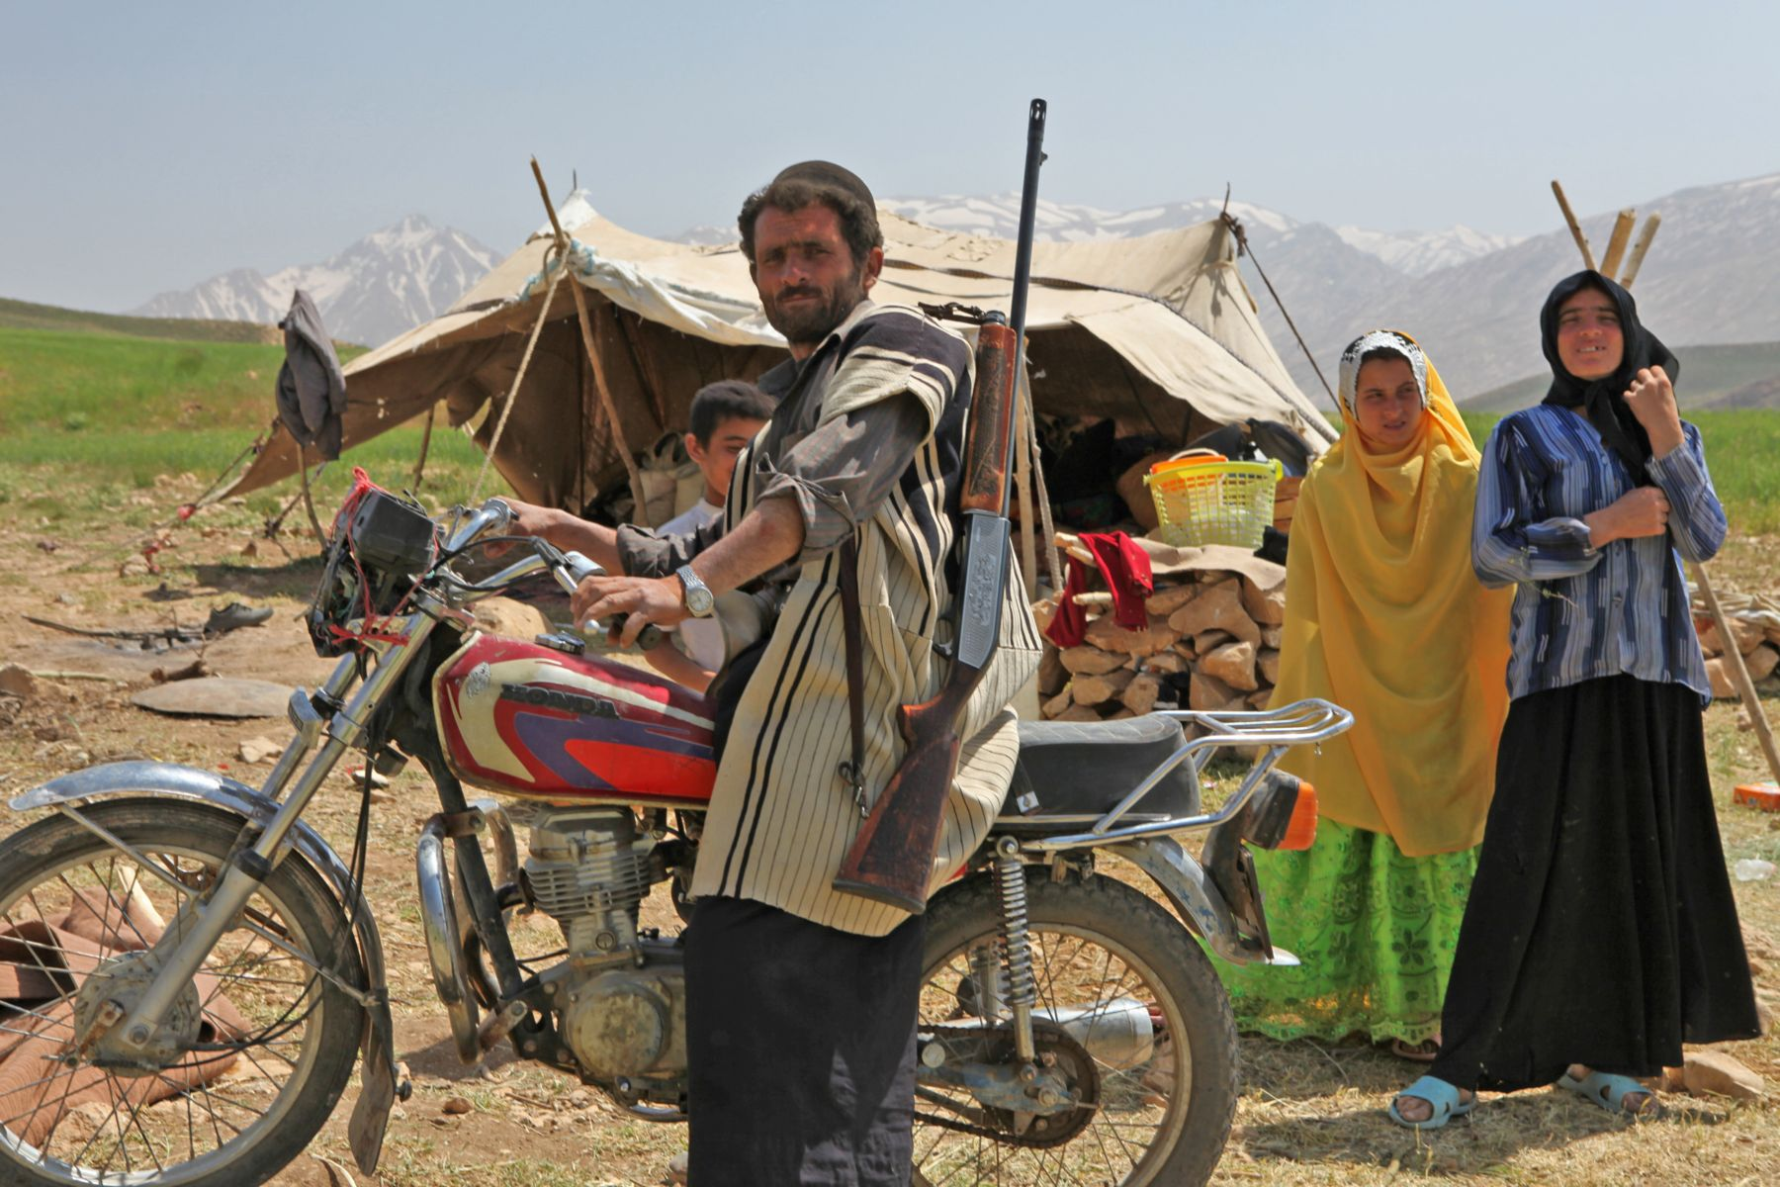
Nomadism
Modern Bakhtiari family of pastoral nomads
Assyrian relief depicting dromedaries, Nimrud, ca. 728 BCE

Slide 10
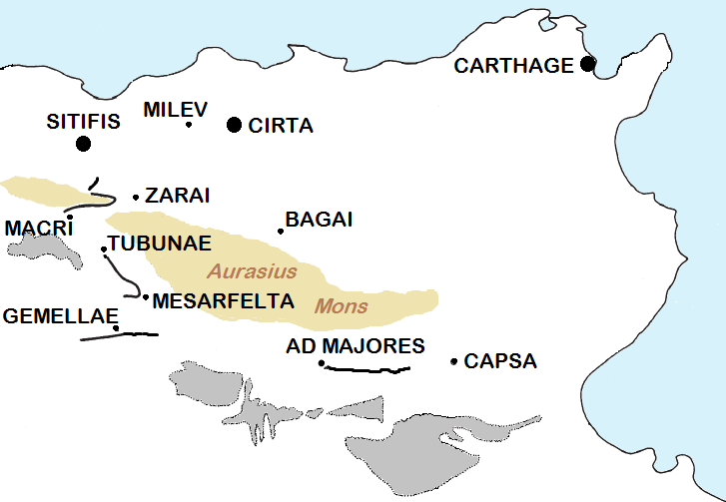
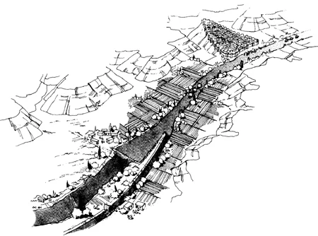
Fossatum Africae

Slide 12
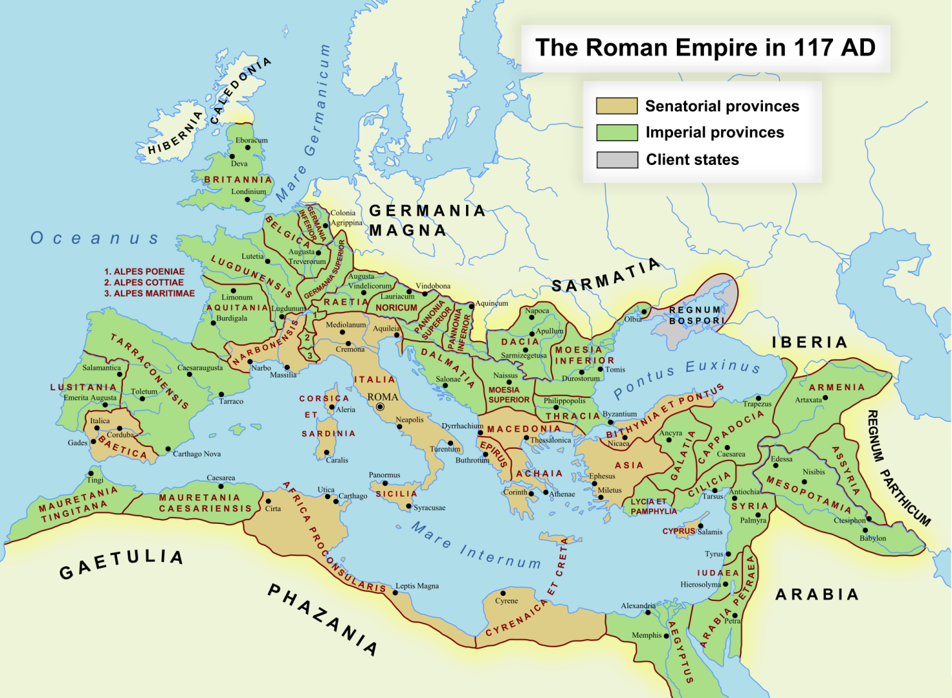

Slide 13
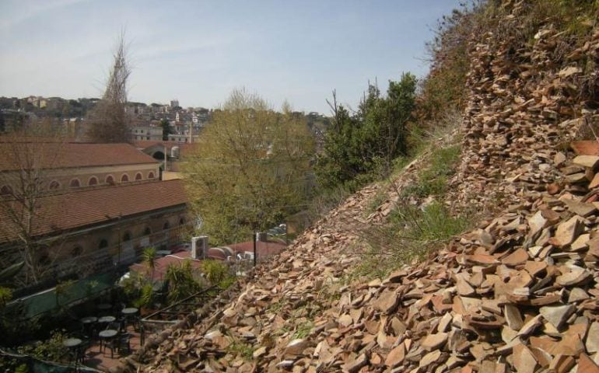
Monte Testaccio, Rome

Slide 14
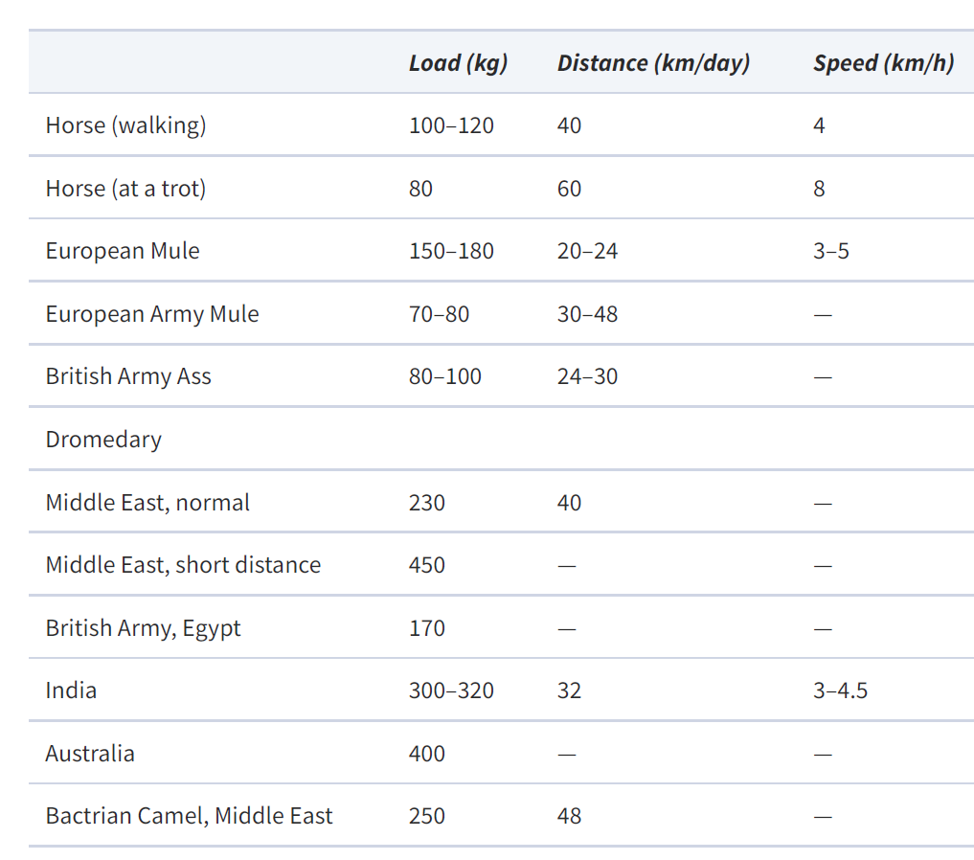
Source: G. Raepsaet, “Land Transport, Part 2: Riding, Harnesses, and Vehicles,” in J. P. Oleson (ed.), The Oxford Handbook of Engineering and Technology in the Classical World (OUP, 2008), table 23.2.

Slide 15
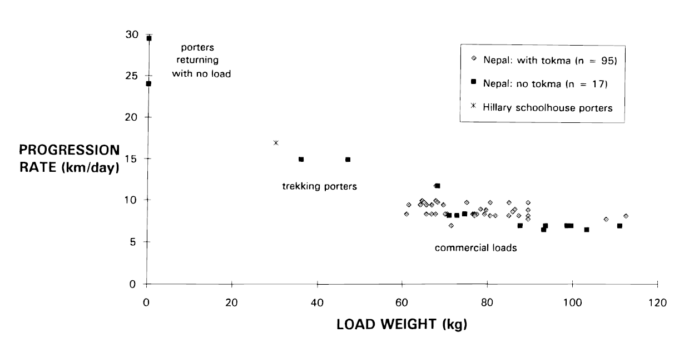
Source: N. J. Malville, “Long-Distance Transport of Bulk Goods in the Pre-Hispanic American Southwest,” Journal of Anthropological Archaeology 20 (2001), fig. 1.

Slide 16
Today’s Schedule
Introductions
How This Class Works
The Ancient Near East: Some Parameters
What Is an Empire (and Other Difficult Words)
Structure vs. Impact
Experience
Judgment

Slide 17
Definitions
Empire
Imperialism
Colony
Colonization
Colonialism
Postcolonial

Slide 18
Gehler and Rollinger 2022
Gehler and Rollinger, “Imperial Turn: Challenges, Problems, Questions” (2022)
What are the differences between empires and nation states?
  Regarding expansion, ideology, etc.?
Can we compare ancient and modern empires?
  What features do both have?
  What do modern empires have that ancient ones do not and vice versa?
  Why is this important?

Slide 19
Structure vs. Impact
Structure
Impact
How does the empire work?
How is it run? Who is in control? How does the ruler exert his authority across the empire?
How does it make money? What form is the money? What does the empire do with it?
What kind of infrastructure does the empire have?
How does the empire cohere? What keeps it from breaking apart?
How does the empire affect the territories it rules?
How does it affect local politics, religion, economics, language, etc.?
How does it change the decisions people make about material culture?

Slide 20
Experience
What’s it like to be part of a given empire?
  As a member of the ruling elite, local elite, military, administration, colonial community, priesthood, or as a private individual, etc.?
  How have your options changed?
    For social mobility, political power, economic opportunities, etc.?
  Do you think about yourself differently than you would have without the empire?
How can we study this archaeologically?

Slide 21
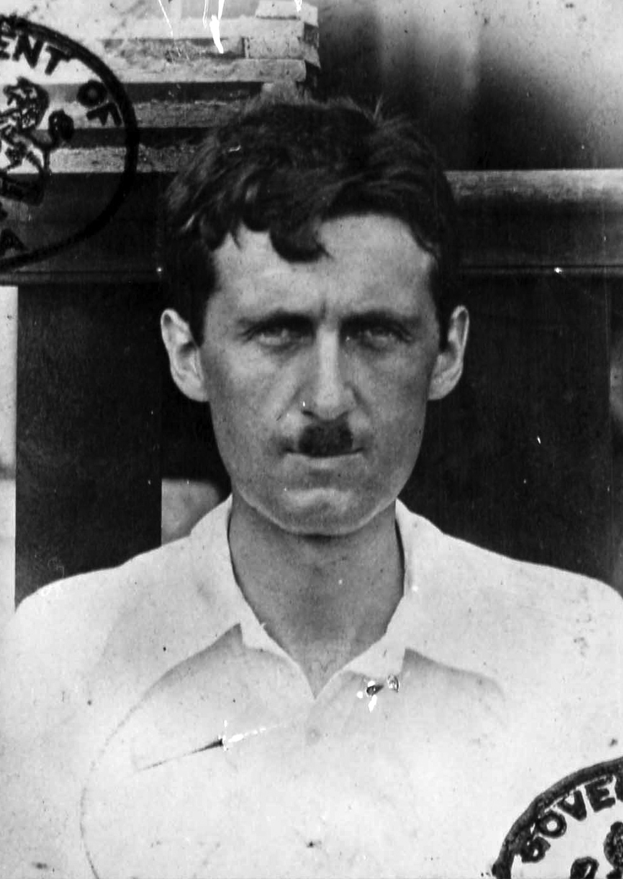
Shooting an Elephant
Personal essay by George Orwell (1903-1950) first published in 1936
Based on his experience in the Indian Imperial Police, 1922-1927
Takes place in Moulmein, Burma Province, British India (modern Mawlamyine, Myanmar)
George Orwell in the 1920s, when toothbrush mustaches were still cool…

Slide 22
Judgment
https://www.youtube.com/watch?v=Qc7HmhrgTuQ

Slide 23
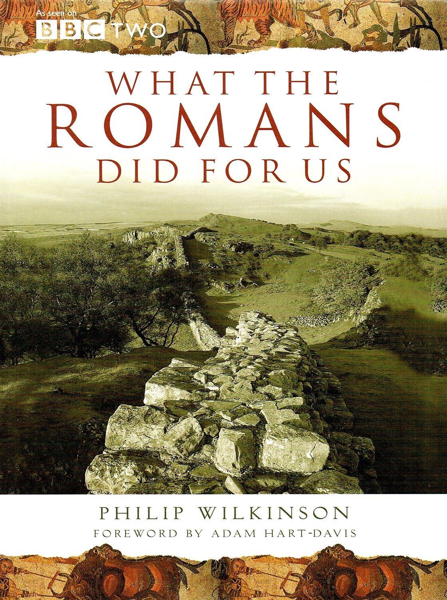
Judgment
What assumptions underlie this scene?
Why might Monty Python have made these assumptions?
What does these assumptions tell us about how the British thought about the Roman Empire in the 1960s and 1970s?
Cover of a companion book to the BBC series What the Romans Did for Us (2008)

Slide 24
Judgment
“The old theory of an age of despotism and decay has been overthrown, and the believer in human nature can now feel confident that, whatever their limitations, the men of the Empire wrought for the betterment and the happiness of the world.”
- Francis Haverfield, The Romanization of Roman Britain (1906 [1923])
“The instrument of civilization used by Rome in achieving such results was the town and the many-sided attainments of amenity and social grace which successful civic organization involves.”
- I. A. Richmond, Roman Britain (1955)

Slide 25
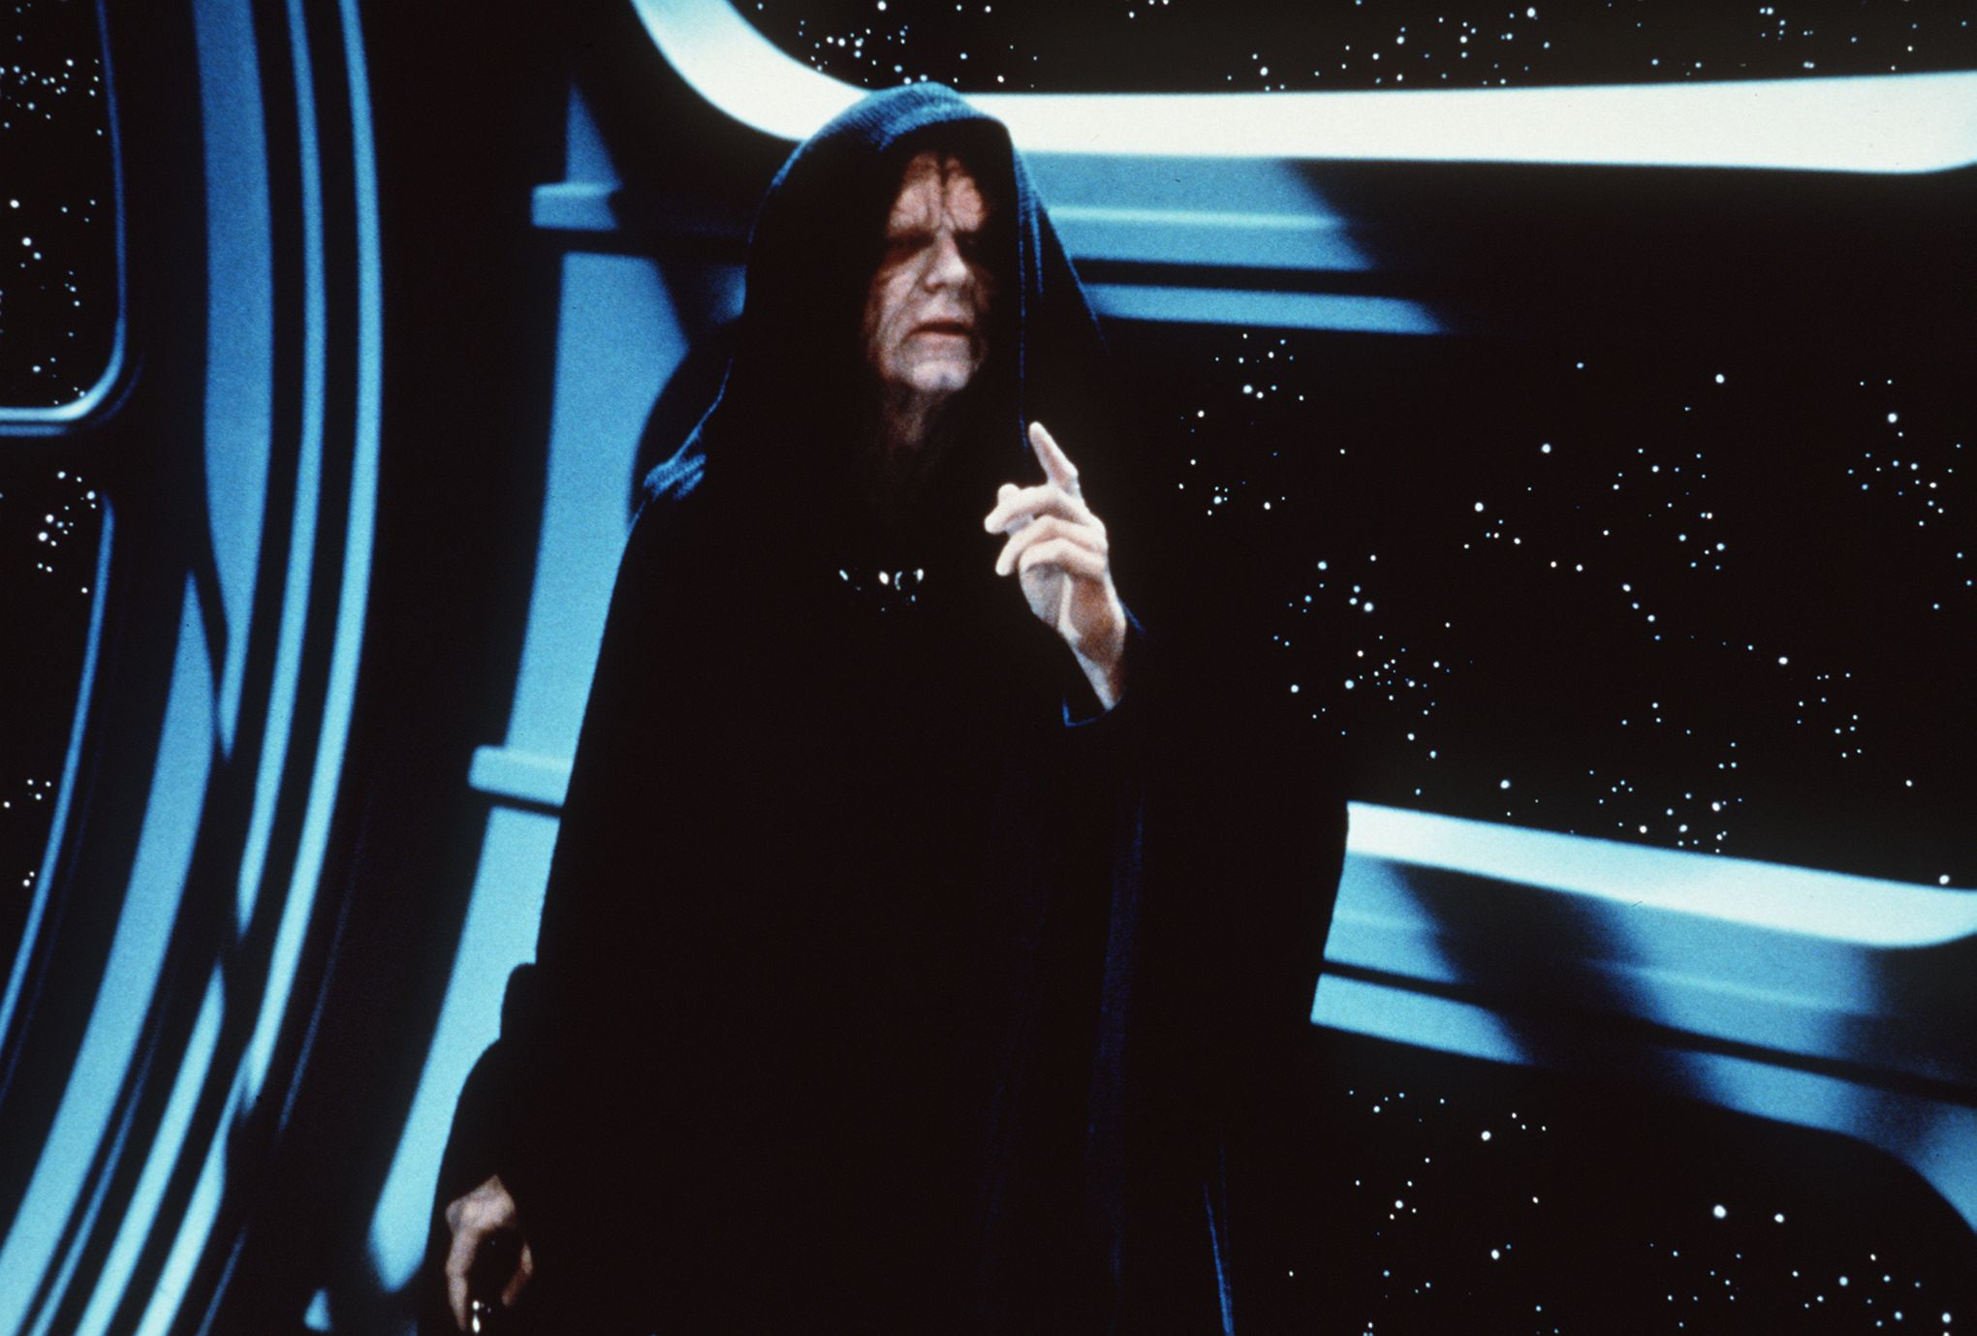
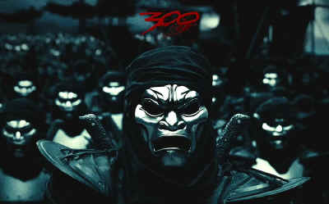
Judgment

Slide 26
Judgment
What determines whether an empire is good or bad?
Should we as scholars judge empires?
How can we talk about empires in a scholarly fashion?
In talking about ancient Near Eastern empires especially, how do we walk the line between orientalism and postcolonialism?

Slide 27
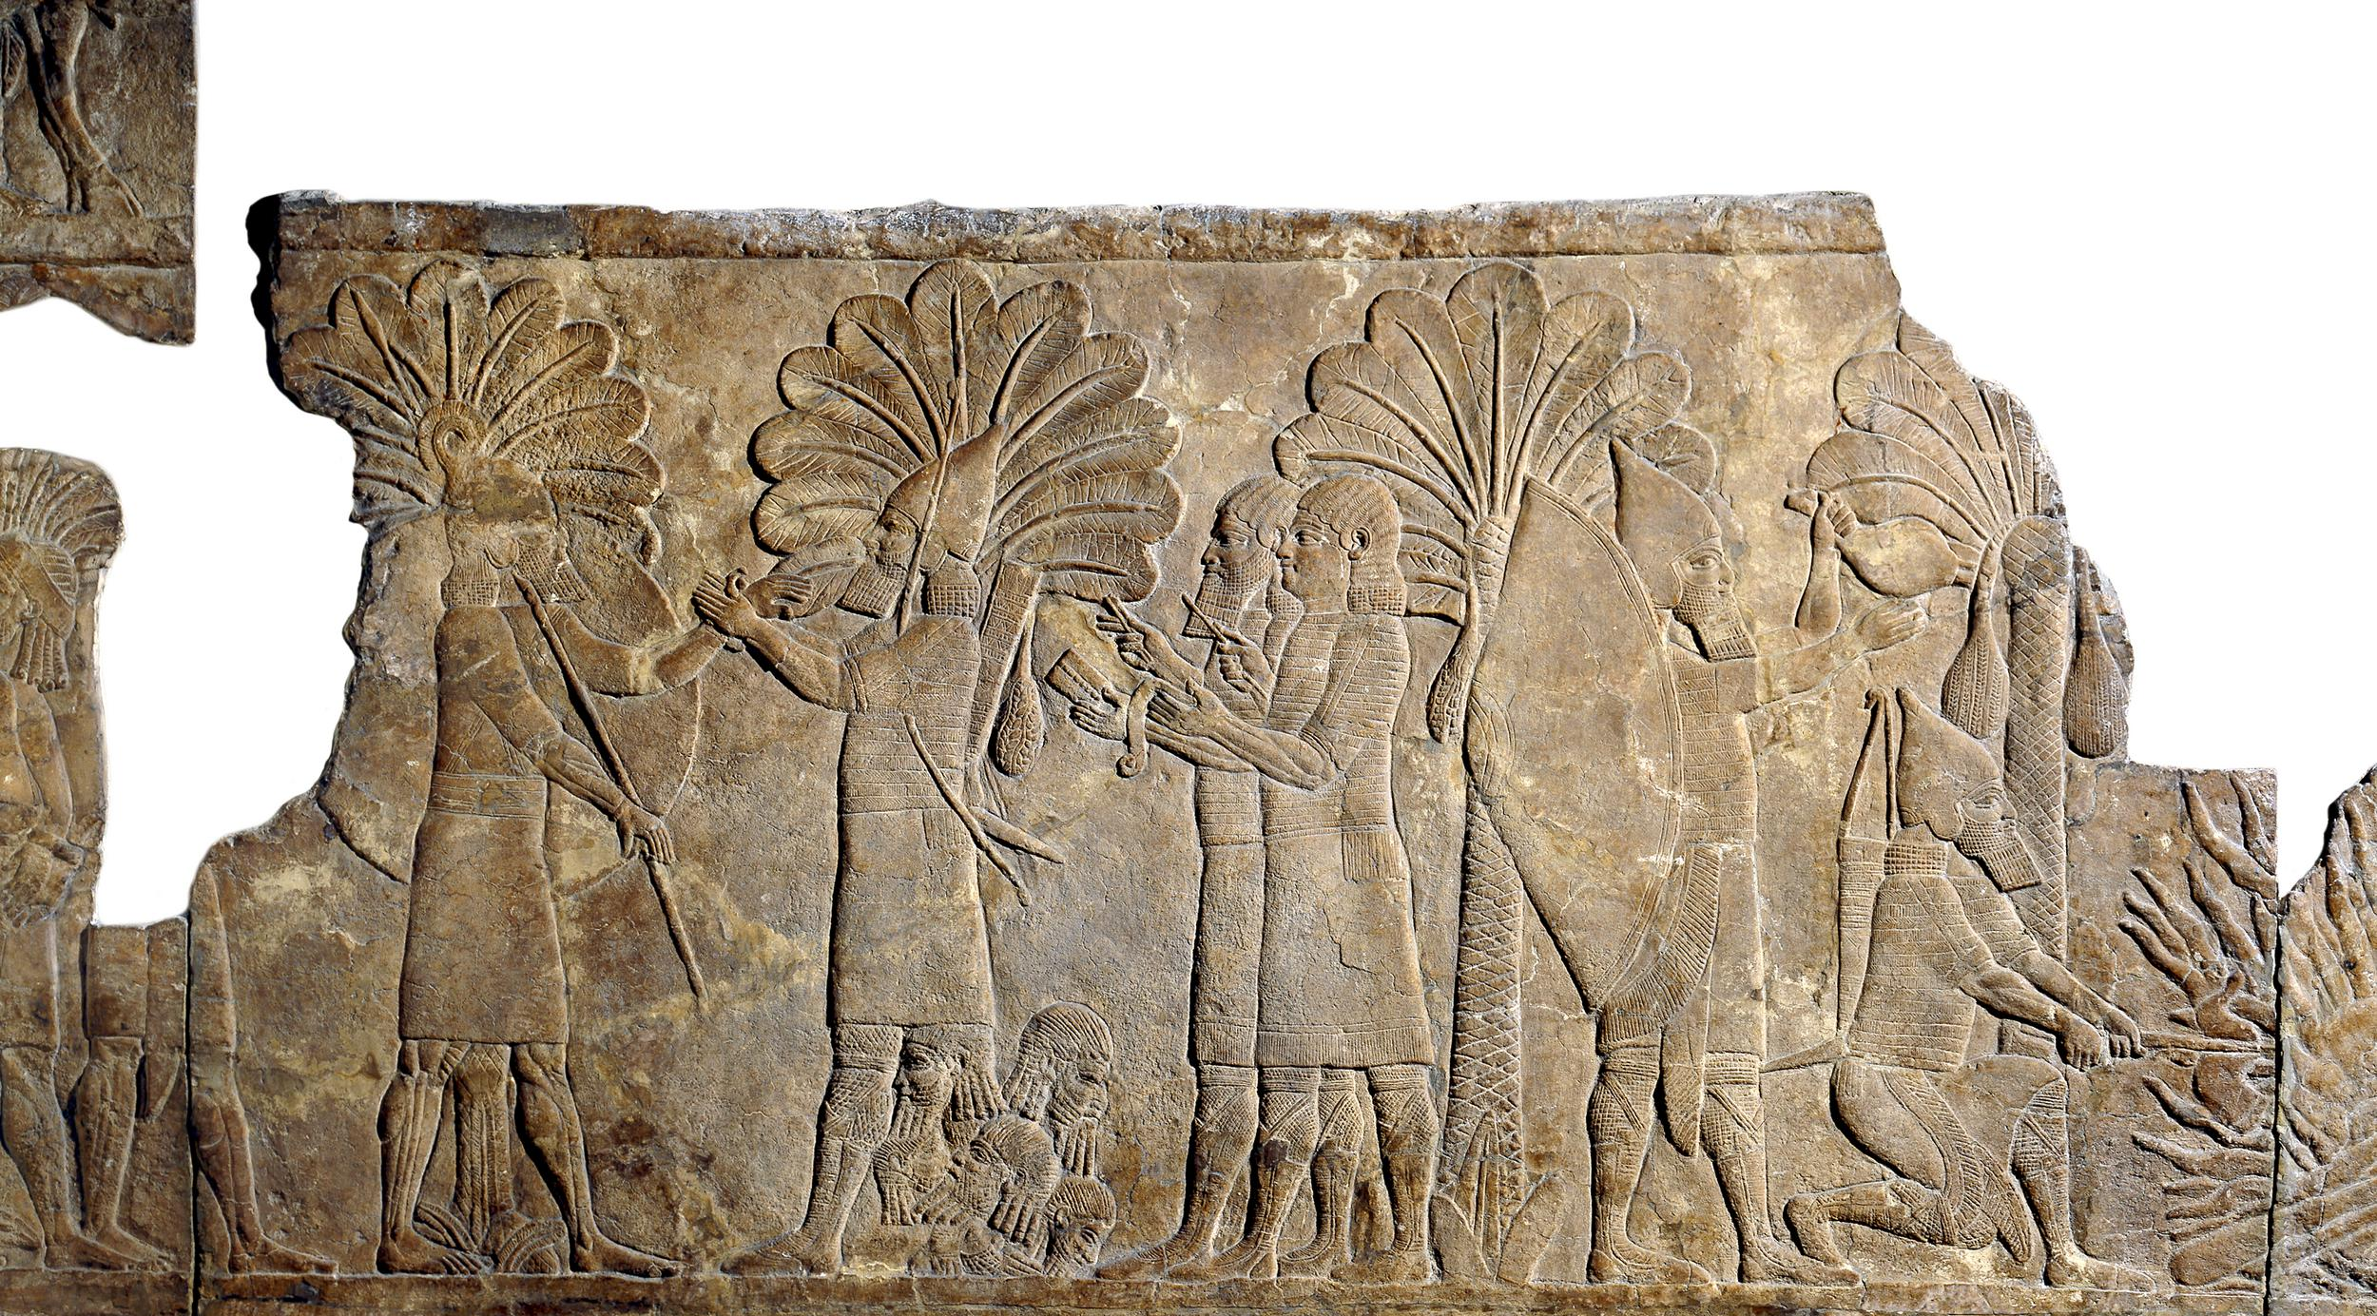
Relief of soldiers and scribes, Nineveh, ca. 640-620 BCE

