Slide 1
Penn’s Great Town Architects
Cyrus Kibel

Slide 2
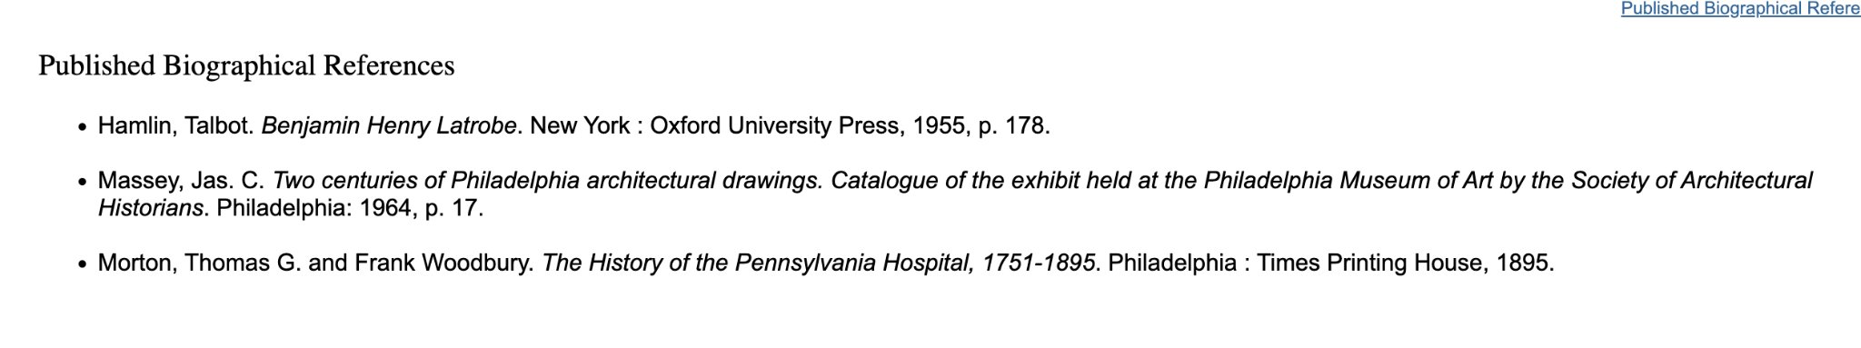
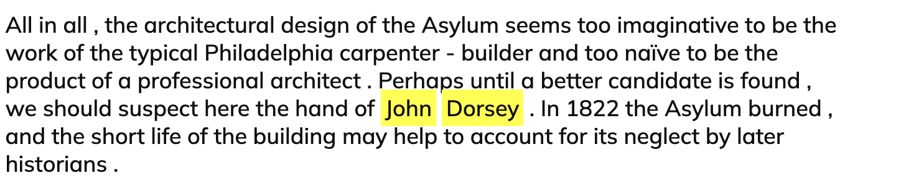
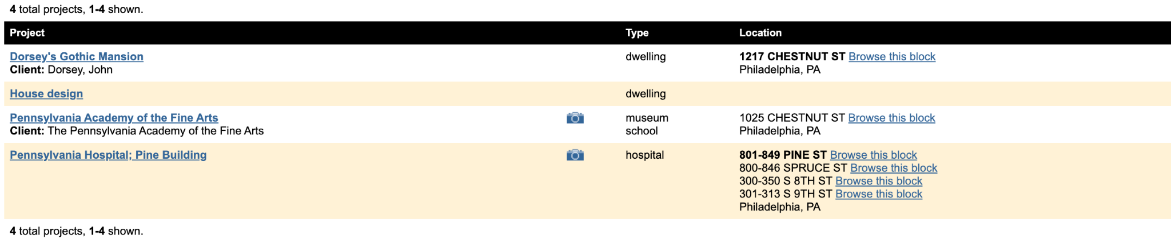
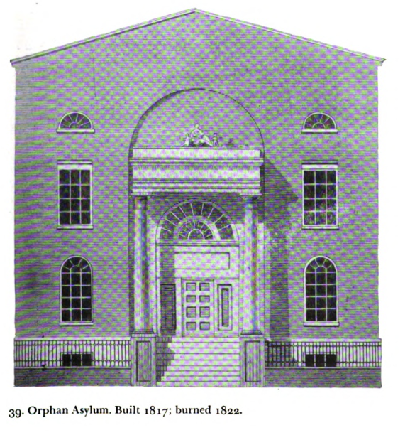

John Dorsey (1759-1821)
Tatum reading not listed as a reference
Possible building designed by Dorsey that's not under his PAB projects. Tatum’s account too seems speculative to confirm out right.
The Tatum reading and PAB bio mention work on a Schuylkill permanent bridge, but its not listed as a project.

Slide 3
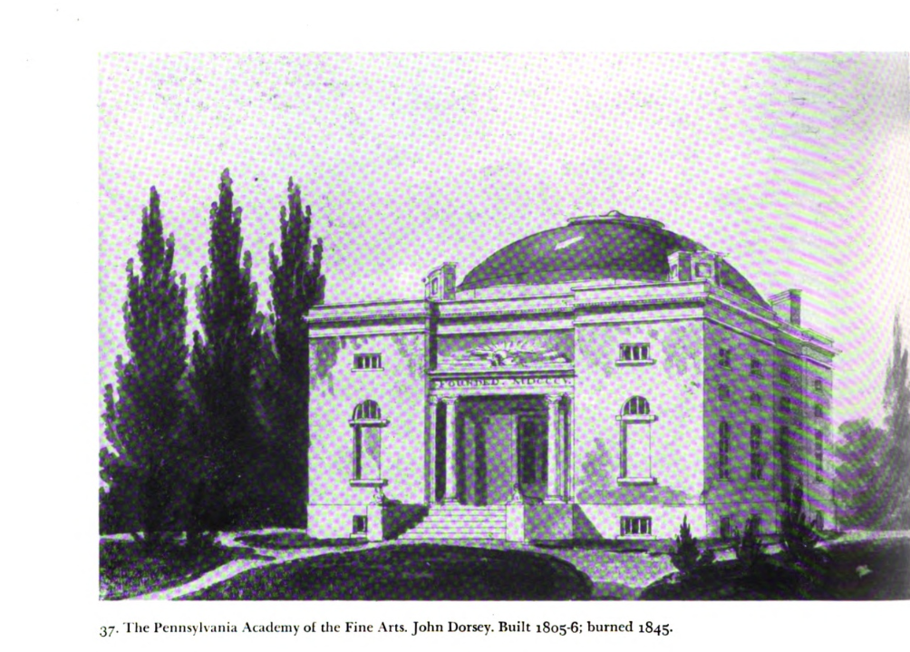
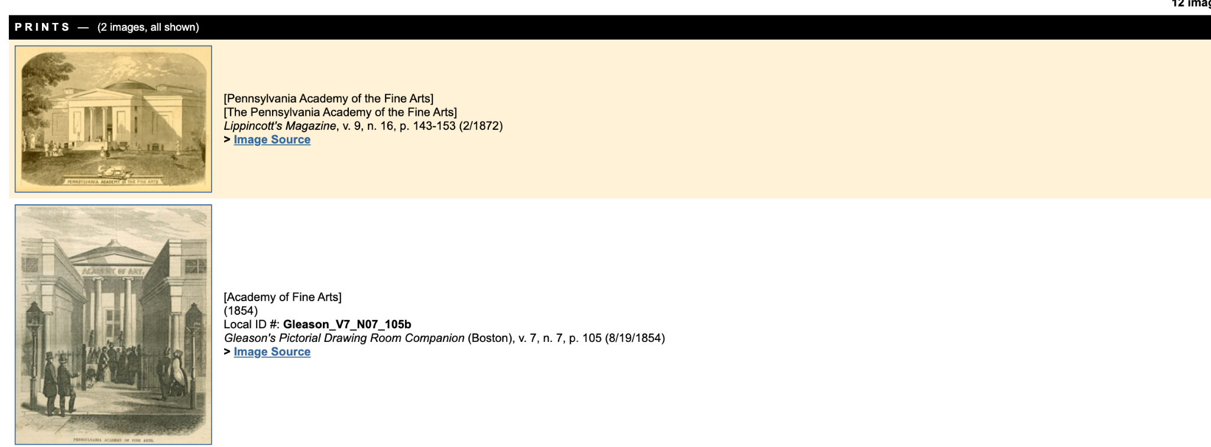
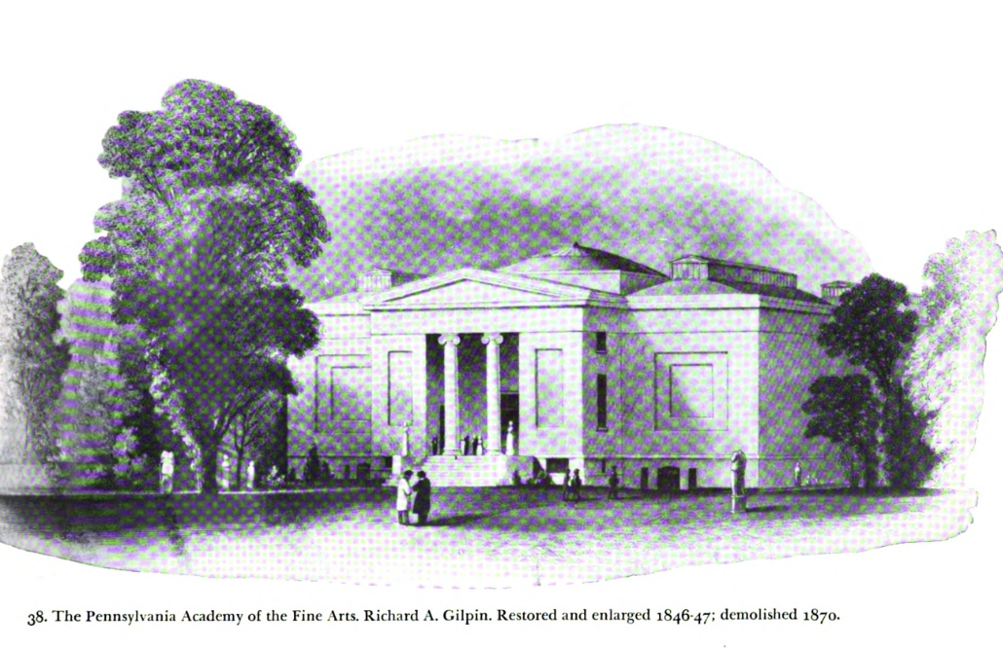
John Dorsey (1759-1821)
An image of the Pennsylvania Academy of the Fine Arts from the Tatum reading is not listed in PAB. The pictures look noticeably different from each other. Tatum credits the later PAB design to another architect, Richard A. Gilpin. The building was rebuilt after a fire in 1845.

Slide 4
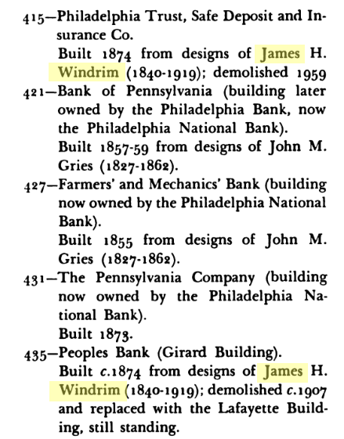
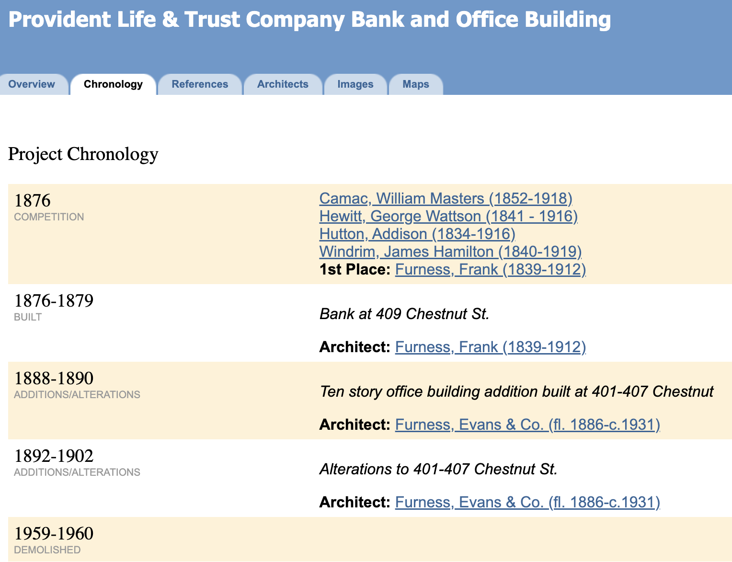
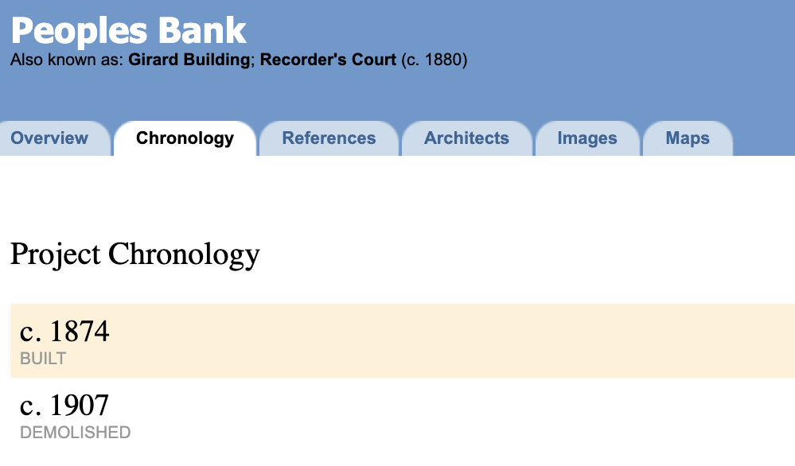
James Hamilton Windrim (1840-1919)
Unidentified builder for the People’s bank. Windrim is listed as the architect in PAB already.
Demolish date from PAB and the Tatum reading disagree with each other

Slide 5
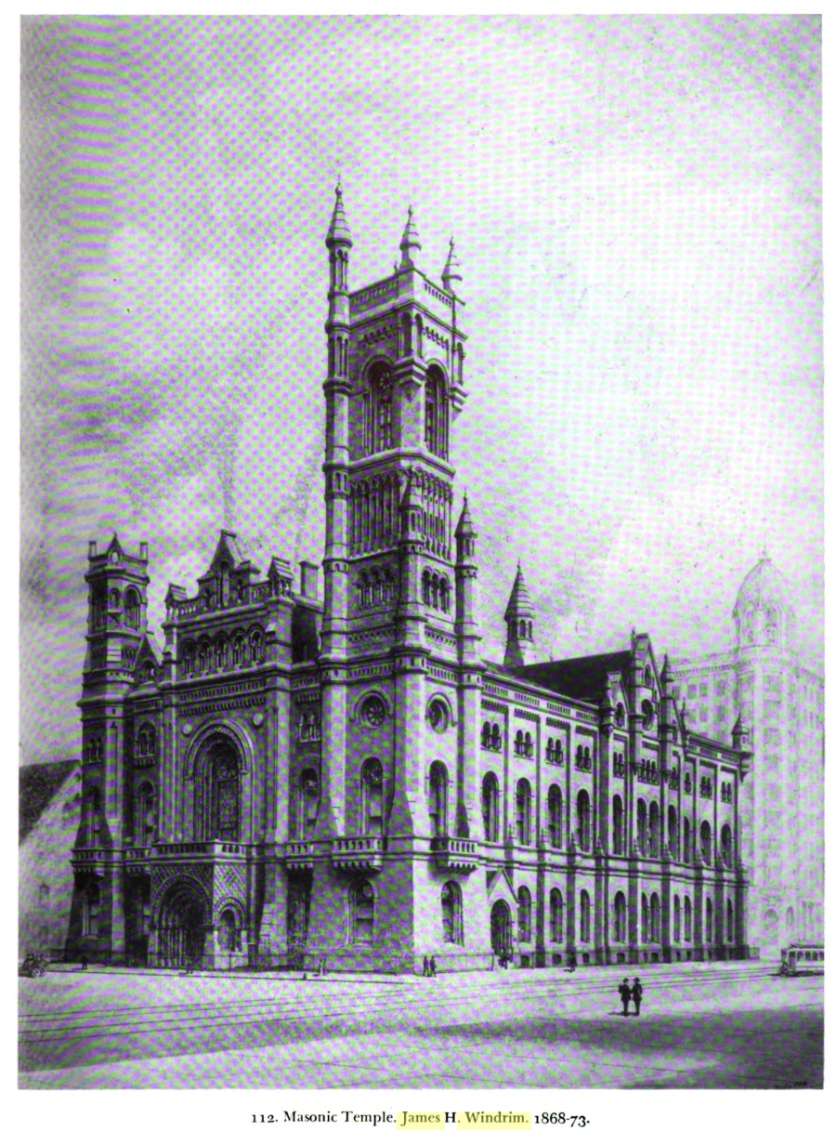
James Hamilton Windrim (1840-1919)
The Tatum photo doesn’t appear in PAB but there are similar photos in its place.

Slide 6
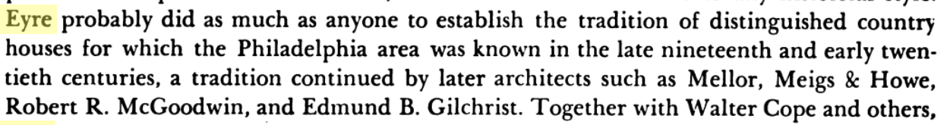
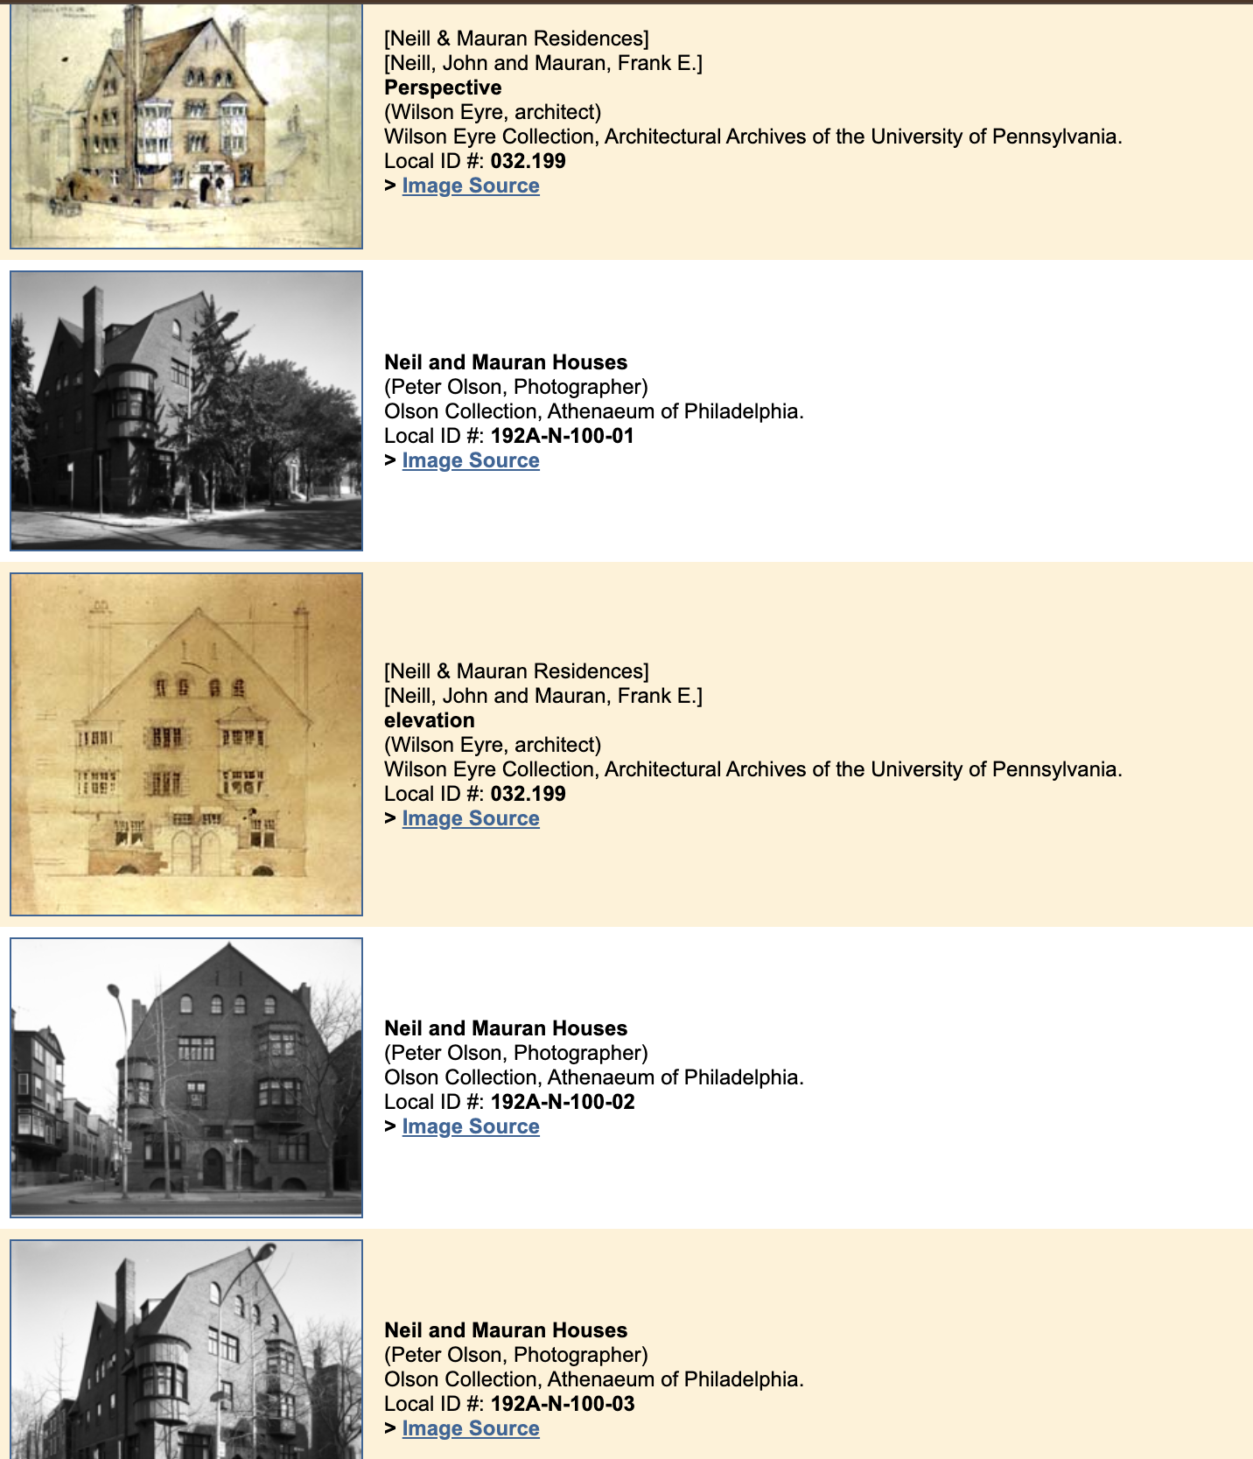
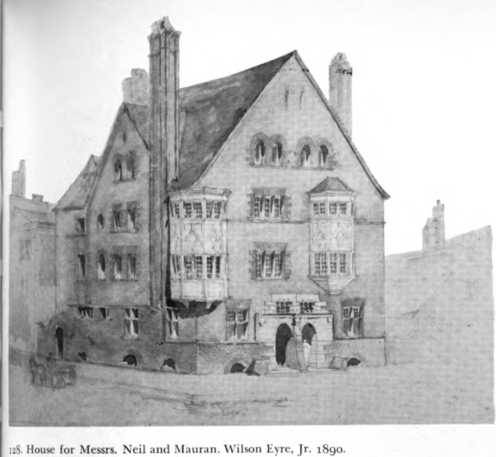
Wilson Eyre (1858-1944)
Possibly add Eyre’s influence on country houses to the PAB biography section.
Good picture to add to this PAB dwelling.

Slide 7
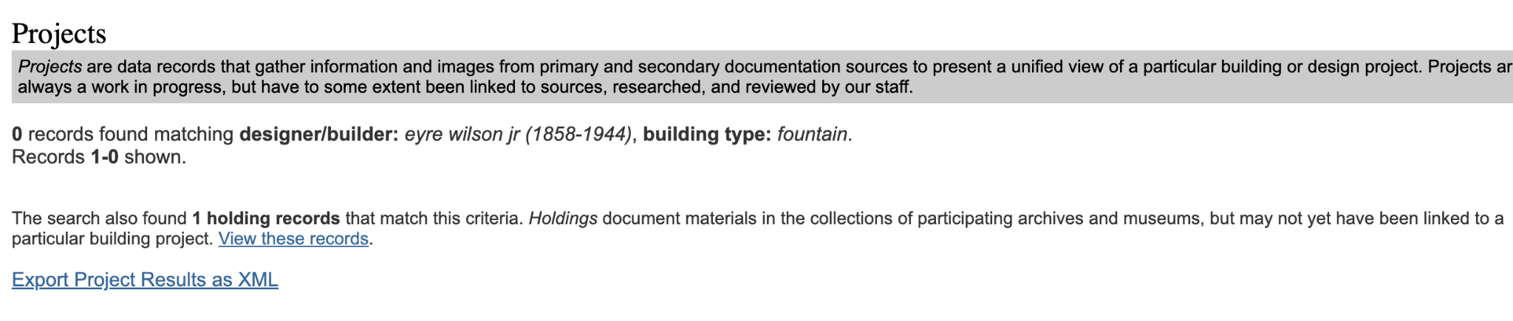
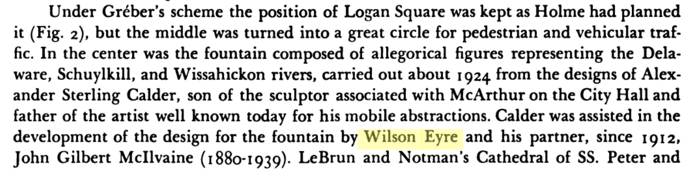
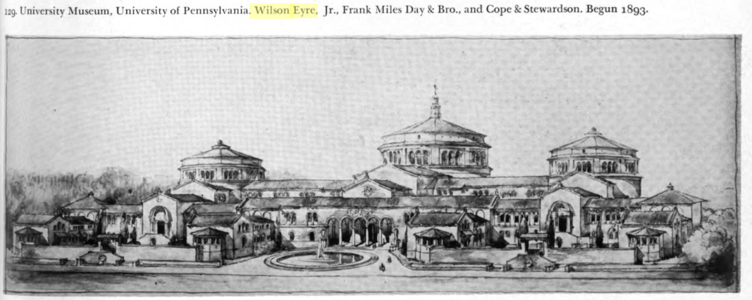
Wilson Eyre (1858-1944)
Add photo into PAB project page for the Penn Museum.

Slide 8
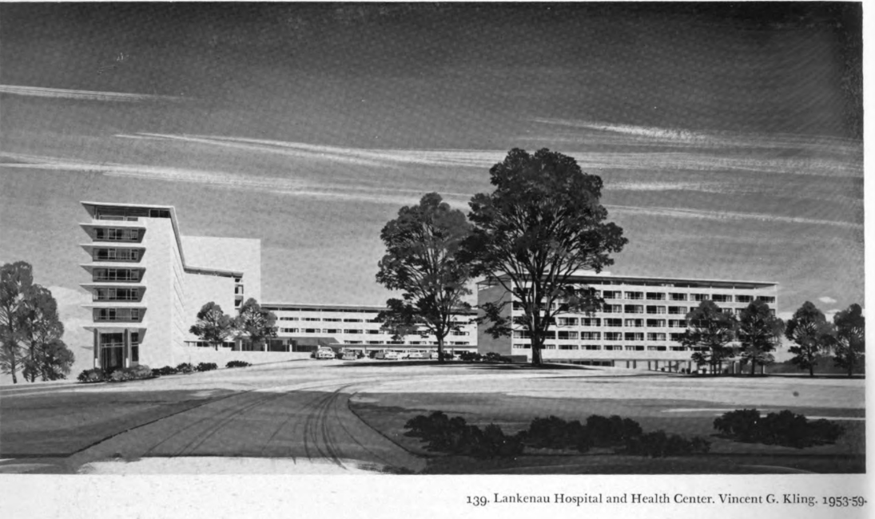
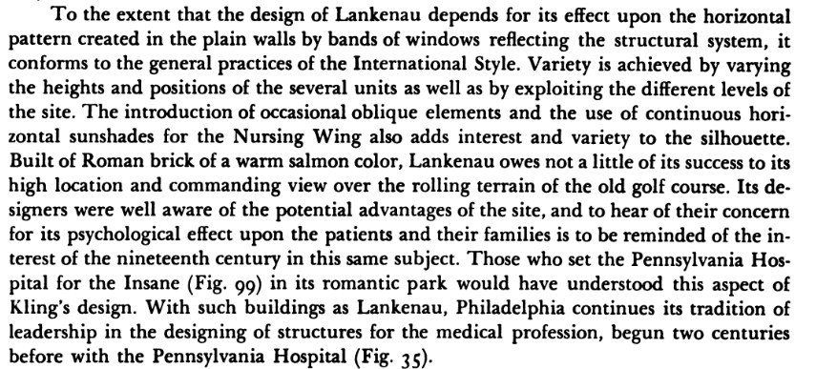
Vincent Kling (1916-2013)
No photo of the Lankenau Hospital and Health center in PAB.

