Slide 1
Assignment 1b
Philadelphia Architects: Tatum vs. PAB
1796–1860
1860–1900
1900–1930
1930–1960
William Strickland
Frank Furness
Paul Philippe Cret
Louis I. Kahn
Notes:
Comparison based on Tatum, Penn’s Great Town (1961), including the Notes to the Illustrations, especially p. 143, and PAB project galleries. Both sources contain visual evidence, historical information, and interpretation. PAB coverage varies by building.

Slide 2
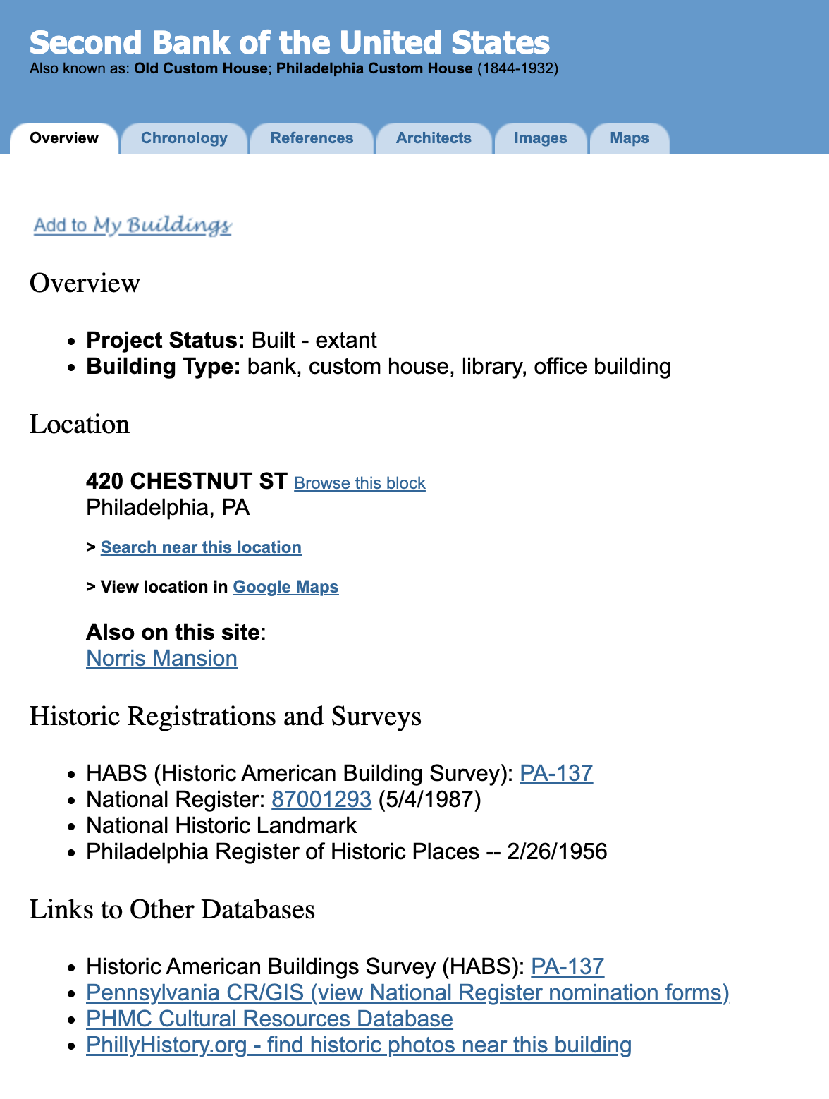
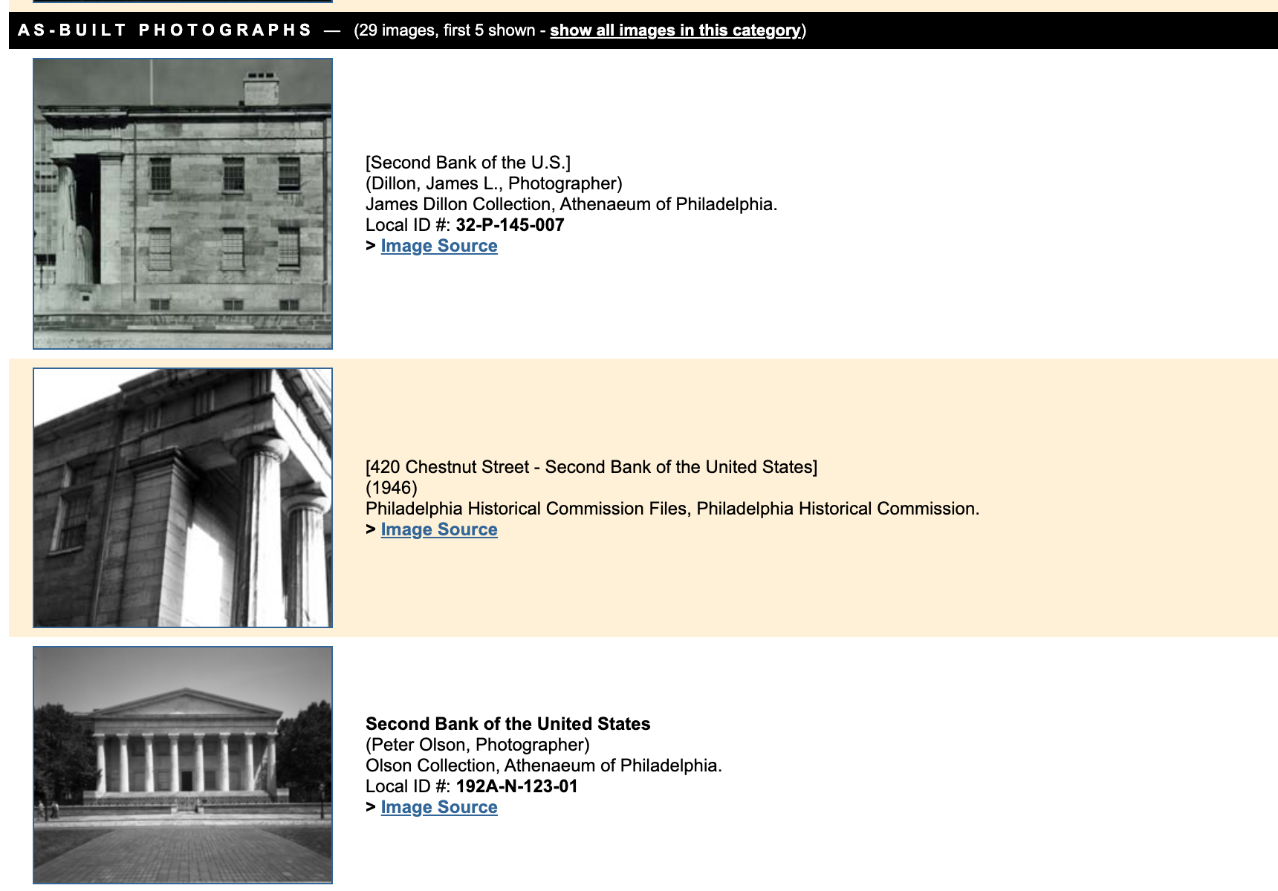
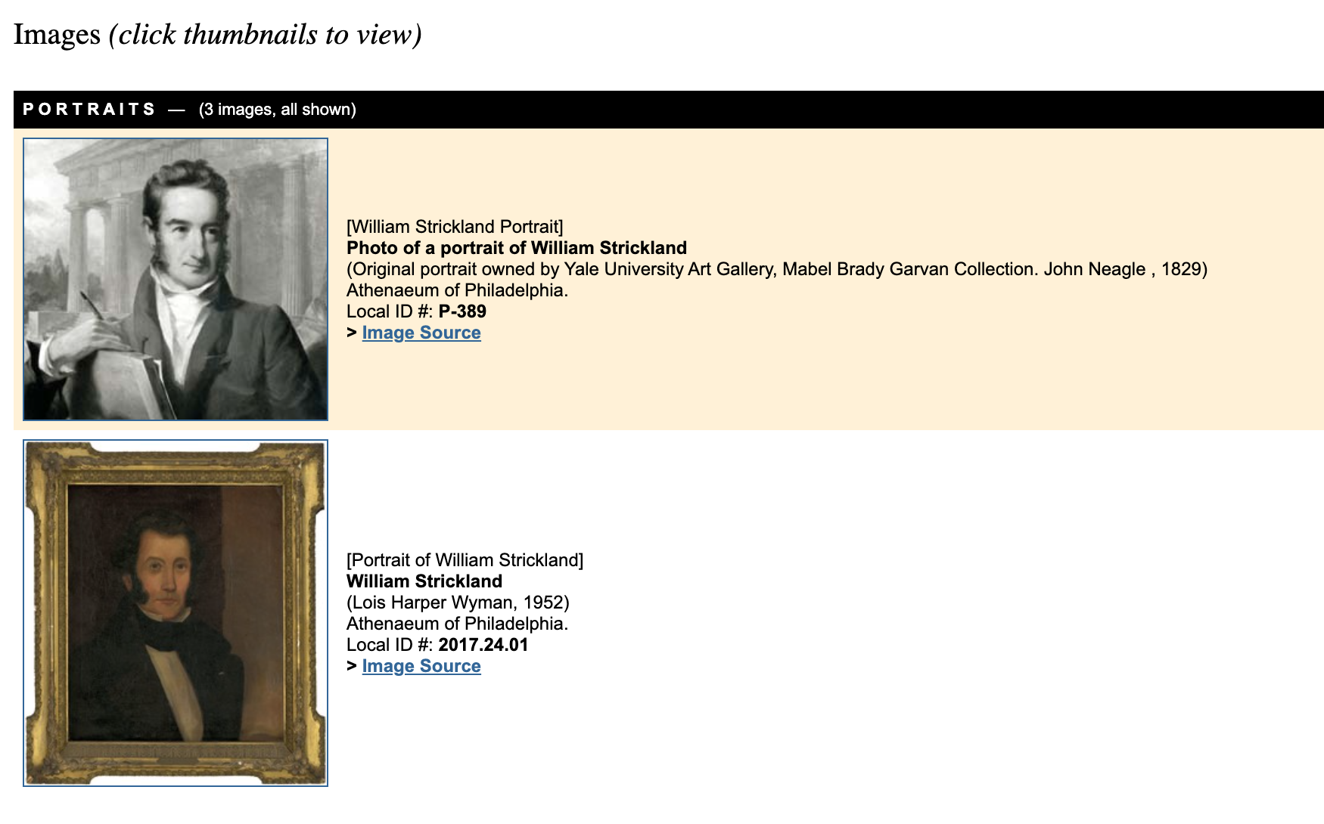
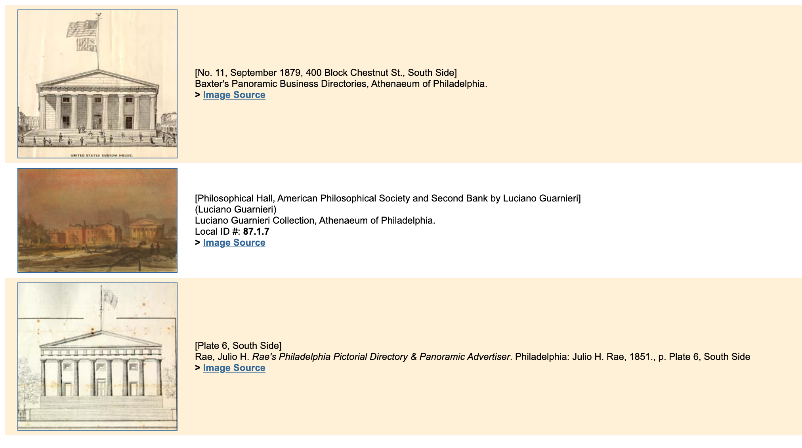
William Strickland
1788–1854
Tatum
Important early professional architect in Philadelphia.
Strongly connected to Greek Revival and classical design.
Second Bank adapts the Parthenon to a real bank and city lot.
PAB
Clearer bio, training, and related architects.
Broader project list shows more than just his Greek Revival work.
More images and records help compare the building over time.
Tatum explains why Strickland matters;
PAB gives a fuller picture of his career and work.
Notes:
Tatum, pp. 65–68; figures 54–55. PAB gallery: https://www.philadelphiabuildings.org/pab/app/image_gallery.cfm/19640
Walter’s drawing is a later proposal, not Strickland’s original design and not proof of a built change.

Slide 3
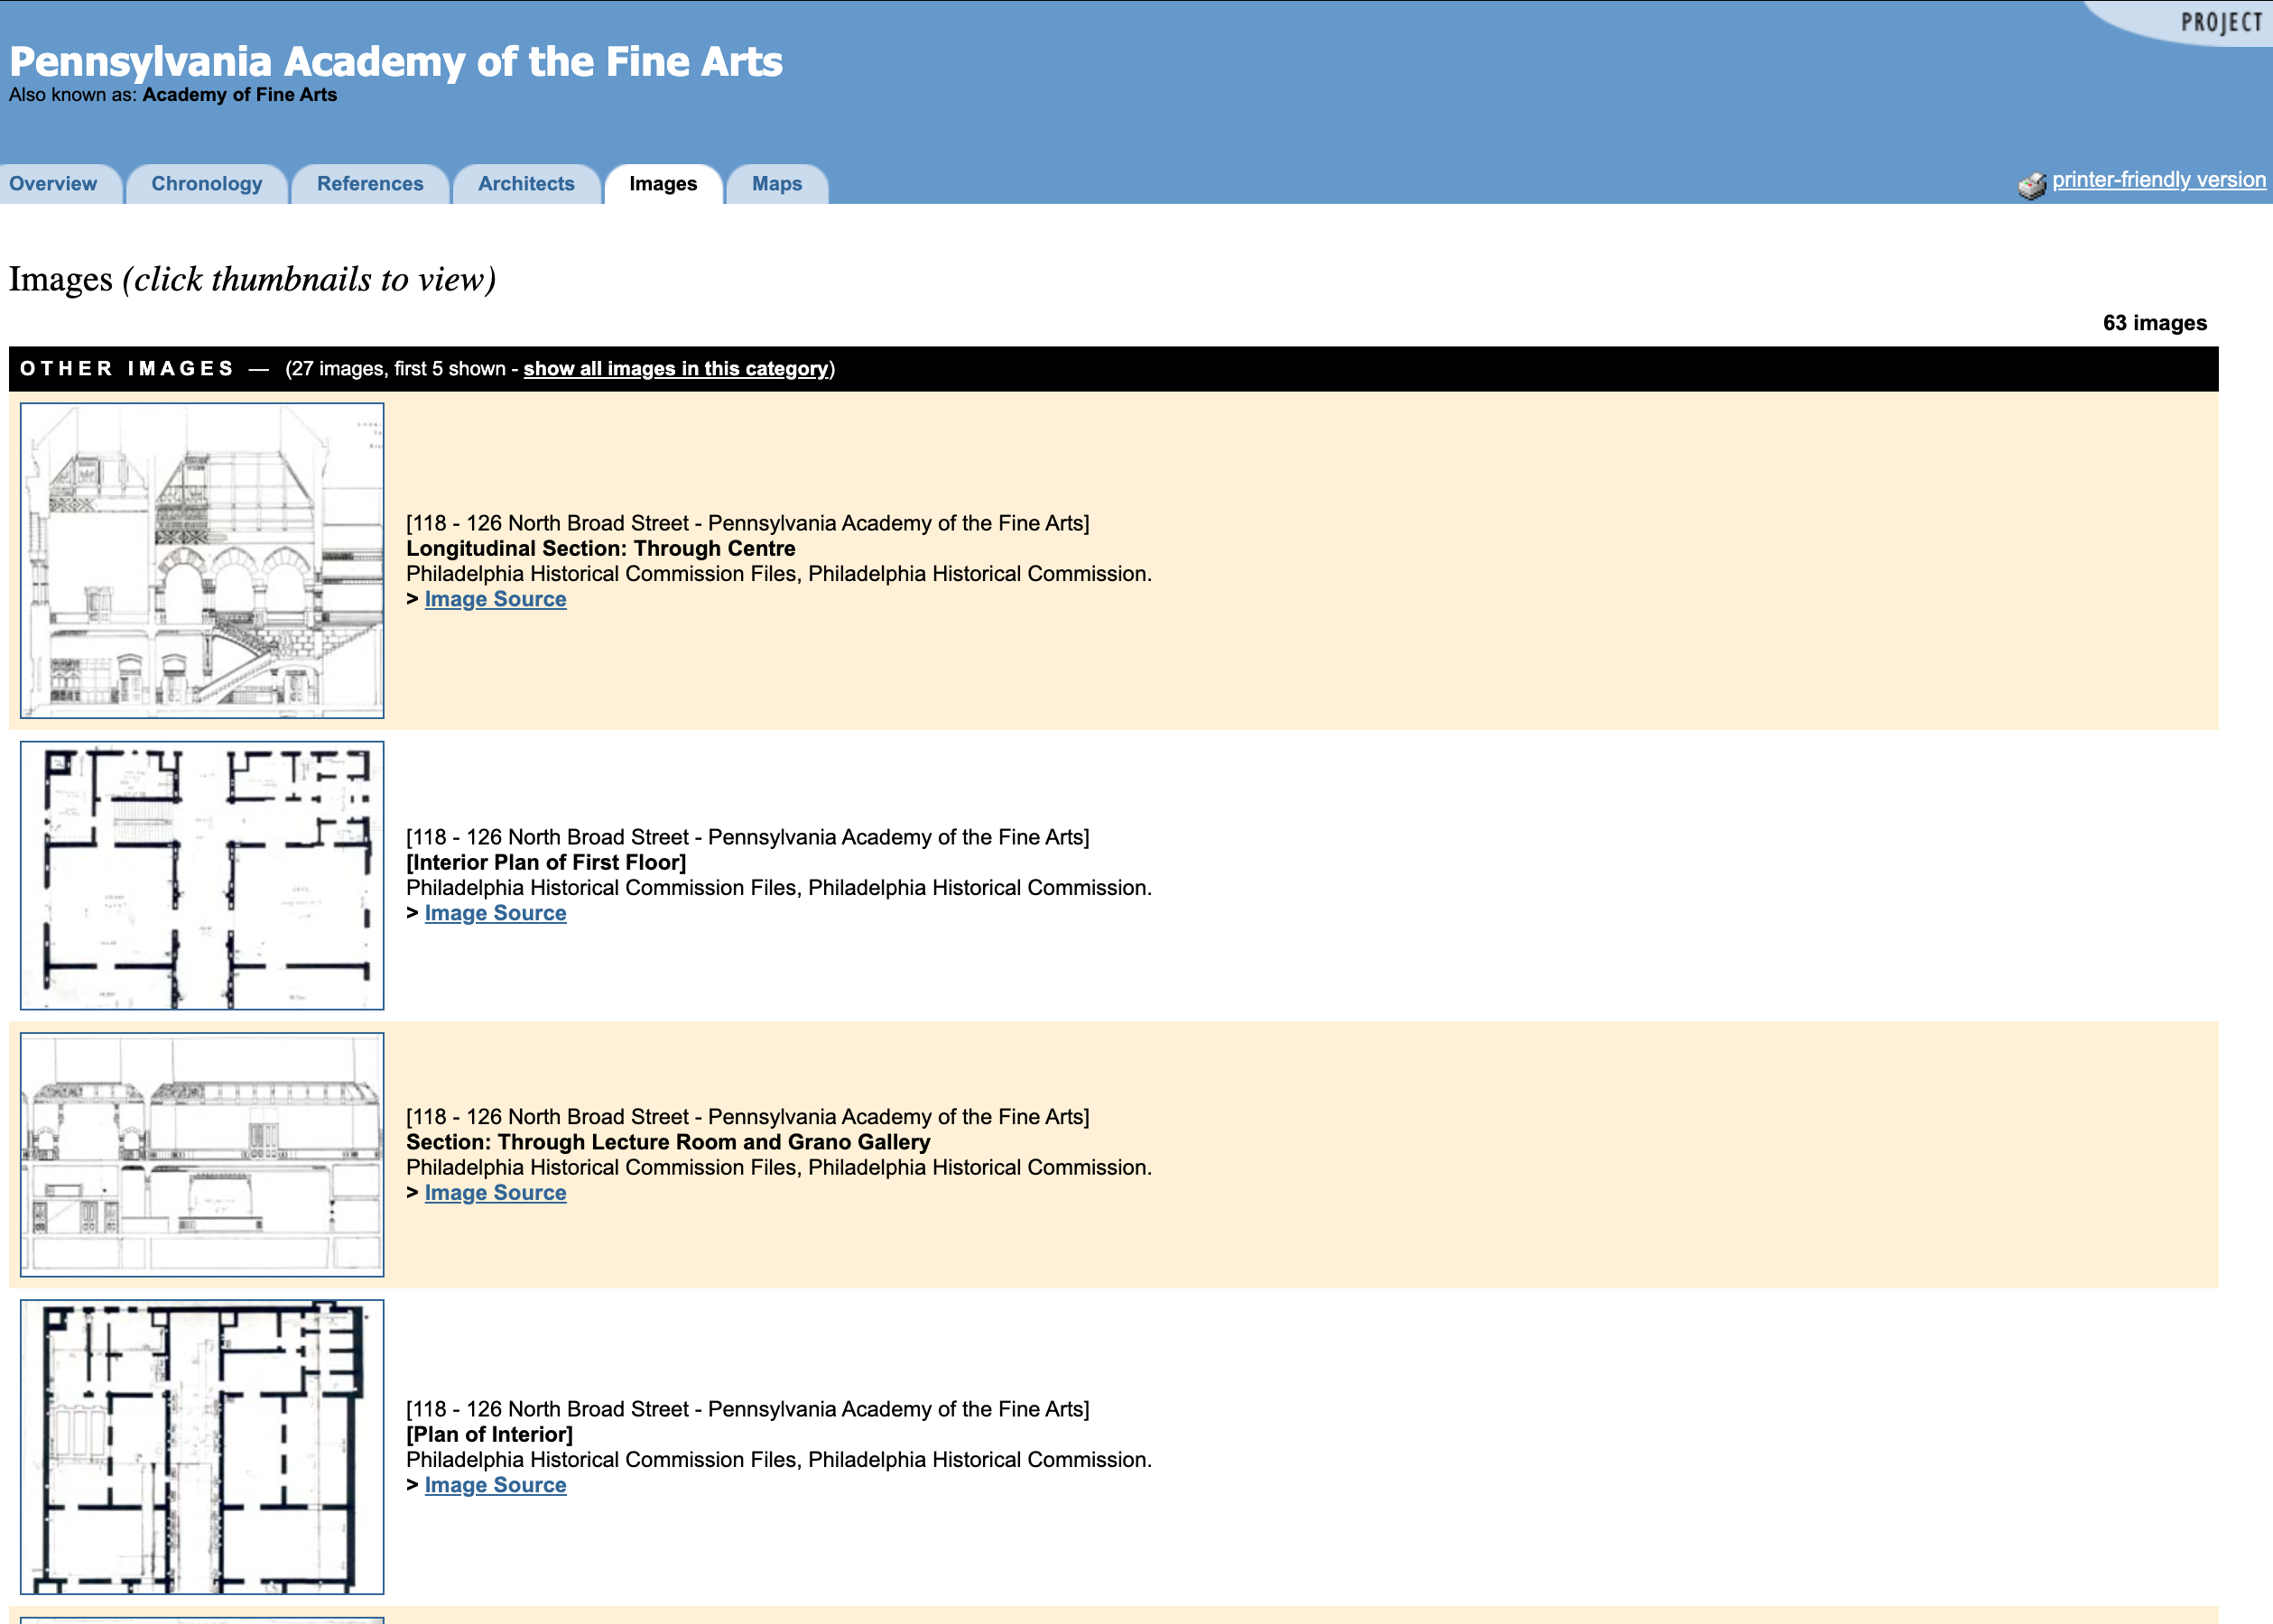
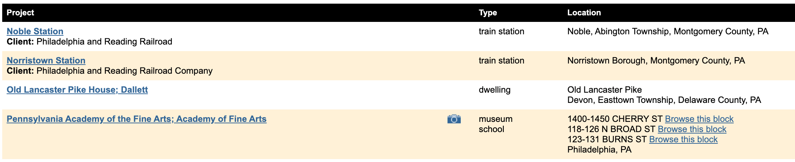
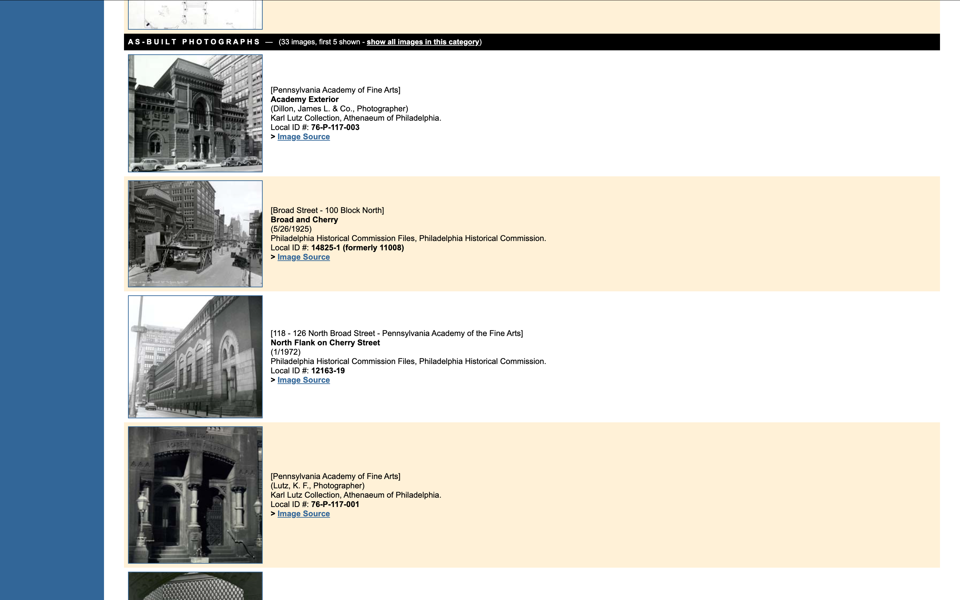
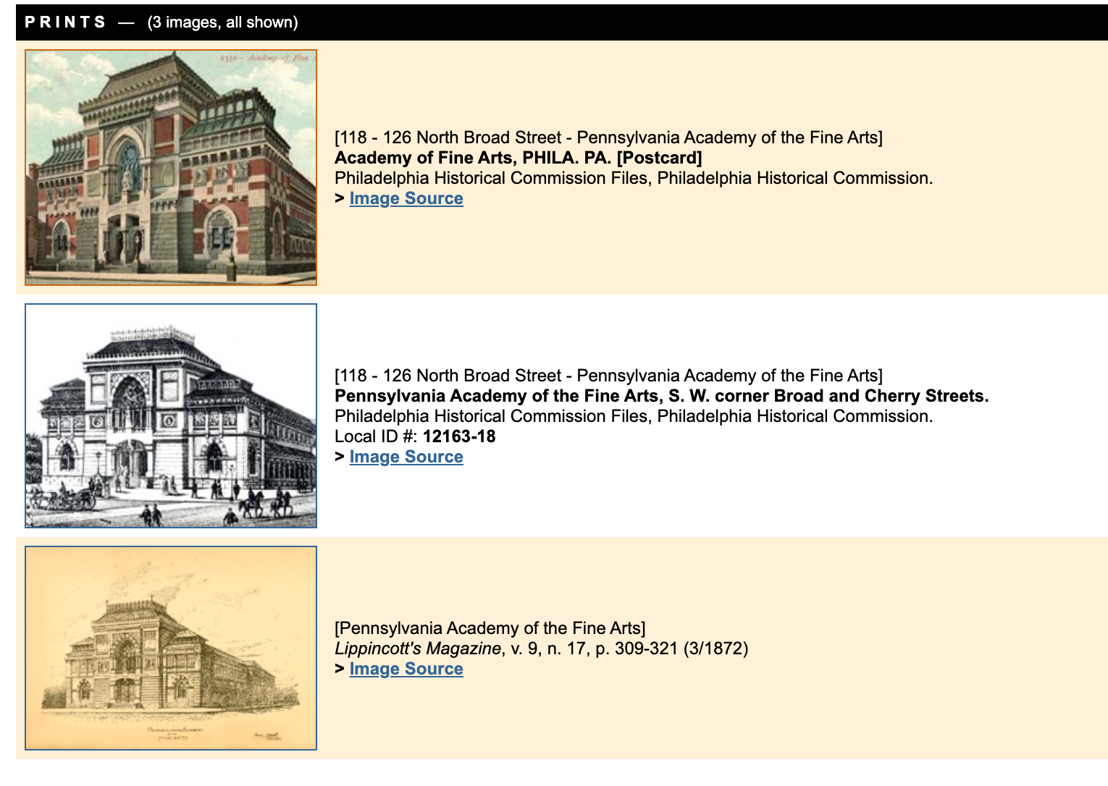
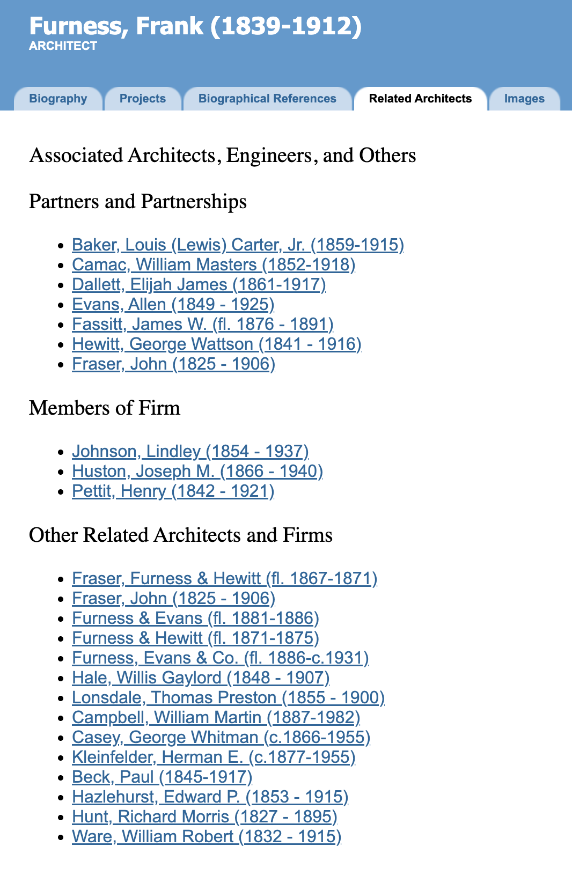
Frank Furness
1839–1912
Tatum
Presents Furness as one of Philadelphia’s most original architects.
Emphasizes his bold mix of styles, materials, and colors.
PAFA shows his strong contrasts and unusual design ideas.
PAB
More detail on his training, partnerships, and related architects.
A larger project list shows the range of his practice.
Plans, sections, and interior images help explain how his buildings work.
Tatum explains Furness’s style;
PAB helps us understand both his career and his buildings in more detail.
Notes:
Tatum, pp. 109–111 and p. 194, note 118; figure 118 is a colored drawing by Joseph P. Sims. PAB: https://www.philadelphiabuildings.org/pab/app/image_gallery.cfm/20387
The comparison is an analytical use of the catalogued images, not a claim that Tatum ignores interiors.

Slide 4
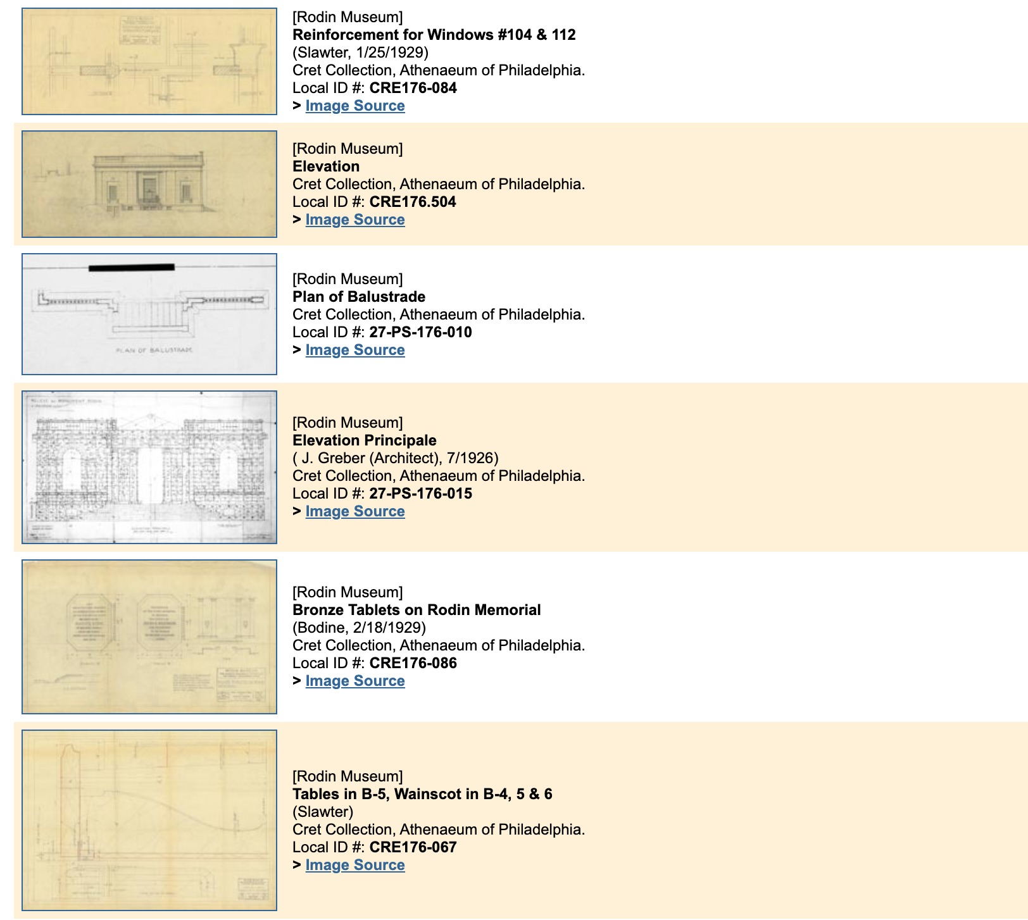
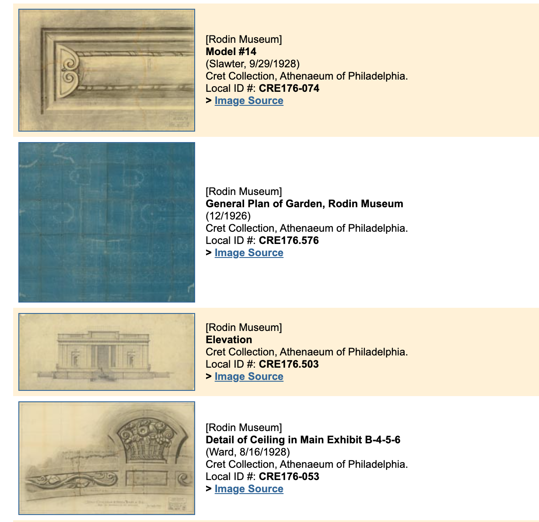
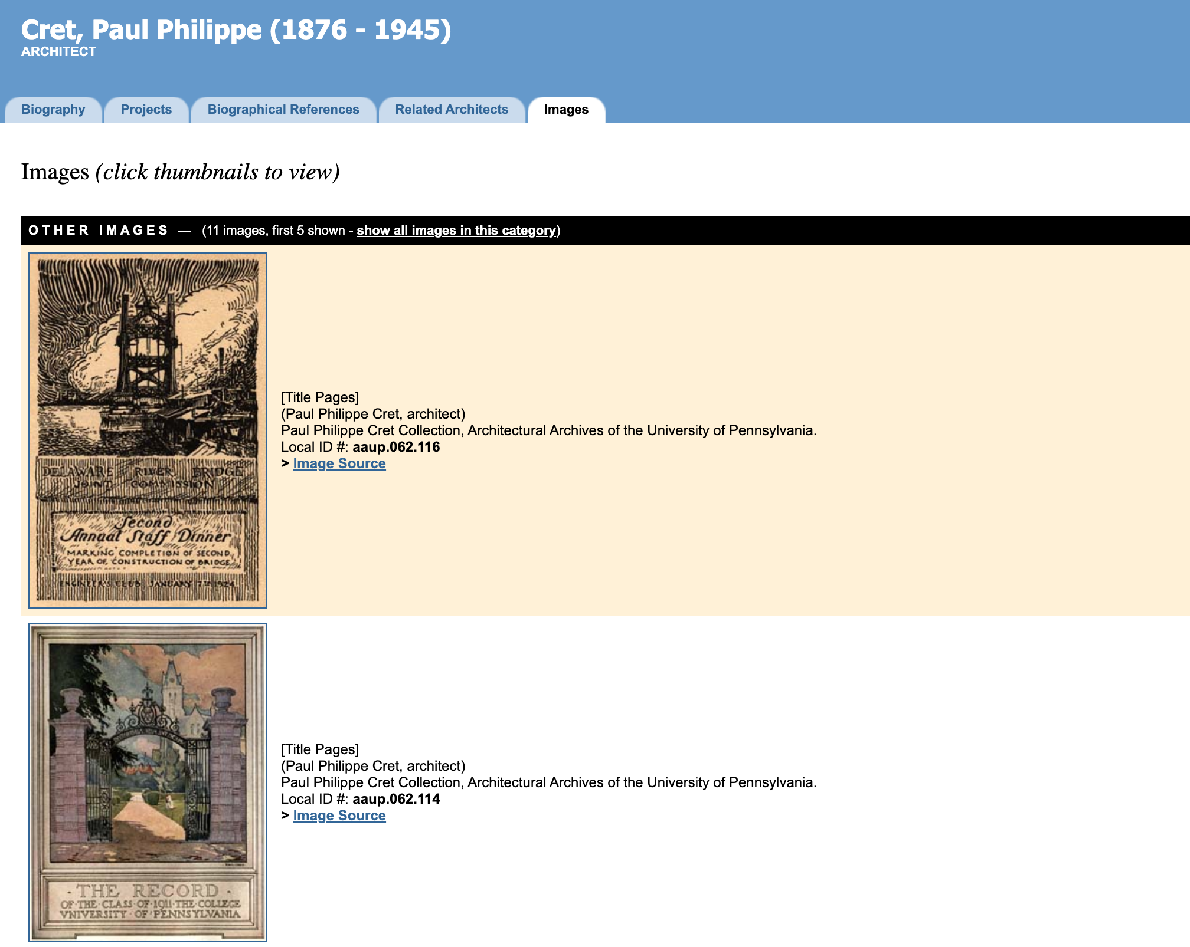
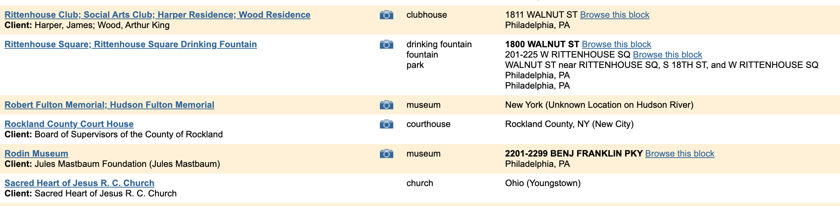
Paul Philippe Cret
1876–1945
Tatum
Describes Cret as a very influential Philadelphia architect and teacher.
Shows how he simplified classical design instead of directly copying it.
Connects his work to both architecture and modern engineering.
PAB
More detail on his career, collaborators, and office work.
Shows a wider range of projects and records.
Plans and drawings help us study how projects developed.
Tatum explains Cret’s ideas;
PAB shows more of his professional network and design process.
Notes:
Tatum, pp. 129–130 and p. 202, notes 134–135; figure 134 is the Federal Reserve Bank rendering. PAB Rodin gallery: https://www.philadelphiabuildings.org/pab/app/image_gallery.cfm/20813?ShowAll=9999
Useful records: CRE176.576 (General Plan of Garden, 12/1926); CRE176.552 (Transversal Section on Garden Looking Toward Museum, 10/1927). Tatum already names Gréber and discusses teaching; neither is unique to PAB.

Slide 5
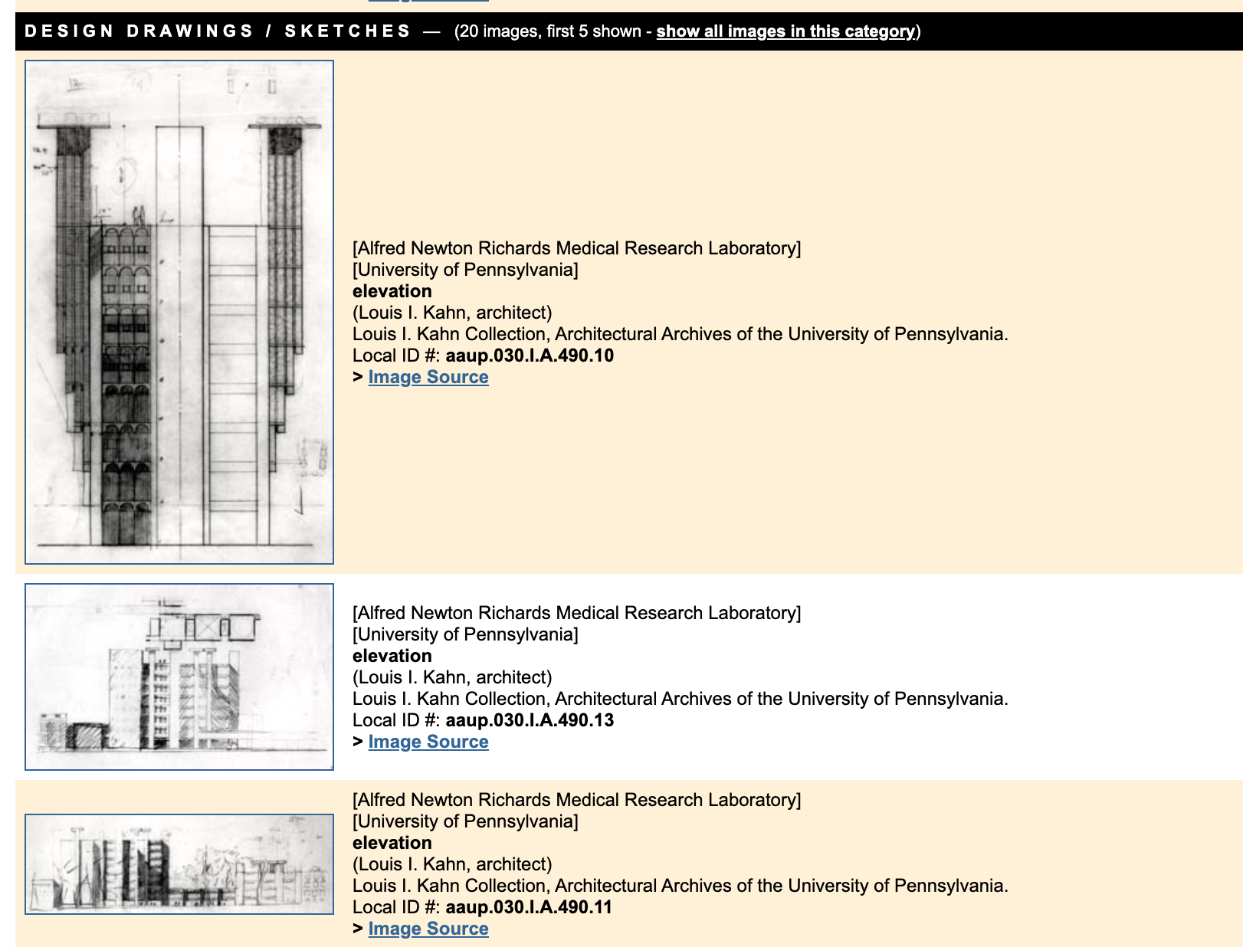
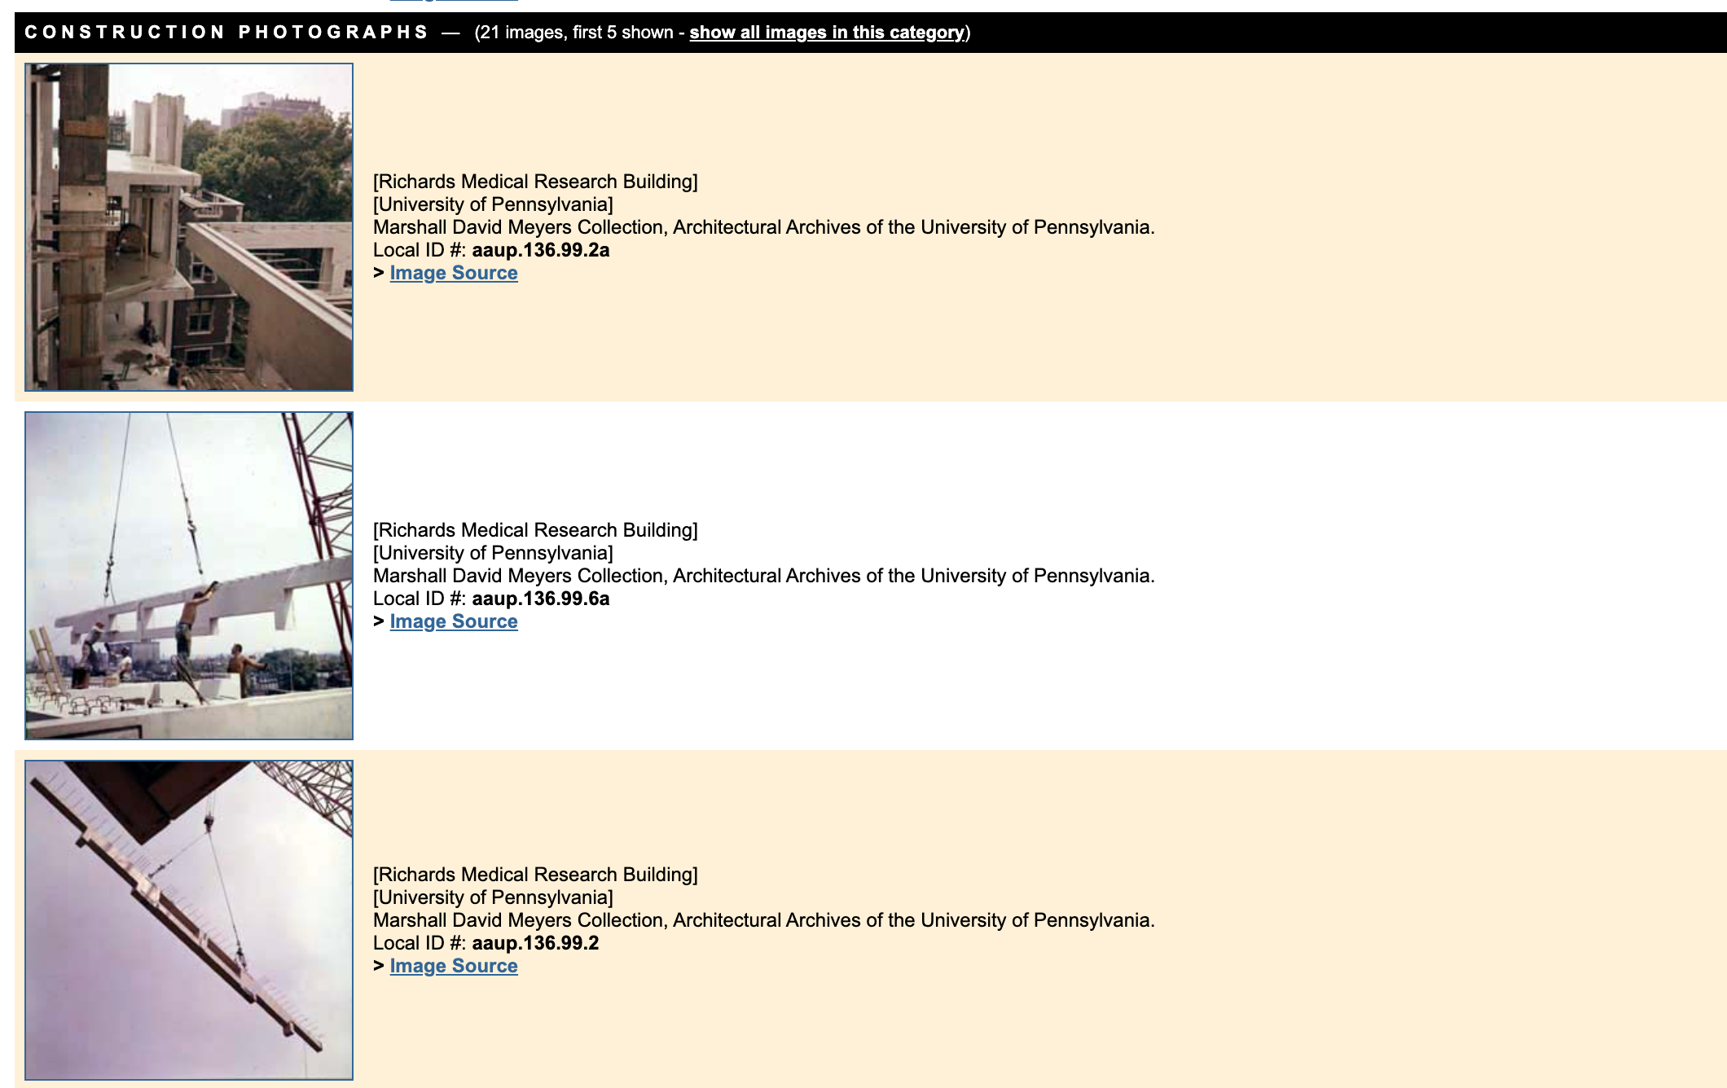
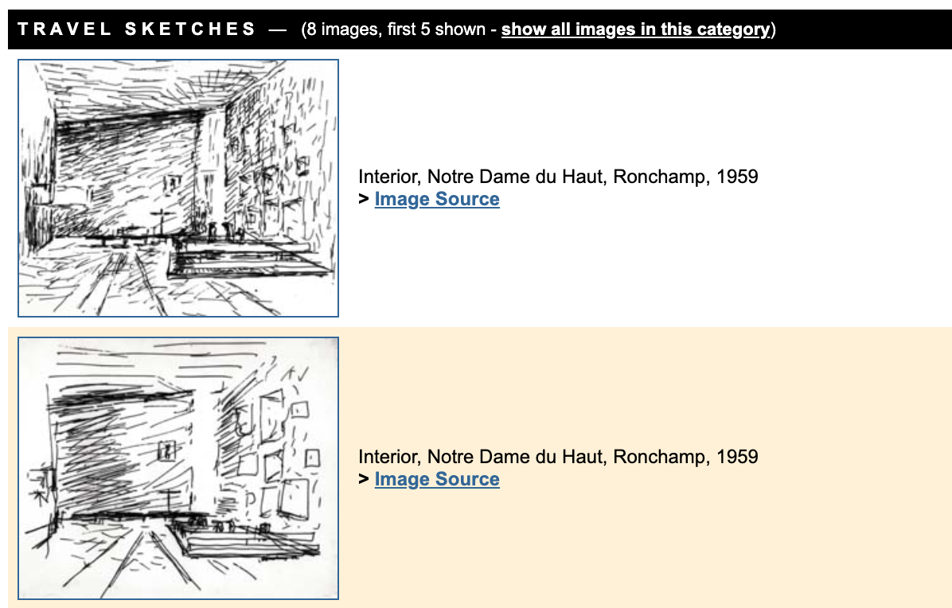
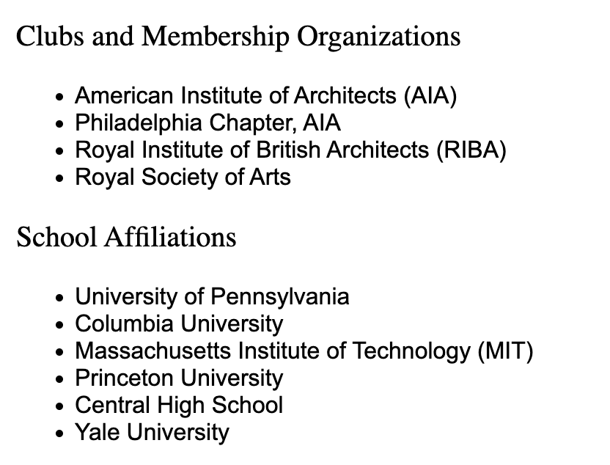
Louis I. Kahn
1901–1974
Tatum
Presents Kahn as an important new architect in Philadelphia.
Focuses on Richards and the idea of separating main and service spaces.
Tatum already sees his work as highly influential.
PAB
Gives a fuller view of his education, career, and related architects.
Connects Richards to more of his projects.
Plans, construction photos, and finished views show the building more fully.
Tatum captures Kahn at an early important moment;
PAB gives a broader view of his career and work.
Notes:
Tatum, p. 139; pp. 206–207, note 145; figure 145 is a 1960 pencil drawing by Kahn. PAB: https://www.philadelphiabuildings.org/pab/app/image_gallery.cfm/17894
Examples: ground-floor plan aaup.030.I.A.490.2; section aaup.030.I.A.490.20; construction photos in the Marshall David Meyers Collection; completed-building photos in the Kahn Collection. Images support comparison, not proof of functional success.

