Slide 1
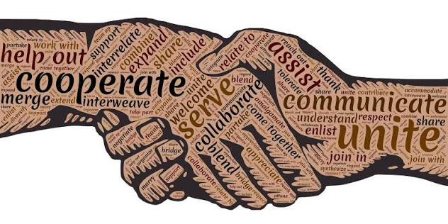
Respect
ESem 2026
Human & Posthuman
Notes:
Since we'll be discussing challenging and sometimes personal material all semester, I want you to collectively set the ground rules for how we treat each other.
Image source: https://emilypost.com/about/definition-of-etiquette-consideration-respect-and-honesty

Slide 2

Think-Journal
Define Respect
Think of a time you were in a class discussion (here or elsewhere) that felt respectful and productive even if people disagreed. What made it work?
Think of a time a discussion felt disrespectful or shut you down. What happened?
Make a list of concrete behaviors based on these experiences.
Notes:
Stock image via PPT

Slide 3

Pair- Groups of 3-4
Work together to determine what qualities and guidelines encourage respectful and dynamic discussions.
Draft 2-3 guidelines
Determine via collaborative group consensus which one you think is most important.
Notes:
PPT Design generated and brought in stock photo

Slide 4
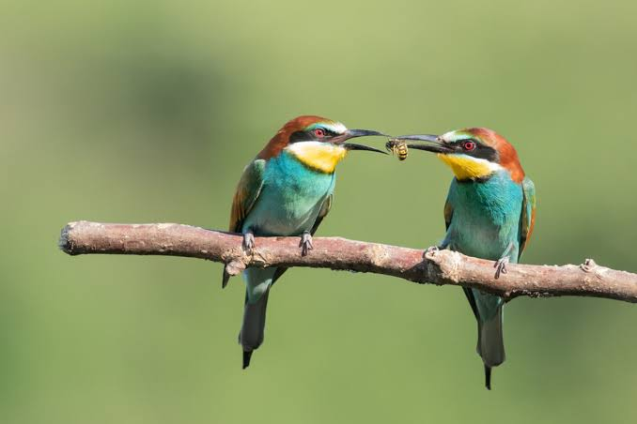
Share
Let’s make a list on the board!
Do we have at least one guideline about how to disagree with an idea without attacking the person?
What about what happens when someone says something that does not land well?
And how should students and Dr. Harper work to ensure equitable airtime?
Notes:
Respect from students- doing the readings?
Respect from Professor- valuing all student perspectives
Image Credit & Source: Light & Vision/shutter stock https://www.discovermagazine.com/do-animals-share-out-of-the-goodness-of-their-hearts-46882

Slide 5
Our Agreement
Put effort into understanding someone’s viewpoint, even if you disagree
Be patient and courteous
Add on to the discussion (not switching topics really fast- Active listening)
Ask clarifying questions (to help ensure interpretation)
Be open to challenging your own worldview
Acknowledge difficulties with respect (or when you felt disrespected-in a safe space for you whatever that may be)
Be intentional when disagreeing through acknowledgment of complexities
Reciprocal vulnerability
Invite sharing
Be mindful of own airtime

